Slide 1










Fluorescent signal intensity vs Time (∆I / ∆t)
Permeability coefficinet
Open
ROI 1
Save as
∆I / ∆t =
$I_{o}$=
Vessel Diameter (D) = cm
Load
Export Data
P = D/4 * $\frac{1}{I_{o}}$ *∆I / ∆t = cm/s
ROI 2
Frame per second:
∆I / ∆t =
∆I / ∆t =
$I_{o}$=
Vessel Diameter (D) = cm
XXX
(to be given by the user)
P = D/4 * $\frac{1}{I_{o}}$ *∆I / ∆t = cm/s
Fluorescent signal intensity vs Time
ROI3
∆I / ∆t =
$I_{o}$=
Vessel Diameter (D) = cm
P = D/4 * $\frac{1}{I_{o}}$ *∆I / ∆t = cm/s
Save as
ROI 4
Export Data
∆I / ∆t =
$I_{o}$=
Vessel Diameter (D) = cm
P = D/4 * $\frac{1}{I_{o}}$ *∆I / ∆t = cm/s
$\frac{1}{I_{o}}$ ∆I / ∆t =
Average P = cm/s
Save as
Run
Export Data

Slide 2




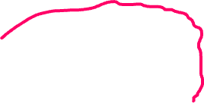
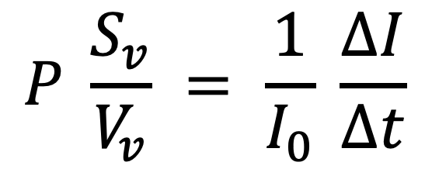



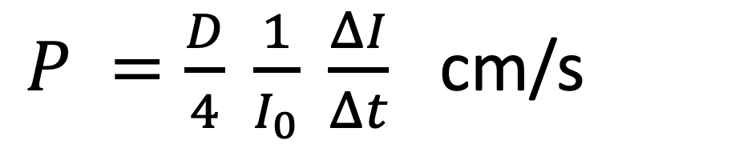
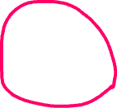
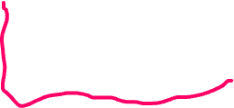
Permeability coefficient through vessel wall (cylindrical structure)
Fluorescent signal intensity vs Time (1/s)
Vessel Surface
As the network of the vessels is non-homogenous, quantifying this coefficient must be regional following the process on the next slide
Fluorescent signal intensity vs Time
$$P \frac{S_{v}}{V_{v}} = \frac{1}{I_{0}} \frac{ΔI}{Δt}$$
Permeability Coefficient
$P =\frac{D}{4} \frac{1}{I_{0}} \frac{ΔI}{Δt}$ cm/s
Vessel volume
Maximum fluorescent dye intensity at time 0
(inside the vessel/for normalization/constant)

Slide 3
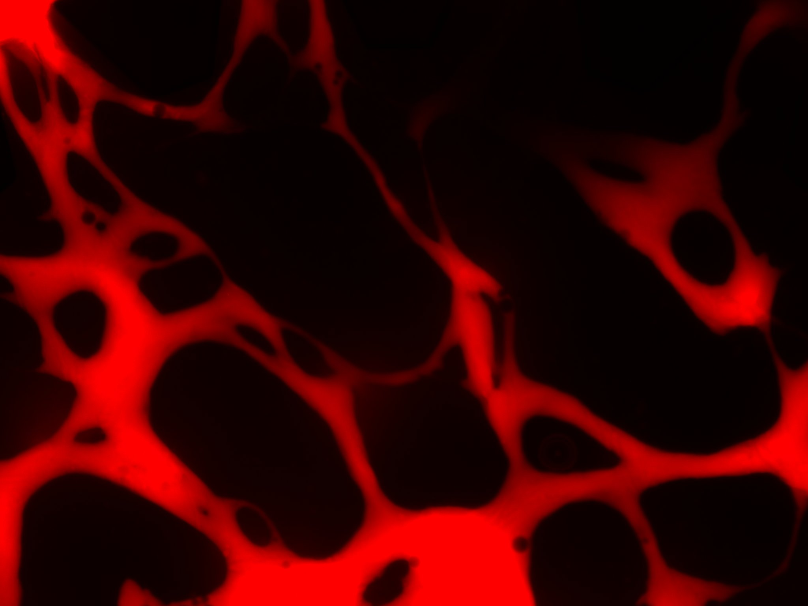
Soheila’s manual method to calculate the permeability coefficient
ROI1
D/2 (cm) 0.0019
Slope (∆I/∆t) 4.20 (using Fiji and based on the mean fluorescent intensity of the region inside the ROI1 polygonal vs time)
I₀ 746
P (cm/s) 1.07e-5
ROI3
ROI2
ROI1
ROI4
The same process to be applied for the other regions of interest (min. 4 regions) and the average to be considered as the permeability coefficient.

