Slide 1
Internship
A Bridge from Academia to Industry
Dairy Science Seminar
February 2014
Yalda Zare

Slide 2
Outline
About me
Why to do an internship?
Where to do it and how to get it?
Do’s and Don’ts
Summary

Slide 3



About me
PhD Animal Sciences – Genetics
(2009-2013)
Interned at Pfizer Animal Health (Kalamazoo, MI)
(now Zoetis) in summer 2012
Position: Quantitative Analyst
Current position: Research Scientist
at ABS Global since 10/2013

Slide 4

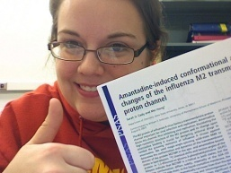
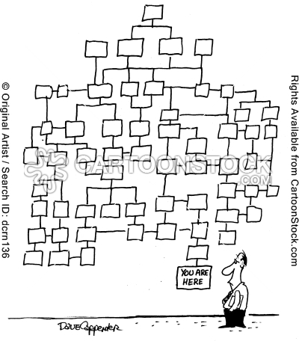

Why to do an internship?
Helps you
see differences between academia and industry
Mindset
Structure
Life style
Figure out your real interest (academia or industry?)
Expand your professional network
Have confidence in yourself (If you get an internship, you can get a job too!)
Make some money on the side!

Slide 5
Where to do it/how to get it?
Search in leading companies, breed associations, USDA.
Positions are not always posted, be proactive.
Network in conferences
Similar work to your PhD would be beneficial
The Interview:
Be confident
Be honest
Travel cost, affordable accommodation

Slide 6

Do’s & Don’ts
Do good work
Be organized (Take notes, arrange files, etc.)
Remember you will be under a microscope
Be yourself and figure out if there is a good fit
Be easy to work with
Be independent but not stubborn

Slide 7
Do’s & Don’ts (Cont.)
Let them see you (talk about yourself, share your project, ask questions)
Network, network, network
Learn as much as you can
Keep an open mind
Be social
Make friends
Attend social events (seminars, sport events, meetings, etc.)

Slide 8
Summary
Go for the experience even if you are sure you are going to stay in academia.
Be yourself
Expand your network
Keep an open mind
Have fun

Slide 9
Questions?

