Slide 1
Genetic Basis of Susceptibility to Mycobacterium avium subsp. paratuberculosis Infection in Jersey Cattle
Ph.D. Defense
Yalda Zare
Advisor: Dr. Brian Kirkpatrick
July 31, 2013

Slide 2
Outline
Chapter 1: Background
Data
Chapter 2: Heritability
Chapter 3: Birth seasonality and clustering in MAP-infection cases
Chapter 4: GWAS and genomic prediction
Final discussion/conclusions

Slide 3
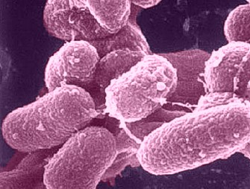
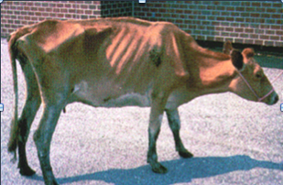
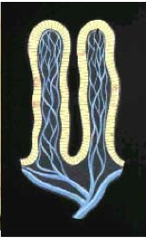
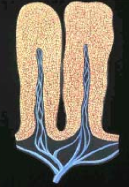
Background
Paratuberculosis (Johne’s disease, JD):
A chronic bacterial infection of the small intestine
Caused by Mycobacterium avium ssp. paratuberculosis (MAP)
Major transmission route is fecal-oral; young calves are at the highest risk
Apparent herd-level prevalence in the US 68% (NAHMS 2007)
Incubation period 2-10 years

Slide 4
Clinical signs: Poor nutrient uptake, diarrhea, low milk production, weight loss and eventually death
Economic loss: $200 M- $1.5 B/year
Not curable; effective vaccine is not available
Potential zoonosis for Crohn’s disease in humans
Difference in susceptibility among breeds
Jersey 1.4 times more susceptible to MAP infection than Holstein
JD is a complex disease; Heritability estimates 0.03-0.28 in Holsteins
JD is a good candidate for genetic selection

Slide 5
Candidate gene studies:
NOD2 (CARD15); SLC11A1; TLR 1, 2, 4; SP110; IL10RA, BoIFNG; PGLYRP1; etc.
Genome-wide association studies (GWAS):
Multiple SNPs on various chromosomes have been identified.
Objectives:
To estimate h² of JD in Jersey (Chapter 2)
To assess seasonal variation and clustering at birth of MAP-infected animals (Chapter 3)
To identify genomic regions underlying susceptibility to JD in Jersey and to develop a multi-marker prediction model (Chapter 4)

Slide 6
Outline
Chapter 1: Background
Data
Chapter 2: Heritability
Chapter 3: Birth seasonality and clustering of MAP-infection cases
Chapter 4: GWAS and genomic prediction
Final discussion/conclusions

Slide 7
Data
Blood and fecal samples from ~5,000 mature cows from 30 commercial Jersey herds
Cross-sectional; one-time sampling
Diagnostic tests:
Serum ELISA (Sensitivity 30%, specificity >99%) Complete
Fecal culture (FC) (Se 74%, Sp 100%) Partial
Table 1. Cross-tabulation of serum ELISA scores by fecal culture test results
ELISA-positive

Slide 8
Outline
Chapter 1: Background
Data
Chapter 2: Heritability
Chapter 3: Birth seasonality and clustering of MAP-infection cases
Chapter 4: GWAS and genomic prediction
Final discussion/conclusions

Slide 9
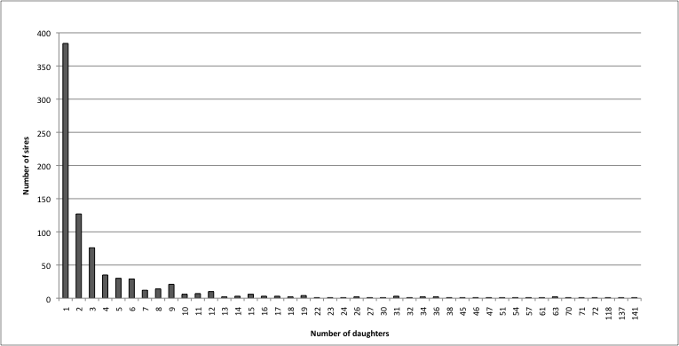
Chapter 2- Material & Methods
Data:
3,918 daughters, 25 herds, 806 sires
Range of daughters 1-141
28 sires had > 25 daughters

Slide 10
Phenotype definition
ELISA S/P ratios as a linear trait
log transformation: log₁₀ (S/P ratio + 0.01)
ELISA results as a binary trait (0/1)
ELISA-suspect and missing results were removed.
ELISA results as an ordered categorical trait (1-5 for negative to strong positive)
Combined test (binary trait)
Test-positive: ELISA+ or FC+ or ELISA+/FC+
Test-negative: ELISA- or ELISA-/FC-

Slide 11



Statistical analysis
Linear model:
y_{ijk} = µ + age_{i} + (age_{i})² + herd_{j} + sire_{k} + e_{ijk}
y_{ijk} is the transformed ELISA S/P ratio of animal ijk
µ is the overall mean
age_{i} is the fixed effect of age as a continuous variable
herd_{j} is the random effect of herd
sire_{k} the random effect of sire
e_{ijk} the random residual component.
Heritability estimation:

Slide 12
Binary (Ordered) threshold model:
l_{ijk} = µ + age_{i} + (age_{i})² + herd_{j} + sire_{k} + e_{ijk}
l_{ijk} is liability of MAP infection for animal ijk
For BT, the threshold was set to zero and residual variance was set to 1.
For OT, first threshold (i.e. S/P 0.10) was set to zero.
Logit link function was used.
Heritability estimation:
All analyses were executed using sire model and the
restricted maximum likelihood method in ASReml 3 software.

Slide 13
Chapter 2- Results & Discussion
Table 2-1. Heritability and variance component estimates from univariate
sire model analyses for susceptibility to paratuberculosis infection.
Heritability estimates ranged from 0.064 to 0.157.
Estimate based on combined test is probably closer to the true
h².
Notes:
Predicted probability of future MAP-infected daughters ranged from 0.076 to 0.206 (average 0.109) for all 806 sires and from 0.10-0.11 for the majority of sires (~72%)

Slide 14
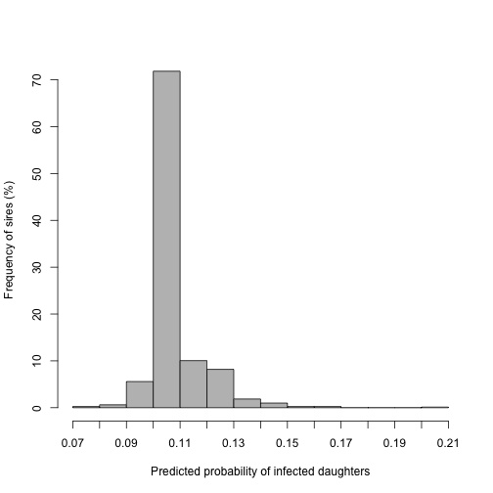
Figure 2-2. Frequency distribution of predicted Probabilities of MAP-infected daughters for all 806 sires.
Predicted probability of MAP infection in future daughters
was 0.10-0.11 for ~70% of sires.

Slide 15
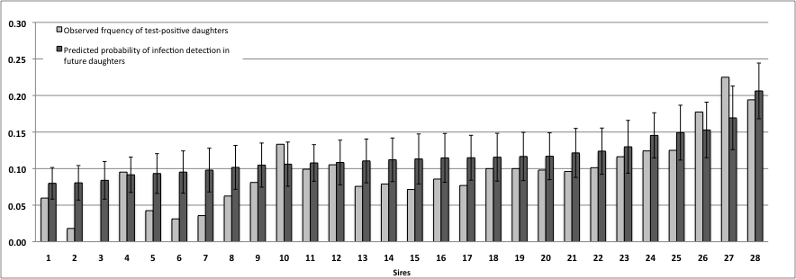
Figure 2-3. Observed frequency of test-positive daughters and predicted
Probability of infection detection in future daughters for sires with > 25
daughters based on the combined test.
Less susceptible sires
0.06
More susceptible sires
0.12
Notes:
For 28 sires with > 25 daughters the predicted probabilities ranged from 0.079 to 0.206 (average 0.116)

Slide 16
Chapter 2- Conclusions
h² estimates (0.06-0.15) for MAP infection in Jersey were in the range of reported h² for Holsteins.
Non-zero h² indicates that susceptibility to MAP infection in Jersey cattle is influenced by genetic factors.
Difference between sires in predicted probability of future infected daughters (0.07-0.20).
selection of less susceptible sires may decrease genetic predisposition to MAP infection in Jersey cattle in future generations.

Slide 17
Outline
Chapter 1: Background
Data
Chapter 2: Heritability
Chapter 3: Birth seasonality and clustering of MAP-infection cases
Chapter 4: GWAS and genomic prediction
Final discussion/conclusions

Slide 18
Chapter 3- Introduction
Neonates and young calves are at the highest risk for acquiring MAP infection.
The major route of MAP transmission is fecal-oral:
Fecal contamination of teats/udder or calving pens
pooling colostrum and/or milk
Not only cows but also infected calves play role in transmitting MAP to their herd mates (Cow-to-calf and calf-to-calf transmission .
Notes:
due to increased permeability of intestines during the first 24 hours of life in neonates and an immature immune system in young calves

Slide 19
Hypothesis I:
Early life exposure to MAP occurs more commonly at a certain time of the year and seasonal variation can be detected in the pattern of birth dates of animals that develop infection.
Hypothesis II:
Animals with proximate birth dates are likely to have been exposed to a similar extent to MAP, such that grouping of infected animals by birth date will occur
Why important?
Better understanding dynamics of MAP transmission
Identifying environmental risk factors
Improving control programs

Slide 20
Chapter3- Materials & Methods
24 Jersey herds throughout the US (n = 3,890) and 4 Holstein herds in Wisconsin (n = 4,110).
Complete ELISA results and birth and sampling dates
Two Jersey herds (n = 857) had complete ELISA and FC results.
Two case definitions (CDs):
CD1: Only ELISA results
CD2: ELISA and FC results of two herds
Test-positive: ELISA+ or FC+ or ELISA+/FC+
Test-negative: ELISA- or ELISA-/FC-

Slide 21
Seasonality
Data were pooled (8,000 cows for CD1 and 857 cows for CD2); animals > 100 months were removed.
Logistic regression:
y_{ijk}: Binary infection status of animal k
age_{ijk}: Fixed effect of age as a continuous variable
breed_{i} : Fixed effect of breed
herd_{j(i)} :Random effect of herd nested within breed
t_{ijk} : Continuous fixed effect of the day in which animal k was born
expressed as the sequential day of the year starting with January 1st as day 1.
e_{ijk} : Random residual component,
μ is an intercept, and βs are regression coefficients.

Slide 22
Temporal clustering
Herds with a minimum size of 150 animals were selected.
The retrospective purely temporal “scan statistic” test implemented in SatScan v. 9.1 was utilized (Kulldorff, 1997).
Age effects were accounted for by subdividing the data from a herd into overlapping 24-month subsets.
Scanning windows of 4, 10, 60, 90 and 120 days
Likelihood ratio test based on a Bernoulli model
H₀: No clustering; H₁: There is an elevated risk of disease within compared to outside the window.
Permutation testing and Bonferroni correction for statistical significance

Slide 23
Chapter 3- Results (Seasonality)
Table 3-2. Results of logistic regression analysis for seasonality in birth of
MAP infection cases based on only ELISA results (CD1) and ELISA-fecal
results (CD2).
CD1
CD2

Slide 24
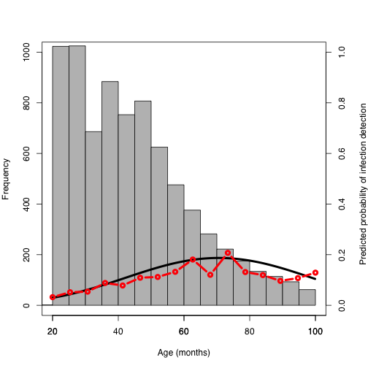
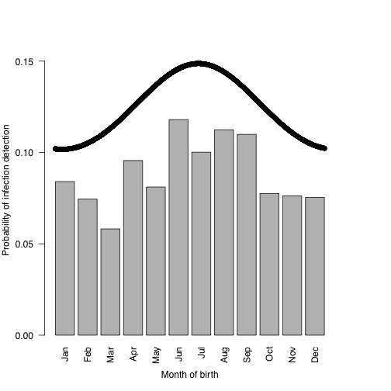
Results (Seasonality)

Slide 25
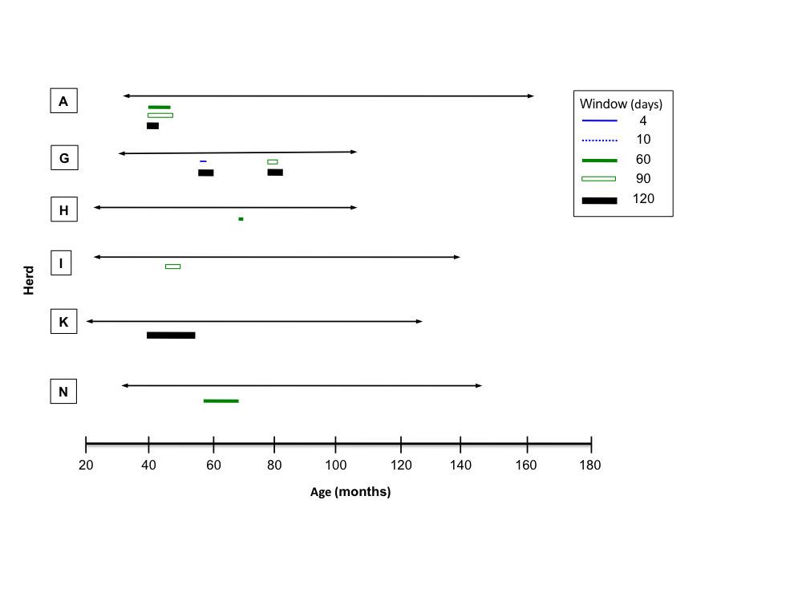
Results (Clustering)

Slide 26
Chapter3- Conclusions
Evidence for seasonal pattern in birth of ELISA-positive cows in the US dairy herds.
The highest probability of MAP infection detection (testing ELISA-positive) occurred for animals born in summer.
ELISA-positive cows were clustered by birth date within herds, likely due to high exposure of calves to MAP in the same time and place.
Results necessitate matching cases and controls on their birth dates to control for non-uniform exposure to MAP in case-control GWAS or candidate gene analyses

Slide 27
Outline
Chapter 1: Background
Data
Chapter 2: Heritability
Chapter 3: Birth seasonality and clustering of MAP-infection cases
Chapter 4: GWAS and genomic prediction
Final discussion/conclusions

Slide 28
Chapter 4- Introduction
GWAS for IBD in humans have identified 163 loci for Crohn’s disease and Ulcerative colitis (Jostins et al., 2012).
Six GWAS and one meta-analysis for susceptibility/tolerance to JD in Holsteins (Settles et al., 2009; Kirkpatrick et al., 2010; Minozzi et al., 2010; Pant et al., 2010; Zanella et al., 2011; van Hulzen et al., 2012) and (Minozzi et al., 2012).
Two objectives:
Discovery and validation
Prediction

Slide 29
Chapter 4- Materials & Methods
Discovery:
500 cases (ELISA+ and FC+), 500 birth date-matched controls (ELISA- and FC-)
Validation:
100 cases (FC+), 100 controls (ELISA and FC-) from same herds
Combined (discovery + validation)

Slide 30
Analysis flowchart (Discovery & validation)
Combined
Discovery
Validation
Raw data
(450+, 439-)
50K SNPs
Raw data
(91+, 91-)7K SNPs
QC in GenABEL
Cleaned
(450+, 439 -)
32K SNPs
Cleaned
(90+, 90 -)
~6.8K SNPs
BEAGLE
Combined data
(540+, 529-)
32K SNPs
Imputed
(450+, 439 -)
32K SNPs
Imputed
(90+, 90 -)
32K SNPs
GenABEL
GenABEL
GenSel
Single-marker
GWAS
(GRAMMAR-GC)
Bayesian GWAS
(Bayes C)
Single-marker
GWAS
(GRAMMAR-GC)
Notes:
5000 cows from 30 commercial herds
QC in discovery: SNP and sample call rate, MAF, HWE
QC in validation: SNP and sample call rate

Slide 31
Analysis flowchart (Prediction)
Discovery
Validation
Prediction
Imputed data
(450+, 439-)
32K SNPs
Imputed data
(90+, 90-)
32K SNPs
GenSel
10-fold
Cross-validation
Combined data
(540+, 529-)
32K SNPs
10-fold
Cross-validation
Notes:
The GEBVs were estimated for 180 animals in validation set

Slide 32
GRAMMAR-GC (Genome-wide Rapid Association using Mixed Model and Regression-Genomic Control)
Aluchenko et al., 2007
Amin et al., 2007
1) Derive the familial correlation-free residuals:
Genomic kinship
2) Regressing these residuals on marker genotypes:
3) Genomic Control (GC):
Notes:
It is a three-step approach
The advantage is in livestock because of relatedness between animals

Slide 33
Bayesian analysis
Threshold model in Bayes C with a probit link function:
y: The liability vector
μ: The overall mean
z_{j} : Vector of genotype covariates at SNP_{j}
α_{j} : Allele substitution effect of SNP_{j}
δ_{j} : A variable indicating presence or absence of SNP_{j}
e: Vector of random residual effects
Priors:
Parameter π was assumed to be 0.999
Residual variance was set to 1
With h² = 0.1, additive genetic variance 0.11
Fernando and Garrick, (2013)

Slide 34
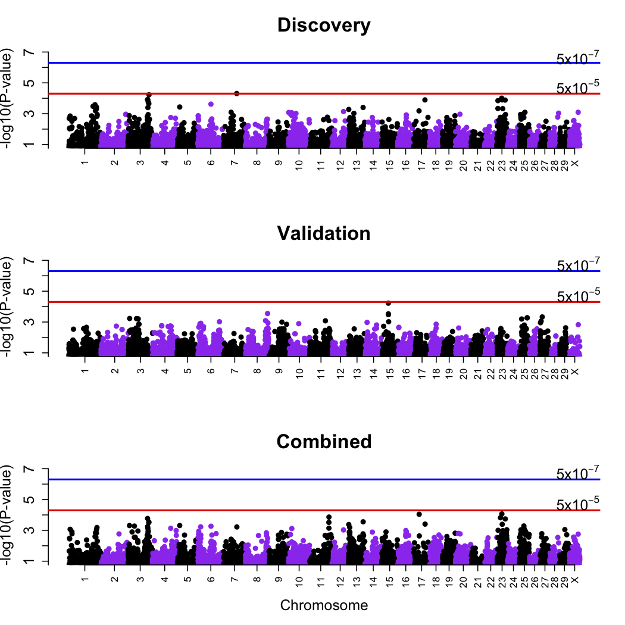
Single-marker GWAS

Slide 35
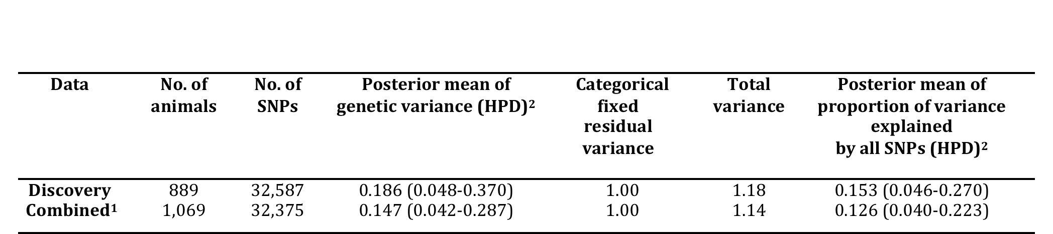
Marker-based estimates of h²
Table 4-3. Posterior means of variance components in Bayesian GWAS of
susceptibility to MAP infection in US Jersey cattle.
Mean posterior estimates of h² of MAP infection in Jersey were
in the range of pedigree-based estimates (0.06-0.157).

Slide 36
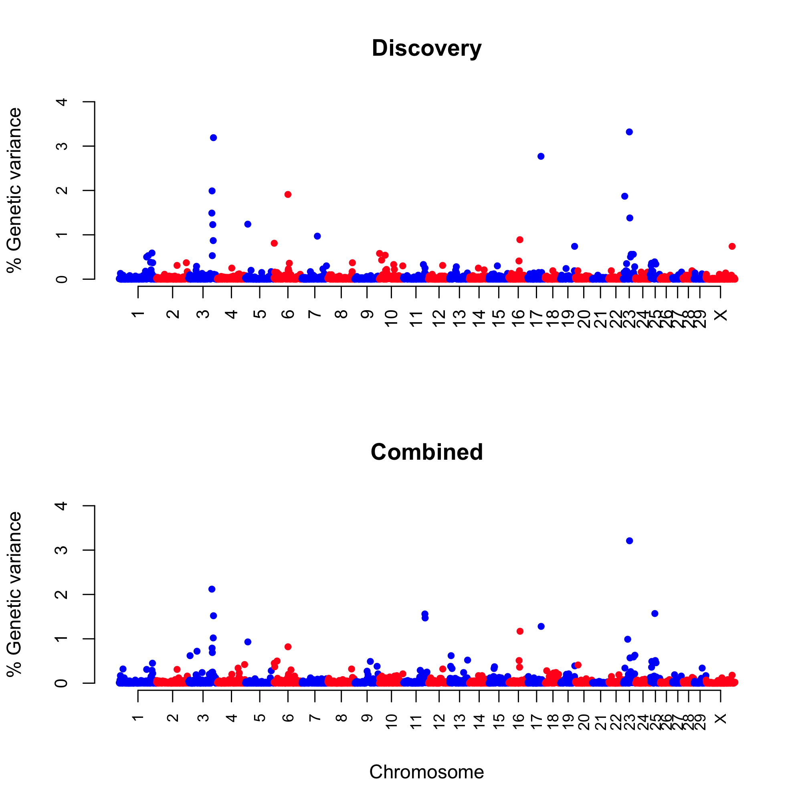
Bayesian GWAS
MHC (27-28 Mb)
TCF19 (27.7 Mb)
FAT10 (29 Mb)
HIVEP1 (44 Mb)
SLC (32 Mb)
CCDC17 (101 Mb)
ZNF 684 (106 Mb)
MIR2416 (107 Mb)
FAM109A (57 Mb)
UBE2K (60 Mb)

Slide 37
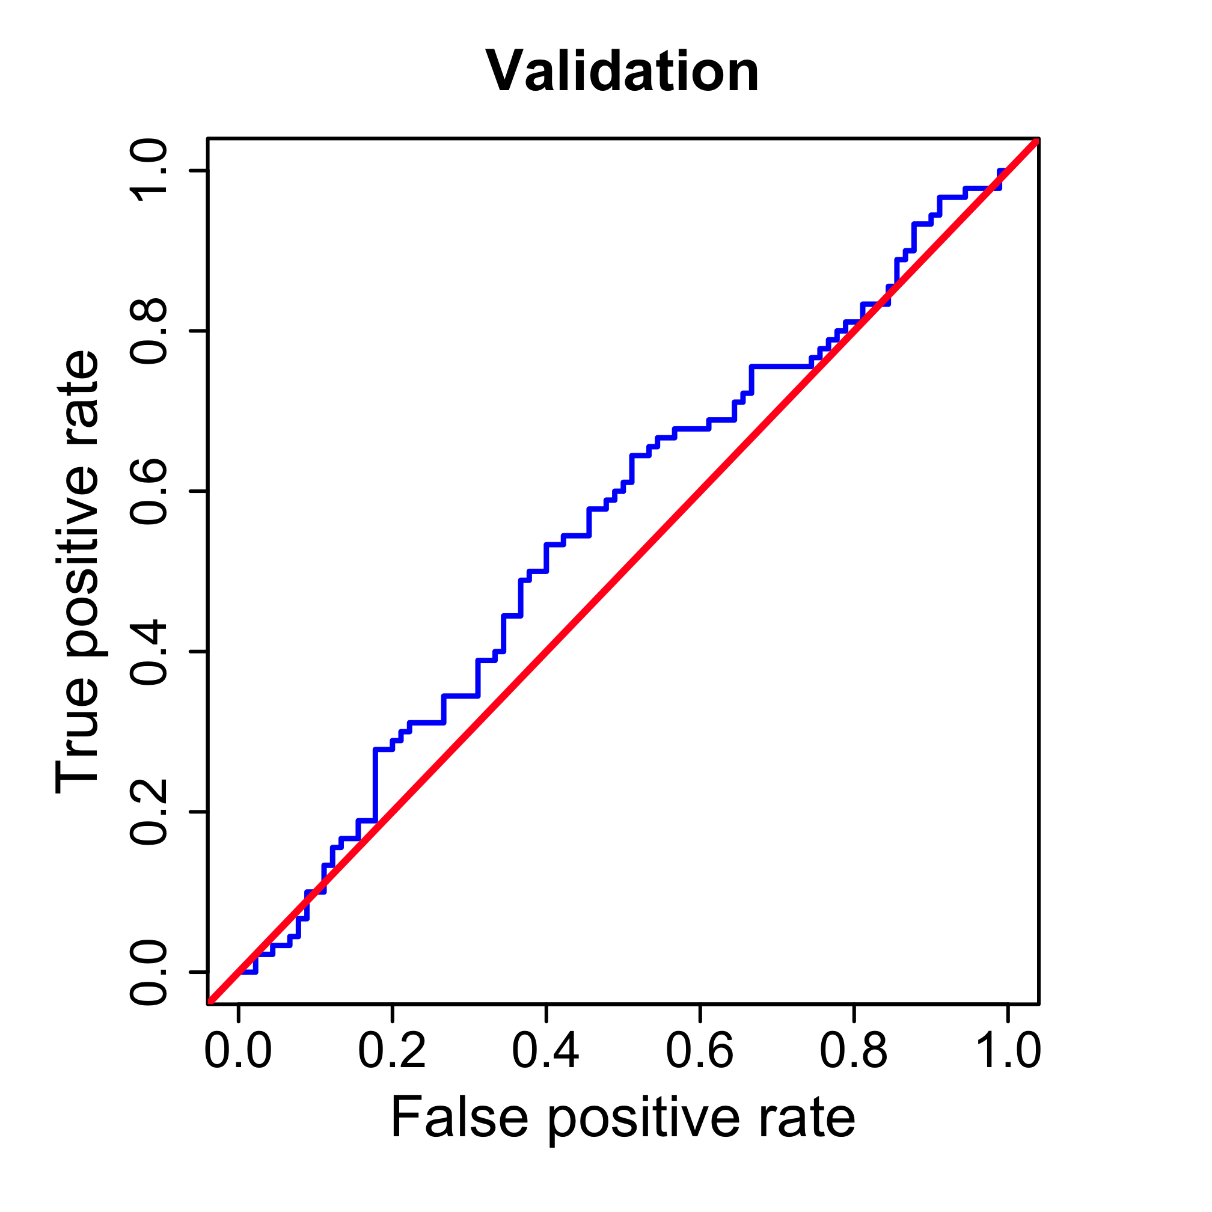
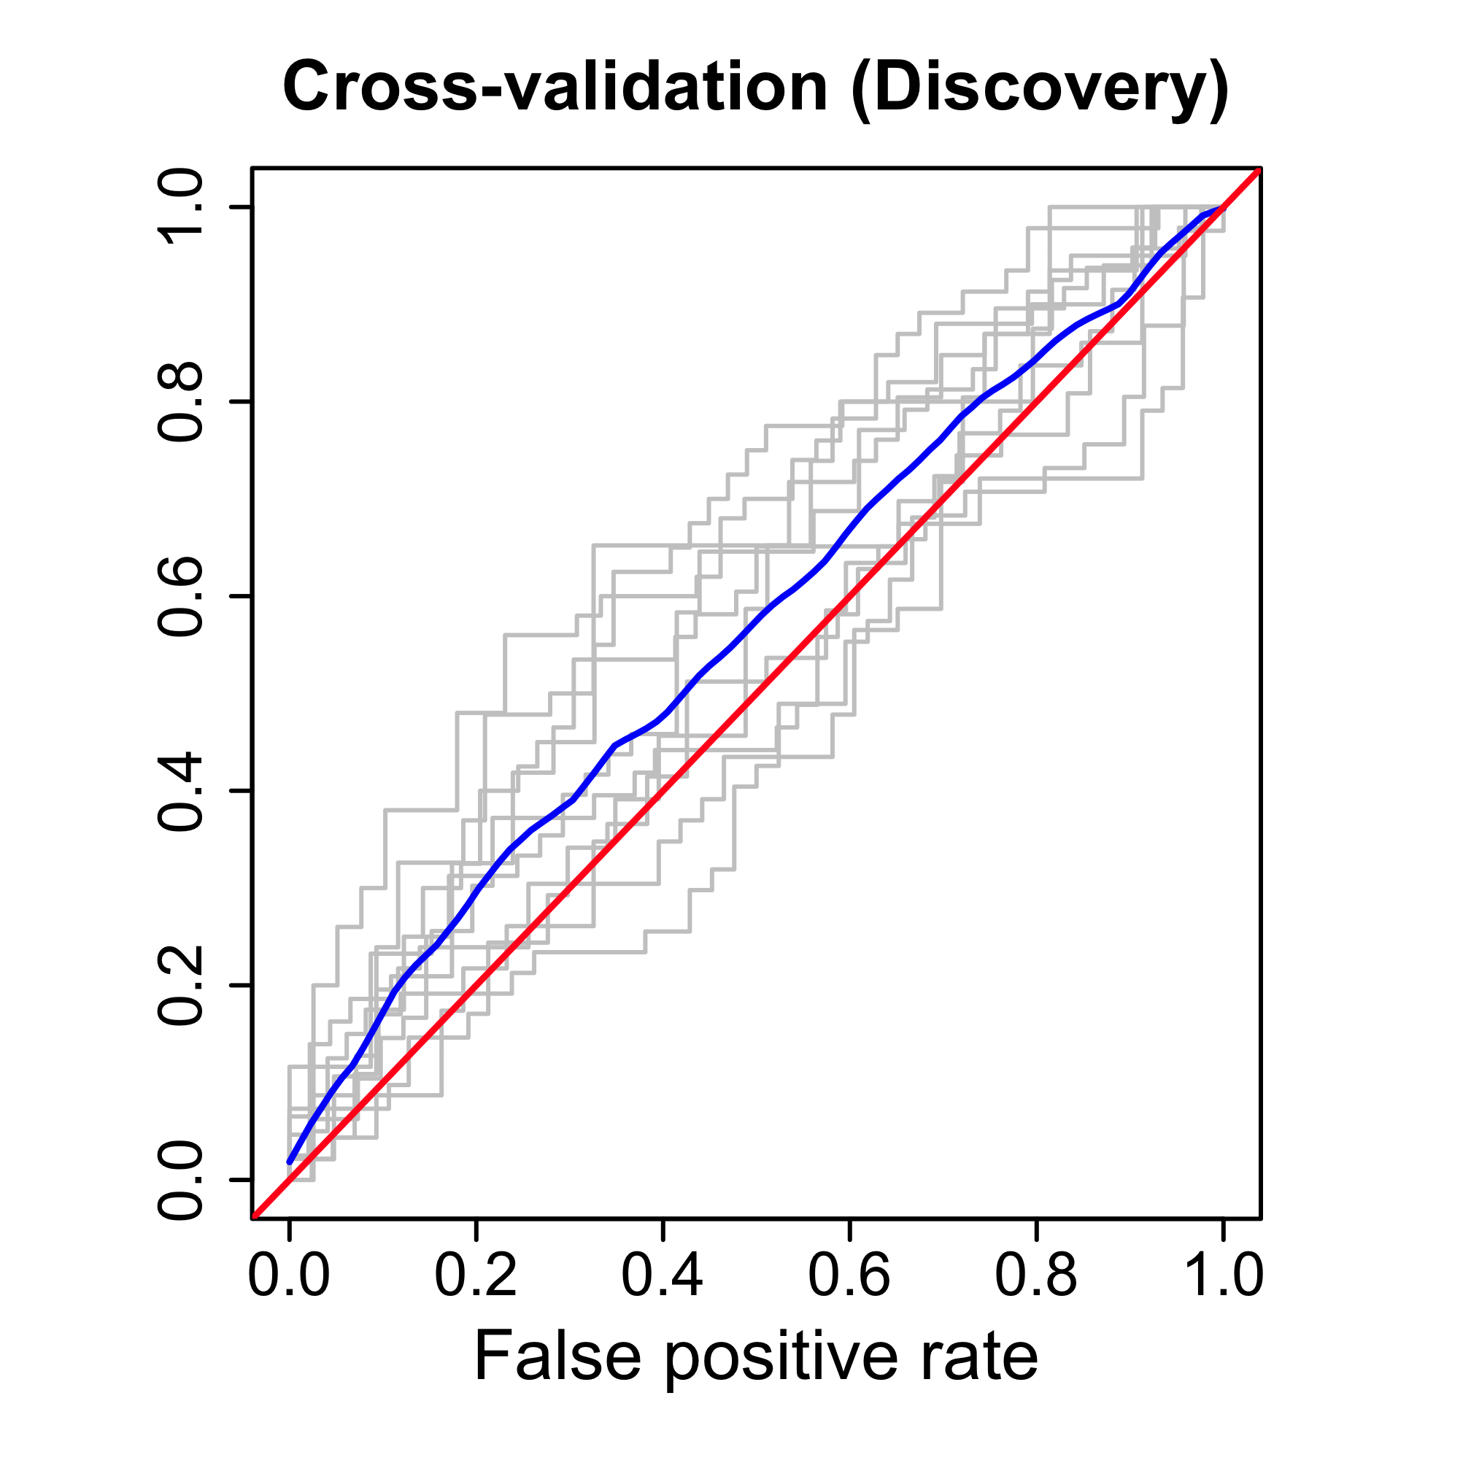
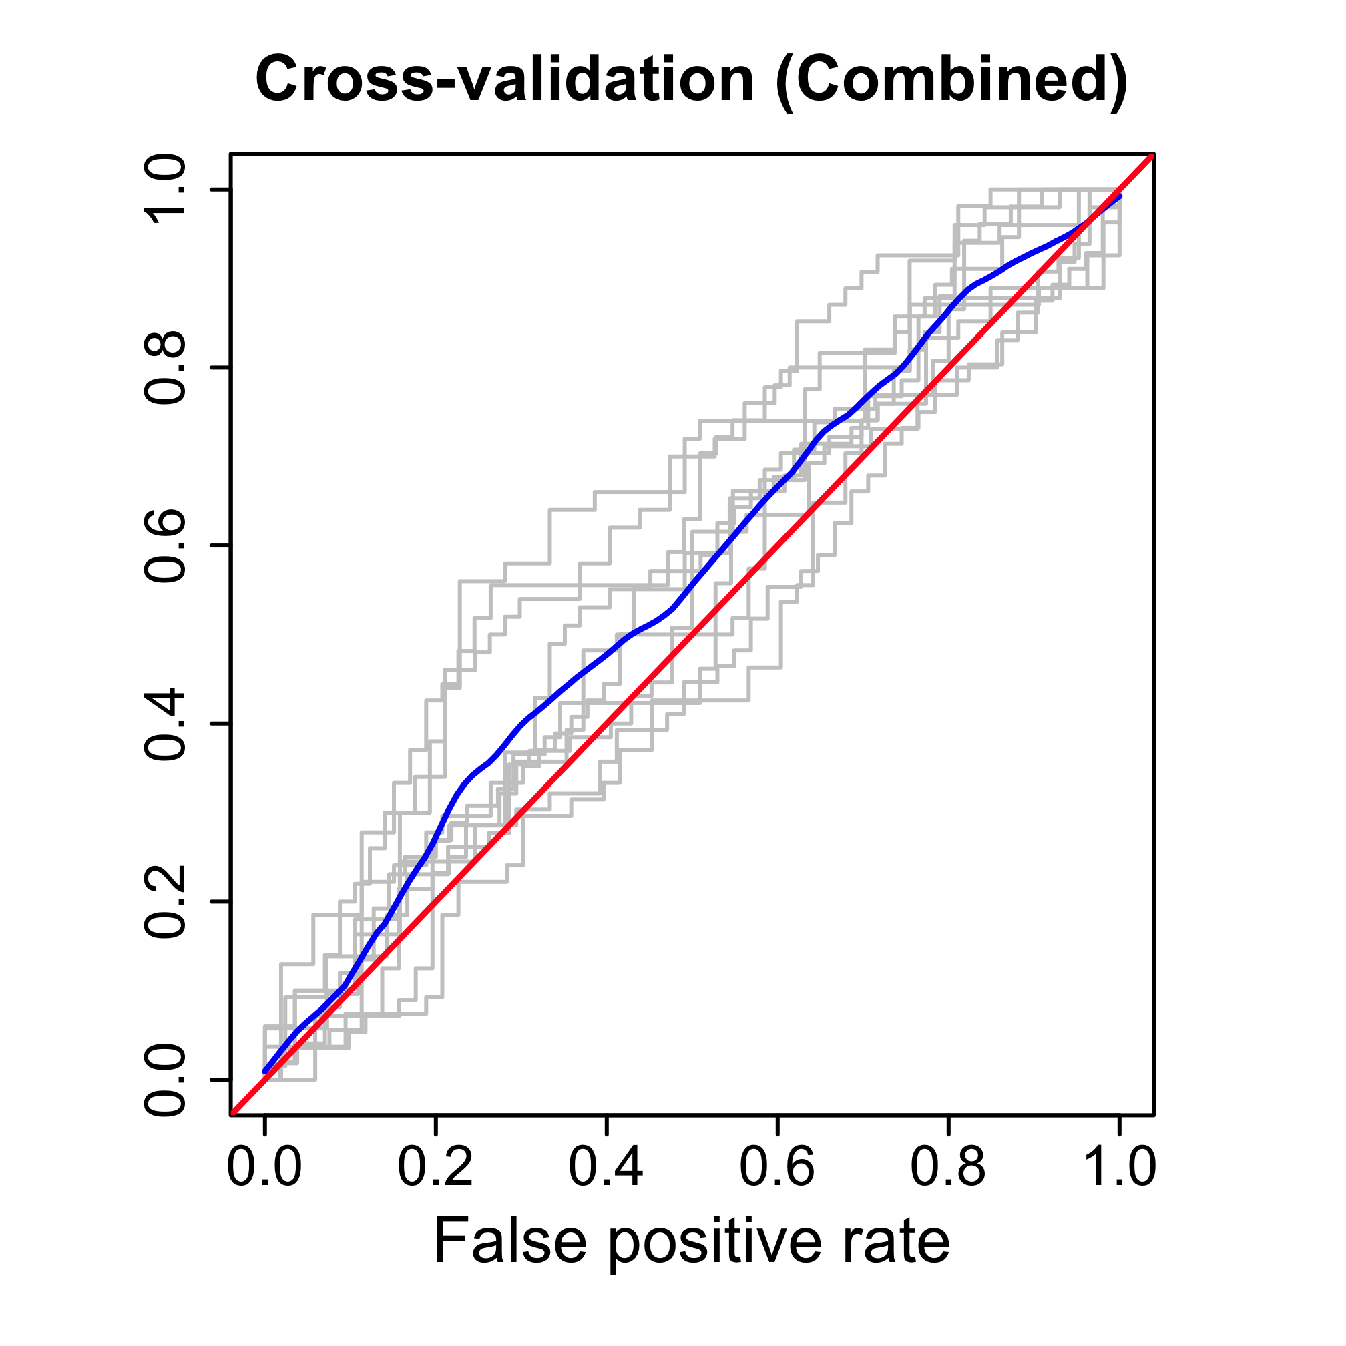
Genomic prediction
AUC = 0.55
AUC = 0.56
AUC = 0.55
N = 180
N = 889
AUC: 0.47-0.67
N = 1,069
AUC: 0.46-0.65
Notes:
Se and sp? False negative formula???

Slide 38
Chapter 4- Discussion
The discovery results were not validated at P<0.01; small sample size or use of different phenotype.
High correspondence (70-80%) between the results of single-marker and Bayesian analyses.
14-18% of genetic variance was explained by markers.
Pedigree-based and marker-based estimates of h² in Jersey were in the same range.
The highest percentage of genetic variance (3.3%) was accounted for by one SNP on BTA23 at 27.7 Mb (MHC region).

Slide 39
Nine SNPs on 4 chromosomes were commonly identified by all analyses mapped to BTA23 (27, 29 and 44 Mb), BTA3 (100,101, 106 and 107 Mb) and BTA17 (57 Mb) and BTA6 (60 Mb).
The ability of the multi-marker models in prediction of future phenotypes was low.
Future steps:
Predict genetics instead of disease status
Development of a model for across-breed selection against JD in dairy cattle
Identification of functional variants in positional candidate genes, and pathways

Slide 40
Outline
Chapter 1: Background
Data
Chapter 2: Heritability
Chapter 3: Birth seasonality and clustering of MAP-infection cases
Chapter 4: GWAS and genomic prediction
Final discussion

Slide 41
Final discussion
Susceptibility to JD in Jersey is heritable.
There is temporal variation in exposure to MAP within dairy herds. Match cases and controls on birth dates!
Loci underlying JD in Jersey were identified.
One region on BTA23 at ~32 Mb common between Jerseys and Holsteins.

Slide 42
Possible reasons for discrepancies between GWAS results:
Small sample size
Classification bias due to low-sensitivity diagnostic tests
Different definition of cases and controls may identify different loci
Different allele frequency in different populations
Selection of less susceptible AI sires or dairy cow replacements could reduce prevalence of MAP infection in dairy herds in future generations.
Loci commonly identified by all
analyses in Jersey study
Notes:
Little correspondence between the results of previous GWAS for JD; and no correspondence with the results of candidate gene studies.
Need a well-defined phenotype
Parallel or repeated testing (milk ELISA)
Larger sample size, meta-analysis

Slide 43
Acknowledgement
Dr. Brian Kirkpatrick
Dr. George Shook
Dr. Michael Collins
Committee members: Dr. Khatib, Dr. Rosa and Dr. Weigel
All Animal Sciences and Dairy Science friends, colleagues and staff

