Slide 1

CNET
Invisible network over L3 cache

Slide 2
Covert channels
Discover common cache sets by just reading
from process’ own memory space!
Sender
L3 cache set
Receiver
L3 cache set
Sender’s address space (mmap)
Reciever’s address space (mmap)

Slide 3
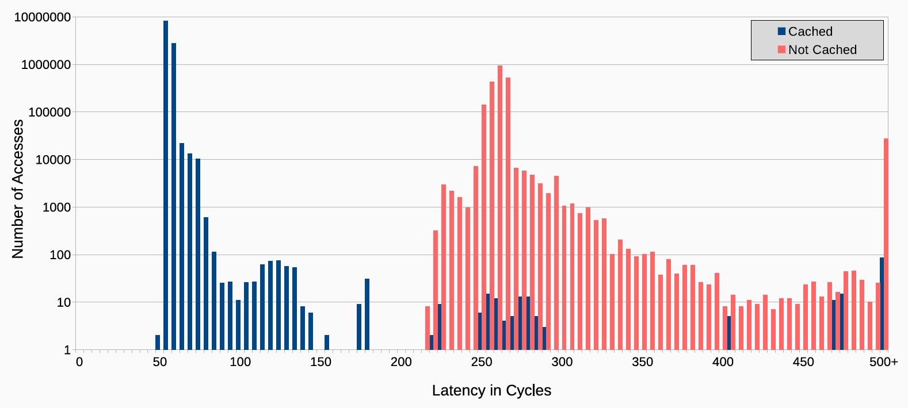
Based on Access Latency

Slide 4
How '0' and '1' are transferred
RAM access is slow, cache access is fast
Read and measure access time
Fast? '0'!
No one else accesses this cache set
Slow? '1'!
Someone else accesses this cache set
False positives possible but communication proved to be stable even under load

Slide 5
Sending
Sender
Last-level cache
Receiver
0
Cache Set #1
1
evict
Cache Set #2
0
Cache Set #3
0
Cache Set #4
1
evict
Cache Set #5
0
Cache Set #6
0
Cache Set #7
0
Cache Set #8

Slide 6
Notes:
<номер>

Slide 7


Receiving
Sender
Last-level cache
Receiver
0
Cache Set #1
measure
0
1
Cache Set #2
measure
1
0
Cache Set #3
measure
0
0
Cache Set #4
measure
0
1
Cache Set #5
measure
1
0
Cache Set #6
measure
0
0
Cache Set #7
measure
0
0
Cache Set #8
measure
0

Slide 8
Communication protocol
8 covert channels means 8 virtual 'bits'
Reading from channel sets bit
Sender
For '1' — read from corresponding channels
Receiver
Read channels in a loop until getting 4 of '1'

Slide 9
Encoding
70 bit patterns of 4 bits set + 4 unset
01001101 → 4 bits set, 4 unset
Why 4+4?
Most patterns, e.g. for 3+5 there are only 56
70 patterns → 64 for data, 6 for commands
64 for data → 6 bits of data could be transferred
Data encoded and packed into packets
Hypervisor does not see it!

Slide 10
Transparent to Hypervisor
vm1
vm2
Process 1
Process N
Sender Process
Receiver
Process
Process 1
Process N
Covert Channel
Covert Channel
Hypervisor
Prime + Probe
Prime + Probe
Last Level Cache (LLC)

Slide 11
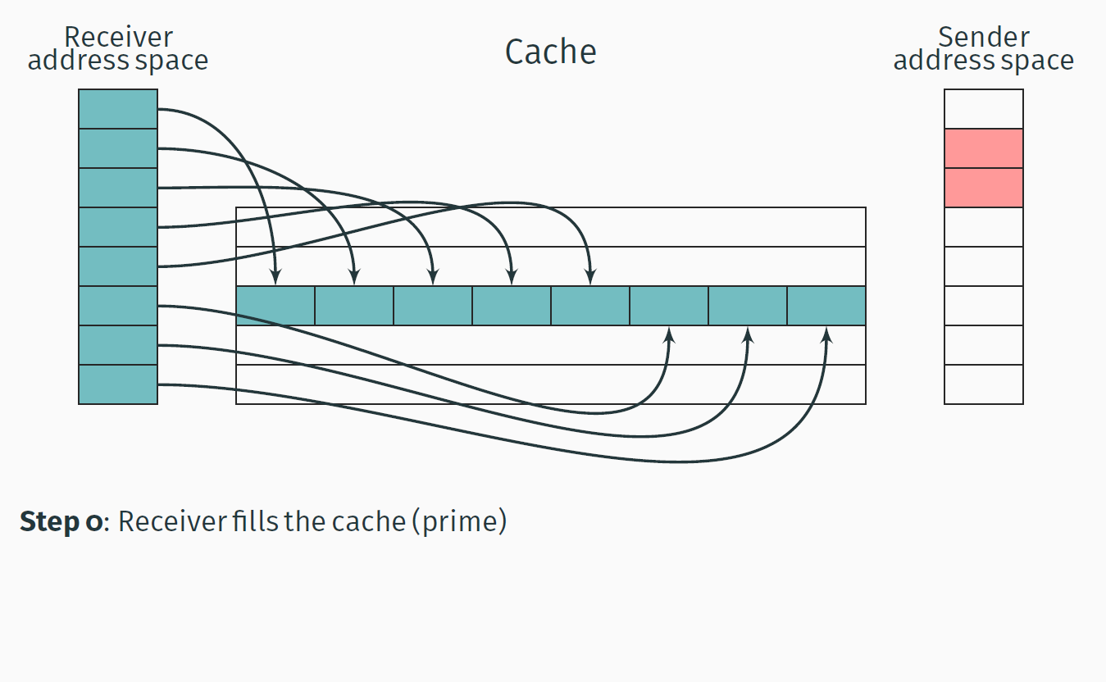
Prime + Probe

Slide 12
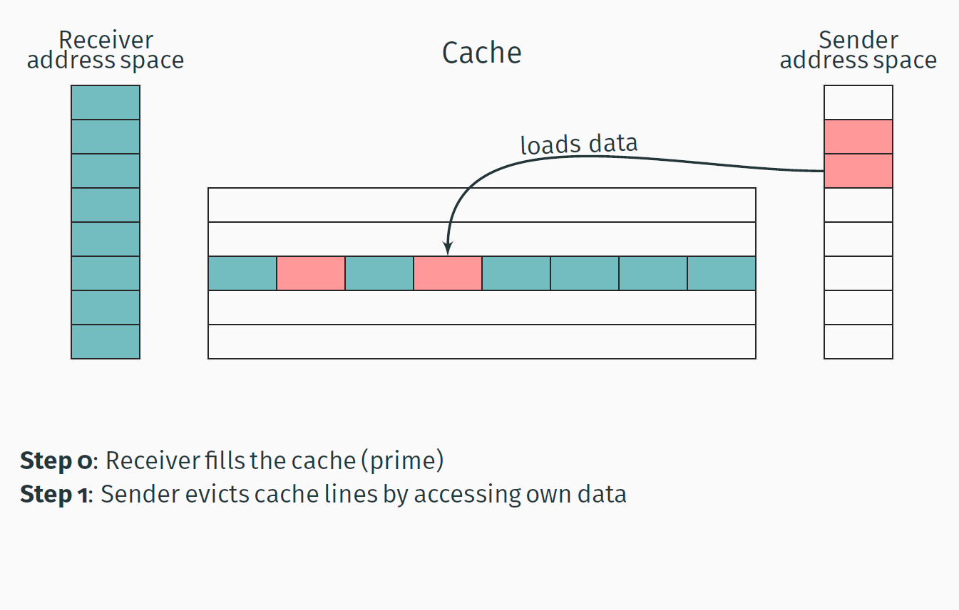
Prime + Probe

Slide 13
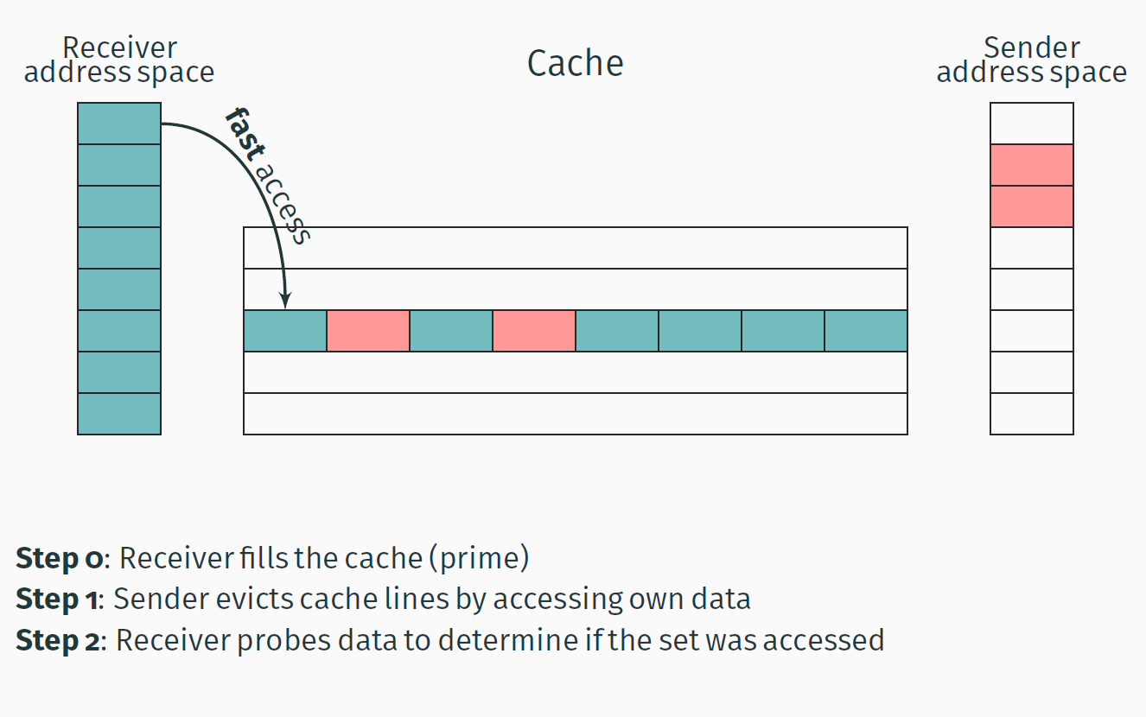
Prime + Probe

Slide 14
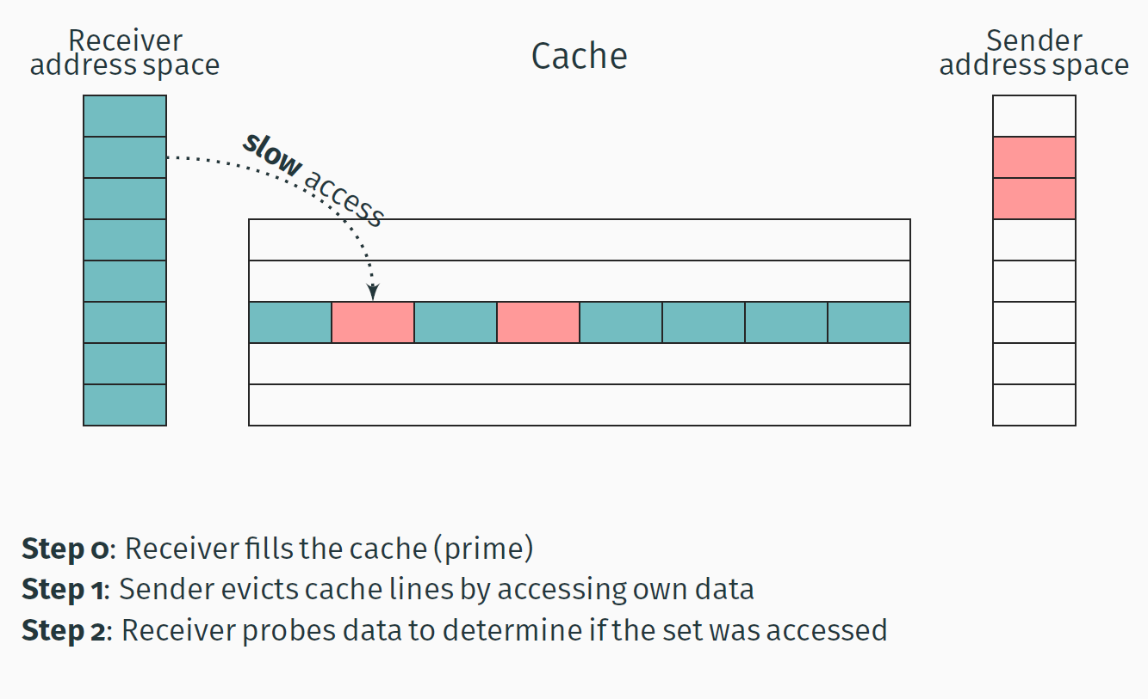
Prime + Probe

Slide 15
References
Clémentine Maurice, Manuel Weber, Michael Schwarz, Lukas Giner, Daniel Gruss, Carlo Alberto Boano, Stefan Mangard, Kay Römer, “Hello from the Other Side: SSH over Robust Cache Covert Channels in the Cloud”.
F. Liu, Y. Yarom, Q. Ge, G. Heiser, and R. B. Lee, “Last-Level Cache Side-Channel Attacks are Practical”.
D. A. Osvik, A. Shamir, and E. Tromer, “Cache attacksand countermeasures: the case of AES”.

