Slide 1






$$z$$
$$θ_{i}$$
………………..
$$x$$
$$l_{1}$$
$$l_{M−1}$$
$$l_{M}$$

Slide 2






$$z$$
$$θ$$
………………..
$$x$$
$$l_{1}$$
$$l_{M−1}$$
$$l_{M}$$

Slide 3
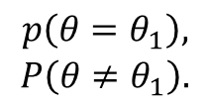

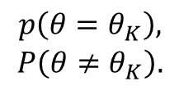
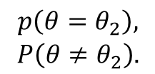
Prediction process
Prediction output
Classifier 1
Classifier 2
……..
Classifier K
Input, $y_{i}$
$$\begin{aligned}p\left(θ=θ_{1}\right), \\ P\left(θ≠θ_{1}\right).\end{aligned}$$
$$\begin{aligned}p\left(θ=θ_{2}\right), \\ P\left(θ≠θ_{2}\right).\end{aligned}$$
$$\begin{aligned}p\left(θ=θ_{K}\right), \\ P\left(θ≠θ_{K}\right).\end{aligned}$$

