Slide 1
201x/mm/dd
杨志超 00300912

Slide 3
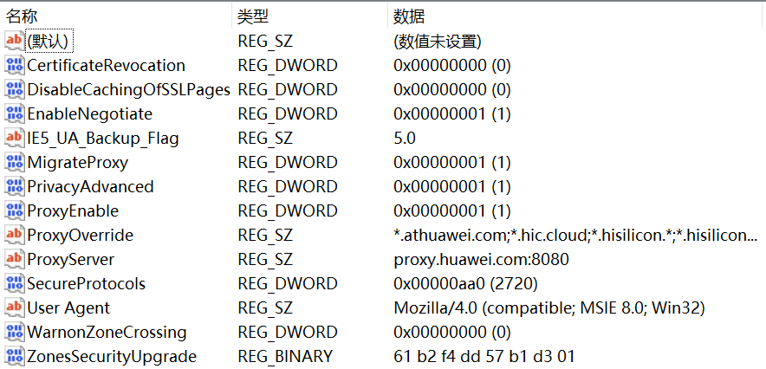


Slide 4
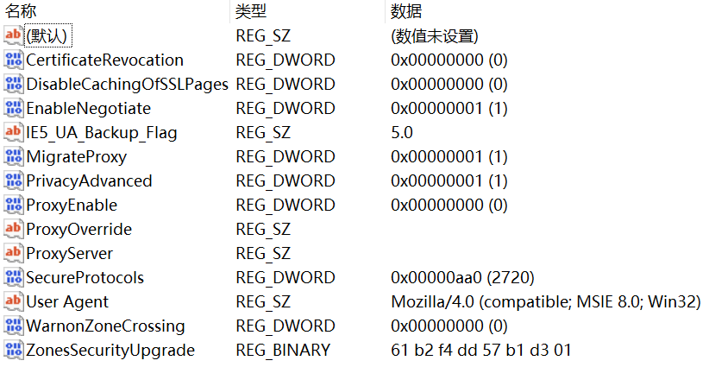
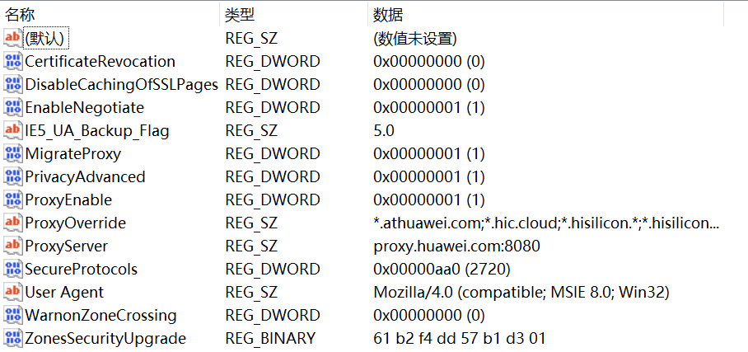
Text 微软雅黑-24

