Slide 1
CS 425 / ECE 428
Distributed Systems
Fall 2019
Indranil Gupta (Indy)
Lecture 1: Welcome, and Introduction
Aug 27, 2019
Web: courses.engr.illinois.edu/cs425/

Slide 2
Course Staff
Myself (Indy): 3112 Siebel Center
  Office Hours Every Tuesday and Thursday right after class – see website
TAs: (see course website for office hours)
  Rui Yang (lead TA)
    TAs for On-campus Students: Tarek Elgamal, Rahul Govind, Amit Patil, Le Xu, Federico Cifuentes-Urtube
  Beomyeol Jeon (lead TA for MCS Online)
    TAs for MCS Online Students: Shegufta Ahsan, Stuart Zhu, Dan Plyukhin, Atul Sandur (Non-contact)
More about course logistics later in this lecture…

Slide 3
What This Course is About
US Elections
Movies
Travel to Mars
Company Acquisitions
(Not Kidding)

Slide 4
What This Course is Really About
Distributed Systems
How to Design Algorithms for them
How to Design The Systems
How they work in real life
How to build real distributed systems

Slide 5
Many Students are Intimidated by Computer Science…
… It’s a good sign that you will do well!
(Ice skating story: Narration)
Sometimes, one has to unlearn first, before learning.

Slide 6
Our Main Goal Today
To Define the Term Distributed System

Slide 7
Can you name some examples of Operating Systems?

Slide 8
Can you name some examples of Operating Systems?
…
Linux WinXP Vista 7/8 Unix FreeBSD macOS OSX
2K Aegis Scout Hydra Mach SPIN
OS/2 Express Flux Hope Spring
AntaresOS EOS LOS SQOS LittleOS TINOS
PalmOS WinCE TinyOS iOS
…

Slide 9
What is an Operating System?

Slide 10
What is an Operating System?
User interface to hardware (device driver)
Provides abstractions (processes, file system)
Resource manager (scheduler)
Means of communication (networking)
…

Slide 11
FOLDOC definition
(FOLDOC = Free On-Line Dictionary of Computing)
Operating System - The low-level software which handles the interface to peripheral hardware, schedules tasks, allocates storage, and presents a default interface to the user when no application program is running.

Slide 12
Can you name some examples of
Distributed Systems?

Slide 13
Can you name some examples of
Distributed Systems?
Client-Server (NFS)
The Web
The internet
A wireless network
DNS
Gnutella or BitTorrent (peer to peer overlays)
A “cloud”, e.g., Amazon EC2/S3, Microsoft Azure
A datacenter, e.g., NCSA, a Google datacenter, AWS

Slide 14
What is a Distributed System?

Slide 15
FOLDOC definition
A collection of (probably heterogeneous) automata whose distribution is transparent to the user so that the system appears as one local machine. This is in contrast to a network, where the user is aware that there are several machines, and their location, storage replication, load balancing and functionality is not transparent. Distributed systems usually use some kind of client-server organization.

Slide 16
Textbook definitions
A distributed system is a collection of independent computers that appear to the users of the system as a single computer.
[Andrew Tanenbaum]
A distributed system is several computers doing something together. Thus, a distributed system has three primary characteristics: multiple computers, interconnections, and shared state.
[Michael Schroeder]
Notes:
Contradictions:
uh, doesn’t each computer need to know about a few other computers in the system (somewhere deep down there in the RAM)?
If computers don’t exchange any information and make no progress, would this count as a distributed system?

Slide 17
Unsatisfactory
Why are these definitions short?
Why do these definitions look inadequate to us?
Because we are interested in the insides of a distributed system
  design and implementation
  Maintenance
  Algorithmics (“protocols” or “distributed algorithms”)

Slide 18
“I shall not today attempt further to define the kinds of material I understand to be embraced within that shorthand description; and perhaps I could never succeed in intelligibly doing so. But I know it when I see it, and the motion picture involved in this case is not that.”
[Potter Stewart, Associate Justice, US Supreme Court (talking about his interpretation of a technical term laid down in the law, case Jacobellis versus Ohio 1964) ]

Slide 19
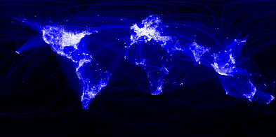
Which is a Distributed System – (A) or (B)?
(A)
(A) Facebook Social Network Graph among humans
Source: https://www.facebook.com/note.php?note_id=469716398919

Slide 20
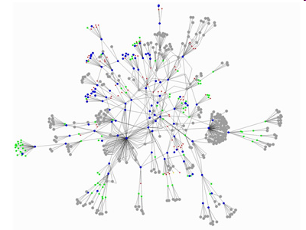
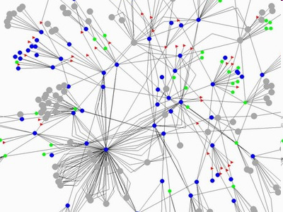
(B)
(B) Peer to peer file-sharing system (Gnutella)

Slide 21
A working definition for us
A distributed system is a collection of entities, each of which is autonomous, programmable, asynchronous and failure-prone, and which communicate through an unreliable communication medium.
Entity=a process on a device (PC, PDA)
Communication Medium=Wired or wireless network
Our interest in distributed systems involves
  design and implementation, maintenance, algorithmics
Notes:
Designers and progammers interested in : algorithmics, maintenance.
(informal definition, for us programmers of distributed systems)
Ok: peer to peer systems
Contradiction: a computer without ROM or disk drives that needs to boot over the network. Is a collection of these computers a distributed system?

Slide 22
Gnutella Peer to Peer System
What are the “entities”
(nodes)?
What is the
communication medium
(links)?
Source: GnuMap Project

Slide 23
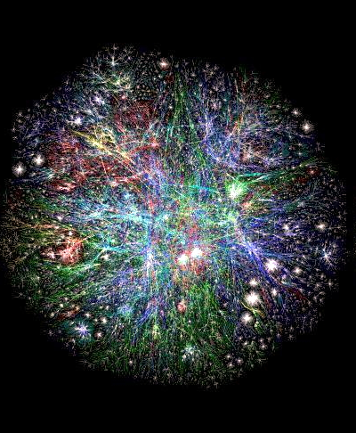
Web Domains
What are the “entities”
(nodes)?
What is the
communication medium
(links)?
Source: http://www.vlib.us/web/worldwideweb3d.html

Slide 24
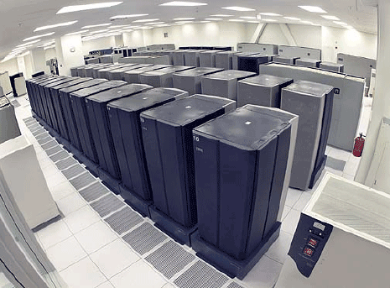
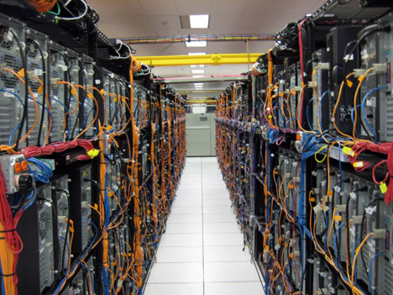
Datacenter
What are the “entities”
(nodes)?
What is the
communication medium
(links)?

Slide 25
The internet – Quick Refresher
Underlies many distributed systems.
A vast interconnected collection of computer networks of many types.
Intranets – subnetworks operated by companies and organizations.
Intranets contain LANs (local area networks).
WAN – wide area networks, consists of subnets (intranets, LANs, etc.)
ISPs – Internet Service Providers. Companies that provide modem links and other types of connections to users.
Intranets (actually the ISPs’ core routers) are linked by backbones – network links of large bandwidth, such as satellite connections, fiber optic cables, and other high-bandwidth circuits.
UC2B? Google Fiber? (MAN = Metropolitan Area Networks)

Slide 26
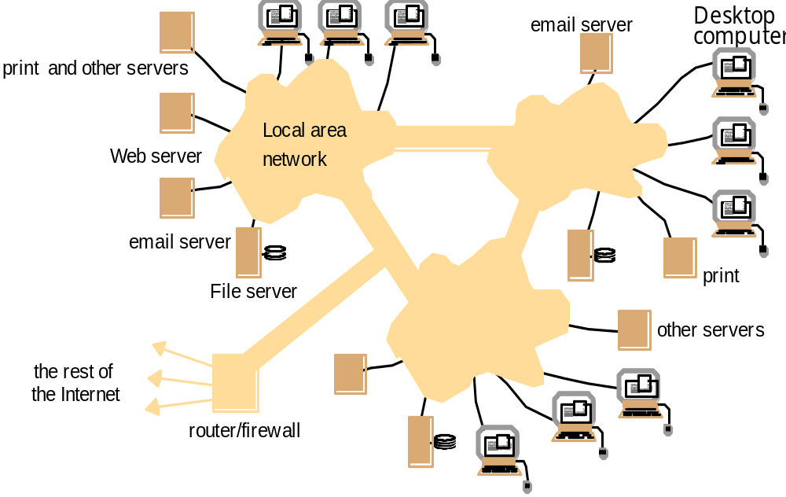
An Intranet & a distributed system
Running over this Intranet is a distributed file system
prevents unauthorized messages from leaving/entering;
implemented by filtering incoming and outgoing messages
via firewall “rules” (configurable)

Slide 27
Networking Stacks
Application
layer protocol
smtp [RFC 821]
telnet [RFC 854]
http [RFC 2068]
ftp [RFC 959]
proprietary
(e.g. RealNetworks)
NFS
proprietary
(e.g., Skype)
Underlying
transport protocol
TCP
TCP
TCP
TCP
TCP or UDP
TCP or UDP
typically UDP
Application
e-mail
remote terminal access
Web
file transfer
streaming multimedia
remote file server
internet telephony
Distributed System Protocols!
Networking Protocols
TCP=Transmission Control Protocol
UDP=User Datagram Protocol
(Implemented via sockets)

Slide 28
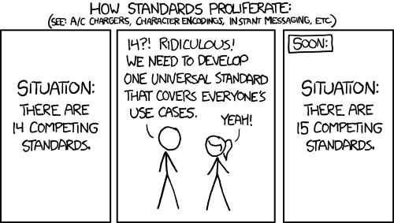
The History of internet Standards
Source: http://xkcd.com/927/

Slide 29

The Heart of the World Wide Web: the HTTP Standard
HTTP: hypertext transfer protocol
WWW’s application layer protocol
client/server model
  client: browser that requests, receives, and “displays” WWW objects
  server: WWW server, which is storing the website, sends objects in response to requests
http1.0: RFC 1945
http1.1: RFC 2068
  Leverages same connection to download images, scripts, etc.
http request
PC running
Explorer
http response
http request
Server
Running
Apache
Web
server
http response
Mac running
Safari

Slide 30
The HTTP Protocol: More
http: TCP transport service:
client initiates a TCP connection (creates socket) to server, port 80
server accepts the TCP connection from client
http messages (application-layer protocol messages) exchanged between browser (http client) and WWW server (http server)
TCP connection closed
http is “stateless”
server maintains no information about past client requests
Why?
Protocols that maintain session “state” are complex!
past history (state) must be maintained and updated.
if server/client crashes, their views of “state” may be inconsistent, and hence must be reconciled.
RESTful protocols are stateless.

Slide 31
HTTP Example
(contains text,
references to 10
jpeg images)
Suppose user enters URL www.cs.uiuc.edu/
1a. http client initiates a TCP connection to http server (process) at www.cs.uiuc.edu. Port 80 is default for http server.
1b. http server at host www.cs.uiuc.edu waiting for a TCP connection at port 80. “accepts” connection, notifying client
2. http client sends a http request message (containing URL) into TCP connection socket
3. http server receives request messages, forms a response message containing requested object (index.html), sends message into socket
time

Slide 32
HTTP Example (cont.)
4. http server closes the TCP connection (if necessary).
5. http client receives a response message containing html file, displays html, Parses html file, finds 10 referenced jpeg objects
6. Steps 1-5 are then repeated for each of 10 jpeg objects
time
For fetching referenced objects, have 2 options:
non-persistent connection: only one object fetched per TCP connection
  some browsers create multiple TCP connections simultaneously - one per object
persistent connection: multiple objects transferred within one TCP connection

Slide 33
Your Shell as a Web browser
1. Telnet to your favorite WWW server:
telnet www.google.com 80
Opens TCP connection to port 80
(default http server port) at www.google.com
Anything typed in sent
to port 80 at www.google.com
2. Type in a GET http request:
GET /index.html
Or
GET /index.html HTTP/1.0
By typing this in (may need to hit
return twice), you send
this minimal (but complete)
GET request to http server
3. Look at response message sent by http server!
What do you think the response is?

Slide 34
Does our Working Definition work for the http
Web?
A distributed system is a collection of entities, each of which is autonomous, programmable, asynchronous and failure-prone, and that communicate through an unreliable communication medium.
Entity=a process on a device (PC, PDA)
Communication Medium=Wired or wireless network
Our interest in distributed systems involves
  design and implementation, maintenance, study, algorithmics
Notes:
Designers and progammers interested in : algorithmics, maintenance.
(informal definition, for us programmers of distributed systems)
Ok: peer to peer systems
Contradiction: a computer without ROM or disk drives that needs to boot over the network. Is a collection of these computers a distributed system?

Slide 35
“Important” Distributed Systems Issues
No global clock; no single global notion of the correct time (asynchrony)
Unpredictable failures of components: lack of response may be due to either failure of a network component, network path being down, or a computer crash (failure-prone, unreliable)
Highly variable bandwidth: from 16Kbps (slow modems or Google Balloon) to Gbps (Internet2) to Tbps (in between DCs of same big company)
Possibly large and variable latency: few ms to several seconds
Large numbers of hosts: 2 to several million

Slide 36
Many Interesting Design Problems
Real distributed systems
  Cloud Computing, Peer to peer systems, Hadoop, key-value stores/NoSQL, distributed file systems, sensor networks, measurements, graph processing, stream processing, …
Classical Problems
  Failure detection, Asynchrony, Snapshots, Multicast, Consensus, Mutual Exclusion, Election, …
Concurrency
  RPCs, Concurrency Control, Replication Control, Paxos, …
Security
  ACLs, Capabilities, …
Others…

Slide 37
Typical Distributed Systems Design Goals
Common Goals:
  Heterogeneity – can the system handle a large variety of types of PCs and devices?
  Robustness – is the system resilient to host crashes and failures, and to the network dropping messages?
  Availability – are data+services always there for clients?
  Transparency – can the system hide its internal workings from the users? (warning: term means the opposite of what the name implies!)
  Concurrency – can the server handle multiple clients simultaneously?
  Efficiency – is the service fast enough? Does it utilize 100% of all resources?
  Scalability – can it handle 100 million nodes without degrading service? (nodes=clients and/or servers) How about 6 B? More?
  Security – can the system withstand hacker attacks?
  Openness – is the system extensible?

Slide 38
“Important” Issues
If you’re already complaining that the list of topics we’ve discussed so far has been perplexing…
  You’re right!
  It was meant to be (perplexing)
The Goal for the Rest of the Course: see enough examples and learn enough concepts so these topics and issues will make sense
  We will revisit many of these slides in the very last lecture of the course!

Slide 39
“Concepts”?
Which of the following inventions do you think is the most important?
  Car
  Wheel
  Bicycle
“What lies beneath?” Concepts!

Slide 40
How will We Learn?
All this information is contained in handout on course website: “Course Information and Schedule”
Web: courses.engr.illinois.edu/cs425/
Textbook, Recommended but not Required
  Colouris, Dollimore, Kindberg and Blair (5th edition)
  CDK Textbook
  If you use a different or older version, be sure to check problem numbers, etc.
  Textbook is a great source of practice problems for the exams (midterm and final)
Lectures

Slide 41
How will We Learn? (2)
All this information contained in handout on course website: “Course Information and Schedule”
Web: courses.engr.illinois.edu/cs425/
Homeworks (HWs)
  Four in total, two before midterm (mid-Oct) and two after
  About 2-3 weeks per homework
  Solutions need to be typed, figures can be hand-drawn
Programming assignments (MPs, i.e., Machine Programming Assignments)
  Only for 4 credit students (3 credit students welcome to do it, but we won’t be able to grade it or use it as extra credit)
  You will be building a distributed stream processing system in stages
  Four in total, two before midterm (mid-Oct) and two after
  Demo dates set: make sure you’re in town on that day (no excuses for interviews, travel, …)
Exams/quizzes
  Midterm (Oct 15th) + Final (date decided by campus)

Slide 42
What assistance is available to you?
Lectures
  Lecture slides will be placed online at course website
    “Tentative” version before lecture
    “Final” version after lecture
Asking Questions (most preferable first)
  Piazza: Your first stop for all questions (see if your question has already been asked)
    We will try to ensure that every question is answered within 24 hours of posting (during weekdays).
    Do not post solutions or code on Piazza – that’ll immediately earn you a zero on the HW/MP.
  Office Hours (posted on course website): Every weekday has at least one office hours scheduled.
  Email staff mailing list (don’t email individual instructor/TA except for private issues)
Course Prerequisite: CS 241 or ECE 391 or equivalent OS/networking course (latter need instructor permission)

Slide 43
Course Staff (Again)
Myself (Indy): 3112 Siebel Center
  Office Hours Every Tuesday and Thursday right after class – see website
TAs: (see course website for office hours)
  Rui Yang (lead TA)
    TAs for On-campus Students: Tarek Elgamal, Rahul Govind, Amit Patil, Le Xu, Federico Cifuentes-Urtube
  Beomyeol Jeon (lead TA for MCS Online)
    TAs for MCS Online Students: Shegufta Ahsan, Stuart Zhu, Dan Plyukhin, Atul Sandur (Non-contact)

Slide 44
Individual vs. Group Work
Homeworks
  Individual only. All work must be your own.
MPs
  In groups of 2
  Within group: Can discuss everything.
For both HWs and MPs
  You can discuss with others (and course staff) lecture concepts and the HW/MP question/spec itself, but you cannot discuss solutions or even ideas.
  You cannot copy solutions/code or look at someone else’s solutions
    We will check (we use Moss, we also compare HWs)
First violation: zero on HW/MP. Second violation: F in course. (Both have happened in the past!)

Slide 45
Speaking of HWs and MPs
HW1 and MP1 have both been released!
Don’t worry – you have time
But start early! Start now.
You must let us know the composition of your group for MP by Thursday 9/5 5 pm.
  If you don’t meet this deadline you won’t get VMs to do your MP!
  Instructions on how to inform us are on the course website
You can start on MP right away (don’t need lectures for it)
Due in about 2 weeks
  MP1 due 9/15 (demos on 9/16)
  HW1 due 9/24 (Please read submission instructions carefully)

Slide 46
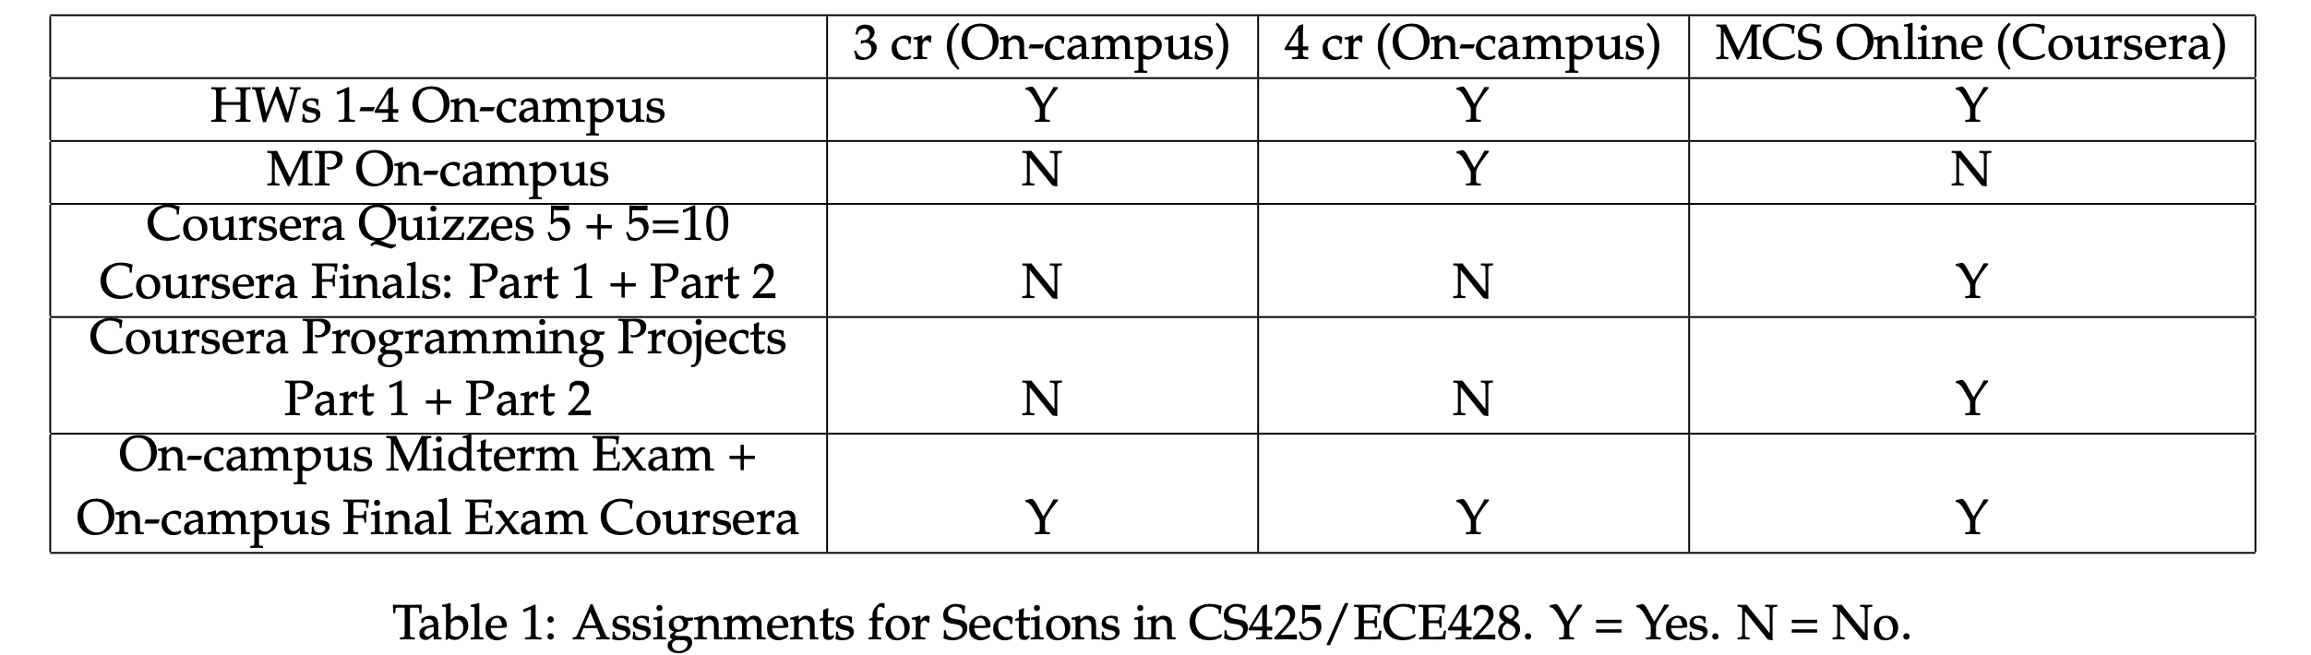
3 cr vs 4 cr vs MCS Online/DSO

Slide 47
Wrap-Up
(Reading for today’s lecture: Relevant parts of Chapter 1)
All students:
  Go to course website https://courses.engr.illinois.edu/cs425/
  Todos:
    (All) Sign up for Piazza by today
    (4 cr) Form MP group by 9/5
    (All) Fill out Student Survey sheet by today
  Not yet registered?
    No waitlist this year ☹
    Continue to do all the HWs, (MPs if 4 cr). Usually we get everyone in by end of September (no guarantees though!).

