Slide 1
CAPSTONE PROJECT
MACHINE LEARNING FUNDAMENTALS
Y. ZENG
11/1/2018

Slide 2
TABLE OF CONTENTS
Data Exploration
Questions
Augmenting the Dataset
Classification Approaches
Regression Approaches
Conclusions and Future Steps

Slide 3
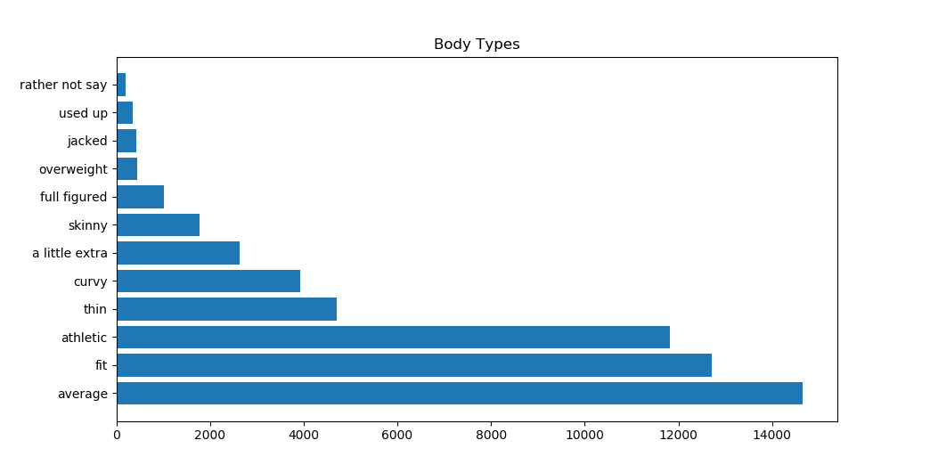
DATA EXPLORATION
Bar chart showing the distribution of body types

Slide 4
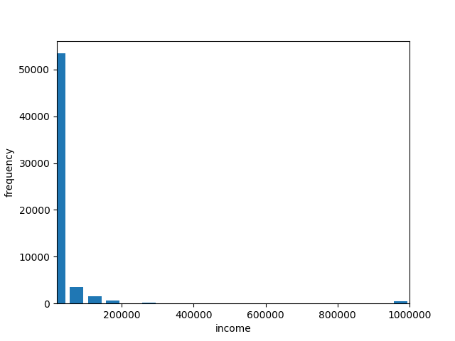
Histogram of income

Slide 5
QUESTIONS
Can we predict body type with drinking and smoking habits?
Can we predict income with average word length in essays 2 and 6?

Slide 6
AUGMENTING THE DATA
Converted the ‘drinks’ column into numerical data:
drink_mapping= {"not at all": 0, "rarely": 1, "socially": 2, "often": 3, "very often": 4, "desperately": 5}
Converted the ‘drugs’ column into numerical data:
drug_mapping={"never": 0, "sometimes": 1, "often": 3}
Combined columns ‘essay2’ and ‘essay6’ and calculate the averaged word length
Removed the rows that do not have any input data
Normalized the data of interest

Slide 7
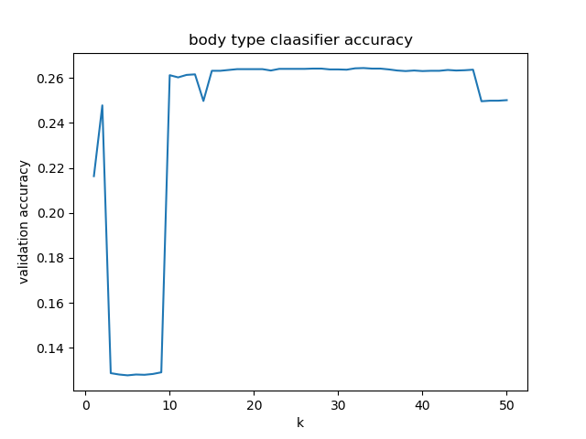
CLASSIFICATION 1: K-nearest Neighbors
Question: Can we predict body type with drinking and smoking habits?
Based on the graph, K=10 was selected to perform the k-nearest neighbors classification
Accuracy: 0.2613
Precision: 0.2613
Recall: 0.2613
Graph showing k value and its corresponding accuracy of the prediction

Slide 8
CLASSIFICATION 2: Support Vector Machines
Question: Can we predict body type with drinking and smoking habits?
Kernel=‘rbf’, gamma=0.5, C=2
Accuracy: 0.27
Precision: 0.27
Recall: 0.27
Comparison:
K-nearest Neighbors:
Accuracy: 0.2613
Running Time: faster
Support Vector Machines:
Accuracy: 0.27
Running Time: slower

Slide 9
CONCLUSIONS
Question: Can we predict body type with drinking and smoking habits?
Both k-nearest neighbor and supported vector machines approaches have low accuracy on this specific classification task. Supported vector machines algorithm runs much slower, but generates a result that was only slightly better than k-nearest neighbor approach. It is very likely that body type is not related to drinking and smoking habits.

Slide 10
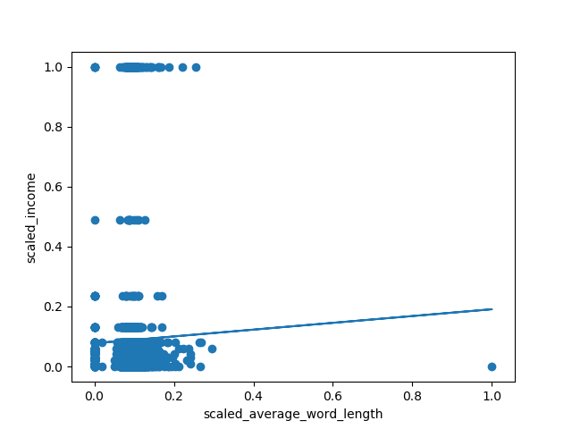
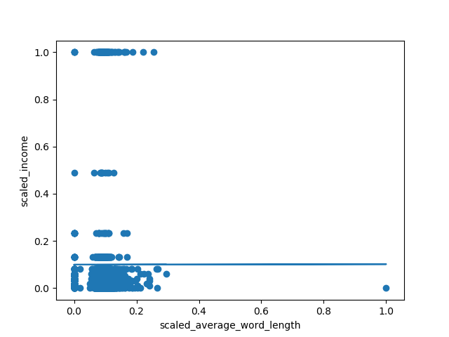
REGRESSION
Question: Can we predict income with average word length in essays 2 and 6?
Linear Regression
Supported Vector Regression
Average word length in essay 2 & 6 VS income
Average word length in essay 2 & 6 VS income
Coefficient: 0.11343261

Slide 11
CONCLUSIONS
Question: Can we predict income with average word length in essays 2 and 6??
There is no obvious relationship between the average word length in essays 2/6 and income.

