Slide 1


Faster and Better Solution to Embed
Lp Metrics by Tree Metrics
Yuxiang Zeng ¹, Yongxin Tong ², Lei Chen ¹
¹ The Hong Kong University of Science and Technology
² Beihang University
We get some pictures and materials from the Internet for this slides.

Slide 2
Outline
Background
Problem Statement
Methodology
Experiment
Conclusion

Slide 3
Background: Metric Embedding
“Metric embedding plays an important role in a vast range of application areas such as matching, planning, computer vision, computational biology, machine learning, networking, statistics, to name a few” [1]
  HST is one of the most popular metric embeddings
  E.g., the seminal work of HST by J. Fakcharoenphol et al. [2] has over 900 citations in Google scholar
[1] I. Abraham et al. Advances in metric embedding theory. In STOC 2006
[2] J. Fakcharoenphol et al. A Tight Bound on Approximating Arbitrary Metrics by Tree Metrics. In STOC 2003

Slide 4
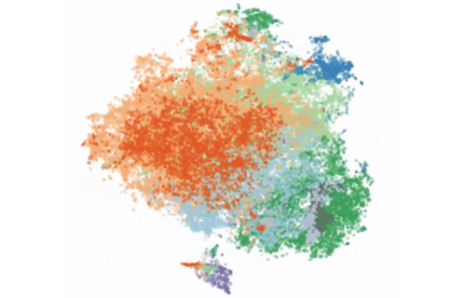



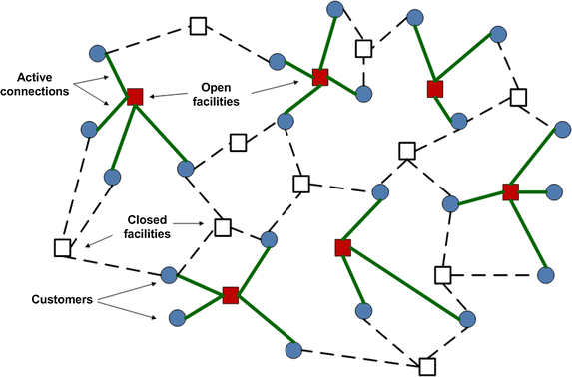

Background: Application of HST
A few selected applications: spatial crowdsourcing
(1) clustering (A. Backurs etal. in ICML19)
(2) spatial crowdsourcing (Y. Tong etal. in VLDB16)
(3) trip planning (C. Coester etal. in STOC19)
Lp metrics are commonly used in these applications
(4) privacy protection (Y. Esencayi etal. in NeurIPS19)
(5) facility location (Y.
Azar etal. in FOCS19)
(6) distributed query processing (J. Li etal. in ICDE09)

Slide 5
Background: Usage of HST
When to use HST? Hard optimization problems
Hard to be solved on input metric
with bad approx. guarantees
Online metric bipartite matching
is hard on L₂ metric [3,4]
Construct metric embedding
(HST) of input metric
Construct HST of L₂ metric
Reduce instance
from input metric to HST
Location (coordinate) → leaf
L₂ distance → tree distance
Easier to be solved on HST
with better approx. guarantee
Greedy vs HST-Greedy
O(2^{n}) vs O(log^{o(1)}n)
[3] A. Meyerson et al. Randomized online algorithms for minimum metric bipartite matching. In SODA 2006
[4] Y. Tong et al. Online Minimum Matching in Real-Time Spatial Data: Experiments and Analysis. In VLDB 2016

Slide 6
Motivation: Construct HST
Impact of construction on efficiency/effectiveness
Online metric bipartite matching
is hard on L₂ metric [1,2]
Construction becomes the efficiency bottleneck
Construct HST of L₂ metric
Location (coordinate) → leaf
L₂ distance → tree distance
Distortion of constructed HST affects approx. ratio
Greedy vs HST-Greedy
O(2^{n}) vs O(log^{o(1)}n)

Slide 7
Motivation: Construct HST
Impact of construction on efficiency/effectiveness
A case study on online metric bipartite matching (OMBM) problem (objective: bottleneck distance)
  By using HST, the objective can be improved
  Lower distortion → better objective of OMBM
  Faster construction → Lower (overall) time cost
 | Distortion of Constructed HST | Construction Time | Bottleneck Distance
Greedy | N/A | N/A | 151.3
HST-Greedy (by SOTA) | 732.5 | 0.241 | 127.6
HST-Greedy (by this paper) | 517.0 | 0.058 | 115.8
23.4%

Slide 8
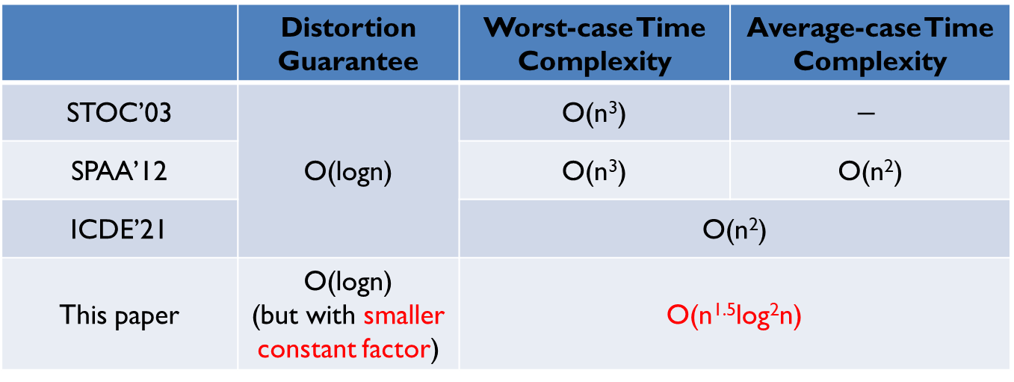
Related Work: State-Of-The-Art
Existing solutions to construct HSTs of Lp metrics
  High time complexity for large-scale dataset
  Distortion is only satisfactory for high-dimensional data
 | Distortion Guarantee | Worst-case Time Complexity | Average-case Time Complexity
STOC’03 | O(logn) | O(n³) | $$−$$
SPAA’12 |  | O(n³) | O(n²)
ICDE’21 |  | O(n²)
This paper | O(logn) (but with smaller constant factor) | O(n^{1.5}log²n)
We are motivated to design faster and better solutions to construct HST (embed Lp metrics by tree metrics problem).
[2] J. Fakcharoenphol et al. A Tight Bound on Approximating Arbitrary Metrics by Tree Metrics. In STOC 2003
[5] G. E. Blelloch et al. Parallel probabilistic tree embeddings, k-median, and buy-at-bulk network design. In SPAA 2012
[6] Y. Zeng et al. HST+: An Efficient Index for Embedding Arbitrary Metric Spaces. In ICDE 2021

Slide 9
Outline
Background
Problem Statement
Methodology
Experiment
Conclusion

Slide 10
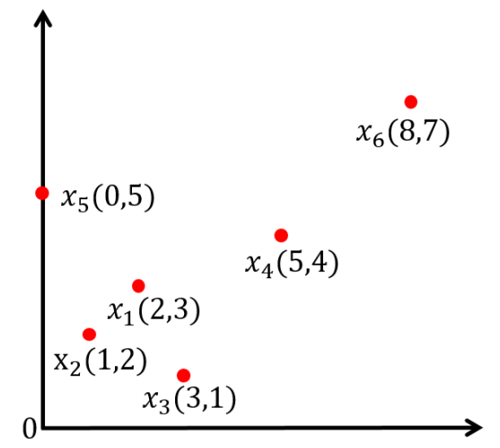
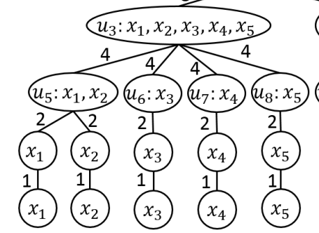
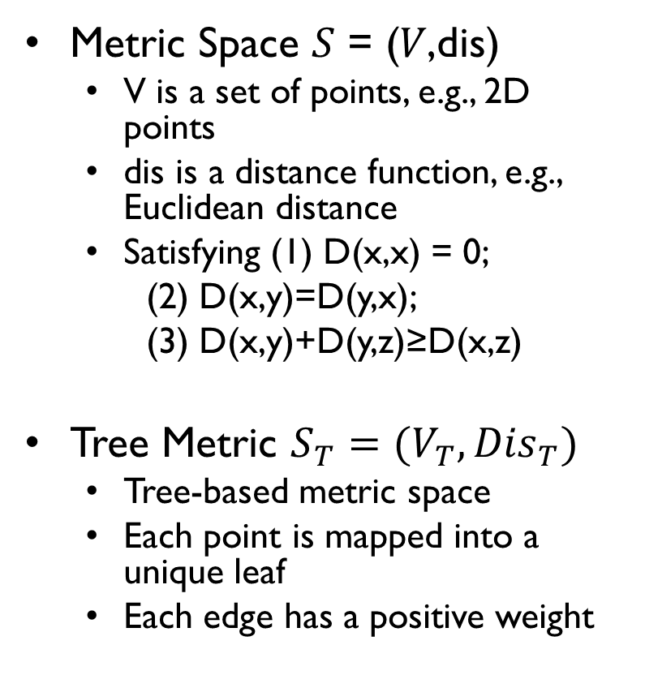
Basic Concepts: Tree Metrics
Metric Space 𝑆 = (𝑉,dis)
  V is a set of points, e.g., 2D points
  dis is a distance function, e.g., Euclidean distance
  Satisfying (1) D(x,x) = 0;
  (2) D(x,y)=D(y,x);
  (3) D(x,y)+D(y,z)≥D(x,z)
Tree Metric $S_{T}=(V_{T},{Dis}_{T})$
  Tree-based metric space
  Each point is mapped into a unique leaf
  Each edge has a positive weight
a 2D Euclidean space

Slide 11
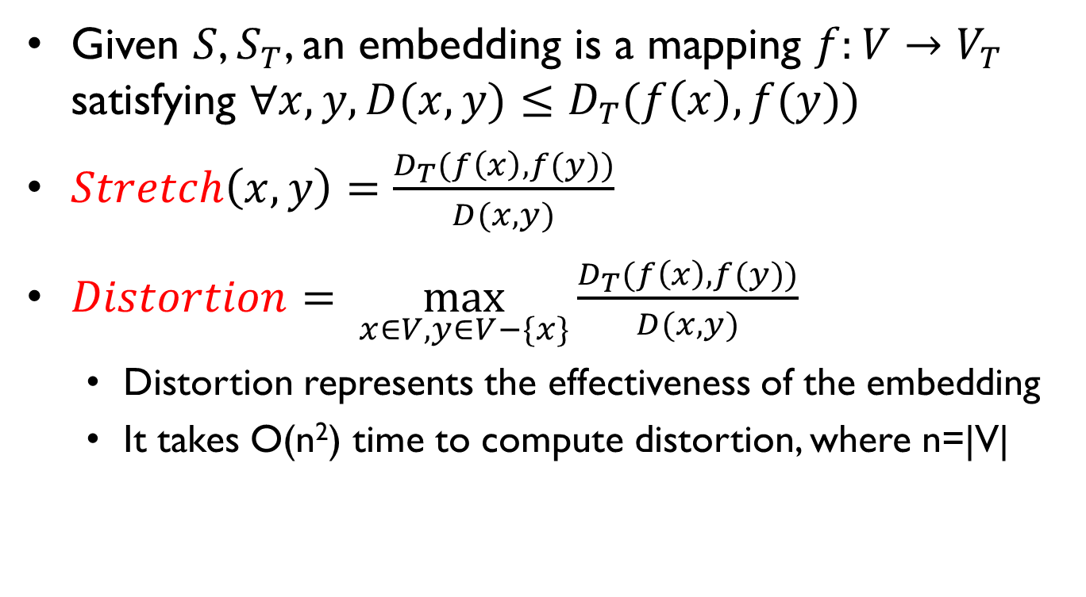
Basic Concepts: Stretch & Distortion
Given $S$, $S_{T}$, an embedding is a mapping $f:V→V_{T}$ satisfying $∀x,y, D(x,y)≤D_{T}(f\left(x\right),f(y))$
$Stretch\left(x,y\right)=\frac{D_{T}(f\left(x\right),f(y))}{D(x,y)}$
$Distortion= \max_{x∈V,y∈V−\{x\}}{\frac{D_{T}(f\left(x\right), f(y))}{D(x, y)}}$
  Distortion represents the effectiveness of the embedding
  It takes O(n²) time to compute distortion, where n=|V|

Slide 12
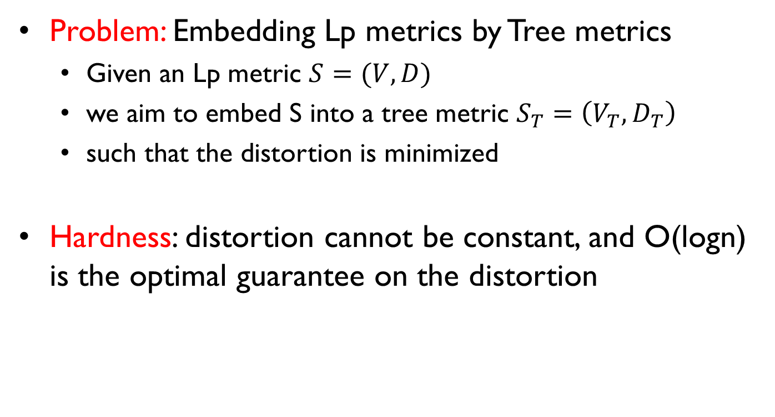
Problem Definition
Problem: Embedding Lp metrics by Tree metrics
  Given an Lp metric $S=(V,D)$
  we aim to embed S into a tree metric $S_{T}=\left(V_{T},D_{T}\right)$
  such that the distortion is minimized
Hardness: distortion cannot be constant, and O(logn) is the optimal guarantee on the distortion

Slide 13
Outline
Background
Problem Statement
Methodology
Experiment
Conclusion

Slide 14


































Preliminary: Structure of HST
HST (Hierarchically Separated Tree) was proposed by Yair Bartal in FOCS’96 as the solution
  k is a parameter (k-HST, 2-HST)
We follow the structure properties
Weight property:
Edge weights at same level are same
Weights are geometrically decreased by a factor k (e.g., k is often 2)
Node property:
a leaf → a (unique) point
an internal node → a point subset
at same level, nodes are disjoint
L1
$$u_{1}$$
$$p_{1},p_{2},p_{3},p_{4},p_{5},p_{6}$$
16
$$u_{2}$$
$$p_{2},p_{3},p_{4},p_{5},p_{6}$$
$$u_{3}$$
$$p_{1}$$
L2
8
$$u_{4}$$
$$u_{5}$$
$$u_{6}$$
L3
$$p_{1}$$
$$p_{2},p_{3}, p_{5}$$
$$p_{4},p_{6}$$
4
$$u_{7}$$
$$u_{8}$$
$$u_{9}$$
$$u_{10}$$
$$u_{11}$$
$$p_{2}$$
$$p_{3},p_{5}$$
$$p_{4}$$
$$p_{6}$$
$$p_{1}$$
L4
2
$$u_{12}$$
$$u_{13}$$
$$u_{14}$$
$$u_{15}$$
$$u_{16}$$
$$u_{17}$$
$$p_{2}$$
$$p_{3}$$
$$p_{5}$$
$$p_{4}$$
$$p_{6}$$
$$p_{1}$$
L5

Slide 15
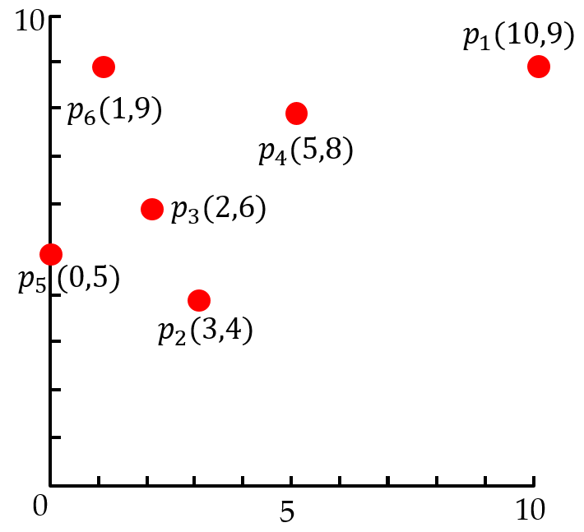
Solution: Main Idea
Our Idea: divide and conquer
  Divide: divide input metric space into disjoint subspaces
  Conquer: construct subtree (HST) for each subspace
  Combine: link the subtrees into the final HST
L1
$$u_{1}$$
$$p_{1},p_{2},p_{3},p_{4},p_{5},p_{6}$$
16
$$u_{2}$$
$$p_{2},p_{3},p_{4},p_{5},p_{6}$$
$$u_{3}$$
$$p_{1}$$
L2
8
$$u_{4}$$
$$u_{5}$$
$$u_{6}$$
L3
$$p_{1}$$
$$p_{2},p_{3}, p_{5}$$
$$p_{4},p_{6}$$
4
$$u_{7}$$
$$u_{8}$$
$$u_{9}$$
$$u_{10}$$
$$u_{11}$$
$$p_{2}$$
$$p_{3},p_{5}$$
$$p_{4}$$
$$p_{6}$$
$$p_{1}$$
L4
2
$$u_{12}$$
$$u_{13}$$
$$u_{14}$$
$$u_{15}$$
$$u_{16}$$
$$u_{17}$$
$$p_{2}$$
$$p_{3}$$
$$p_{5}$$
$$p_{4}$$
$$p_{6}$$
$$p_{1}$$
L5
Technical challenge: how to decide the space partition?

Slide 16
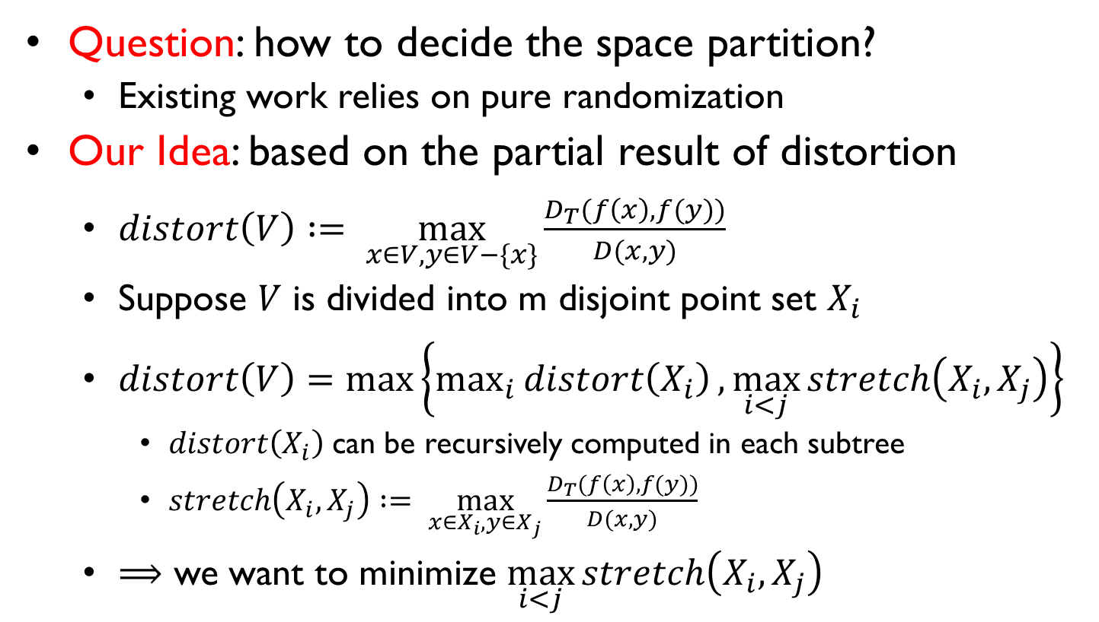
Solution: Main Idea
Question: how to decide the space partition?
  Existing work relies on pure randomization
Our Idea: based on the partial result of distortion
  $distort\left(V\right) := \max_{x∈V,y∈V−\{x\}}{\frac{D_{T}(f\left(x\right), f(y))}{D(x, y)}}$
  Suppose $V$ is divided into m disjoint point set $X_{i}$
  $distort\left(V\right)=\max\left\{\max_{i}{distort\left(X_{i}\right)},\max_{i<j}{stretch\left(X_{i},X_{j}\right)}\right\}$
    $distort\left(X_{i}\right)$can be recursively computed in each subtree
    $stretch\left(X_{i},X_{j}\right)$ $:= \max_{x∈X_{i},y∈X_{j}}{\frac{D_{T}(f\left(x\right), f(y))}{D(x, y)}}$
  $⟹$ we want to minimize $\max_{i<j}{stretch\left(X_{i},X_{j}\right)}$

Slide 17
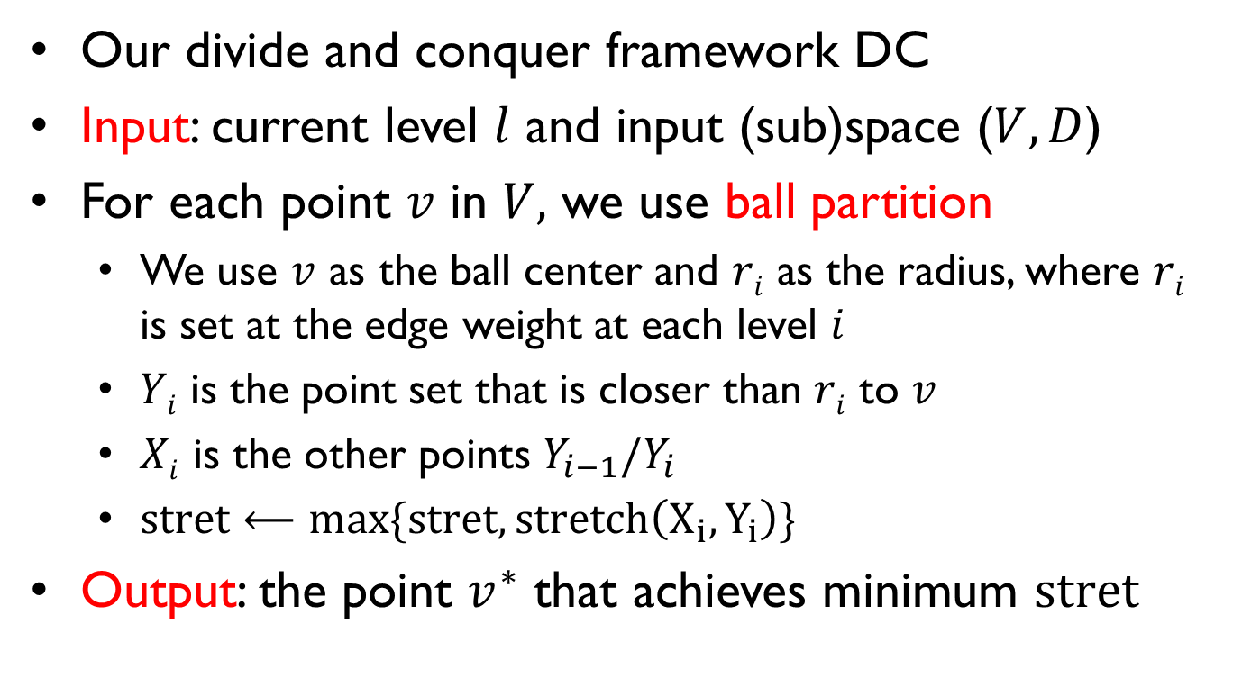
Solution: Our Framework DC
Our divide and conquer framework DC
Input: current level $l$ and input (sub)space ($V, D$)
For each point $v$ in $V,$ we use ball partition
  We use $v$ as the ball center and $ri$ as the radius, where $ri$ is set at the edge weight at each level $i$
  $Yi$ is the point set that is closer than $ri$ to $v$
  $Xi$ is the other points $Y_{i−1}/Y_{i}$
  $stret⟵max\{stret, stretch\left(X_{i},Y_{i}\right)\}$
Output: the point $v^{∗}$ that achieves minimum $stret$

Slide 18


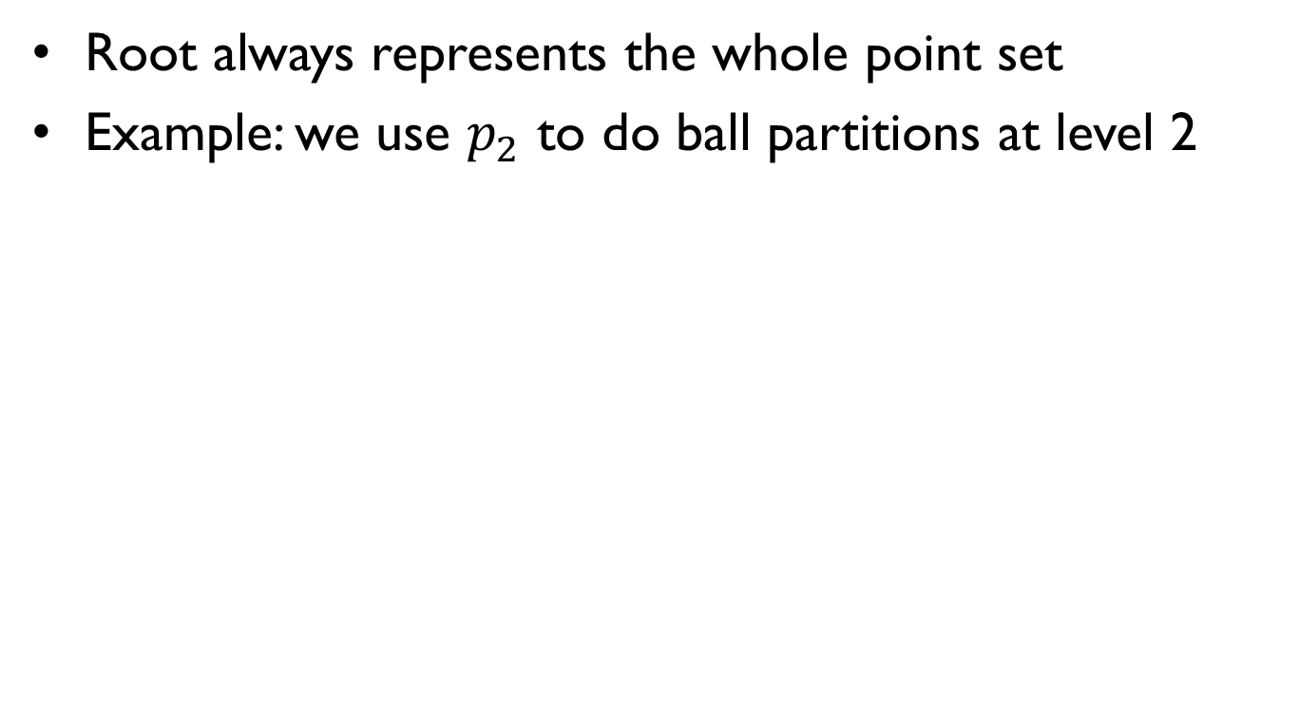



























Solution: Example
Root always represents the whole point set
Example: we use $p_{2}$ to do ball partitions at level 2
$stretch\left(X_{2},Y_{2}\right)$ $:= \max_{x∈X_{2},y∈Y_{2}}{\frac{D_{T}(f\left(x\right), f(y))}{D(x, y)}}=11.77$, $stret = 11.77$
L1
$$u_{1}$$
$$p_{1},p_{2},p_{3},p_{4},p_{5},p_{6}$$
16
$$u_{2}$$
$$p_{2},p_{3},p_{4},p_{5},p_{6}$$
$$u_{3}$$
$$p_{1}$$
L2
8
8
$$u_{4}$$
$$u_{5}$$
L3
$$X_{2}=\left\{p_{1}\right\}$$
$$Y_{2}=\left\{p_{2},p_{3},p_{4},p_{5},p_{6}\right\}$$
$$p_{2},p_{3}, p_{5}$$
$$p_{4},p_{6}$$
4
$$u_{7}$$
$$u_{8}$$
$$u_{9}$$
$$u_{10}$$
$$p_{2}$$
$$p_{3},p_{5}$$
$$p_{4}$$
$$p_{6}$$
L4
2
$$u_{13}$$
$$u_{14}$$
$$u_{15}$$
$$u_{16}$$
$$p_{2}$$
$$p_{3}$$
$$p_{5}$$
$$p_{4}$$
$$p_{6}$$
L5

Slide 19























Solution: Example
Root always represents the whole point set
Example: we use $p_{2}$ to do ball partitions at level 3
$stretch\left(X_{3},Y_{3}\right)$ $:= \max_{x∈X_{3},y∈Y_{3}}{\frac{D_{T}(f\left(x\right), f(y))}{D(x, y)}}=8.85$, $stret = 11.77$
L1
$$u_{1}$$
$$p_{1},p_{2},p_{3},p_{4},p_{5},p_{6}$$
16
$$u_{2}$$
$$p_{2},p_{3},p_{4},p_{5},p_{6}$$
$$u_{3}$$
$$p_{1}$$
L2
4
8
$$u_{4}$$
$$u_{5}$$
L3
$$p_{2},p_{3}, p_{5}$$
$$p_{4},p_{6}$$
4
$$u_{7}$$
$$u_{8}$$
$$p_{2}$$
$$p_{3},p_{5}$$
$$p_{2}$$
$$p_{3},p_{5}$$
L4
$$X_{3}=\left\{p_{4},p_{6}\right\}$$
$$Y_{3}=\left\{p_{2},p_{3}, p_{5}\right\}$$
$$u_{13}$$
$$u_{12}$$
$$u_{13}$$
$$u_{14}$$
2
$$u_{14}$$
$$p_{2}$$
$$p_{3}$$
$$p_{5}$$
$$p_{2}$$
$$p_{3}$$
$$p_{5}$$
L5

Slide 20



















Solution: Example
Root always represents the whole point set
Example: we use $p_{2}$ to do ball partitions at level 4
$stretch\left(X_{4},Y_{4}\right)$ $:= \max_{x∈X_{4},y∈Y_{4}}{\frac{D_{T}(f\left(x\right), f(y))}{D(x, y)}}=5.37$, $stret = 11.77$
L1
$$u_{1}$$
$$p_{1},p_{2},p_{3},p_{4},p_{5},p_{6}$$
16
$$u_{2}$$
$$p_{2},p_{3},p_{4},p_{5},p_{6}$$
$$u_{3}$$
$$p_{1}$$
L2
2
8
$$u_{4}$$
$$u_{5}$$
L3
$$p_{2},p_{3}, p_{5}$$
$$p_{4},p_{6}$$
4
$$u_{7}$$
$$u_{8}$$
$$p_{2}$$
$$p_{3},p_{5}$$
L4
2
$$u_{12}$$
$$p_{2}$$
$$Y_{4}=\left\{p_{2}\right\}$$
$$X_{4}=\left\{p_{3},p_{5}\right\}$$
L5

Slide 21



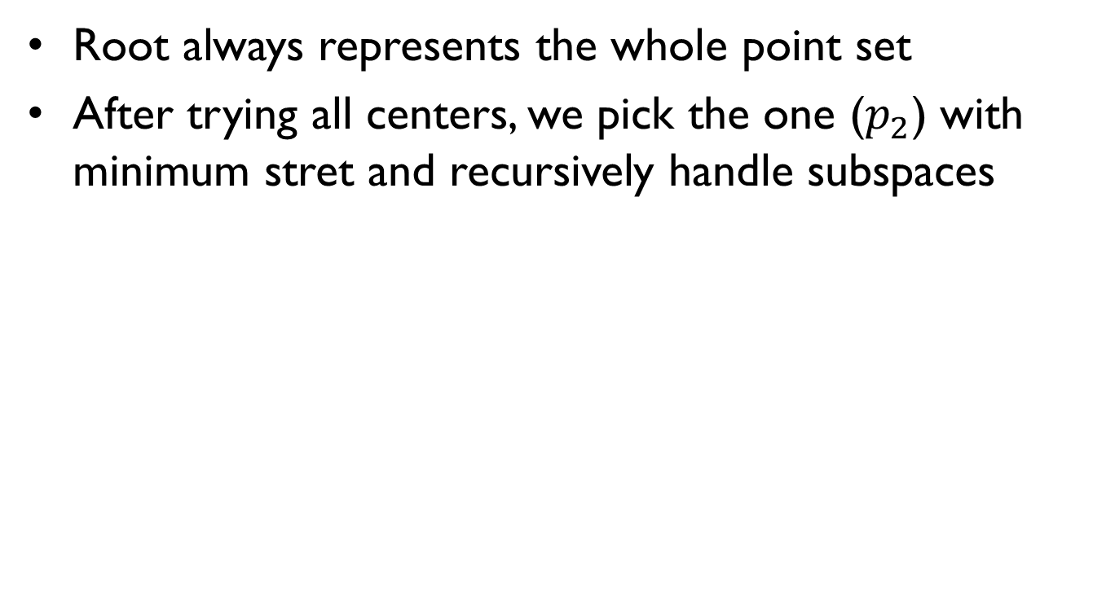



















Solution: Example
Root always represents the whole point set
After trying all centers, we pick the one ($p_{2}$) with minimum stret and recursively handle subspaces
L1
$$u_{1}$$
$$p_{1},p_{2},p_{3},p_{4},p_{5},p_{6}$$
16
$$u_{2}$$
$$p_{2},p_{3},p_{4},p_{5},p_{6}$$
$$u_{3}$$
$$p_{1}$$
L2
8
$$u_{4}$$
$$u_{5}$$
$$u_{6}$$
L3
$$p_{1}$$
$$p_{2},p_{3}, p_{5}$$
$$p_{4},p_{6}$$
4
$$u_{7}$$
$$u_{8}$$
$$u_{11}$$
$$p_{2}$$
$$p_{3},p_{5}$$
$$p_{1}$$
$$p_{2}$$
$$p_{3},p_{5}$$
L4
2
$$u_{12}$$
$$u_{13}$$
$$u_{16}$$
$$u_{17}$$
$$p_{2}$$
$$p_{2}$$
$$p_{1}$$
L5

Slide 22








Solution: Example
Root always represents the whole point set
After trying all centers, we pick the one ($p_{2}$) with minimum stret and recursively handle subspaces
L1
$$u_{1}$$
$$p_{1},p_{2},p_{3},p_{4},p_{5},p_{6}$$
16
$$u_{2}$$
$$p_{2},p_{3},p_{4},p_{5},p_{6}$$
$$u_{3}$$
$$p_{1}$$
L2
8
$$u_{4}$$
$$u_{5}$$
$$u_{6}$$
L3
$$p_{1}$$
$$p_{2},p_{3}, p_{5}$$
$$p_{4},p_{6}$$
4
$$u_{7}$$
$$u_{8}$$
$$u_{9}$$
$$u_{10}$$
$$u_{11}$$
$$p_{2}$$
$$p_{3},p_{5}$$
$$p_{4}$$
$$p_{6}$$
$$p_{1}$$
$$p_{2}$$
$$p_{3},p_{5}$$
$$p_{4}$$
$$p_{6}$$
L4
2
$$u_{12}$$
$$u_{13}$$
$$u_{14}$$
$$u_{15}$$
$$u_{16}$$
$$u_{17}$$
$$u_{15}$$
$$u_{16}$$
$$p_{2}$$
$$p_{4}$$
$$p_{6}$$
$$p_{2}$$
$$p_{4}$$
$$p_{6}$$
$$p_{1}$$
L5

Slide 23




Solution: Example
Root always represents the whole point set
After trying all centers, we pick the one ($p_{2}$) with minimum stret and recursively handle subspaces
L1
$$u_{1}$$
$$p_{1},p_{2},p_{3},p_{4},p_{5},p_{6}$$
16
$$u_{2}$$
$$p_{2},p_{3},p_{4},p_{5},p_{6}$$
$$u_{3}$$
$$p_{1}$$
L2
8
$$u_{4}$$
$$u_{5}$$
$$u_{6}$$
L3
$$p_{1}$$
$$p_{2},p_{3}, p_{5}$$
$$p_{4},p_{6}$$
4
$$u_{7}$$
$$u_{8}$$
$$u_{9}$$
$$u_{10}$$
$$u_{11}$$
$$p_{2}$$
$$p_{3},p_{5}$$
$$p_{4}$$
$$p_{6}$$
$$p_{1}$$
$$p_{2}$$
$$p_{3},p_{5}$$
$$p_{4}$$
$$p_{6}$$
L4
$$u_{13}$$
$$u_{12}$$
$$u_{13}$$
$$u_{14}$$
$$u_{17}$$
2
$$u_{12}$$
$$u_{14}$$
$$u_{15}$$
$$u_{16}$$
$$u_{15}$$
$$u_{16}$$
$$p_{2}$$
$$p_{3}$$
$$p_{5}$$
$$p_{4}$$
$$p_{6}$$
$$p_{2}$$
$$p_{3}$$
$$p_{5}$$
$$p_{4}$$
$$p_{6}$$
$$p_{2}$$
$$p_{1}$$
L5

Slide 24
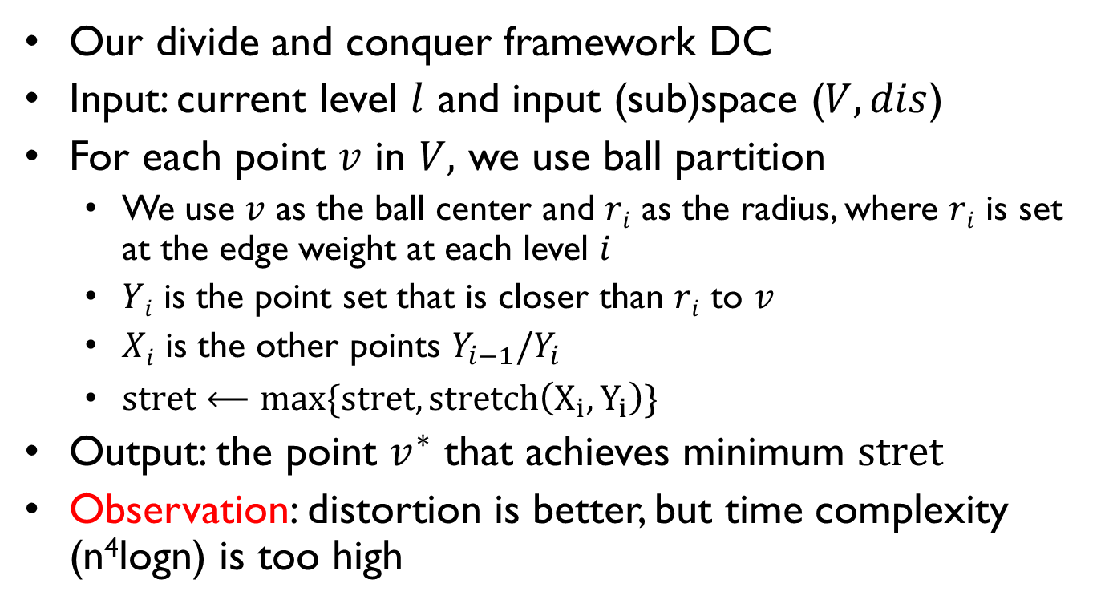
Solution: Our Framework DC
Our divide and conquer framework DC
Input: current level $l$ and input (sub)space ($V, dis$)
For each point $v$ in $V,$ we use ball partition
  We use $v$ as the ball center and $ri$ as the radius, where $ri$ is set at the edge weight at each level $i$
  $Yi$ is the point set that is closer than $ri$ to $v$
  $Xi$ is the other points $Y_{i−1}/Y_{i}$
  $stret⟵max\{stret, stretch\left(X_{i},Y_{i}\right)\}$
Output: the point $v^{∗}$ that achieves minimum $stret$
Observation: distortion is better, but time complexity (n⁴logn) is too high
←Reduce by sampling
←Reduce by indexing
Our Main Idea: reduce time for picking best center

Slide 25
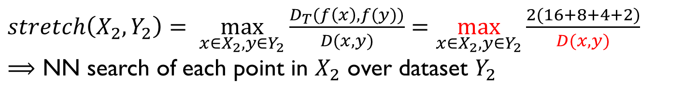
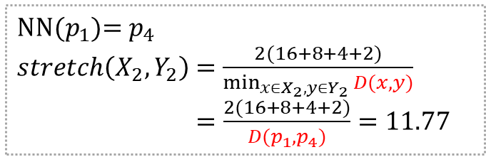
Solution: Optimization by (A)NN
Idea #1: reduce time for computing stret
$stretch\left(X_{2},Y_{2}\right)$ $= \max_{x∈X_{2},y∈Y_{2}}{\frac{D_{T}(f\left(x\right), f(y))}{D(x, y)}}=\max_{x∈X_{2},y∈Y_{2}}{\frac{2(16+8+4+2)}{D(x, y)}}$
$⟹$ NN search of each point in $X_{2}$ over dataset $Y_{2}$
L1
$$u_{1}$$
$$p_{1},p_{2},p_{3},p_{4},p_{5},p_{6}$$
16
$$u_{2}$$
$$p_{2},p_{3},p_{4},p_{5},p_{6}$$
$$u_{3}$$
$$p_{1}$$
L2
8
8
$$u_{4}$$
$$u_{5}$$
L3
$$X_{2}=\left\{p_{1}\right\}$$
$$Y_{2}=\left\{p_{2},p_{3},p_{4},p_{5},p_{6}\right\}$$
$$p_{2},p_{3}, p_{5}$$
$$p_{4},p_{6}$$
4
$$u_{7}$$
$$u_{8}$$
$$u_{9}$$
$$u_{10}$$
NN($p_{1}$)= $p_{4}$
$stretch\left(X_{2},Y_{2}\right)$ $=\frac{2(16+8+4+2)}{\min_{x∈X_{2},y∈Y_{2}}{D(x, y)}}$
$=\frac{2(16+8+4+2)}{D(p_{1},p_{4})}=11.77$
$$p_{2}$$
$$p_{3},p_{5}$$
$$p_{4}$$
$$p_{6}$$
L4
2
$$u_{13}$$
$$u_{14}$$
$$u_{15}$$
$$u_{16}$$
$$p_{2}$$
$$p_{3}$$
$$p_{5}$$
$$p_{4}$$
$$p_{6}$$
L5

Slide 26
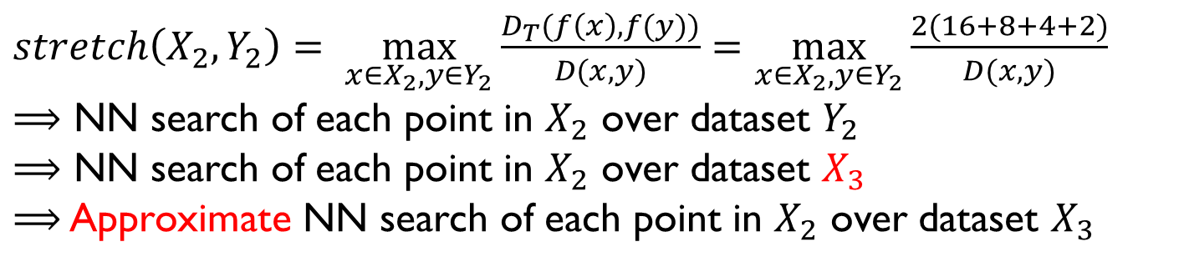
Solution: Optimization by (A)NN
Idea #1: reduce time for computing stret
Theoretical result:
  Distortion guarantee is optimal, O(logn)
  Time complexity is O(n³logn)
$stretch\left(X_{2},Y_{2}\right)$ $= \max_{x∈X_{2},y∈Y_{2}}{\frac{D_{T}(f\left(x\right), f(y))}{D(x, y)}}=\max_{x∈X_{2},y∈Y_{2}}{\frac{2(16+8+4+2)}{D(x, y)}}$
$⟹$ NN search of each point in $X_{2}$ over dataset $Y_{2}$
$⟹$ NN search of each point in $X_{2}$ over dataset $X_{3}$
$⟹$ Approximate NN search of each point in $X_{2}$ over dataset $X_{3}$

Slide 27
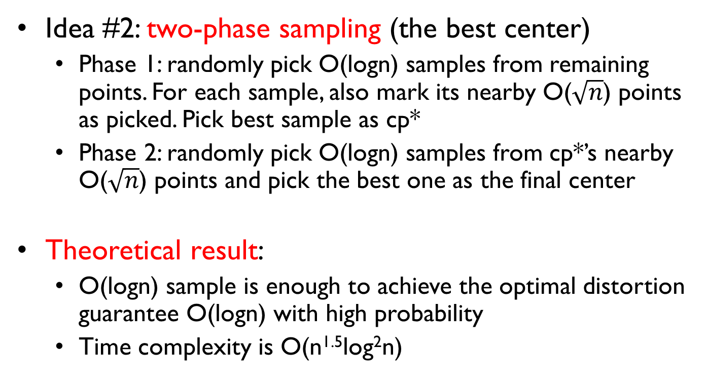
Solution: Optimization by Sampling
Idea #2: two-phase sampling (the best center)
  Phase 1: randomly pick O(logn) samples from remaining points. For each sample, also mark its nearby O($\sqrt{n}$) points as picked. Pick best sample as cp*
  Phase 2: randomly pick O(logn) samples from cp*’s nearby O($\sqrt{n}$) points and pick the best one as the final center
Theoretical result:
  O(logn) sample is enough to achieve the optimal distortion guarantee O(logn) with high probability
  Time complexity is O(n^{1.5}log²n)
Our time complexity O(n^{1.5}log²n) is lower than SOTA (O(n²))

Slide 28
Outline
Background
Problem Statement
Methodology
Experiment
Conclusion

Slide 29
Experiment: Setup
Compared algorithms:
  Bar96 and Bar98: the classic algorithms designed by Bartal
  FRT: the state-of-the-art algorithm with O(n²) time
  DC: our framework without any optimization
  DCnn: our framework optimized by NN search
  DCsam: our framework optimized by ANN search and sampling
4 real datasets on Euclidean metrics
  NYC and Tokyo: 42k-67k unique locations
  Chengdu and Haikou: 214k-319k unique locations
4 synthetic datasets on multi-dimensional L₂ metrics
  Uniform, normal, exponential and skewed distributions
  #(points), n: up to 100 million
  #(dimensions), d: up to 100

Slide 30
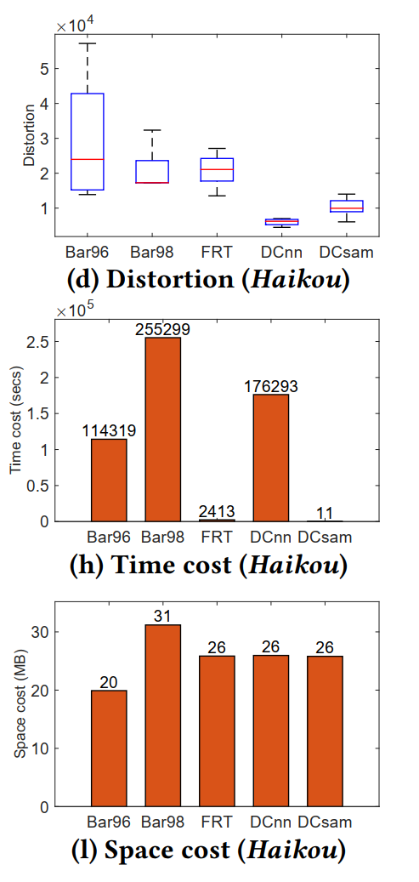
Experiment: Real Dataset
Our solution always achieves the lowest distortion
  E.g., distortions of DCnn and DCsam are 24.8x and 12.9x lower than that of the SOTA algorithm (FRT)
Our solution (DCsam) is always the fastest
  E.g., Dcsam is 218x faster than the SOTA algorithm (FRT)
The sacrifice of our space cost is marginal (<6MB)
218x
24.8
12.9
(a) Distortion
(b) Runtime
(c) Index size
Experimental results on Haikou dataset

Slide 31
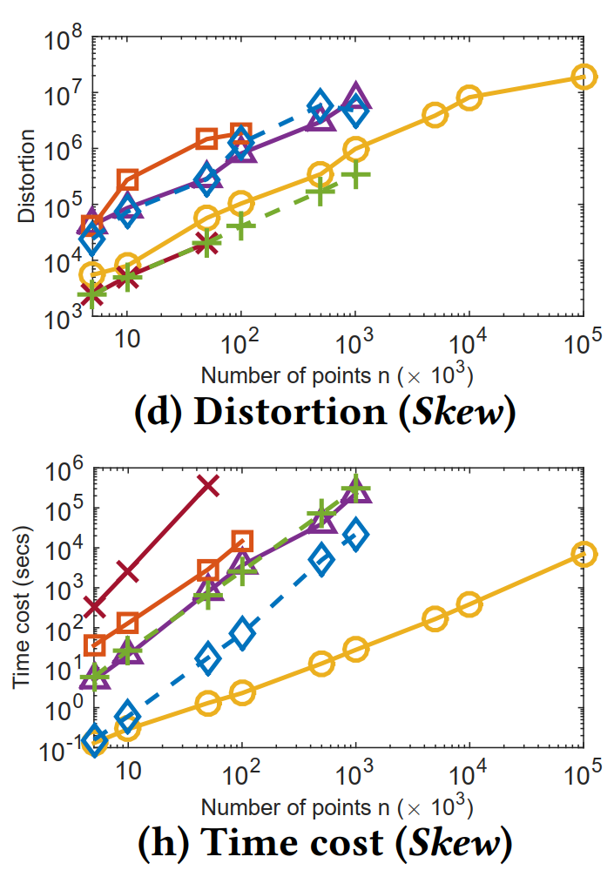
Experiment: Scalability Test
Our solution always achieves the lowest distortion
  E.g., distortion of DCsam is up to 10x-34x lower than those of existing baselines, Bar96, Bar98, and FRT
Our solution (DCsam) is always the fastest
  E.g., DCsam is 2-4 orders of magnitude faster than existing baselines, Bar96, Bar98, and FRT
(a) Distortion
(b) Runtime
Experimental results on Skewed dataset with up to 100 million points

Slide 32
Outline
Background
Problem Statement
Methodology
Experiment
Conclusion

Slide 33


Conclusion
We propose a faster and better solution DCsam to Embedding Lp metrics by Tree metrics problem (construct HST)
Our source code, real data, data generators, and experimental scripts are available at https://github.com/yzengal/SIGMOD22_Git

Slide 34

Q & A
Thank You

