Slide 1
Selfish Routing and the Price of Anarchy
Hao Cheng

Slide 2
Quantifying the inefficiency of equilibria
Notes:
背景。为什么要研究均衡状态的低效？

Slide 3
Recall the Goals of this course
Course Goal 1: Understand how to design systems with strategic participants that have good performance guarantees.
Course Goal 2: When is selfish behavior essentially benign?
Course Goal 3: How do strategic players reach an equilibrium? (Or do they?)

Slide 4
Background
Games in the wild generally have no dominant strategies.
In this course, we’ll focus only on full-information games.
When do games in the wild have near-optimal equilibria?
Notes:
Full-information使得我们更容易预测game的结果

Slide 5
Selfish routing: examples

Slide 6





Braess’s Paradox
In equilibrium, half of the traffic uses each route. $⇒$ Travel time = 3/2
v
$$c\left(x\right)=x$$
50%
$$c\left(x\right)=1$$
s
t
50%
$$c\left(x\right)=1$$
$$c\left(x\right)=x$$
w

Slide 7


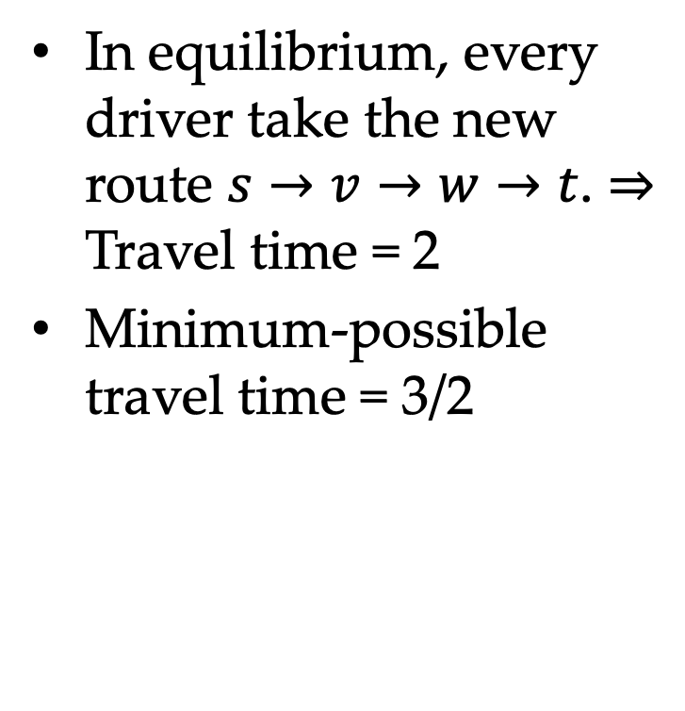

Braess’s Paradox
In equilibrium, every driver take the new route $s→v→w→t$. $⇒$ Travel time = 2
Minimum-possible travel time = 3/2
v
$$c\left(x\right)=x$$
$$c\left(x\right)=1$$
s
$$c\left(x\right)=0$$
t
$$c\left(x\right)=1$$
$$c\left(x\right)=x$$
w
$$x+0≤1$$
$$x+0≤1$$

Slide 8






Braess’s Paradox
Price of Anarchy (POA) = $\frac{\text{Travel} \text{time} \text{in} \text{an} \text{equilibrium}}{\text{Minimum}\text{−}\text{possible} \text{average} \text{travel} \text{time}}$
In this case, POA = 2 / (3/2) = 4/3.
v
$$c\left(x\right)=x$$
$$c\left(x\right)=1$$
s
$$c\left(x\right)=0$$
t
$$c\left(x\right)=1$$
$$c\left(x\right)=x$$
w

Slide 9

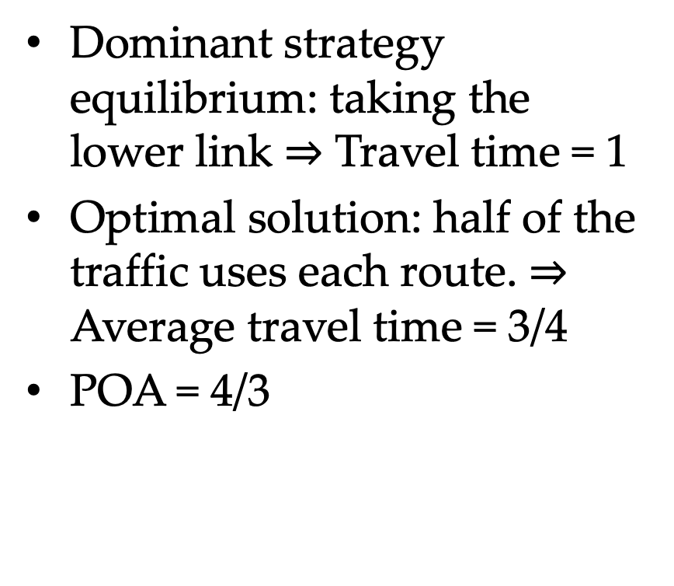

Pigou’s Example
Dominant strategy equilibrium: taking the lower link $⇒$ Travel time = 1
Optimal solution: half of the traffic uses each route. $⇒$ Average travel time = 3/4
POA = 4/3
$$c\left(x\right)=1$$
s
t
$$c\left(x\right)=x$$
Why?

Slide 10

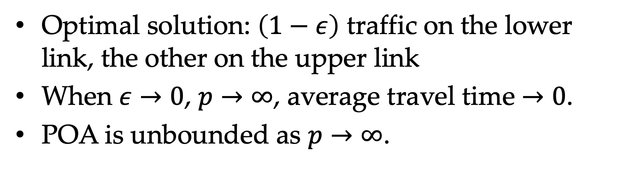
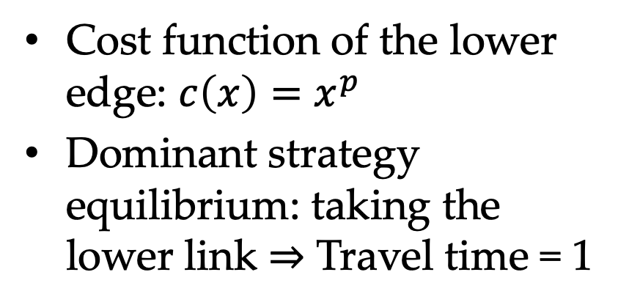
Nonlinear Pigou’s Example
Cost function of the lower edge: $c\left(x\right)=x^{p}$
Dominant strategy equilibrium: taking the lower link $⇒$ Travel time = 1
$$c\left(x\right)=1$$
s
t
$$c\left(x\right)=x^{p}$$
Optimal solution: $\left(1−ε\right)$ traffic on the lower link, the other on the upper link
When $ε→0$, $p→∞$, average travel time $→0$.
POA is unbounded as $p→∞$.
What is the optimal solution when 𝑝→∞?

Slide 11
Main result: Statement and interpretation

Slide 12










A Conjecture
POA = 4/3
v
Question: When the POA of selfish routing is close to 1?
Observation: Example 1 and Example 2 with linear cost functions have a small POA, while Example 3 with “highly nonlinear” cost function has a large POA.
$$c\left(x\right)=x$$
$$c\left(x\right)=1$$
s
$$c\left(x\right)=0$$
t
$$c\left(x\right)=1$$
$$c\left(x\right)=x$$
w
$$c\left(x\right)=1$$
s
POA = 4/3
t
$$c\left(x\right)=x$$
$$c\left(x\right)=1$$
s
POA = $∞$
t
$$c\left(x\right)=x^{p}$$

Slide 13
A Conjecture
POA = 4/3
v
Conjecture: Every network with not-too-nonlinear cost functions, no matter how complex, has POA close to 1.
$$c\left(x\right)=x$$
$$c\left(x\right)=1$$
s
$$c\left(x\right)=0$$
t
$$c\left(x\right)=1$$
$$c\left(x\right)=x$$
w
$$c\left(x\right)=1$$
s
POA = 4/3
t
$$c\left(x\right)=x$$
$$c\left(x\right)=1$$
s
POA = $∞$
t
$$c\left(x\right)=x^{p}$$

Slide 14
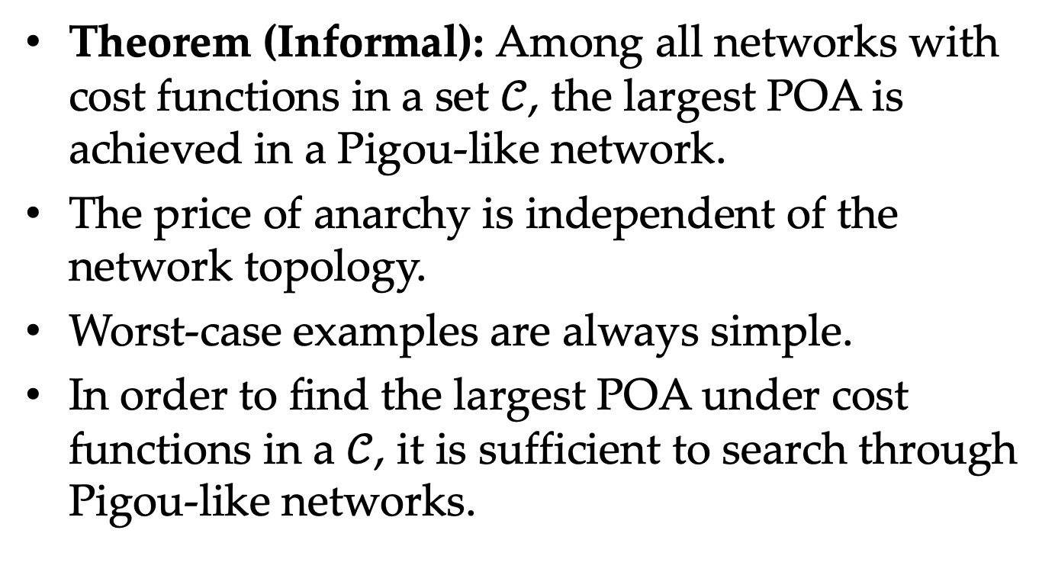
Informal Version of the Main Result
Theorem (Informal): Among all networks with cost functions in a set $𝒞$, the largest POA is achieved in a Pigou-like network.
The price of anarchy is independent of the network topology.
Worst-case examples are always simple.
In order to find the largest POA under cost functions in a $𝒞$, it is sufficient to search through Pigou-like networks.

Slide 15

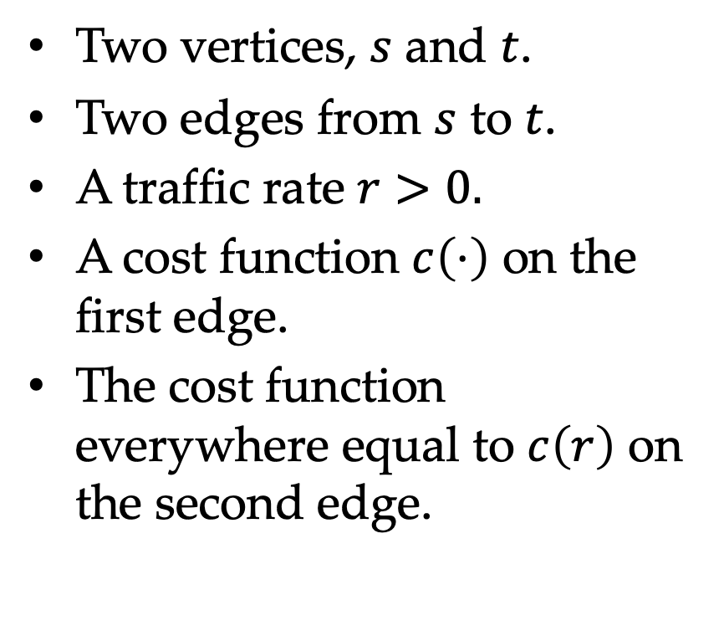
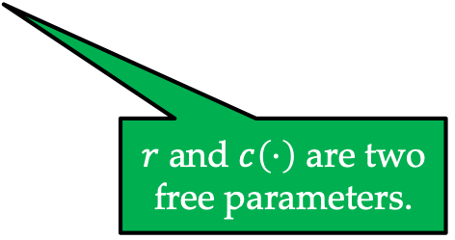

Pigou-like Network
A constant
Two vertices, $s$ and $t$.
Two edges from $s$ to $t$.
A traffic rate $r>0.$
A cost function $c\left(⋅\right)$ on the first edge.
The cost function everywhere equal to $c\left(r\right)$ on the second edge.
$$c\left(r\right)$$
s
t
$$c\left(⋅\right)$$
$r$ and $c\left(⋅\right)$ are two free parameters.

Slide 16
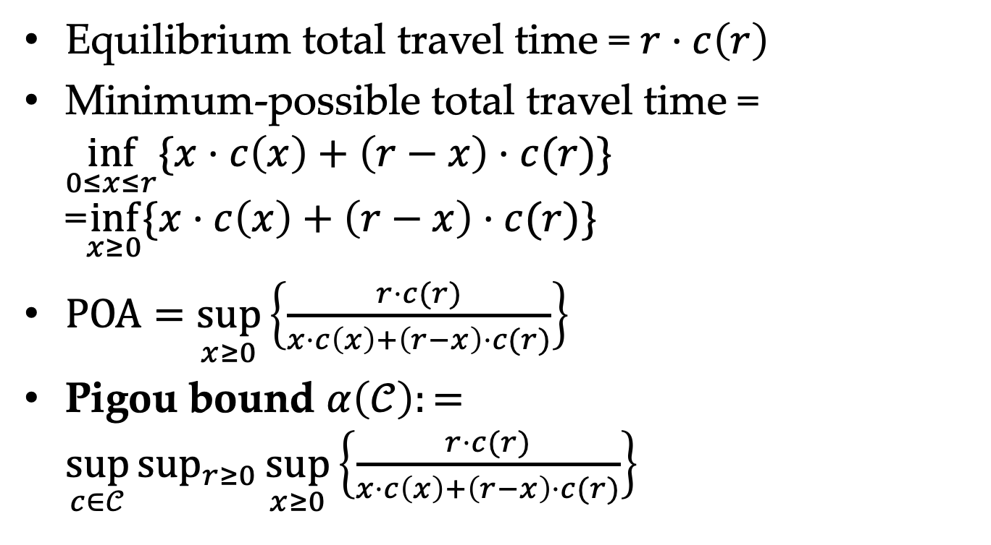
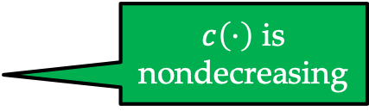


Pigou-like Network
Equilibrium total travel time = $r⋅c\left(r\right)$
Minimum-possible total travel time = $\inf_{0≤x≤r}{\{x⋅c\left(x\right)+\left(r−x\right)⋅c(r)\}}$ =$\inf_{x≥0}{\{x⋅c\left(x\right)+\left(r−x\right)⋅c(r)\}}$
$\text{POA}=\sup_{x≥0}\left\{\frac{r⋅c(r)}{x⋅c\left(x\right)+\left(r−x\right)⋅c(r)}\right\}$
Pigou bound $α\left(𝒞\right):=\sup_{c∈𝒞}{\sup_{r≥0}{\sup_{x≥0}\left\{\frac{r⋅c(r)}{x⋅c\left(x\right)+\left(r−x\right)⋅c(r)}\right\}}}$
$c\left(⋅\right)$ is nondecreasing
$$c\left(r\right)$$
s
t
$$c\left(⋅\right)$$
Notes:
可以考虑下面的边的流量从r变成r+e，总时间会变大，所以当我们求下确界的时候，可以不用限制x<=r，因为x>r的情况肯定都是大的，不会影响下确界。

Slide 17
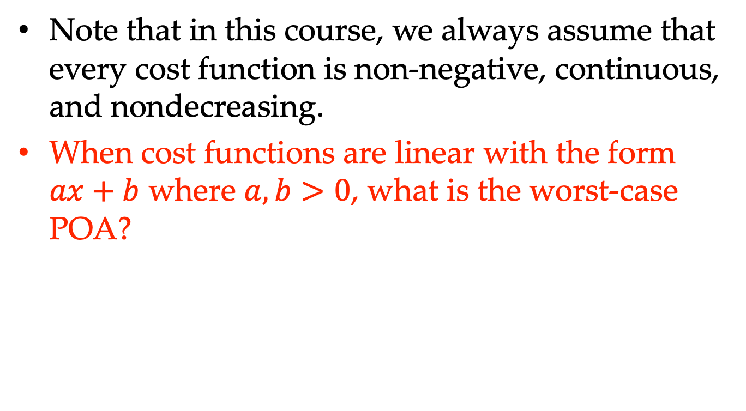
Affine Cost Functions
Note that in this course, we always assume that every cost function is non-negative, continuous, and nondecreasing.
When cost functions are linear with the form $ax+b$ where $a,b>0$, what is the worst-case POA?

Slide 18
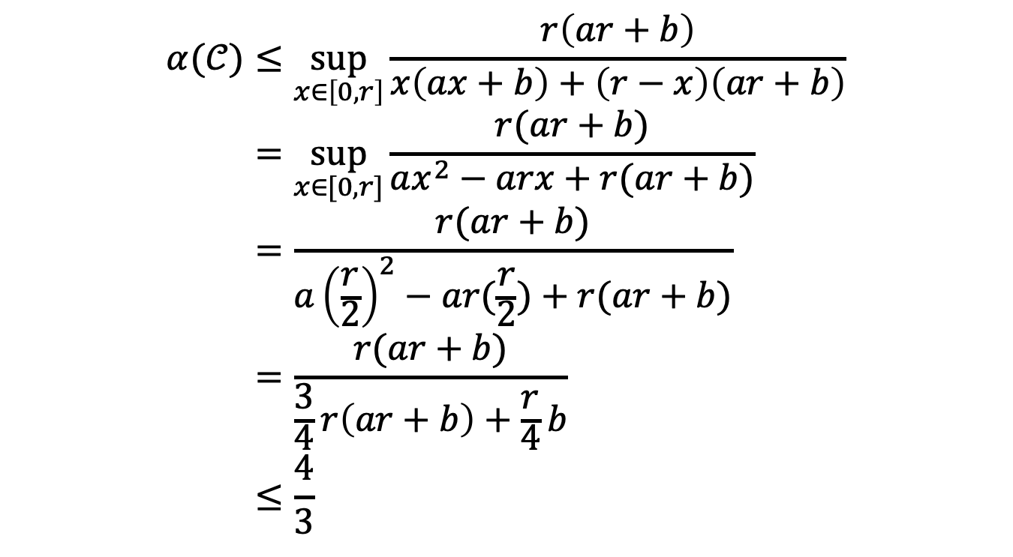
Affine Cost Functions
$$α(𝒞)≤\sup_{x∈\left[0,r\right]}{\frac{r\left(ar+b\right)}{x\left(ax+b\right)+\left(r−x\right)\left(ar+b\right)}} \\ =\sup_{x∈[0,r]}{\frac{r(ar+b)}{ax^{2}−arx+r(ar+b)}} \\ =\frac{r(ar+b)}{a{\left(\frac{r}{2}\right)}^{2}−ar(\frac{r}{2})+r(ar+b)} \\ =\frac{r(ar+b)}{\frac{3}{4}r\left(ar+b\right)+\frac{r}{4}b} \\ ≤\frac{4}{3}$$
Olsthoorn, Floris. The price of anarchy. Diss. Master’s thesis, Mathematisch Instituut, Universiteit Leiden, 2012.

Slide 19
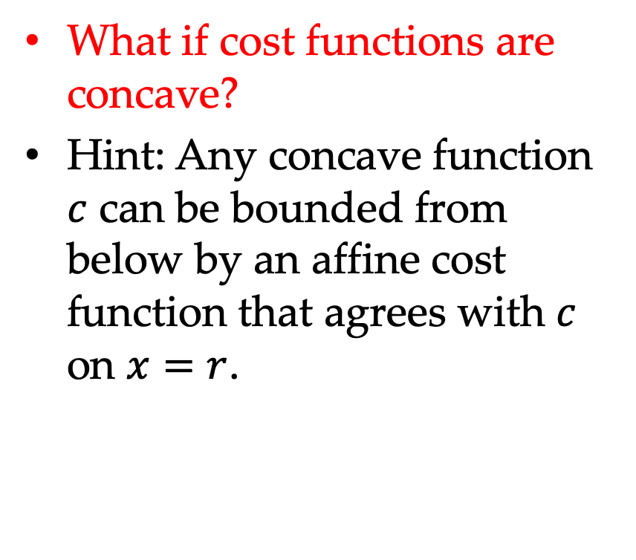


Concave Cost Functions
What if cost functions are concave?
Hint: Any concave function $c$ can be bounded from below by an affine cost function that agrees with $c$ on $x=r$.
$$c(x)$$
$$r$$
Olsthoorn, Floris. The price of anarchy. Diss. Master’s thesis, Mathematisch Instituut, Universiteit Leiden, 2012.
Notes:
Any concave function c can be bounded from below by an affine cost function that agrees with c on x=r. See the reference for more details.

Slide 20
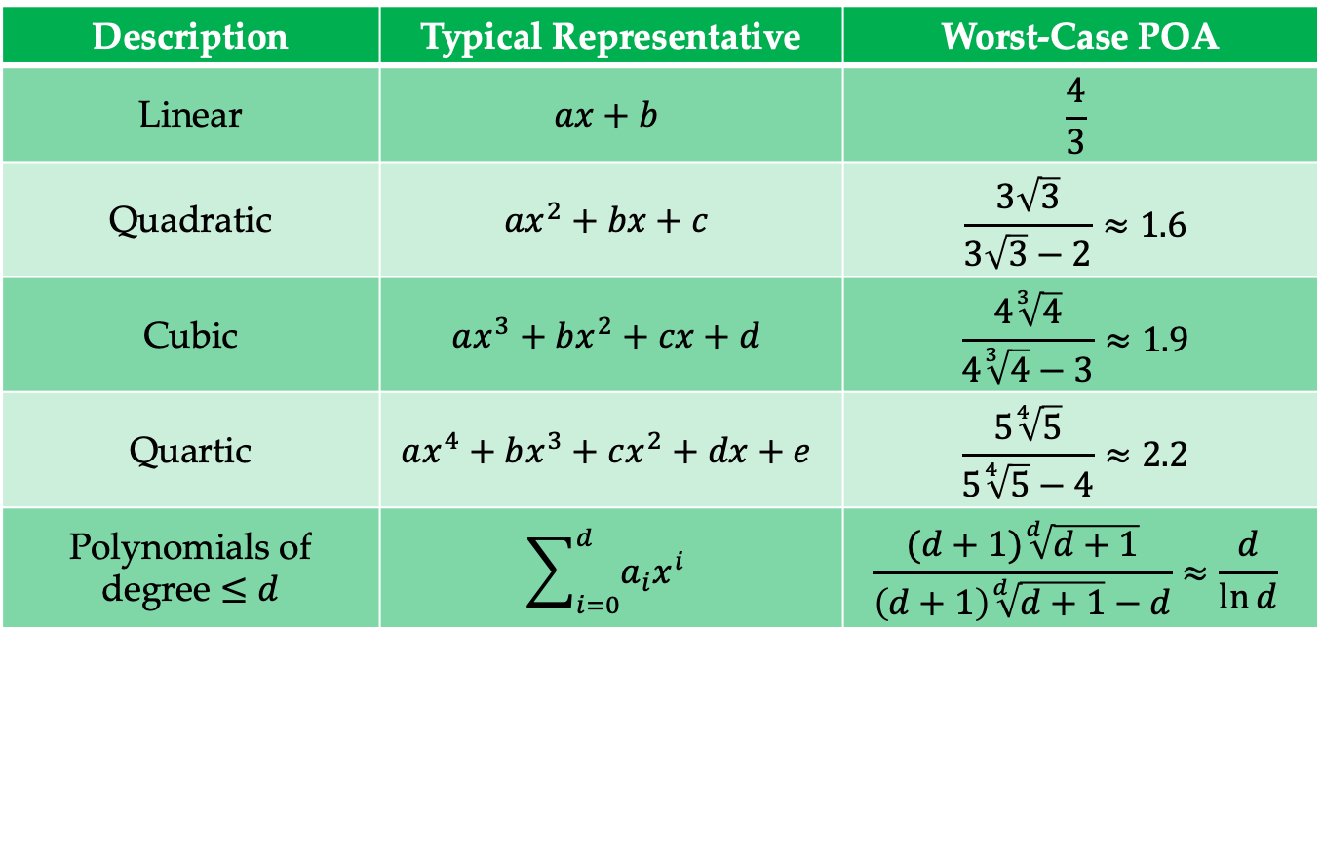
Polynomial Cost Functions
Description | Typical Representative | Worst-Case POA
Linear | $$ax+b$$ | $$\frac{4}{3}$$
Quadratic | $$ax^{2}+bx+c$$ | $$\frac{3\sqrt{3}}{3\sqrt{3}−2}≈1.6$$
Cubic | $$ax^{3}+bx^{2}+cx+d$$ | $$\frac{4\sqrt[3]{4}}{4\sqrt[3]{4}−3}≈1.9$$
Quartic | $$ax^{4}+bx^{3}+cx^{2}+dx+e$$ | $$\frac{5\sqrt[4]{5}}{5\sqrt[4]{5}−4}≈2.2$$
Polynomials of degree $≤d$ | $$\sum_{i=0}^{d}{a_{i}x^{i}}$$ | $$\frac{(d+1)\sqrt[d]{d+1}}{\left(d+1\right)\sqrt[d]{d+1}−d}≈\frac{d}{\ln{d}}$$

Slide 21
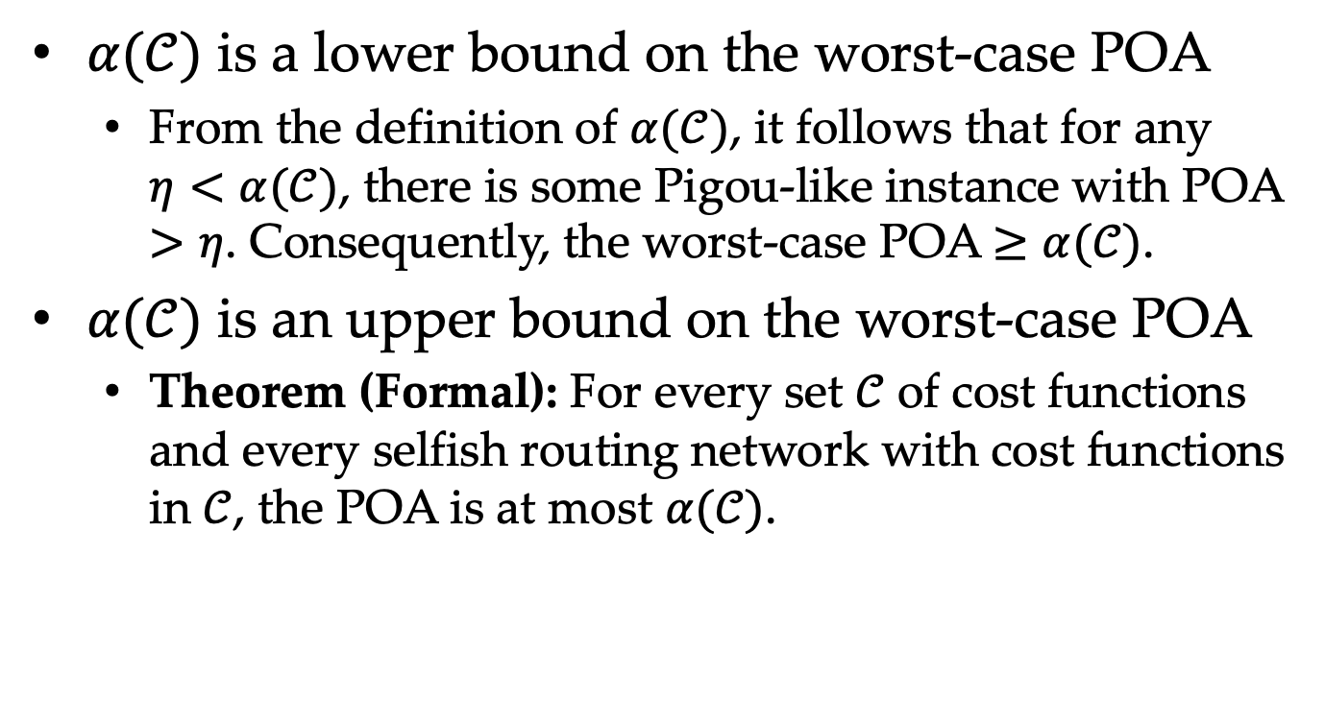
Formal Theorem
$α(𝒞)$ is a lower bound on the worst-case POA
From the definition of $α(𝒞)$, it follows that for any $η<α(𝒞)$, there is some Pigou-like instance with POA $>η$. Consequently, the worst-case POA $≥α(𝒞)$.
$α(𝒞)$ is an upper bound on the worst-case POA
Theorem (Formal): For every set $𝒞$ of cost functions and every selfish routing network with cost functions in $𝒞$, the POA is at most $α(𝒞)$.
Olsthoorn, Floris. The price of anarchy. Diss. Master’s thesis, Mathematisch Instituut, Universiteit Leiden, 2012.

Slide 22
Technical Preiminaries

Slide 23
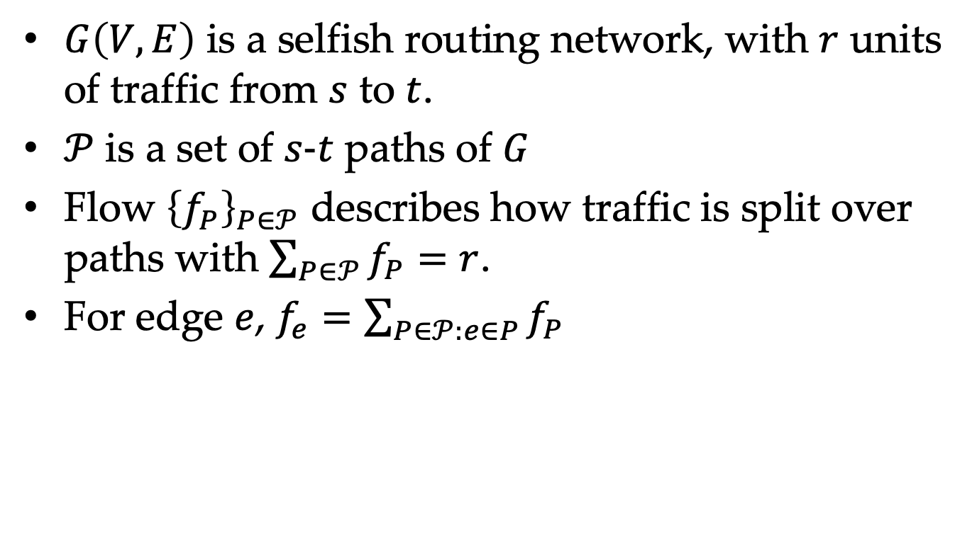
Flow network
$G\left(V,E\right)$ is a selfish routing network, with $r$ units of traffic from $s$ to $t$.
$𝒫$ is a set of $s\text{−}t$ paths of $G$
Flow ${\left\{f_{P}\right\}}_{P∈𝒫}$ describes how traffic is split over paths with $\sum_{P∈𝒫}{f_{P}}=r$.
For edge $e$, $f_{e}=\sum_{P∈𝒫:e∈P}{f_{P}}$

Slide 24
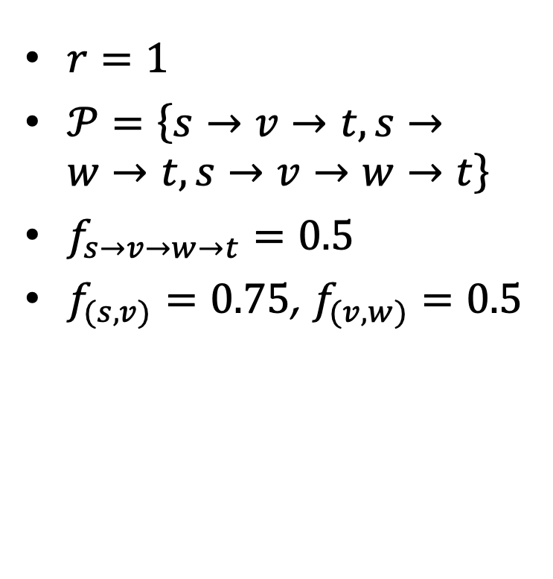
Flow Network
$r=1$
$𝒫=\left\{s→v→t,s→w→t,s→v→w→t\right\}$
$f_{s→v→w→t}=0.5$
$f_{(s,v)}=0.75$, $f_{(v,w)}=0.5$
v
25%
s
50%
t
w
25%

Slide 25
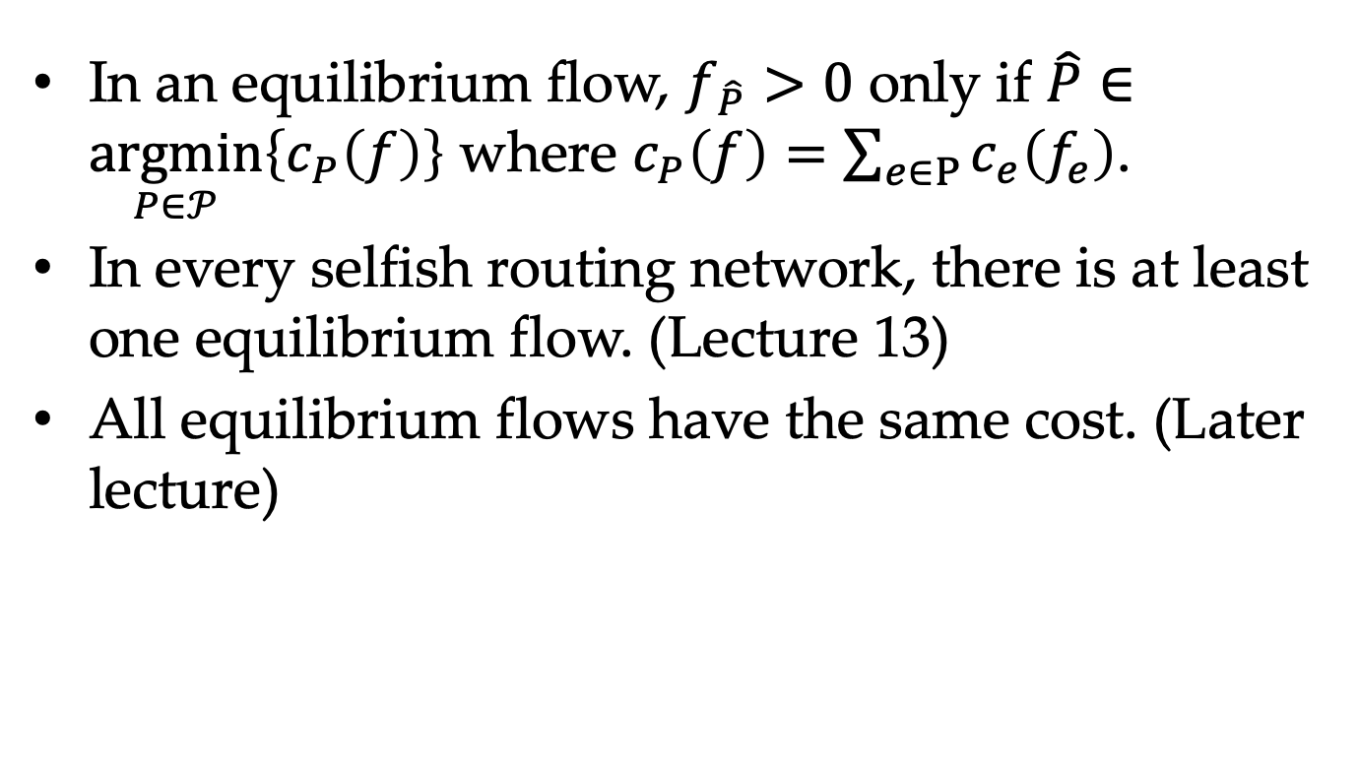
Flow Network
In an equilibrium flow, $f_{\hat{P}}>0$ only if $\hat{P}∈\underset{P∈𝒫}{argmin}\left\{c_{P}\left(f\right)\right\}$ where $c_{P}\left(f\right)=\sum_{e∈P}{c_{e}\left(f_{e}\right)}$.
In every selfish routing network, there is at least one equilibrium flow. (Lecture 13)
All equilibrium flows have the same cost. (Later lecture)

Slide 26
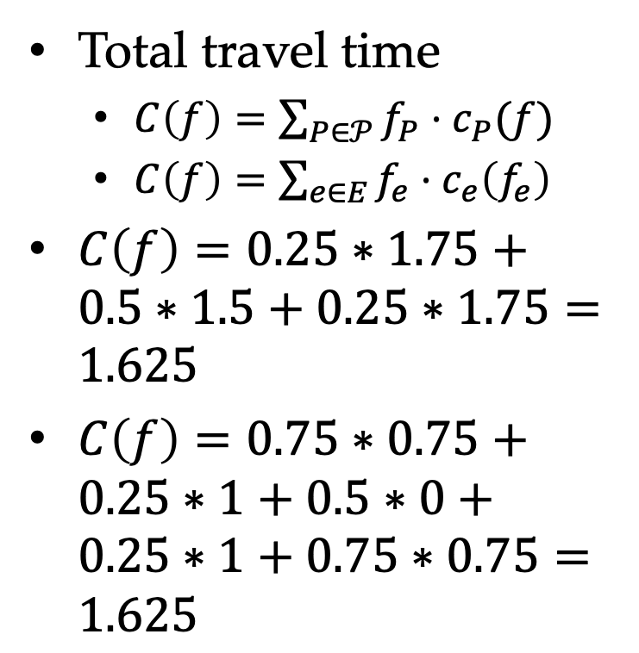
Flow Network
Total travel time
$C\left(f\right)=\sum_{P∈𝒫}{f_{P}⋅c_{P}(f)}$
$C\left(f\right)=\sum_{e∈E}{f_{e}⋅c_{e}\left(f_{e}\right)}$
$C\left(f\right)=0.25∗1.75+0.5∗1.5+0.25∗1.75=1.625$
$C\left(f\right)=0.75∗0.75+0.25∗1+0.5∗0+0.25∗1+0.75∗0.75=1.625$
v
25%
$$c\left(x\right)=x$$
$$c\left(x\right)=1$$
s
50%
t
$$c\left(x\right)=1$$
$$c\left(x\right)=x$$
w
25%

Slide 27
Main result: proof

Slide 28
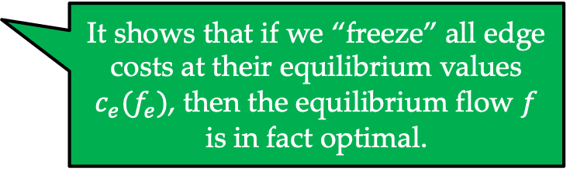

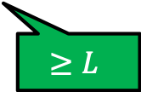
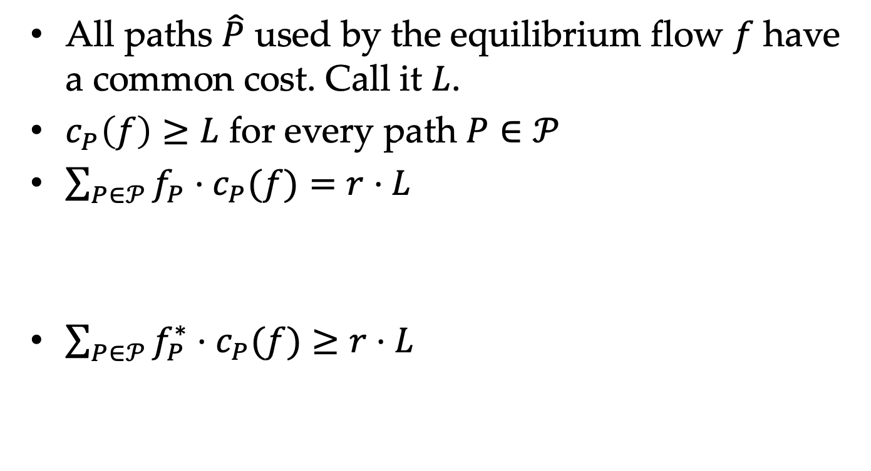
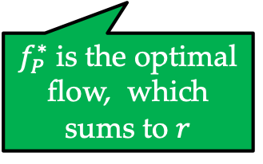


First Part of the Proof
All paths $\hat{P}$ used by the equilibrium flow $f$ have a common cost. Call it $L$.
$c_{P}\left(f\right)≥L$ for every path $P∈𝒫$
$\sum_{P∈𝒫}{f_{P}⋅c_{P}(f)}=r⋅L$
$\sum_{P∈𝒫}{f_{P}^{∗}⋅c_{P}(f)}≥r⋅L$
Sums to $r$
$=L$ if $f_{P}>0$
Every unit of traffic incurs a cost of $L$
It shows that if we “freeze” all edge costs at their equilibrium values $c_{e}(f_{e})$, then the equilibrium flow $f$ is in fact optimal.
$f_{P}^{∗}$ is the optimal flow, which sums to $r$
$$≥L$$

Slide 29

First Part of the Proof
Subtracting last two results yields $\sum_{P∈𝒫}{(f_{P}^{∗}−f_{P})⋅c_{P}(f)}≥0$
Rewriting LHS as sums over edges yields $\sum_{e∈E}{(f_{e}^{∗}−f_{e})⋅c_{e}(f_{e})}≥0$

Slide 30

Second Part of the Proof
For a Pigou-like network with $r=f_{e}$, if $f_{e}^{∗}$ units of traffic choose the path with a cost of $c_{e}(f_{e}^{∗})$, and the other traffic chooses the path with a cost of $c_{e}(f_{e})$, it holds that $α\left(𝒞\right)≥\frac{f_{e}⋅c_{e}(f_{e})}{f_{e}^{∗}⋅c_{e}\left(f_{e}^{∗}\right)+\left(f_{e}−f_{e}^{∗}\right)c_{e}(f_{e})}$.
It might not be the optimal flow in such a Pigou-like network, but the inequality still holds.

Slide 31

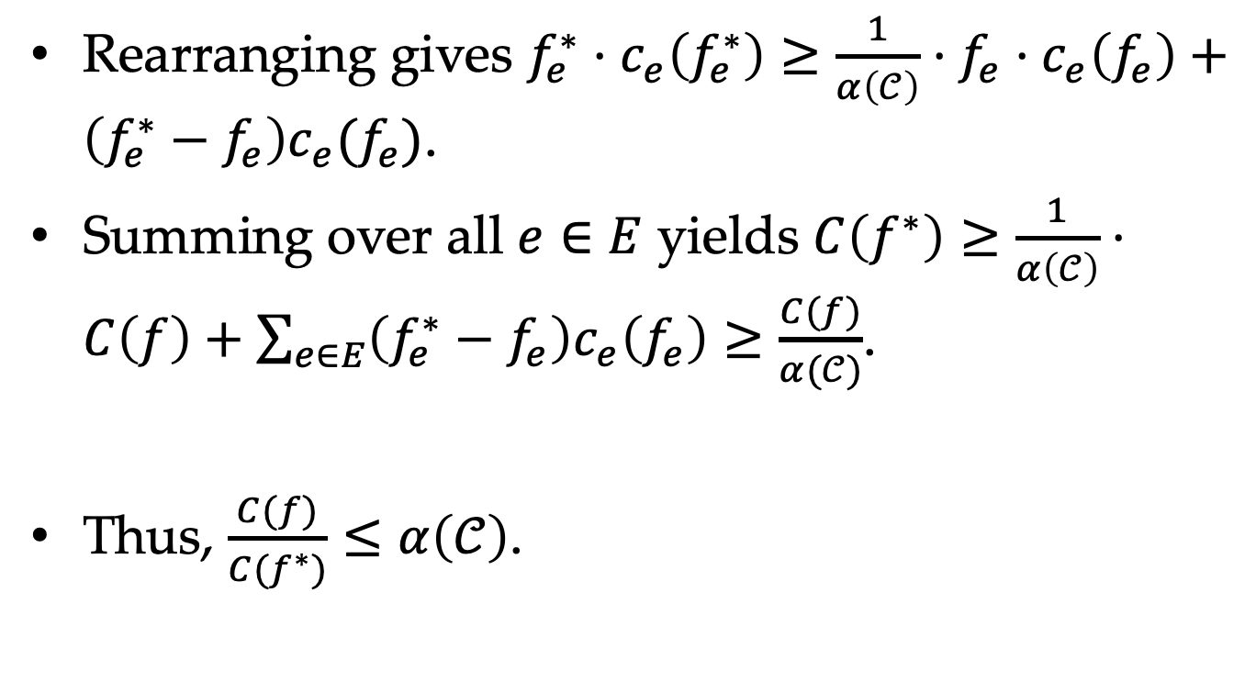
Second Part of the Proof
Rearranging gives $f_{e}^{∗}⋅c_{e}\left(f_{e}^{∗}\right)≥\frac{1}{α\left(𝒞\right)}⋅f_{e}⋅c_{e}\left(f_{e}\right)+\left(f_{e}^{∗}−f_{e}\right)c_{e}(f_{e})$.
Summing over all $e∈E$ yields $C\left(f^{∗}\right)≥\frac{1}{α\left(𝒞\right)}⋅C\left(f\right)+\sum_{e∈E}{\left(f_{e}^{∗}−f_{e}\right)c_{e}\left(f_{e}\right)}≥\frac{C(f)}{α(𝒞)}$.
Thus, $\frac{C(f)}{C(f^{∗})}≤α\left(𝒞\right)$.
$$≥0$$

Slide 32
summary

Slide 33
Summary
Price of anarchy
Worst-case examples are always simple, with Pigou-like networks maximizing the POA.
The POA of selfish routing is small only when network cost functions are highly nonlinear.

