Slide 1
Algorithmic Mechanism Design
Prepared and Presented by
Fang Jingzhi

Slide 2

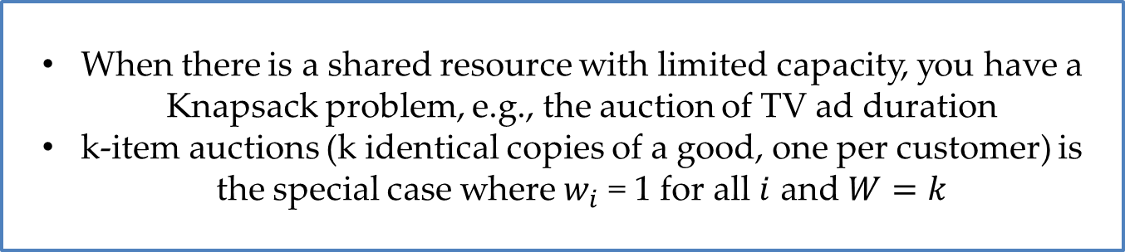
Knapsack Auctions
Problem Deﬁnition
each bidder $i$ has a publicly known size $w_{i}$ and a private valuation. The seller has a capacity $W$. The feasible set $X$ is deﬁned as the 0-1 n-vectors $(x_{1},…,x_{n})$such that $\sum_{i=1}^{n}{w_{i}x_{i}}≤W$. (As usual, $x_{i}=1$indicates that $i$ is a winning bidder.)
When there is a shared resource with limited capacity, you have a Knapsack problem, e.g., the auction of TV ad duration
k-item auctions (k identical copies of a good, one per customer) is the special case where $w_{i}$ = 1 for all $i$ and $W=k$

Slide 3
Try to design an awesome knapsack auction

Slide 4
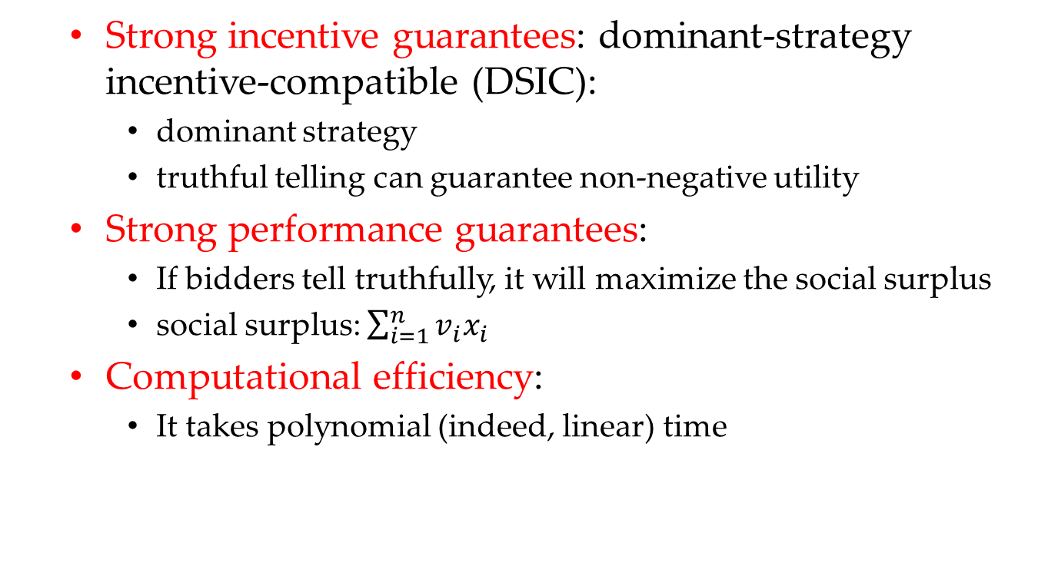
Awesome Auction
Strong incentive guarantees: dominant-strategy incentive-compatible (DSIC):
dominant strategy
truthful telling can guarantee non-negative utility
Strong performance guarantees:
If bidders tell truthfully, it will maximize the social surplus
social surplus: $\sum_{i=1}^{n}{v_{i}x_{i}}$
Computational efficiency:
It takes polynomial (indeed, linear) time

Slide 5
Two-step paradigm
Step1
Assume that bids equal values, i.e., truthful telling, and then decide on the allocation rule
Step2
Devise a payment rule that extends the allocation rule to a DSIC mechanism

Slide 6

The allocation rule
Deﬁne the allocation rule by
$$x\left(b\right)=\arg{\max_{X}{\sum_{i=1}^{n}{b_{i}x_{i}}}}$$
The allocation rule solves an instance of the Knapsack problem

Slide 7
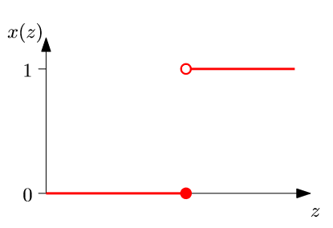
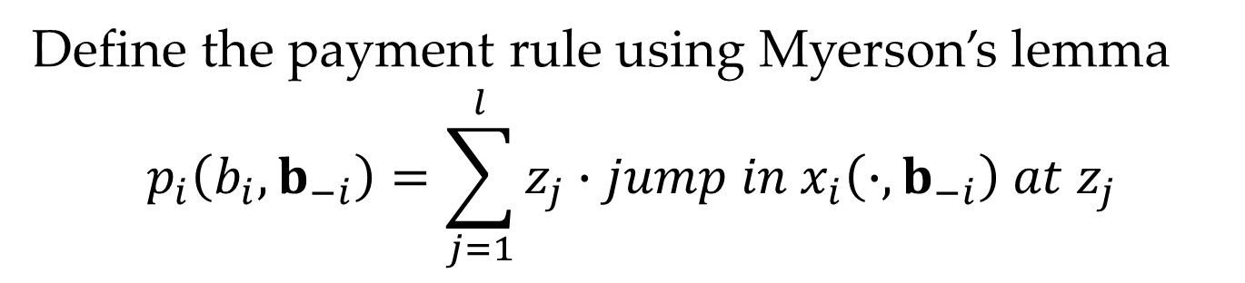
The payment rule
Define the payment rule using Myerson’s lemma
$$p_{i}\left(b_{i},b_{−i}\right)=\sum_{j=1}^{l}{z_{j}∙jump in x_{i}\left(∙,b_{−i}\right) at z_{j}}$$
This is a single-parameter environment, so Myerson’s Lemma will apply

Slide 8
Is this auction awesome?
Strong incentive guarantees | √
Strong performance guarantees | √
Computational efficiency | ×
Because the Knapsack problem is NP-hard

Slide 9
Is this auction awesome?
Strong incentive guarantees | √
Strong performance guarantees | √
Computational efficiency | ×
We need to relax some goals, in this case, the third one, since the allocation rule can be implemented in pseudopolynomial time using dynamic programming

Slide 10
The dominant paradigm to relax
Strong incentive guarantees
Strong performance guarantees
Computational efficiency
The dominant paradigm in algorithmic mechanism design is to relax the second constraint (optimal surplus) as little as possible, subject to the ﬁrst (DSIC) and third (polynomial-time) constraints
For single-parameter environments, by Myerson’s Lemma, “designing a polynomial-time and monotone allocation rule that comes as close as possible to maximizing the social surplus” is equivalent

Slide 11
Question
The DSIC/monotone constraint is satisﬁed “for free” with exact surplus-maximization
Will it hold with approximate surplus maximization?
Actually, we want to know after relaxing the second goal, whether the other two can be reached
Notes:
“for free” because We know that surplus-maximization yields a monotone allocation rule, 并且意味着DSIC不会给surplus带来额外损失
这个问题，其实是在问：再放松了第二个条件之后，其他两个条件是否一定能被满足

Slide 12
See an example
Notes:
“for free” because We know that surplus-maximization yields a monotone allocation rule, 并且意味着DSIC不会给surplus带来额外损失

Slide 13
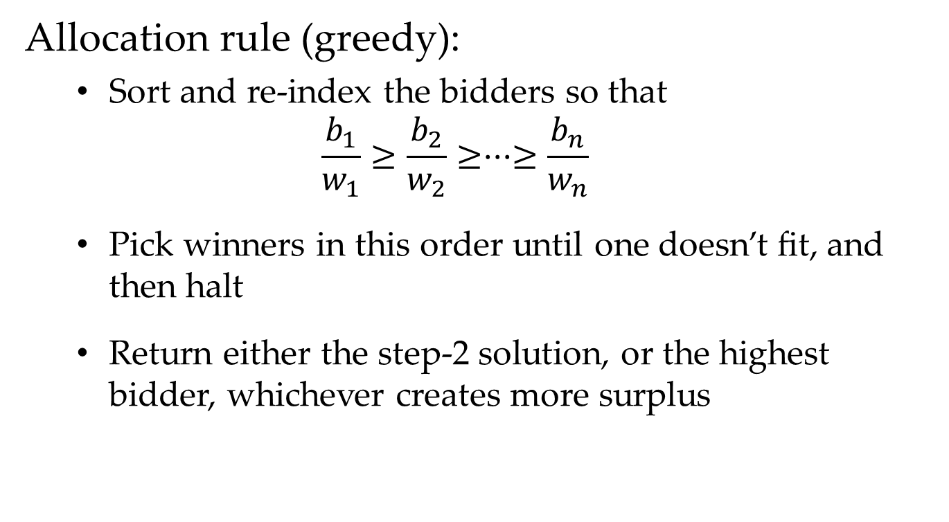
A heuristic for the knapsack problem
Allocation rule (greedy):
Sort and re-index the bidders so that
$$\frac{b_{1}}{w_{1}}≥\frac{b_{2}}{w_{2}}≥···≥\frac{b_{n}}{w_{n}}$$
Pick winners in this order until one doesn’t ﬁt, and then halt
Return either the step-2 solution, or the highest bidder, whichever creates more surplus
This is a $\frac{1}{2}$-approximation algorithm

Slide 14
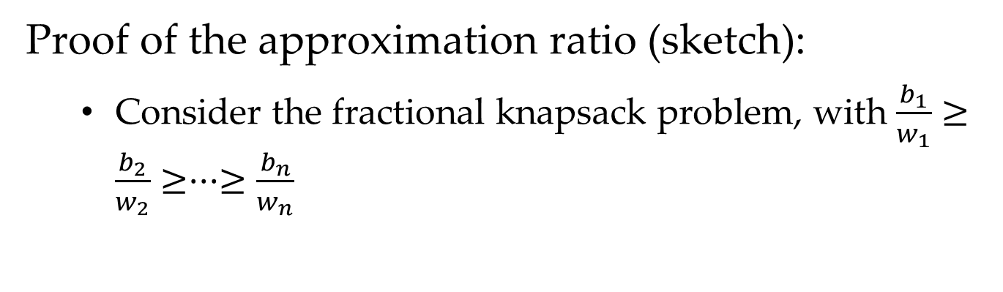
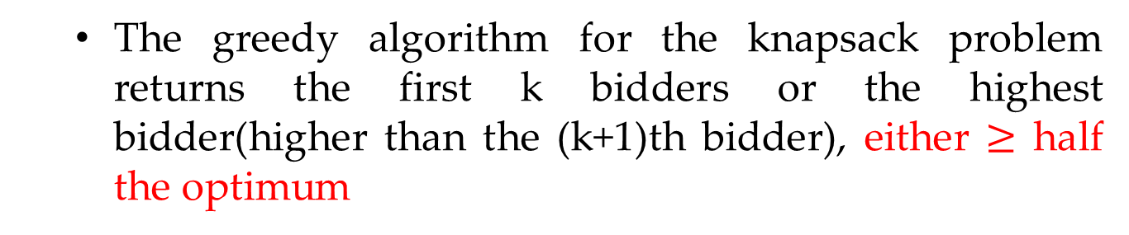
A heuristic for the knapsack problem
Proof of the approximation ratio (sketch):
Consider the fractional knapsack problem, with $\frac{b_{1}}{w_{1}}≥\frac{b_{2}}{w_{2}}≥···≥\frac{b_{n}}{w_{n}}$
…
…
1
2
K
K+1
n
The first k bidders win and the (k+1)th bidder fractionally wins, which is the optimal result
The greedy algorithm for the knapsack problem returns the first k bidders or the highest bidder(higher than the (k+1)th bidder), either $≥$ half the optimum

Slide 15
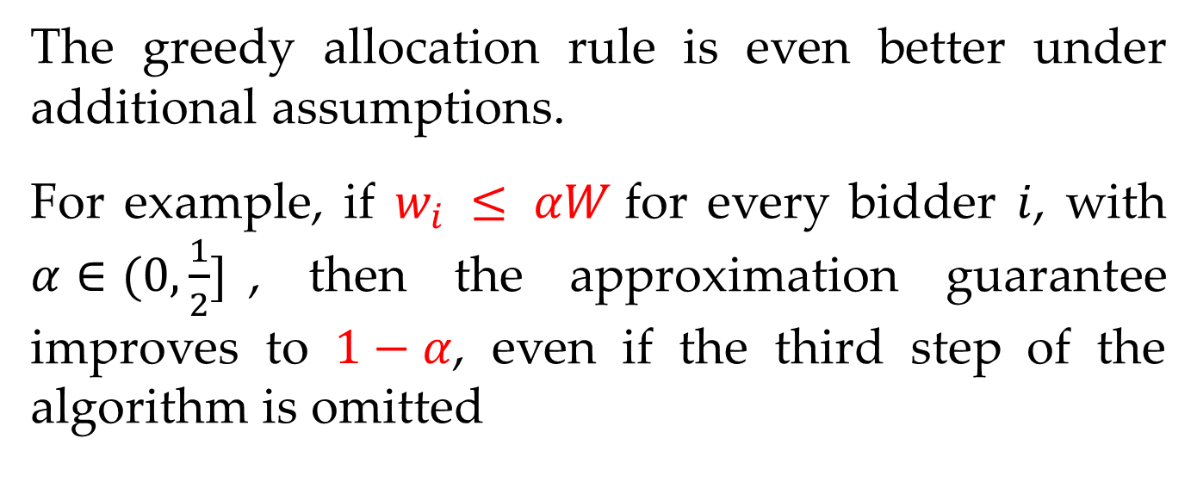
A heuristic for the knapsack problem
The greedy allocation rule is even better under additional assumptions.
For example, if $w_{i} ≤ αW$for every bidder $i$, with $α∈(0,\frac{1}{2}]$, then the approximation guarantee improves to $1−α$, even if the third step of the algorithm is omitted
How to prove it?
Notes:
Easy to prove, 利用单价和量之间的关系

Slide 16
A heuristic for the knapsack problem
The greedy allocation rule is monotone
Therefore “the DSIC/monotone constraint is satisﬁed for free” holds with this example
The proof is easy
Notes:
Easy to prove, 利用单价和量之间的关系

Slide 17
However, natural allocation rules are not always monotone
Notes:
We know that surplus-maximization yields a monotone allocation rule.这句话我只能感觉上理解，how to prove it？

Slide 18
Algorithmic mechanism design considering an NP-hard optimization problem
Step1
Check if the state-of-the-art approximation algorithm directly leads to a DSIC mechanism
Step2
If not, tweak it or design a new approximation algorithm, hopefully without degrading the approximation guarantee
Good news: the state-of-the-art approximation algorithms for the single-parameter problems are generally either monotone or can redesigned to be monotone
Notes:
当我们考虑一个NP难优化问题，无法得到准确解，同时也无法得到单调的近似分配函数时，可以采用tweek或者重新设计的方法。

Slide 19
We now want to ask:
Is there a natural single-parameter problem for which the best approximation guarantee achievable by a polynomial-time algorithm is strictly better than the best approximation guarantee achievable by a polynomial-time and monotone algorithm?
If not, for all single-parameter problems, the monotonicity/DSIC constraint can always be added “for free”.
Notes:
此处是希望下一个严格的结论，而不是前面的generally可以变成单调的分配函数

Slide 20
black-box reduction
This is a way of proving the result in last page
It is a generic way of taking a possibly non-monotone polynomial-time algorithm and transmuting it into a monotone polynomial-time algorithm without degrading the approximation guarantee
Recent work shows that there is no fully general black-box reduction of the above type for single-parameter environments. There might well be large and important subclasses of such environments, though, for which a black-box reduction exists.
Notes:
可以尝试用black-box reduction来证明

Slide 21
Another Question
Can non-DSIC mechanisms accomplish things that DSIC mechanisms cannot?
Notes:
我们目前只讨论了DSIC机制，因为DSIC机制有自身的优点

Slide 22
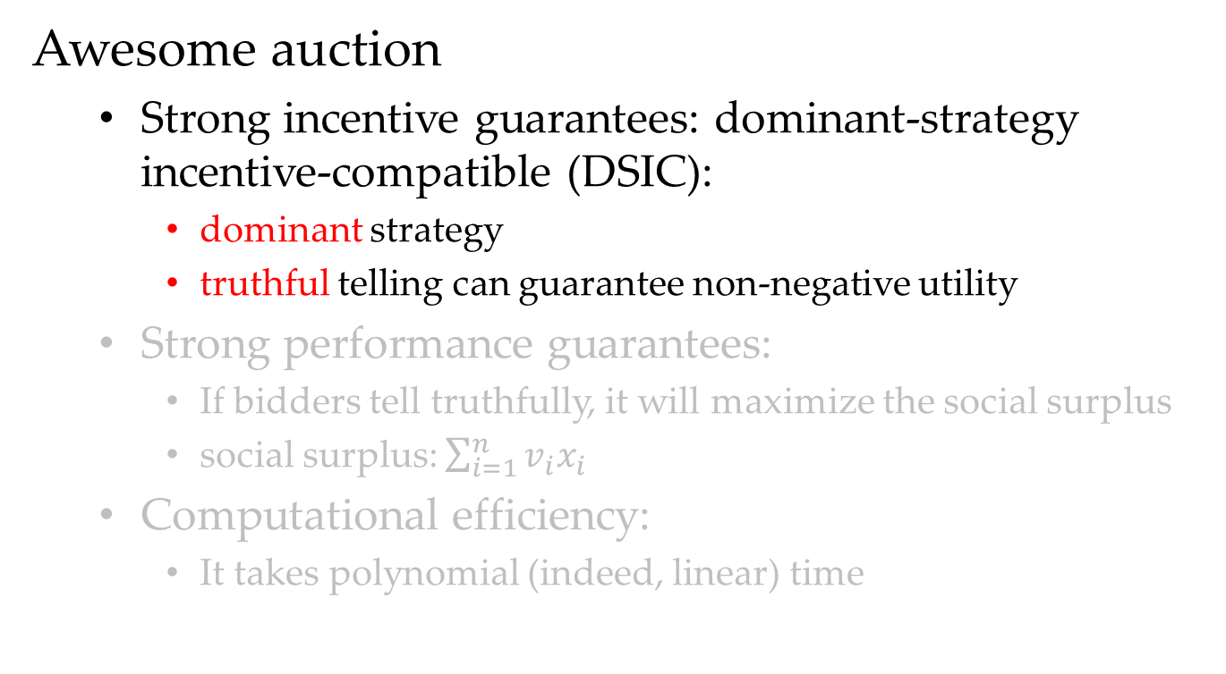
Discussion
Awesome auction
Strong incentive guarantees: dominant-strategy incentive-compatible (DSIC):
dominant strategy
truthful telling can guarantee non-negative utility
Strong performance guarantees:
If bidders tell truthfully, it will maximize the social surplus
social surplus: $\sum_{i=1}^{n}{v_{i}x_{i}}$
Computational efficiency:
It takes polynomial (indeed, linear) time
Notes:
之前的问题是Can non-DSIC mechanisms accomplish things that DSIC mechanisms cannot?

Slide 23
Discussion
dominant strategy
truthful telling can guarantee non-negative utility
If we relax the first condition, then
We then need stronger assumptions to predict the behavior of participants and the mechanism’s outcome, e.g., Bayes-Nash equilibrium with respect to a common prior, a Nash equilibrium in a full-information model.
We can sometimes do better than with DSIC mechanisms, since non-DSIC mechanisms are common in practice.

Slide 24
Discussion
dominant strategy
truthful telling can guarantee non-negative utility
If we satisfy the first condition, then the second condition is satisfied “for free”, by the Revelation Principle.

Slide 25
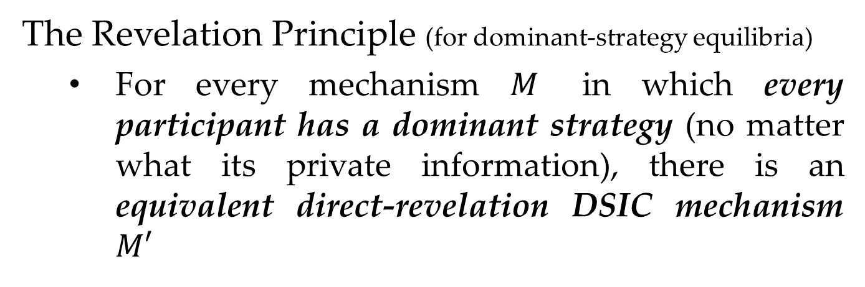
Discussion
The Revelation Principle (for dominant-strategy equilibria)
For every mechanism $M$ in which every participant has a dominant strategy (no matter what its private information), there is an equivalent direct-revelation DSIC mechanism $M′$
Note：
Many other equilibrium concepts have their own Revelation Principle
The Revelation Principles show that, given the choice of incentive constraints, direct revelation is without loss of generality.
Truthfulness is not important, but a desired outcome in an equilibrium of some type is.
Varying the choice of equilibrium concept can lead to quite diﬀerent mechanism design theories
Notes:
其他类型的均衡也有显示原理

Slide 26
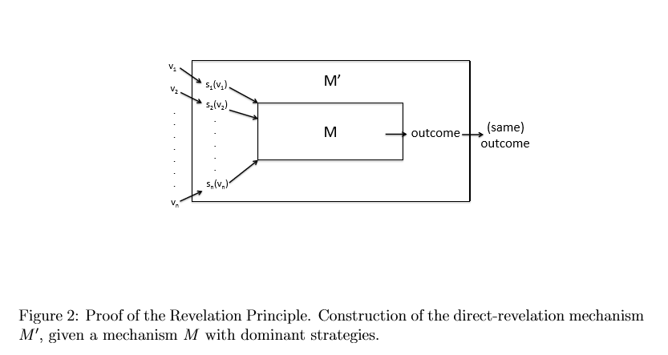
Discussion
Proof of the Revelation Principle (for dominant-strategy equilibria)
Notes:
其他类型的均衡也有显示原理

Slide 27
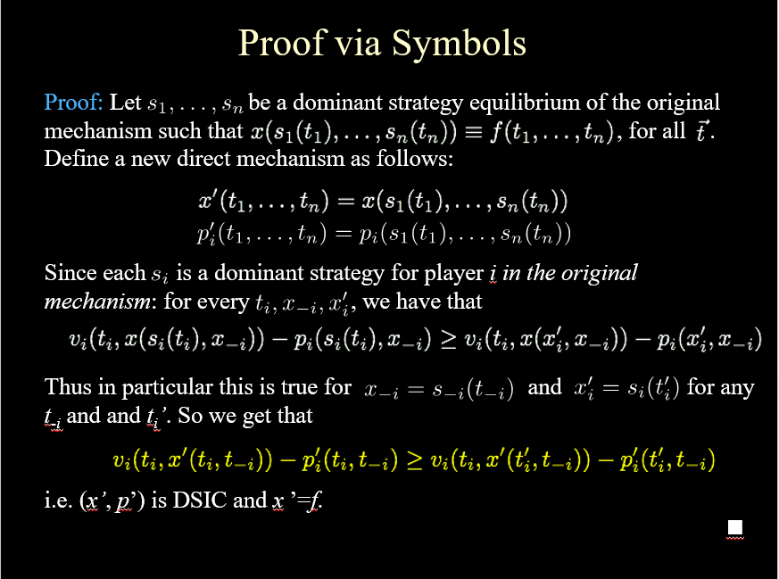
Notes:
其他类型的均衡也有显示原理

Slide 28
Summary

Slide 29
Summary
The paradigm of designing mechanisms considering NP-hard problems
Non-DSIC mechanisms and DSIC mechanisms

Slide 30
Thanks
Any Questions ???

