Slide 1
Simple Near-Optimal Auctions
Prepared and Presented by
Zeng Yuxiang

Slide 2
Optimal Auctions Can Be Complex

Slide 3
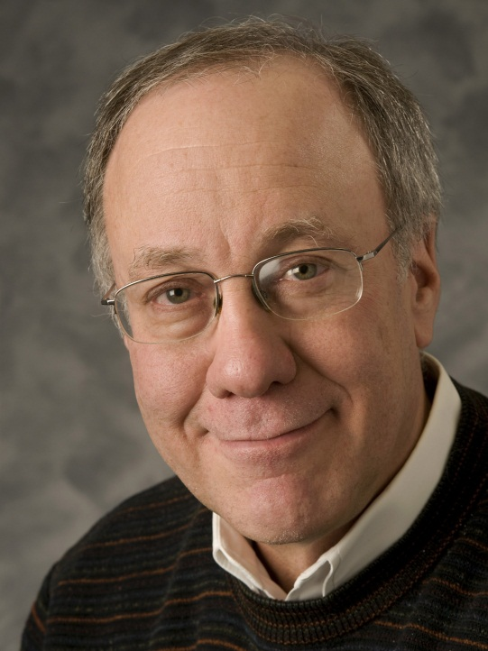
Revenue = Virtual Welfare
Fix a Bayesian single-dimensional environment, where bidder distributions are F₁,…,F_{n}, and F=F₁x…xF_{n}.
Let also (x,p) be a DSIC mechanism satisfying interim IR and NPT.
The expected revenue of this mechanism under truth-telling is
E_{v~F}[Σ_{i} p_{i}(v)]=E_{v~F}[Σ_{i} x_{i}(v) φ_{i} (v_{i})],
where φ_{i} (v_{i}) := v_{i}- (1-F_{i}(v_{i}))/f_{i}(v_{i}) is bidder i’s “virtual value function” (f_{i} is the density function for F_{i}).
Myerson’81
Maximizing expected revenue over the space of DSIC auctions
reduces to maximizing the expected virtual welfare.

Slide 4
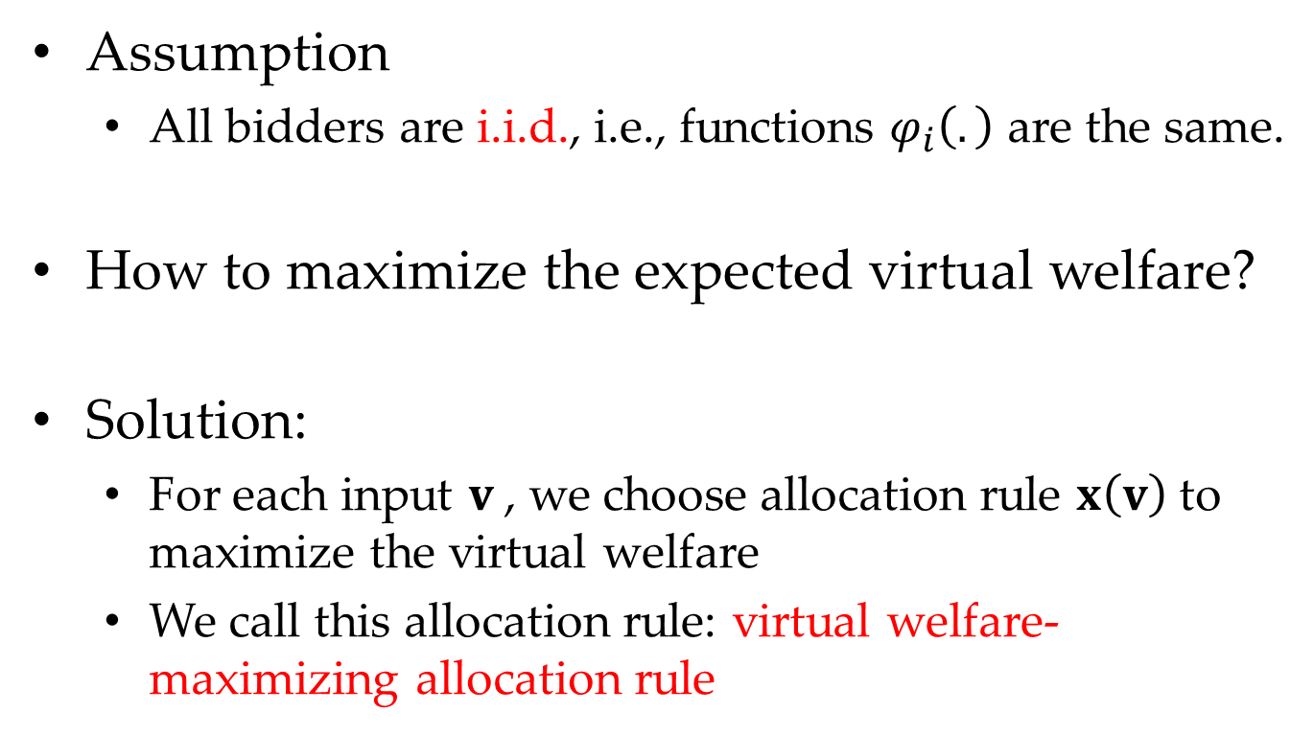
Bayesian Optimal Auctions
Assumption
All bidders are i.i.d., i.e., functions $φ_{i}\left(.\right)$ are the same.
How to maximize the expected virtual welfare?
Solution:
For each input $v$, we choose allocation rule $x\left(v\right)$ to maximize the virtual welfare
We call this allocation rule: virtual welfare-maximizing allocation rule
i.i.d. assumptions are usually not practical.

Slide 5
The Prophet Inequality

Slide 6
Secretary Problem
There are n candidates for apply your secretary.
After each of them show you his ability which are denoted by a float value (the larger, the better), you need to decide whether to hire him or not?
If you decide to hire him, the process ends.
If you decide to reject him, the process continues and you can not regret.

Slide 7


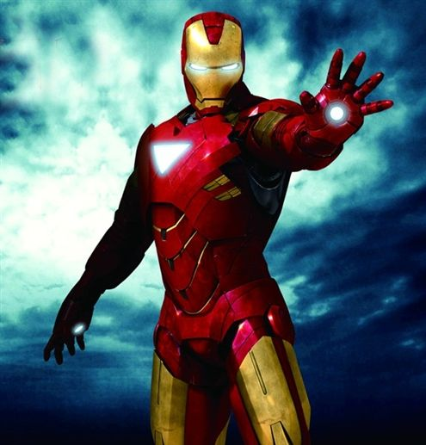
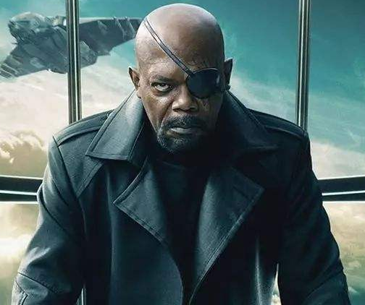
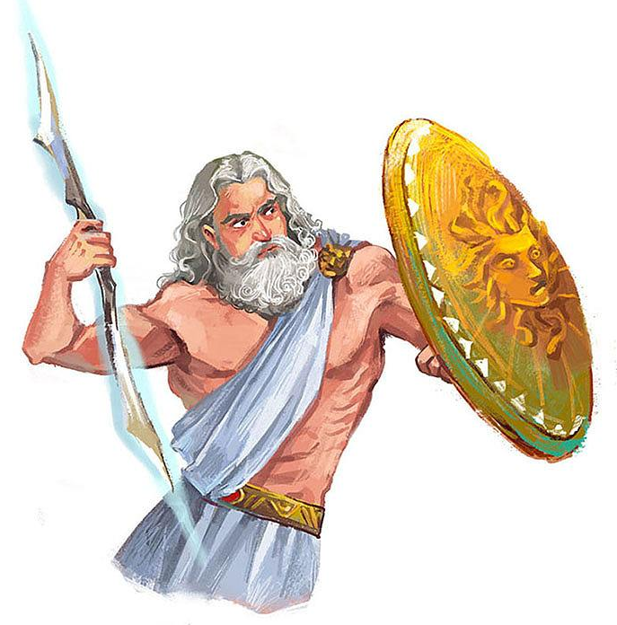
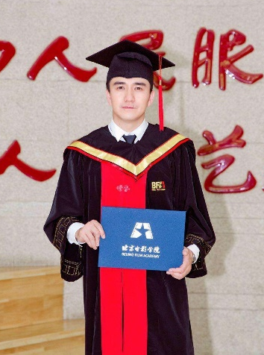
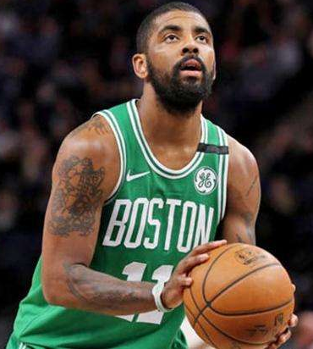
Secretary Problem
面试官
应聘者

Slide 8
Secretary Problem
Solution: Any Suggestion?
Hint: Greedy and Sampling.

Slide 9

Secretary Problem
Basic Idea: we reject the first $(i−1)$-th candidates and accept the other candidates as long as he is better than all the first $(i−1)$-th candidates.

Slide 10
Secretary Problem
面试官
应聘者

Slide 11
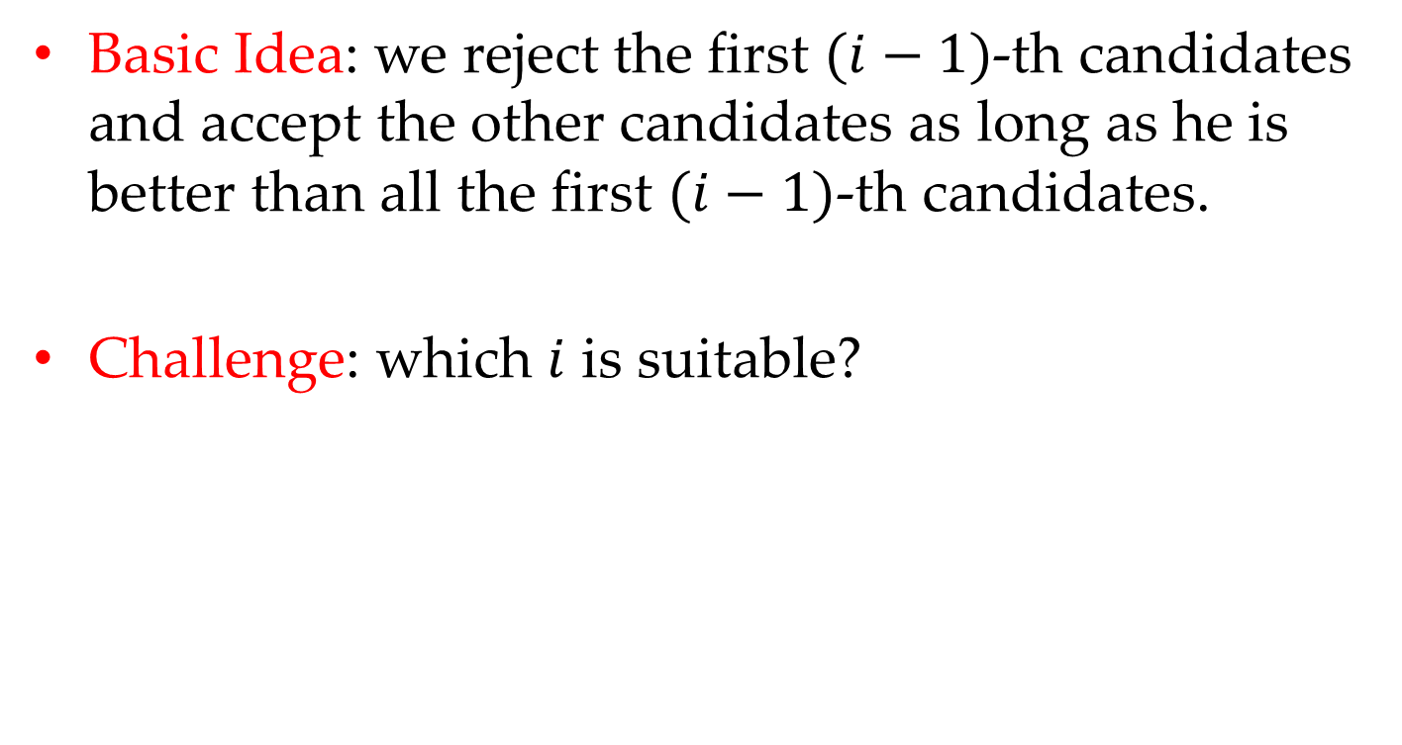
Secretary Problem
Basic Idea: we reject the first $(i−1)$-th candidates and accept the other candidates as long as he is better than all the first $(i−1)$-th candidates.
Challenge: which $i$ is suitable?

Slide 12
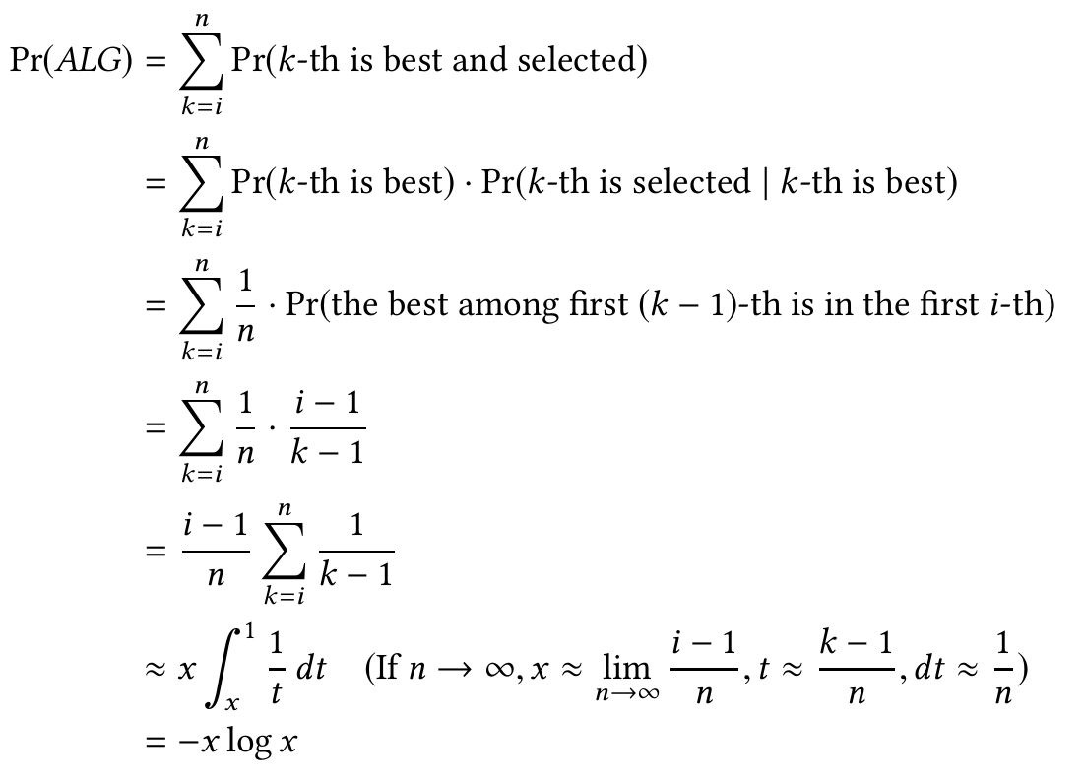
Secretary Problem
Theoretical Analysis:

Slide 13
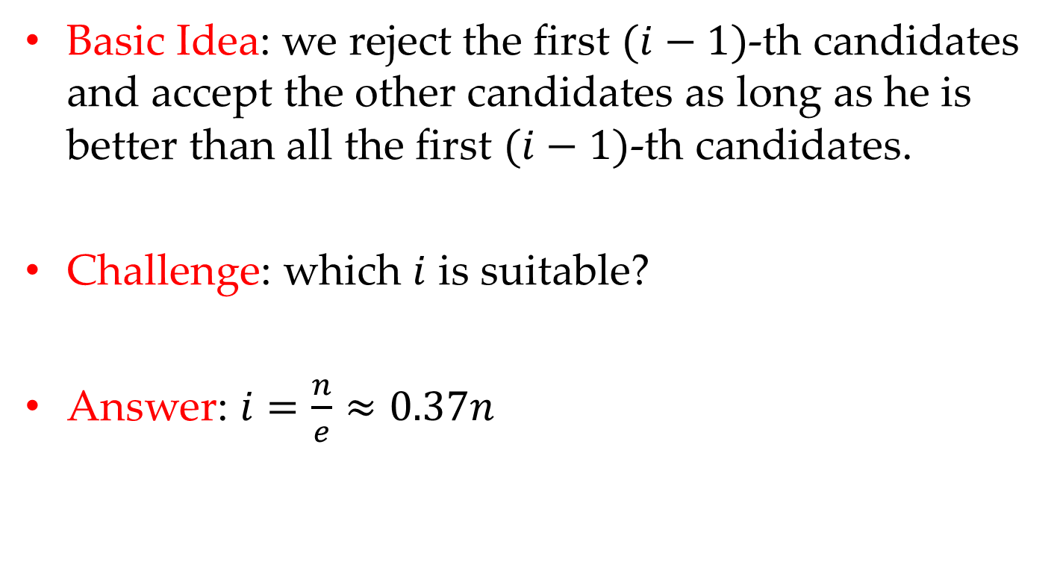
Secretary Problem
Basic Idea: we reject the first $(i−1)$-th candidates and accept the other candidates as long as he is better than all the first $(i−1)$-th candidates.
Challenge: which $i$ is suitable?
Answer: $i=\frac{n}{e}≈0.37n$

Slide 14
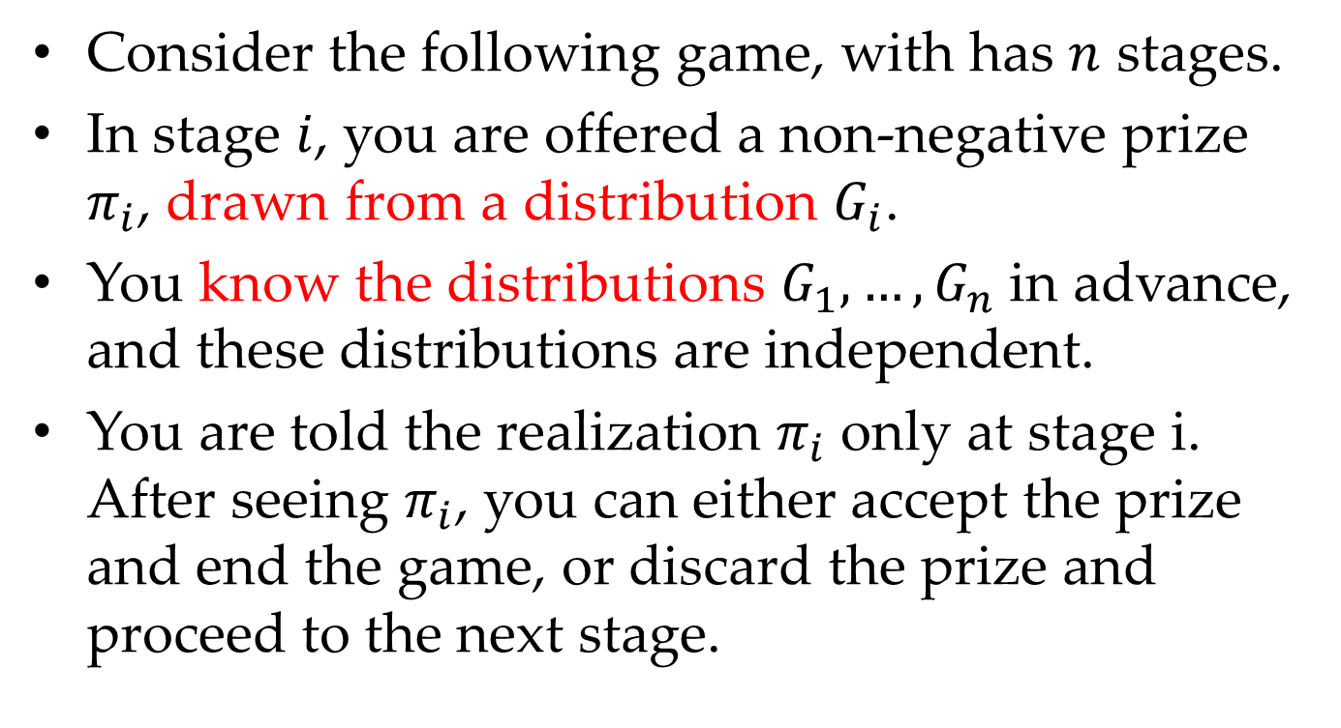
An Optimal Stopping Game
Consider the following game, with has $n$ stages.
In stage $i$, you are offered a non-negative prize $π_{i}$, drawn from a distribution $G_{i}$.
You know the distributions $G_{1},…,G_{n}$ in advance, and these distributions are independent.
You are told the realization $π_{i}$ only at stage i. After seeing $π_{i}$, you can either accept the prize and end the game, or discard the prize and proceed to the next stage.

Slide 15
An Optimal Stopping Game
Solution: Any suggestion?
Basic Idea: Filter, Barrier, Threshold based.

Slide 16
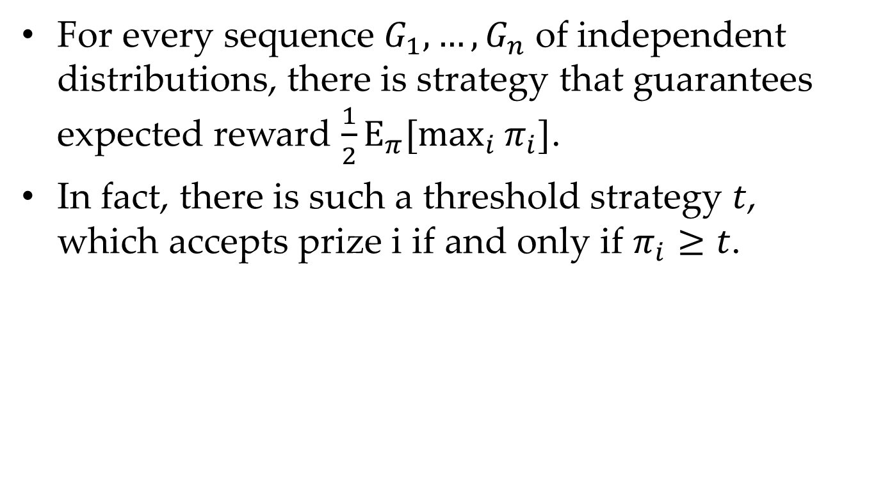
Prophet Inequality
For every sequence $G_{1},…,G_{n}$ of independent distributions, there is strategy that guarantees expected reward $\frac{1}{2}Ε_{π}[\max_{i}{π_{i}}]$.
In fact, there is such a threshold strategy $t$, which accepts prize i if and only if $π_{i}≥t$.
[1] What is the upper bound of the game?
[2] Does the upper bound tight?

Slide 17
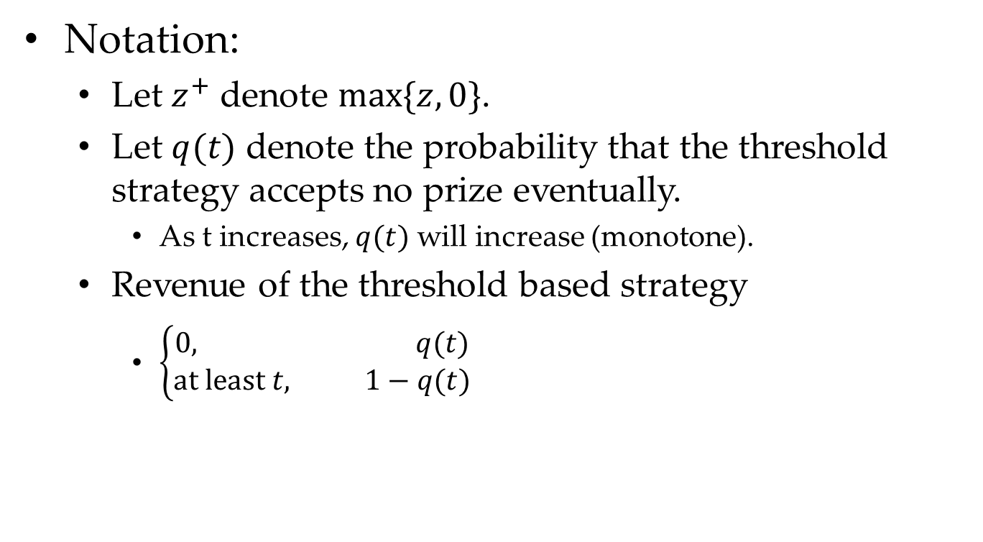
Proof of Prophet Inequality
Notation:
Let $z^{+}$ denote $max⁡\{z,0\}$.
Let $q(t)$ denote the probability that the threshold strategy accepts no prize eventually.
As t increases, $q(t)$ will increase (monotone).
Revenue of the threshold based strategy
$\left\{\begin{aligned}0, q(t) \\ at least t, 1−q(t)\end{aligned}\right.$
Here, t is not tight.
[1] What is the lower bound of the strategy?
[2] Does the lower bound tight?

Slide 18
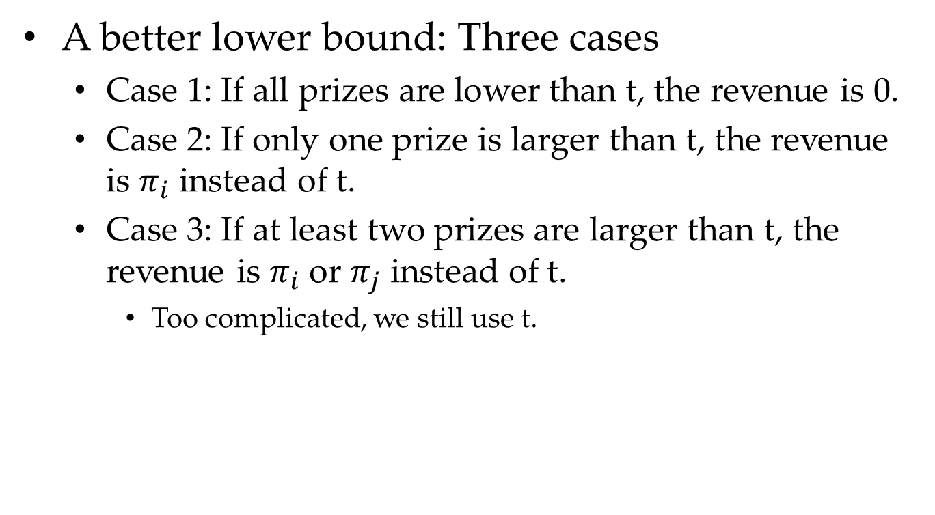
Proof of Prophet Inequality
A better lower bound: Three cases
Case 1: If all prizes are lower than t, the revenue is 0.
Case 2: If only one prize is larger than t, the revenue is $π_{i}$ instead of t.
Case 3: If at least two prizes are larger than t, the revenue is $π_{i}$ or $π_{j}$ instead of t.
Too complicated, we still use t.
[1] Does the lower bound tight?

Slide 19
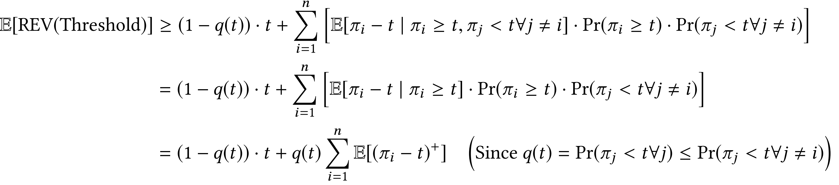


Proof of Prophet Inequality
The lower bound is as follows
$$E[{\left(π_{i}−t\right)}^{+}]$$
$$≥q(t)$$

Slide 20
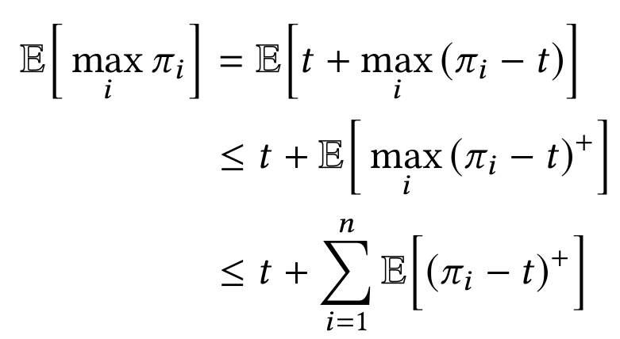
Proof of Prophet Inequality
The upper bound is as follows

Slide 21
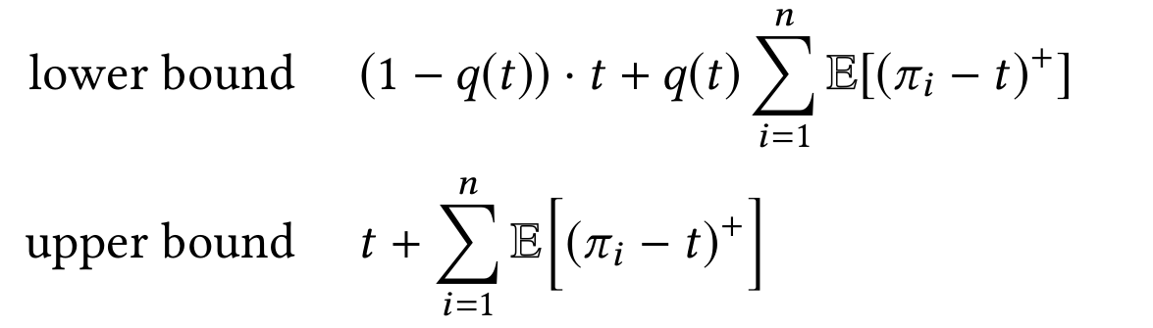
Proof of Prophet Inequality
Optimal q(t)=1/2, AR = 1/2
If we back to i.i.d. setting,
½ is also optimal for uniform distribution on [0,1].

Slide 22
Simple Single-Item Auctions

Slide 23
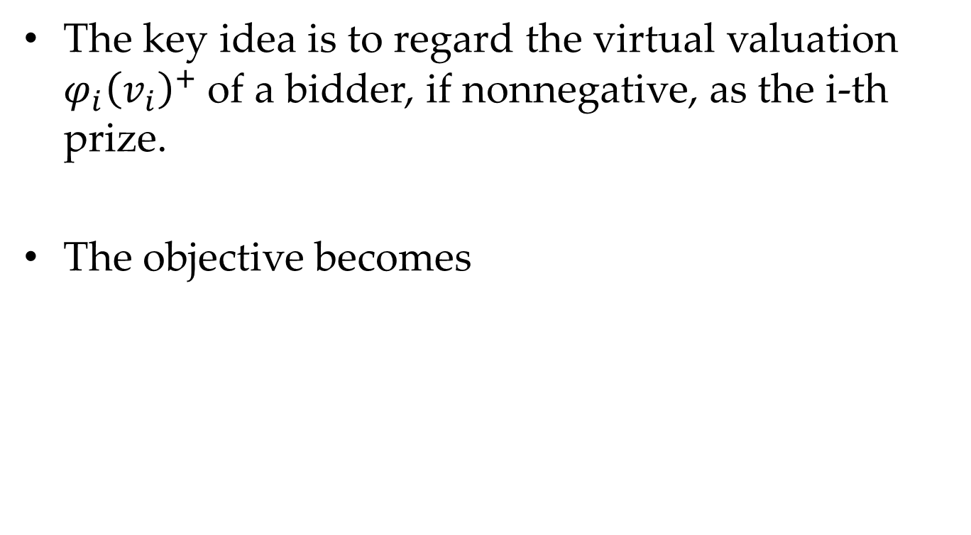
Apply Prophet Inequality
The key idea is to regard the virtual valuation $φ_{i}{\left(v_{i}\right)}^{+}$of a bidder, if nonnegative, as the i-th prize.
The objective becomes

Slide 24
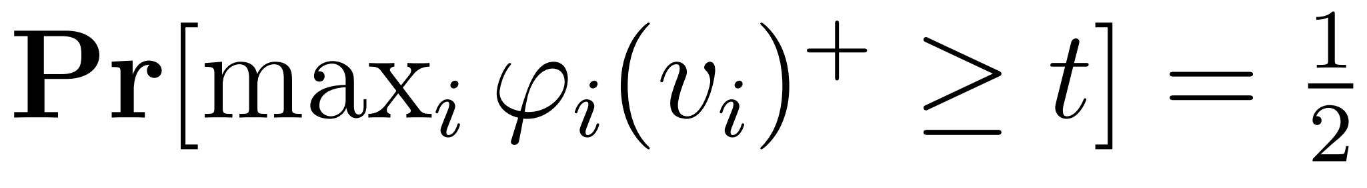

Apply Prophet Inequality
Allocation Rule
(1) Choose t such that
(2) Give the item to a bidder i with $φ_{i}{\left(v_{i}\right)}^{}≥t$, if any, breaking ties among multiple candidate winners arbitrarily (subject to monotonicity).

Slide 25
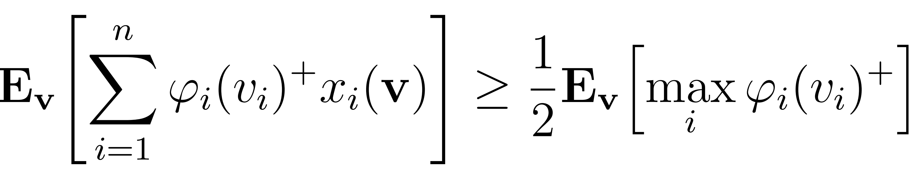
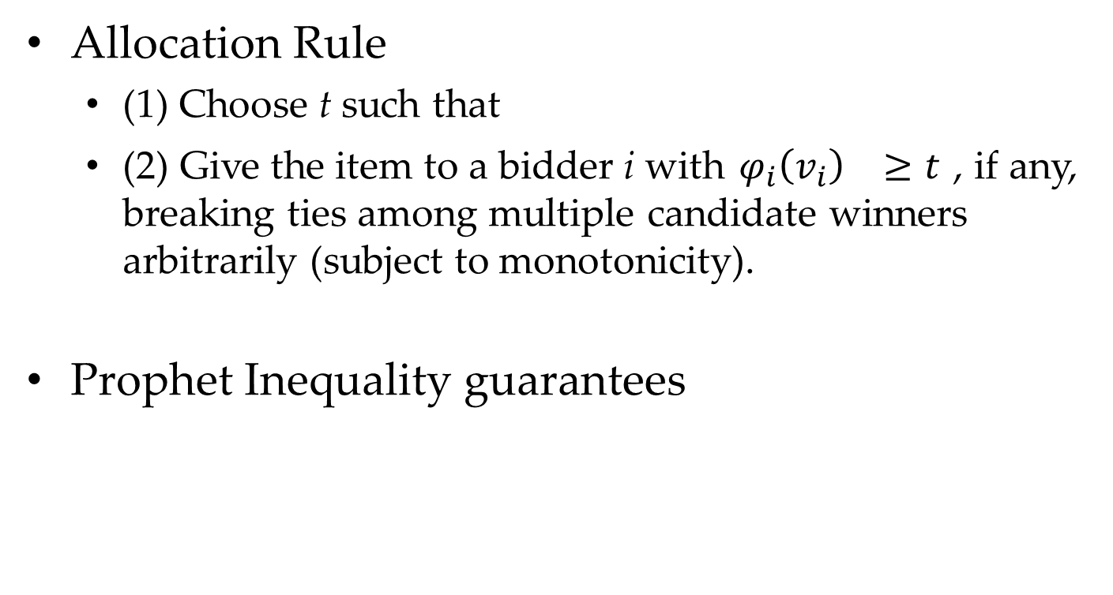
Apply Prophet Inequality
Allocation Rule
(1) Choose t such that
(2) Give the item to a bidder i with $φ_{i}{\left(v_{i}\right)}^{}≥t$, if any, breaking ties among multiple candidate winners arbitrarily (subject to monotonicity).
Prophet Inequality guarantees

Slide 26
Bulow-Klemperer Theorem

Slide 27
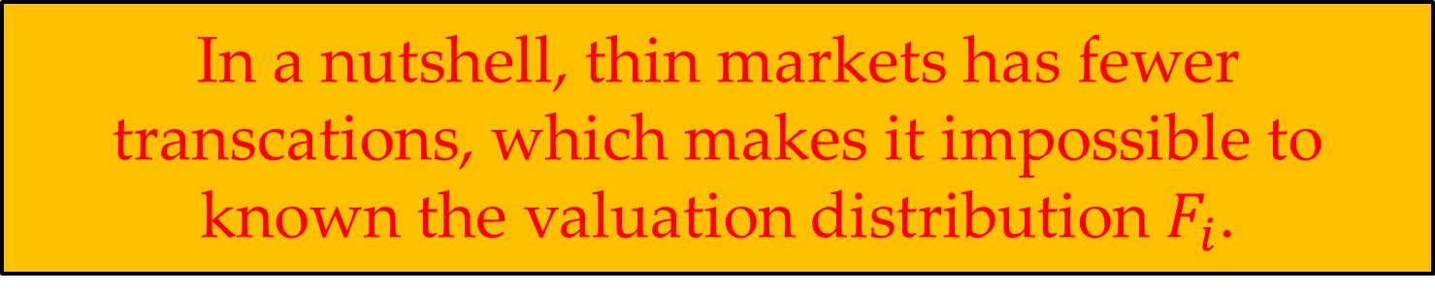
Thin Markets
What is Thin Market (a.k.a., Narrow Market)?
A thin market is a market with a low number of buyers and sellers.
Since few transactions take place in a thin market, prices are often more volatile and assets are less liquid.
A thin market has high price volatility and low liquidity.
If supply or demand changes abruptly, resulting in more buyers than sellers or vice versa, there will typically be a material impact on prices.
In a nutshell, thin markets has fewer transcations, which makes it impossible to known the valuation distribution $F_{i}$.
[1] Thin Market. https://www.investopedia.com/terms/t/thinmarket.asp

Slide 28
Known Distribution vs. Unknown Distribution
In Lecture5 (Bayesian Analysis), the valuation distributions are assumed to be known since the markets can produce enough data.
In Lecture6 (Thin Market), the valuation distributions are unknown due to insufficient data. However, we can still assume that the personal valuations follow specific distribution.

Slide 29
Known/Unknown Distribution in Online Bipartite Matching
In Tong et al. VLDB’17, the analysis of competitive ratio is under i.i.d. setting. The basic idea is to first learn the spatio-temporal distribution of vertices.
Question: Known or Unknown Distribution?
Answer: Clearly, known distribution.
Reason: The key assumption is whether you have sufficient data.
KIID is a stronger assumption than IID.
Stronger assumption in definition makes the problem easier.

Slide 30
Thereotical Analysis based on Unknown Distribution
Challenges:
The mechanism design should have nothing to do with the specifici distribution.
Only the analysis can utilize the i.i.d. setting. However, you can not have assumption on specific distribution parameters, etc.
Purpose:
Design auctions that do not use any knowledge about the distributions, but perform almost as well as if they knew everything about the distributions.

Slide 31
Bulow-Klemperer Theorem
Model: Prior-independent auctions with Vickrey Mechanism

Slide 32
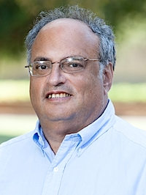
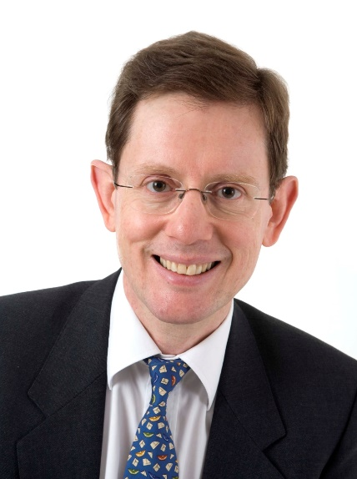
Bulow-Klemperer Theorem
Theorem: Let F be a regular distribution and n a positive integer. Then:
Vickrey has no reserve price
OPT: optimal auction
[1] J. Bulow and P. Klemperer. Auctions versus negotiations. American Economic Review, 86(1):180{194, 1996

Slide 33
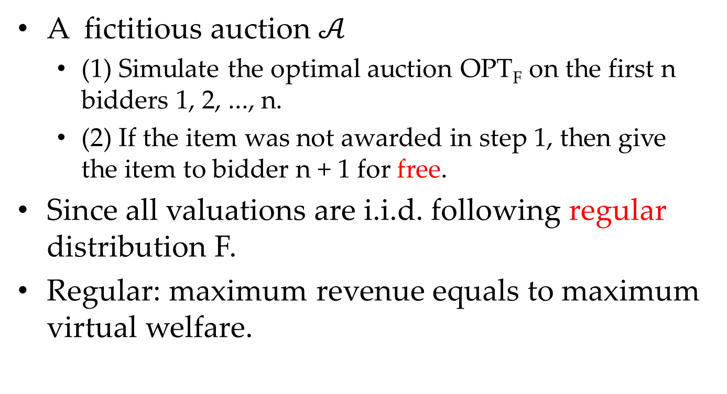
Proof of Bulow-Klemperer Theorem
A fictitious auction $𝒜$
(1) Simulate the optimal auction OPT_{F} on the first n bidders 1, 2, ..., n.
(2) If the item was not awarded in step 1, then give the item to bidder n + 1 for free.
Since all valuations are i.i.d. following regular distribution F.
Regular: maximum revenue equals to maximum virtual welfare.
[1] Why was the item not awarded in step 1?
[2] How to utilize these properties in the final proof?

Slide 34
Bulow-Klemperer Corollary
Corollary: Consider any regular distribution F and integer n. Then
Similar to previous one, who can give a solid proof?

Slide 35
Case Study: Reserve Prices in Yahoo! Keyword Auctions

Slide 36
Reserve Prices in Yahoo!
The reserve prices are relatively low up to 2008.
Initially $.01, later $.05, and $.10
A lognormal valuation distribution was posited.
The optimal reserve price varies a lot across keywords, but there are plenty of keywords with a theoretically optimal reserve price of $.30 or $.40.
Set the new reserve prices to be the average of the old ones ($.10) and the theoretically optimal ones.
[1] M. Ostrovsky and M. Schwarz. Reserve prices in internet advertising auctions: A field experiment. Working paper, December 2009.

Slide 37
Reserve Prices in Yahoo!
What is the loss to be conservative in theoretical analysis?
I call it “the price of conservative”.
Better reserve prices were credited by Yahoo!’s president as the biggest reason for higher search revenue in Yahoo!’s third-quarter report in 2008.
[1] M. Ostrovsky and M. Schwarz. Reserve prices in internet advertising auctions: A field experiment. Working paper, December 2009.

Slide 38
Exercises

Slide 39
Tim: Exercise 23
Consider an auction with k identical goods, with at most one given to each bidder. There are n bidders whose valuations are i.i.d. draws from a regular distribution F.
Describe the optimal auction in this case.
Which of the following does the reserve price depend on: k, n, and/or F?

Slide 40
Tim: Exercise 24
Repeat the previous exercise for sponsored search auctions, with n bidders with valuations-per-click drawn i.i.d. from a regular distribution, and with k ≤ n slots with α1 ≥ α2 ≥ · · · ≥ αk.
Notes:
virtual 为什么可能是负的

Slide 41
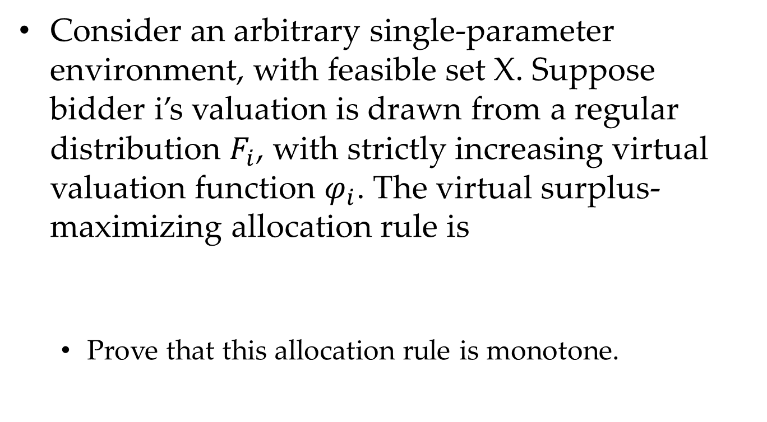
Tim: Exercise 25
Consider an arbitrary single-parameter environment, with feasible set X. Suppose bidder i’s valuation is drawn from a regular distribution $F_{i}$, with strictly increasing virtual valuation function $φ_{i}$. The virtual surplus-maximizing allocation rule is
Prove that this allocation rule is monotone.

Slide 42
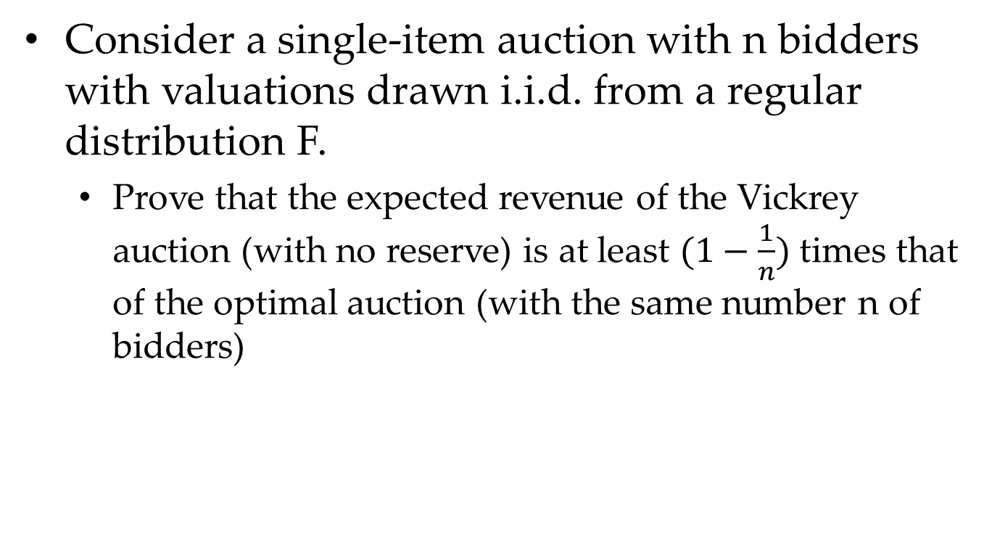
Tim: Exercise 27
Consider a single-item auction with n bidders with valuations drawn i.i.d. from a regular distribution F.
Prove that the expected revenue of the Vickrey auction (with no reserve) is at least $(1−\frac{1}{n})$ times that of the optimal auction (with the same number n of bidders)

Slide 43
Summary

Slide 44
Summary
Optimal Auctions Can Be Complex
Secretary Problem
The Prophet Inequality
Bulow-Klemperer Theorem

Slide 45
Thanks
Any Questions ???

Slide 46
XXXX

Slide 47
XXXX

