Slide 1
Beyond Quasi-Linearity
Prepared and Presented by
Zeng Yuxiang

Slide 2
Budget Constraints

Slide 3

Quasi-linear Utility
In previous lectures, we focus on the quasi-linear utility function as follows
meaning the private valuation minus the payment

Slide 4
Budget Constraint
Budget constraints limit the amount of money that an agent can pay.
For example,
In a single-item auction, the maximum willingness-to-pay (valuation) is bounded above by its budget.
In sponsored search auction, a bidder is not only asked to provide his bid-per-click ($.25) and his daily budget ($100).

Slide 5
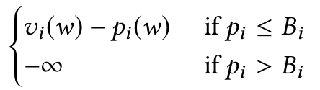

How to incorporate budget in the utility model
redefine the utility of player $i$ with budget $B_{i}$ for outcome $w$ and payment $p_{i}$ as

Slide 6
Payment Constraints
Payment constraints such as budget constraints join the two other types of constraints
incentive constraints: often in the form of monotonicity
allocation constraints: such as allocating each good to at most one agent

Slide 7
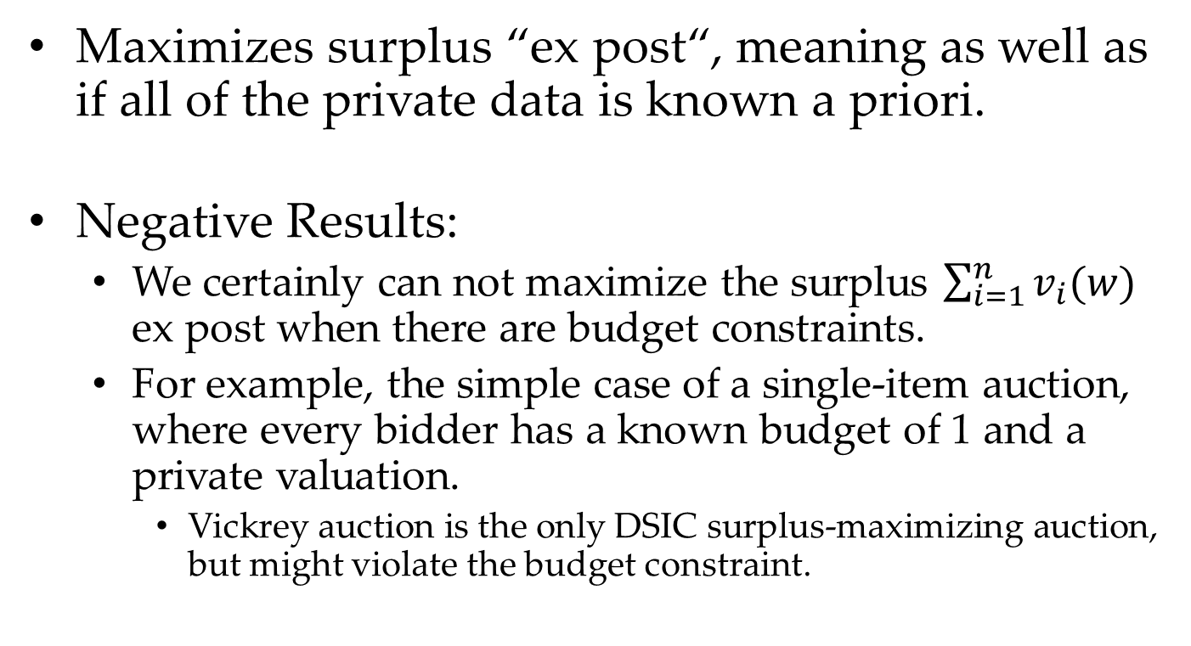
Negative Results
Maximizes surplus “ex post“, meaning as well as if all of the private data is known a priori.
Negative Results:
We certainly can not maximize the surplus $\sum_{i=1}^{n}{v_{i}(w)}$ ex post when there are budget constraints.
For example, the simple case of a single-item auction, where every bidder has a known budget of 1 and a private valuation.
Vickrey auction is the only DSIC surplus-maximizing auction, but might violate the budget constraint.

Slide 8
The Clinching Auction

Slide 9
Clinching Auction Model
There are m identical goods, and each bidder might want many of them (like clicks in a keyword auction).
Each bidder i has a private valuation v_{i} for each good that it gets. So if it gets k goods, its valuation for them is k · v_{i}.
Each bidder has a budget B_{i} that we assume is public, meaning it is known to the seller in advance.

Slide 10
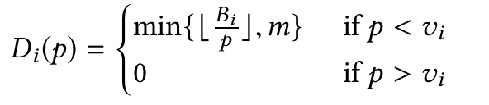
Market-Clearing Price Based Auction
It is based on selling goods at the “market-clearing price", where supply equals demand.
It’s clear what the supply is m (goods).
The demand of a bidder depends on the current price, with higher prices meaning less demand.
Formally we define the demand of bidder i at price p as:
When p=v_{i}, D_{i}(p) can be any integer
without violation of budget constraint.

Slide 11
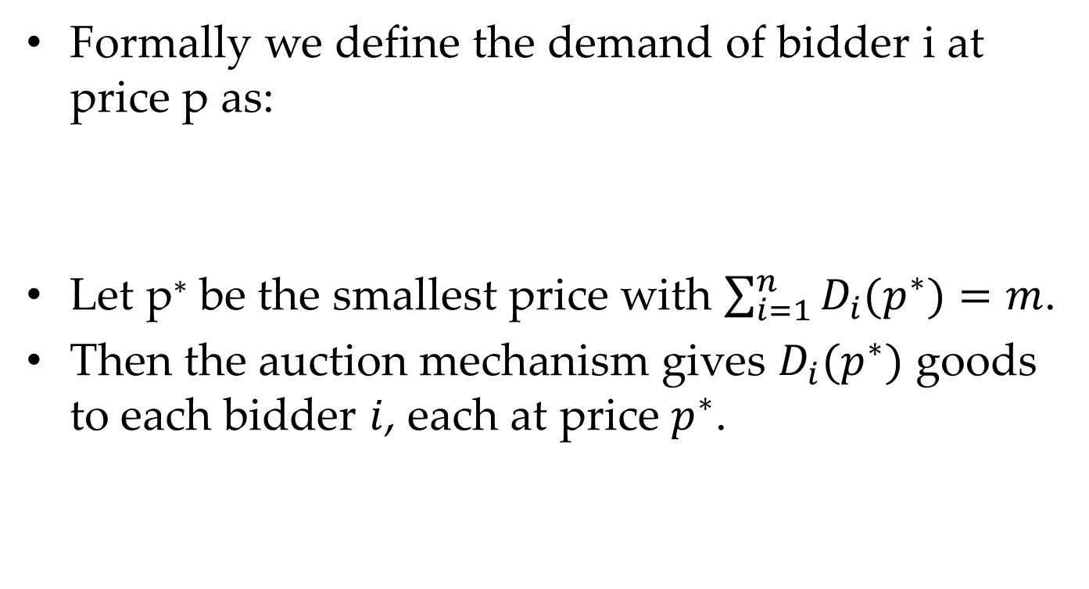
Market-Clearing Price Based Auction
Formally we define the demand of bidder i at price p as:
Let p∗ be the smallest price with $\sum_{i=1}^{n}{D_{i}(p^{∗})}=m$.
Then the auction mechanism gives $D_{i}(p^{∗})$ goods to each bidder $i$, each at price $p^{∗}$.
Question 1. Does the mechanism guarantees DSIC property?

Slide 12

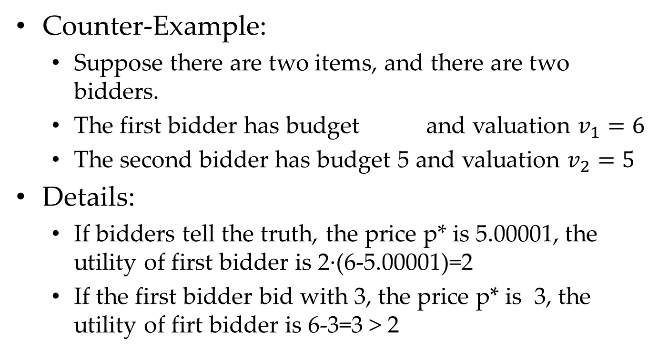
Market-Clearing Price Based Auction Is Not DSIC
Counter-Example:
Suppose there are two items, and there are two bidders.
The first bidder has budget and valuation $v_{1}=6$
The second bidder has budget 5 and valuation $v_{2}=5$
Details:
If bidders tell the truth, the price p* is 5.00001, the utility of first bidder is 2·(6-5.00001)=2
If the first bidder bid with 3, the price p* is 3, the utility of firt bidder is 6-3=3 > 2

Slide 13
Market-Clearing Price Based Auction
The allocation rule of the auction mechanism is monotone.
Since the allocation rule is monotone, the Myerson Lemma tells us that the payment rule leads to non-DSIC.
Question 1. The proof of the monotone property?

Slide 14
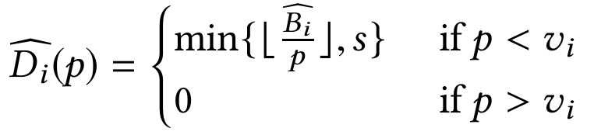
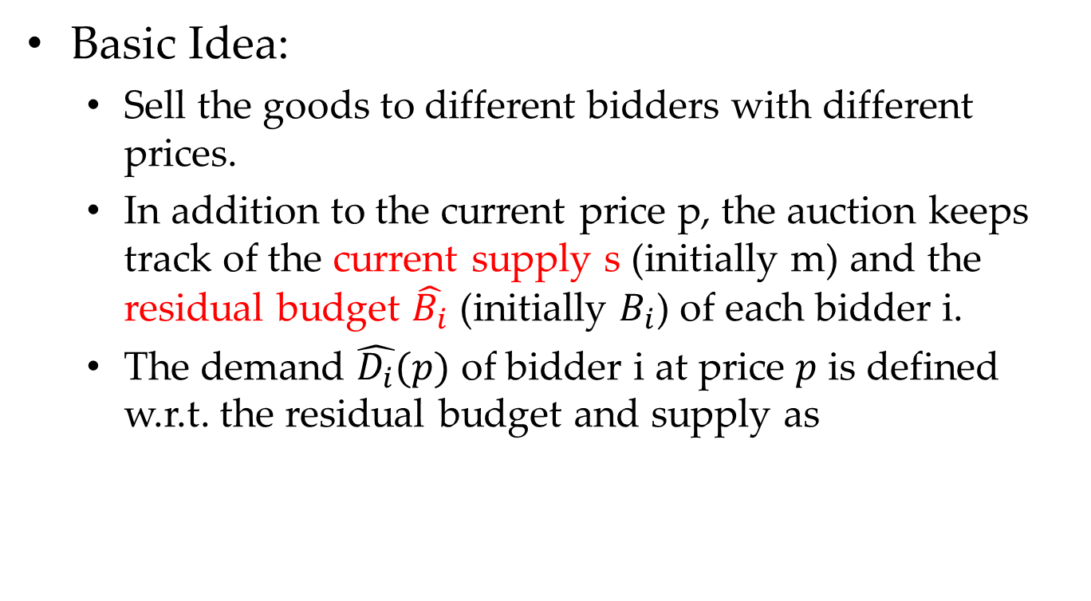
Clinching Auction for Budgeted Bidders
Basic Idea:
Sell the goods to different bidders with different prices.
In addition to the current price p, the auction keeps track of the current supply s (initially m) and the residual budget $\hat{B_{i}}$ (initially $B_{i}$) of each bidder i.
The demand $\hat{D_{i}}(p)$ of bidder i at price $p$ is defined w.r.t. the residual budget and supply as

Slide 15
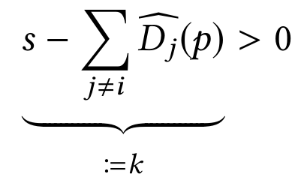
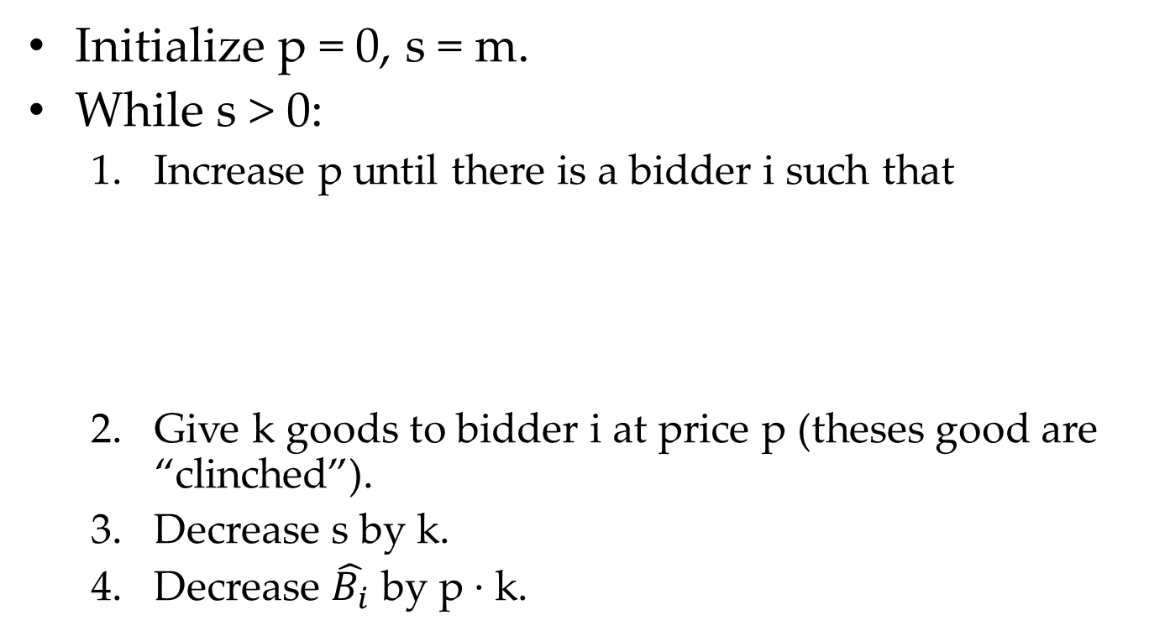
Clinching Auction for Budgeted Bidders
Initialize p = 0, s = m.
While s > 0:
Increase p until there is a bidder i such that
Give k goods to bidder i at price p (theses good are “clinched”).
Decrease s by k.
Decrease $\hat{B_{i}}$ by p · k.

Slide 16
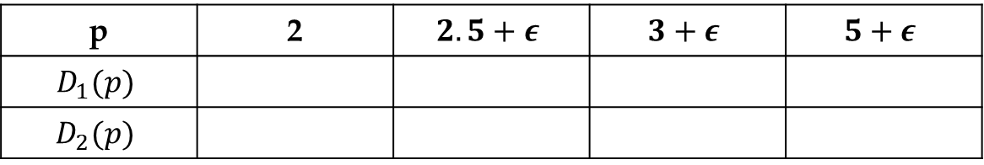
Clinching Auction for Budgeted Bidders
Suppose there are two items and two bidders,
p | 2 | $$2.5+ε$$ | $$3+ε$$ | $$5+ε$$
$$D_{1}(p)$$
$$D_{2}(p)$$

Slide 17

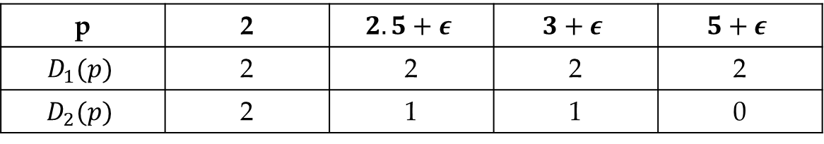
Clinching Auction for Budgeted Bidders
Suppose there are two items and two bidders,
Increase p until there is a bidder i such that
p $≈$ 2.5
p | 2 | $$2.5+ε$$ | $$3+ε$$ | $$5+ε$$
$$D_{1}(p)$$ | 2 | 2 | 2 | 2
$$D_{2}(p)$$ | 2 | 1 | 1 | 0

Slide 18
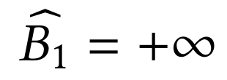
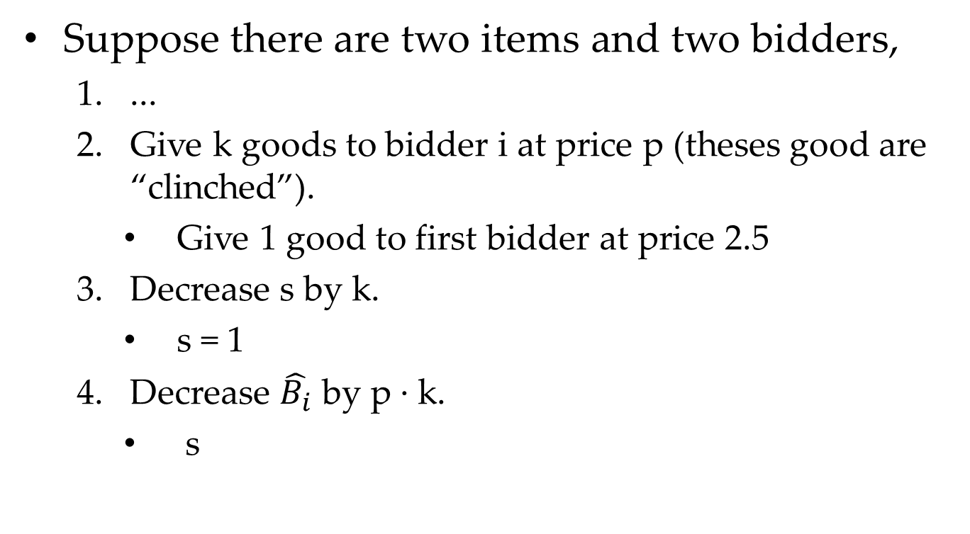
Clinching Auction for Budgeted Bidders
Suppose there are two items and two bidders,
...
Give k goods to bidder i at price p (theses good are “clinched”).
Give 1 good to first bidder at price 2.5
Decrease s by k.
s = 1
Decrease $\hat{B_{i}}$ by p · k.
s

Slide 19
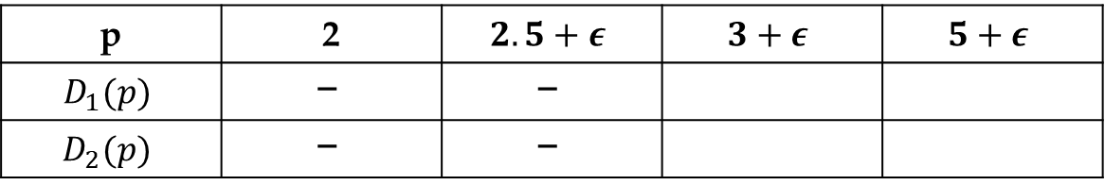
Clinching Auction for Budgeted Bidders
Suppose there are two items and two bidders,
p | 2 | $$2.5+ε$$ | $$3+ε$$ | $$5+ε$$
$$D_{1}(p)$$ | $$ꟷ$$ | $$ꟷ$$
$$D_{2}(p)$$ | $$ꟷ$$ | $$ꟷ$$

Slide 20

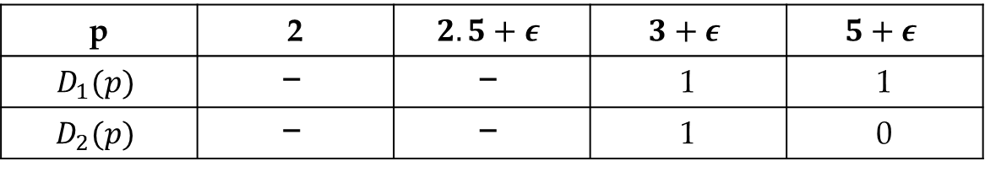
Clinching Auction for Budgeted Bidders
Suppose there are two items and two bidders,
Increase p until there is a bidder i such that
p $≈$ 5
p | 2 | $$2.5+ε$$ | $$3+ε$$ | $$5+ε$$
$$D_{1}(p)$$ | $$ꟷ$$ | $$ꟷ$$ | 1 | 1
$$D_{2}(p)$$ | $$ꟷ$$ | $$ꟷ$$ | 1 | 0

Slide 21
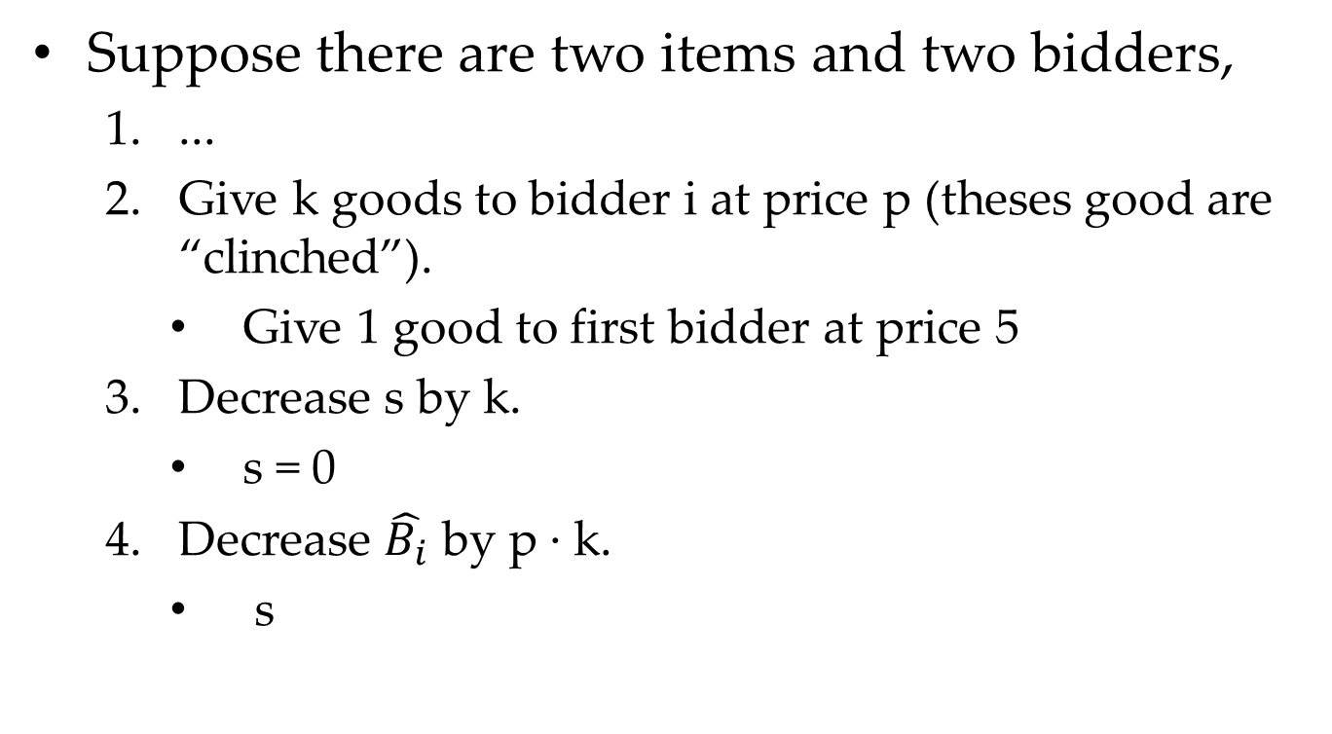
Clinching Auction for Budgeted Bidders
Suppose there are two items and two bidders,
...
Give k goods to bidder i at price p (theses good are “clinched”).
Give 1 good to first bidder at price 5
Decrease s by k.
s = 0
Decrease $\hat{B_{i}}$ by p · k.
s

Slide 22
Clinching Auction for Budgeted Bidders
Suppose there are two items and two bidders,
Comparison between two mechanisms
Market-Clearing Price Based Auction
First Bidder was awarded both goods at price 5
Clinching Auction
First Bidder was awarded both goods at price 2.5 and 5
Question 1. What is the utility of first bidder in two mechanisms?

Slide 23
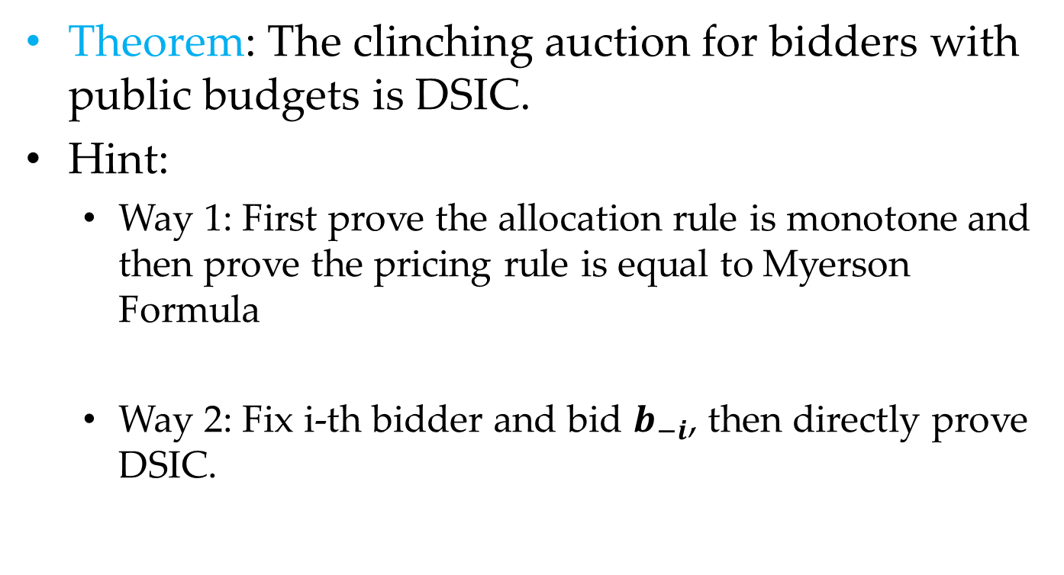
Clinching Auction for Budgeted Bidders is DSIC
Theorem: The clinching auction for bidders with public budgets is DSIC.
Hint:
Way 1: First prove the allocation rule is monotone and then prove the pricing rule is equal to Myerson Formula
Way 2: Fix i-th bidder and bid $b_{−i}$, then directly prove DSIC.

Slide 24

Clinching Auction for Budgeted Bidders is DSIC
Proof:
If $b_{i}<v_{i}$, the i-th bidder will lose utility when the price are increasing from $b_{i}$ to $v_{i}$.
Question 1. Why the statement ($b_{i}<v_{i}$) is correct?

Slide 25
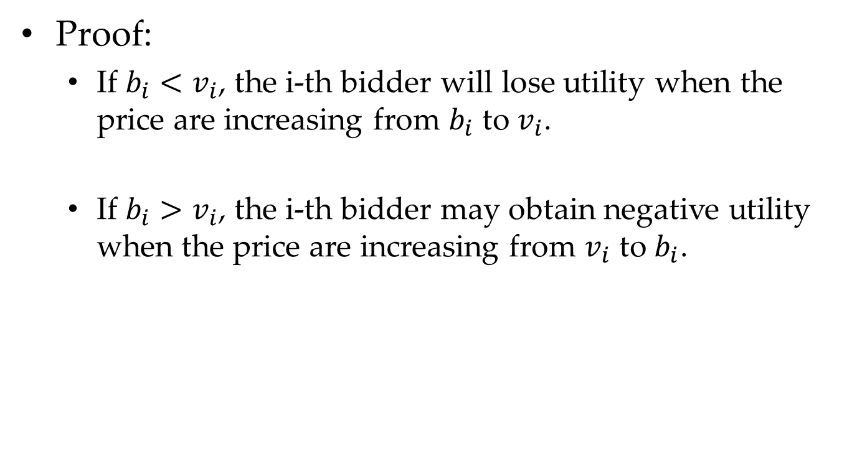
Clinching Auction for Budgeted Bidders is DSIC
Proof:
If $b_{i}<v_{i}$, the i-th bidder will lose utility when the price are increasing from $b_{i}$ to $v_{i}$.
If $b_{i}>v_{i}$, the i-th bidder may obtain negative utility when the price are increasing from $v_{i}$ to $b_{i}$.
Question 1. Why the statement ($b_{i}>v_{i}$) is correct?

Slide 26
DSIC is not enough
DSIC sometimes is not the promising property.
For example, the random allocation for free is also DSIC.
Question 1. Why the random allocation mechanism is DSIC?

Slide 27
DSIC is not enough
DSIC sometimes is not the promising property.
For example, the random allocation for free is also DSIC.
Scientists focus on the other aspects.
Pareto optimal
“Simple near-optimal” and “Prior-independent” ^{[1,2]}
[1] M. M. Pai and R. Vohra. Optimal auctions with financially constrained buyers. Journal of Economic Theory, 2013.
[2] N. R. Devanur, B. Q. Ha, and J. D. Hartline. Prior-free auctions for budgeted agents. In EC, 2013.

Slide 28
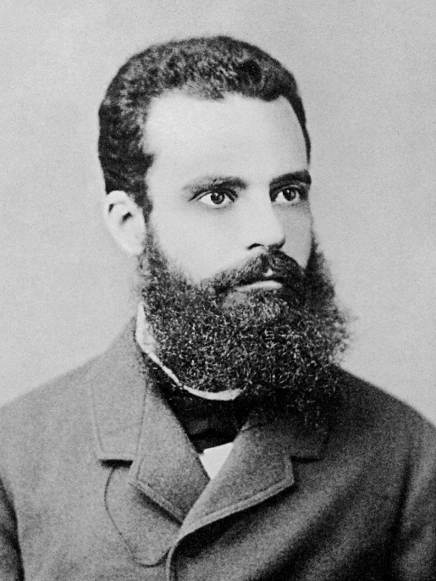
Pareto optimal
Pareto-optimality
a.k.a., Pareto-efficiency
A state of affairs is Pareto-optimal (or Pareto-efficient) if and only if there is no alternative state that would make some people better off without making anyone worse off.
Vilfredo Pareto
Pareto Optimal
80/20 Rule
Pareto Distribution

Slide 29
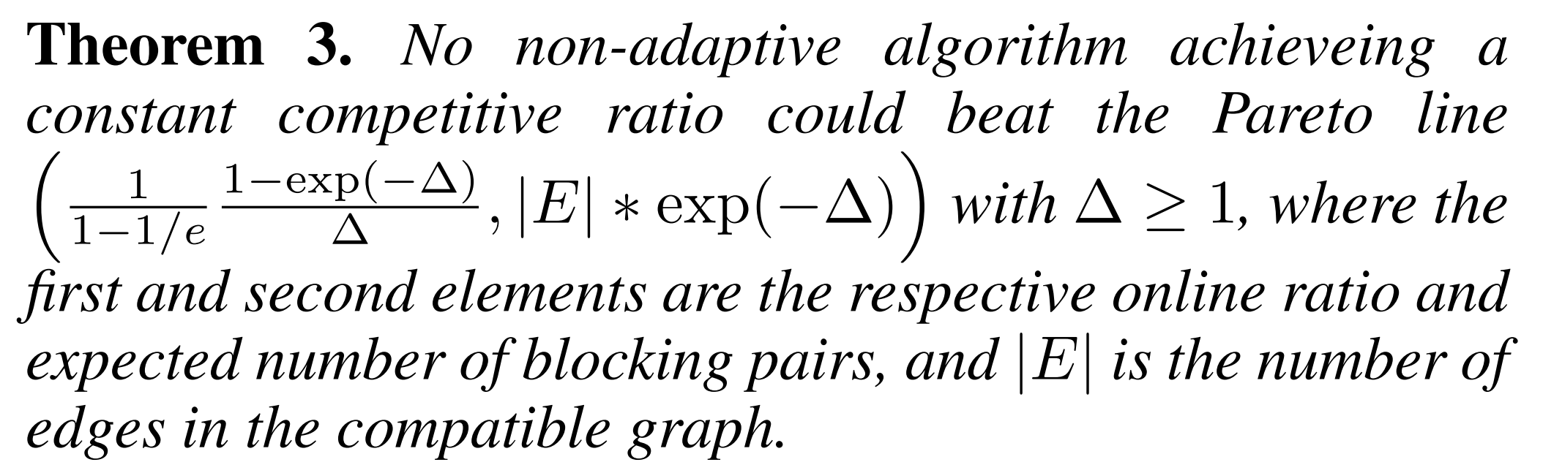
Pareto optimal
Our work focuses on two-objectives online stable matching in AAAI’19.
OBJ2
This area has
no algorithm.
OBJ1

Slide 30
Mechanism Design without Money

Slide 31



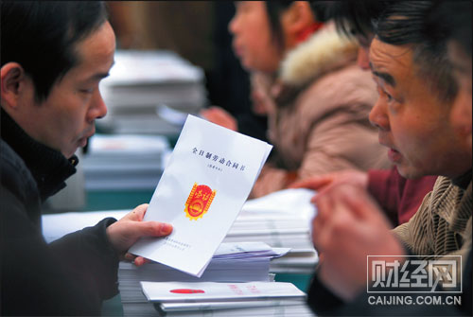
Without Money
Money is infeasible or illegal in some incentive applications. For example,
voting
organ donation
school choice
labor markets

Slide 32

House Allocation Problem
There are n agents, and each initially owns one house. Each has a total ordering over the n houses, and need not prefer their own over the others.
Question: how to sensibly reallocate the houses to make the agents better off?

Slide 33






Top Trading Cycle Algorithm
While agents remain:
Each remaining agent points to its favorite remaining house. This induces a directed graph G on the remaining agents in which every vertex has out-degree 1.
1
2
3
4
5

Slide 34
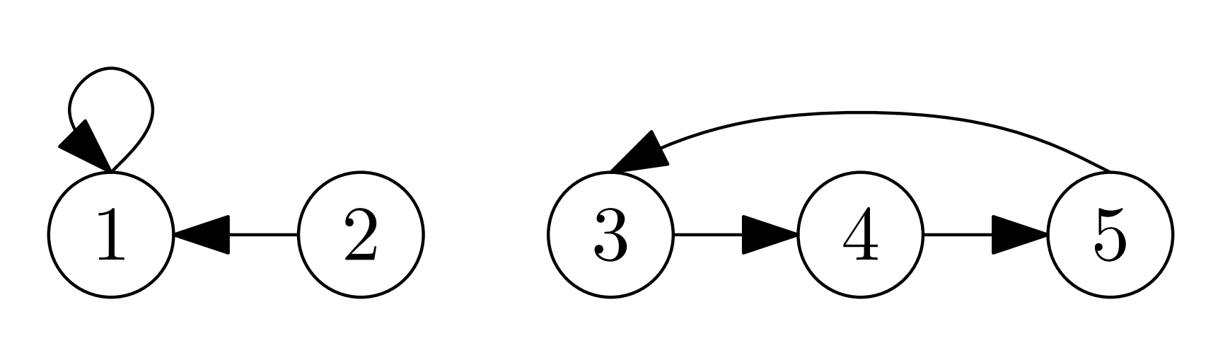
Top Trading Cycle Algorithm
While agents remain:
Each remaining agent points to its favorite remaining house. This induces a directed graph G on the remaining agents in which every vertex has out-degree 1.

Slide 35
Top Trading Cycle Algorithm
While agents remain:
The graph G has at least one directed cycle. Self-loops count as directed cycles.
Question 1. Why the graph has at least one directed cycle?

Slide 36
Top Trading Cycle Algorithm
While agents remain:
Reallocate as suggested by the directed cycles, with each agent on a directed cycle C giving its house to the agent that points to it, that is, to its predecessor on C.
Cycle 1
Cycle 2

Slide 37
Top Trading Cycle Algorithm
While agents remain:
Reallocate as suggested by the directed cycles, with each agent on a directed cycle C giving its house to the agent that points to it, that is, to its predecessor on C.
Cycle 2

Slide 38
Top Trading Cycle Algorithm
While agents remain:
Reallocate as suggested by the directed cycles, with each agent on a directed cycle C giving its house to the agent that points to it, that is, to its predecessor on C.
1
2
3
4
5

Slide 39
Top Trading Cycle Algorithm
While agents remain:
Delete the agents and the houses that were reallocated in the previous step.

Slide 40
Top Trading Cycle Algorithm
While agents remain:
Each remaining agent points to its favorite remaining house. This induces a directed graph G on the remaining agents in which every vertex has out-degree 1.
The graph G has at least one directed cycle. Self-loops count as directed cycles.
Reallocate as suggested by the directed cycles, with each agent on a directed cycle C giving its house to the agent that points to it, that is, to its predecessor on C.
Delete the agents and the houses that were reallocated in the previous step.

Slide 41
Top Trading Cycle Algorithm
While agents remain:
Delete the agents and the houses that were reallocated in the previous step.
Cycle 1

Slide 42
Top Trading Cycle Algorithm
While agents remain:
...
...
...
...
1
2
4
5
3

Slide 43
Top Trading Cycle Algorithm
While agents remain:
Each remaining agent points to its favorite remaining house. This induces a directed graph G on the remaining agents in which every vertex has out-degree 1.
The graph G has at least one directed cycle. Self-loops count as directed cycles.
Reallocate as suggested by the directed cycles, with each agent on a directed cycle C giving its house to the agent that points to it, that is, to its predecessor on C.
Delete the agents and the houses that were reallocated in the previous step.
Question 2. What is the time complexity of TTCA?

Slide 44
Top Trading Cycle Algorithm
Theorem: TTCA induces a DSIC mechanism.
Hint:
Suppose in the j-th iteration, N(j) agents are allocated due to the j-th cycle.
If the agent n in N(j) tells the lie, what will happen?
Question 3. Is the proof solid?

Slide 45
Top Trading Cycle Algorithm
Theorem: For every house allocation problem, the allocation computed by the TTCA is the unique core allocation.
Hint:
Core:
For any subset of agents S, k is the first iteration such that N(k)∩S is not empty.
Unique:
Suppose the TTCA is the core allocation.
N(1) is obviously unique, then what about N(2)?
Question 4. Is the proof solid?

Slide 46
Exercise

Slide 47

Exercise #35
Consider single-item auctions with known bidder budgets. Give a DSIC auction (possibly randomized) that is guaranteed to achieve (in expectation) at least a 1/n fraction of the maximum-possible surplus $\sum_{i}{v_{i}x_{i}}$.

Slide 48
Exercise #36
Continuing the previous exercise, prove that for every DSIC auction (possibly randomized), there is a valuation profile on which its expected surplus is O(1/n) times the maximum possible. For partial credit, prove this for deterministic DSIC auctions only.

Slide 49
Exercise #40
Consider a multi-unit auction where bidders have private valuations per unit and private budgets. We can still try to run the clinching auction, by asking bidders to report their budgets and running the mechanism with the reported budgets and valuations. Prove that this mechanism is not DSIC.

Slide 50
Exercise #40
Hint:
Dobzinski, Lavi, and Nisan (2008) offer the follow intuition: “If bidder A slightly delays reporting a demand decrease, bidder B will pay as a result a slightly higher price for his acquired items, which reduces his future demand. In turn, the fact that bidder B now has a lower demand implies that bidder A pays a lower price for future items...”

Slide 51
Exercise #41
Prove that the output of the TTCA is uniquely defined — that is, it is independent of which cycle is chosen in each iteration of the algorithm.
You should prove this directly, without relying on any facts about the core of the housing allocation problem.

Slide 52
Programming Exercise
TBD

Slide 53
Summary

Slide 54
Summary
Budget Constraint
The Clinching Auction
Market-Clearing Price Based Mechanism
which is not DSIC
Mechanism Design without Money
Top Trading Cycle Algorithm

Slide 55
Thanks
Any Questions ???

Slide 56
XXXX

Slide 57
XXXX

