Slide 1
Overview of Complexity Theory
yuxiang
2018/04/03

Slide 2
Outline
Problem and Computational Problem
Types of computational problems
P , NP and co-NP
NP-complete and NP-hard
RP, co-NP, ZPP, DTIME and ZTIME

Slide 3
Outline
Problem and Computational Problem
Types of computational problems
P , NP and co-NP
NP-complete and NP-hard
RP, co-NP, ZPP, DTIME and ZTIME

Slide 4
Problem and Computational Problem
Problem: There are all kinds of problems, e.g.
How old are you?
Is Beijing the capital of China?
What is the shortest distance between Beijing to Hong Kong?
Computational Problem: A mathemematical object representing a collection of questions that computers might able to solve.
w old are you?

Slide 5
Problem and Computational Problem
Problem: There are all kinds of problems, e.g.
How old are you?
Is Beijing the capital of China?
What is the shortest distance between Beijing to Hong Kong?
Computational Problem: A mathemematical object representing a collection of questions that computers might able to solve.
Is x is an odd?
How old are you?

Slide 6
Problem and Computational Problem
Problem: There are all kinds of problems, e.g.
How old are you?
Is Beijing the capital of China?
What is the shortest distance between Beijing to Hong Kong?
Computational Problem: A mathemematical object representing a collection of questions that computers might able to solve.
Is x is an odd?
How old are you?
It is an obvious computational problem.
It is not an obvious computational problem.

Slide 7
Outline
Problem and Computational Problem
Types of computational problems
P , NP and co-NP
NP-complete and NP-hard
RP, co-NP, ZPP, DTIME and ZTIME

Slide 8
Types of computational problems
Decision Problem
a problem that can be posed as a yes-no question of the input values
Input
Algorithm
YES
NO
Decision Problem

Slide 9
Types of computational problems
Decision Problem
a problem that can be posed as a yes-no question of the input values
Search Problem
a problem of searching all feasible solutions
Input
Algorithm
Sol. 1
Sol. 2
Sol. 3
Search Problem

Slide 10
Types of computational problems
Decision Problem
a problem that can be posed as a yes-no question of the input values
Search Problem
a problem of searching all feasible solutions
Optimization Problem
a problem of finding the best solution from all feasible solutions
Input
Algorithm
Sol. 1
Sol. 2
(Best)
Sol. 3
Optimization Problem

Slide 11
Types of computational problems
Decision Problem
a problem that can be posed as a yes-no question of the input values
Search Problem
a problem of searching all feasible solutions
Optimization Problem
a problem of finding the best solution from all feasible solutions
Counting Problem
a problem that asks for the number of solutions to a given search problem
Input
Algorithm
How many?
Sol. 1
Sol. 2
Sol. 3
Counting Problem

Slide 12
Outline
Problem and Computational Problem
Types of computational problems
P , NP and co-NP
NP-complete and NP-hard
RP, co-NP, ZPP, DTIME and ZTIME

Slide 13
P and NP
class P
consists of all decision problems that can be solved on a deterministic sequential machine in amount of time that is polynomial in the size of input

Slide 14
P and NP
class P
consists of all decision problems that can be solved on a deterministic sequential machine in amount of time that is polynomial in the size of input
classs NP
consists of all decision problems whose positive solutions can be verified (by certifier) in polynomial time given the right information
class EXP
consist of decision problems that can be solved by an exponential-time algorithm

Slide 15
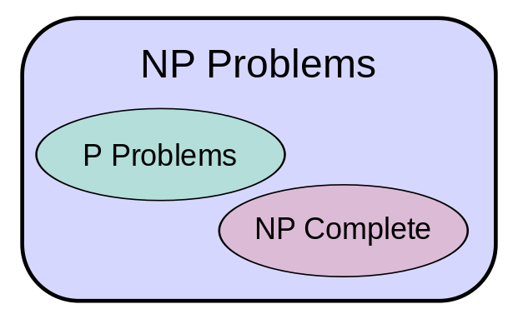
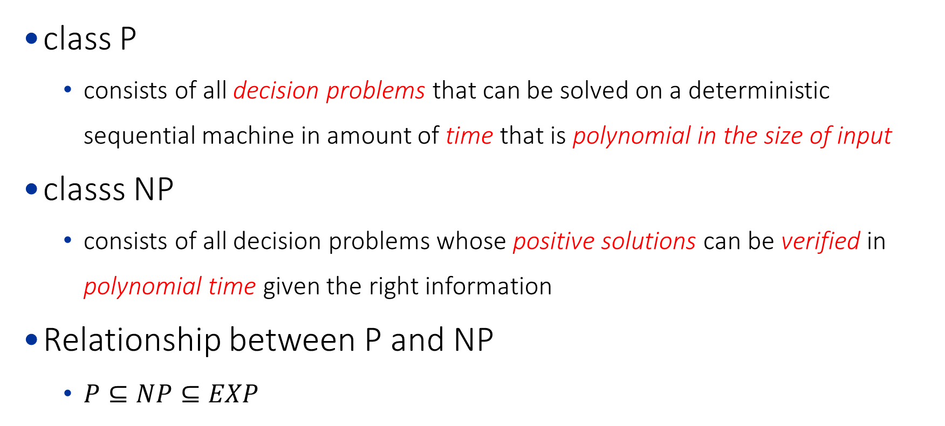
P and NP
class P
consists of all decision problems that can be solved on a deterministic sequential machine in amount of time that is polynomial in the size of input
classs NP
consists of all decision problems whose positive solutions can be verified in polynomial time given the right information
Relationship between P and NP
$P⊆NP⊆EXP$

Slide 16
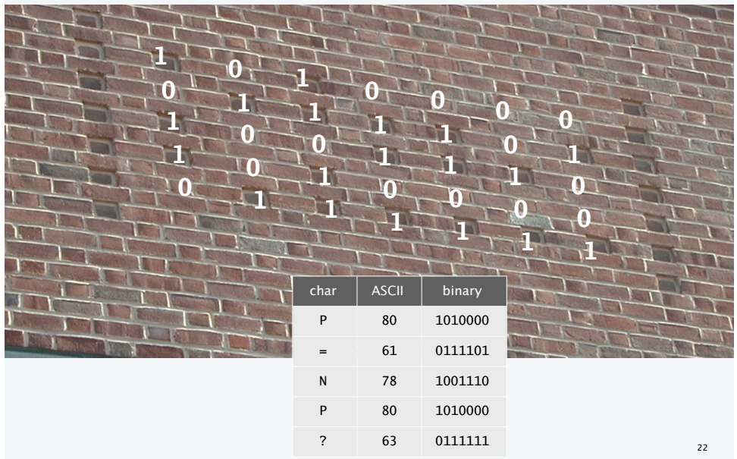
P and NP: Example
Example
class P:
Is an array is sorted?
Is the matching is stable?
class NP:
Is x is a prime?
Is P = NP?
Princeton CS Building, West Wall, Circa 2001

Slide 17
Outline
Problem and Computational Problem
Types of computational problems
P , NP and co-NP
NP-complete and NP-hard
RP, co-NP, ZPP, DTIME and ZTIME

Slide 18
NP and co-NP
classs NP
consists of all decision problems whose positive solutions can be verified in polynomial time.
class co-NP
consists of all decision problems whose complementary problem is in class NP
Example, given a finite set of integers,
class NP: it there a non-empty subset that sums to zero ?
class co-NP: does every non-empty subset have a non-zero sum?

Slide 19
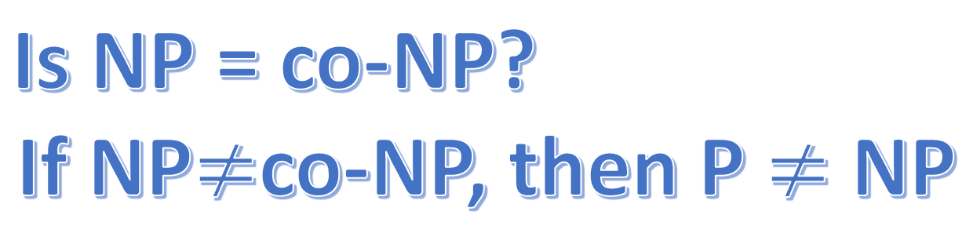
NP and co-NP
classs NP
consists of all decision problems whose positive solutions can be verified in polynomial time given the right information
class co-NP
consists of all decision problems whose complementary problem is in class NP
Is NP = co-NP?
If NP$≠$co-NP, then P $≠$ NP

Slide 20
Outline
Problem and Computational Problem
Types of computational problems
P , NP and co-NP
NP-complete and NP-hard
RP, co-NP, ZPP, DTIME and ZTIME

Slide 21
Polynomial transformation
Problem X polynomial (Cook) reduces to problem Y if arbitrary instances of problem X can be solved using:
Polynomial number of standard computational steps, plus
Polynomial number of calls to oracle that solves problem Y.
Problem X polynomial (Karp) transforms to problem Y if given any input x to X, we can construct an input y such that x is a yes instance of X iff y is a yes instance of Y.
Note. Polynomial transformation is polynomial reduction with just one call to oracle for Y, exactly at the end of the algorithm for X.

Slide 22
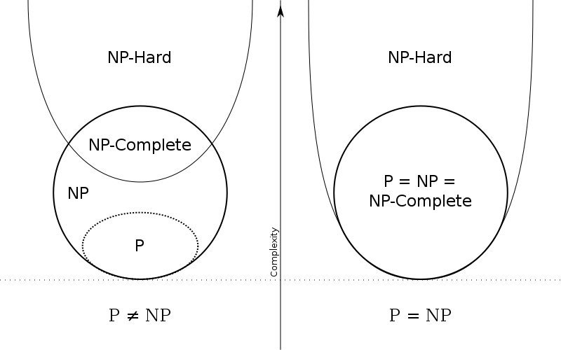
NP-complete and NP-hard
A decision problem X is NP-complete if:
X is in class NP
Every problem in class NP is reducible to X in polynomial time
A decision problem X is NP-hard if
Every problem in class NP is reducible to X in polynomial time

Slide 23
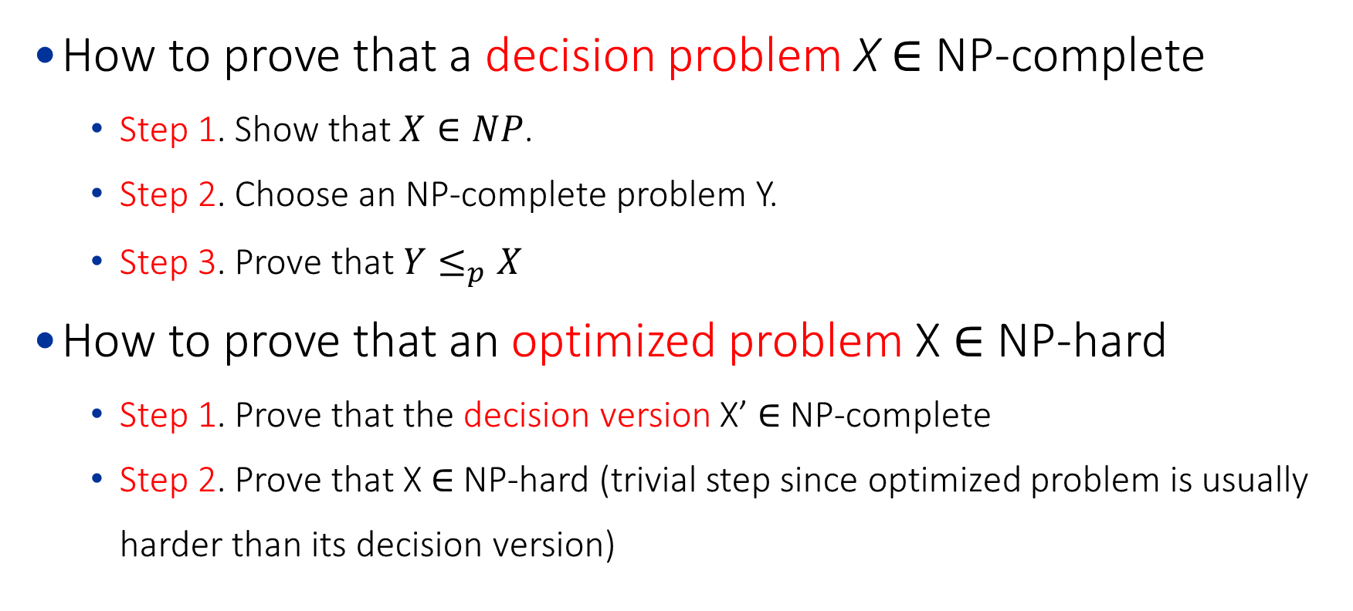
NP-complete and NP-hard
How to prove that a decision problem X $∈$ NP-complete
Step 1. Show that $X∈NP$.
Step 2. Choose an NP-complete problem Y.
Step 3. Prove that $Y≤_{p}X$
How to prove that an optimized problem X $∈$ NP-hard
Step 1. Prove that the decision version X’ $∈$ NP-complete
Step 2. Prove that X $∈$ NP-hard (trivial step since optimized problem is usually harder than its decision version)

Slide 24
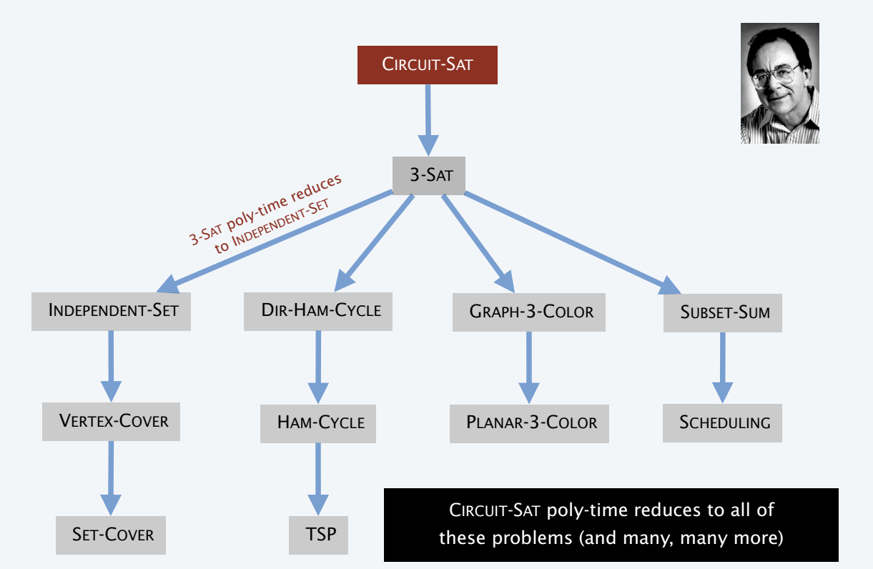
NP-complete and NP-hard: Reduction
Richard
Karp

Slide 25
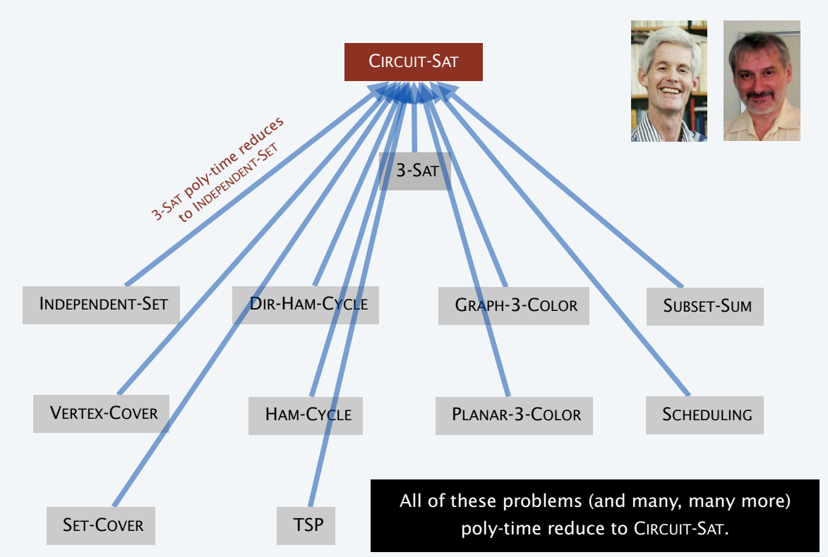
NP-complete and NP-hard: Reduction
Stephen Cook
Leonid
Levin

Slide 26
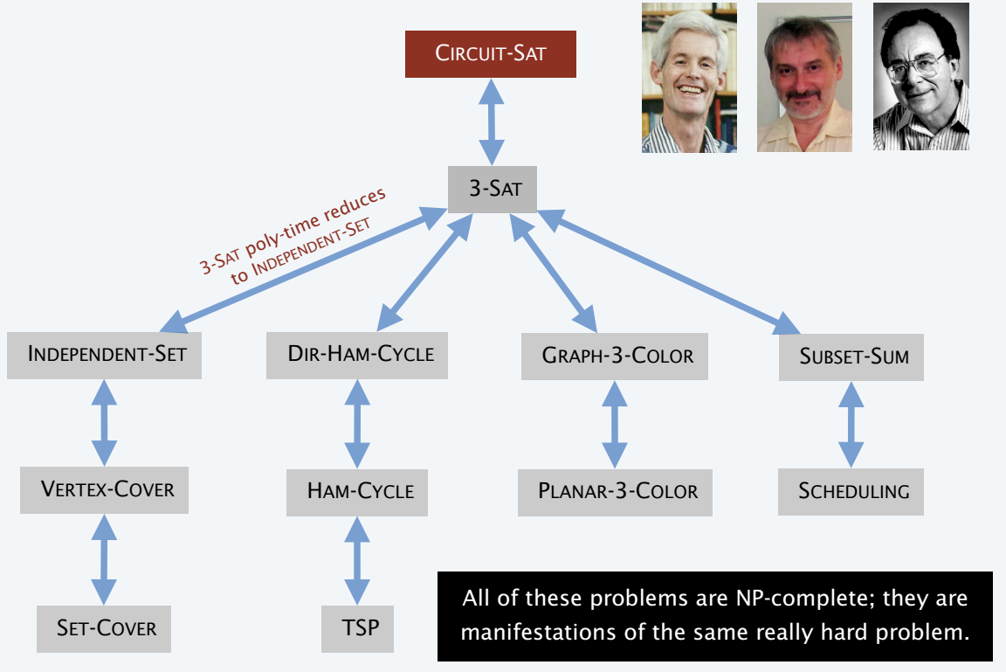
NP-complete and NP-hard: Reduction
Stephen Cook
Leonid
Levin
Richard
Karp

Slide 27
Outline
Problem and Computational Problem
Types of computational problems
P , NP and co-NP
NP-complete and NP-hard
RP, co-NP, ZPP, DTIME and ZTIME

Slide 28
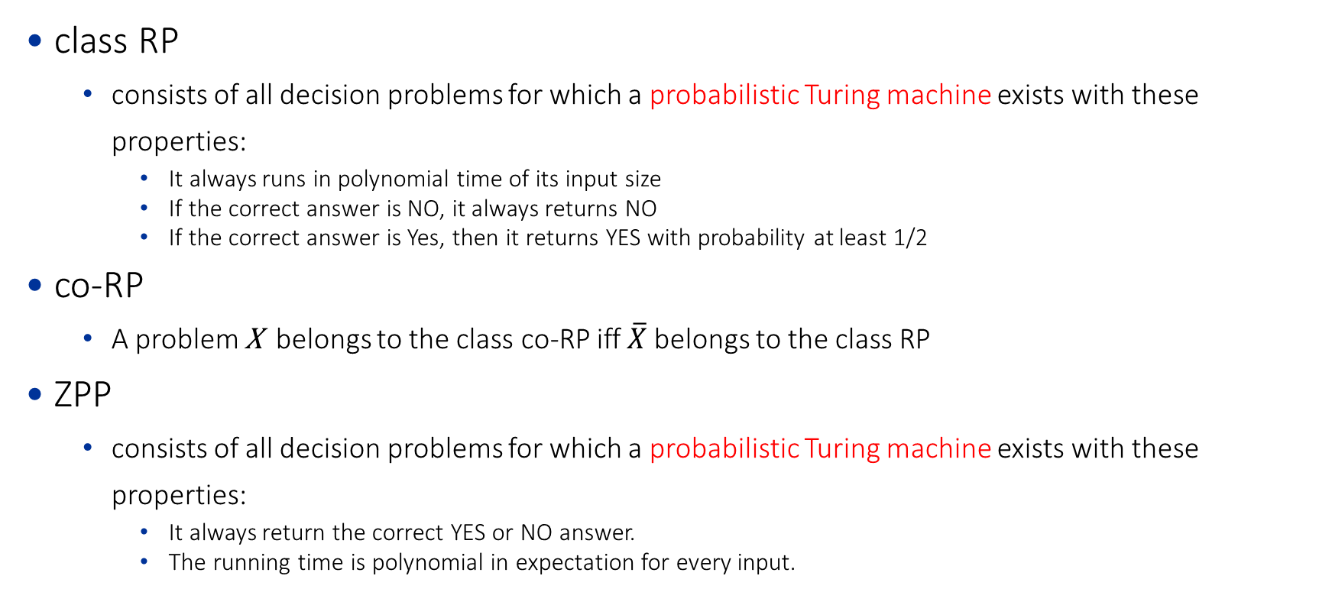
Complexity Theory of Randomized Algo.
class RP
consists of all decision problems for which a probabilistic Turing machine exists with these properties:
It always runs in polynomial time of its input size
If the correct answer is NO, it always returns NO
If the correct answer is Yes, then it returns YES with probability at least 1/2
co-RP
A problem X belongs to the class co-RP iff $\overline{X}$ belongs to the class RP
ZPP
consists of all decision problems for which a probabilistic Turing machine exists with these properties:
It always return the correct YES or NO answer.
The running time is polynomial in expectation for every input.

Slide 29

Complexity Theory of Randomized Algo.
class RP
consists of all decision problems for which a probabilistic Turing machine exists with these properties:
It always runs in polynomial time of its input size
If the correct answer is NO, it always returns NO
If the correct answer is Yes, then it returns YES with probability at least 1/2
co-RP
A problem X belongs to the class co-RP iff $\overline{X}$ belongs to the class RP
ZPP
consists of all decision problems for which a probabilistic Turing machine exists with these properties:
It always return the correct YES or NO answer.
The running time is polynomial in expectation for every input.
$$ZPP=RP∩co−RP$$

Slide 30
Outline
Problem and Computational Problem
Types of computational problems
P , NP and co-NP
NP-complete and NP-hard
RP, co-NP, ZPP, DTIME and ZTIME

Slide 31
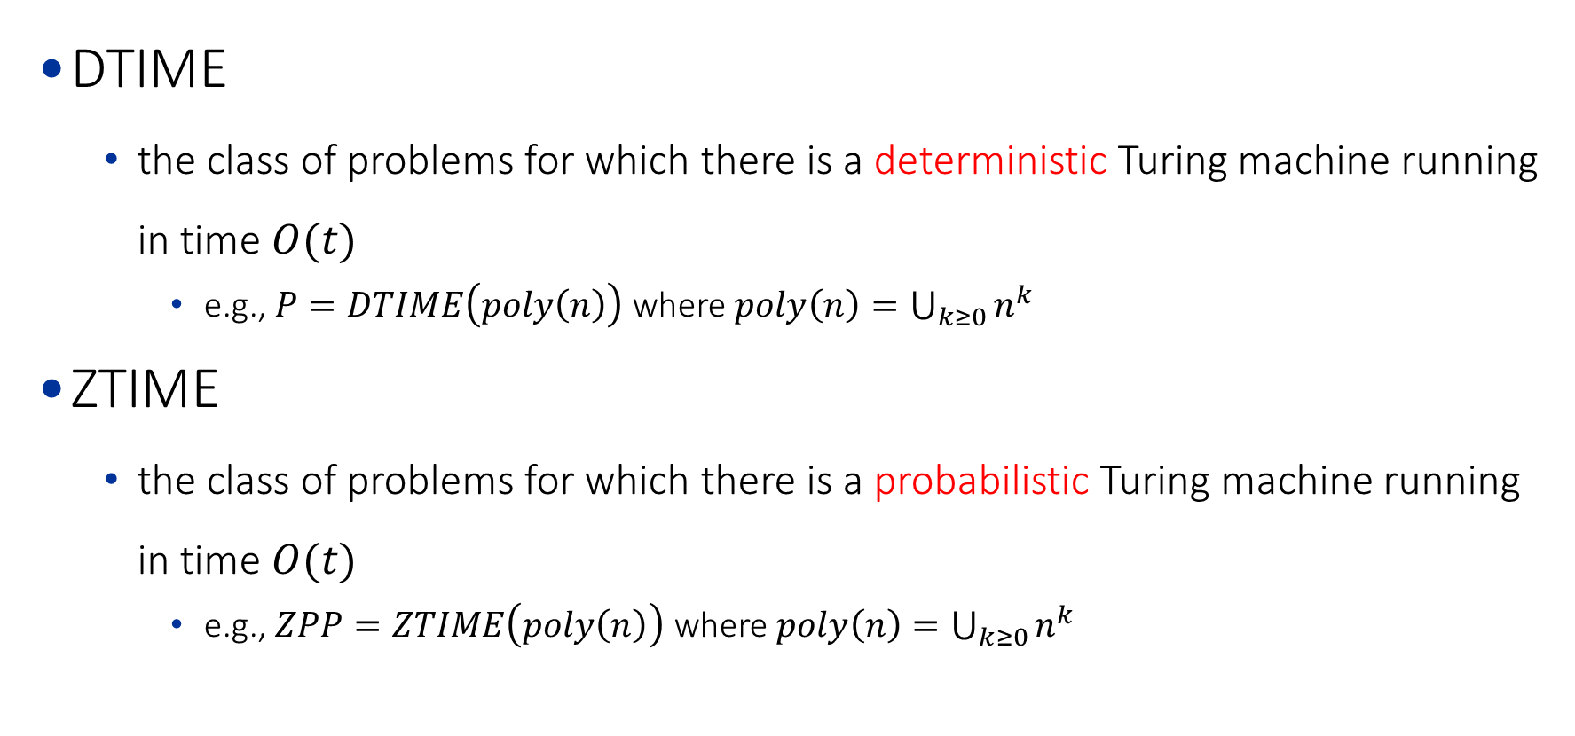
DTIME, ZTIME, etc
DTIME
the class of problems for which there is a deterministic Turing machine running in time $O(t)$
e.g., $P=DTIME\left(poly\left(n\right)\right)$ where $poly\left(n\right)=\bigcup_{k≥0}{n^{k}}$
ZTIME
the class of problems for which there is a probabilistic Turing machine running in time $O(t)$
e.g., $ZPP=ZTIME\left(poly\left(n\right)\right)$ where $poly\left(n\right)=\bigcup_{k≥0}{n^{k}}$

