Slide 1
Approximation Algorithms: Chapter 1 Introduction
yuxiang
2018/04/03

Slide 2
Outline
Preliminary
Example: Vertex Cover
Definition
Approximation Algorithm
Summary

Slide 3
Outline
Preliminary
Example: Vertex Cover
Definition
Approximation Algorithm
Summary

Slide 4
Introduction: Preliminary
Question: How to solve an NP-hard problem.

Slide 5
Introduction: Preliminary
Question: How to solve an NP-hard problem.
Scarifice one of three desired features.
Solve arbitrary instances of the problem .
Solve problem to optimality.
Solve problem in polynomial time.

Slide 6
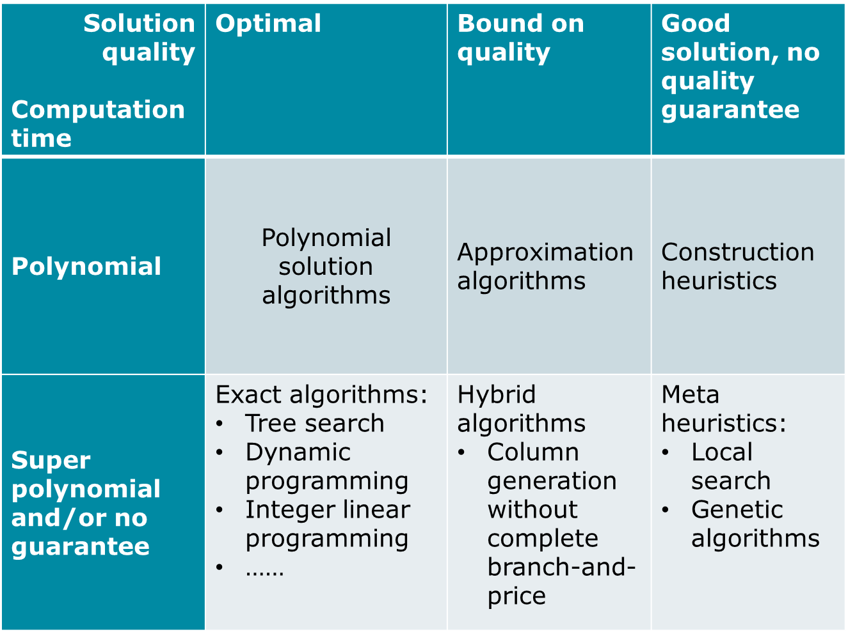
Introduction: Categories of Algorithm

Slide 7
Introduction: Definition of Approx.
Approximation Algorithm: Definition
Given an optimization problem P, an algorithm A is said to be an approximation algorithm for P, if for any given instance I, it returns an approximate solution, that is a feasible solution.

Slide 8
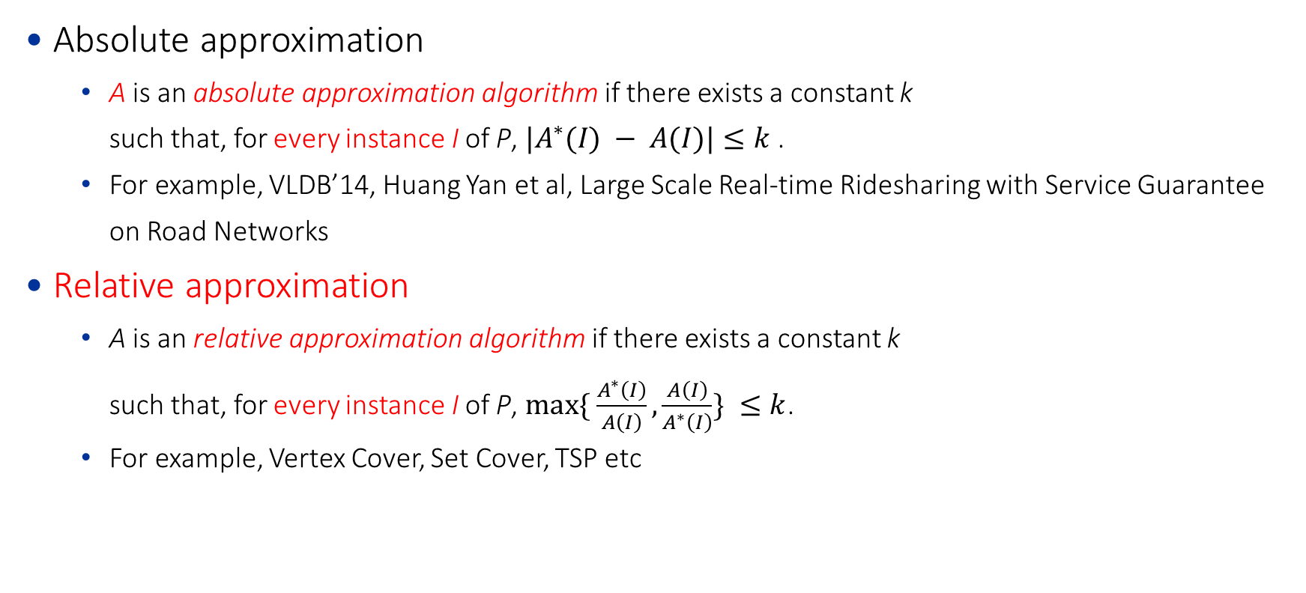
Introduction: Types of Approx.
Absolute approximation
A is an absolute approximation algorithm if there exists a constant k such that, for every instance I of P, $|A^{∗}(I) − A(I)|≤k$.
For example, VLDB’14, Huang Yan et al, Large Scale Real-time Ridesharing with Service Guarantee on Road Networks
Relative approximation
A is an relative approximation algorithm if there exists a constant k such that, for every instance I of P, $max⁡\{ \frac{A^{∗}\left(I\right)}{A\left(I\right)},\frac{A\left(I\right)}{A^{∗}\left(I\right)}\} ≤k$.
For example, Vertex Cover, Set Cover, TSP etc

Slide 9
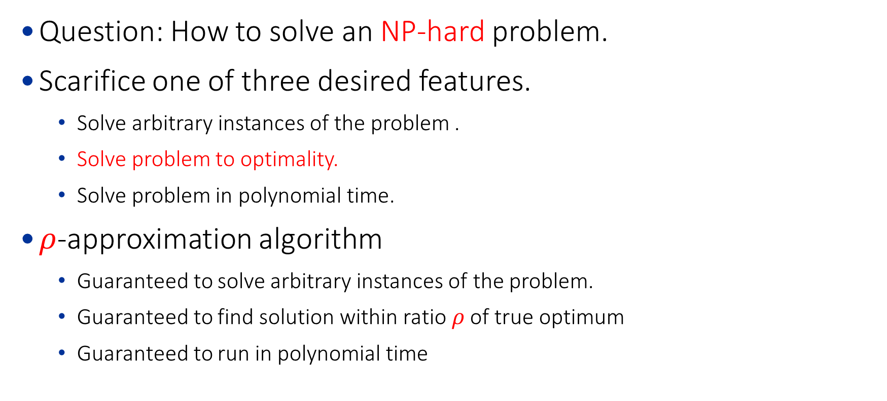
Introduction: Basic
Question: How to solve an NP-hard problem.
Scarifice one of three desired features.
Solve arbitrary instances of the problem .
Solve problem to optimality.
Solve problem in polynomial time.
$ρ$-approximation algorithm
Guaranteed to solve arbitrary instances of the problem.
Guaranteed to find solution within ratio $ρ$ of true optimum
Guaranteed to run in polynomial time

Slide 10
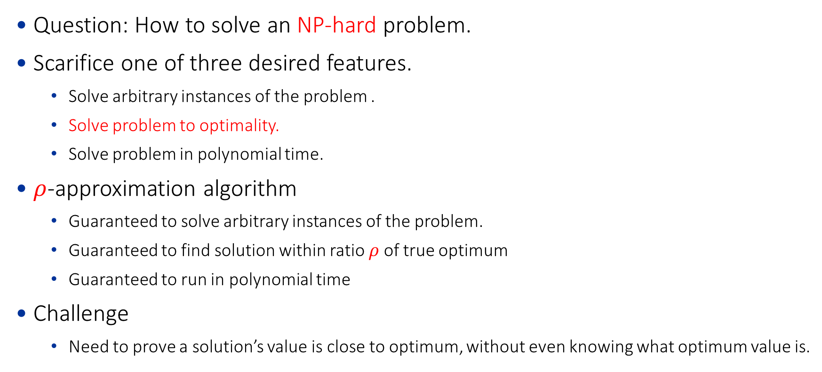
Introduction: Preliminary
Question: How to solve an NP-hard problem.
Scarifice one of three desired features.
Solve arbitrary instances of the problem .
Solve problem to optimality.
Solve problem in polynomial time.
$ρ$-approximation algorithm
Guaranteed to solve arbitrary instances of the problem.
Guaranteed to find solution within ratio $ρ$ of true optimum
Guaranteed to run in polynomial time
Challenge
Need to prove a solution’s value is close to optimum, without even knowing what optimum value is.

Slide 11
Outline
Preliminary
Example: Vertex Cover
Definition
Approximation Algorithm
Summary

Slide 12

Introduction: Definition of Vertex Cover
Input:
Given an undirected graph $G=\left(V,E\right)$
Objective:
find a set $V^{′}$ with minimal number of vertex such that
Constraint:
for each edge $(u,v)∈E$, either $u∈V′$ or $v∈V′$

Slide 13
Vertex Cover: Example
v6
v6
v2
v2
v8
v5
v8
v5
v1
v1
v7
v7
v3
v3
Fig. 1. An instance of graph
Fig. 2. An example of approx. solution
v6
v2
v2
v5
v8
v5
v8
v1
v1
v7
v7
v3
v3
Fig. 3. An example of optimal solution
Fig. 4. Another example of optimal solution

Slide 14
Outline
Preliminary
Example: Vertex Cover
Definition
Approximation Algorithm
Summary

Slide 15
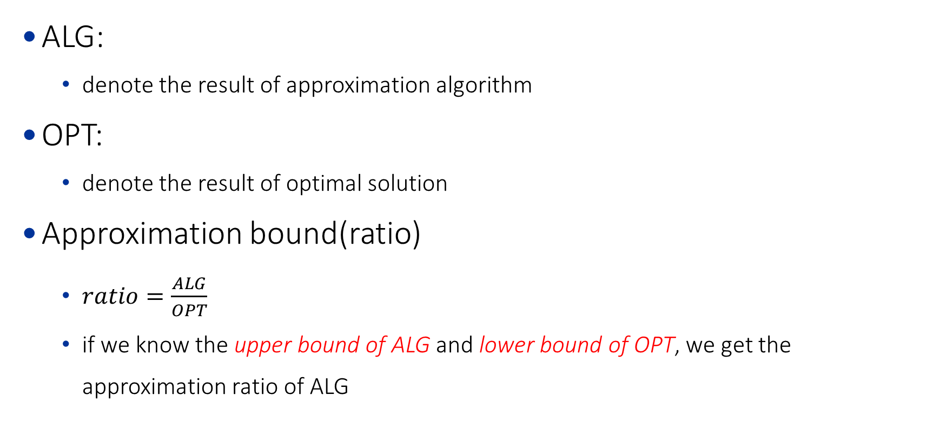
Vertex Cover: Notations
ALG:
denote the result of approximation algorithm
OPT:
denote the result of optimal solution
Approximation bound(ratio)
$ratio=\frac{ALG}{OPT}$
if we know the upper bound of ALG and lower bound of OPT, we get the approximation ratio of ALG
Notes:
ALG <= X, OPT >= Y, ratio <= X/Y.

Slide 16
Vertex Cover: Approx. Algorithm
My Own Experience
Usually, upper bound of ALG can be easily calculated since it is your designed algorithm.
It is more challenge to obtain the lower bound of OPT.
Different lower bound may yield different approximation ratio.
What is lower bound of vertex Cover
A matching-based lower bound.

Slide 17



Vertex Cover: Lower bound of OPT
Matching of Graph
Given a graph $G=(V,E)$, a subset of edges $M⊆E$ is said to be a matching if no edges of M share an endpoint.
v6
v6
v6
v2
v2
v2
v5
v8
v5
v8
v5
v8
v1
v1
v1
v7
v7
v7
v3
v3
v3
Fig. 1. An instance of graph
Fig. 2. An example of cover
Fig. 3. An example of matching
$$V^{′}=\{v2,v3,v6,v7\}$$
$$M^{∗}=\{(v1,v2),(v3,v5),(v6,v8)\}$$

Slide 18
Vertex Cover: Lower bound of OPT
Matching of Graph
maximal matching: A matching M is said to be maximal if M is not properly contained in any other matching
v6
v6
v2
v2
v5
v5
v1
v1
v7
v7
v3
v3
Fig. 1. An instance of graph
Fig. 2. An example of maximal matching

Slide 19
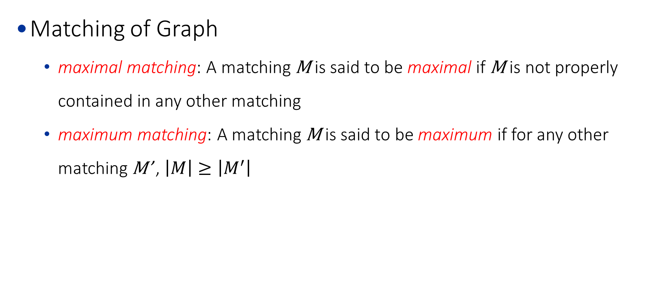
Vertex Cover: Lower bound of OPT
Matching of Graph
maximal matching: A matching M is said to be maximal if M is not properly contained in any other matching
maximum matching: A matching M is said to be maximum if for any other matching M’ , $\left|M\right|≥\left|M^{′}\right|$
v6
v6
v6
v2
v2
v2
v5
v5
v5
v1
v1
v1
v7
v7
v7
v3
v3
v3
Fig. 1. An instance of graph
Fig. 2. An example of maximal matching
Fig. 3. An example of maximum matching

Slide 20
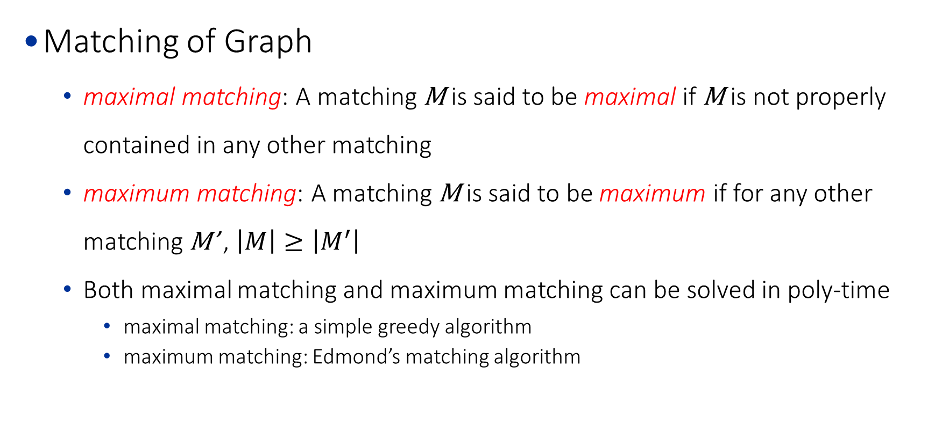
Vertex Cover: Lower bound of OPT
Matching of Graph
maximal matching: A matching M is said to be maximal if M is not properly contained in any other matching
maximum matching: A matching M is said to be maximum if for any other matching M’ , $\left|M\right|≥\left|M^{′}\right|$
Both maximal matching and maximum matching can be solved in poly-time
maximal matching: a simple greedy algorithm
maximum matching: Edmond’s matching algorithm

Slide 21
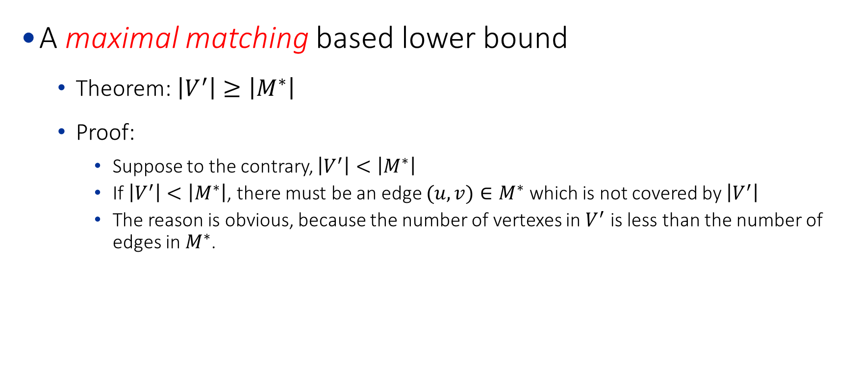
Vertex Cover: Lower bound of OPT
A maximal matching based lower bound
Theorem: $\left|V^{′}\right|≥\left|M^{∗}\right|$
Proof:
Suppose to the contrary, $\left|V^{′}\right|<\left|M^{∗}\right|$
If $\left|V^{′}\right|<\left|M^{∗}\right|$, there must be an edge $(u,v)∈M^{∗}$ which is not covered by $\left|V^{′}\right|$
The reason is obvious, because the number of vertexes in $V^{′}$ is less than the number of edges in $M^{∗}$.

Slide 22
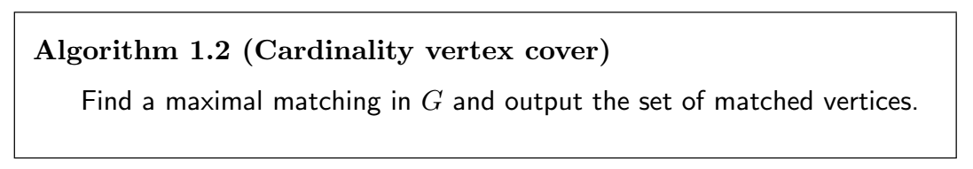

Vertex Cover: Upper bound of ALG
A maximal matching-based algorithm
$ALG=\left\{u \right| (u,v)∈M^{∗}\}∪$ $\left\{v \right| (u,v)∈M^{∗}\}$
Upper bound of ALG
It is obvious that $\left|ALG\right|=2\left|M^{∗}\right|≤2\left|M^{∗}\right|$
the ratio is $\frac{ALG}{OPT}≤\frac{2\left|M^{∗}\right|}{\left|M^{∗}\right|}=2$

Slide 23
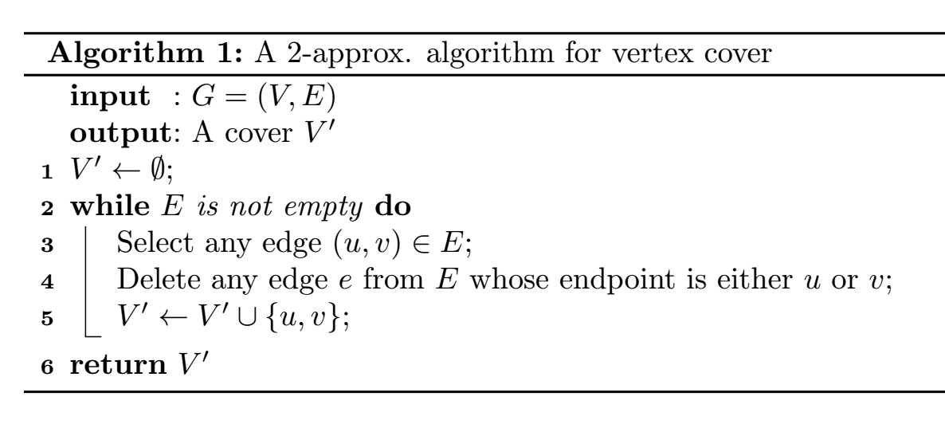
Vertex Cover: 2-Approx. Algorithm
A 2-approx. algorithm

Slide 24
Vertex Cover: 2-Approx. Algorithm
A 2-approx. algorithm: Example
v6
v2
v5
v8
v1
v7
v3
Fig. 1. An instance of graph
step | V’ | E
0 | {} | {(v1,v2),(v1,v3),(v2,v3),(v2,v5),(v3,v5),(v3,v7),(v5,v7),(v5,v6),(v6,v8),(v7,v8)}

Slide 25
Vertex Cover: 2-Approx. Algorithm
A 2-approx. algorithm: Example
v6
v2
v5
v8
v1
v7
v3
Fig. 1. An instance of graph
step | V’ | E
0 | {} | {(v1,v2),(v1,v3),(v2,v3),(v2,v5),(v3,v5),(v3,v7),(v5,v7),(v5,v6),(v6,v8),(v7,v8)}
1 | {v1,v2} | {(v3,v5),(v3,v7),(v5,v7),(v5,v6),(v6,v8),(v7,v8)}

Slide 26
Vertex Cover: 2-Approx. Algorithm
A 2-approx. algorithm: Example
v6
v2
v5
v8
v1
v7
v3
Fig. 1. An instance of graph
step | V’ | E
1 | {v1,v2} | {(v3,v5),(v3,v7),(v5,v7),(v5,v6),(v6,v8),(v7,v8)}
2 | {v1,v2,v3,v5} | {(v6,v8),(v7,v8)}

Slide 27
Vertex Cover: 2-Approx. Algorithm
A 2-approx. algorithm: Example
v6
v2
v5
v8
v1
v7
v3
Fig. 1. An instance of graph
step | V’ | E
2 | {v1,v2,v3,v5} | {(v6,v8),(v7,v8)}
3 | {v1,v2,v3,v5,v6,v8} | {}

Slide 28

Vertex Cover: Another view
What if you do not know matching?
Then always try GREEDY first.
A Greedy based algorithm
Theorem. ${|V}^{∗}|≥\frac{1}{2}\left|V^{′}\right|$
Proof.
According to the definition of vertex cover, for any edge selected at each step ($\left|V^{′}\right|/2$ steps in total), there must be either $u_{i}$ or $v_{i}$ in $V^{∗}$.
Then $V^{∗}$ must contain at least $\left|V^{′}\right|/2$ vertex.
Therefore,${|V}^{∗}|≥\frac{1}{2}\left|V^{′}\right|$.

Slide 29
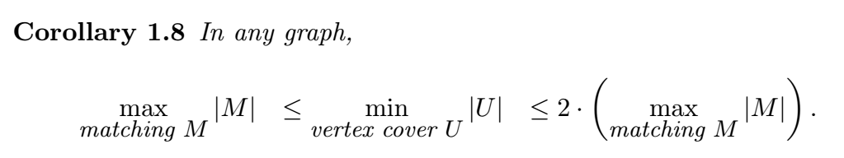
Vertex Cover: Other theorems
min-max theorem

Slide 30
Outline
Preliminary
Example: Vertex Cover
Definition
Approximation Algorithm
Summary

Slide 31
Summary of Chapter 1
The core step is to find the lower bound of OPT.

