Slide 1
Approximation Algorithms Chapter 10: Minimum Makespan Scheduling
Vijay V. Vazirani Georgia Institute of Technology
Zeng Yuxiang
2018/05/10

Slide 2
Outline
Chapter 10: Minimum Makespan Scheduling
Definition
Basics
Algorithms
Conclusions

Slide 3
Outline
Chapter 10: Minimum Makespan Scheduling
Definition
Basics
Algorithms
Conclusions

Slide 4

Min. Makespan Scheduling: Def.
Given: a set of $n$ jobs $P=\{p_{1},⋯p_{n}\}$ and $m$identical machine
Objective: find an assignment of jobs to the machines so that the completion time, a.k.a., makespan is minimized

Slide 5
Bin Packing
Example
objects
size | 4 | 8 | 1 | 4 | 2 | 1
shape
Bin
How many bins we must use?

Slide 6


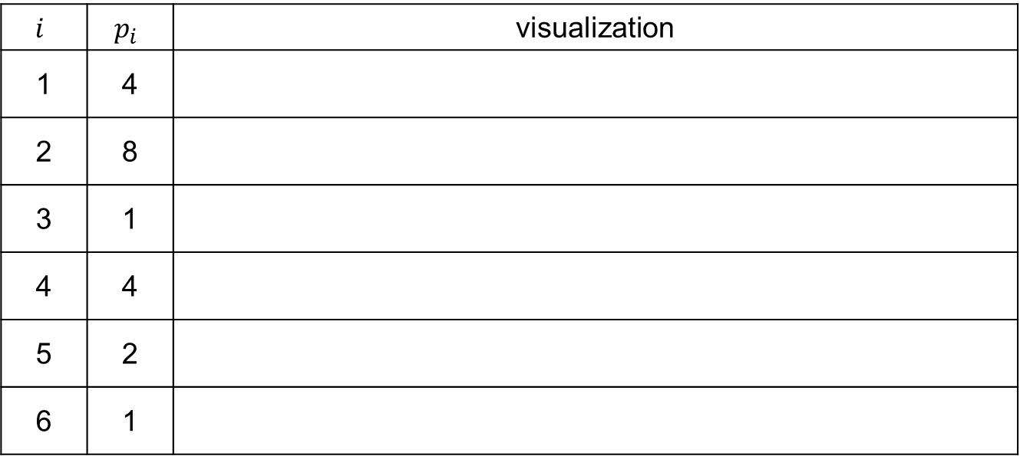
Min. Makespan Scheduling
Example: $n=6,m=2$
$$i$$ | $$p_{i}$$ | visualization
1 | 4
2 | 8
3 | 1
4 | 4
5 | 2
6 | 1

Slide 7
Outline
Chapter 10: Minimum Makespan Scheduling
Definition
Basics
Algorithms
Conclusions

Slide 8
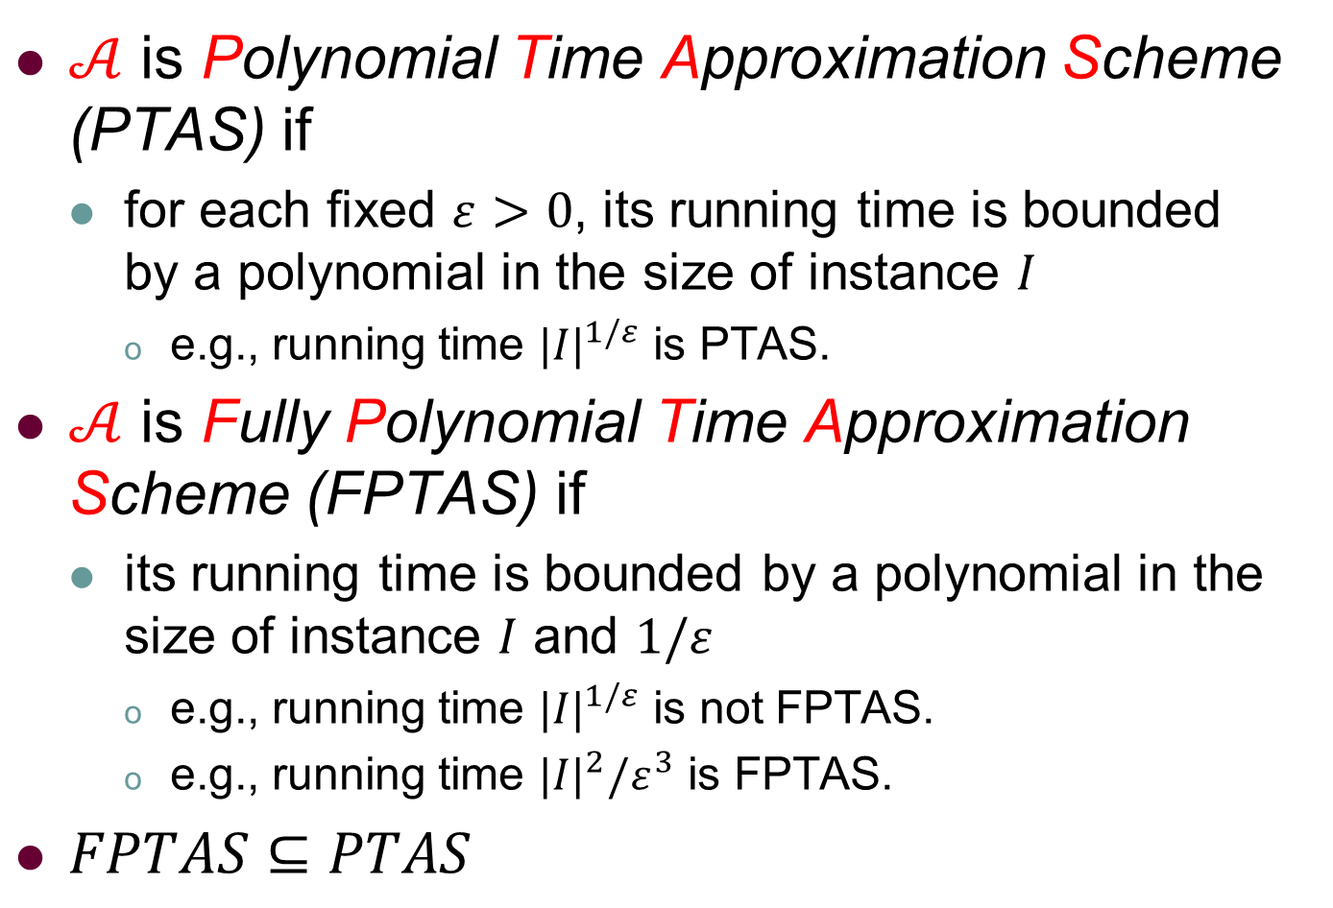
Basics: PTAS vs FPTAS
$𝒜$ is Polynomial Time Approximation Scheme (PTAS) if
for each fixed $ε>0$, its running time is bounded by a polynomial in the size of instance $I$
e.g., running time ${|I|}^{1/ε}$ is PTAS.
$𝒜$ is Fully Polynomial Time Approximation Scheme (FPTAS) if
its running time is bounded by a polynomial in the size of instance $I$ and $1/ε$
e.g., running time ${|I|}^{1/ε}$ is not FPTAS.
e.g., running time ${|I|}^{2}/ε^{3}$ is FPTAS.
$FPTAS⊆PTAS$

Slide 9
Outline
Chapter 10: Minimum Makespan Scheduling
Definition
Basics
Algorithms
Conclusions

Slide 10
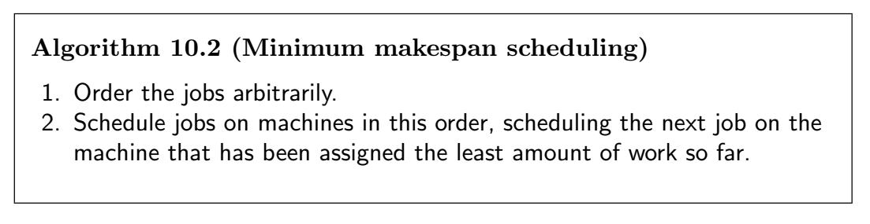
Algorithms: A 2-approx. algorithm

Slide 11
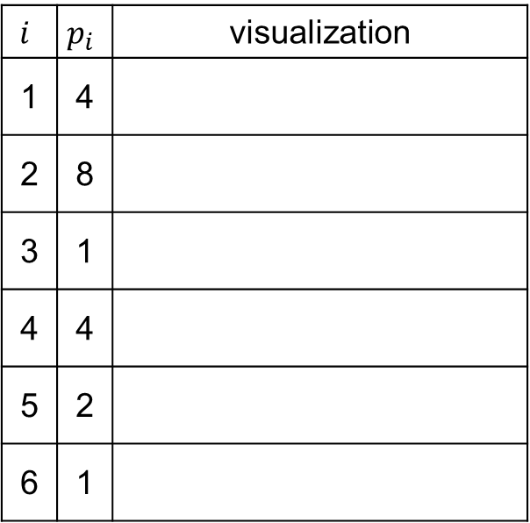
Algorithms: A 2-approx. algorithm
$$i$$ | $$p_{i}$$ | visualization
1 | 4
2 | 8
3 | 1
4 | 4
5 | 2
6 | 1
0
0

Slide 12
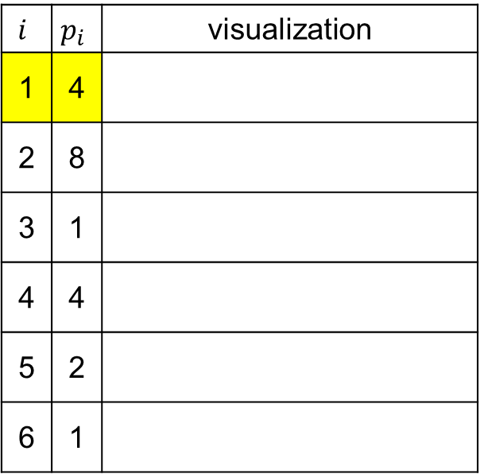
Algorithms: A 2-approx. algorithm
$$i$$ | $$p_{i}$$ | visualization
1 | 4
2 | 8
3 | 1
4 | 4
5 | 2
6 | 1
0→4
0

Slide 13
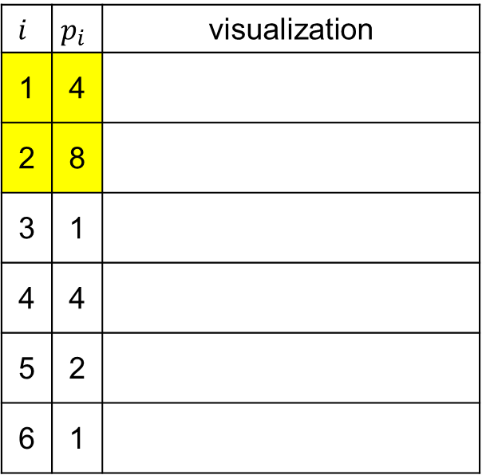
Algorithms: A 2-approx. algorithm
$$i$$ | $$p_{i}$$ | visualization
1 | 4
2 | 8
3 | 1
4 | 4
5 | 2
6 | 1
4
0→8

Slide 14
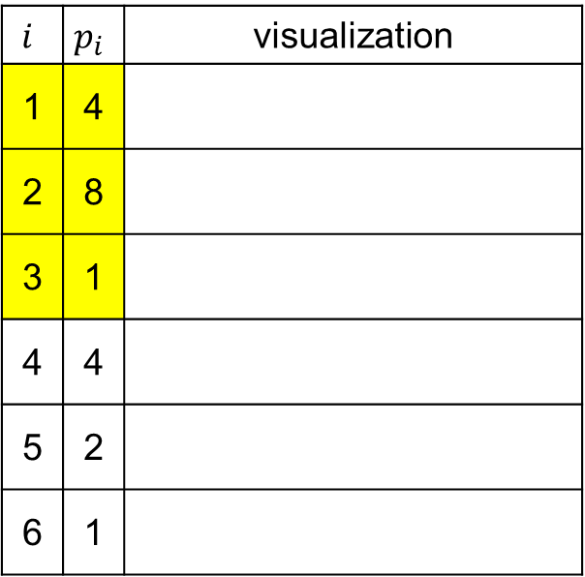
Algorithms: A 2-approx. algorithm
$$i$$ | $$p_{i}$$ | visualization
1 | 4
2 | 8
3 | 1
4 | 4
5 | 2
6 | 1
4→5
8

Slide 15
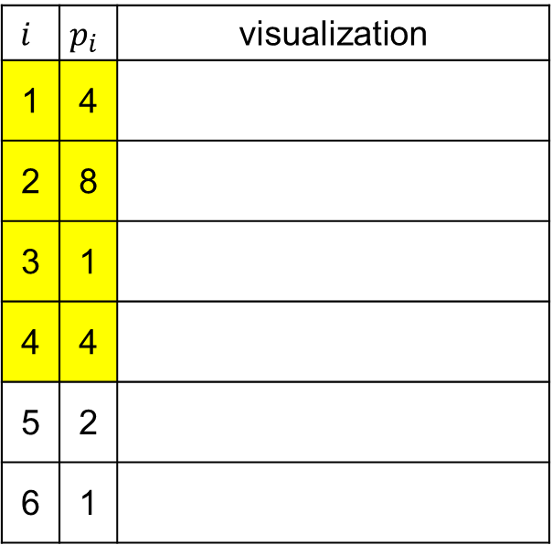
Algorithms: A 2-approx. algorithm
$$i$$ | $$p_{i}$$ | visualization
1 | 4
2 | 8
3 | 1
4 | 4
5 | 2
6 | 1
5→9
8

Slide 16
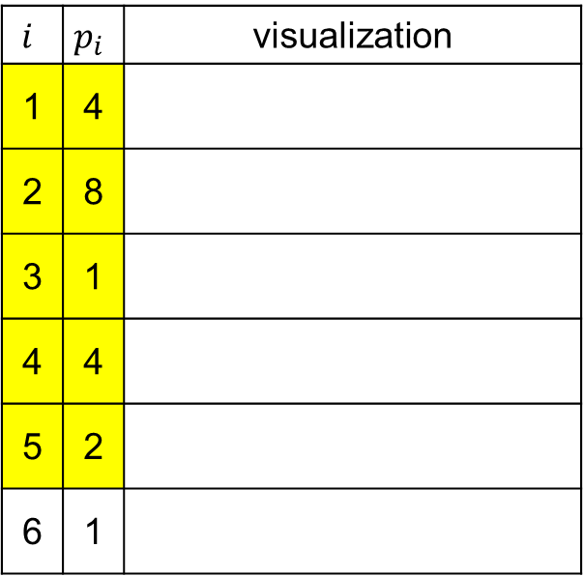
Algorithms: A 2-approx. algorithm
$$i$$ | $$p_{i}$$ | visualization
1 | 4
2 | 8
3 | 1
4 | 4
5 | 2
6 | 1
9
8→10

Slide 17
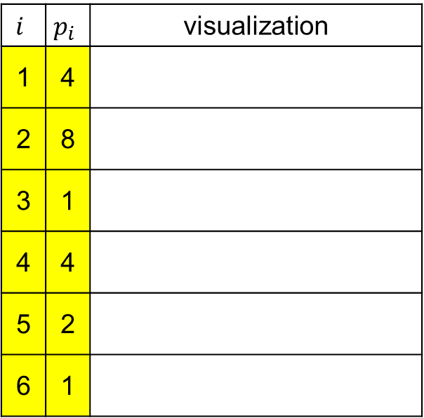
Algorithms: A 2-approx. algorithm
$$i$$ | $$p_{i}$$ | visualization
1 | 4
2 | 8
3 | 1
4 | 4
5 | 2
6 | 1
9→10
10

Slide 18
Algorithms: A 2-approx. algorithm
If two machines process all the assigned jobs in parallel,
the makespan is 10.
$$i$$ | $$p_{i}$$ | visualization
1 | 4
2 | 8
3 | 1
4 | 4
5 | 2
6 | 1
10
10

Slide 19

Algorithms: A 2-approx. algorithm
Lower bound(Naughton rule)
$OPT≥max⁡\{\frac{1}{m}\sum_{i=1}^{n}{p_{i}},\max_{i}{\{p_{i}\}}\}$
Average
bottleneck

Slide 20
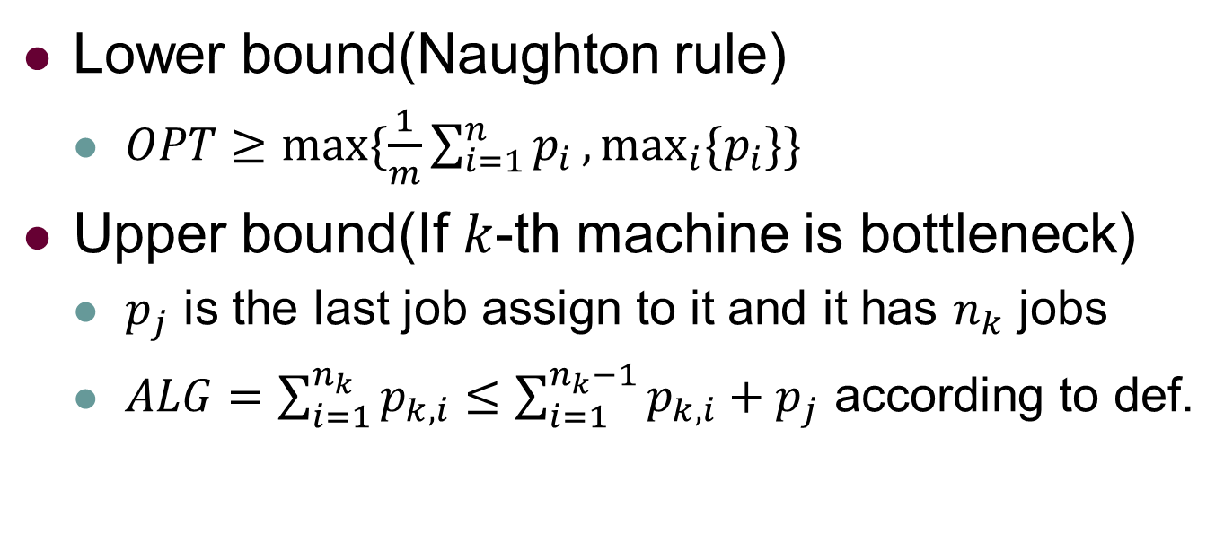
Algorithms: A 2-approx. algorithm
Lower bound(Naughton rule)
$OPT≥max⁡\{\frac{1}{m}\sum_{i=1}^{n}{p_{i}},\max_{i}{\{p_{i}\}}\}$
Upper bound(If $k$-th machine is bottleneck)
$p_{j}$ is the last job assign to it and it has $n_{k}$ jobs
$ALG=\sum_{i=1}^{n_{k}}{p_{k,i}}≤\sum_{i=1}^{n_{k}−1}{p_{k,i}}+p_{j}$ according to def.

Slide 21
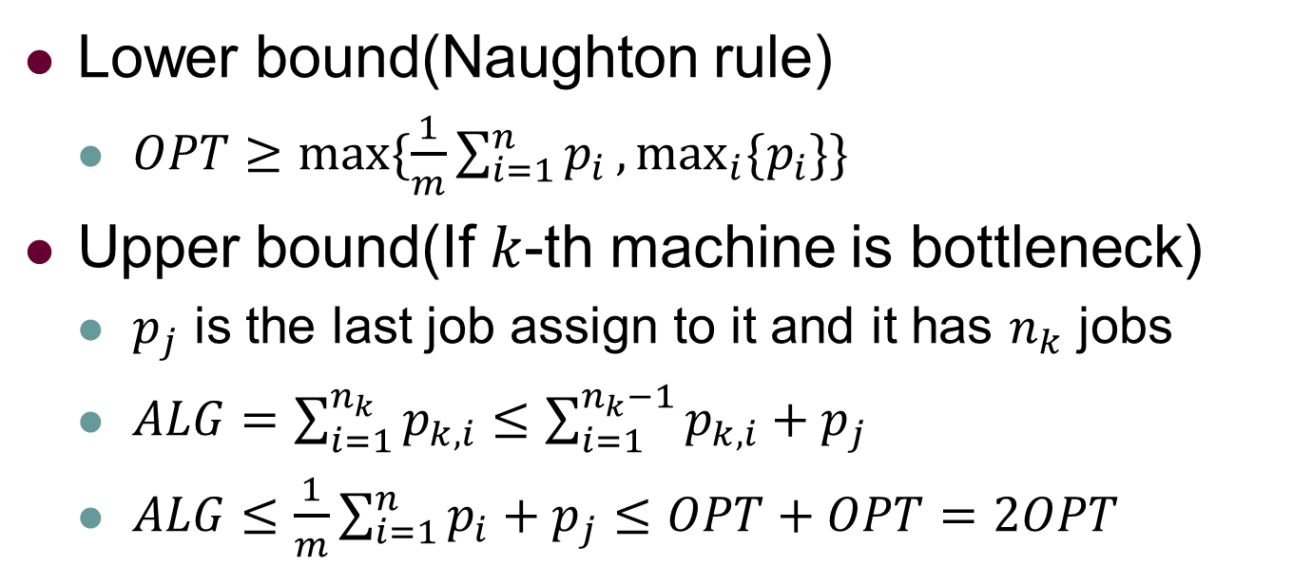
Algorithms: A 2-approx. algorithm
Lower bound(Naughton rule)
$OPT≥max⁡\{\frac{1}{m}\sum_{i=1}^{n}{p_{i}},\max_{i}{\{p_{i}\}}\}$
Upper bound(If $k$-th machine is bottleneck)
$p_{j}$ is the last job assign to it and it has $n_{k}$ jobs
$ALG=\sum_{i=1}^{n_{k}}{p_{k,i}}≤\sum_{i=1}^{n_{k}−1}{p_{k,i}}+p_{j}$
$ALG≤\frac{1}{m}\sum_{i=1}^{n}{p_{i}}+p_{j}≤OPT+OPT=2OPT$

Slide 22
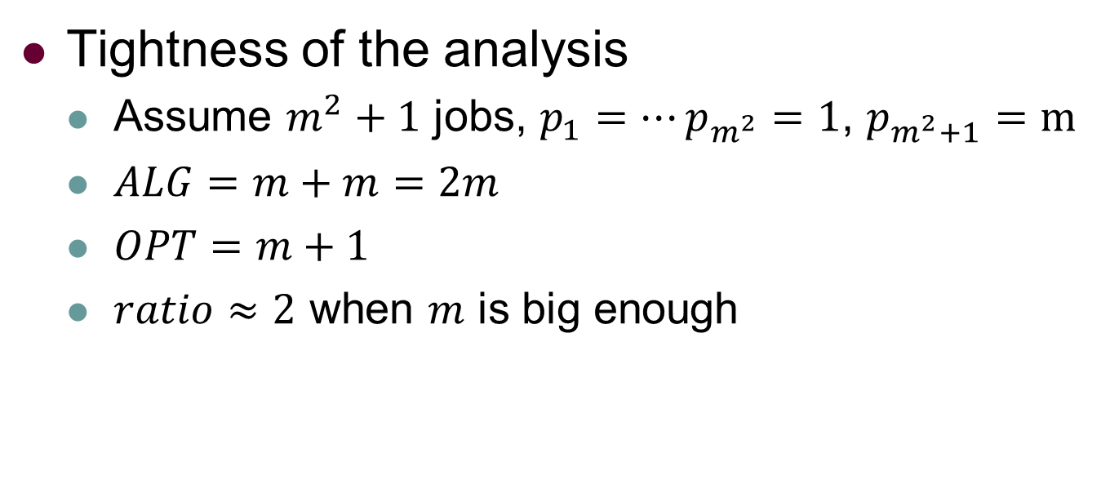
Algorithms: A 2-approx. algorithm
Tightness of the analysis
Assume $m^{2}+1$ jobs, $p_{1}=⋯p_{m^{2}}=1$, $p_{m^{2}+1}=m$
$ALG=m+m=2m$
$OPT=m+1$
$ratio≈2$ when $m$ is big enough

Slide 23
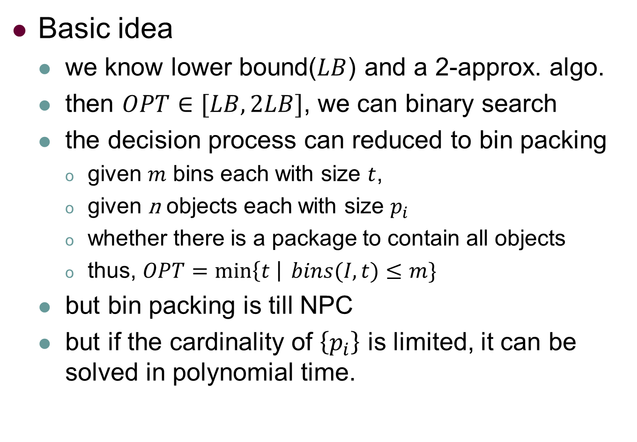
Algorithms: A PTAS
Basic idea
we know lower bound($LB$) and a 2-approx. algo.
then $OPT∈[LB,2LB]$, we can binary search
the decision process can reduced to bin packing
given $m$ bins each with size $t$,
given n objects each with size $p_{i}$
whether there is a package to contain all objects
thus, $OPT=\min\left\{t \right| bins(I,t)≤m\}$
but bin packing is till NPC
but if the cardinality of $\left\{p_{i}\right\}$ is limited, it can be solved in polynomial time.

Slide 24

Definition: Bin Packing
Given:
a set of $k$ unique sizes $s_{1},⋯s_{k}$ each with $n_{1},⋯n_{k}$ objects
the size of bin is $t$
find a package to minimize the number of used bins

Slide 25
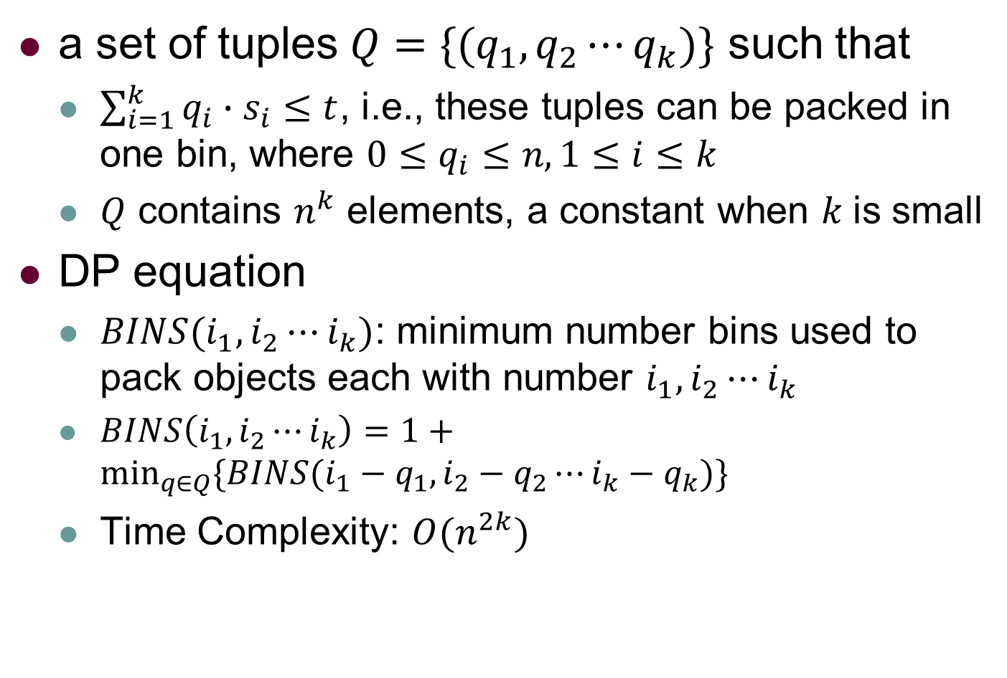
Algorithms: DP for Bin Packing
a set of tuples $Q=\{(q_{1},q_{2}⋯q_{k})\}$ such that
$\sum_{i=1}^{k}{q_{i}∙s_{i}}≤t$, i.e., these tuples can be packed in one bin, where $0≤q_{i}≤n,1≤i≤k$
$Q$ contains $n^{k}$ elements, a constant when $k$is small
DP equation
$BINS(i_{1},i_{2}⋯i_{k})$: minimum number bins used to pack objects each with number $i_{1},i_{2}⋯i_{k}$
$BINS\left(i_{1},i_{2}⋯i_{k}\right)=1+\min_{q∈Q}{\{BINS(i_{1}−q_{1},i_{2}−q_{2}⋯i_{k}−q_{k})\}}$
Time Complexity: $O(n^{2k})$

Slide 26
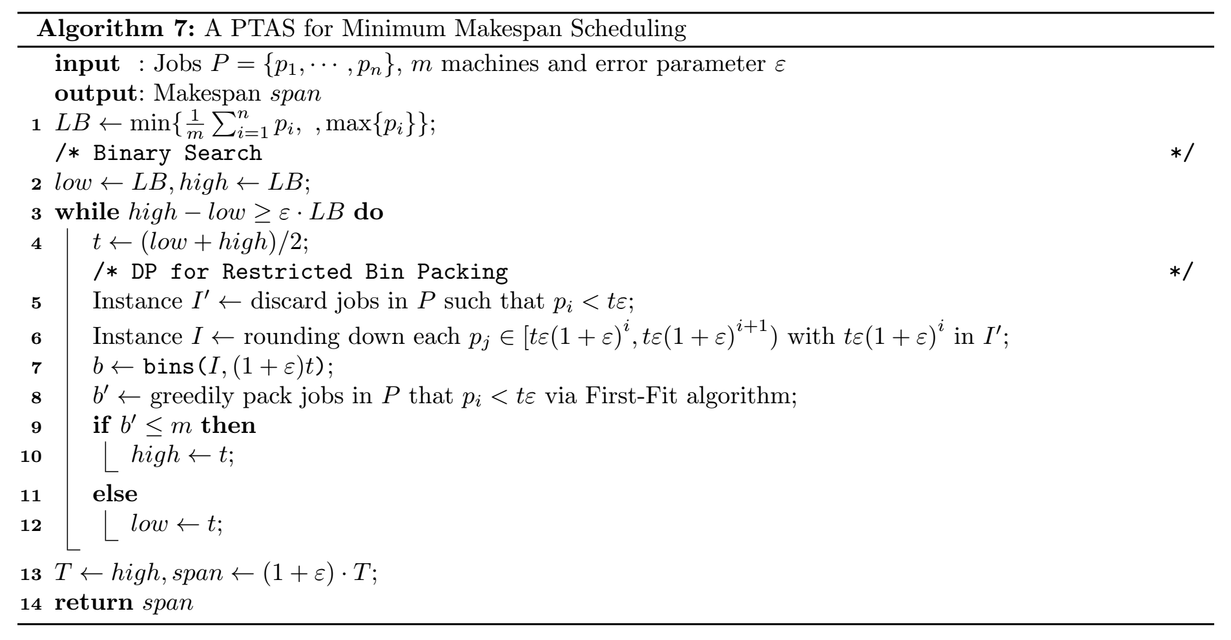
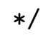
PTAS: DP+BiSearch for Makespan

Slide 27
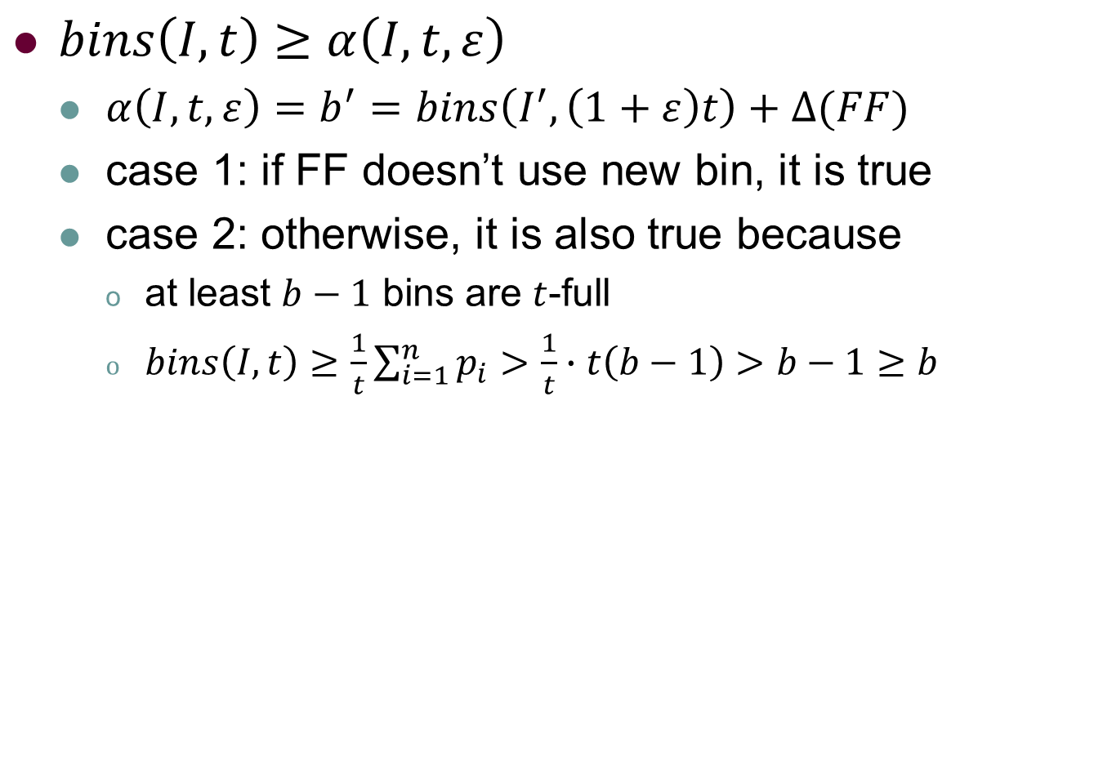
PTAS: DP+BiSearch for Makespan
$bins\left(I,t\right)≥α\left(I,t,ε\right)$
$α\left(I,t,ε\right)=b^{′}=bins\left(I^{′},\left(1+ε\right)t\right)+∆(FF)$
case 1: if FF doesn’t use new bin, it is true
case 2: otherwise, it is also true because
at least $b−1$ bins are $t$-full
$bins\left(I,t\right)≥\frac{1}{t}\sum_{i=1}^{n}{p_{i}}>\frac{1}{t}∙t\left(b−1\right)>b−1≥b$

Slide 28
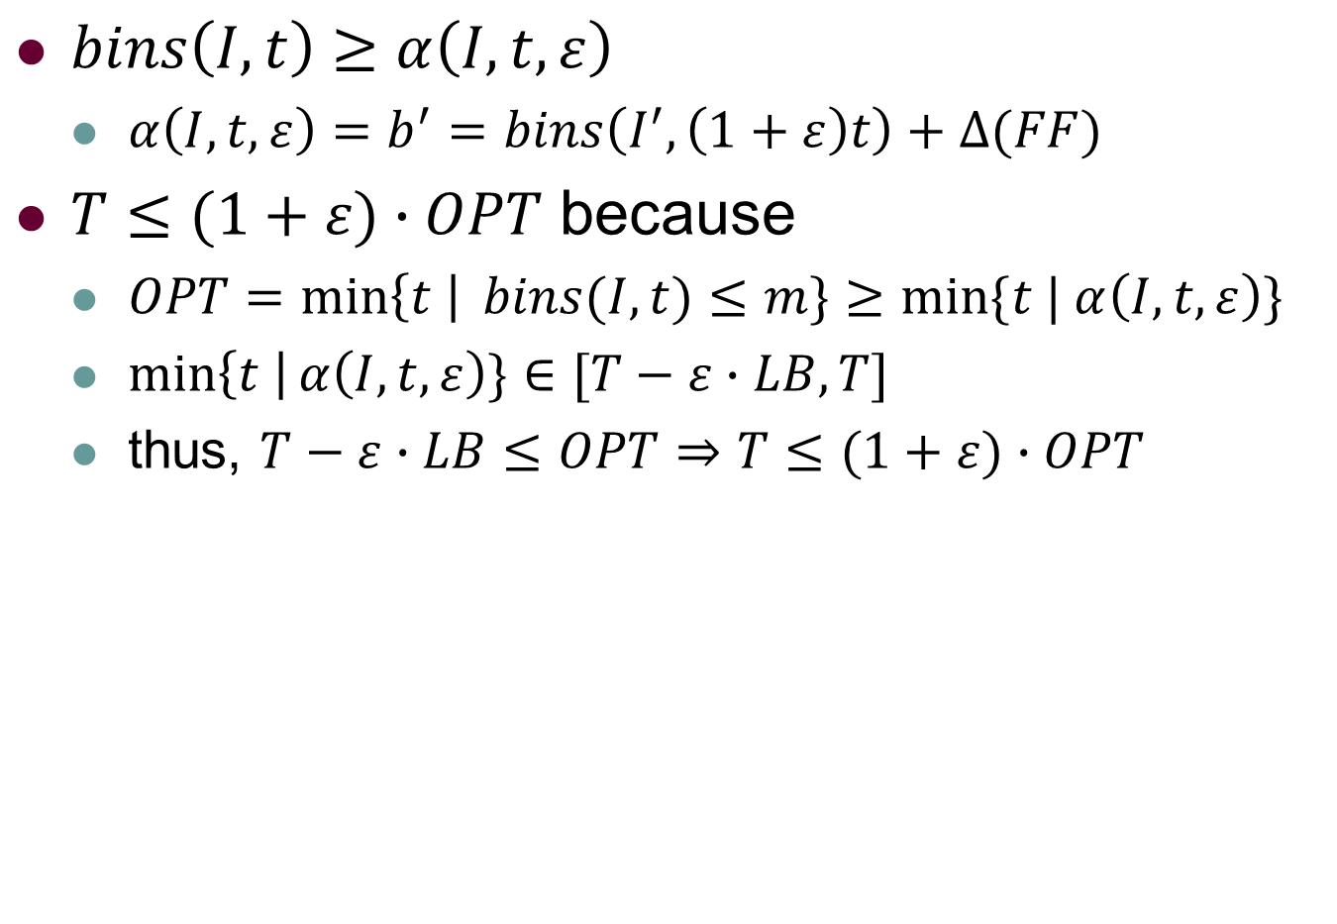
PTAS: DP+BiSearch for Makespan
$bins\left(I,t\right)≥α\left(I,t,ε\right)$
$α\left(I,t,ε\right)=b^{′}=bins\left(I^{′},\left(1+ε\right)t\right)+∆(FF)$
$T≤(1+ε)∙OPT$ because
$OPT=\min\left\{t \right| bins(I,t)≤m\}≥min⁡\{t | α\left(I,t,ε\right)\}$
$\min\left\{t \right|α\left(I,t,ε\right)\}∈[T−ε∙LB,T]$
thus, $T−ε∙LB≤OPT⇒T≤(1+ε)∙OPT$

Slide 29
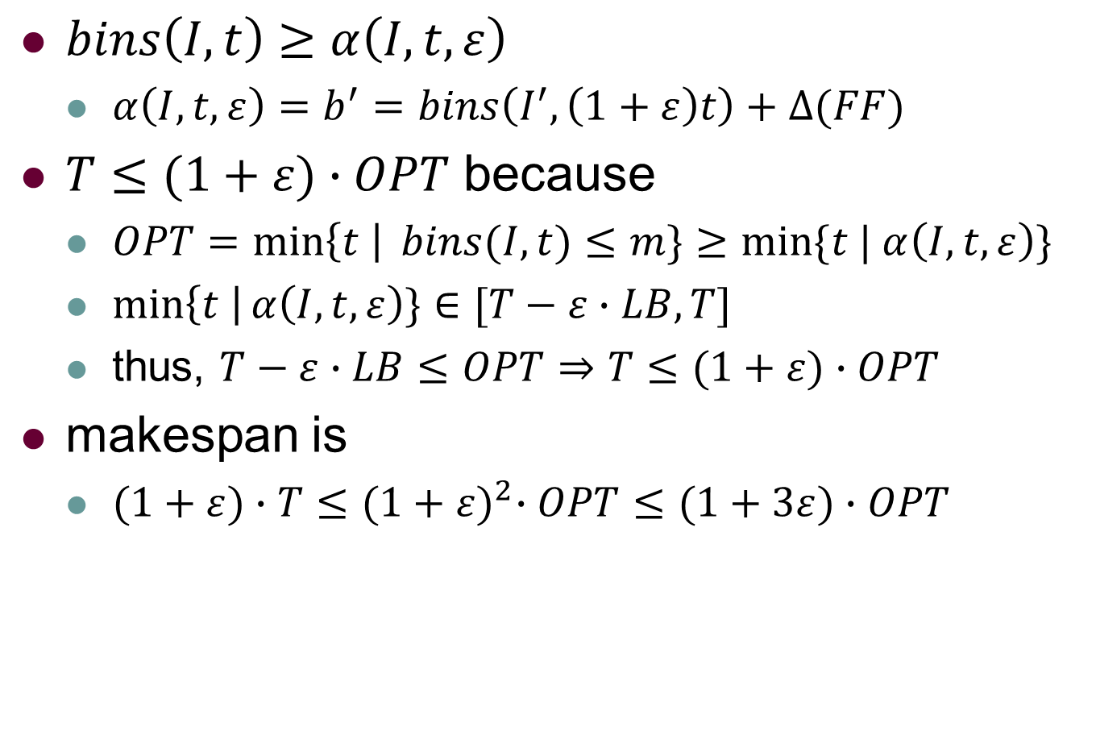
PTAS: DP+BiSearch for Makespan
$bins\left(I,t\right)≥α\left(I,t,ε\right)$
$α\left(I,t,ε\right)=b^{′}=bins\left(I^{′},\left(1+ε\right)t\right)+∆(FF)$
$T≤(1+ε)∙OPT$ because
$OPT=\min\left\{t \right| bins(I,t)≤m\}≥min⁡\{t | α\left(I,t,ε\right)\}$
$\min\left\{t \right|α\left(I,t,ε\right)\}∈[T−ε∙LB,T]$
thus, $T−ε∙LB≤OPT⇒T≤(1+ε)∙OPT$
makespan is
$(1+ε)∙T≤{(1+ε)}^{2}∙OPT≤(1+3ε)∙OPT$

Slide 30
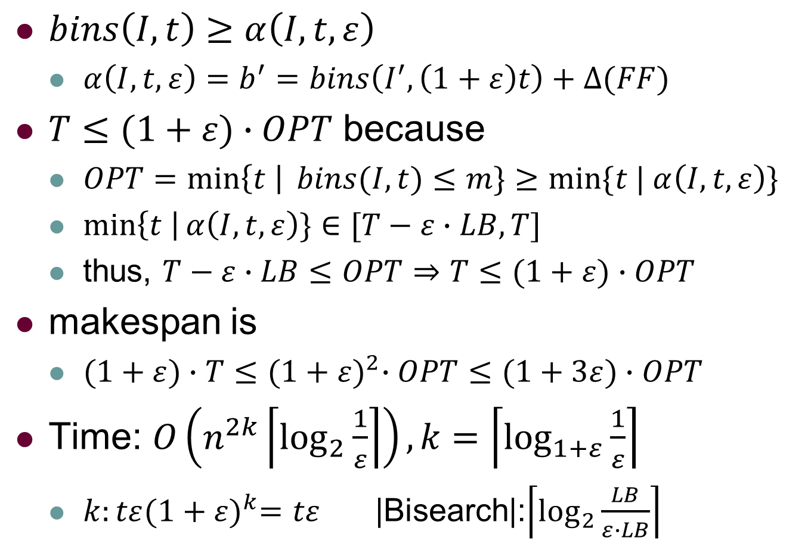
PTAS: DP+BiSearch for Makespan
$bins\left(I,t\right)≥α\left(I,t,ε\right)$
$α\left(I,t,ε\right)=b^{′}=bins\left(I^{′},\left(1+ε\right)t\right)+∆(FF)$
$T≤(1+ε)∙OPT$ because
$OPT=\min\left\{t \right| bins(I,t)≤m\}≥min⁡\{t | α\left(I,t,ε\right)\}$
$\min\left\{t \right|α\left(I,t,ε\right)\}∈[T−ε∙LB,T]$
thus, $T−ε∙LB≤OPT⇒T≤(1+ε)∙OPT$
makespan is
$(1+ε)∙T≤{(1+ε)}^{2}∙OPT≤(1+3ε)∙OPT$
Time: $O\left(n^{2k}\left\lceil \log_{2}{\frac{1}{ε}}\right\rceil \right), k=\left\lceil \log_{1+ε}{\frac{1}{ε}}\right\rceil$
$k:tε{(1+ε)}^{k}=tε$ |Bisearch|:$\left\lceil \log_{2}{\frac{LB}{ε∙LB}}\right\rceil$

Slide 31
Outline
Chapter 10: Minimum Makespan Scheduling
Definition
Basics
Algorithms
Conclusions

Slide 32

Conclusions
How to use $ε$ to restrict the instance
How to use DP to get a PTAS

