Slide 1
Approximation Algorithms: Chapter 2 Set Cover
yuxiang
2018/04/03

Slide 2
Outline
Definition
Example
Approximation Algorithm
Ratio Analysis
Tightness Analysis
Shortest Superstring Problem
Summary

Slide 3
Outline
Definition
Example
Approximation Algorithm
Ratio Analysis
Tightness Analysis
Shortest Superstring Problem
Summary

Slide 4

Set Cover: Definition
Input:
Given a universe U of n elements
a collection of subsets of U, $S=\{s_{1},s_{2},…,s_{k}\}$ each with cost $c_{k}$
Objective:
find a subset C of S with minimum cost such that
Constraint:
C covers all elements of U

Slide 5
Outline
Definition
Example
Approximation Algorithm
Ratio Analysis
Tightness Analysis
Shortest Superstring Problem
Summary

Slide 6








Set Cover: Example
$$s_{3}$$
U
$$s_{3}$$
U
$$s_{1}$$
$$s_{1}$$
$$s_{2}$$
$$s_{2}$$
$$c_{1}=6,c_{2}=15,c_{3}=7$$
$$c_{1}=6,c_{2}=15,c_{3}=7$$
Fig. 1. An instance of Set Cover problem
Fig. 2. A solution of Set Cover problem

Slide 7


Set Cover: Example
$$s_{3}$$
U
$$s_{3}$$
U
$$s_{1}$$
$$s_{1}$$
$$s_{2}$$
$$s_{2}$$
$$c_{1}=6,c_{2}=15,c_{3}=7$$
$$c_{1}=6,c_{2}=15,c_{3}=7$$
Fig. 1. An instance of Set Cover problem
Fig. 2. NOT A solution of Set Cover problem

Slide 8
Outline
Definition
Example
Approximation Algorithm
Ratio Analysis
Tightness Analysis
Shortest Superstring Problem
Summary

Slide 9
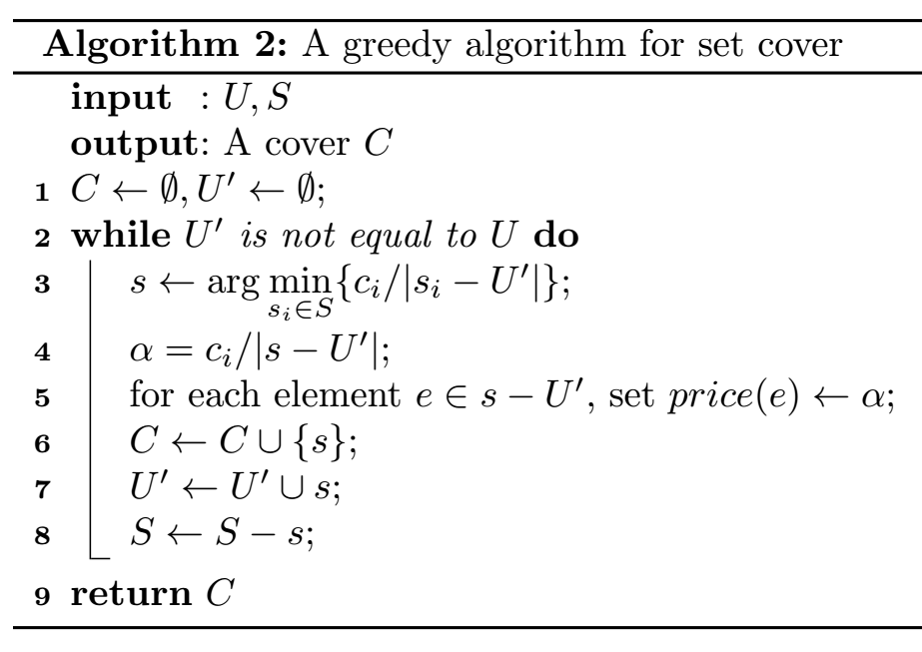
Set Cover: Greedy Based Algorithm
Greedy
select the set from S which is the most cost-effective in each step.

Slide 10




Set Cover: Greedy Based Algorithm
$$s_{3}$$
U
$$s_{1}$$
$$s_{2}$$
$$c_{1}=6,c_{2}=15,c_{3}=7$$
step | C | s | cost-effective
0 | {}

Slide 11
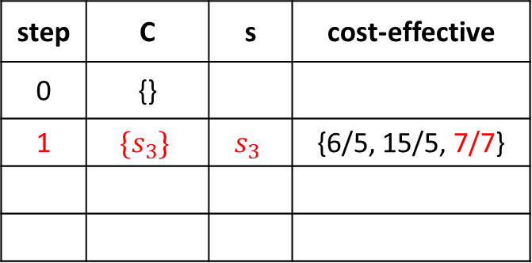
Set Cover: Greedy Based Algorithm
$$s_{3}$$
U
$$s_{1}$$
$$s_{2}$$
$$c_{1}=6,c_{2}=15,c_{3}=7$$
step | C | s | cost-effective
0 | {}
1 | $$\{s_{3}\}$$ | $$s_{3}$$ | {6/5, 15/5, 7/7}

Slide 12
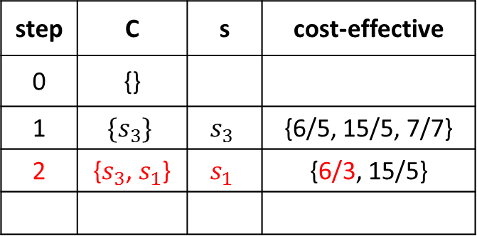
Set Cover: Greedy Based Algorithm
$$s_{3}$$
U
$$s_{1}$$
$$s_{2}$$
$$c_{1}=6,c_{2}=15,c_{3}=7$$
step | C | s | cost-effective
0 | {}
1 | $$\{s_{3}\}$$ | $$s_{3}$$ | {6/5, 15/5, 7/7}
2 | {$s_{3}$, $s_{1}$} | $$s_{1}$$ | {6/3, 15/5}

Slide 13
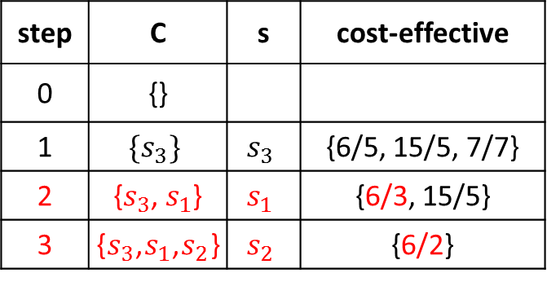
Set Cover: Greedy Based Algorithm
$$s_{3}$$
U
$$s_{1}$$
$$s_{2}$$
$$c_{1}=6,c_{2}=15,c_{3}=7$$
step | C | s | cost-effective
0 | {}
1 | $$\{s_{3}\}$$ | $$s_{3}$$ | {6/5, 15/5, 7/7}
2 | {$s_{3}$, $s_{1}$} | $$s_{1}$$ | {6/3, 15/5}
3 | {$s_{3}$,$s_{1}$,$s_{2}$} | $$s_{2}$$ | {6/2}

Slide 14
Outline
Definition
Example
Approximation Algorithm
Ratio Analysis
Tightness Analysis
Shortest Superstring Problem
Summary

Slide 15
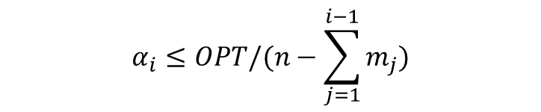
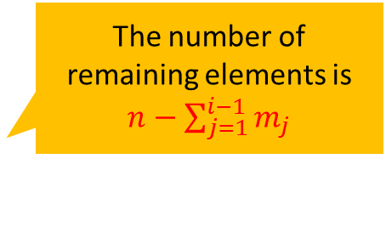

Set Cover: Approx. ratio
Find relation between ALG and OPT
Assume there are k steps
The price of i-th step,
because we greedily select
The number of remaining elements is $n−\sum_{j=1}^{i−1}{m_{j}}$
$$m_{i}=\left|s_{i}−U_{i}^{′}\right|$$
$$α_{i}≤OPT/(n−\sum_{j=1}^{i−1}{m_{j}})$$
OPT is always feasible to cover all the remaining elements
We greedily select most cost-effective in current step. It should be less than optimal cost-effective.

Slide 16
Set Cover: Approx. ratio
Find relation between ALG and OPT
Assume there are k steps
The price of i-th step,
because we greedily select
Then
$$m_{i}=\left|s_{i}−U_{i}^{′}\right|$$
$$α_{i}≤OPT/(n−\sum_{j=1}^{i−1}{m_{j}})$$
$$ALG= \sum_{i=1}^{k}{c_{i}}=\sum_{i=1}^{k}{α_{i}×m_{i}}$$

Slide 17

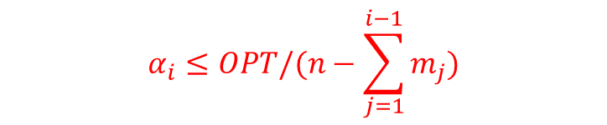
Set Cover: Approx. ratio
Find relation between ALG and OPT
Assume there are k steps
The price of i-th step,
because we greedily select
Then
$$m_{i}=\left|s_{i}−U_{i}^{′}\right|$$
$$α_{i}≤OPT/(n−\sum_{j=1}^{i−1}{m_{j}})$$
$$ALG= \sum_{i=1}^{k}{c_{i}}=\sum_{i=1}^{k}{α_{i}×m_{i}}≤\sum_{i=1}^{k}{\frac{OPT}{n−\sum_{j=1}^{i−1}{m_{j}}}×m_{i}}$$
Substitute $α_{i}$

Slide 18
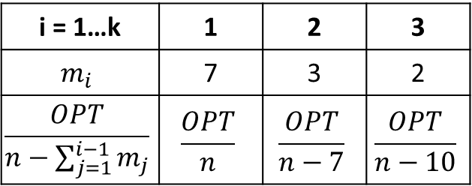
Set Cover: Approx. ratio
Find relation between ALG and OPT
Assume there are k steps
The price of i-th step,
because we greedily select
Then
$$m_{i}=\left|s_{i}−U_{i}^{′}\right|$$
Back to our example.
$$α_{i}≤OPT/(n−\sum_{j=1}^{i−1}{m_{j}})$$
i = 1…k | 1 | 2 | 3
$$m_{i}$$ | 7 | 3 | 2
$$\frac{OPT}{n−\sum_{j=1}^{i−1}{m_{j}}}$$ | $$\frac{OPT}{n}$$ | $$\frac{OPT}{n−7}$$ | $$\frac{OPT}{n−10}$$
$$ALG= \sum_{i=1}^{k}{c_{i}}=\sum_{i=1}^{k}{α_{i}×m_{i}}≤\sum_{i=1}^{k}{\frac{OPT}{n−\sum_{j=1}^{i−1}{m_{j}}}×m_{i}}≤\sum_{i=1}^{n}{\frac{OPT}{n−i+1}}$$
i = 1…n | 1 | 2 | … | 7 | 8 | 9 | 10 | 11 | 12
$$\frac{OPT}{n−i+1}$$ | $$\frac{OPT}{n}$$ | $$\frac{OPT}{n−1}$$ | … | $$\frac{OPT}{n−6}$$ | $$\frac{OPT}{n−7}$$ | $$\frac{OPT}{n−8}$$ | $$\frac{OPT}{n−9}$$ | $$\frac{OPT}{n−10}$$ | $$\frac{OPT}{n−11}$$

Slide 19
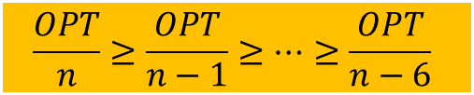
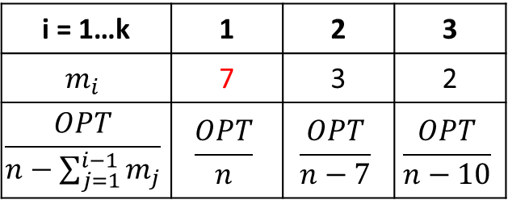
Set Cover: Approx. ratio
Find relation between ALG and OPT
Assume there are k steps
The price of i-th step,
because we greedily select
Then
$$m_{i}=\left|s_{i}−U_{i}^{′}\right|$$
Back to our example.
$$α_{i}≤OPT/(n−\sum_{j=1}^{i−1}{m_{j}})$$
i = 1…k | 1 | 2 | 3
$$m_{i}$$ | 7 | 3 | 2
$$\frac{OPT}{n−\sum_{j=1}^{i−1}{m_{j}}}$$ | $$\frac{OPT}{n}$$ | $$\frac{OPT}{n−7}$$ | $$\frac{OPT}{n−10}$$
$$\frac{OPT}{n}≥\frac{OPT}{n−1}≥…≥\frac{OPT}{n−6}$$
$$ALG= \sum_{i=1}^{k}{c_{i}}=\sum_{i=1}^{k}{α_{i}×m_{i}}≤\sum_{i=1}^{k}{\frac{OPT}{n−\sum_{j=1}^{i−1}{m_{j}}}×m_{i}}≤\sum_{i=1}^{n}{\frac{OPT}{n−i+1}}$$
i = 1…n | 1 | 2 | … | 7 | 8 | 9 | 10 | 11 | 12
$$\frac{OPT}{n−i+1}$$ | $$\frac{OPT}{n}$$ | $$\frac{OPT}{n−1}$$ | … | $$\frac{OPT}{n−6}$$ | $$\frac{OPT}{n−7}$$ | $$\frac{OPT}{n−8}$$ | $$\frac{OPT}{n−9}$$ | $$\frac{OPT}{n−10}$$ | $$\frac{OPT}{n−11}$$

Slide 20
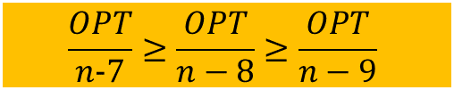
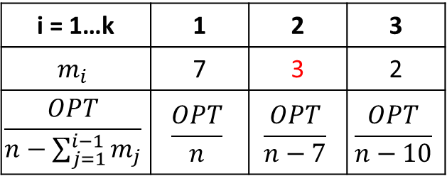
Set Cover: Approx. ratio
Find relation between ALG and OPT
Assume there are k steps
The price of i-th step,
because we greedily select
Then
$$m_{i}=\left|s_{i}−U_{i}^{′}\right|$$
Back to our example.
$$α_{i}≤OPT/(n−\sum_{j=1}^{i−1}{m_{j}})$$
i = 1…k | 1 | 2 | 3
$$m_{i}$$ | 7 | 3 | 2
$$\frac{OPT}{n−\sum_{j=1}^{i−1}{m_{j}}}$$ | $$\frac{OPT}{n}$$ | $$\frac{OPT}{n−7}$$ | $$\frac{OPT}{n−10}$$
$$\frac{OPT}{n−7}≥\frac{OPT}{n−8}≥\frac{OPT}{n−9}$$
$$ALG= \sum_{i=1}^{k}{c_{i}}=\sum_{i=1}^{k}{α_{i}×m_{i}}≤\sum_{i=1}^{k}{\frac{OPT}{n−\sum_{j=1}^{i−1}{m_{j}}}×m_{i}}≤\sum_{i=1}^{n}{\frac{OPT}{n−i+1}}$$
i = 1…n | 1 | 2 | … | 7 | 8 | 9 | 10 | 11 | 12
$$\frac{OPT}{n−i+1}$$ | $$\frac{OPT}{n}$$ | $$\frac{OPT}{n−1}$$ | … | $$\frac{OPT}{n−6}$$ | $$\frac{OPT}{n−7}$$ | $$\frac{OPT}{n−8}$$ | $$\frac{OPT}{n−9}$$ | $$\frac{OPT}{n−10}$$ | $$\frac{OPT}{n−11}$$

Slide 21
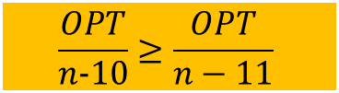
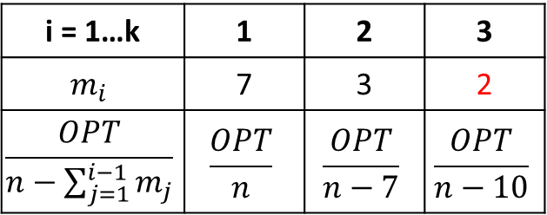
Set Cover: Approx. ratio
Find relation between ALG and OPT
Assume there are k steps
The price of i-th step,
because we greedily select
Then
$$m_{i}=\left|s_{i}−U_{i}^{′}\right|$$
Back to our example.
$$α_{i}≤OPT/(n−\sum_{j=1}^{i−1}{m_{j}})$$
i = 1…k | 1 | 2 | 3
$$m_{i}$$ | 7 | 3 | 2
$$\frac{OPT}{n−\sum_{j=1}^{i−1}{m_{j}}}$$ | $$\frac{OPT}{n}$$ | $$\frac{OPT}{n−7}$$ | $$\frac{OPT}{n−10}$$
$$ALG= \sum_{i=1}^{k}{c_{i}}=\sum_{i=1}^{k}{α_{i}×m_{i}}≤\sum_{i=1}^{k}{\frac{OPT}{n−\sum_{j=1}^{i−1}{m_{j}}}×m_{i}}≤\sum_{i=1}^{n}{\frac{OPT}{n−i+1}}$$
$$\frac{OPT}{n−10}≥\frac{OPT}{n−11}$$
i = 1…n | 1 | 2 | … | 7 | 8 | 9 | 10 | 11 | 12
$$\frac{OPT}{n−i+1}$$ | $$\frac{OPT}{n}$$ | $$\frac{OPT}{n−1}$$ | … | $$\frac{OPT}{n−6}$$ | $$\frac{OPT}{n−7}$$ | $$\frac{OPT}{n−8}$$ | $$\frac{OPT}{n−9}$$ | $$\frac{OPT}{n−10}$$ | $$\frac{OPT}{n−11}$$

Slide 22
Set Cover: Approx. ratio
Find relation between ALG and OPT
Assume there are k steps
The price of i-th step,
because we greedily select
Then
$$m_{i}=\left|s_{i}−U_{i}^{′}\right|$$
$$α_{i}≤OPT/(n−\sum_{j=1}^{i−1}{m_{j}})$$
$$ALG= \sum_{i=1}^{k}{c_{i}}=\sum_{i=1}^{k}{α_{i}×m_{i}}≤\sum_{i=1}^{k}{\frac{OPT}{n−\sum_{j=1}^{i−1}{m_{j}}}×m_{i}}≤\sum_{i=1}^{n}{\frac{OPT}{n−i+1}}=OPT×\sum_{i=1}^{n}{\frac{1}{i}}$$
totally equal

Slide 23
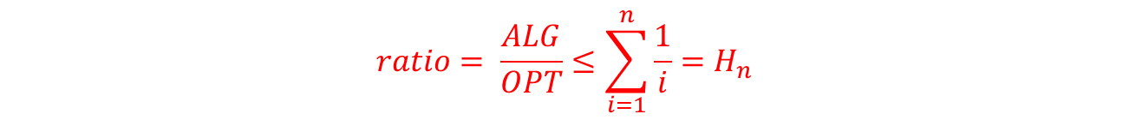
Set Cover: Approx. ratio
Find relation between ALG and OPT
Assume there are k steps
The price of i-th step,
because we greedily select
Then
$$m_{i}=\left|s_{i}−U_{i}^{′}\right|$$
$$α_{i}≤OPT/(n−\sum_{j=1}^{i−1}{m_{j}})$$
$$ALG= \sum_{i=1}^{k}{c_{i}}=\sum_{i=1}^{k}{α_{i}×m_{i}}≤\sum_{i=1}^{k}{\frac{OPT}{n−\sum_{j=1}^{i−1}{m_{j}}}×m_{i}}≤\sum_{i=1}^{n}{\frac{OPT}{n−i+1}}=OPT×\sum_{i=1}^{n}{\frac{1}{i}}$$
$$ratio= \frac{ALG}{OPT}≤\sum_{i=1}^{n}{\frac{1}{i}}=H_{n}$$

Slide 24
Outline
Definition
Example
Approximation Algorithm
Ratio Analysis
Tightness Analysis
Shortest Superstring Problem
Summary

Slide 25





Set Cover: Tightness
Types of Tightness
Tightness of your analysis
Q. How to prove your analysis is tight?
A. You can just construct an instance.
$$s_{1}$$
$$s_{2}$$
$$s_{n}$$
U
$$⋯⋯$$
$$s_{n+1}$$
$$c_{1}=1,…,c_{n}=1,c_{n+1}=1+ε$$
Fig.1. An instance to show the tightness of the analysis

Slide 26
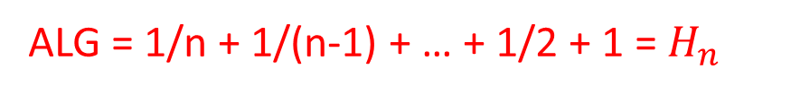
Set Cover: Tightness
Types of Tightness
Tightness of your analysis
Q. How to prove your analysis is tight?
A. You can just construct an instance.
$$s_{1}$$
$$s_{2}$$
$$s_{n}$$
U
ALG = 1/n + 1/(n-1) + … + 1/2 + 1 = $H_{n}$
$$⋯⋯$$
$$s_{n+1}$$
$$c_{1}=1,c_{2}=1/2,…,c_{n}=1/n,c_{n+1}=1+ε$$
Fig.2. The result of greed based approx. algo.

Slide 27

Set Cover: Tightness
Types of Tightness
Tightness of your analysis
Q. How to prove your analysis is tight?
A. You can just construct an instance.
$$s_{1}$$
$$s_{2}$$
$$s_{n}$$
U
ALG = 1/n + 1/(n-1) + … + 1/2 + 1 = $H_{n}$
OPT = $1+ε$
Then, as long as $ε$ is small enough, this example yields a ratio with $H_{n}$.
$$⋯⋯$$
$$s_{n+1}$$
$$c_{1}=1,…,c_{n}=1,c_{n+1}=1+ε$$
Fig.3. The result of optimal set cover

Slide 28
Set Cover: Tightness
Types of Tightness
Tightness of your analysis
Q. How to prove your analysis is tight?
A. You can just construct an instance.
Tightness of your ratio
Q. How to prove your analysis is tight?
A. Suppose to the contrary, assume there is a better approximation algorithm
Then some NP-complete decision problem can be determined in polynomial time.
which is not true unless P = NP
Then some NP-hard optimized problem P’ can be solve with a tighter approx. bound.
which is not true because the tightness of P’ have been studied (unless P = NP)

Slide 29
Outline
Definition
Example
Approximation Algorithm
Ratio Analysis
Tightness Analysis
Shortest Superstring Problem
Summary

Slide 30

Set Cover: Exercises
Shortest superstring problem
Input
a set of n strings $S=\{s_{1},s_{2},…,s_{n}\}$
Objective
find a shortest string s such that
Constraint
s contains each $s_{i}$ as a substring

Slide 31
Shortest superstring: Example
Input:
CATGC
CTAAGT
GCTA
TTCA
ATGCATC
Output:
GCTAAGTTCATGCATC
GCTAAGTTCATGCATC
GCTAAGTTCATGCATC
GCTAAGTTCATGCATC
GCTAAGTTCATGCATC

Slide 32
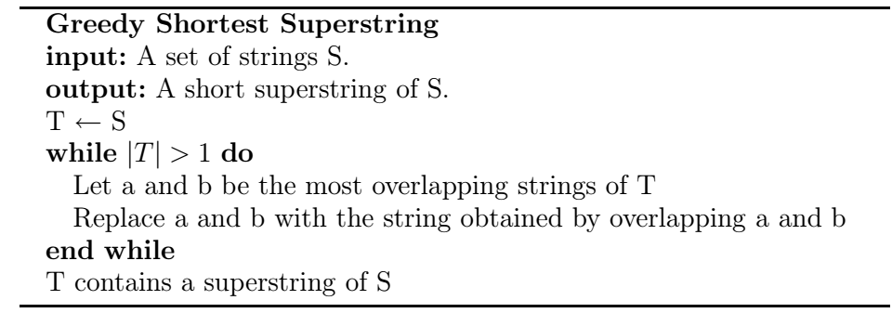
Shortest superstring: A Greedy Approx.

Slide 33
Shortest superstring: A Greedy Approx.
Input:
CATGC
CTAAGT
GCTA
TTCA
ATGCATC
Step | T
0 | {CATGC, CTAAGT, GCTA, TTCA, ATGCATC}

Slide 34
Shortest superstring: A Greedy Approx.
Input:
CATGC
CTAAGT
GCTA
TTCA
ATGCATC
Step | T
0 | {CATGC, CTAAGT, GCTA, TTCA, ATGCATC}
1 | {CATGCATC, CTAAGT, GCTA, TTCA}

Slide 35
Shortest superstring: A Greedy Approx.
Input:
CATGC
CTAAGT
GCTA
TTCA
ATGCATC
Step | T
0 | {CATGC, CTAAGT, GCTA, TTCA, ATGCATC}
1 | {CATGCATC, CTAAGT, GCTA, TTCA}
2 | {CATGCATC, GCTAAGT, TTCA}

Slide 36
Shortest superstring: A Greedy Approx.
Input:
CATGC
CTAAGT
GCTA
TTCA
ATGCATC
Step | T
0 | {CATGC, CTAAGT, GCTA, TTCA, ATGCATC}
1 | {CATGCATC, CTAAGT, GCTA, TTCA}
2 | {CATGCATC, GCTAAGT, TTCA}
3 | {TTCATGCATC, GCTAAGT}

Slide 37
Shortest superstring: A Greedy Approx.
Input:
CATGC
CTAAGT
GCTA
TTCA
ATGCATC
Step | T
0 | {CATGC, CTAAGT, GCTA, TTCA, ATGCATC}
1 | {CATGCATC, CTAAGT, GCTA, TTCA}
2 | {CATGCATC, GCTAAGT, TTCA}
3 | {TTCATGCATC, GCTAAGT}
4 | {GCTAAGTTCATGCATC}

Slide 38
Shortest superstring: A Greedy Approx.
Input:
CATGC
CTAAGT
GCTA
TTCA
ATGCATC
What is the approximation ratio?
Step | T
0 | {CATGC, CTAAGT, GCTA, TTCA, ATGCATC}
1 | {CATGCATC, CTAAGT, GCTA, TTCA}
2 | {CATGCATC, GCTAAGT, TTCA}
3 | {TTCATGCATC, GCTAAGT}
4 | {GCTAAGTTCATGCATC}

Slide 39
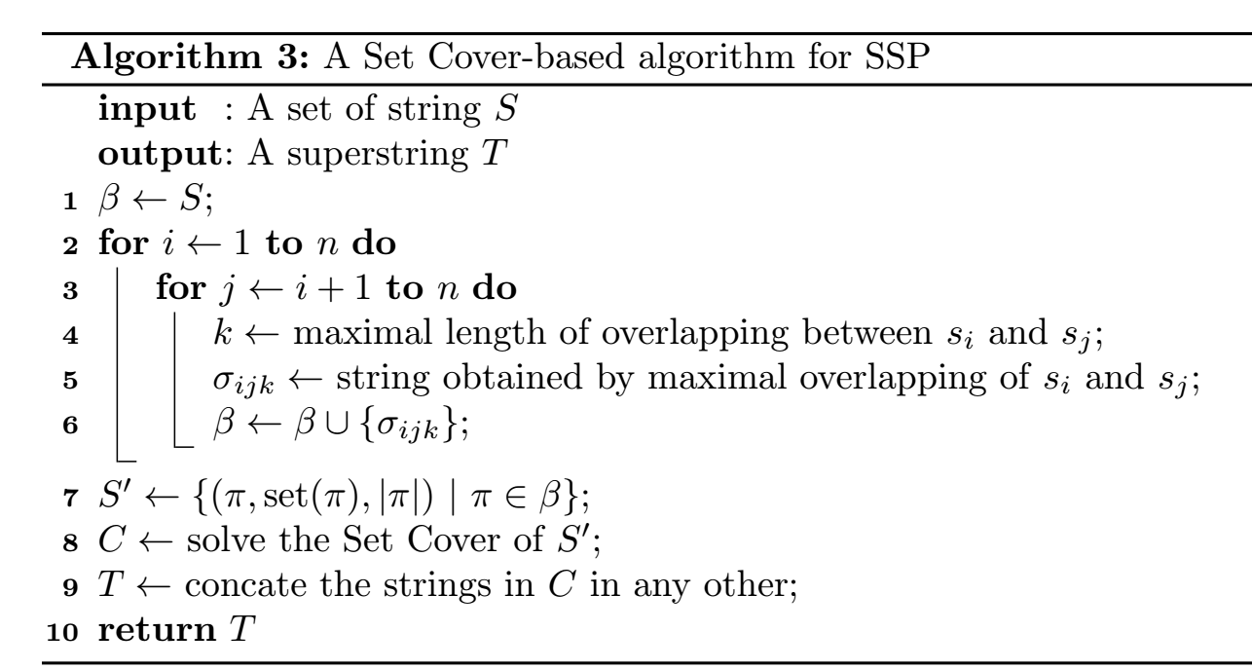
Shortest superstring: A Set Cover Approx.

Slide 40
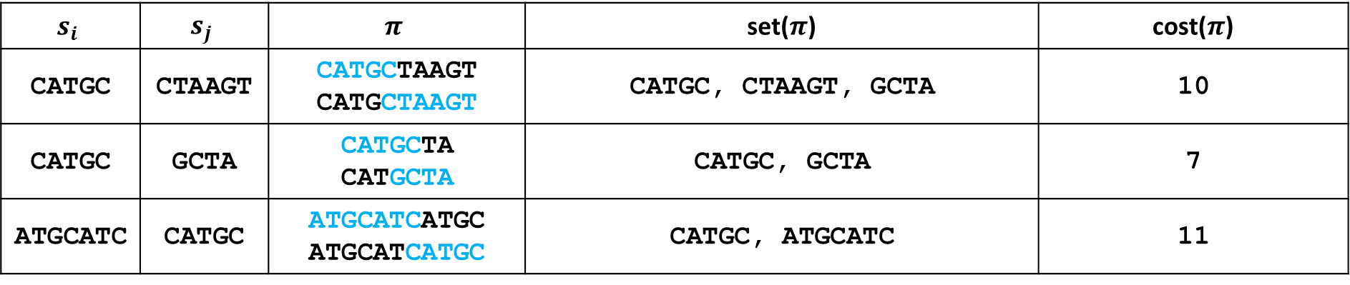
Shortest superstring: A Set Cover Approx.
Input:
CATGC
CTAAGT
GCTA
TTCA
ATGCATC
$$s_{i}$$ | $$s_{j}$$ | $$π$$ | set($π$) | cost($π$)
CATGC | CTAAGT | CATGCTAAGT CATGCTAAGT | CATGC, CTAAGT, GCTA | 10
CATGC | GCTA | CATGCTA CATGCTA | CATGC, GCTA | 7
ATGCATC | CATGC | ATGCATCATGC ATGCATCATGC | CATGC, ATGCATC | 11

Slide 41
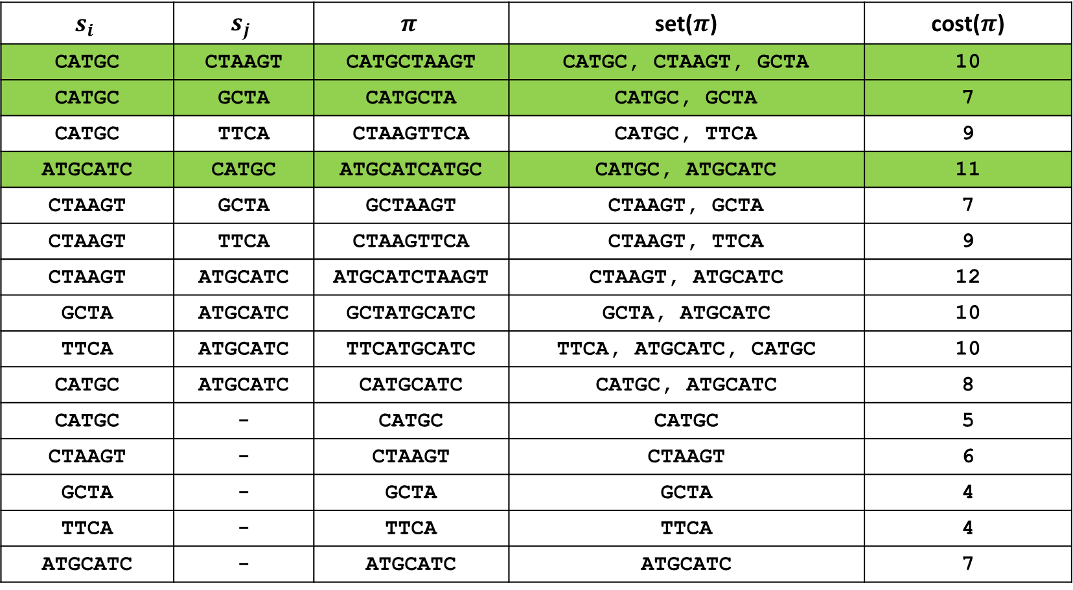
Shortest superstring: A Set Cover Approx.
$$s_{i}$$ | $$s_{j}$$ | $$π$$ | set($π$) | cost($π$)
CATGC | CTAAGT | CATGCTAAGT | CATGC, CTAAGT, GCTA | 10
CATGC | GCTA | CATGCTA | CATGC, GCTA | 7
CATGC | TTCA | CTAAGTTCA | CATGC, TTCA | 9
ATGCATC | CATGC | ATGCATCATGC | CATGC, ATGCATC | 11
CTAAGT | GCTA | GCTAAGT | CTAAGT, GCTA | 7
CTAAGT | TTCA | CTAAGTTCA | CTAAGT, TTCA | 9
CTAAGT | ATGCATC | ATGCATCTAAGT | CTAAGT, ATGCATC | 12
GCTA | ATGCATC | GCTATGCATC | GCTA, ATGCATC | 10
TTCA | ATGCATC | TTCATGCATC | TTCA, ATGCATC, CATGC | 10
CATGC | ATGCATC | CATGCATC | CATGC, ATGCATC | 8
CATGC | - | CATGC | CATGC | 5
CTAAGT | - | CTAAGT | CTAAGT | 6
GCTA | - | GCTA | GCTA | 4
TTCA | - | TTCA | TTCA | 4
ATGCATC | - | ATGCATC | ATGCATC | 7
Input:
CATGC
CTAAGT
GCTA
TTCA
ATGCATC

Slide 42
Shortest superstring: A Set Cover Approx.
Input:
CATGC
CTAAGT
GCTA
TTCA
ATGCATC

Slide 43
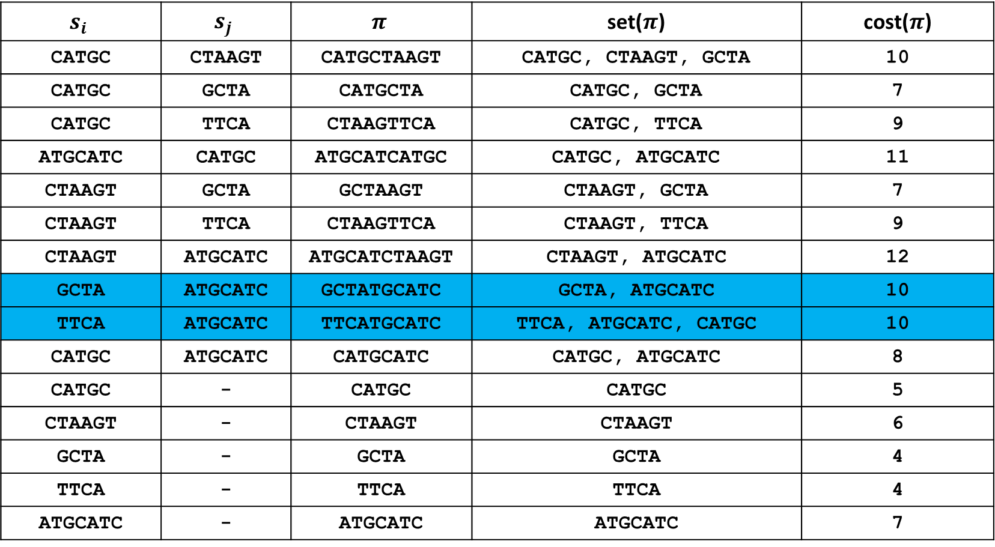
Shortest superstring: A Set Cover Approx.
$$s_{i}$$ | $$s_{j}$$ | $$π$$ | set($π$) | cost($π$)
CATGC | CTAAGT | CATGCTAAGT | CATGC, CTAAGT, GCTA | 10
CATGC | GCTA | CATGCTA | CATGC, GCTA | 7
CATGC | TTCA | CTAAGTTCA | CATGC, TTCA | 9
ATGCATC | CATGC | ATGCATCATGC | CATGC, ATGCATC | 11
CTAAGT | GCTA | GCTAAGT | CTAAGT, GCTA | 7
CTAAGT | TTCA | CTAAGTTCA | CTAAGT, TTCA | 9
CTAAGT | ATGCATC | ATGCATCTAAGT | CTAAGT, ATGCATC | 12
GCTA | ATGCATC | GCTATGCATC | GCTA, ATGCATC | 10
TTCA | ATGCATC | TTCATGCATC | TTCA, ATGCATC, CATGC | 10
CATGC | ATGCATC | CATGCATC | CATGC, ATGCATC | 8
CATGC | - | CATGC | CATGC | 5
CTAAGT | - | CTAAGT | CTAAGT | 6
GCTA | - | GCTA | GCTA | 4
TTCA | - | TTCA | TTCA | 4
ATGCATC | - | ATGCATC | ATGCATC | 7
Input:
CATGC
CTAAGT
GCTA
TTCA
ATGCATC
:Cover

Slide 44
Shortest superstring: A Set Cover Approx.
Input:
CATGC
CTAAGT
GCTA
TTCA
ATGCATC
Cover:
TTCATGCATC
GCTATGCATC
Answer:
TTCATGCATCGCTATGCATC

Slide 45
Shortest superstring: A Set Cover Approx.
Input:
CATGC
CTAAGT
GCTA
TTCA
ATGCATC
Cover:
TTCATGCATC
GCTATGCATC
What is the approximation ratio?
Answer:
TTCATGCATCGCTATGCATC

Slide 46
Outline
Definition
Example
Approximation Algorithm
Ratio Analysis
Tightness Analysis
Shortest Superstring Problem
Summary

Slide 47
Summary of Chapter 2
Greedy based algorithm usually can be approximated.

