Slide 1
Approximation Algorithms: Chapter 3 Steiner Tree and TSP
yuxiang
2018/04/03

Slide 2
Outline
Definition: Steiner Tree and Metric Steiner Tree
Approximation Algorithm: Metric Steiner Tree
Ratio Analysis
Thightness Analysis
Definition: TSP and Metric TSP
Approximation Algorithm: Metric TSP
Hardness Analysis
Ratio Analysis
Thightness Analysis
Summary

Slide 3
Outline
Definition: Steiner Tree and Metric Steiner Tree
Approximation Algorithm: Metric Steiner Tree
Ratio Analysis
Thightness Analysis
Definition: TSP and Metric TSP
Approximation Algorithm: Metric TSP
Hardness Analysis
Ratio Analysis
Thightness Analysis
Summary

Slide 4

Steiner Tree: Definition
Input
An undirected graph $G=(V,E)$
A subset of vertex $N$ (terminals)
Objective
find a subtree T of G with minimum cost such that
Constraint
T connects all vertex in N and any other vertex

Slide 5
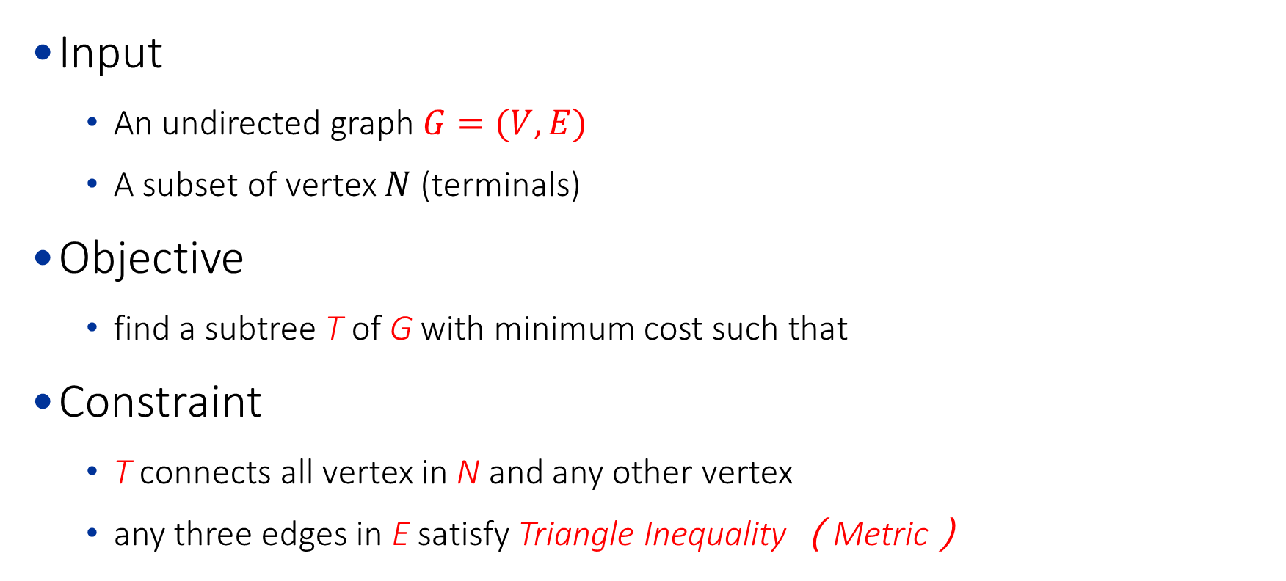
Metric Steiner Tree: Definition
Input
An undirected graph $G=(V,E)$
A subset of vertex $N$ (terminals)
Objective
find a subtree T of G with minimum cost such that
Constraint
T connects all vertex in N and any other vertex
any three edges in E satisfy Triangle Inequality （Metric）

Slide 6
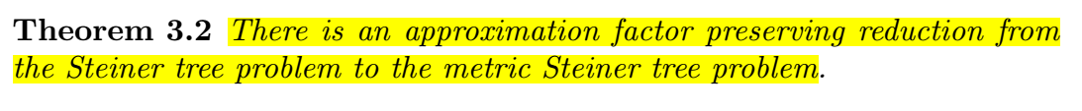
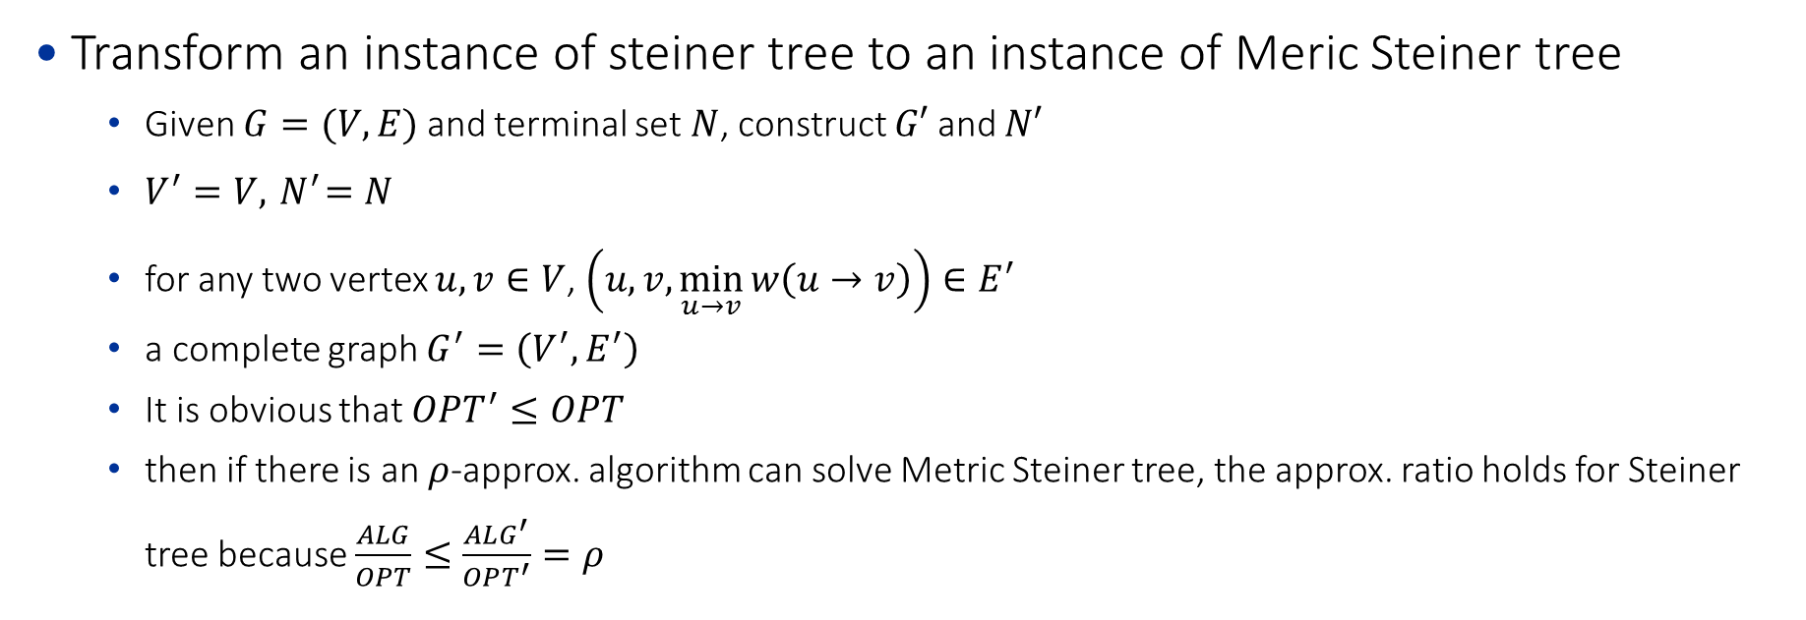
Steiner Tree and Metric Steiner Tree
Transform an instance of steiner tree to an instance of Meric Steiner tree
Given $G=(V,E)$ and terminal set $N$, construct $G′$ and $N′$
$V^{′}=V,{ N}^{′}=N$
for any two vertex $u,v∈V$, $\left(u,v, \min_{u→v}{w\left(u→v\right)}\right)∈E^{′}$
a complete graph $G^{′}=\left(V^{′},E^{′}\right)$
It is obvious that $OPT^{′}≤OPT$
then if there is an $ρ$-approx. algorithm can solve Metric Steiner tree, the approx. ratio holds for Steiner tree because $\frac{ALG}{OPT}≤\frac{ALG^{′}}{OPT^{′}}=ρ$

Slide 7
Steiner Tree: Example
: N
1
1
v3
v0
v3
v0
4
3
3
3
3
3
3
v1
v2
v1
6
v2
10
Fig.1. An instance of Steiner Tree
Fig.2. An instance of Metric Steiner Tree

Slide 8
Steiner Tree: Example
: N
1
v0
1
v3
v0
v3
4
3
3
3
3
3
3
v1
v2
v1
6
v2
10
Fig.1. An instance of Steiner Tree
Fig.2. An instance of Metric Steiner Tree
v0
1
v3
4
3
3
3
v1
6
v2
Fig.3. An solution of Metric Steiner Tree
total cost = 1 + 4 = 5

Slide 9
Steiner Tree: Example
: N
1
v0
1
v3
v0
v3
4
3
3
3
3
3
3
v1
v2
v1
6
v2
10
Fig.1. An instance of Steiner Tree
Fig.2. An instance of Metric Steiner Tree
v0
1
v3
v0
1
v3
4
3
3
3
3
3
3
v1
6
v2
v1
v2
10
Fig.3. An solution of Metric Steiner Tree
Fig.4. An solution of Steiner Tree
total cost of T’ = 1 + 4 = 5
total cost of T = 1 + 3 = 4

Slide 10
Outline
Definition: Steiner Tree and Metric Steiner Tree
Approximation Algorithm: Metric Steiner Tree
Ratio Analysis
Thightness Analysis
Definition: TSP and Metric TSP
Approximation Algorithm: Metric TSP
Hardness Analysis
Ratio Analysis
Thightness Analysis
Summary

Slide 11
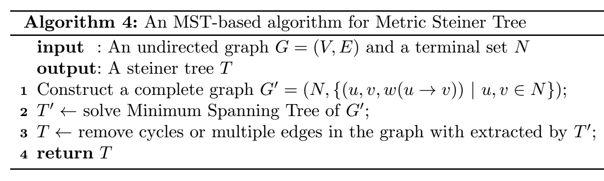
Metric Steiner Tree: A MST-based Approx.

Slide 12
Metric Steiner Tree: A MST-based Approx.
: N
1
v3
v0
4
3
3
3
v1
6
v2
Fig.1. An instance of Metric Steiner Tree

Slide 13
Metric Steiner Tree: A MST-based Approx.
: N
1
1
v3
v0
v3
v0
4
4
3
3
3
3
v1
6
v2
v1
Fig.1. An instance of Metric Steiner Tree
Fig.2. An instance of Complete Graph G’

Slide 14
Metric Steiner Tree: A MST-based Approx.
: N
1
1
v0
v3
v0
v3
4
4
3
3
3
3
v1
6
v2
v1
Fig.1. An instance of Metric Steiner Tree
Fig.3. An instance of Minimum Spanning Tree T’

Slide 15
Metric Steiner Tree: A MST-based Approx.
: N
1
1
v0
v3
v0
v3
4
3
3
3
3
v1
6
v2
v1
Fig.1. An instance of Metric Steiner Tree
Fig.3. An instance of steiner tree T

Slide 16
Outline
Definition: Steiner Tree and Metric Steiner Tree
Approximation Algorithm: Metric Steiner Tree
Ratio Analysis
Thightness Analysis
Definition: TSP and Metric TSP
Approximation Algorithm: Metric TSP
Hardness Analysis
Ratio Analysis
Thightness Analysis
Summary

Slide 17
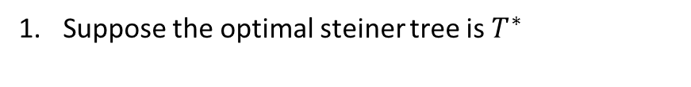
Metric Steiner Tree: A MST-based Approx.
Suppose the optimal steiner tree is $T^{∗}$
Fig.1. An instance of Steiner Tree

Slide 18
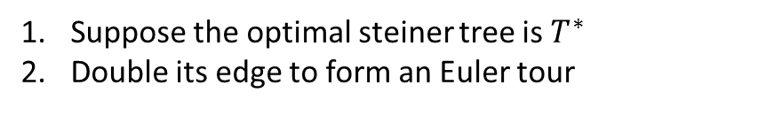
Metric Steiner Tree: A MST-based Approx.
Suppose the optimal steiner tree is $T^{∗}$
Double its edge to form an Euler tour
Fig.2. An instance of Euler tour

Slide 19
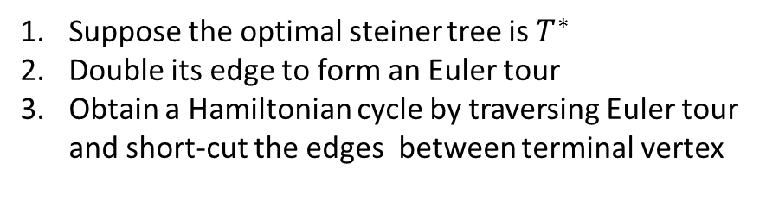
Metric Steiner Tree: A MST-based Approx.
Suppose the optimal steiner tree is $T^{∗}$
Double its edge to form an Euler tour
Obtain a Hamiltonian cycle by traversing Euler tour and short-cut the edges between terminal vertex
Fig.3. An instance of Hamiltonian tour

Slide 20
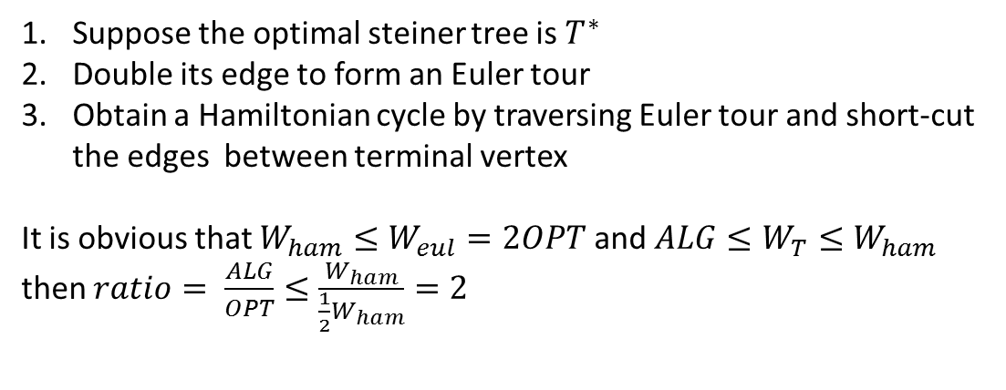
Metric Steiner Tree: A MST-based Approx.
Suppose the optimal steiner tree is $T^{∗}$
Double its edge to form an Euler tour
Obtain a Hamiltonian cycle by traversing Euler tour and short-cut the edges between terminal vertex
It is obvious that $W_{ham}≤W_{eul}=2OPT$ and $ALG≤W_{T}≤W_{ham}$
then $ratio= \frac{ALG}{OPT}≤\frac{W_{ham}}{\frac{1}{2}W_{ham}}=2$
Fig.3. An instance of Hamiltonian tour

Slide 21
Metric Steiner Tree: A MST-based Approx.
Suppose the optimal steiner tree is $T^{∗}$
Double its edge to form an Euler tour
Obtain a Hamiltonian cycle by traversing Euler tour and short-cut the edges between terminal vertex
It is obvious that $W_{ham}≤W_{eul}=2OPT$ and $ALG≤W_{T}≤W_{ham}$
then $ratio= \frac{ALG}{OPT}≤\frac{W_{ham}}{\frac{1}{2}W_{ham}}=2$
Is the analysis tight? Is the bound tight?
Fig.3. An instance of Hamiltonian tour

Slide 22
Outline
Definition: Steiner Tree and Metric Steiner Tree
Approximation Algorithm: Metric Steiner Tree
Ratio Analysis
Thightness Analysis
Definition: TSP and Metric TSP
Approximation Algorithm: Metric TSP
Hardness Analysis
Ratio Analysis
Thightness Analysis
Summary

Slide 23

TSP: Definition
Input
a complete graph $G=(V,E)$
Objective
find a minimum tour $T$ such that
Constraint
T starts from any vertex and returns to that vertex
T visits every vertex in V exactly once

Slide 24
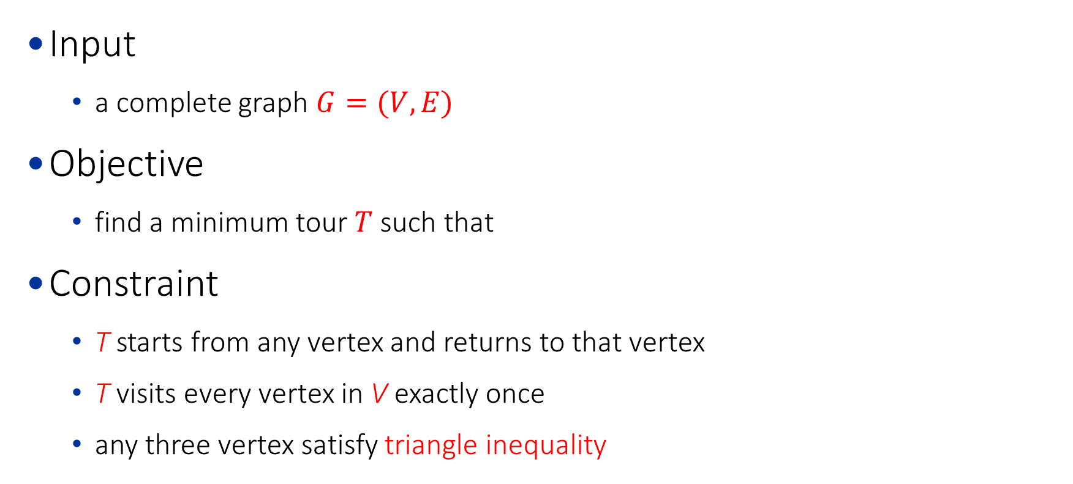
Metric TSP: Definition
Input
a complete graph $G=(V,E)$
Objective
find a minimum tour $T$ such that
Constraint
T starts from any vertex and returns to that vertex
T visits every vertex in V exactly once
any three vertex satisfy triangle inequality

Slide 25
TSP: Example
v0
4
v1
3
2
5
2
2
v2
v3
Fig.1. An instance of TSP

Slide 26
TSP: Example
v0
4
v1
v0
4
v1
v0
4
v1
3
3
3
2
5
2
5
2
5
2
2
2
2
2
2
v2
v3
v2
v3
v2
v3
Fig.1. An instance of TSP
Fig.2. A solution of TSP
Fig.3. A solution of TSP
cost = 4 + 2 + 2 + 5 = 13
cost = 4 + 3 + 2 + 2 = 11

Slide 27
Outline
Definition: Steiner Tree and Metric Steiner Tree
Approximation Algorithm: Metric Steiner Tree
Ratio Analysis
Thightness Analysis
Definition: TSP and Metric TSP
Approximation Algorithm: Metric TSP
Hardness Analysis
Ratio Analysis
Thightness Analysis
Summary

Slide 28
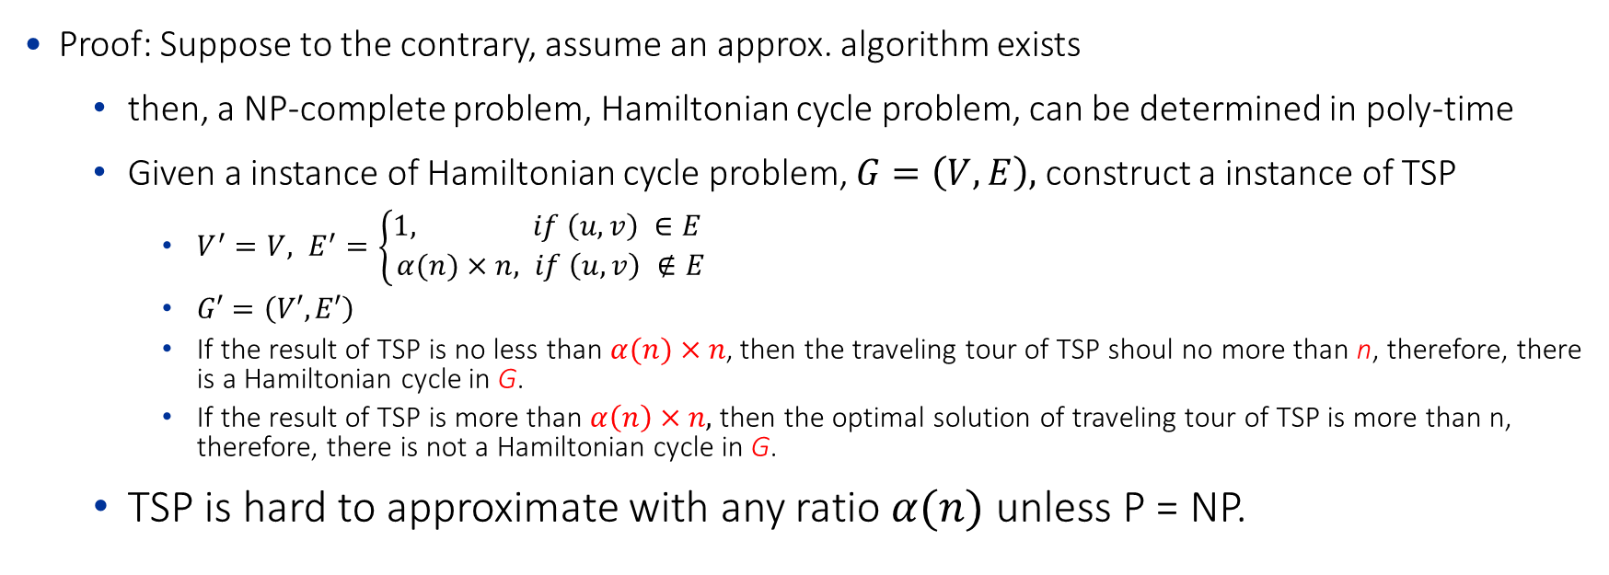
TSP: Hard to approximate
Proof: Suppose to the contrary, assume an approx. algorithm exists
then, a NP-complete problem, Hamiltonian cycle problem, can be determined in poly-time
Given a instance of Hamiltonian cycle problem, $G=\left(V,E\right),$ construct a instance of TSP
$V^{′}=V, E^{′}=\left\{\begin{aligned}1, if \left(u,v\right) ∈E \\ α(n)×n, if \left(u,v\right) ∉E\end{aligned}\right.$
$G′=\left(V′,E′\right)$
If the result of TSP is no less than $α(n)×n$, then the traveling tour of TSP shoul no more than n, therefore, there is a Hamiltonian cycle in G.
If the result of TSP is more than $α\left(n\right)×n,$ then the optimal solution of traveling tour of TSP is more than n, therefore, there is not a Hamiltonian cycle in G.
TSP is hard to approximate with any ratio $α(n)$ unless P = NP.

Slide 29
Outline
Definition: Steiner Tree and Metric Steiner Tree
Approximation Algorithm: Metric Steiner Tree
Ratio Analysis
Thightness Analysis
Definition: TSP and Metric TSP
Approximation Algorithm: Metric TSP
Hardness Analysis
Ratio Analysis
Thightness Analysis
Summary

Slide 30
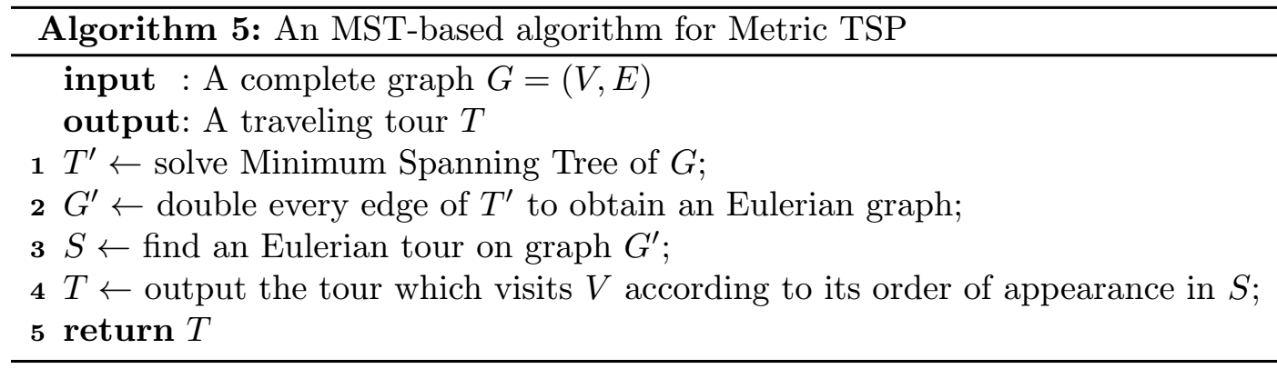
Metric TSP: a 2-Approx. Algorithm

Slide 31
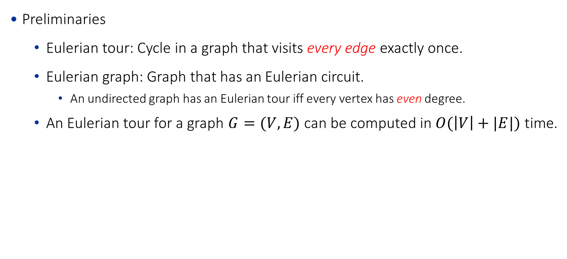
Metric TSP: a 2-Approx. Algorithm
Preliminaries
Eulerian tour: Cycle in a graph that visits every edge exactly once.
Eulerian graph: Graph that has an Eulerian circuit.
An undirected graph has an Eulerian tour iff every vertex has even degree.
An Eulerian tour for a graph $G=(V,E)$ can be computed in $O(\left|V\right|+|E|)$ time.

Slide 32
Metric TSP: a 2-Approx. Algorithm
v0
4
v1
v0
4
v1
3
3
2
5
2
5
4
4
2
2
v2
v3
v2
v3
Fig.1. An instance of TSP
Fig.2. An instance of T’

Slide 33
Metric TSP: a 2-Approx. Algorithm
v0
4
v1
v0
4
v1
3
2
5
2
4
2
2
v2
v3
v2
v3
Fig.1. An instance of TSP
Fig.2. An instance of G’

Slide 34
Metric TSP: a 2-Approx. Algorithm
①
v0
4
v1
v0
②
v1
3
2
5
⑥
③
4
④
2
v2
v3
v2
⑤
v3
Fig.1. An instance of TSP
Fig.3. An instance of S

Slide 35
Metric TSP: a 2-Approx. Algorithm
v0
4
v1
v0
4
v1
3
3
2
5
2
5
4
4
2
2
v2
v3
v2
v3
Fig.1. An instance of TSP
Fig.4. An instance of T={v0,v1,v2,v3,v1}

Slide 36
Outline
Definition: Steiner Tree and Metric Steiner Tree
Approximation Algorithm: Metric Steiner Tree
Ratio Analysis
Thightness Analysis
Definition: TSP and Metric TSP
Approximation Algorithm: Metric TSP
Hardness Analysis
Ratio Analysis
Thightness Analysis
Summary

Slide 37

Metric TSP: a 2-Approx. Algorithm
$ALG≤cost(G′)$
v0
4
v1
v0
4
v1
3
3
2
5
2
5
4
4
2
2
v2
v3
v2
v3
Fig.1. An instance of TSP
Fig.4. An instance of T={v0,v1,v2,v3,v1}

Slide 38

Metric TSP: a 2-Approx. Algorithm
$ALG≤cost(G′)$
$cost(G′)≤2cost(T′)$
v0
4
v1
v0
4
v1
3
2
5
2
4
2
2
v2
v3
v2
v3
Fig.1. An instance of TSP
Fig.2. An instance of G’

Slide 39
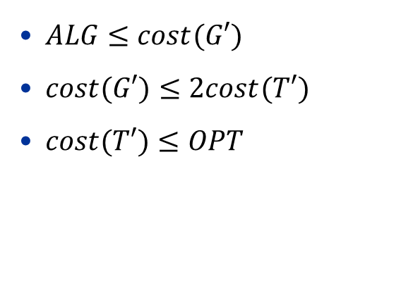
Metric TSP: a 2-Approx. Algorithm
$ALG≤cost(G′)$
$cost(G′)≤2cost(T′)$
$cost(T′)≤OPT$
v0
4
v1
v0
4
v1
3
3
2
5
2
5
4
4
2
2
v2
v3
v2
v3
Fig.1. An instance of TSP
Fig.2. An instance of T’

Slide 40
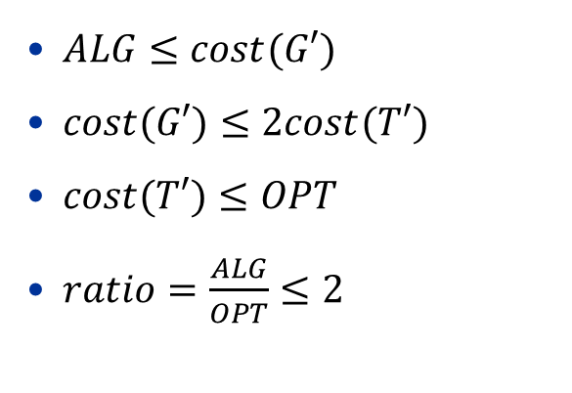
Metric TSP: a 2-Approx. Algorithm
$ALG≤cost(G′)$
$cost(G′)≤2cost(T′)$
$cost(T′)≤OPT$
$ratio=\frac{ALG}{OPT}≤2$
v0
4
v1
v0
4
v1
3
3
2
5
2
5
4
4
2
2
v2
v3
v2
v3
Fig.1. An instance of TSP
Fig.4. An instance of T={v0,v1,v2,v3,v1}

Slide 41
Outline
Definition: Steiner Tree and Metric Steiner Tree
Approximation Algorithm: Metric Steiner Tree
Ratio Analysis
Thightness Analysis
Definition: TSP and Metric TSP
Approximation Algorithm: Metric TSP
Hardness Analysis
Ratio Analysis
Thightness Analysis
Summary

Slide 42
Metric TSP: a 2-Approx. Algorithm
Is the analysis tight?
Is the approx. ratio tight?
The answer is No if you can find a better approx. algorithm.
How to optimize the approx. algorithm.

Slide 43

Metric TSP: a 2-Approx. Algorithm
$ALG≤cost(G′)$
$cost\left(G^{′}\right)≤2cost\left(T^{′}\right)$
$cost(T′)≤OPT$
$ratio=\frac{ALG}{OPT}≤2$
v0
4
v1
v0
4
If we can reduce 2 in this step to 1.5, we get a better approx.
v1
3
2
5
2
4
2
2
v2
v3
v2
v3
Fig.1. An instance of TSP
Fig.2. An instance of G’

Slide 44
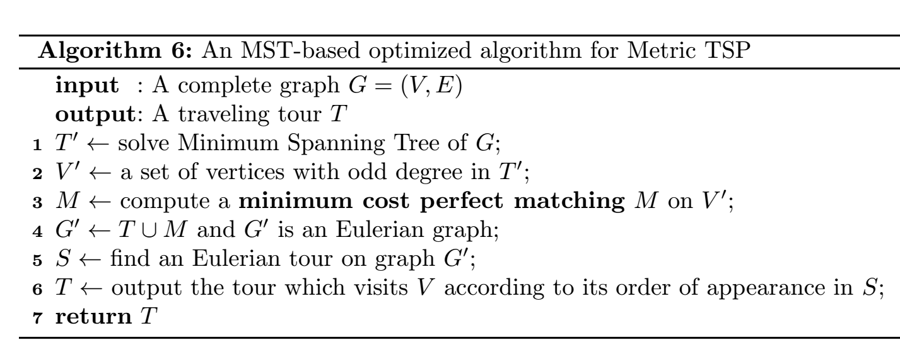
Metric TSP: a 3/2-Approx. Algorithm
Only different steps

Slide 45
Metric TSP: a 3/2-Approx. Algorithm
v0
4
v1
v0
4
v1
3
3
2
5
2
5
4
4
2
2
v2
v3
v2
v3
Fig.1. An instance of TSP
Fig.2. An instance of T’

Slide 46
Metric TSP: a 3/2-Approx. Algorithm
v0
4
v1
v0
4
v1
3
3
2
5
2
5
4
4
2
2
v2
v3
v2
v3
Fig.1. An instance of TSP
Fig.3. V’={v1,v3} because the degree is 1

Slide 47
Metric TSP: a 3/2-Approx. Algorithm
v0
4
v1
v0
4
v1
3
3
2
5
2
5
blue: MST
red: match
4
4
2
2
v2
v3
v2
v3
Fig.1. An instance of TSP
Fig.4. M only contains edge (v1,v3).

Slide 48
Metric TSP: a 3/2-Approx. Algorithm
v0
4
v1
v0
4
v1
3
2
5
2
5
4
2
2
v2
v3
v2
v3
Fig.1. An instance of TSP
Fig.5. The Eulerian graph G’

Slide 49
Metric TSP: a 3/2-Approx. Algorithm
v0
4
v1
v0
4
④
v1
3
2
5
2
5
4
①
③
2
2
v2
v3
v2
v3
②
Fig.1. An instance of TSP
Fig.6. S is an Eulerian tour starting from v0

Slide 50
Metric TSP: a 3/2-Approx. Algorithm
v0
4
v1
v0
4
④
v1
3
2
5
2
5
4
①
③
2
2
v2
v3
v2
v3
②
Fig.1. An instance of TSP
Fig.7. T = {v0,v2,v3,v1}.

Slide 51

Metric TSP: a 3/2-Approx. Algorithm
v0
4
4
$ALG≤cost(G′)$
v1
v0
v1
It still holds.
3
2
5
2
5
4
2
2
v2
v3
v2
v3
Fig.1. An instance of TSP
Fig.7. T = {v0,v2,v3,v1}.

Slide 52

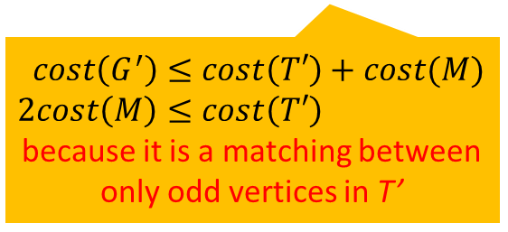
Metric TSP: a 3/2-Approx. Algorithm
v0
4
v1
v0
4
$ALG≤cost\left(G^{′}\right)$
$cost\left(G^{′}\right)≤1.5cost\left(T′\right)$
v1
3
2
5
2
5
4
2
2
$$cost\left(G^{′}\right)≤cost\left(T′\right)+cost(M)$$
$$2cost\left(M\right)≤cost\left(T′\right)$$
because it is a matching between only odd vertices in T’
v2
v3
v2
v3
Fig.1. An instance of TSP
Fig.5. The Eulerian graph G’

Slide 53

Metric TSP: a 3/2-Approx. Algorithm
v0
4
v1
v0
4
$ALG≤cost\left(G^{′}\right)$
$cost\left(G^{′}\right)≤1.5cost\left(T′\right)$
$cost\left(T^{′}\right)≤OPT$
v1
3
3
2
5
2
5
4
4
2
2
v2
v3
v2
v3
Because T’ is a Minimum Spanning Tree.
Fig.1. An instance of TSP
Fig.2. An instance of T’

Slide 54

Metric TSP: a 3/2-Approx. Algorithm
v0
4
v1
v0
4
$ALG≤cost(G′)$
$cost\left(G^{′}\right)≤1.5cost\left(T^{′}\right)$
$cost(T′)≤OPT$
$ratio=\frac{ALG}{OPT}≤1.5$
v1
3
2
5
2
5
4
2
2
v2
v3
v2
v3
Fig.1. An instance of TSP
Fig.7. T = {v0,v2,v3,v1}.

Slide 55
Outline
Definition: Steiner Tree and Metric Steiner Tree
Approximation Algorithm: Metric Steiner Tree
Ratio Analysis
Thightness Analysis
Definition: TSP and Metric TSP
Approximation Algorithm: Metric TSP
Hardness Analysis
Ratio Analysis
Thightness Analysis
Summary

Slide 56
Summary of Chapter 3
Poly-time solvable problem is helpful to approximate.

Slide 57
Summary of Chapter 1-3
The core step is to find the lower bound of OPT.
Greedy based algorithm usually can be approximated.
Poly-time solvable problem is helpful to approximate.

Slide 58
Reading list
Approximation Algorithms. Vijay, V. Vazirani.
Introduction to Algorithms, CLRS.
Slides for the course “Complexity Theory”, http://sma.epfl.ch/~moustafa/Other/Complexityslides/
Slides for the book “Algorithm Design”, http://www.cs.princeton.edu/~wayne/kleinberg-tardos/

