Slide 1
Multiway Cut and k-Cut
Qiyu Liu
2018/4/12

Slide 2
Outline
Minimum s-t cut.
Minimum multiway cut.
Minimum k-cut.

Slide 3
Outline
Minimum s-t cut.
Minimum multiway cut.
Minimum k-cut.

Slide 4
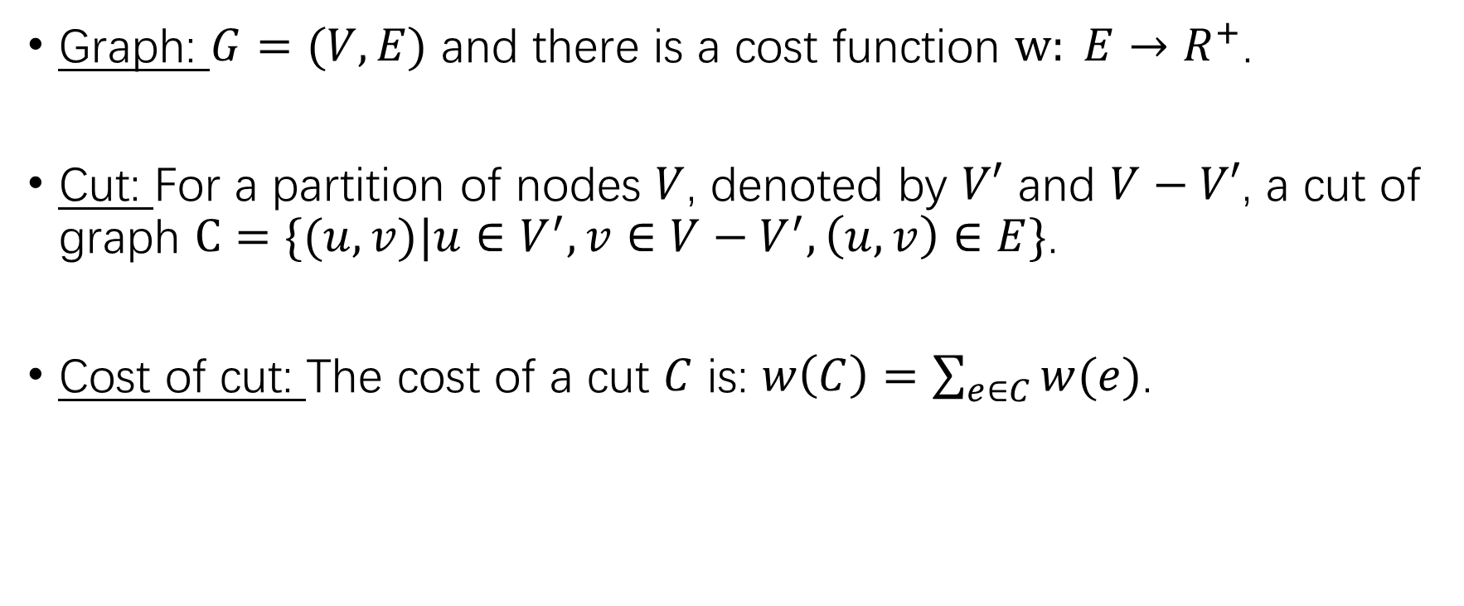
Graph Partition
Graph: $G=(V,E)$ and there is a cost function $w: E→R^{+}$.
Cut: For a partition of nodes $V$, denoted by $V′$ and $V−V′$, a cut of graph $C=\{(u,v)|u∈V^{′},v∈V−V^{′}, \left(u,v\right)∈E\}$.
Cost of cut: The cost of a cut $C$ is: $w\left(C\right)=\sum_{e∈C}{w(e)}$.

Slide 5
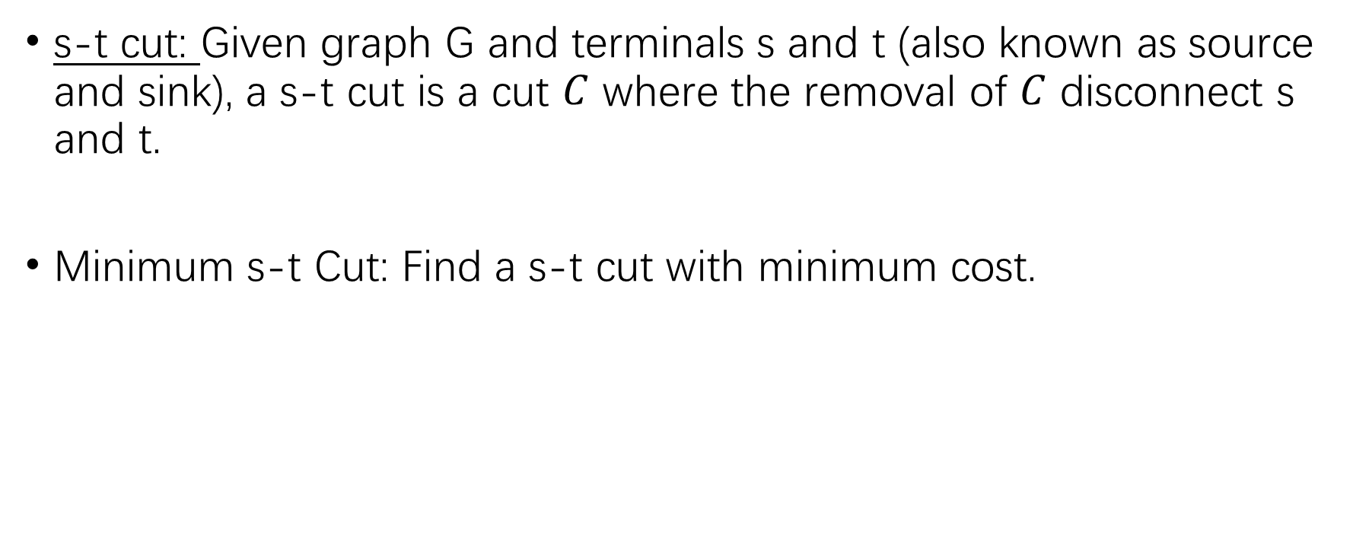
Minimum s-t Cut
s-t cut: Given graph G and terminals s and t (also known as source and sink), a s-t cut is a cut $C$ where the removal of $C$ disconnect s and t.
Minimum s-t Cut: Find a s-t cut with minimum cost.

Slide 6
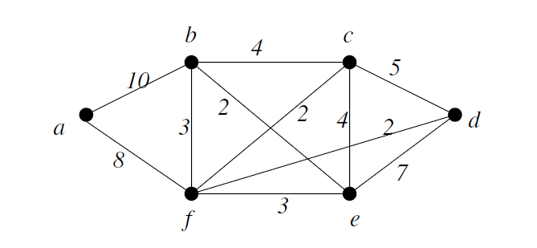
Minimum s-t Cut
Let s and t be a and d,

Slide 7
Minimum s-t Cut
There exists polynomial algorithm to solve s-t cut problem optimally.
Min-cut max-flow theorem: Minimize cost of s-t cut is equal to maximize s-t flow. (min s-t cut is dual problem of max s-t flow)

Slide 8
Outline
Minimum s-t cut.
Minimum multiway cut.
Minimum k-cut.

Slide 9
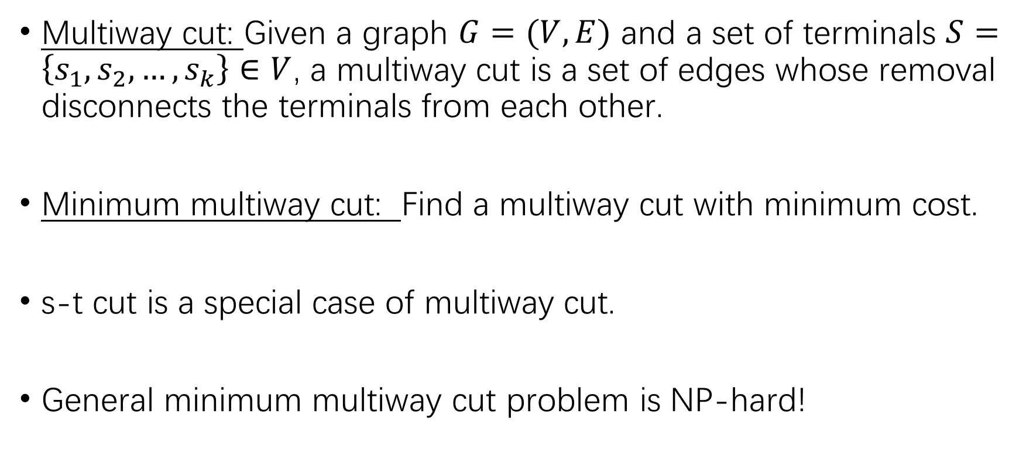
Minimum Multiway Cut
Multiway cut: Given a graph $G=(V,E)$ and a set of terminals $S=\left\{s_{1},s_{2},…,s_{k}\right\}∈V$, a multiway cut is a set of edges whose removal disconnects the terminals from each other.
Minimum multiway cut: Find a multiway cut with minimum cost.
s-t cut is a special case of multiway cut.
General minimum multiway cut problem is NP-hard!

Slide 10

Minimum Multiway Cut
Isolating cut: For a terminal $s_{i}∈S$, its isolating cut is a set of edges whose removal disconnects $s_{i}$ from all the rest terminals.
Suppose S={a, c, d}, for terminal a, its isolating cut can be …

Slide 11
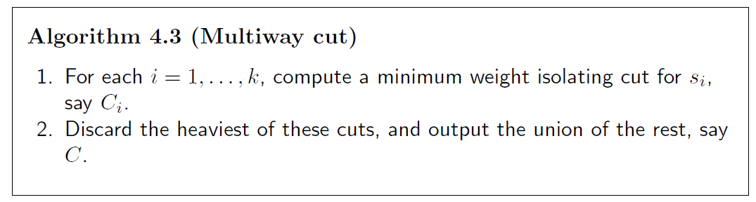
Minimum Multiway Cut-Algorithm
How to obtain?

Slide 12


Minimum Multiway Cut-Algorithm
S={a, c, d} and we want to calculate minimum isolating cut of terminal a.
For the remaining terminals c and d, create a new vertex t with edges connecting c and d. Set the cost of (c, t) and (d, t) as infinity.
Invoke minimum s-t cut algorithm by setting a and t as terminals.
$$+∞$$
t
$$+∞$$

Slide 13
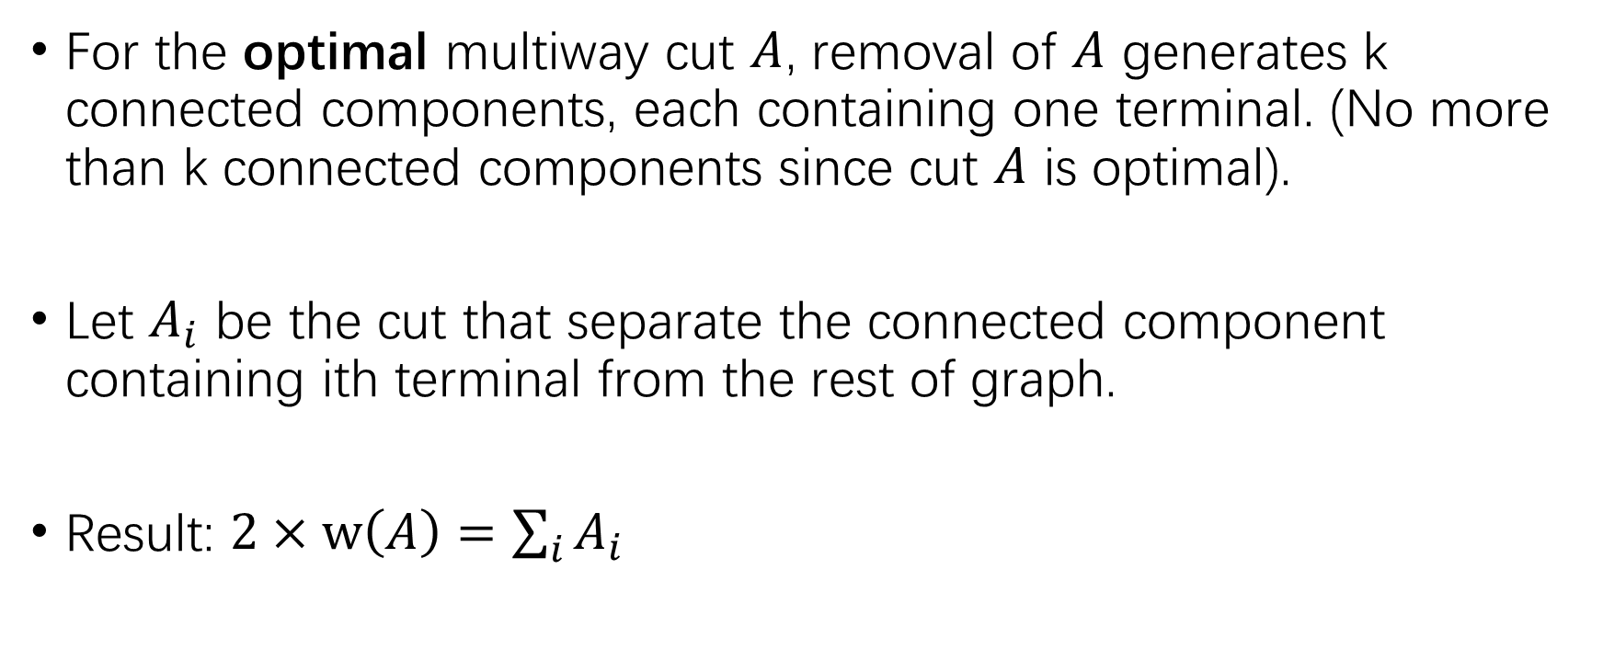
Minimum Multiway Cut-Analysis
For the optimal multiway cut $A$, removal of $A$ generates k connected components, each containing one terminal. (No more than k connected components since cut $A$ is optimal).
Let $A_{i}$ be the cut that separate the connected component containing ith terminal from the rest of graph.
Result: $2×w\left(A\right)=\sum_{i}{A_{i}}$

Slide 14

Minimum Multiway Cut-Analysis
Result: $2×w\left(A\right)=\sum_{i}{A_{i}}$
This result is very common and useful in graph based problem!

Slide 15
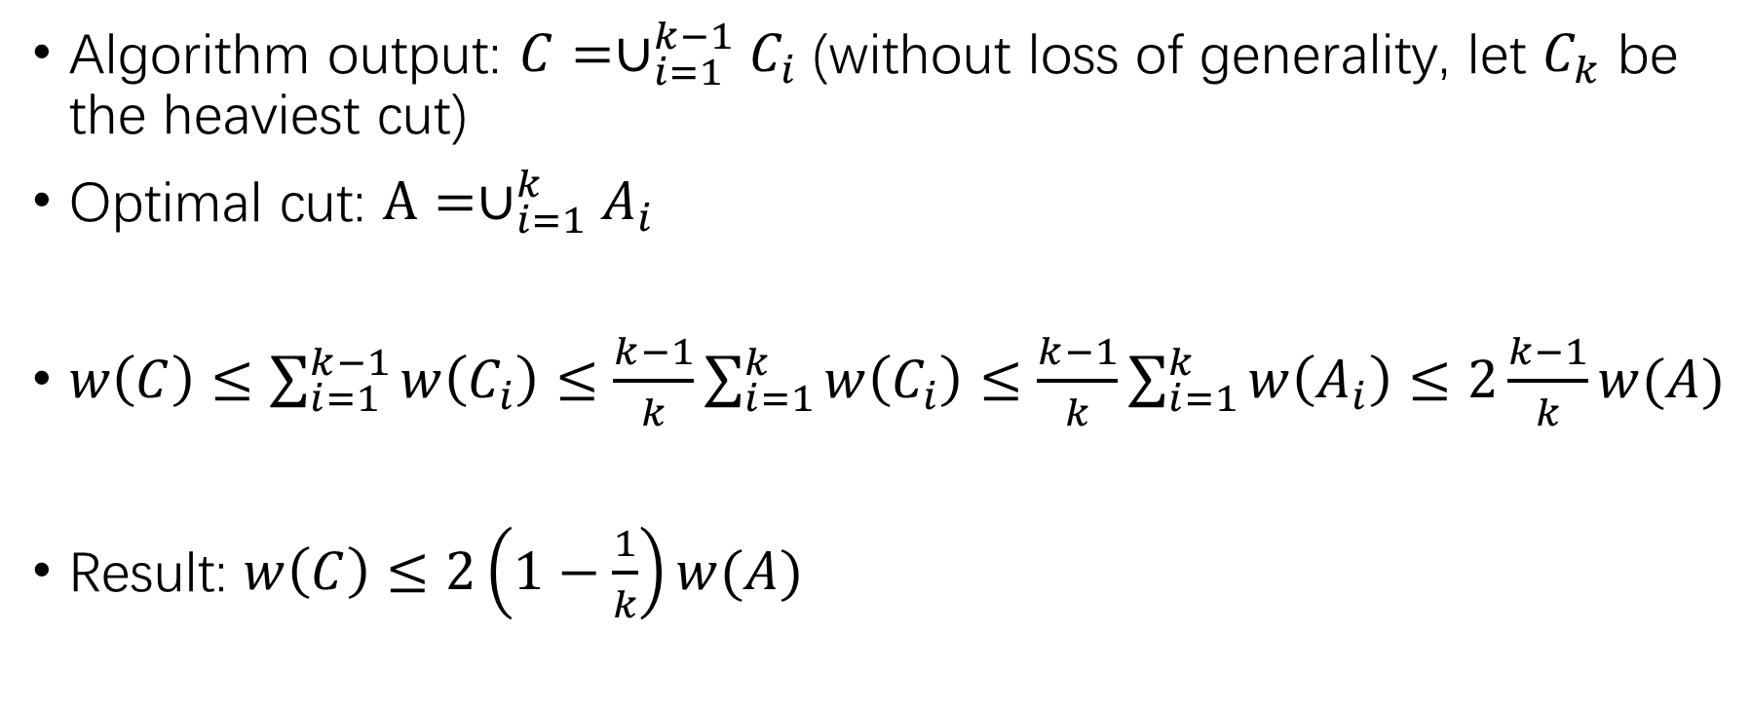
Minimum Multiway Cut-Analysis
Algorithm output: $C=∪_{i=1}^{k−1}C_{i}$ (without loss of generality, let $C_{k}$ be the heaviest cut)
Optimal cut: $A=∪_{i=1}^{k}A_{i}$
$w\left(C\right)≤\sum_{i=1}^{k−1}{w\left(C_{i}\right)}≤\frac{k−1}{k}\sum_{i=1}^{k}{w\left(C_{i}\right)}≤\frac{k−1}{k}\sum_{i=1}^{k}{w\left(A_{i}\right)}≤$ $2\frac{k−1}{k}w(A)$
Result: $w\left(C\right)≤2\left(1−\frac{1}{k}\right)w(A)$

Slide 16
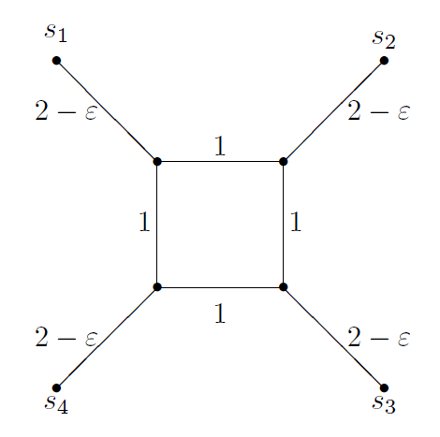

Minimum Multiway Cut-Analysis
Analysis is tight by considering such a case:
Our algorithm outputs the blue line.
Optimal cut is the red line.
Ratio is: $\lim_{ε→0}{\frac{(k−1)(2−ε)}{k}}=2×(1−\frac{1}{k})$

Slide 17
Outline
Minimum s-t cut.
Minimum multiway cut.
Minimum k-cut.

Slide 18
Minimum k-Cut
What if terminal set is not given?
k-cut: A set of edges whose removal generates k connected components.
Minimum k-cut: Find k-cut with minimum cost.

Slide 19
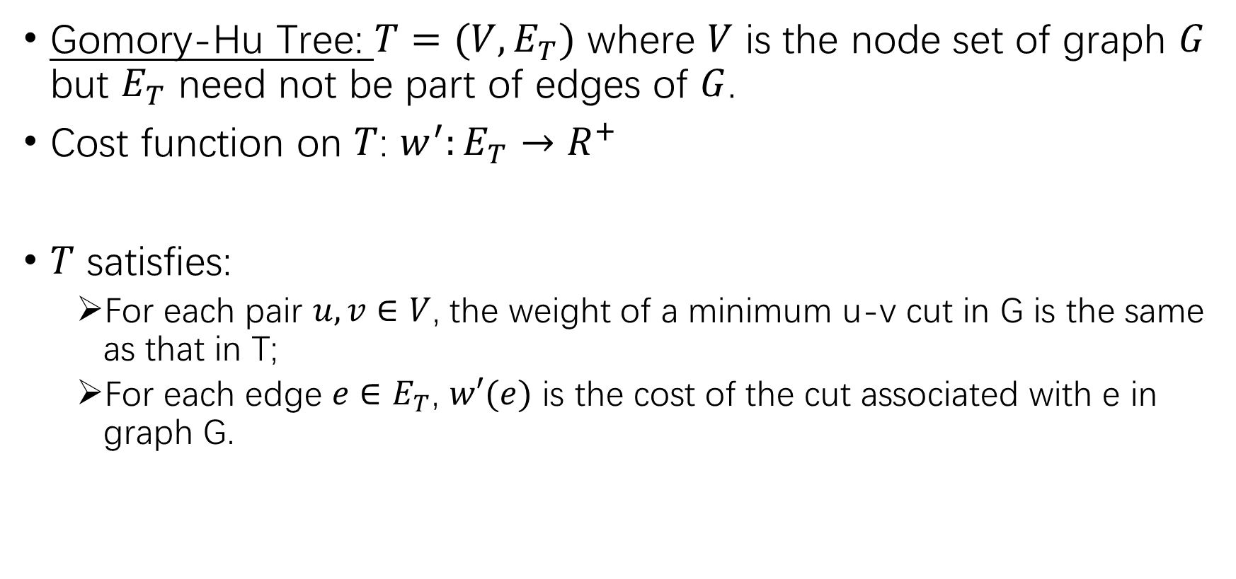
Minimum k-Cut
Gomory-Hu Tree: $T=(V,E_{T})$ where $V$ is the node set of graph $G$ but $E_{T}$ need not be part of edges of $G$.
Cost function on $T$: $w^{′}:E_{T}→R^{+}$
$T$ satisfies:
For each pair $u, v∈V$, the weight of a minimum u-v cut in G is the same as that in T;
For each edge $e∈E_{T}$, $w′(e)$ is the cost of the cut associated with e in graph G.

Slide 20
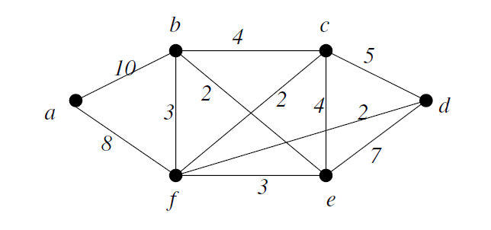
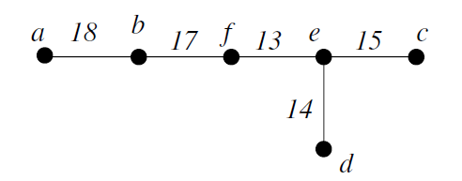

Minimum k-Cut
Gomory-Hu Tree Example:
Existence of Gomory-Hu tree implies that there are totally $\left|V\right|−1$ different values among all $C_{|V|}^{2}$ pairs of minimum s-t cut.

Slide 21

Minimum k-Cut
More Example:
(a,b): a-b
(b,f): a-f, b-f
(f,e): a-e, b-e, f-e, a-c, b-c, f-c, a-d, b-d, f-d
(e,c): e-c
(e,d): e-d, c-d
$$C_{6}^{2}=15$$

Slide 22
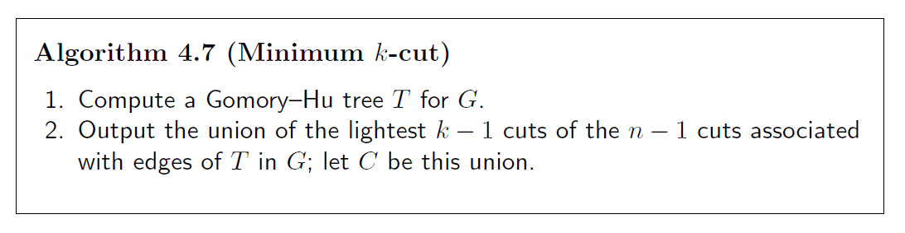
Minimum k-Cut - Algorithm
Please refer to the lecture notes in attachment for details.

Slide 23
Minimum k-Cut - Algorithm
In line 2, removal of C generates at least k connected components.
If more than k, throwback some edges until there are exactly k connected components.

Slide 24






Minimum k-Cut - Analysis
Assume the optimal cut $A$, removal of $A$ generates k connected components denoted by $V_{1},V_{2},…,V_{k}$. Let $A_{i}$ be the cut that separates $V_{i}$ from the rest of the graph.
$$V_{1}$$
$$V_{4}$$
$$2×w\left(A\right)=\sum_{i}{A_{i}}$$
$$V_{2}$$
$$V_{3}$$

Slide 25








Minimum k-Cut - Analysis
Construct a new graph G’:
Nodes are k components;
Edges are edges in Gomory-Hu tree that cross two different components.
Example:
$$V_{1}$$
$$V_{4}$$
$$V_{1}$$
$$V_{4}$$
$$V_{2}$$
$$V_{2}$$
$$V_{3}$$
$$V_{3}$$

Slide 26
Minimum k-Cut - Analysis
Claim: G’ must be connected.
The proof is straightforward since the Gomory-Hu tree of G is connected.

Slide 27



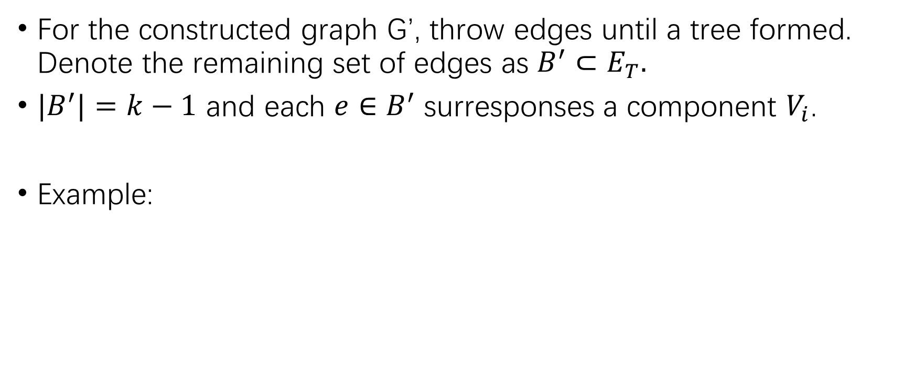





Minimum k-Cut - Analysis
For the constructed graph G’, throw edges until a tree formed. Denote the remaining set of edges as $B^{′}⊂E_{T}.$
${|B}^{′}|=k−1$ and each $e∈B^{′}$ surresponses a component $V_{i}$.
Example:
$$V_{1}$$
$$V_{4}$$
$$V_{1}$$
$$V_{4}$$
$$V_{2}$$
$$V_{2}$$
$$V_{3}$$
$$V_{3}$$

Slide 28
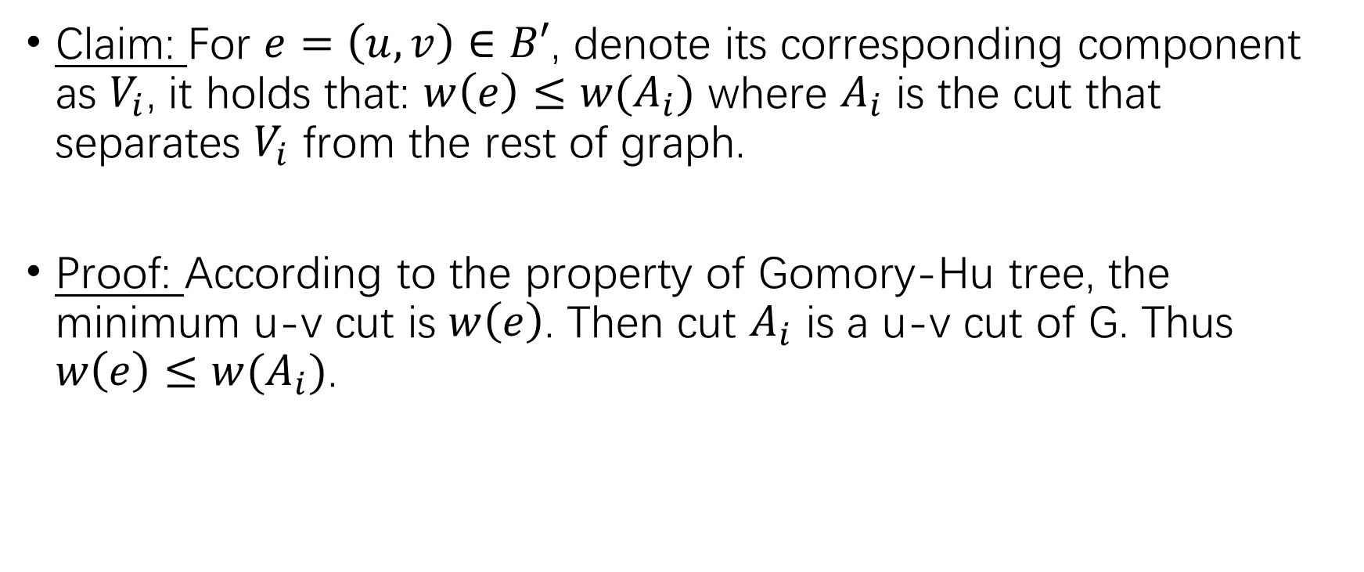
Minimum k-Cut - Analysis
Claim: For $e=\left(u,v\right)∈B′$, denote its corresponding component as $V_{i}$, it holds that: $w\left(e\right)≤w(A_{i})$ where $A_{i}$ is the cut that separates $V_{i}$ from the rest of graph.
Proof: According to the property of Gomory-Hu tree, the minimum u-v cut is $w\left(e\right)$. Then cut $A_{i}$ is a u-v cut of G. Thus $w\left(e\right)≤w(A_{i})$.

Slide 29
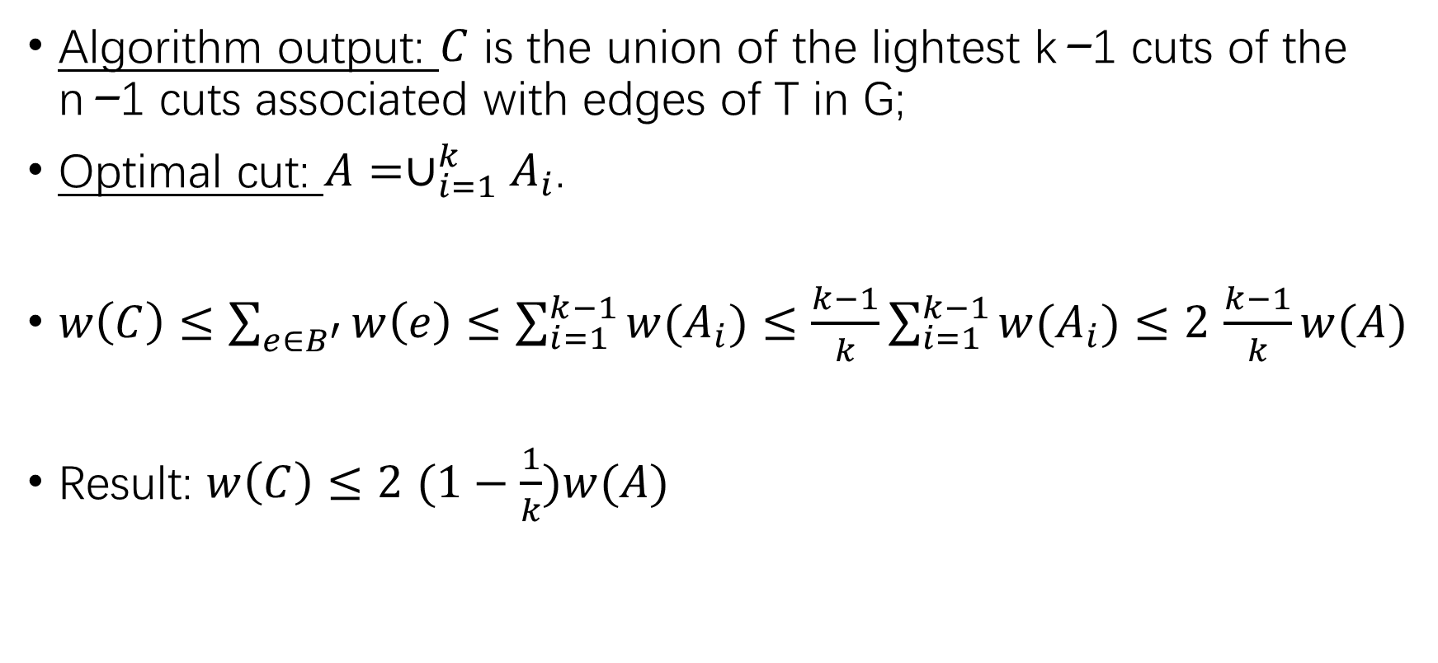
Minimum k-Cut - Analysis
Algorithm output: $C$ is the union of the lightest k−1 cuts of the n−1 cuts associated with edges of T in G;
Optimal cut: $A=∪_{i=1}^{k}A_{i}$.
$w\left(C\right)≤\sum_{e∈B^{′}}{w\left(e\right)≤\sum_{i=1}^{k−1}{{w(A}_{i})}}≤\frac{k−1}{k}\sum_{i=1}^{k−1}{{w(A}_{i})}≤2$ $\frac{k−1}{k}w(A)$
Result: $w\left(C\right)≤2 (1−\frac{1}{k})w(A)$

Slide 30
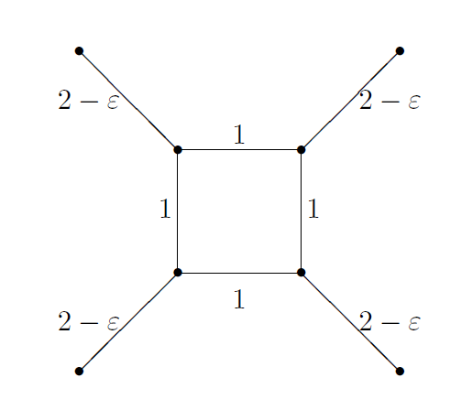
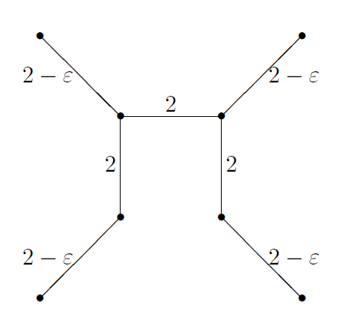
Minimum k-Cut - Analysis
Analysis is tight by considering the following example:
Graph G
Gomory-Hu tree T

Slide 31

Minimum k-Cut - Analysis
Our algorithm outputs the blue line.
Optimal cut is the red line.
Ratio is: $\lim_{ε→0}{\frac{(k−1)(2−ε)}{k}}=2×(1−\frac{1}{k})$

