Slide 1

$k$-center
——Yao Kai

Slide 2
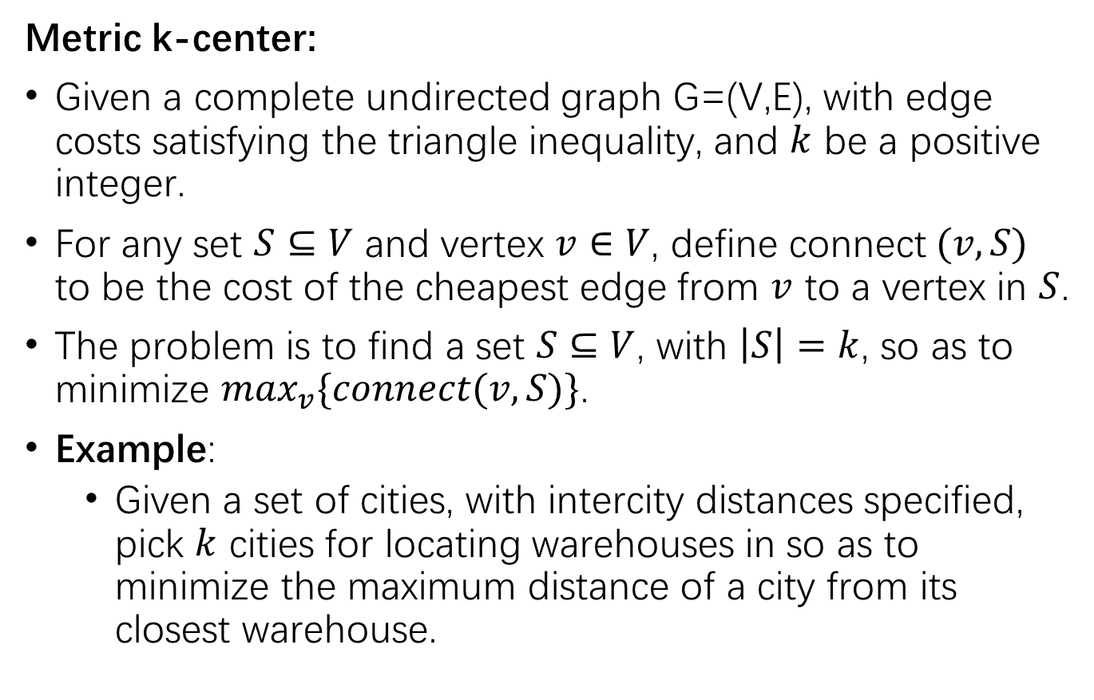
1 Definition
1
1
Metric k-center:
Given a complete undirected graph G=(V,E), with edge costs satisfying the triangle inequality, and $k$ be a positive integer.
For any set $S⊆V$ and vertex $v∈V$, define connect $(v,S)$ to be the cost of the cheapest edge from $v$ to a vertex in $S$.
The problem is to find a set $S⊆V$, with $\left|S\right|=k$, so as to minimize $\max_{v}\{connect(v,S)\}$.
Example:
Given a set of cities, with intercity distances specified, pick $k$ cities for locating warehouses in so as to minimize the maximum distance of a city from its closest warehouse.
2
2
2
1
2
2
1
1

Slide 3
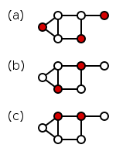
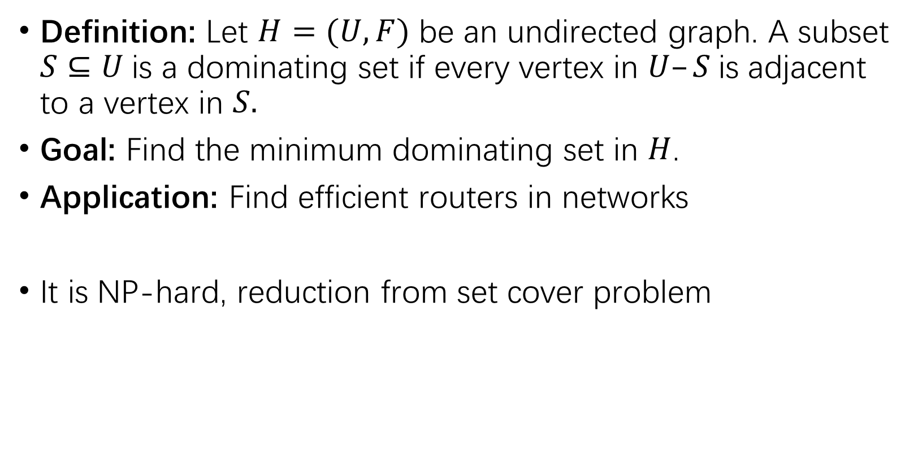
2 Minimum Dominating Set (MDS)
Definition: Let $H=(U,F)$ be an undirected graph. A subset $S⊆U$is a dominating set if every vertex in $U–S$is adjacent to a vertex in $S.$
Goal: Find the minimum dominating set in $H$.
Application: Find efficient routers in networks
It is NP-hard, reduction from set cover problem
OPT solution: 1
Another solution: 5

Slide 4
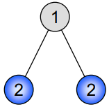
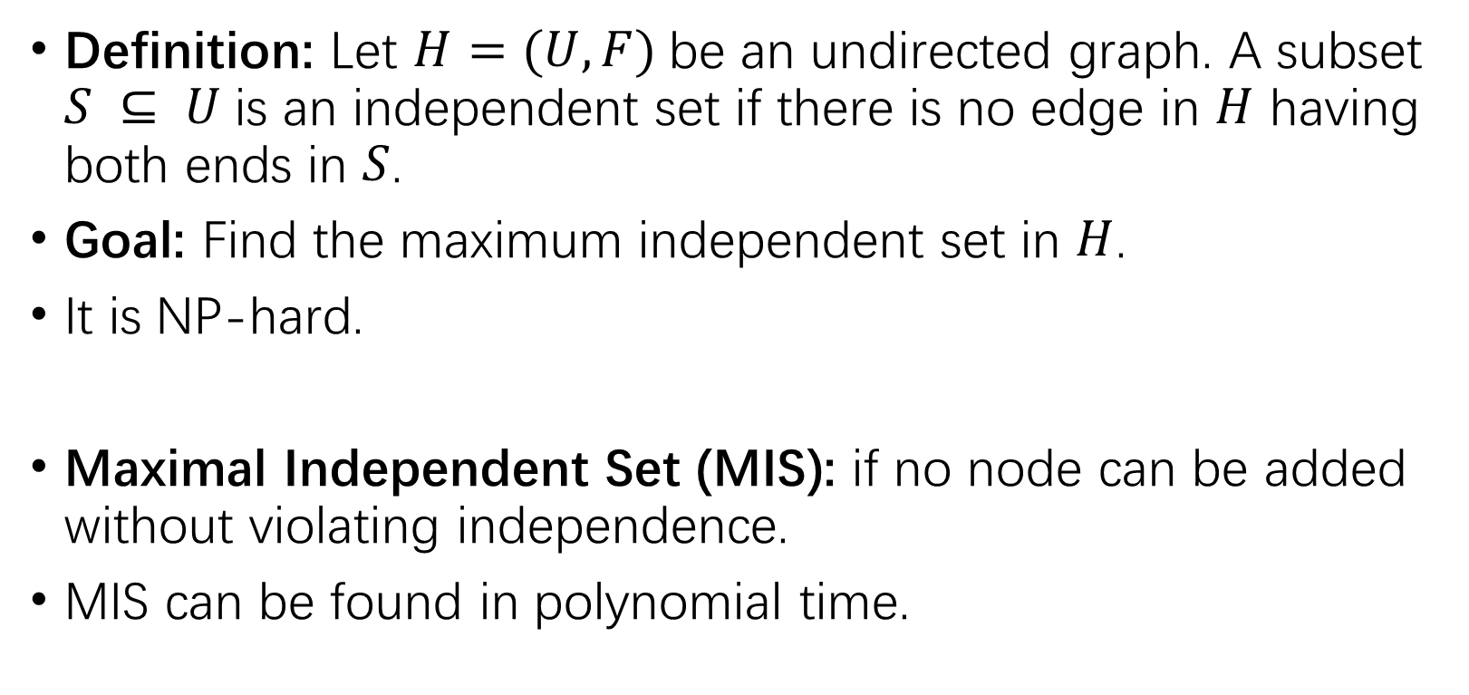
3 Maximum Independent Set (MaxIS)
Definition: Let $H=(U,F)$be an undirected graph. A subset $S ⊆ U$is an independent set if there is no edge in $H$ having both ends in $S$.
Goal: Find the maximum independent set in $H$.
It is NP-hard.
Maximal Independent Set (MIS): if no node can be added without violating independence.
MIS can be found in polynomial time.

Slide 5





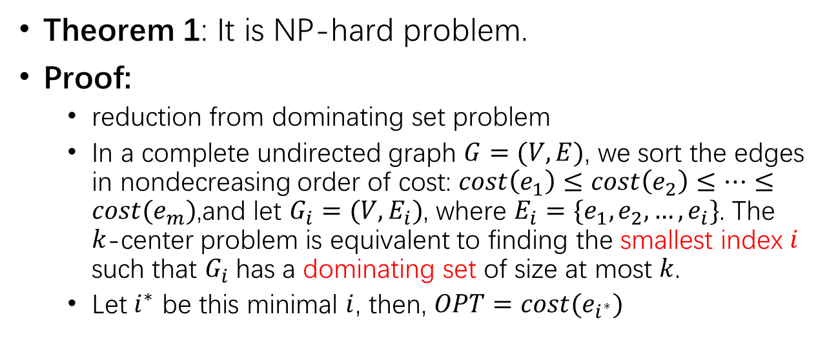






4 NP-hard problem
$$dom(G_{i})$$
Theorem 1: It is NP-hard problem.
Proof:
reduction from dominating set problem
In a complete undirected graph $G=(V, E)$, we sort the edges in nondecreasing order of cost: $cost\left(e_{1}\right)≤cost\left(e_{2}\right)≤…≤cost(e_{m})$,and let $G_{i}=(V,E_{i})$, where $E_{i}=\{e_{1},e_{2},…,e_{i}\}$. The $k$-center problem is equivalent to finding the smallest index $i$ such that $G_{i}$has a dominating set of size at most $k$.
Let $i^{∗}$ be this minimal $i$, then, $OPT=cost(e_{i^{∗}})$
7
8
6
$$G_{1}$$
$$G_{2}$$
$$G_{3}$$
$$G_{4}$$
……
3
5
4
Suppose k=2
OPT=4
$$cost(e_{i})$$
7
6
6
3
3
5
5
3
5
3
3
4
4
4
4
$$G_{1}$$
$$G_{2}$$
$$G_{3}$$
$$G_{4}$$
$$G_{5}$$
Dom=3
Dom=2
Dom=2
Dom=1
Dom=1

Slide 6

5 Powers of graphs
Let $G=(V,E)$be a graph. The square of $G$ is the graph $G2=(V,E’),$where $(u,v) ∈ E’$if there is a path of length at most 2 between $u$ and $v$ in $G$ (and $u≠v$)

Slide 7

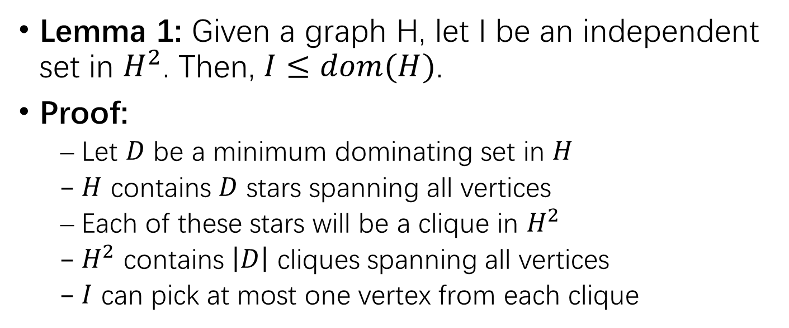

6 Approximation algorithm with ratio 2
Lemma 1: Given a graph H, let I be an independent set in $H^{2}$. Then, $I≤dom(H)$.
Proof:
Let $D$ be a minimum dominating set in $H$
$H$ contains $D$ stars spanning all vertices
Each of these stars will be a clique in $H^{2}$
$H^{2}$ contains $\left|D\right|$ cliques spanning all vertices
$I$ can pick at most one vertex from each clique
H
D: black nodes
H
D: black nodes
$$H^{2}$$
$$H^{2}$$

Slide 8
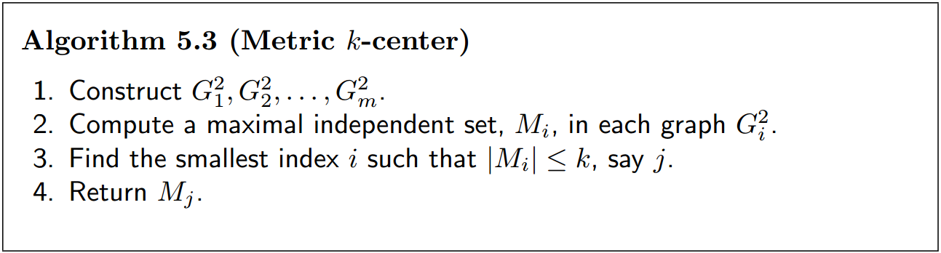

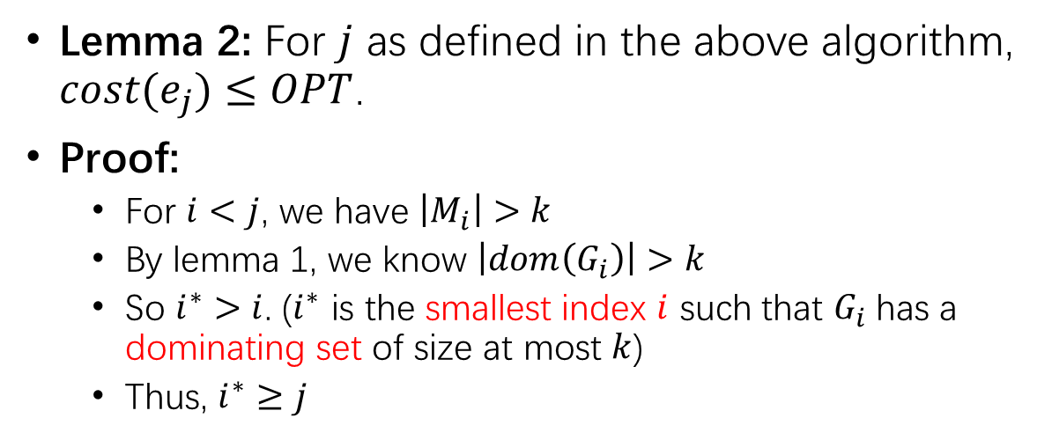




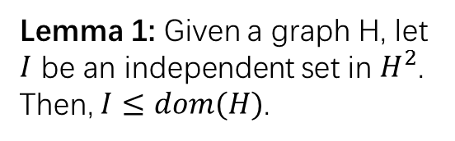

maximal independent set can be found in polynomial time.
Lemma 2: For $j$ as defined in the above algorithm, $cost(e_{j})≤OPT$.
Proof:
For $i<j$, we have $\left|M_{i}\right|>k$
By lemma 1, we know $\left|dom\left(G_{i}\right)\right|>k$
So $i^{∗}>i$. ($i^{∗}$ is the smallest index $i$ such that $G_{i}$has a dominating set of size at most $k$)
Thus, $i^{∗}≥j$
Lemma 1: Given a graph H, let $I$ be an independent set in $H^{2}$. Then, $I≤dom(H)$.
$$dom(G_{i})$$
$$G_{1}$$
$$G_{2}$$
$$G_{3}$$
$$G_{4}$$
……
Intuition behind this lemma:
Maximal independent set is always smaller than maximum independent set.
$$cost(e_{i})$$

Slide 9
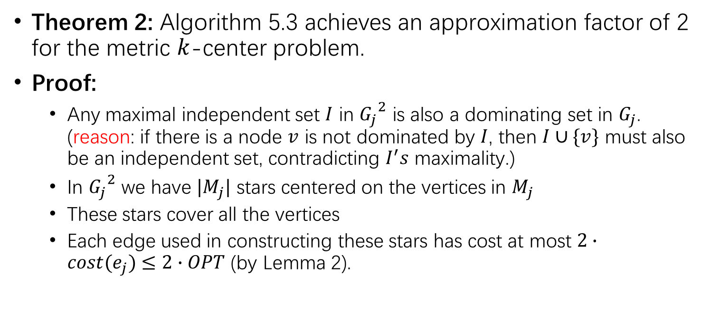
Theorem 2: Algorithm 5.3 achieves an approximation factor of 2 for the metric $k$-center problem.
Proof:
Any maximal independent set $I$ in ${G_{j}}^{2}$ is also a dominating set in $G_{j}$. (reason: if there is a node $v$ is not dominated by $I$, then $I∪\{v\}$ must also be an independent set, contradicting $I^{′}s$ maximality.)
In ${G_{j}}^{2}$ we have $|M_{j}|$ stars centered on the vertices in $M_{j}$
These stars cover all the vertices
Each edge used in constructing these stars has cost at most $2∙cost(e_{j})≤2∙OPT$ (by Lemma 2).

Slide 10
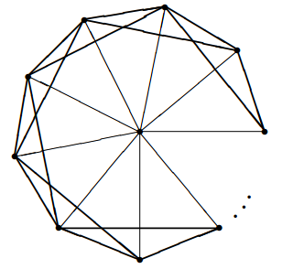
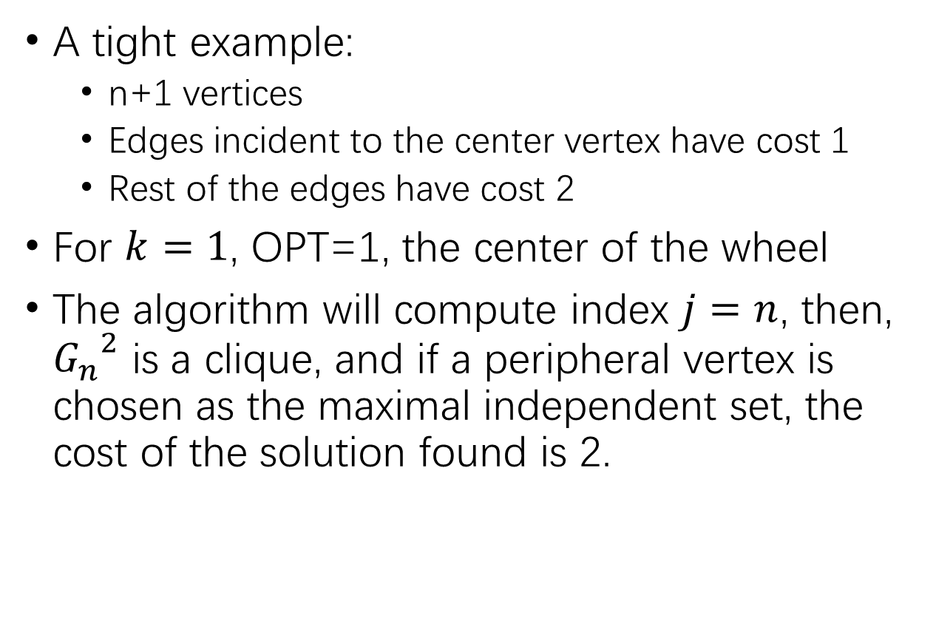
A tight example:
n+1 vertices
Edges incident to the center vertex have cost 1
Rest of the edges have cost 2
For $k=1$, OPT=1, the center of the wheel
The algorithm will compute index $j=n$, then, ${G_{n}}^{2}$ is a clique, and if a peripheral vertex is chosen as the maximal independent set, the cost of the solution found is 2.

Slide 11
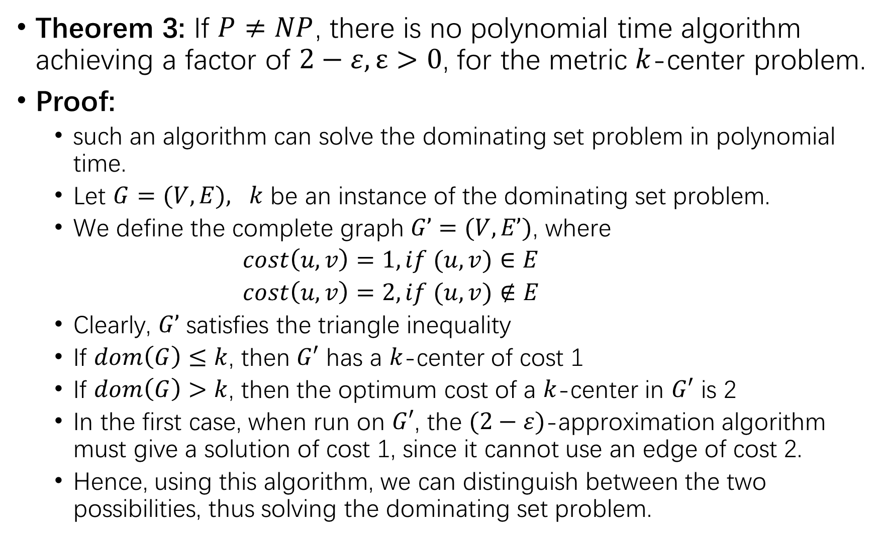
Theorem 3: If $P≠NP$, there is no polynomial time algorithm achieving a factor of $2−ε, ε>0$, for the metric $k$-center problem.
Proof:
such an algorithm can solve the dominating set problem in polynomial time.
Let $G=(V,E), k$ be an instance of the dominating set problem.
We define the complete graph $G’=(V,E’)$, where
$cost\left(u,v\right)=1, if (u,v)∈E$
$cost\left(u,v\right)=2, if (u,v)∉E$
Clearly, $G’$ satisfies the triangle inequality
If $dom\left(G\right)≤k$, then $G′$ has a $k$-center of cost 1
If $dom\left(G\right)>k$, then the optimum cost of a $k$-center in $G′$ is 2
In the first case, when run on $G′$, the $(2−ε)$-approximation algorithm must give a solution of cost 1, since it cannot use an edge of cost 2.
Hence, using this algorithm, we can distinguish between the two possibilities, thus solving the dominating set problem.

Slide 12
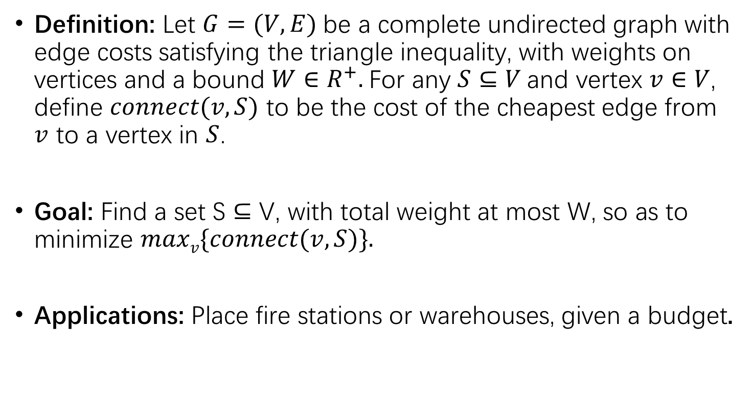

The weighted $k$-center problem
Definition: Let $G=(V,E)$be a complete undirected graph with edge costs satisfying the triangle inequality, with weights on vertices and a bound $W∈R^{+}.$For any $S⊆V$and vertex $v∈V$, define $connect(v,S)$ to be the cost of the cheapest edge from $v$ to a vertex in $S$.
Goal: Find a set S ⊆ V, with total weight at most W, so as to minimize $maxv\{connect(v,S)\}.$
Applications: Place fire stations or warehouses, given a budget.
2
5
3
2
4
1
Suppose W=1,
OPT=5

Slide 13


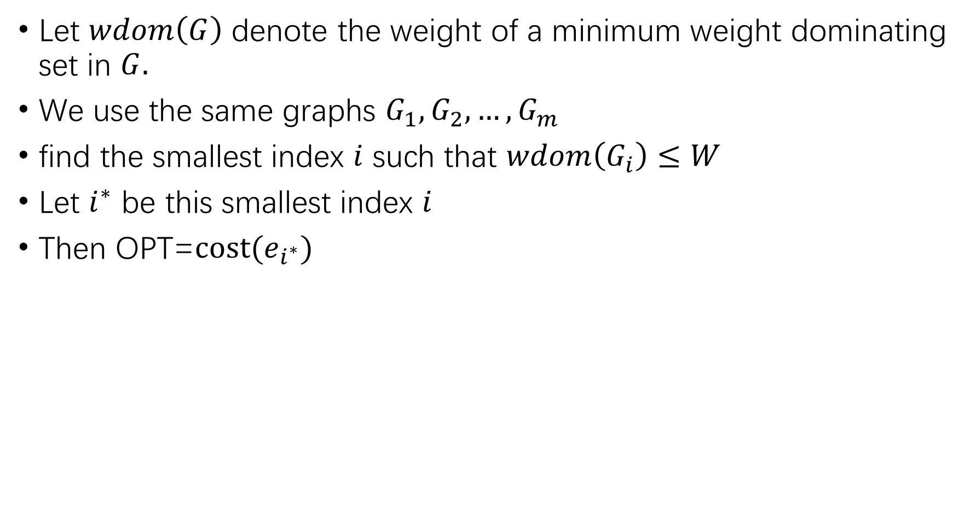
Let $wdom\left(G\right)$ denote the weight of a minimum weight dominating set in $G.$
We use the same graphs $G_{1}, G_{2}, …,G_{m}$
find the smallest index $i$ such that $wdom\left(G_{i}\right)≤W$
Let $i^{∗}$ be this smallest index $i$
Then OPT=$cost(e_{i^{∗}})$
$$wdom(G_{i})$$
$$G_{1}$$
$$G_{2}$$
$$G_{3}$$
$$G_{4}$$
……
$$cost(e_{i})$$

Slide 14
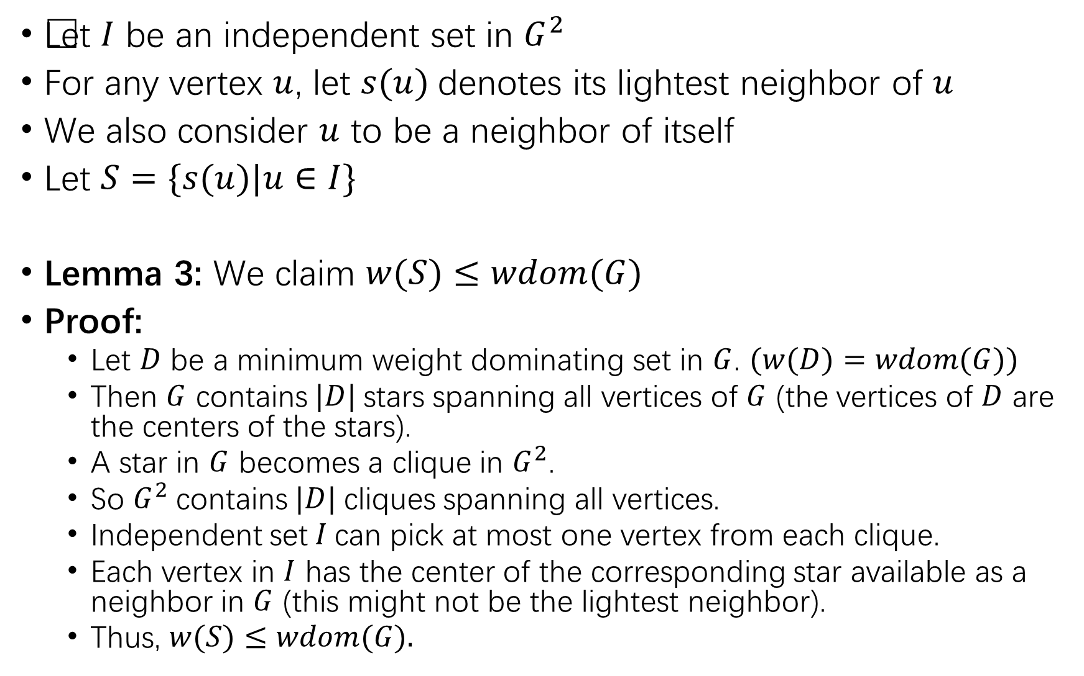
Let $I$ be an independent set in $G^{2}$
For any vertex $u$, let $s(u)$denotes its lightest neighbor of $u$
We also consider $u$ to be a neighbor of itself
Let $S=\{s(u)|u∈I\}$
Lemma 3: We claim $w(S)≤wdom(G)$
Proof:
Let $D$ be a minimum weight dominating set in $G$. $(w(D)=wdom(G))$
Then $G$ contains$|D|$stars spanning all vertices of $G$ (the vertices of $D$ are the centers of the stars).
A star in $G$ becomes a clique in $G^{2}$.
So $G^{2}$contains$|D|$cliques spanning all vertices.
Independent set$I$can pick at most one vertex from each clique.
Each vertex in $I$ has the center of the corresponding star available as a neighbor in $G$ (this might not be the lightest neighbor).
Thus, $w(S)≤wdom(G).$

Slide 15


Example:
2
2
1
1
3
1
3
1
3
2
3
3
2
3
$$G$$
$$wdom\left(G\right)=3$$
$$G^{2}$$
$$w\left(S\right)=2$$

Slide 16
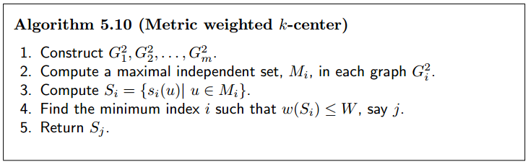
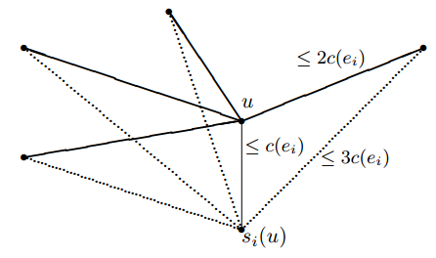
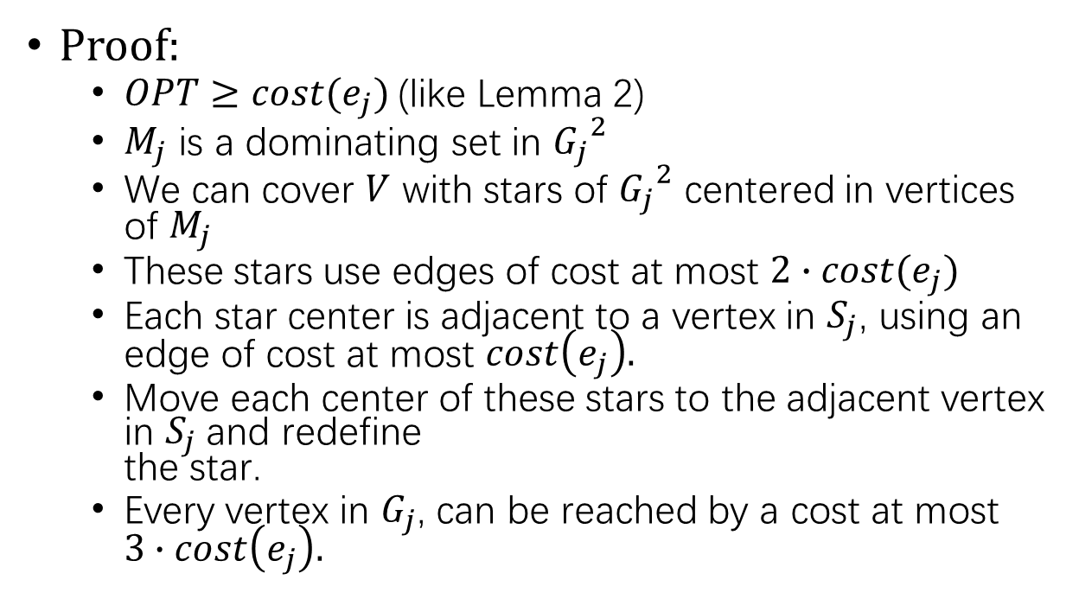
Proof:
$OPT≥cost(e_{j})$(like Lemma 2)
$M_{j}$ is a dominating set in ${G_{j}}^{2}$
We can cover $V$ with stars of ${G_{j}}^{2}$ centered in vertices of $M_{j}$
These stars use edges of cost at most $2∙cost(e_{j})$
Each star center is adjacent to a vertex in $S_{j}$, using an edge of cost at most $cost\left(e_{j}\right).$
Move each center of these stars to the adjacent vertex in $S_{j}$and redefine the star.
Every vertex in $G_{j}$, can be reached by a cost at most $3∙cost\left(e_{j}\right).$

Slide 17
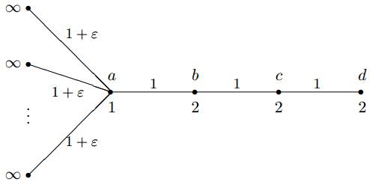
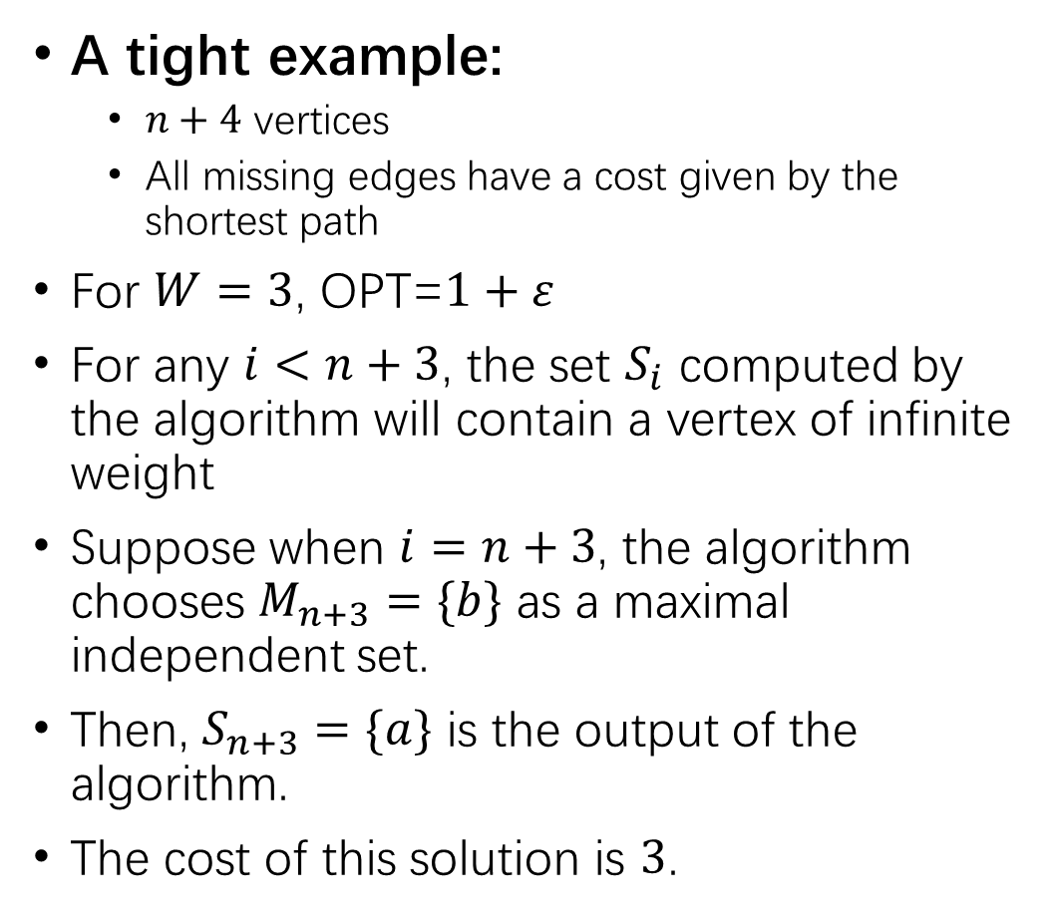
A tight example:
$n+4$ vertices
All missing edges have a cost given by the shortest path
For $W=3$, OPT=$1+ε$
For any $i<n+3$, the set $S_{i}$ computed by the algorithm will contain a vertex of infinite weight
Suppose when $i=n+3$, the algorithm chooses $M_{n+3}=\{b\}$ as a maximal independent set.
Then, $S_{n+3}=\{a\}$ is the output of the algorithm.
The cost of this solution is $3$.

