Slide 1
Approximation Algorithms Chapter 8: Knapsack
Vijay V. Vazirani Georgia Institute of Technology
Zeng Yuxiang
2018/04/30

Slide 2
Outline
Chapter 8: Knapsack
Definition
Basics
Algorithms
Conclusions

Slide 3
Outline
Chapter 8: Knapsack
Definition
Basics
Algorithms
Conclusions

Slide 4
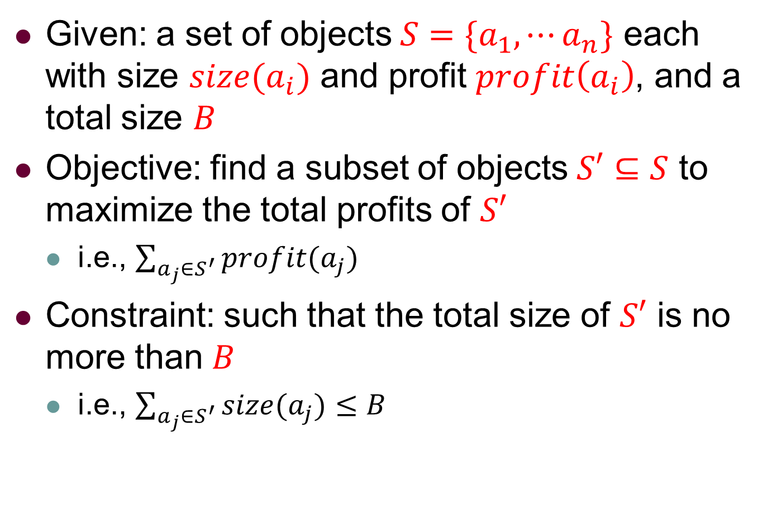
Knapsack: Definition
Given: a set of objects $S=\{a_{1},⋯a_{n}\}$ each with size $size(a_{i})$ and profit $profit\left(a_{i}\right)$, and a total size $B$
Objective: find a subset of objects $S′⊆S$ to maximize the total profits of $S′$
i.e., $\sum_{a_{j}∈S^{′}}{profit(a_{j})}$
Constraint: such that the total size of $S′$ is no more than $B$
i.e., $\sum_{a_{j}∈S^{′}}{size(a_{j})}≤B$

Slide 5
Outline
Chapter 8: Knapsack
Definition
Basics
Algorithms
Conclusions

Slide 6
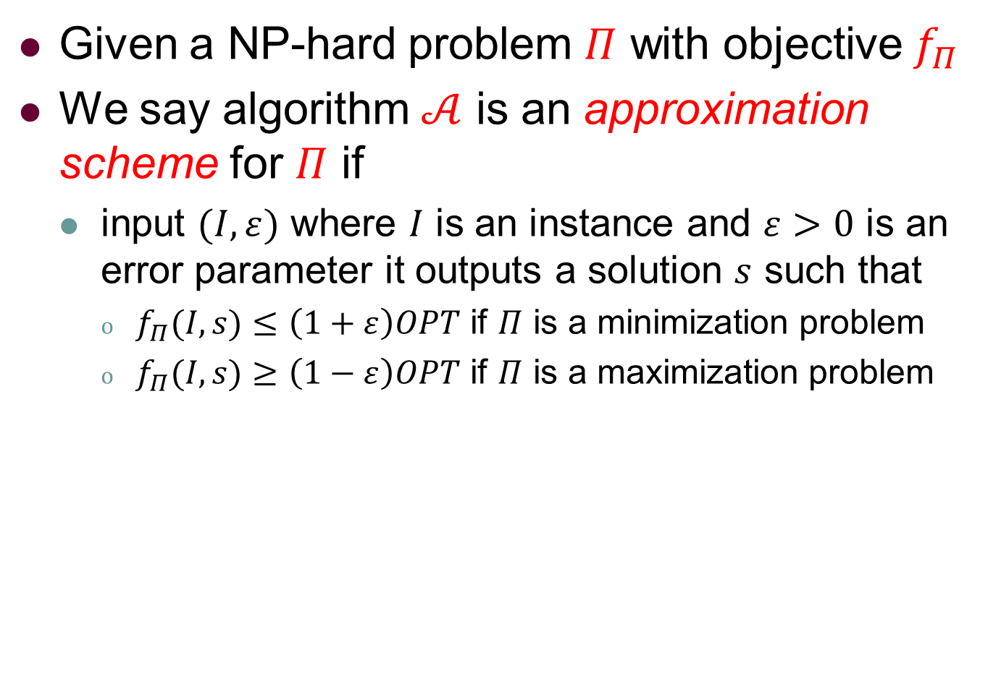
Knapsack: Basics
Given a NP-hard problem $Π$ with objective $f_{Π}$
We say algorithm $𝒜$ is an approximation scheme for $Π$ if
input $(I,ε)$ where $I$ is an instance and $ε>0$ is an error parameter it outputs a solution $s$ such that
$f_{Π}(I,s)≤\left(1+ε\right)OPT$ if $Π$ is a minimization problem
$f_{Π}(I,s)≥\left(1−ε\right)OPT$ if $Π$ is a maximization problem

Slide 7
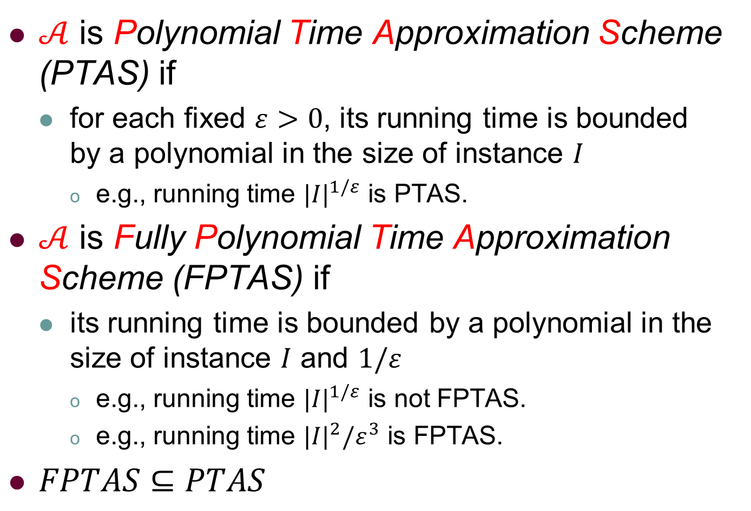
Knapsack: PTAS vs FPTAS
$𝒜$ is Polynomial Time Approximation Scheme (PTAS) if
for each fixed $ε>0$, its running time is bounded by a polynomial in the size of instance $I$
e.g., running time ${|I|}^{1/ε}$ is PTAS.
$𝒜$ is Fully Polynomial Time Approximation Scheme (FPTAS) if
its running time is bounded by a polynomial in the size of instance $I$ and $1/ε$
e.g., running time ${|I|}^{1/ε}$ is not FPTAS.
e.g., running time ${|I|}^{2}/ε^{3}$ is FPTAS.
$FPTAS⊆PTAS$

Slide 8
Knapsack: PTAS vs FPTAS
In a very technical sense, FPTAS is the best algorithm for an NP-hard optimization problem
NP
APX
PTAS
FPTAS
Notes:
APX: approx. algorithm with constant approx. ratio.

Slide 9
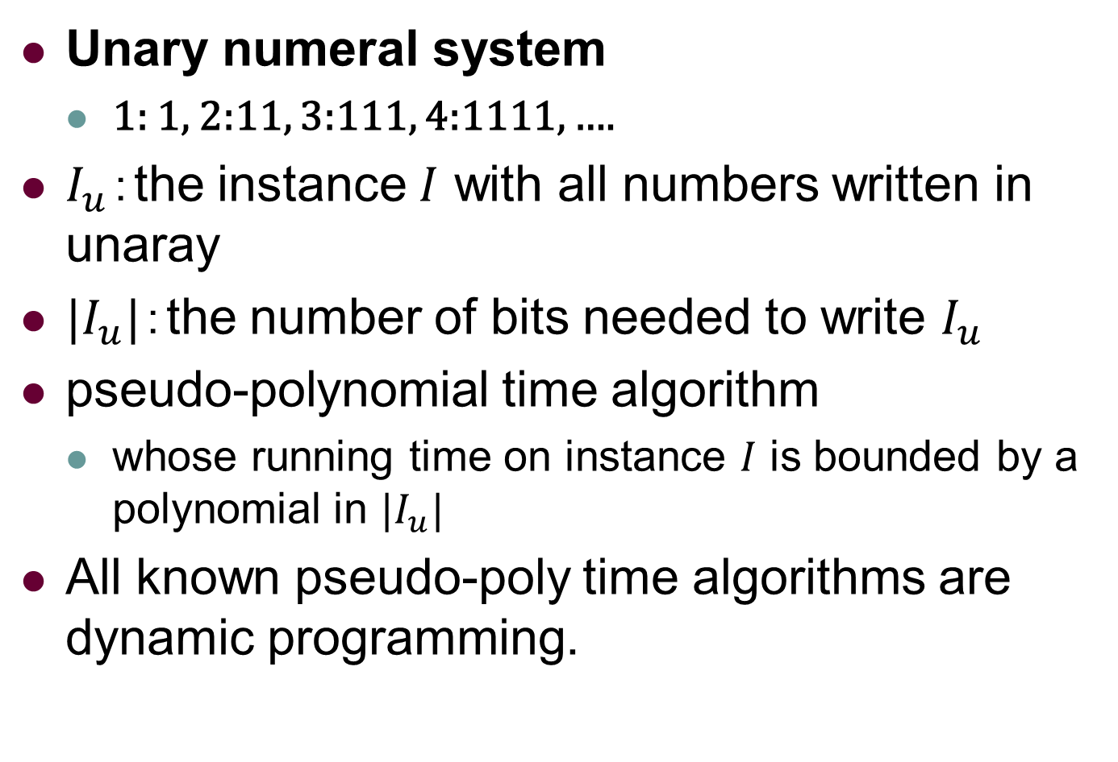
Knapsack: pseudo-poly time algo.
Unary numeral system
1: 1, 2:11, 3:111, 4:1111, ….
$I_{u}$：the instance $I$ with all numbers written in unaray
$|I_{u}|$：the number of bits needed to write $I_{u}$
pseudo-polynomial time algorithm
whose running time on instance $I$ is bounded by a polynomial in $|I_{u}|$
All known pseudo-poly time algorithms are dynamic programming.

Slide 10
Outline
Chapter 8: Knapsack
Definition
Basics
Algorithms
Conclusions

Slide 11
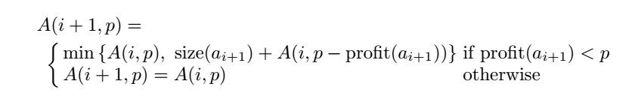
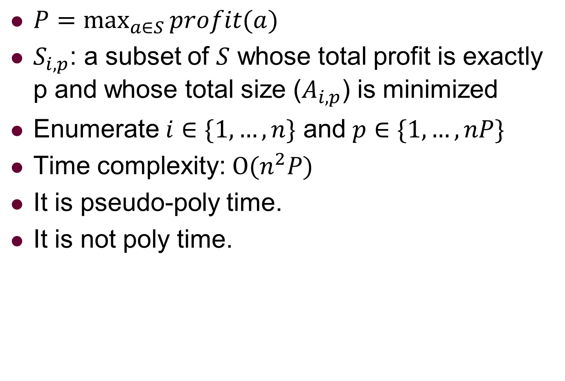
Knapsack: Dynamic Programming
$P=\max_{a∈S}{profit(a)}$
$S_{i,p}$: a subset of $S$ whose total profit is exactly p and whose total size ($A_{i,p}$) is minimized
Enumerate $i∈\{1,…,n\}$ and $p∈\{1,…,nP\}$
Time complexity: $O(n^{2}P)$
It is pseudo-poly time.
It is not poly time.

Slide 12
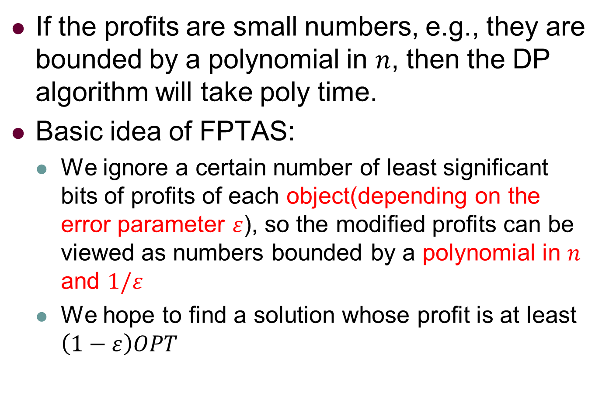
Knapsack: An FPTAS solution
If the profits are small numbers, e.g., they are bounded by a polynomial in $n$, then the DP algorithm will take poly time.
Basic idea of FPTAS:
We ignore a certain number of least significant bits of profits of each object(depending on the error parameter $ε$), so the modified profits can be viewed as numbers bounded by a polynomial in $n$ and $1/ε$
We hope to find a solution whose profit is at least $\left(1−ε\right)OPT$

Slide 13
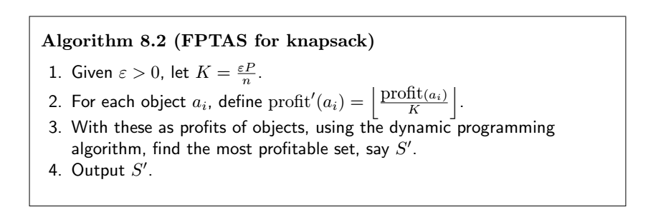
Knapsack: An FPTAS solution

Slide 14
Knapsack: An FPTAS solution
ignore some precision

Slide 15
Knapsack: An FPTAS solution
poly time

Slide 16
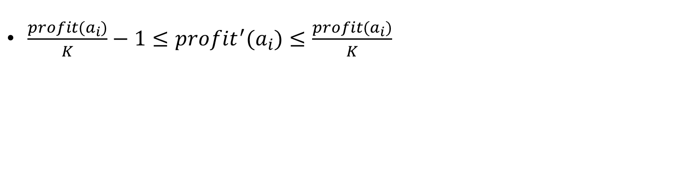
Knapsack: An FPTAS solution
$\frac{profit(a_{i})}{K}−1≤{profit}^{′}(a_{i})≤\frac{profit(a_{i})}{K}$
because of rouding

Slide 17

Knapsack: An FPTAS solution
$\frac{profit(a_{i})}{K}−1≤{profit}^{′}(a_{i})≤\frac{profit(a_{i})}{K}$
$\sum_{a∈S^{∗}}{profit(a)≤K∙\sum_{a∈S^{∗}}{({profit}^{′} \left(a\right)+1)≤}}$
$K\sum_{a∈S^{∗}}{{profit}^{′} \left(a\right)+K|S^{∗}|≤}$ $K\sum_{a∈S^{∗}}{{profit}^{′} \left(a\right)+nK}$

Slide 18
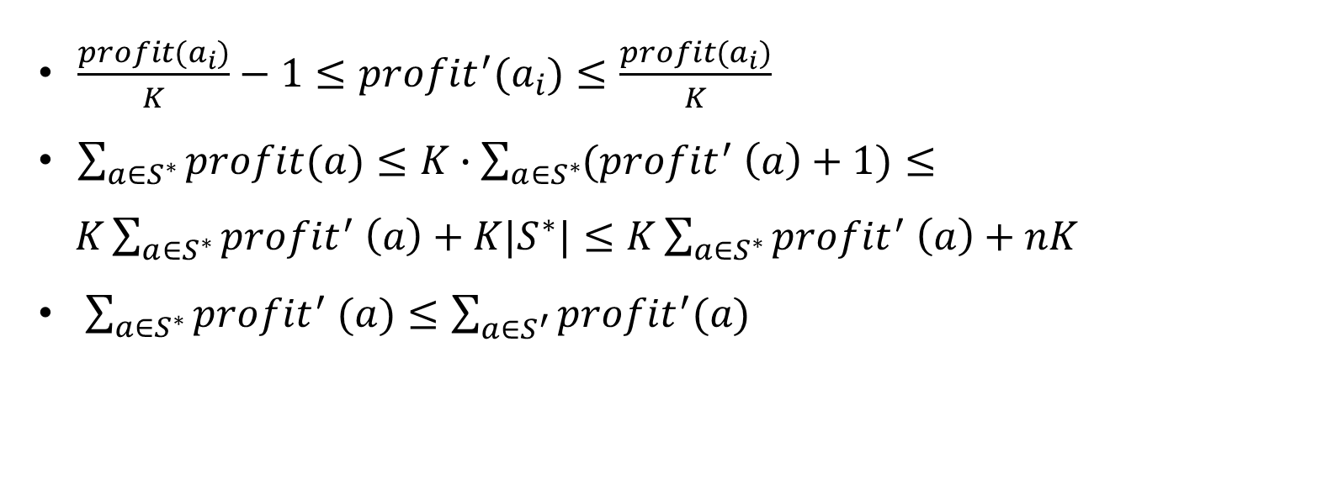
Knapsack: An FPTAS solution
$\frac{profit(a_{i})}{K}−1≤{profit}^{′}(a_{i})≤\frac{profit(a_{i})}{K}$
$\sum_{a∈S^{∗}}{profit(a)≤K∙\sum_{a∈S^{∗}}{({profit}^{′} \left(a\right)+1)≤}}$
$K\sum_{a∈S^{∗}}{{profit}^{′} \left(a\right)+K|S^{∗}|≤}$ $K\sum_{a∈S^{∗}}{{profit}^{′} \left(a\right)+nK}$
$\sum_{a∈S^{∗}}{{profit}^{′} (a)}≤\sum_{a∈S^{′}}{{profit}^{′}(a)}$
because DP is optimal

Slide 19
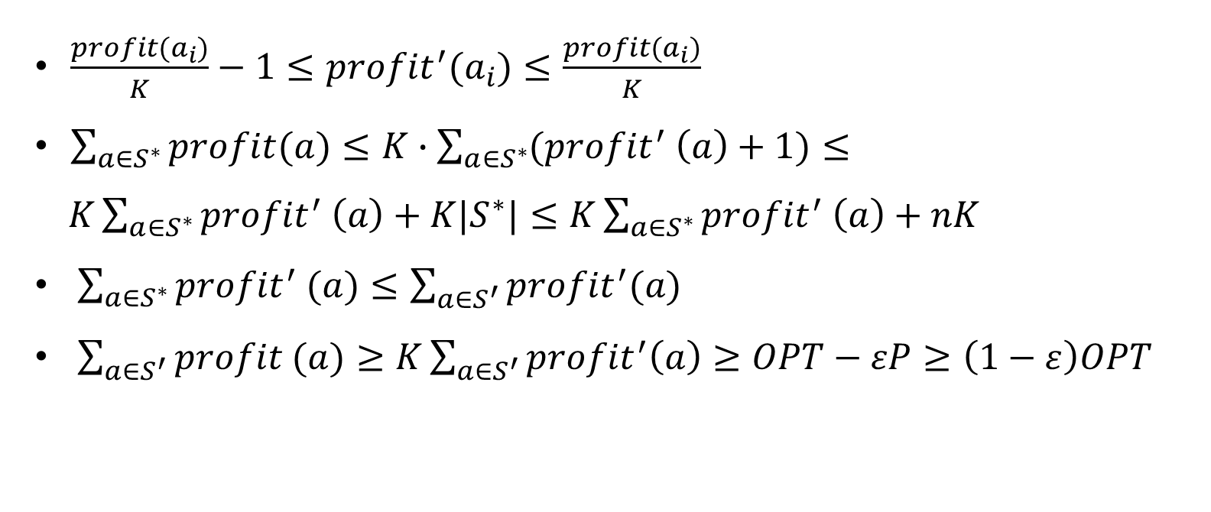
Knapsack: An FPTAS solution
$\frac{profit(a_{i})}{K}−1≤{profit}^{′}(a_{i})≤\frac{profit(a_{i})}{K}$
$\sum_{a∈S^{∗}}{profit(a)≤K∙\sum_{a∈S^{∗}}{({profit}^{′} \left(a\right)+1)≤}}$
$K\sum_{a∈S^{∗}}{{profit}^{′} \left(a\right)+K|S^{∗}|≤}$ $K\sum_{a∈S^{∗}}{{profit}^{′} \left(a\right)+nK}$
$\sum_{a∈S^{∗}}{{profit}^{′} (a)}≤\sum_{a∈S^{′}}{{profit}^{′}(a)}$
$\sum_{a∈S^{′}}{profit (a)}≥K\sum_{a∈S^{′}}{{profit}^{′}\left(a\right)}≥OPT−εP≥\left(1−ε\right)OPT$

Slide 20

Knapsack: An FPTAS solution
Time Complexity: $O\left(n^{2}\left\lfloor \frac{P}{K}\right\rfloor \right)=O(\frac{n^{3}}{ε})$
It is obvious it is FPTAS.

Slide 21
Outline
Chapter 8: Knapsack
Definition
Basics
Algorithms
Conclusions

Slide 22
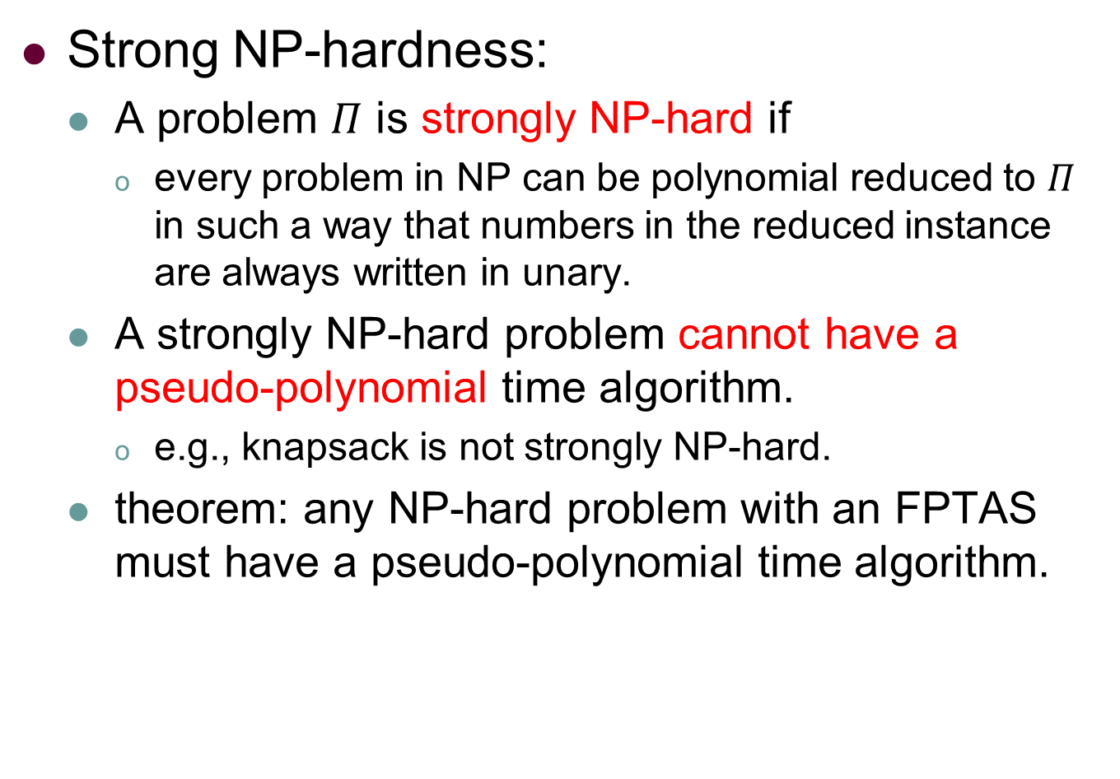
Knapsack: Conclusions
Strong NP-hardness:
A problem $Π$ is strongly NP-hard if
every problem in NP can be polynomial reduced to $Π$ in such a way that numbers in the reduced instance are always written in unary.
A strongly NP-hard problem cannot have a pseudo-polynomial time algorithm.
e.g., knapsack is not strongly NP-hard.
theorem: any NP-hard problem with an FPTAS must have a pseudo-polynomial time algorithm.

Slide 23
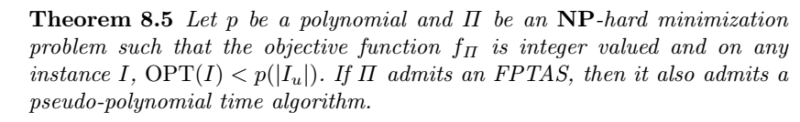
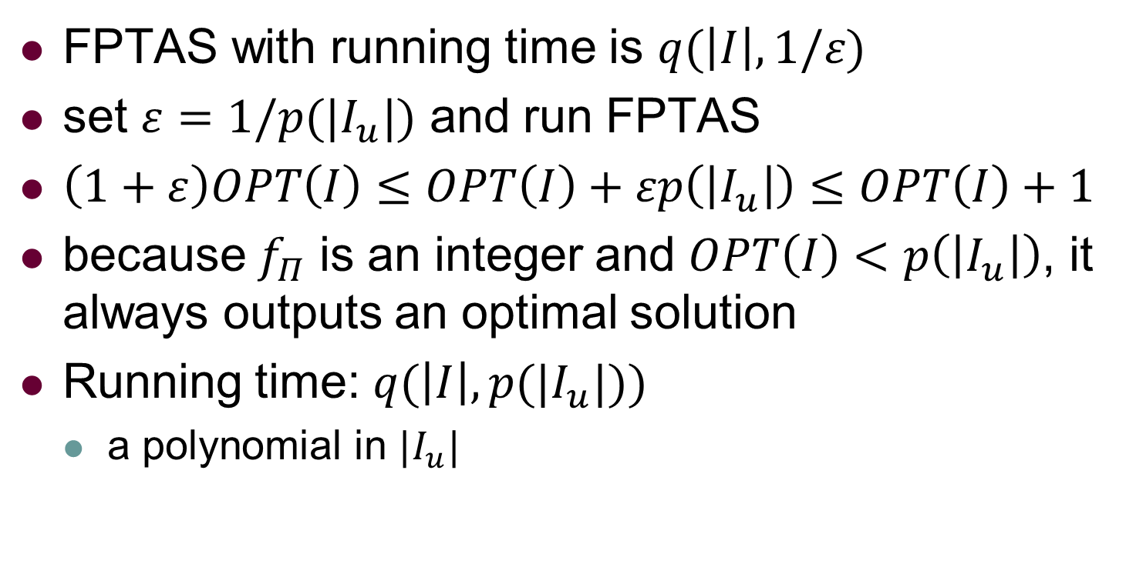
Knapsack: Conclusions
FPTAS with running time is $q(\left|I\right|,1/ε)$
set $ε=1/p(|I_{u}|)$ and run FPTAS
$\left(1+ε\right)OPT\left(I\right)≤OPT\left(I\right)+εp\left(\left|I_{u}\right|\right)≤OPT\left(I\right)+1$
because $f_{Π}$ is an integer and $OPT\left(I\right)<p\left(\left|I_{u}\right|\right)$, it always outputs an optimal solution
Running time: $q(\left|I\right|,p(|I_{u}|))$
a polynomial in $|I_{u}|$

Slide 24
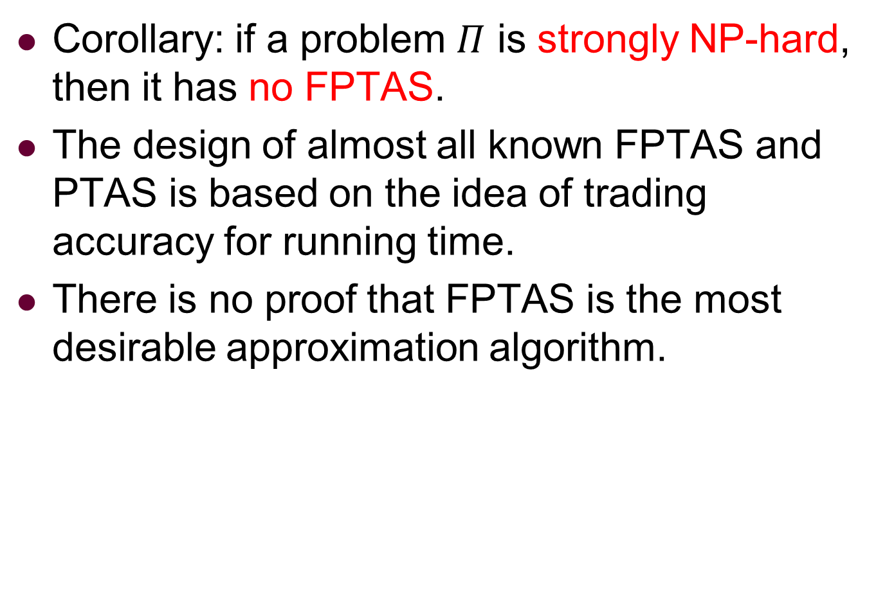
Knapsack: Conclusions
Corollary: if a problem $Π$ is strongly NP-hard, then it has no FPTAS.
The design of almost all known FPTAS and PTAS is based on the idea of trading accuracy for running time.
There is no proof that FPTAS is the most desirable approximation algorithm.

