Slide 1
Approximation Algorithms Chapter 9: Bin Packing
Vijay V. Vazirani Georgia Institute of Technology
Zeng Yuxiang
2018/04/30

Slide 2
Outline
Chapter 9: Bin Packing
Definition
Basics
Algorithms
Conclusions

Slide 3
Outline
Chapter 9: Bin Packing
Definition
Basics
Algorithms
Conclusions

Slide 4
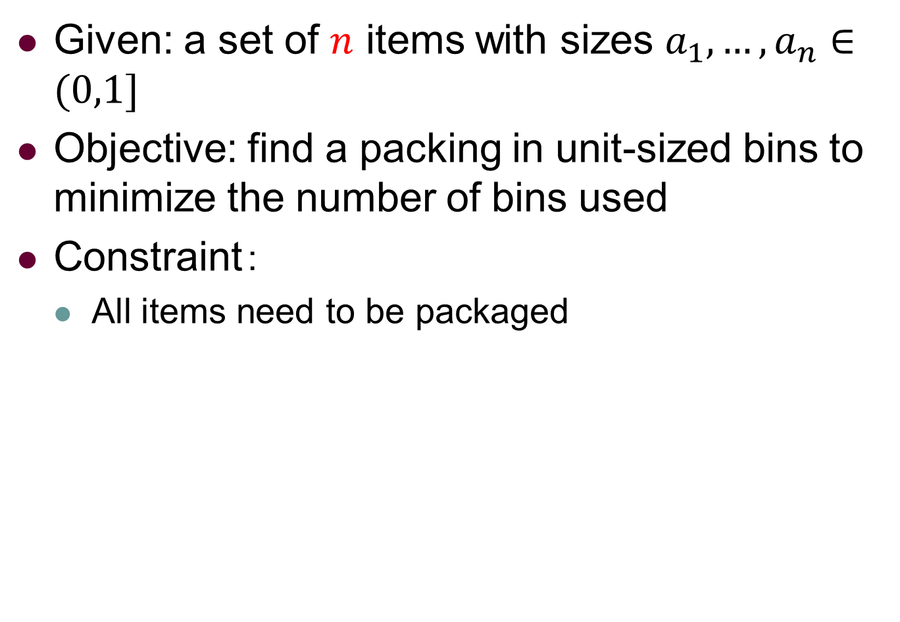
Bin Packing: Definition
Given: a set of $n$ items with sizes $a_{1},…,a_{n}∈(0,1]$
Objective: find a packing in unit-sized bins to minimize the number of bins used
Constraint：
All items need to be packaged

Slide 5
Bin Packing: Definition
Example
items
size | 4 | 8 | 1 | 4 | 2 | 1
shape
Container
How many containers we must use?

Slide 6
Bin Packing: Definition
Example
items
size | 4 | 8 | 1 | 4 | 2 | 1
shape
An optimal solution
Container 1
Container 2

Slide 7
Outline
Chapter 9: Bin Packing
Definition
Basics
Algorithms
Conclusions

Slide 8

Bin Packing: Basics
Asymptotic Polynomial-Time Approximation Scheme(APTAS)
For any $ε>0$ exists polynomial time algorithm $𝒜$ and $N>0$, s.t., $𝒜\left(I\right)≤\left(1+ε\right)OPT$, for $OPT>N$.
NP
APX
APTAS
PTAS
FPTAS

Slide 9
Outline
Chapter 9: Bin Packing
Definition
Basics
Algorithms
Conclusions

Slide 10
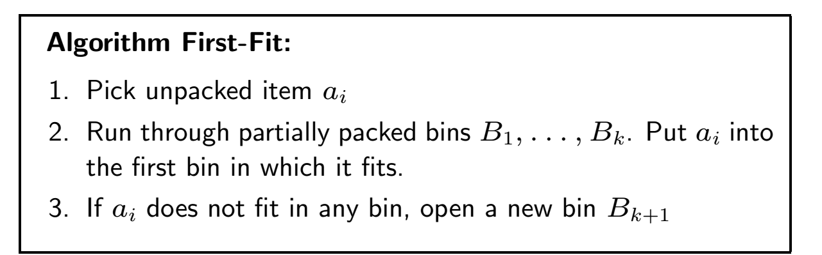
Bin Packing: A 2-approx. algo.

Slide 11
Bin Packing: Definition
Example
items
size | 4 | 8 | 1 | 4 | 2 | 1
shape
Container 1
Container 2

Slide 12
Bin Packing: Definition
Example
items
size | 4 | 8 | 1 | 4 | 2 | 1
shape
Container 1
Container 2

Slide 13
Bin Packing: Definition
Example
items
size | 4 | 8 | 1 | 4 | 2 | 1
shape
Container 1
Container 2

Slide 14
Bin Packing: Definition
Example
items
size | 4 | 8 | 1 | 4 | 2 | 1
shape
Container 1
Container 2

Slide 15
Bin Packing: Definition
Example
items
size | 4 | 8 | 1 | 4 | 2 | 1
shape
Container 1
Container 2

Slide 16
Bin Packing: Definition
Example
items
size | 4 | 8 | 1 | 4 | 2 | 1
shape
Container 1
Container 2

Slide 17
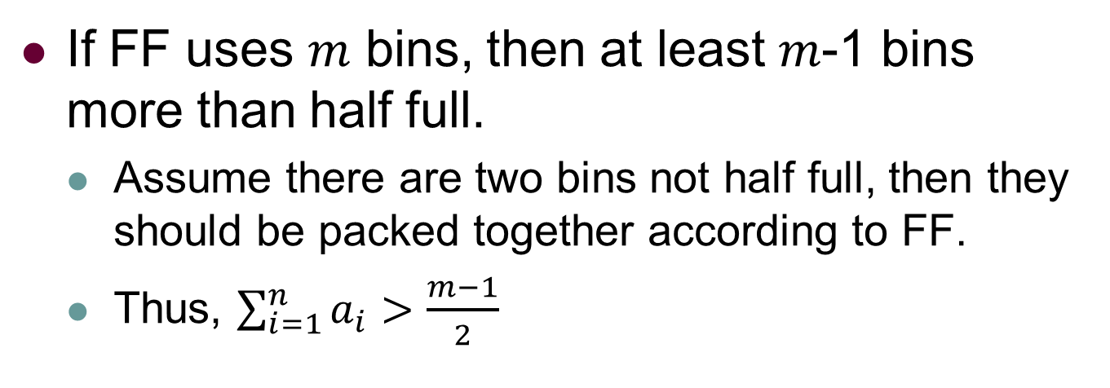
Bin Packing: A 2-approx. algo.
If FF uses $m$ bins, then at least $m$-1 bins more than half full.
Assume there are two bins not half full, then they should be packed together according to FF.
Thus, $\sum_{i=1}^{n}{a_{i}}>\frac{m−1}{2}$

Slide 18
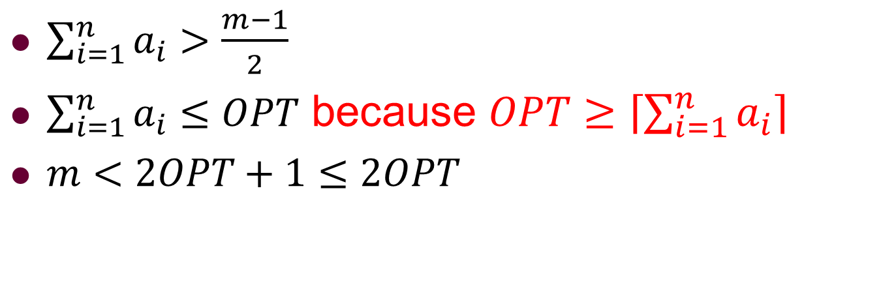
Bin Packing: A 2-approx. algo.
$\sum_{i=1}^{n}{a_{i}}>\frac{m−1}{2}$
$\sum_{i=1}^{n}{a_{i}}≤OPT$ because $OPT≥\left\lceil \sum_{i=1}^{n}{a_{i}}\right\rceil$
$m<2OPT+1≤2OPT$

Slide 19
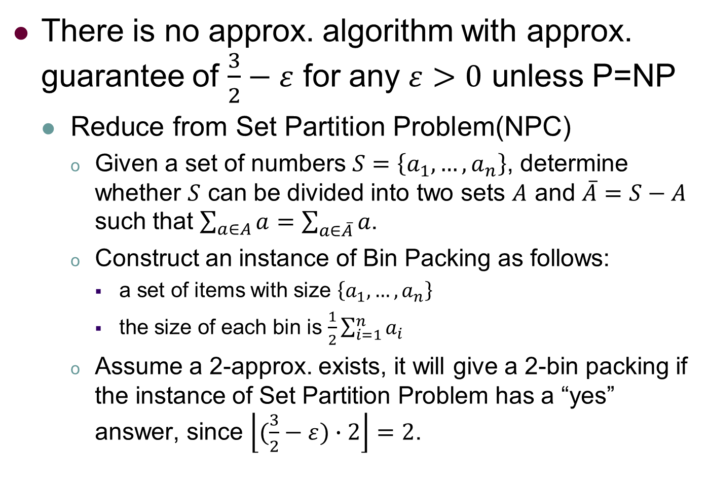
Bin Packing: Tightness Analysis
There is no approx. algorithm with approx. guarantee of $\frac{3}{2}−ε$ for any $ε>0$ unless P=NP
Reduce from Set Partition Problem(NPC)
Given a set of numbers $S=\left\{a_{1},…,a_{n}\right\}$, determine whether $S$ can be divided into two sets $A$ and $\overline{A}=S−A$ such that $\sum_{a∈A}{a}=\sum_{a∈\overline{A}}{a}$.
Construct an instance of Bin Packing as follows:
a set of items with size $\left\{a_{1},…,a_{n}\right\}$
the size of each bin is $\frac{1}{2}\sum_{i=1}^{n}{a_{i}}$
Assume a 2-approx. exists, it will give a 2-bin packing if the instance of Set Partition Problem has a “yes” answer, since $\left\lfloor (\frac{3}{2}−ε)∙2\right\rfloor =2$.
Worst case happens when OPT is small enough, .
e.g., 2 or 3, even though n is unbounded.
How about cases when OPT increases with n?

Slide 20
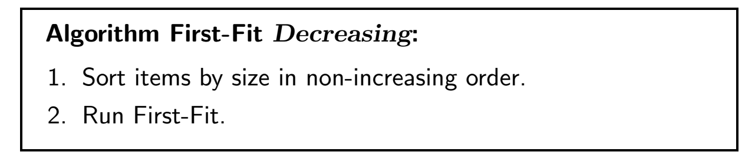
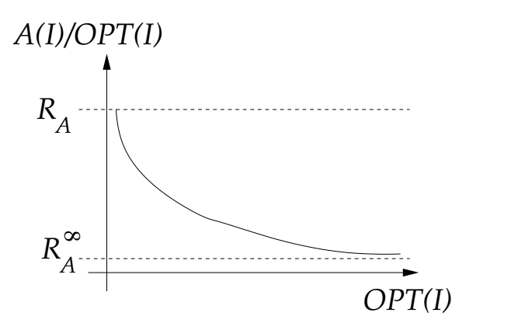
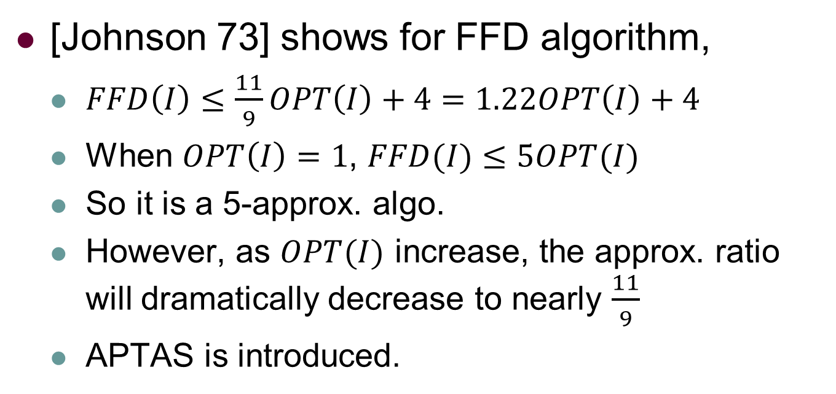
Bin Packing：A 5-approx. algo.
[Johnson 73] shows for FFD algorithm,
$FFD\left(I\right)≤\frac{11}{9}OPT\left(I\right)+4=1.22OPT\left(I\right)+4$
When $OPT\left(I\right)=1$, $FFD(I)≤5OPT(I)$
So it is a 5-approx. algo.
However, as $OPT(I)$ increase, the approx. ratio will dramatically decrease to nearly $\frac{11}{9}$
APTAS is introduced.

Slide 21
Bin Packing: Basics Revisit
Asymptotic Polynomial-Time Approximation Scheme(APTAS)
For any $ε>0$ exists polynomial time algorithm $𝒜$ and $N>0$, s.t., $𝒜\left(I\right)≤\left(1+ε\right)OPT$, for $OPT>N$.
NP
APX
APTAS
PTAS
FPTAS

Slide 22
Outline
Chapter 9: Bin Packing
Definition
Basics
Algorithms
Conclusions

Slide 23
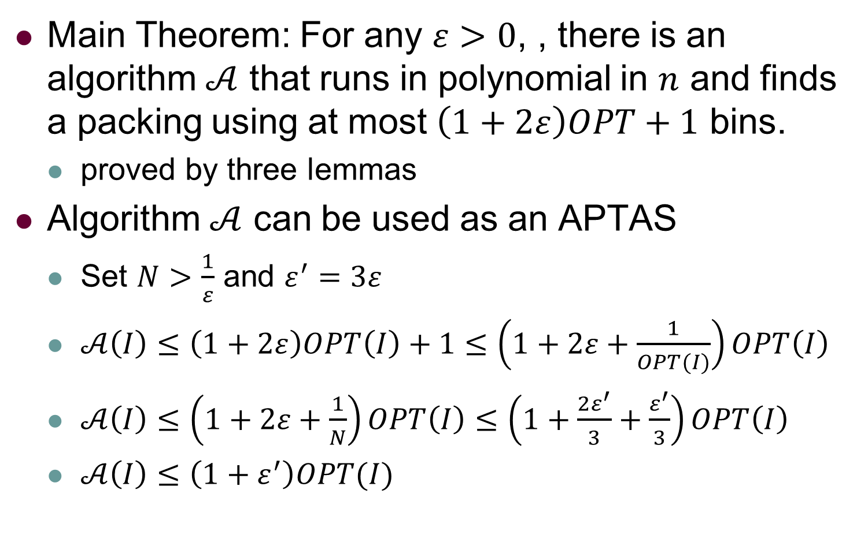
Bin Packing: Conclusions
Main Theorem: For any $ε>0$, , there is an algorithm $𝒜$ that runs in polynomial in $n$ and finds a packing using at most $\left(1+2ε\right)OPT+1$ bins.
proved by three lemmas
Algorithm $𝒜$ can be used as an APTAS
Set $N>\frac{1}{ε}$ and $ε^{′}=3ε$
$𝒜\left(I\right)≤\left(1+2ε\right)OPT\left(I\right)+1≤\left(1+2ε+\frac{1}{OPT(I)}\right)OPT\left(I\right)$
$𝒜\left(I\right)≤\left(1+2ε+\frac{1}{N}\right)OPT\left(I\right)≤\left(1+\frac{2ε^{′}}{3}+\frac{ε^{′}}{3}\right)OPT\left(I\right)$
$𝒜\left(I\right)≤\left(1+ε^{′}\right)OPT(I)$

Slide 24
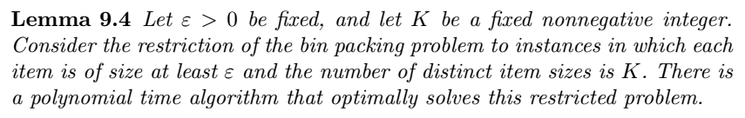
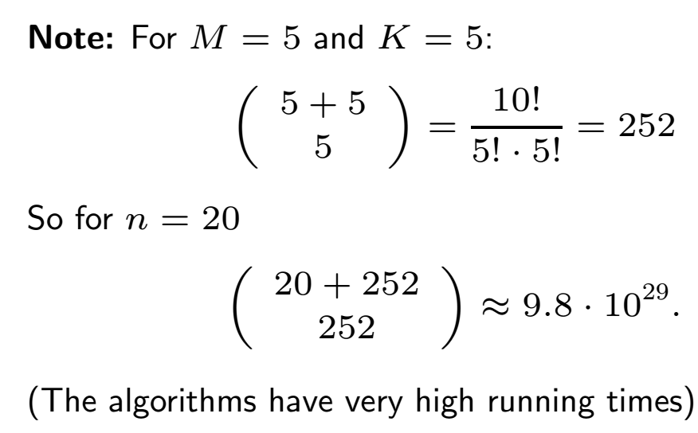

Bin Packing: Three Lemma
$M=\left\lfloor 1/ε\right\rfloor$ is max. number of items in a bin
$R≤\left({M+K \atop M}\right)$ is number of ways to pack in a bin
$P≤\left({n+R \atop R}\right)$ is number of feasible packings
polynomial in $n≤\frac{{(n+R)}^{R}}{R!}$ because R is fixed const.
Enumerate all packings and pick the best

Slide 25
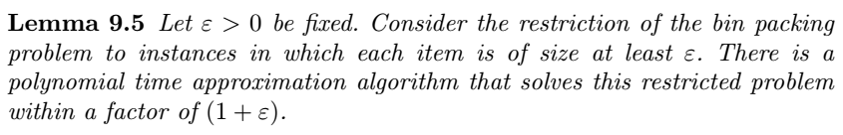
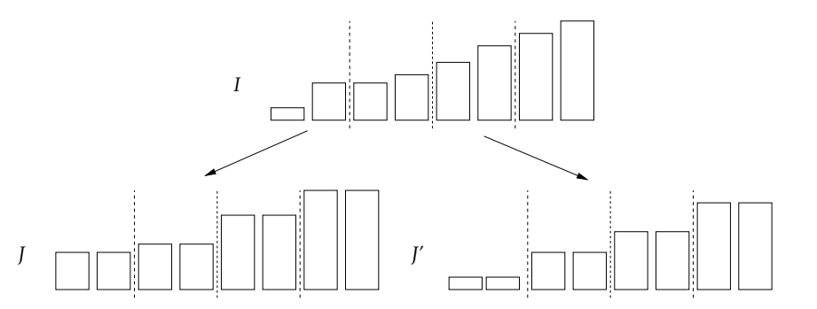
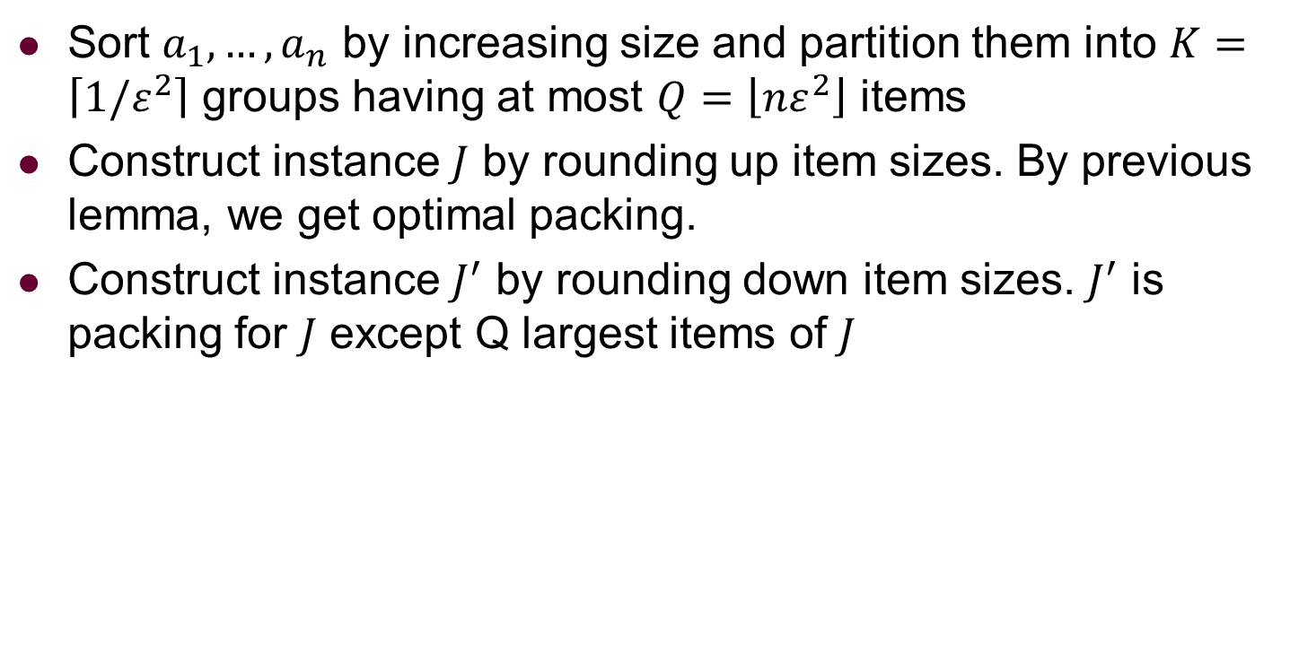
Bin Packing: Three Lemma
Sort $a_{1},…,a_{n}$ by increasing size and partition them into $K=\left\lceil 1/ε^{2}\right\rceil$ groups having at most $Q=\left\lfloor nε^{2}\right\rfloor$ items
Construct instance $J$ by rounding up item sizes. By previous lemma, we get optimal packing.
Construct instance $J^{′}$ by rounding down item sizes. $J^{′}$ is packing for $J$ except Q largest items of $J$

Slide 26
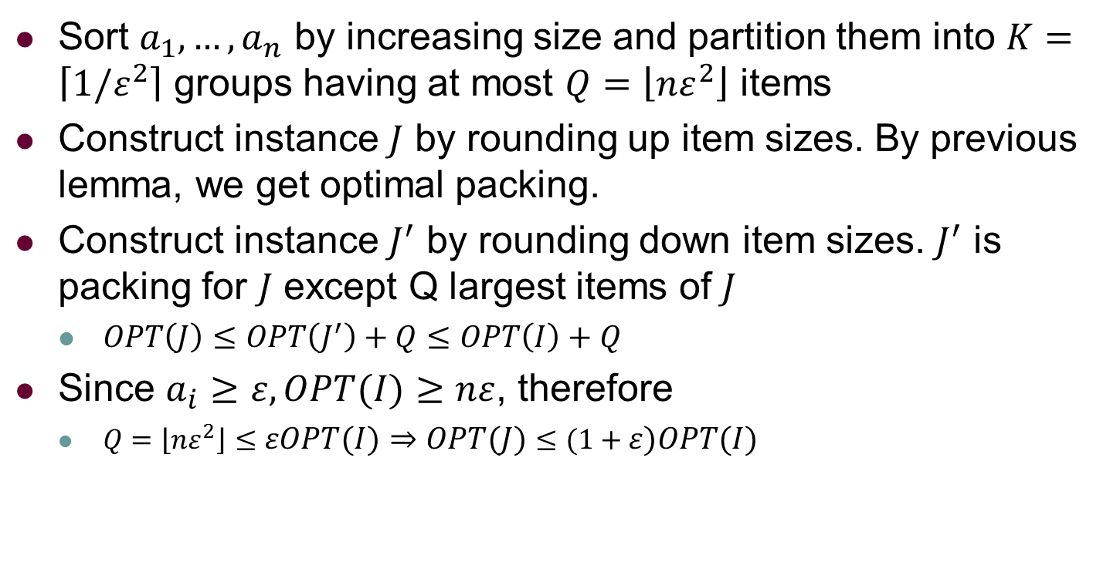
Bin Packing: Three Lemma
Sort $a_{1},…,a_{n}$ by increasing size and partition them into $K=\left\lceil 1/ε^{2}\right\rceil$ groups having at most $Q=\left\lfloor nε^{2}\right\rfloor$ items
Construct instance $J$ by rounding up item sizes. By previous lemma, we get optimal packing.
Construct instance $J^{′}$ by rounding down item sizes. $J^{′}$ is packing for $J$ except Q largest items of $J$
$OPT\left(J\right)≤OPT\left(J^{′}\right)+Q≤OPT\left(I\right)+Q$
Since $a_{i}≥ε, OPT(I)≥nε$, therefore
$Q=\left\lfloor nε^{2}\right\rfloor ≤εOPT(I)⇒OPT(J)≤(1+ε)OPT(I)$

Slide 27
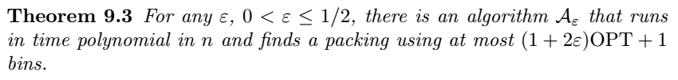
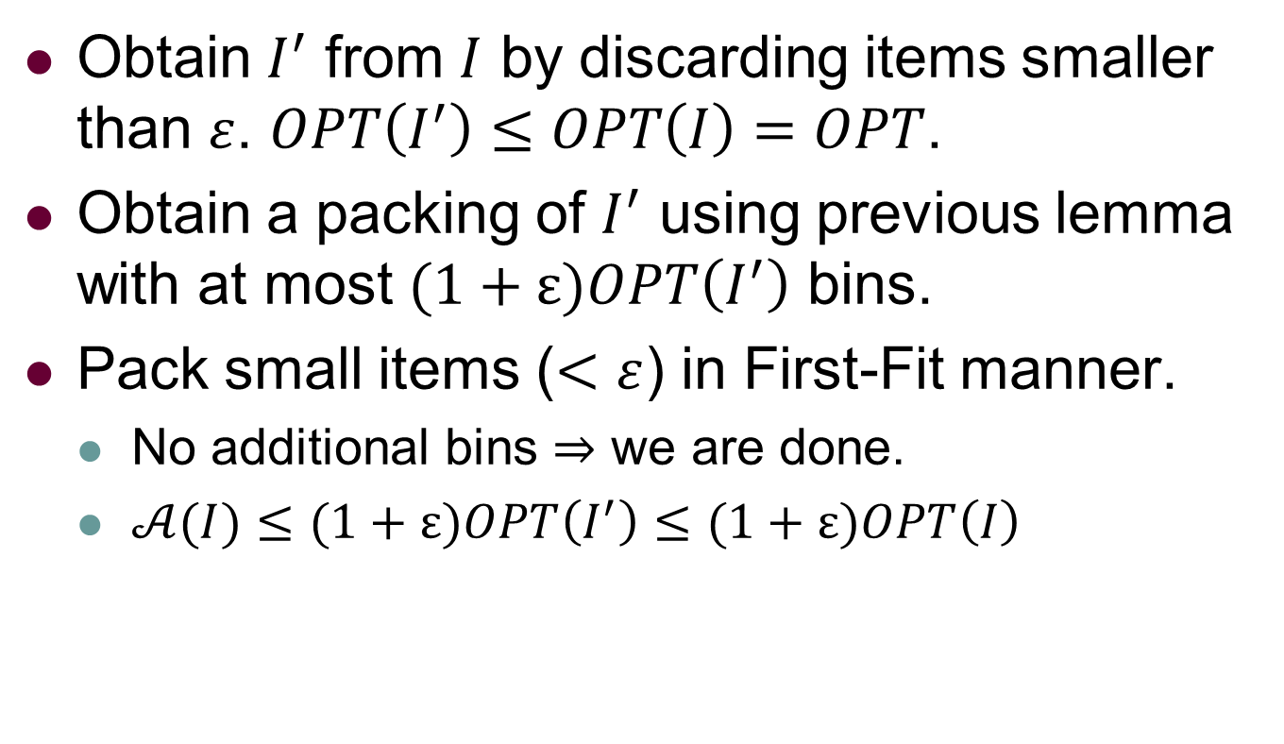
Bin Packing: Three Lemma
Obtain $I^{′}$ from $I$ by discarding items smaller than $ε$. $OPT\left(I^{′}\right)≤OPT\left(I\right)=OPT$.
Obtain a packing of $I^{′}$ using previous lemma with at most $(1+ε)OPT\left(I^{′}\right)$ bins.
Pack small items ($<ε$) in First-Fit manner.
No additional bins $⇒$ we are done.
$𝒜(I)≤(1+ε)OPT\left(I^{′}\right)≤(1+ε)OPT\left(I\right)$

Slide 28

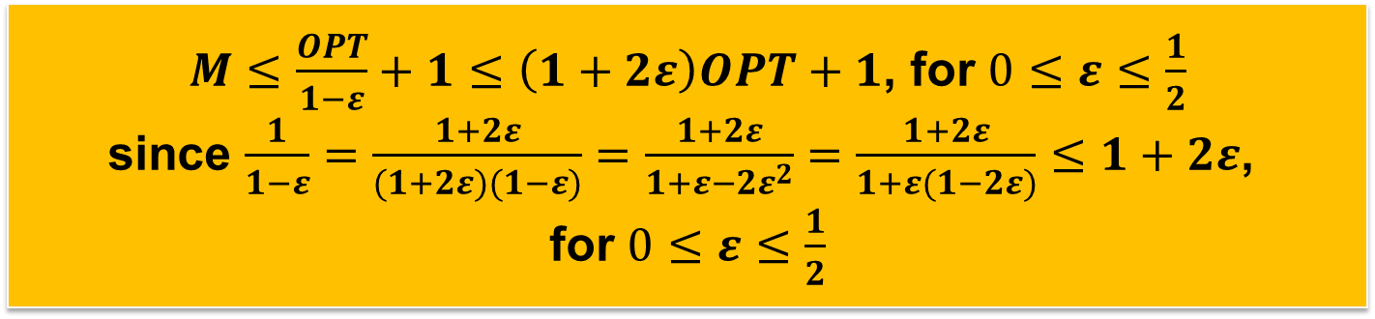
Bin Packing: Three Lemma
Obtain $I^{′}$ from $I$ by discarding items smaller than $ε$. $OPT\left(I^{′}\right)≤OPT\left(I\right)=OPT$.
Obtain a packing of $I^{′}$ using previous lemma with at most $(1+ε)OPT\left(I^{′}\right)$ bins.
Pack small items ($<ε$) in First-Fit manner.
Otherwise, let $M$ be total number of bins.
We know $M−1$ bins are at least $1−ε$ full, so we use lower bound $\left(M−1\right)\left(1−ε\right)<OPT$
$M≤\frac{OPT}{1−ε}+1≤\left(1+2ε\right)OPT+1$, for $0≤ε≤\frac{1}{2}$
since $\frac{1}{1−ε}=\frac{1+2ε}{(1+2ε)(1−ε)}=\frac{1+2ε}{1+ε−{2ε}^{2}}=\frac{1+2ε}{1+ε(1−2ε)}≤1+2ε$,
for $0≤ε≤\frac{1}{2}$

