Slide 1
Probability and Computing Chapter 1: Events and Probability
Michael Mitzenmacher¹ Eli Upfal² ¹Harvard University ²Brown University
Zeng Yuxiang
2018/06/23

Slide 2
Outline
Chapter 1: Probability and Events
Application: Verifying Polynomial Identities
Axioms of Probability
Application: Verifying Matrix Multiplication
Application: A Randomized Min-Cuit Algorithm

Slide 3
Outline
Chapter 1: Probability and Events
Application: Verifying Polynomial Identities
Axioms of Probability
Application: Verifying Matrix Multiplication
Application: A Randomized Min-Cuit Algorithm

Slide 4
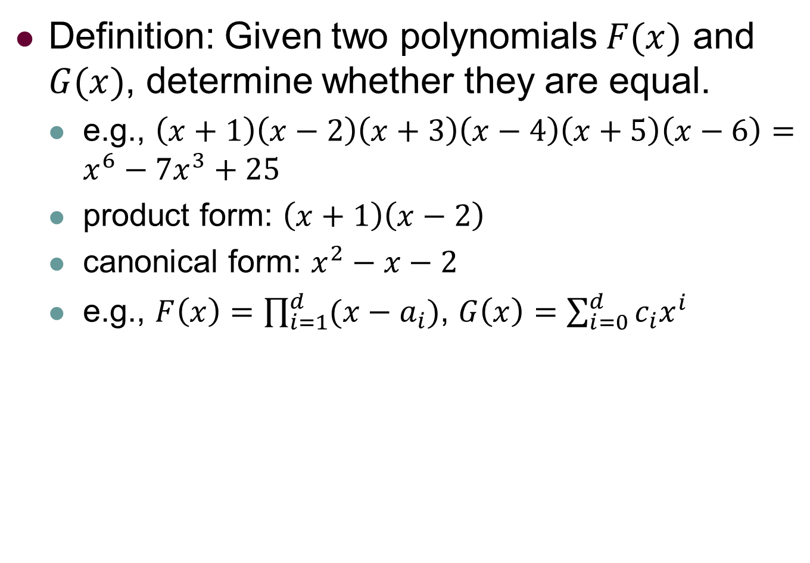
Verifying Polynomial Identities(VPI)
Definition: Given two polynomials $F(x)$ and $G(x)$, determine whether they are equal.
e.g., $\left(x+1\right)\left(x−2\right)\left(x+3\right)\left(x−4\right)\left(x+5\right)\left(x−6\right)=x^{6}−7x^{3}+25$
product form: $\left(x+1\right)\left(x−2\right)$
canonical form: $x^{2}−x−2$
e.g., $F\left(x\right)=\prod_{i=1}^{d}{(x−a_{i})}$, $G\left(x\right)=\sum_{i=0}^{d}{c_{i}x^{i}}$

Slide 5

Deterministic Algorithm: Idea
Transform $F(x)$ into canonical form
i.e., $F\left(x\right)=\prod_{i=1}^{d}{(x−a_{i})}$ $⇒$ $\sum_{i=0}^{d}{c_{i}x^{i}}$
if the coefficients of $F(x)$ are same as $G\left(x\right),$ equal.
time complexity: $Θ(d^{2})$
However, sometimes, canonical form is calculated from product form.
The solution just repeated the process.

Slide 6

Randomized Algorithm: Idea
Step 1: choose an integer $r$ uniformly at random in the range $\{1,…,100d\}$
uniform at random: each integer is equally likely to be chosen.
Step 2: then computes $F(r)$ and $G(r)$
if $F\left(r\right)≠G\left(r\right),$ decide they are not equal.
if $F\left(r\right)=G\left(r\right),$ decide they are equal.
Time complexity: $Θ(d)$
faster than deterministic solution
However, it may give a wrong answer.
How ???

Slide 7
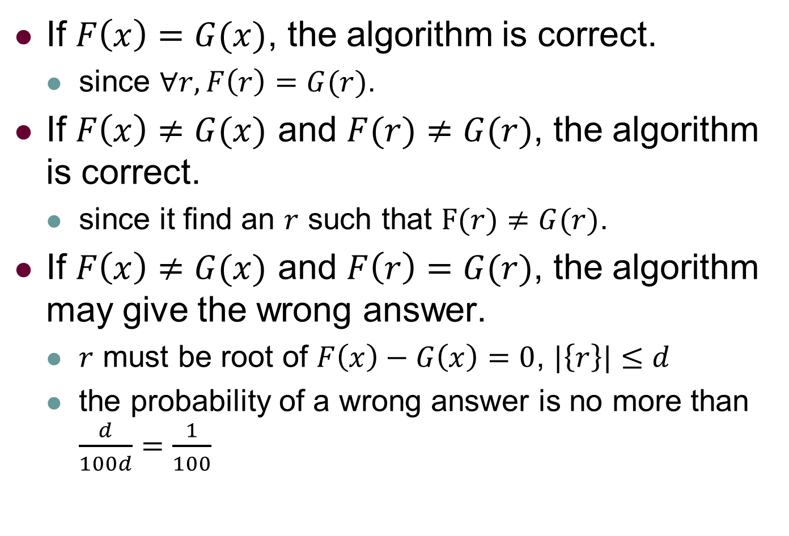
Randomized Algorithm: Analysis
If $F\left(x\right)=G(x)$, the algorithm is correct.
since $∀r, F\left(r\right)=G(r)$.
If $F\left(x\right)≠G(x)$ and $F(r)≠G(r)$, the algorithm is correct.
since it find an $r$ such that $F(r)≠G(r)$.
If $F\left(x\right)≠G(x)$ and $F\left(r\right)=G(r)$, the algorithm may give the wrong answer.
$r$ must be root of $F\left(x\right)−G\left(x\right)=0$, $|\left\{r\right\}|≤d$
the probability of a wrong answer is no more than $\frac{d}{100d}=\frac{1}{100}$

Slide 8
Outline
Chapter 1: Probability and Events
Application: Verifying Polynomial Identities
Axioms of Probability
Application: Verifying Matrix Multiplication
Application: A Randomized Min-Cuit Algorithm

Slide 9
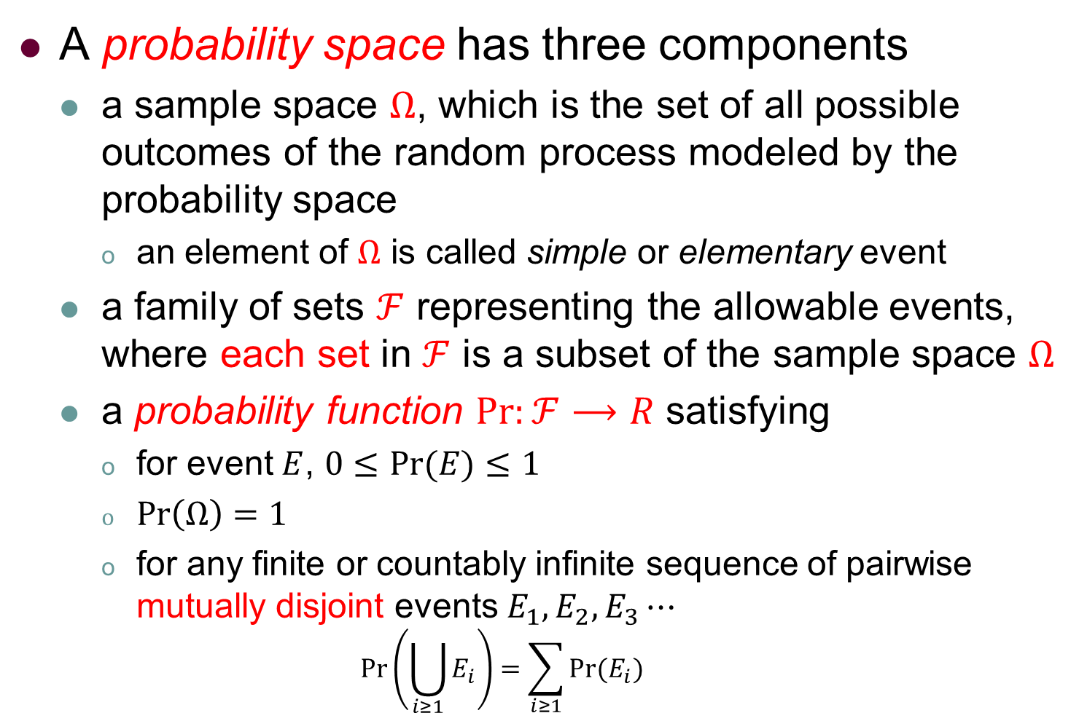
Axioms of Probability
A probability space has three components
a sample space $Ω$, which is the set of all possible outcomes of the random process modeled by the probability space
an element of $Ω$ is called simple or elementary event
a family of sets $ℱ$ representing the allowable events, where each set in $ℱ$ is a subset of the sample space $Ω$
a probability function $Pr:ℱ⟶R$ satisfying
for event $E$, $0≤Pr⁡(E)≤1$
$\operatorname{Pr}\left(Ω\right)=1$
for any finite or countably infinite sequence of pairwise mutually disjoint events $E_{1},E_{2},E_{3}⋯$
$$\operatorname{Pr}\left(\bigcup_{i≥1}{E_{i}}\right)=\sum_{i≥1}{Pr⁡(E_{i})}$$

Slide 10
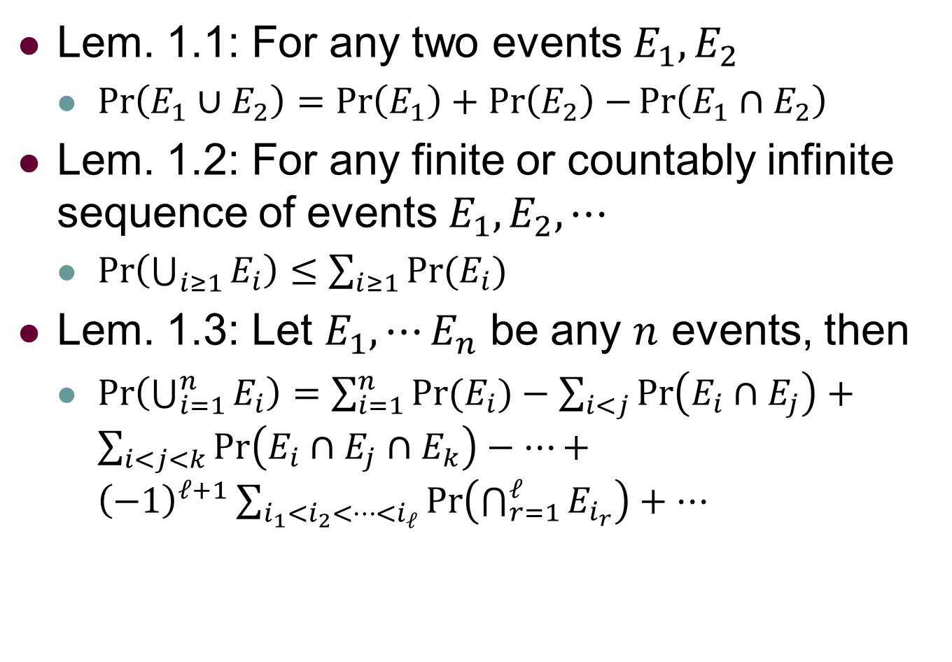
Axioms of Probability
Lem. 1.1: For any two events $E_{1},E_{2}$
$\operatorname{Pr}\left(E_{1}∪E_{2}\right)=\operatorname{Pr}\left(E_{1}\right)+\operatorname{Pr}\left(E_{2}\right)−\operatorname{Pr}\left(E_{1}∩E_{2}\right)$
Lem. 1.2: For any finite or countably infinite sequence of events $E_{1},E_{2},⋯$
$\operatorname{Pr}\left(\bigcup_{i≥1}{E_{i}}\right)≤\sum_{i≥1}{Pr⁡(E_{i})}$
Lem. 1.3: Let $E_{1},{⋯E}_{n}$ be any $n$ events, then
$\operatorname{Pr}\left(\bigcup_{i=1}^{n}{E_{i}}\right)=\sum_{i=1}^{n}{Pr⁡(E_{i})}−\sum_{i<j}{\operatorname{Pr}\left(E_{i}∩E_{j}\right)}+\sum_{i<j<k}{\operatorname{Pr}\left(E_{i}∩E_{j}∩E_{k}\right)}−⋯+{\left(−1\right)}^{ℓ+1}\sum_{i_{1}<i_{2}<⋯<i_{ℓ}}{\operatorname{Pr}\left(\bigcap_{r=1}^{ℓ}{E_{i_{r}}}\right)}+⋯$

Slide 11
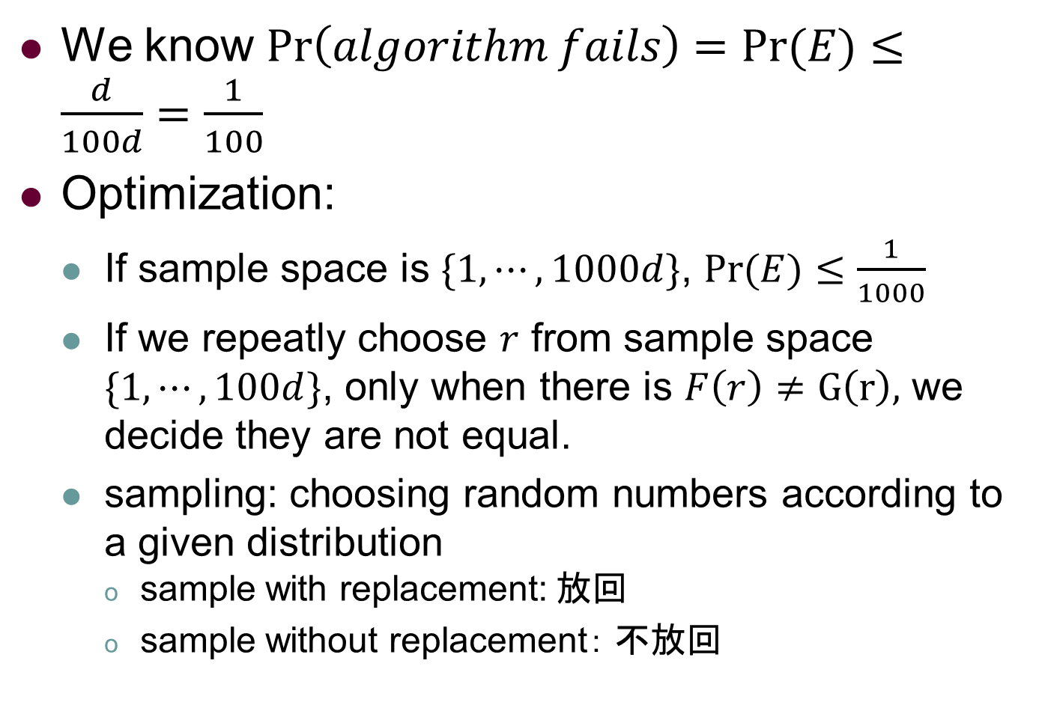
VPI Randomized Algorithm(Cont.)
We know $\operatorname{Pr}\left(algorithm fails\right)=Pr⁡(E)≤\frac{d}{100d}=\frac{1}{100}$
Optimization:
If sample space is $\{1,⋯,1000d\}$, $Pr⁡(E)≤\frac{1}{1000}$
If we repeatly choose $r$ from sample space $\{1,⋯,100d\}$, only when there is $F\left(r\right)≠G\left(r\right),$ we decide they are not equal.
sampling: choosing random numbers according to a given distribution
sample with replacement: 放回
sample without replacement： 不放回

Slide 12

VPI Randomized Algorithm(Cont.)
If sample with replacement for $k$ iterations, the probability of wrong answer is no more than ${(\frac{1}{100})}^{k}$
We say that each sample is independent.
What is independence???

Slide 13
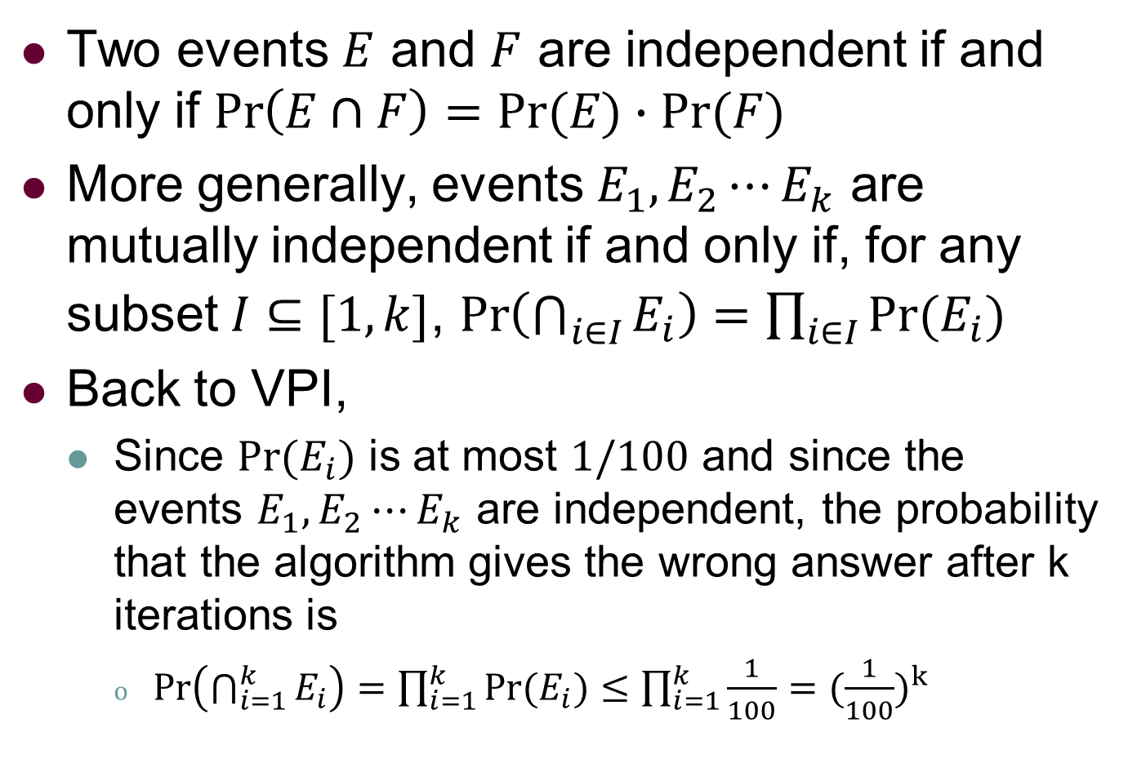
Axioms of Probability
Two events $E$ and $F$ are independent if and only if $\operatorname{Pr}\left(E∩F\right)=Pr⁡(E)∙Pr⁡(F)$
More generally, events $E_{1},E_{2}⋯E_{k}$ are mutually independent if and only if, for any subset $I⊆[1,k]$, $\operatorname{Pr}\left(\bigcap_{i∈I}{E_{i}}\right)=\prod_{i∈I}{Pr⁡(E_{i})}$
Back to VPI,
Since $Pr⁡(E_{i})$ is at most $1/100$ and since the events $E_{1},E_{2}⋯E_{k}$ are independent, the probability that the algorithm gives the wrong answer after k iterations is
$\operatorname{Pr}\left(\bigcap_{i=1}^{k}{E_{i}}\right)=\prod_{i=1}^{k}{Pr⁡(E_{i})}≤\prod_{i=1}^{k}{\frac{1}{100}}={(\frac{1}{100})}^{k}$

Slide 14

VPI Randomized Algorithm(Cont.)
If sample with replacement for $k$ iterations, the probability of wrong answer is no more than ${(\frac{1}{100})}^{k}$
If sample without replacement for $k$ iterations, what is the probability of a wrong answer ?
We say that the probability of choosing a given number is conditioned on the previous events.

Slide 15
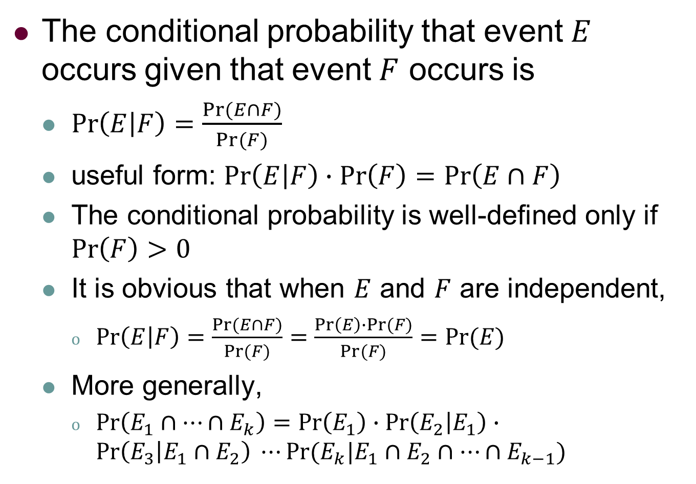
Axioms of Probability
The conditional probability that event $E$ occurs given that event $F$ occurs is
$\operatorname{Pr}\left(E | F\right)=\frac{Pr⁡(E∩F)}{Pr⁡(F)}$
useful form: $\operatorname{Pr}\left(E | F\right)∙Pr\left(F\right)=\operatorname{Pr}\left(E∩F\right)$
The conditional probability is well-defined only if $\operatorname{Pr}\left(F\right)>0$
It is obvious that when $E$ and $F$ are independent,
$\operatorname{Pr}\left(E | F\right)=\frac{Pr⁡(E∩F)}{Pr⁡(F)}=\frac{\operatorname{Pr}\left(E\right)∙Pr⁡(F)}{Pr⁡(F)}=Pr(E)$
More generally,
$\operatorname{Pr}\left(E_{1}∩⋯∩E_{k}\right)=\operatorname{Pr}\left(E_{1}\right)∙\operatorname{Pr}\left(E_{2} | E_{1}\right)∙\operatorname{Pr}\left(E_{3} | E_{1}∩E_{2}\right) ⋯Pr⁡(E_{k}|E_{1}∩E_{2}∩⋯{∩E}_{k−1})$

Slide 16
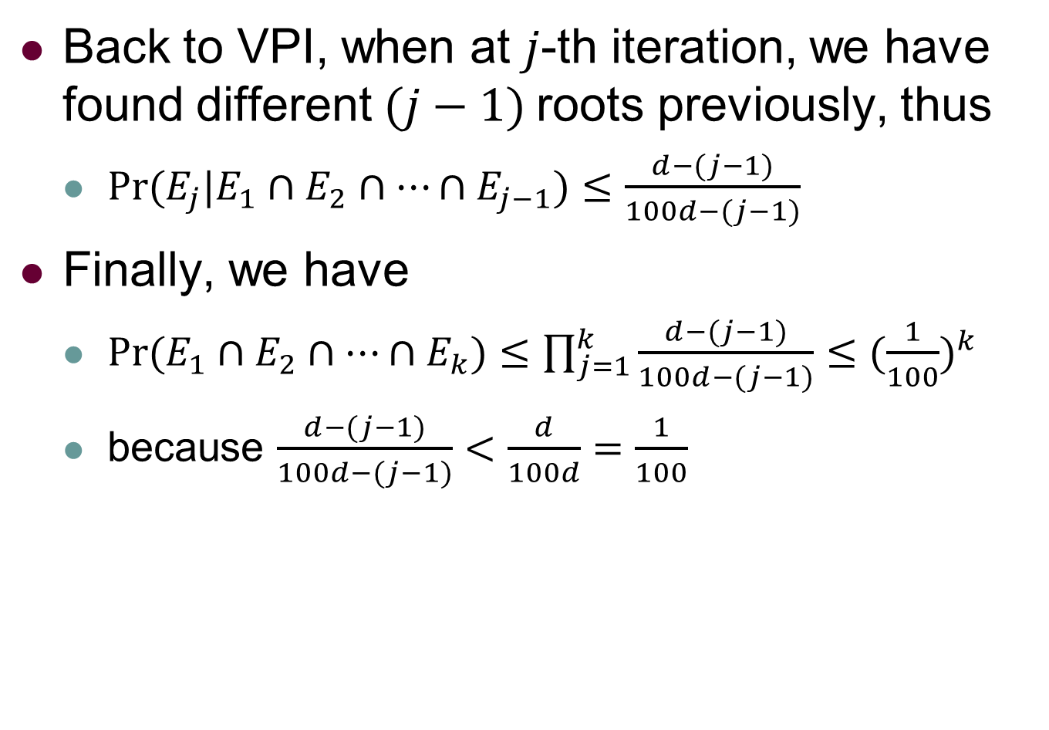
Axioms of Probability
Back to VPI, when at $j$-th iteration, we have found different $(j−1)$roots previously, thus
$Pr⁡(E_{j}|E_{1}∩E_{2}∩⋯{∩E}_{j−1})≤\frac{d−(j−1)}{100d−(j−1)}$
Finally, we have
$Pr⁡(E_{1}∩E_{2}∩⋯{∩E}_{k})≤\prod_{j=1}^{k}{\frac{d−(j−1)}{100d−(j−1)}}≤{(\frac{1}{100})}^{k}$
because $\frac{d−(j−1)}{100d−(j−1)}<\frac{d}{100d}=\frac{1}{100}$

Slide 17
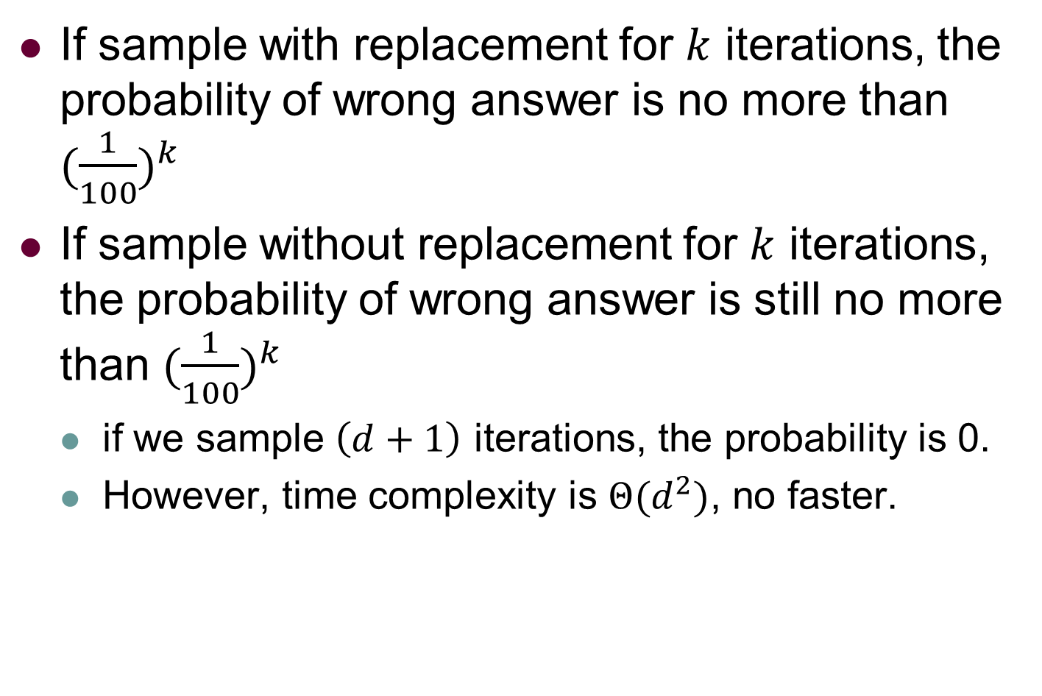
VPI Randomized Algorithm(Cont.)
If sample with replacement for $k$ iterations, the probability of wrong answer is no more than ${(\frac{1}{100})}^{k}$
If sample without replacement for $k$ iterations, the probability of wrong answer is still no more than ${(\frac{1}{100})}^{k}$
if we sample $\left(d+1\right)$ iterations, the probability is 0.
However, time complexity is $Θ(d^{2})$, no faster.

Slide 18
Axioms of Probability
With replacement v.s. Without replacement
With replacement is more desirable
easier to analysis
simpler to code
the probability of making an error is almost negligible

Slide 19
Outline
Chapter 1: Probability and Events
Application: Verifying Polynomial Identities
Axioms of Probability
Application: Verifying Matrix Multiplication
Application: A Randomized Min-Cuit Algorithm

Slide 20

Verifying Matrix Multiplication (VMM)
Definition: Given three $n×n$ matrices $A,B$ and $C$, determine whether $AB=C.$
e.g., $A =\left[\begin{matrix}1 & 2 \\ 3 & 4\end{matrix}\right],B=\left[\begin{matrix}1 & 0 \\ 0 & 1\end{matrix}\right],C=\left[\begin{matrix}1 & 0 \\ 0 & 4\end{matrix}\right]$

Slide 21

Deterministic Algorithm: Idea
Algorithm 1: Brute force
Time complexity: $Θ(n^{3})$
Algorithm 2: Strassen’s method [CLRS Ch.4]
Time complexity: $Θ(n^{2.81})$
Can randomized algorithm speed???

Slide 22
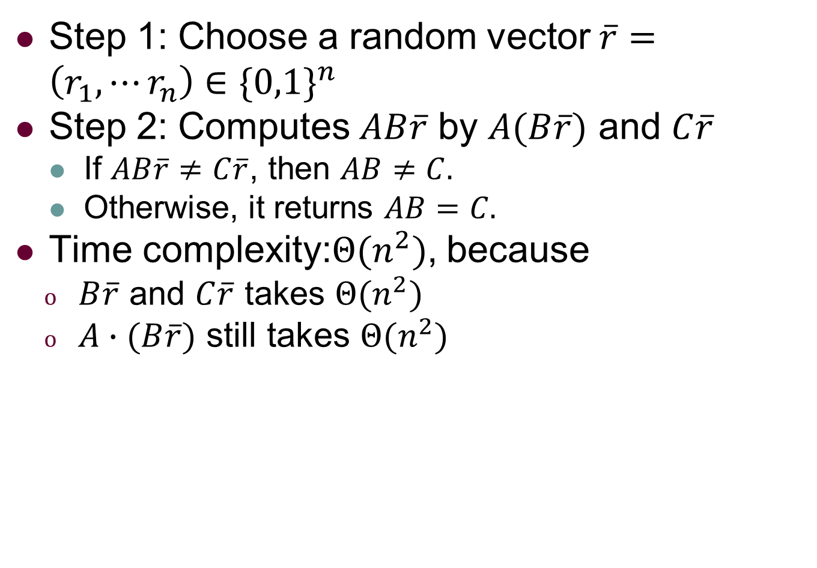
Randomized Algorithm: Idea
Step 1: Choose a random vector $\overline{r}=\left(r_{1},⋯r_{n}\right)∈{\{0,1\}}^{n}$
Step 2: Computes $AB\overline{r}$ by $A(B\overline{r})$ and $C\overline{r}$
If $AB\overline{r}≠C\overline{r}$, then $AB≠C.$
Otherwise, it returns $AB=C.$
Time complexity:$Θ(n^{2})$, because
$B\overline{r}$ and $C\overline{r}$ takes $Θ(n^{2})$
$A∙(B\overline{r})$ still takes $Θ(n^{2})$
If $AB≠C$ and $AB\overline{r}=C\overline{r}$, it gives wrong answers.

Slide 23
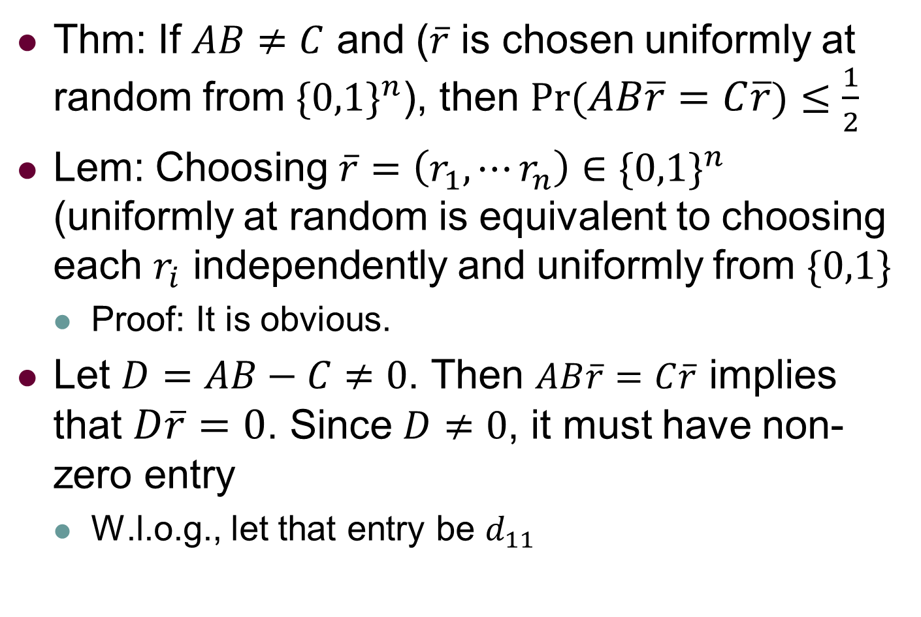
Randomized Algorithm: Analysis
Thm: If $AB≠C$ and ($\overline{r}$ is chosen uniformly at random from ${\{0,1\}}^{n}$), then $Pr⁡(AB\overline{r}=C\overline{r})≤\frac{1}{2}$
Lem: Choosing $\overline{r}=\left(r_{1},⋯r_{n}\right)∈{\{0,1\}}^{n}$ (uniformly at random is equivalent to choosing each $r_{i}$ independently and uniformly from $\{0,1\}$
Proof: It is obvious.
Let $D=AB−C≠0$. Then $AB\overline{r}=C\overline{r}$ implies that $D\overline{r}=0$. Since $D≠0$, it must have non-zero entry
W.l.o.g., let that entry be $d_{11}$

Slide 24

Randomized Algorithm(Cont.)
Because $D\overline{r}=0$, it must be $\sum_{j=1}^{n}{d_{1j}r_{j}}=0$
or equivalently, $r_{1}=−\frac{\sum_{j=2}^{n}{d_{1j}r_{j}}}{d11}$
Suppose we sample from $r_{n}$ to $r_{1}$ independently.
Before $r_{1}$ is sampled, the RHS is determined. There is at most one value from $\{0,1\}$ is RHS.
Hence, $Pr⁡(AB\overline{r}=C\overline{r})≤\frac{1}{2}$
Principle of deferred decisions: Considering several random variables, put them on both sides.

Slide 25
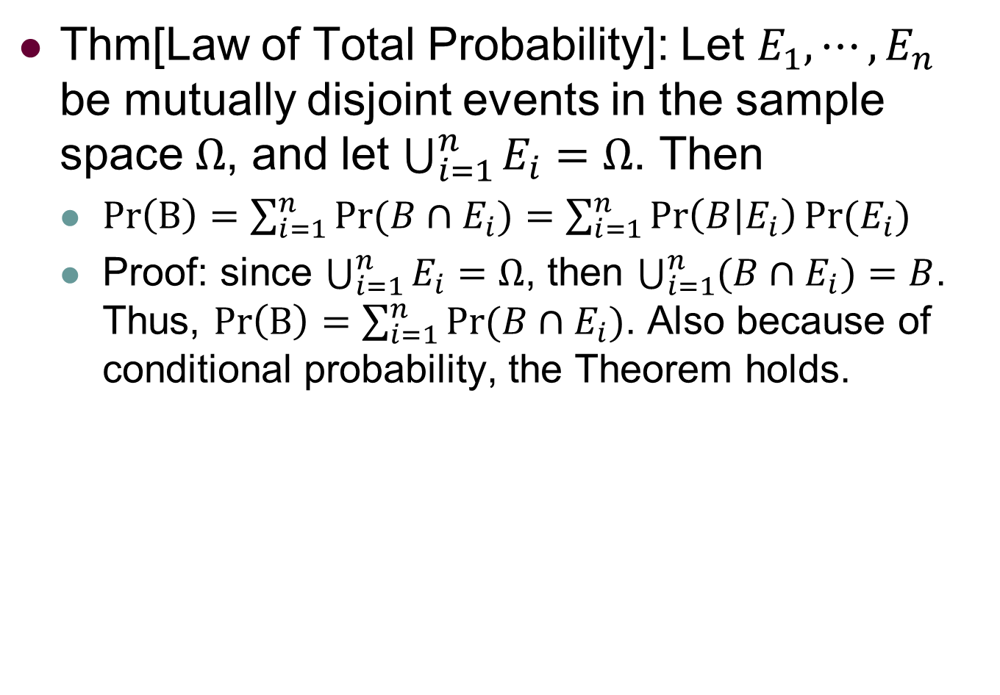
Randomized Algorithm(Cont.)
Thm[Law of Total Probability]: Let $E_{1},⋯,E_{n}$ be mutually disjoint events in the sample space $Ω$, and let $\bigcup_{i=1}^{n}{E_{i}}=Ω$. Then
$\operatorname{Pr}\left(B\right)=\sum_{i=1}^{n}{Pr⁡(B∩E_{i})}=\sum_{i=1}^{n}{\operatorname{Pr}\left(B | E_{i}\right)Pr⁡(E_{i})}$
Proof: since $\bigcup_{i=1}^{n}{E_{i}}=Ω$, then $\bigcup_{i=1}^{n}{{(B∩E}_{i})}=B$. Thus, $\operatorname{Pr}\left(B\right)=\sum_{i=1}^{n}{Pr⁡(B∩E_{i})}$. Also because of conditional probability, the Theorem holds.

Slide 26
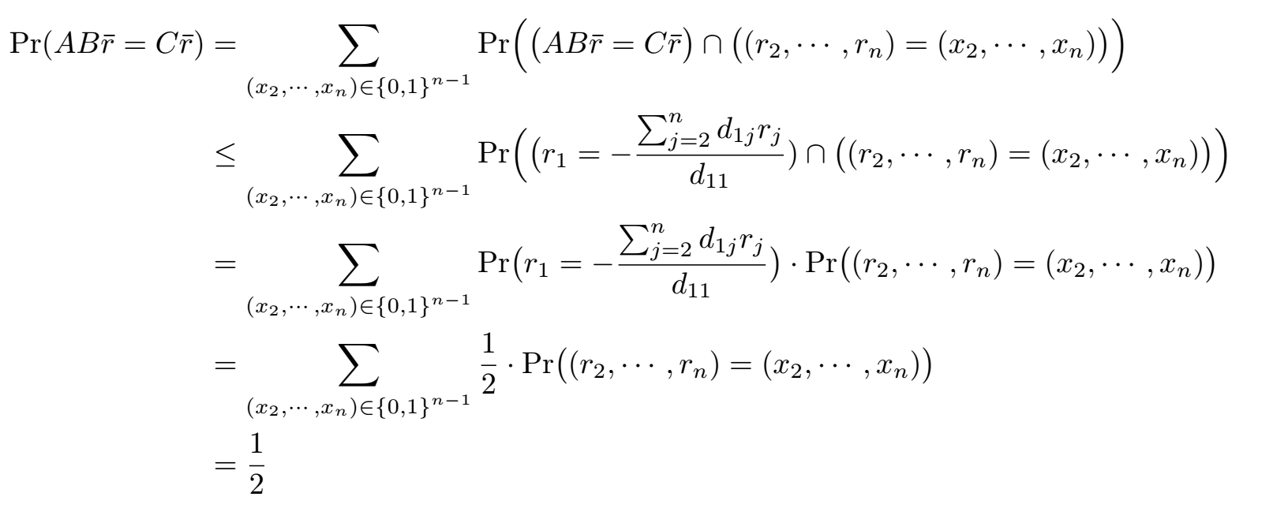

Randomized Algorithm(Cont.)
Thm: If $AB≠C$ and ($\overline{r}$ is chosen uniformly at random from ${\{0,1\}}^{n}$), then $Pr⁡(AB\overline{r}=C\overline{r})≤\frac{1}{2}$
Proof:

Slide 27
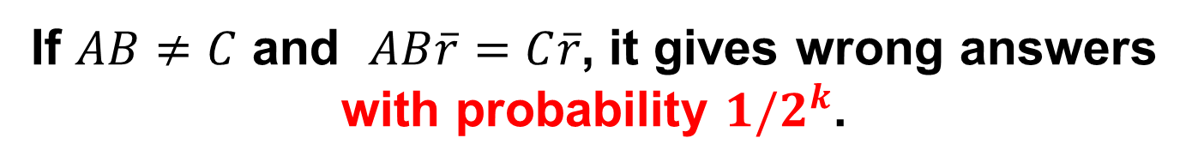

Optimized Randomized Algorithm
Step 1: Choose a random vector $\overline{r}=\left(r_{1},⋯r_{n}\right)∈{\{0,1\}}^{n}$
Step 2: Computes $AB\overline{r}$ by $A(B\overline{r})$ and $C\overline{r}$
Step 3: Repeat $k$ times ($k$ is const., e.g.,100)
If $AB\overline{r}≠C\overline{r}$, then $AB≠C.$
Otherwise, it returns $AB=C.$
Time complexity:$Θ(n^{2})$, because each repeat
$B\overline{r}$ and $C\overline{r}$ takes $Θ(n^{2})$
$A∙(B\overline{r})$ still takes $Θ(n^{2})$
If $AB≠C$ and $AB\overline{r}=C\overline{r}$, it gives wrong answers with probability $1/2^{k}$.

Slide 28
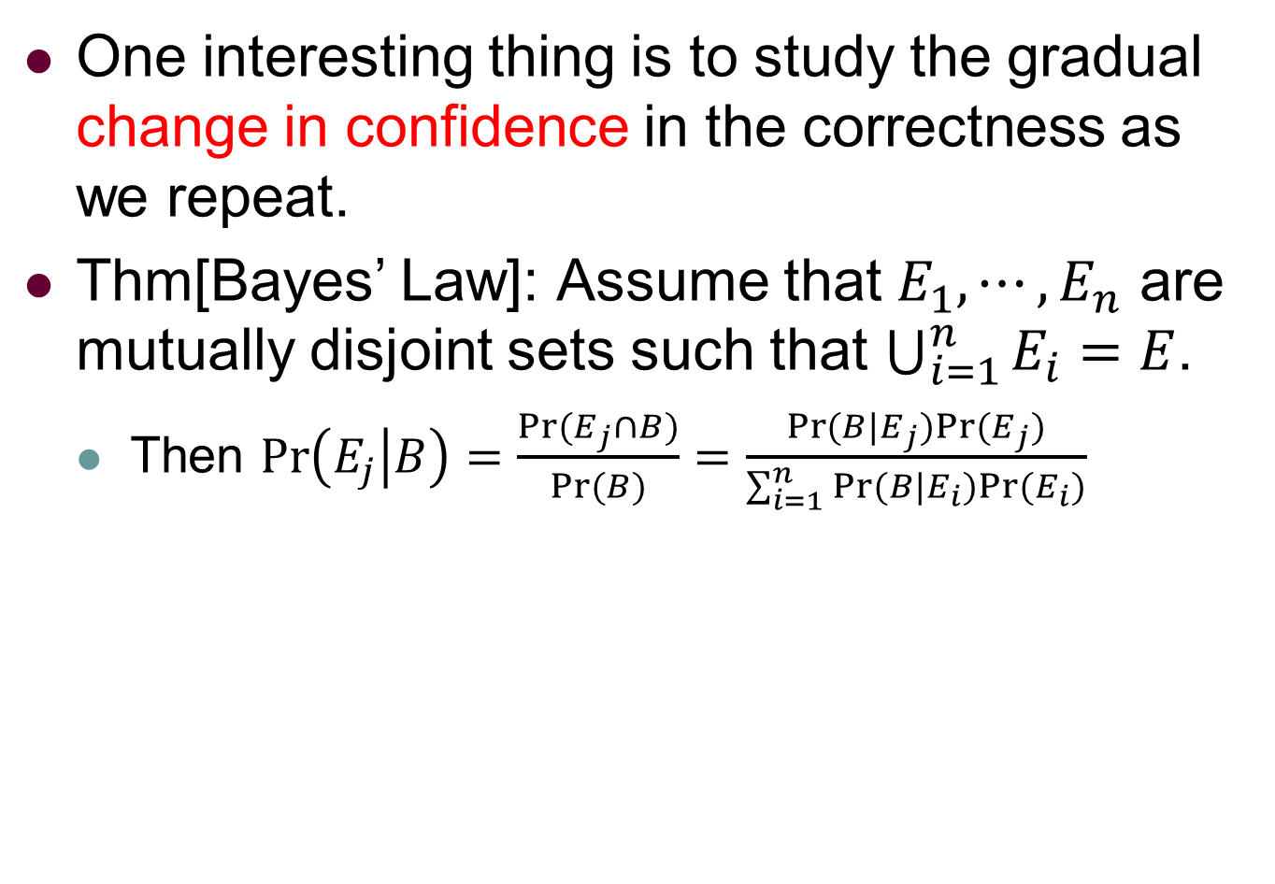
Optimized Randomized Algorithm
One interesting thing is to study the gradual change in confidence in the correctness as we repeat.
Thm[Bayes’ Law]: Assume that $E_{1},⋯,E_{n}$ are mutually disjoint sets such that $\bigcup_{i=1}^{n}{E_{i}}=E$.
Then $\operatorname{Pr}\left(E_{j} | B\right)=\frac{\operatorname{Pr}{(E_{j}∩B)}}{Pr⁡(B)}=\frac{\operatorname{Pr}{(B|E_{j})}Pr⁡(E_{j})}{\sum_{i=1}^{n}{\operatorname{Pr}{(B|E_{i})}Pr⁡(E_{i})}}$

Slide 29
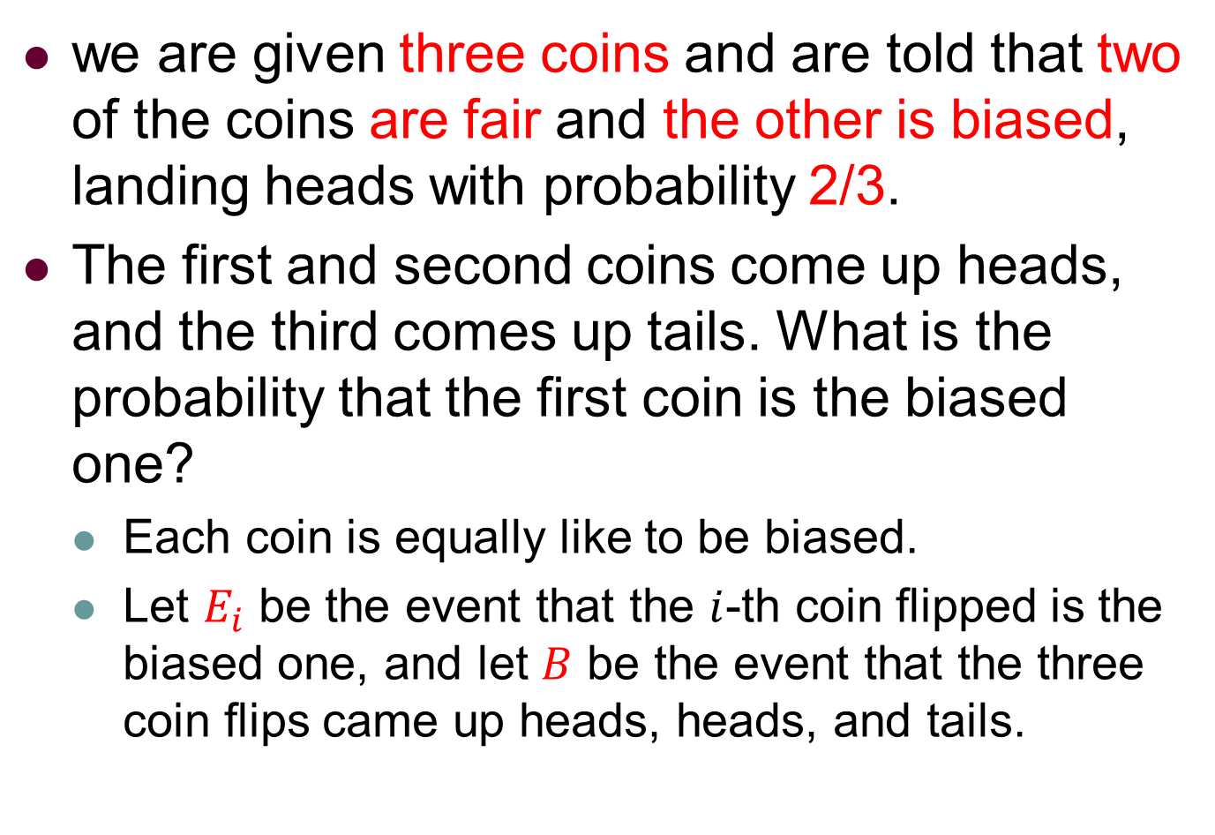
Theorem [Bayes’ Law] Example
we are given three coins and are told that two of the coins are fair and the other is biased, landing heads with probability 2/3.
The first and second coins come up heads, and the third comes up tails. What is the probability that the first coin is the biased one?
Each coin is equally like to be biased.
Let $E_{i}$ be the event that the $i$-th coin flipped is the biased one, and let $B$ be the event that the three coin flips came up heads, heads, and tails.

Slide 30
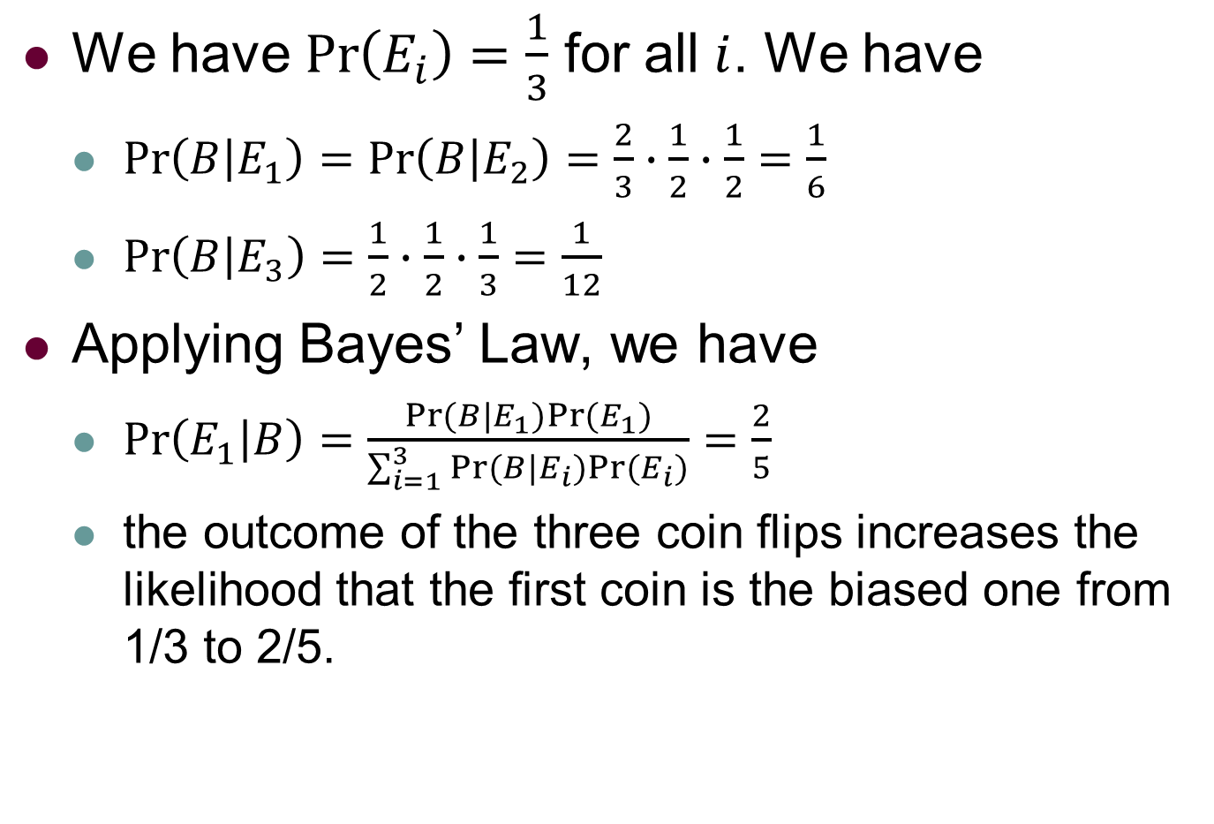
Theorem [Bayes’ Law] Example
We have $\operatorname{Pr}\left(E_{i}\right)=\frac{1}{3}$ for all $i$. We have
$\operatorname{Pr}\left(B | E_{1}\right)=\operatorname{Pr}\left(B | E_{2}\right)=\frac{2}{3}∙\frac{1}{2}∙\frac{1}{2}=\frac{1}{6}$
$Pr\left(B | E_{3}\right)=\frac{1}{2}∙\frac{1}{2}∙\frac{1}{3}=\frac{1}{12}$
Applying Bayes’ Law, we have
$\operatorname{Pr}\left(E_{1} | B\right)=\frac{\operatorname{Pr}{(B|E_{1})}Pr⁡(E_{1})}{\sum_{i=1}^{3}{\operatorname{Pr}{(B|E_{i})}Pr⁡(E_{i})}}=\frac{2}{5}$
the outcome of the three coin flips increases the likelihood that the first coin is the biased one from 1/3 to 2/5.
Notes:
Pr(head) = 2/3 Pr(tail) = 1/3

Slide 31
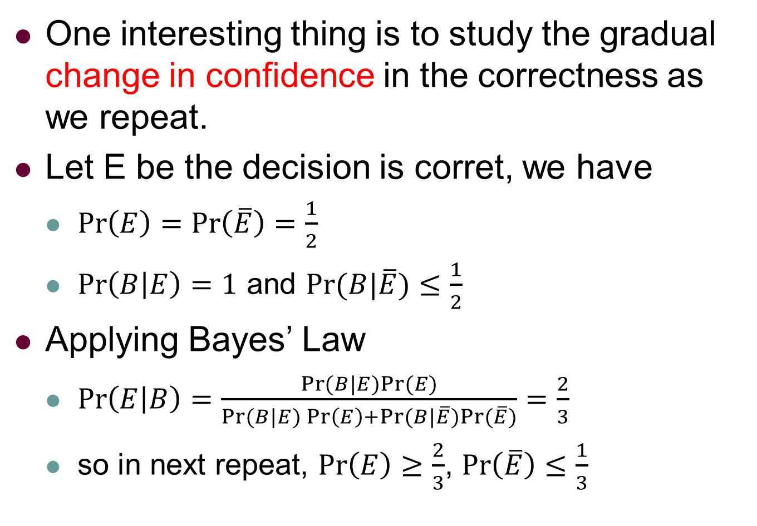
Optimized Randomized Algorithm
One interesting thing is to study the gradual change in confidence in the correctness as we repeat.
Let E be the decision is corret, we have
$\operatorname{Pr}\left(E\right)=\operatorname{Pr}\left(\overline{E}\right)=\frac{1}{2}$
$\operatorname{Pr}\left(B | E\right)=1$ and $Pr⁡(B|\overline{E})≤\frac{1}{2}$
Applying Bayes’ Law
$\operatorname{Pr}\left(E | B\right)=\frac{\operatorname{Pr}{(B|E)}Pr⁡(E)}{\operatorname{Pr}{(B|E)}\operatorname{Pr}\left(E\right)+\operatorname{Pr}{(B|\overline{E})}Pr⁡(\overline{E})}=\frac{2}{3}$
so in next repeat, $\operatorname{Pr}\left(E\right)≥\frac{2}{3}$, $\operatorname{Pr}\left(\overline{E}\right)≤\frac{1}{3}$

Slide 32
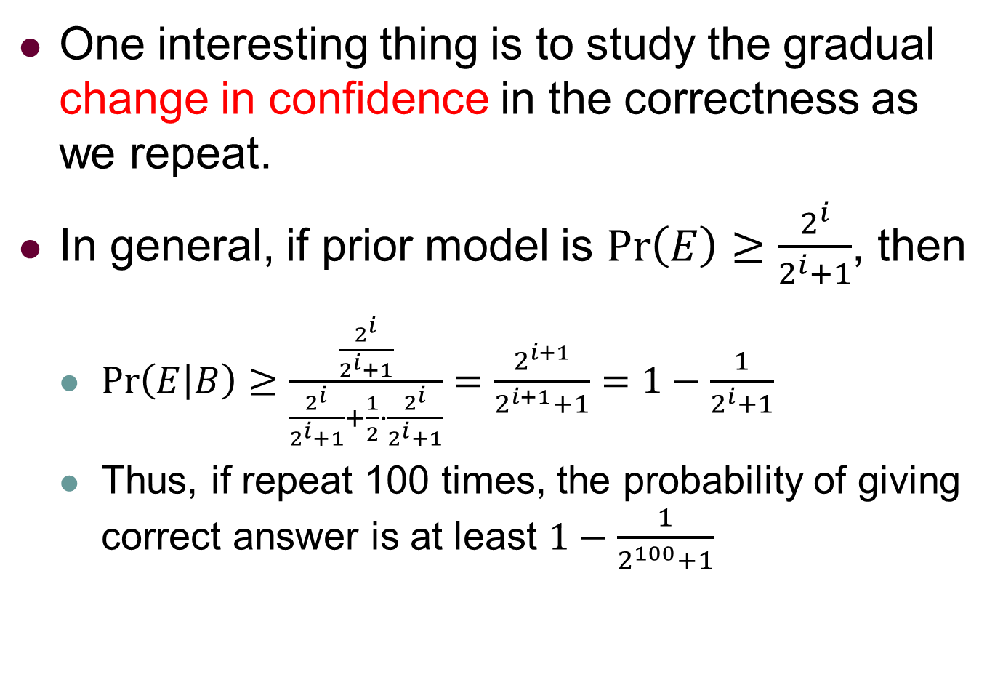
Optimized Randomized Algorithm
One interesting thing is to study the gradual change in confidence in the correctness as we repeat.
In general, if prior model is $\operatorname{Pr}\left(E\right)≥\frac{2^{i}}{2^{i}+1}$, then
$\operatorname{Pr}\left(E | B\right)≥\frac{\frac{2^{i}}{2^{i}+1}}{\frac{2^{i}}{2^{i}+1}+\frac{1}{2}∙\frac{2^{i}}{2^{i}+1}}=\frac{2^{i+1}}{2^{i+1}+1}=1−\frac{1}{2^{i}+1}$
Thus, if repeat 100 times, the probability of giving correct answer is at least $1−\frac{1}{2^{100}+1}$

Slide 33
Outline
Chapter 1: Probability and Events
Application: Verifying Polynomial Identities
Axioms of Probability
Application: Verifying Matrix Multiplication
Application: A Randomized Min-Cut Algorithm

Slide 34

Min-Cut Problem: Definition
Definition: Given a graph $G = (V, E)$with $n$ vertices, the minimum cut or min-cut problem is to find a minimum cardinality cut-set in G.
A cut-set in a graph is a set of edges whose removal breaks the graph into two or more connected components.

Slide 35





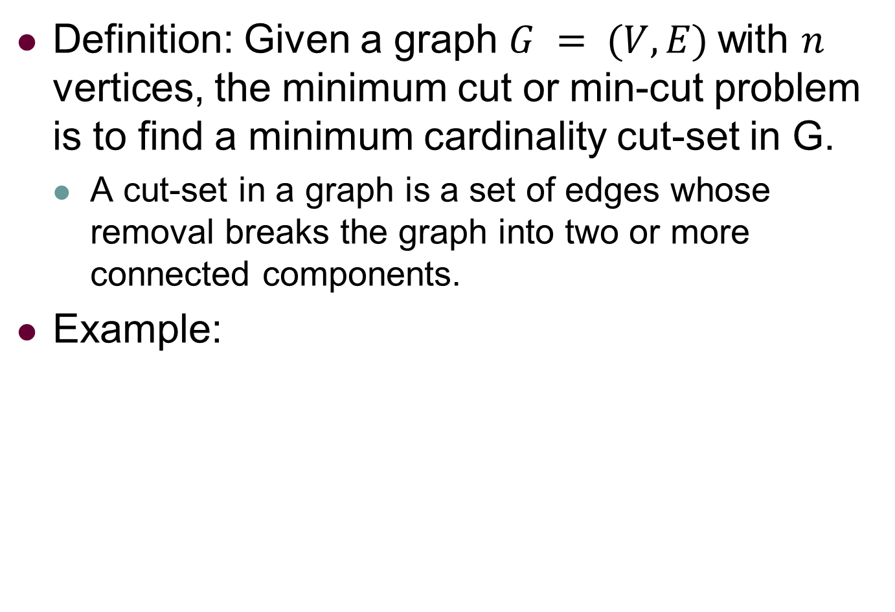






Min-Cut Problem: Example
Definition: Given a graph $G = (V, E)$with $n$ vertices, the minimum cut or min-cut problem is to find a minimum cardinality cut-set in G.
A cut-set in a graph is a set of edges whose removal breaks the graph into two or more connected components.
Example:
$$V_{4}$$
$$V_{3}$$
$$V_{4}$$
$$V_{3}$$
$$V_{2}$$
$$V_{2}$$
$$V_{0}$$
$$V_{1}$$
$$V_{0}$$
$$V_{1}$$
Graph G
min-cut = {($V_{3},V_{2}$), ($V_{1},V_{2}$)}

Slide 36
Approximation Algorithm
TBD

Slide 37
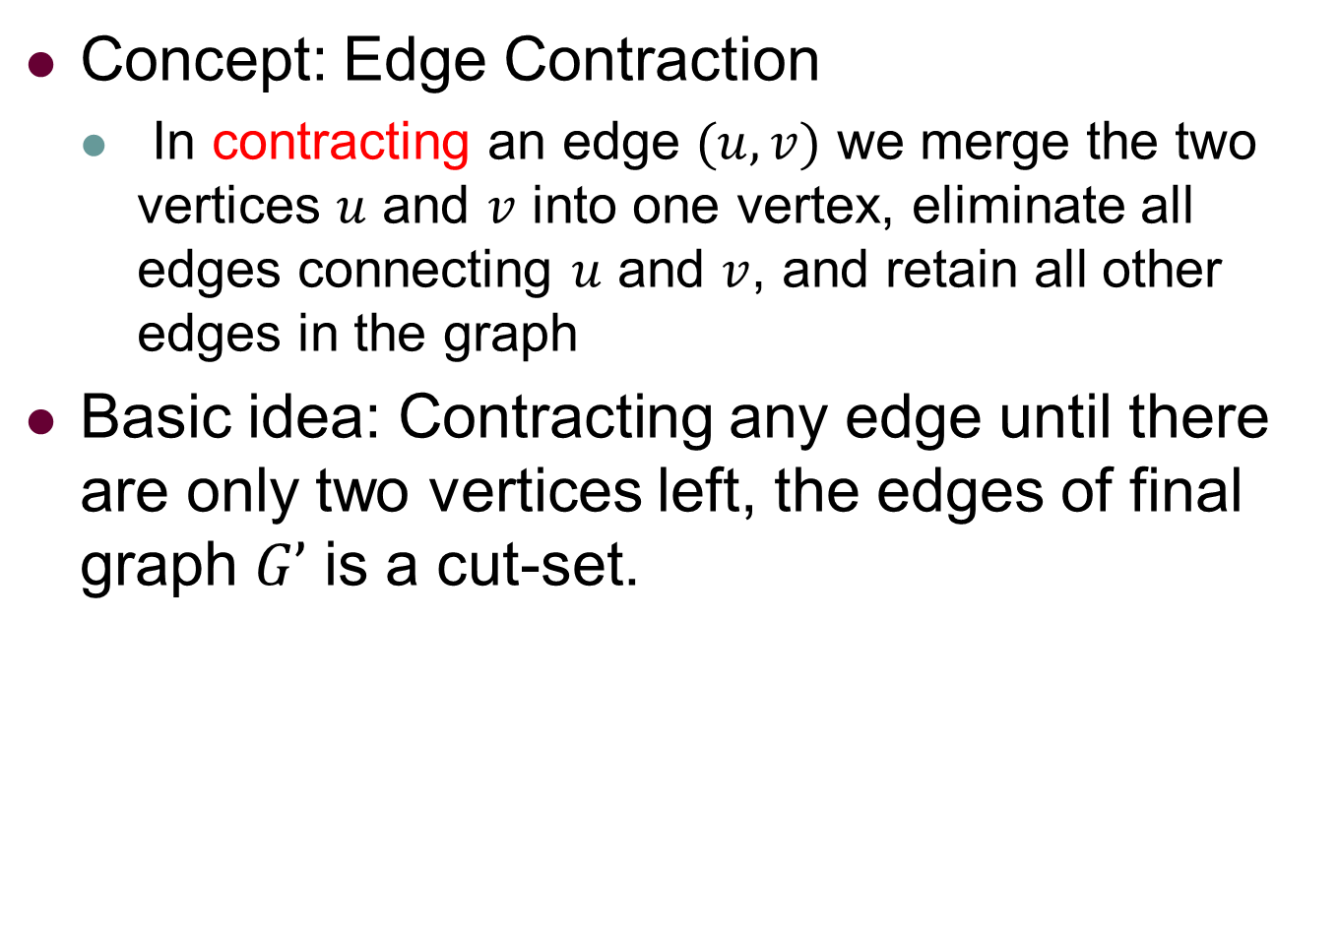
Randomized Algorithm: Idea
Concept: Edge Contraction
In contracting an edge $(u, v)$ we merge the two vertices $u$ and $v$ into one vertex, eliminate all edges connecting $u$ and $v$, and retain all other edges in the graph
Basic idea: Contracting any edge until there are only two vertices left, the edges of final graph $G’$ is a cut-set.

Slide 38









Randomized Algorithm: Example
Example
$$V_{4}$$
$$V_{3}$$
$$V_{4}$$
$$V_{2}$$
$$V_{2}$$
$V_{1},$ $V_{3}$
$$V_{0}$$
$$V_{1}$$
$$V_{0}$$
Graph $G_{0}$
Graph $G_{1}$
$$V_{2}$$
$$V_{2}$$
$V_{1},$ $V_{3}$
$$V_{0},{V_{1},V_{3},V}_{4}$$
$$V_{0},V_{4}$$
Graph $G_{3}$
Graph $G_{2}$

Slide 39
Randomized Algorithm: Idea
Concept: Edge Contraction
In contracting an edge $(u, v)$ we merge the two vertices $u$ and $v$ into one vertex, eliminate all edges connecting $u$ and $v$, and retain all other edges in the graph
Basic idea: Contracting any edge until there are only two vertices left, the edges of final graph $G’$ is a cut-set.
What is the probability of giving a correct answer? i.e., the cut-set is also min-cut.

Slide 40
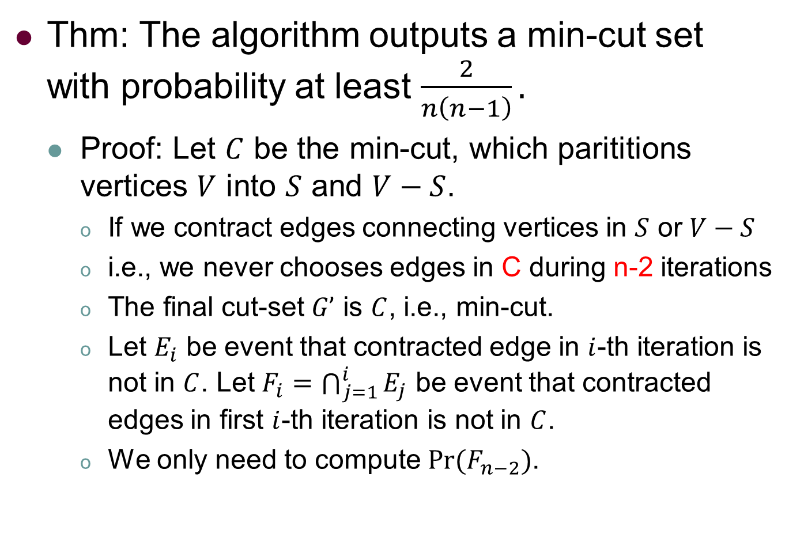
Randomized Algorithm: Analysis
Thm: The algorithm outputs a min-cut set with probability at least $\frac{2}{n\left(n−1\right)}.$
Proof: Let $C$ be the min-cut, which parititions vertices $V$ into $S$ and $V−S$.
If we contract edges connecting vertices in $S$ or $V−S$
i.e., we never chooses edges in C during n-2 iterations
The final cut-set $G’$ is $C$, i.e., min-cut.
Let $E_{i}$ be event that contracted edge in $i$-th iteration is not in $C$. Let $F_{i}=\bigcap_{j=1}^{i}{E_{j}}$ be event that contracted edges in first $i$-th iteration is not in $C$.
We only need to compute $Pr⁡(F_{n−2})$.

Slide 41
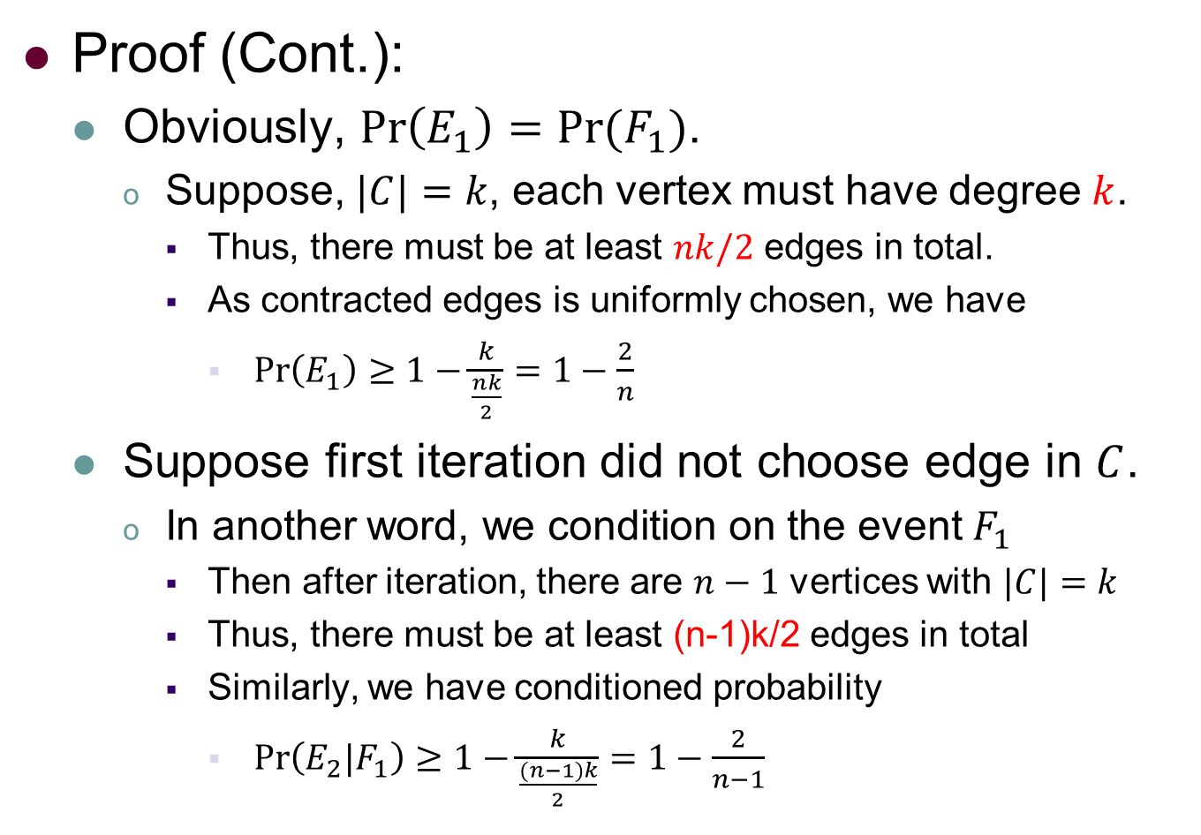
Randomized Algorithm: Analysis
Proof (Cont.):
Obviously, $\operatorname{Pr}\left(E_{1}\right)=Pr⁡(F_{1})$.
Suppose, $|C|=k$, each vertex must have degree $k$.
Thus, there must be at least $nk/2$ edges in total.
As contracted edges is uniformly chosen, we have
$\operatorname{Pr}\left(E_{1}\right)≥1−\frac{k}{\frac{nk}{2}}=1−\frac{2}{n}$
Suppose first iteration did not choose edge in $C$.
In another word, we condition on the event $F_{1}$
Then after iteration, there are $n−1$ vertices with $|C|=k$
Thus, there must be at least (n-1)k/2 edges in total
Similarly, we have conditioned probability
$\operatorname{Pr}\left(E_{2}|F_{1}\right)≥1−\frac{k}{\frac{(n−1)k}{2}}=1−\frac{2}{n−1}$

Slide 42
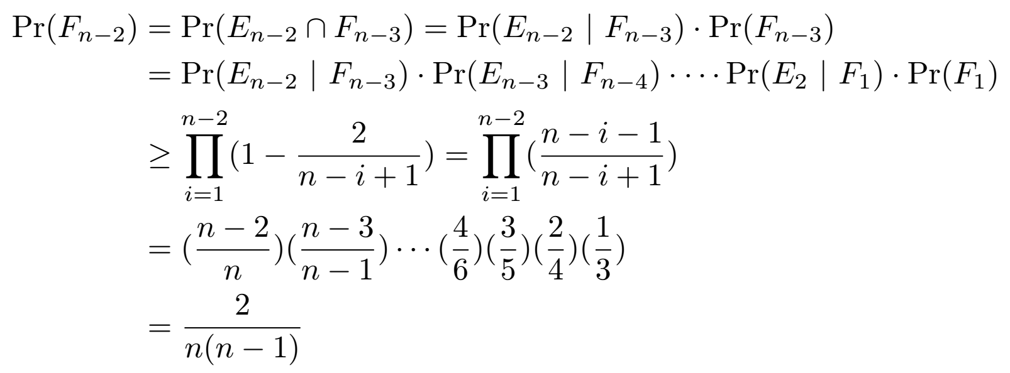

Randomized Algorithm: Analysis
Proof (Cont.):
Generally, $\operatorname{Pr}\left(E_{i}|F_{i−1}\right)≥1−\frac{k}{\frac{k\left(n−i+1\right)}{2}}=1−\frac{2}{n−i+1}$
To compute $Pr(F_{n−2})$, we have

Slide 43
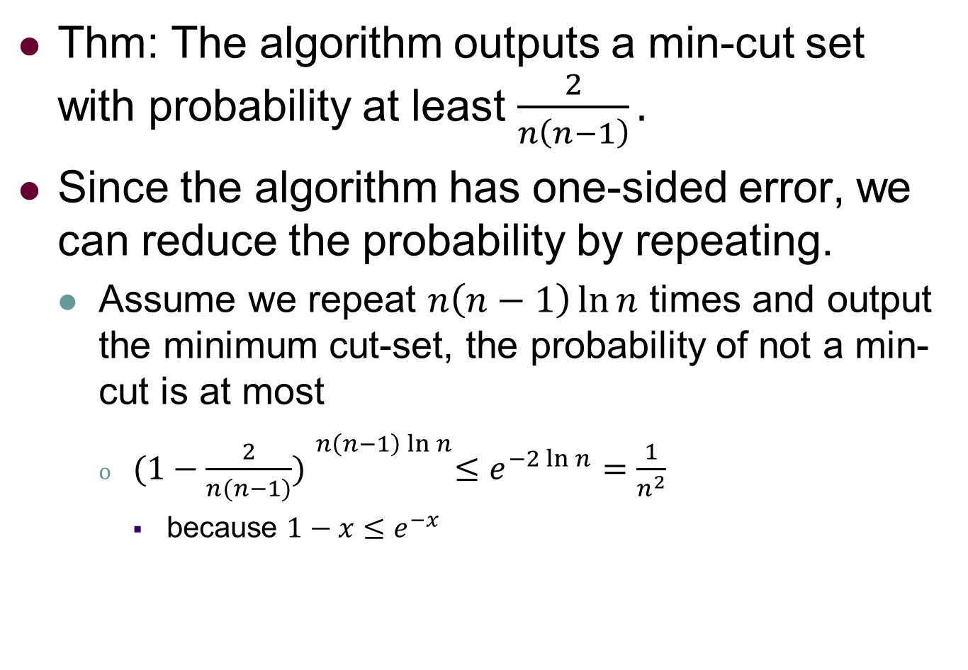
Randomized Algorithm: Analysis
Thm: The algorithm outputs a min-cut set with probability at least $\frac{2}{n\left(n−1\right)}.$
Since the algorithm has one-sided error, we can reduce the probability by repeating.
Assume we repeat $n\left(n−1\right)\ln{n}$ times and output the minimum cut-set, the probability of not a min-cut is at most
${(1−\frac{2}{n(n−1)}) }^{n\left(n−1\right)\ln{n}}≤e^{−2\ln{n}}=\frac{1}{n^{2}}$
because $1−x≤e^{−x}$

Slide 44
Probability and Computing Chapter 2: Discrete Random Variables and Expectation
Michael Mitzenmacher¹ Eli Upfal² ¹Harvard University ²Brown University
Zeng Yuxiang
2018/06/23

Slide 45
Outline
Chapter 2: Discrete Random Variables and Expectation
Random Variables and Expectation
Linearity of Expectations
Jensen’s Inequality
The Bernolli and Binomial Random Variables
Conditional Expectation
The Geometric Distribution
Example: Coupon Collector’s Problem
Application: The Expected Run-Time of Quicksort

