Slide 1

Moments and Deviations
Yao Kai
Hong Kong University of Science and Technology

Slide 2
Outline
Markov’s Inequality
Variance and Moments of a Random Variable
Chebyshev’s Inequality
Application: Computing the Median

Slide 3

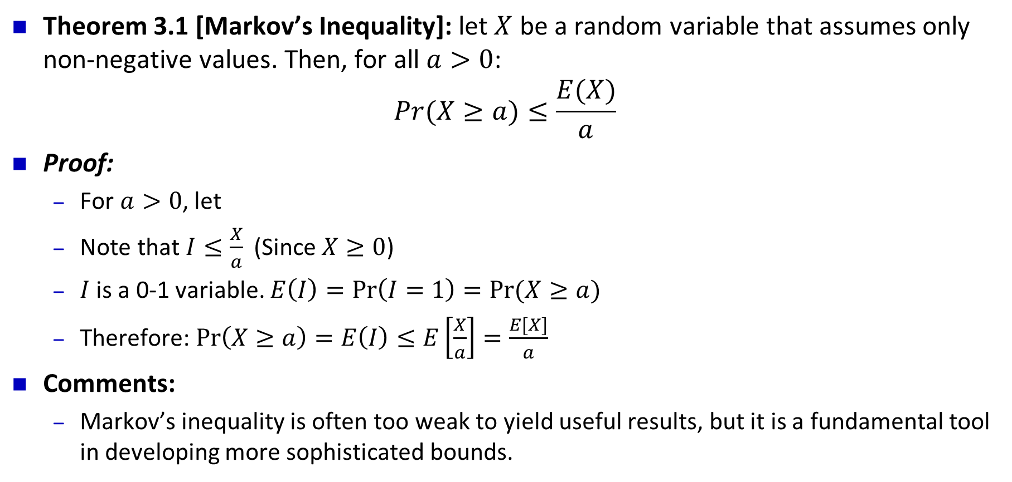
Markov’s Inequality
Theorem 3.1 [Markov’s Inequality]: let $X$ be a random variable that assumes only non-negative values. Then, for all $a>0$:
$$Pr⁡(X≥a)≤\frac{E(X)}{a}$$
Proof:
For $a>0$, let
Note that $I≤\frac{X}{a}$ (Since $X≥0$)
$I$ is a 0-1 variable. $E\left(I\right)=\operatorname{Pr}\left(I=1\right)=Pr⁡(X≥a)$
Therefore: $\operatorname{Pr}\left(X≥a\right)=E\left(I\right)≤E\left[\frac{X}{a}\right]=\frac{E[X]}{a}$
Comments:
Markov’s inequality is often too weak to yield useful results, but it is a fundamental tool in developing more sophisticated bounds.

Slide 4
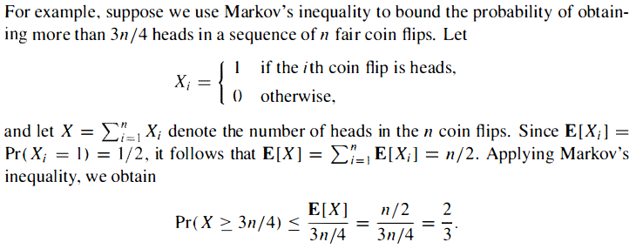
Example: coin-flipping

Slide 5

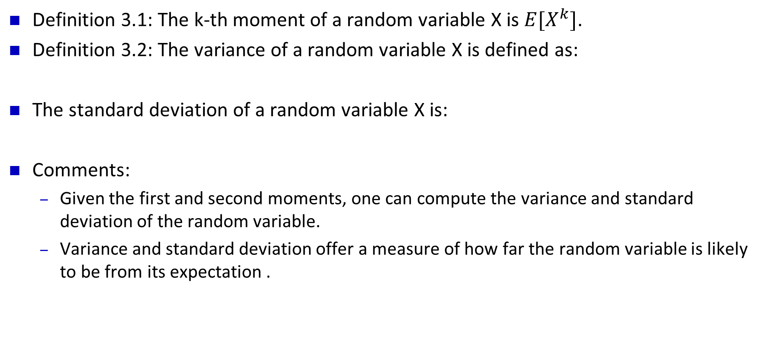
Variance and Moments of a Random Variable
Definition 3.1: The k-th moment of a random variable X is $E[X^{k}]$.
Definition 3.2: The variance of a random variable X is defined as:
The standard deviation of a random variable X is:
Comments:
Given the first and second moments, one can compute the variance and standard deviation of the random variable.
Variance and standard deviation offer a measure of how far the random variable is likely to be from its expectation .

Slide 6
Definition 3.3: The covariance of two random Variables X and Y is:
Definition 3.4: For any two random variables X and Y:
Note that: The variance of the sum of two ( or any finite number of) random variables does equal the sum of the variances when the random variables are independent.

Slide 7
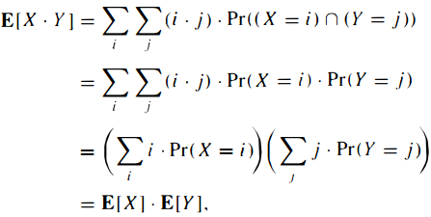
Theorem 3.3: If X and Y are two independent random variables, then:
Proof:

Slide 8



Corollary 3.4: If X and Y are independent random variables, then:
Theorem 3.5: Let $X_{1}, X_{2}, …, X_{n}$ be mutually independent random variables. Then:

Slide 9

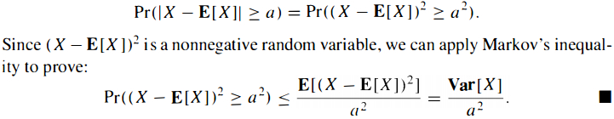
Chebyshev’s Inequality
Theorem 3.6: [Chebyshev’s Inequality]: For any a>0:
Proof:

Slide 10
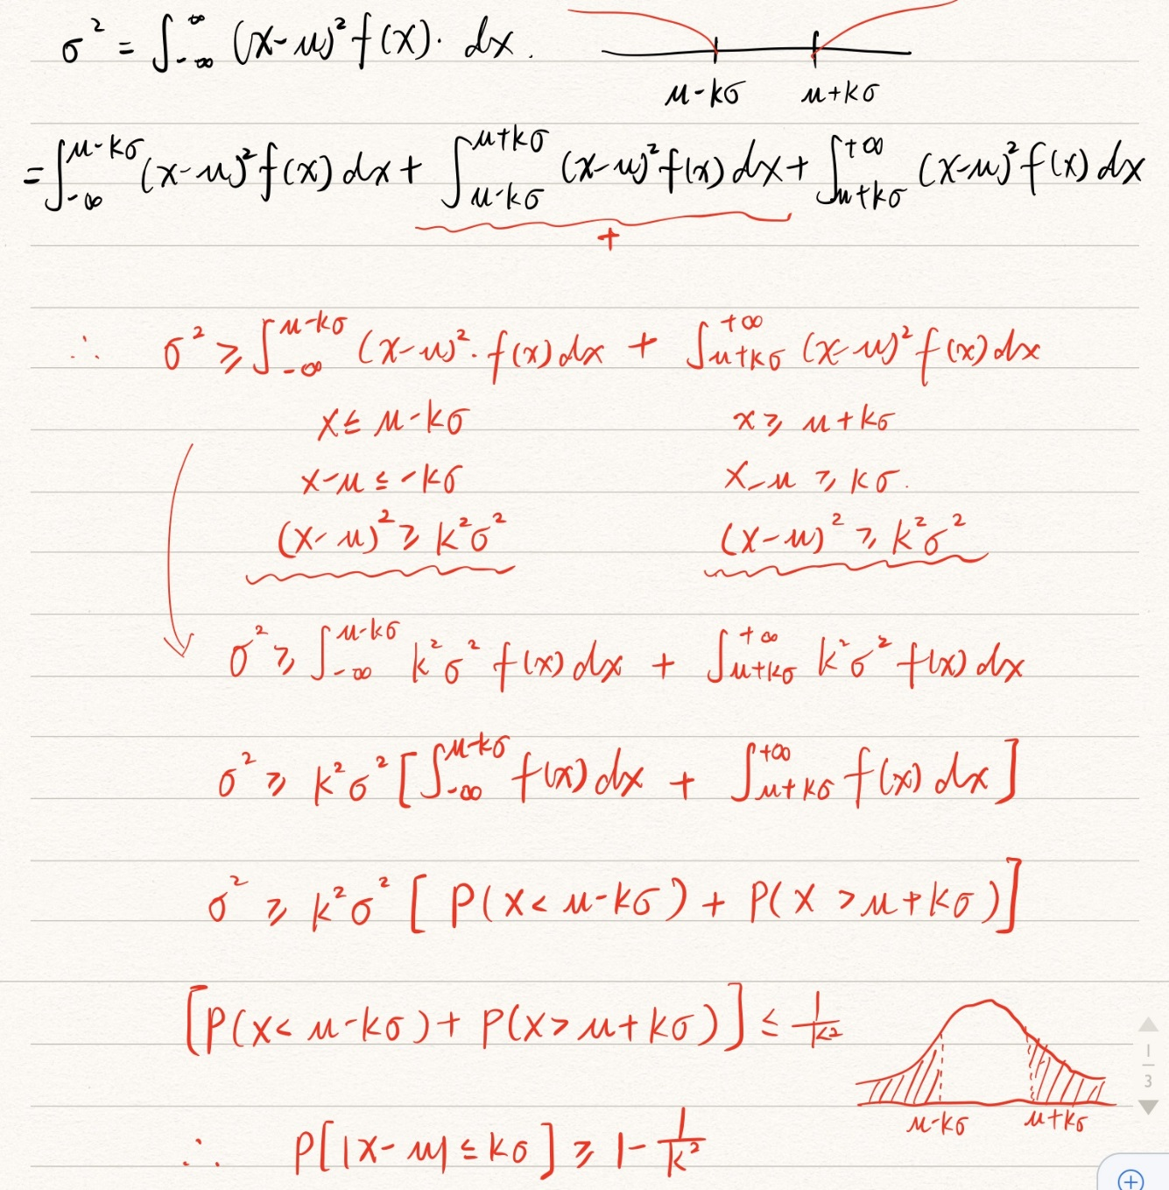
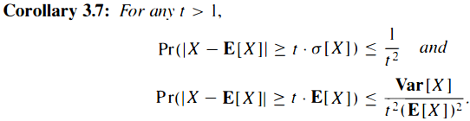

Slide 11
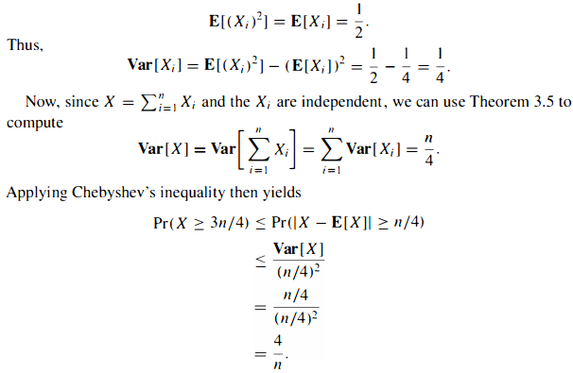
Example: coin-flipping, Pr(obtaining more than 3n/4 heads)

Slide 12
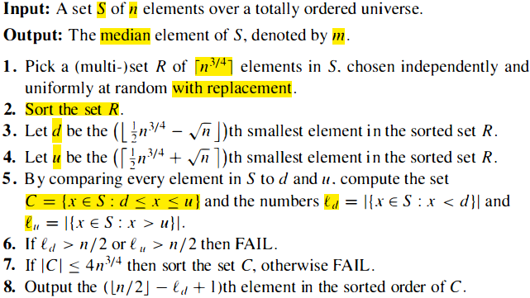
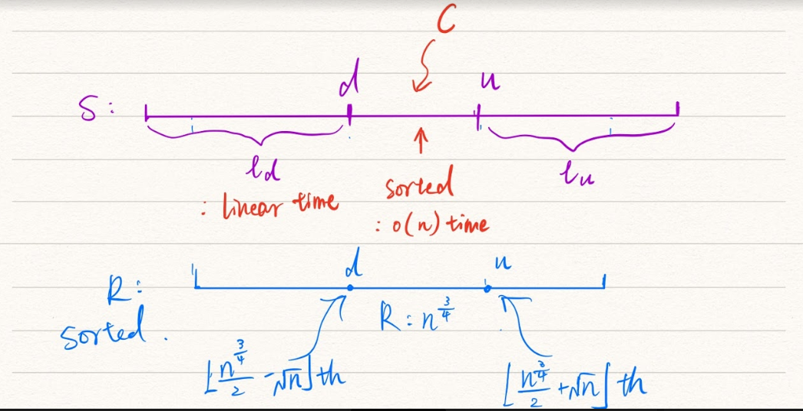
A randomized algorithm for computing the median
Problem: Given n elements drawn from a totally ordered universe, find the median.
Solution:
Sorting. O(nlogn)
A deterministic algorithm. O(n), but complex.
Randomized algorithm:

Slide 13
Analysis of the algorithm
Theorem 3.9: The algorithm terminates in linear time. If it does not output FAIL, it outputs the correct median.
Proof:
Correctness:
the algorithm only give an incorrect answer if the median were not in the set C.
step 6 guarantees that , in these cases, the algorithm outputs FAIL.
Linear time:
as long as C is sufficiently small, the total work is only linear in the size of S.
Step 7 guarantees this.

Slide 14
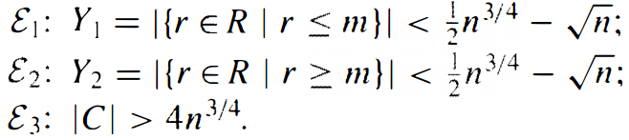
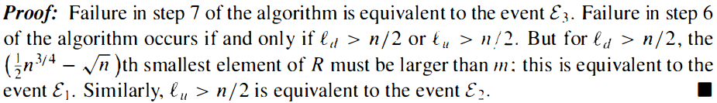
Bounding the probability of FAIL
Three “bad” events:
Lemma 3.10: The randomized median algorithm fails if and only if at least one of these 3 events occurs.

Slide 15

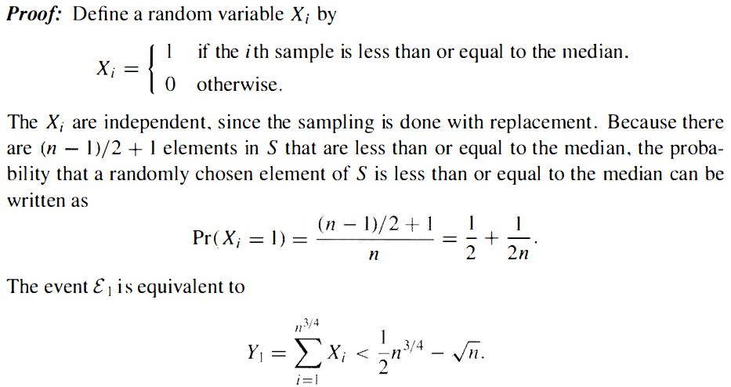

Slide 16
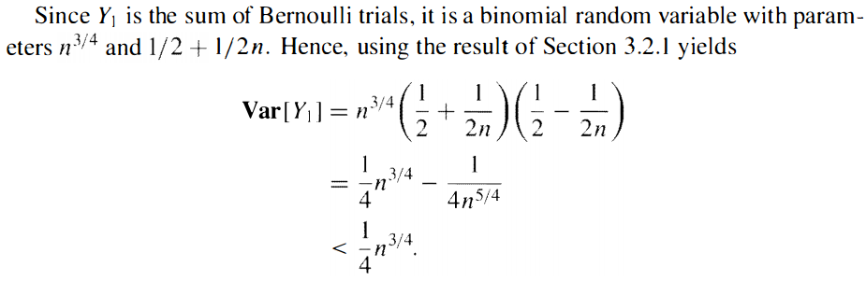
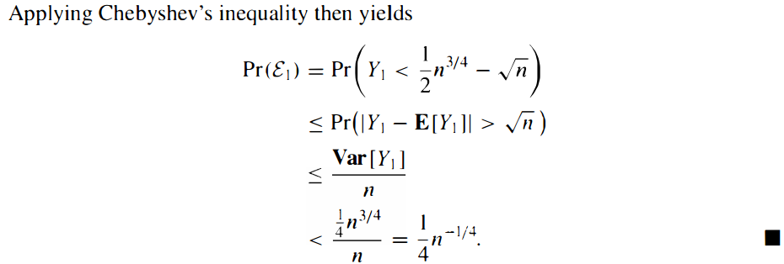

Slide 17
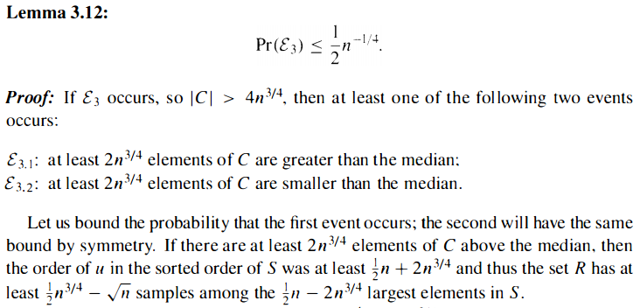

Slide 18
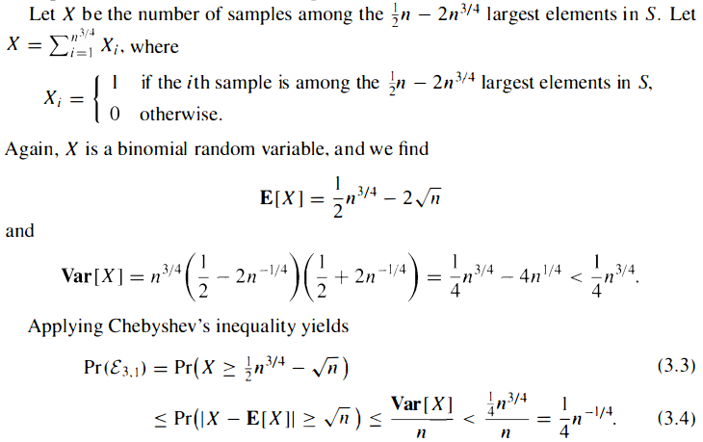

Slide 19


