Slide 1
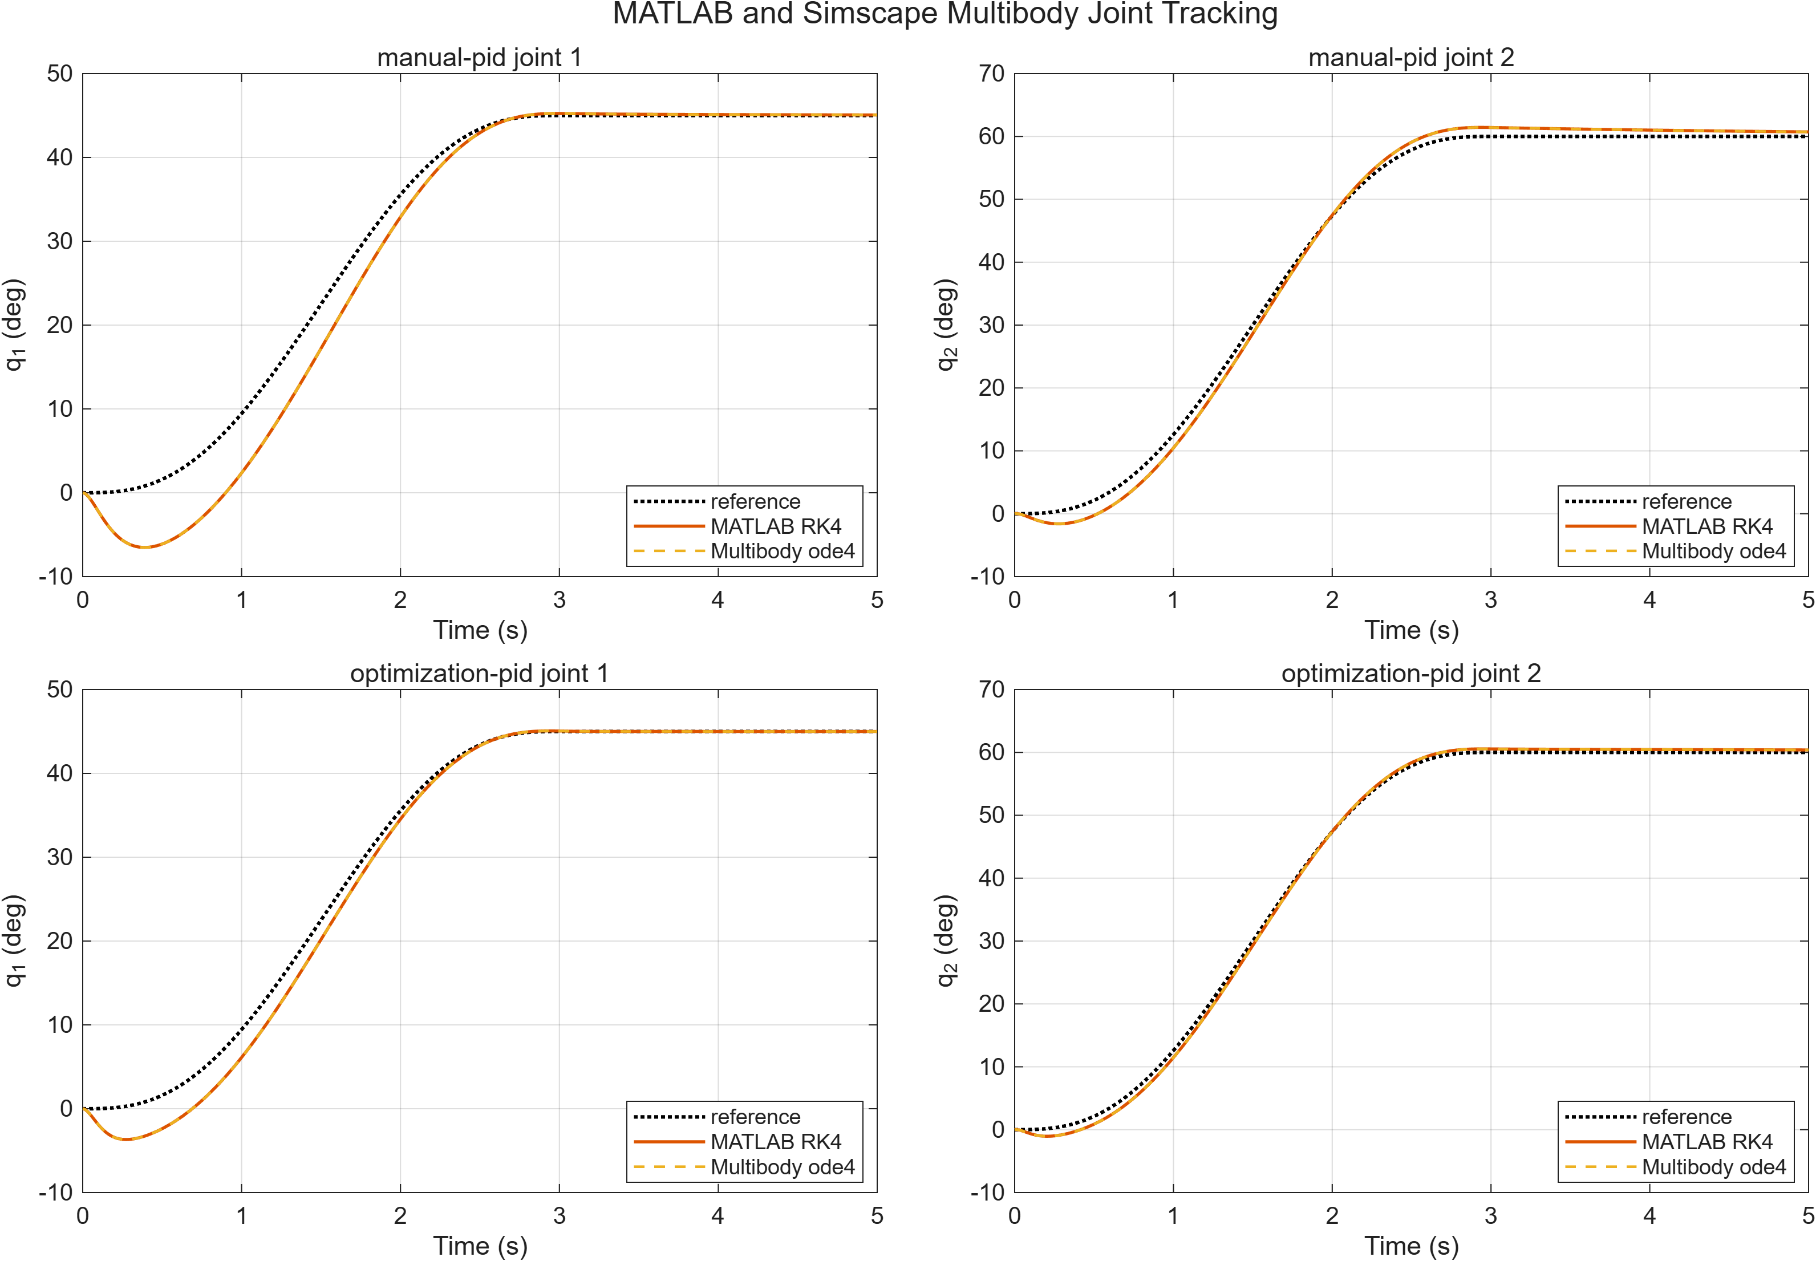
Reliable execution connects plans to physical action
Evidence-grounded PID and Fuzzy-PID evaluation for a 2-link manipulator
Notes:
Frame the project as a validated execution layer rather than an end-to-end robot intelligence stack.
[Sources]
- docs/report/technical_report.md
- results/figures/multibody_cross_validation_tracking.png

Slide 2
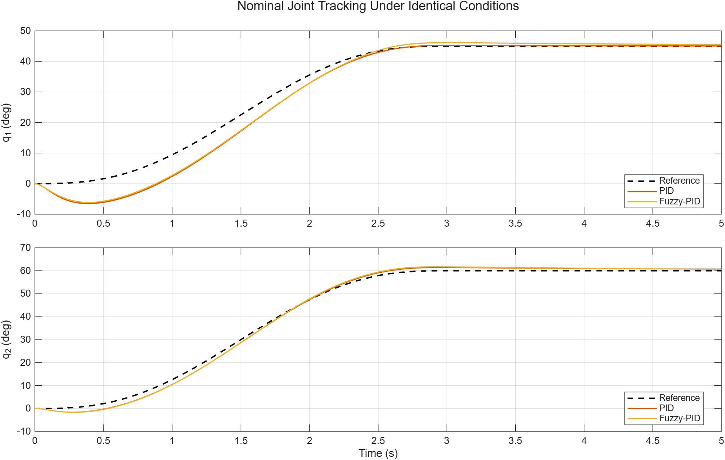
Nominal success is not enough to claim reliable manipulation
The central question is how controller choices survive controlled changes in payload, configuration, noise, disturbance, and actuator authority.
A controller can pass one nominal trajectory and still fail when uncertainties interact.
This study therefore reports failed completed runs instead of filtering them from averages.
All conclusions are simulation-only; no hardware safety or fidelity claim is made.
Notes:
Use the nominal plot to motivate why the later stress matrix is necessary.
[Sources]
- docs/report/technical_report.md
- results/figures/nominal_pid_vs_fuzzy_tracking.png

Slide 3
Every controller faces the same plant, trajectory, limits, and metrics
0.001 s
5.0 s
5001
fixed sample time
nominal duration
samples per nominal run
Manual PID, Mamdani Fuzzy-PID, and optimized PID use identical robot parameters, torque limits, trajectories, thresholds, and random seeds.
Notes:
Emphasize fairness before discussing controller rankings.
[Sources]
- docs/report/technical_report.md
- results/report/report_evidence.json

Slide 4
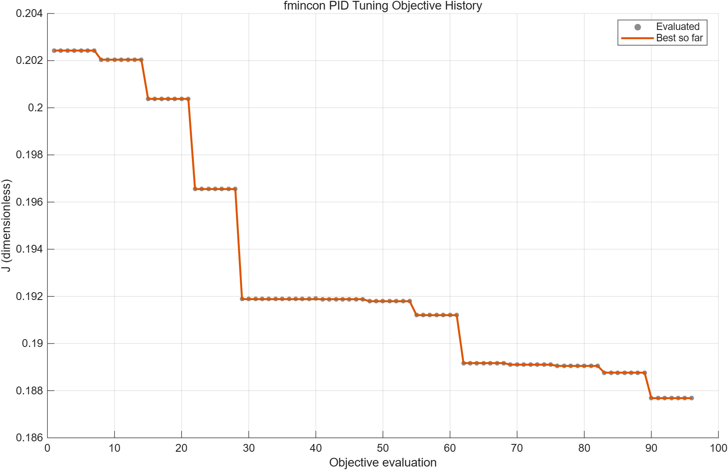
Optimization improves the baseline without changing the protocol
The bounded search reduces the nominal objective by 7.283% and improves the held-out payload objective from 0.214504 to 0.197284.
The search converges with exit flag 1 after 12 iterations and 96 evaluations.
Only PID gains change; the plant, torque limits, trajectory, objective, and evaluation thresholds remain fixed.
Notes:
Separate tuning evidence from reliability evidence: a lower objective does not prove universal robustness.
[Sources]
- docs/report/technical_report.md
- results/figures/pid_optimization_objective.png
- results/data/pid_optimization.mat

Slide 5
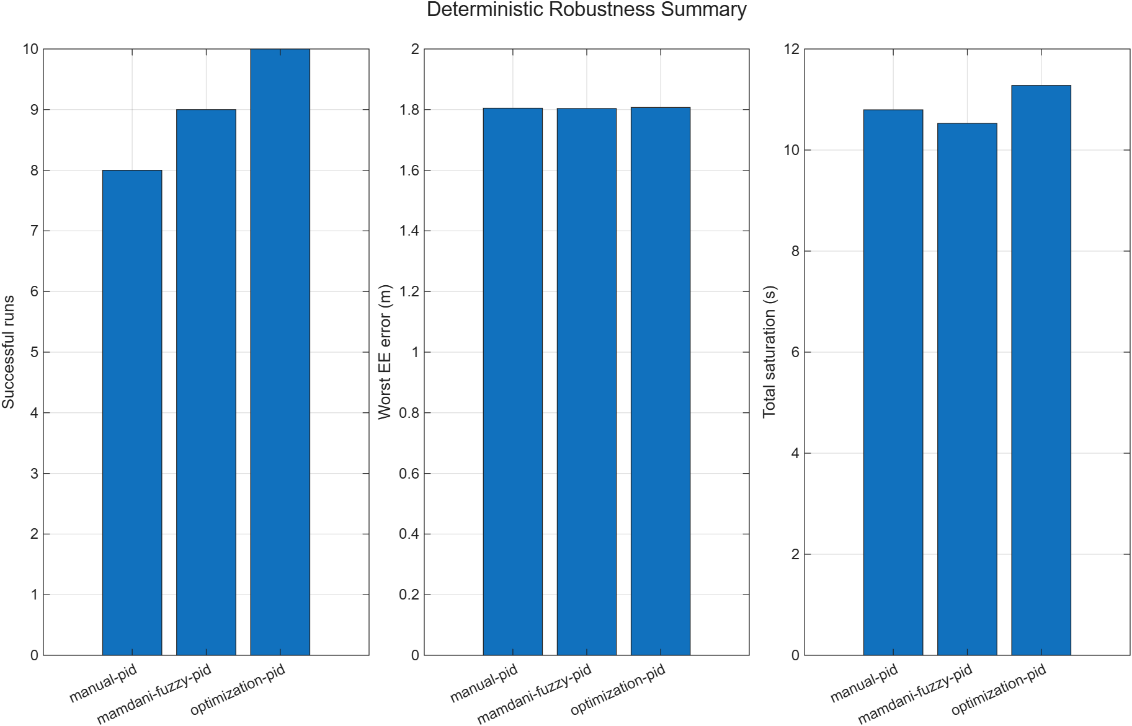
Reliability separates the controllers under deterministic stress
Success rises from 8/13 for manual PID to 9/13 for Fuzzy-PID and 10/13 for optimized PID.
The matrix contains 39 controller-scenario runs across nominal, payload, configuration, uncertainty, disturbance, actuator, and combined conditions.
All 3 controllers fail the combined deterministic case, so the ranking is comparative rather than a safety guarantee.
Notes:
State both the aggregate ranking and the shared combined-condition failure.
[Sources]
- docs/report/technical_report.md
- results/figures/deterministic_robustness_summary.png
- results/data/deterministic_robustness_summary.csv
- results/data/deterministic_robustness_runs.csv

Slide 6
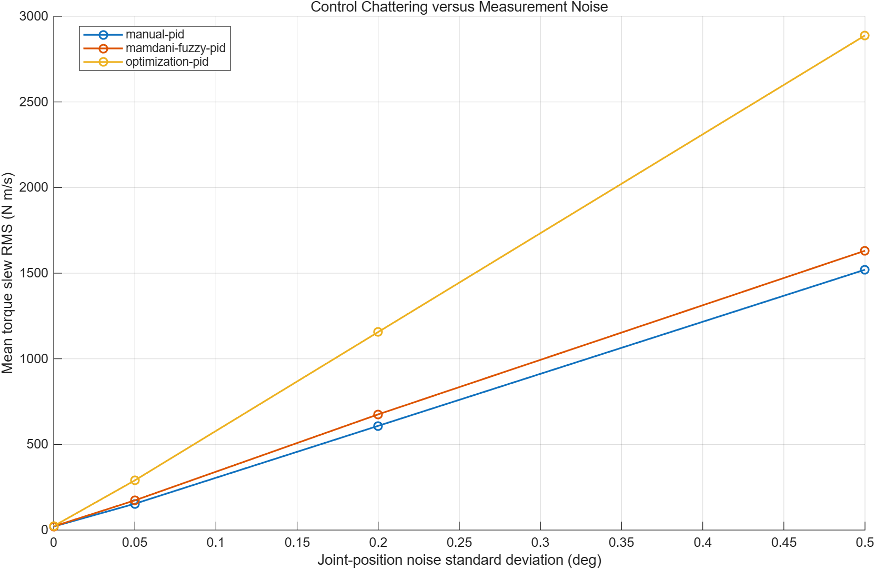
Noise alone is manageable; combined stress is not
Each isolated-noise cell passes 30/30 paired trials, while every combined-stress cell passes 0/30.
The full study contains 360 trials: 4 scenarios x 3 controllers x 30 fixed seeds.
At high noise, optimized PID has the lowest tracking error but the highest mean torque slew (2888.34 N m/s).
Notes:
Use the paired-seed design to explain why the controller comparison is fair.
[Sources]
- docs/report/technical_report.md
- results/figures/stochastic_robustness_chattering.png
- results/data/stochastic_robustness_summary.csv
- results/data/stochastic_robustness_trials.csv

Slide 7
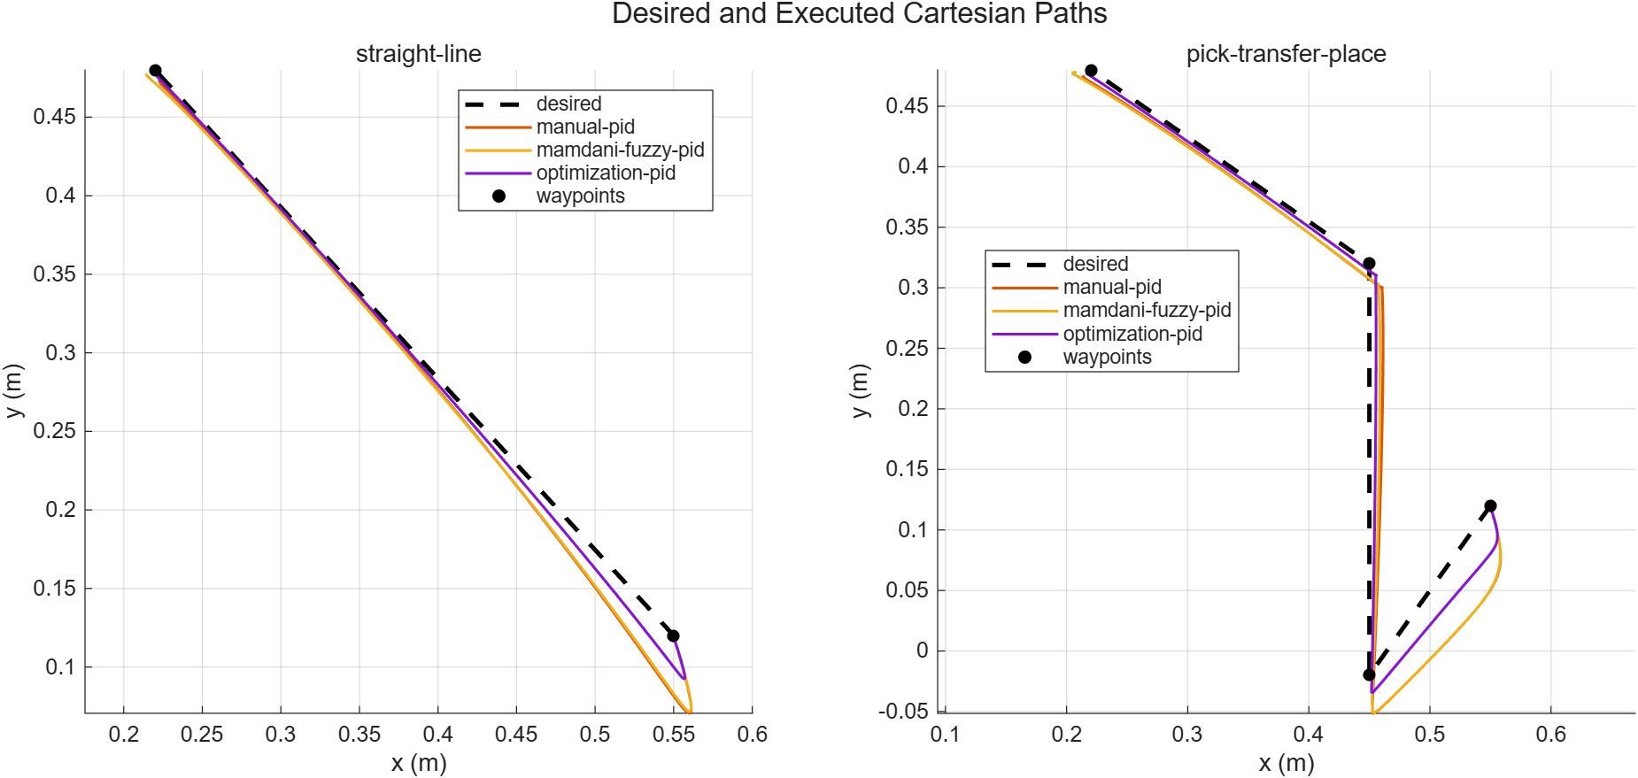
Task-space evaluation exposes failures hidden by joint metrics
All 3 controllers pass the straight-line task; only optimized PID passes pick-transfer-place, so 4 of 6 completed task runs meet every gate.
Manual and Fuzzy-PID complete the pick-transfer-place simulation but fail its quantitative pickup/place criteria.
Optimized PID records 0.01422 m RMS and 0.02970 m maximum Cartesian error.
Notes:
Completed does not mean successful; retain the 2 failed completed runs.
[Sources]
- docs/report/technical_report.md
- results/figures/cartesian_tasks_paths.png
- results/data/cartesian_tasks_runs.csv

Slide 8
Independent formulations agree at numerical precision
2/2
2/2
3.34e-16 m
Simulink agreement and tracking passes
Multibody agreement and tracking passes
worst end-effector difference
The result supports model consistency under one fixed protocol. Shared parameters and target trajectories mean it is not evidence of hardware fidelity.
Notes:
Distinguish independent formulation from independent physical validation.
[Sources]
- docs/report/technical_report.md
- results/data/simulink_cross_validation.mat
- results/data/multibody_cross_validation.mat

Slide 9
There is no universal winner, but
optimized PID is the strongest reliability baseline
8/13
9/13
10/13
manual PID deterministic success
Fuzzy-PID deterministic success
optimized PID deterministic success
Nominal metrics are mixed across manual PID and Fuzzy-PID; optimized PID provides the best aggregate deterministic and Cartesian reliability, with a torque-slew trade-off under noise.
Notes:
Deliver a conditional conclusion, not a universal-controller claim.
[Sources]
- docs/report/technical_report.md
- results/report/report_evidence.json

Slide 10
The validated layer is ready to support the next research step
The next milestone is to test whether the same evidence discipline survives contact with sensing, hardware uncertainty, and online safety constraints.
1. Hardware-in-the-loop and physical-arm validation with calibrated uncertainty.
2. Perception and task-planning integration above the existing inner-loop controller layer.
3. Online monitoring, collision avoidance, and explicit safety supervision before deployment.
Notes:
Close by resolving the opening: the low-level layer is validated for simulation and bounded next research is clear.
[Sources]
- docs/report/technical_report.md
- docs/report/references.json

