Slide 1
Secure SOCKS5 proxy
to circumvent the Great Firewall

Slide 2

The Great Firewall of China
What is GFW?
A giant system built by the government to achieve internet censorship in China
How does it work?
Block any connections to websites on its blacklist
Filter all data, block any connections that contain certain keywords.
If it detects that you are connecting to websites on its blacklist through a proxy, the proxy server will be added to the blacklist

Slide 3
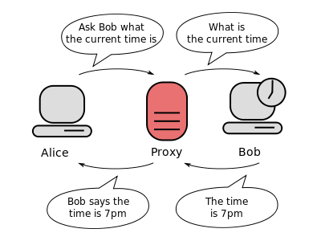
How to circumvent it? Use A Secure Proxy Server!
Use proxy
GFW should not know the address you want to connect is on its blacklist. You connect to the proxy server instead of your true destination.
The proxy server should not on its blacklist.
Encrypt data
Keywords should not be detected by the GFW.
All data should remain encrypted when they are transferred within the wall.
Reference: https://en.wikipedia.org/wiki/Proxy_server

Slide 4
Implementation
General Data flow
1.User input data from browser send to local client
2.The local client encrypt it and send it to the proxy server
3.The proxy server decrypt it and send it to remote server (like google.com)
4. Remote server send data to proxy
5. Proxy encrypt it and send to local client
6.Local client decrypt it and send back to the browser

Slide 5
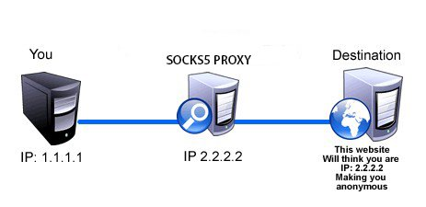
Socks5 & HTTP
Why SOCKS5?
SOCKS5 is a popular protocol that supported by many browsers, and it also provides authentication.
SOCKS operates at a lower level than HTTP proxying:
SOCKS uses a handshake protocol
HTTP proxy simply forwards an HTTP request to the desired HTTP server
Reference: https://en.wikipedia.org/wiki/SOCKS#Comparison_to_HTTP_proxying
Notes:
SOCKS uses a handshake protocol to inform the proxy software about the connection that the client is trying to make, and then acts as transparently as possible, whereas a regular proxy may interpret and rewrite headers (say, to employ another underlying protocol, such as FTP; however, an HTTP proxy simply forwards an HTTP request to the desired HTTP server)

Slide 6
Demo
https://youtu.be/ICG4ld3des8 👈

Slide 7
How could we improve our proxy?
Use better encryption
Currently we are using a simple “exclusive or” encryption because it’s easy to implement.
What if the GFW is upgraded in the future, such as using a whitelist instead of a blacklist?
We can do nothing.

Slide 8
code
https://github.com/ruiqili2/sp17-honors-project/tree/master/submission/socks5

