Slide 1
Hello everyone!
TA for COSC 1304 – C programming: Yiqun Zhang http://www2.cs.uh.edu/~yzhang/
(Click “Teaching Assistant” then “C Programming”)
E-mail: yzhang95@uh.edu or yzhang.uhcs@gmail.com
Office Hour: Every Tuesday and Thursday 4 p.m. to 5 p.m. @ PGH 575
Eason

Slide 2
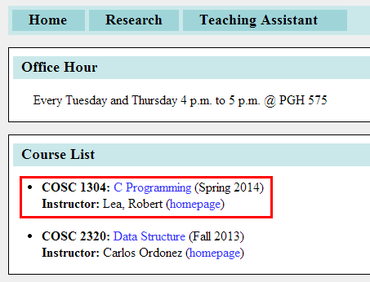
Pay special attention to TA’s page

Slide 3
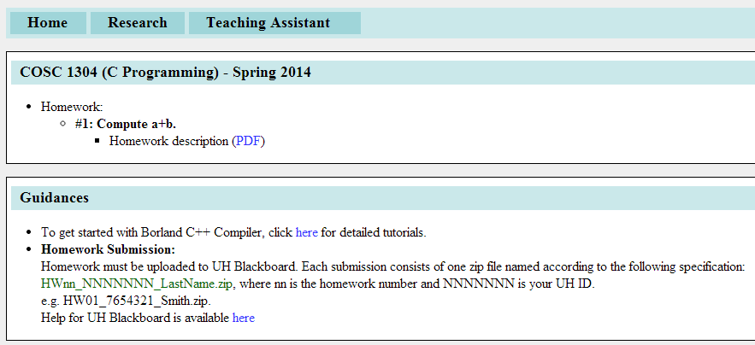

Slide 4
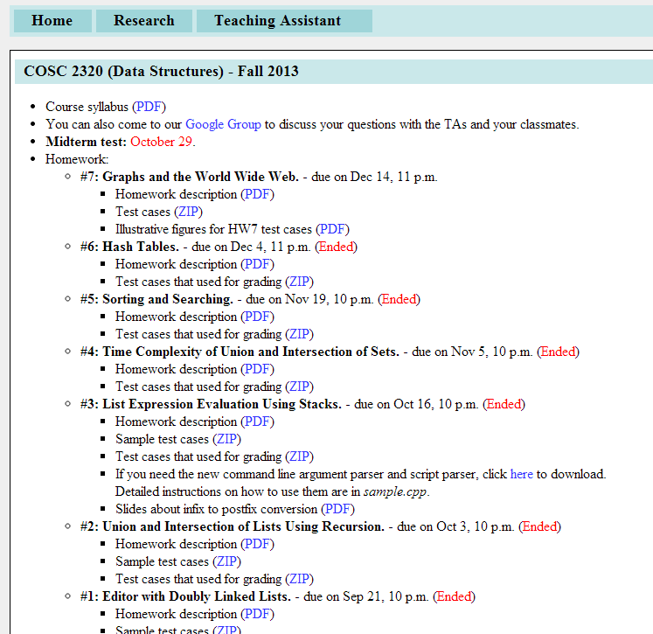

Slide 5
Homework submission
Use Blackboard to submit your homework !

Slide 6
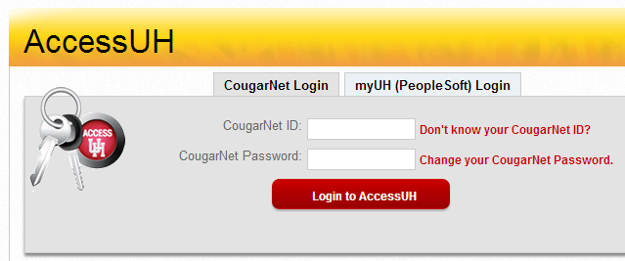
Blackboard
Open https://accessuh.uh.edu/login.php, login with your cougarnet username and password:

Slide 7
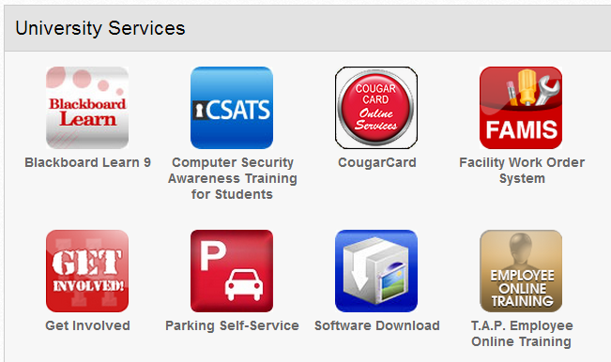
Blackboard
Choose “Blackboard Learn 9”

Slide 8
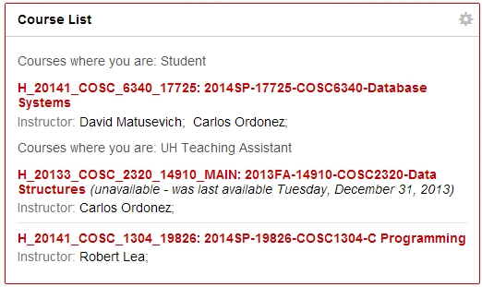
Find COSC 1304

Slide 9
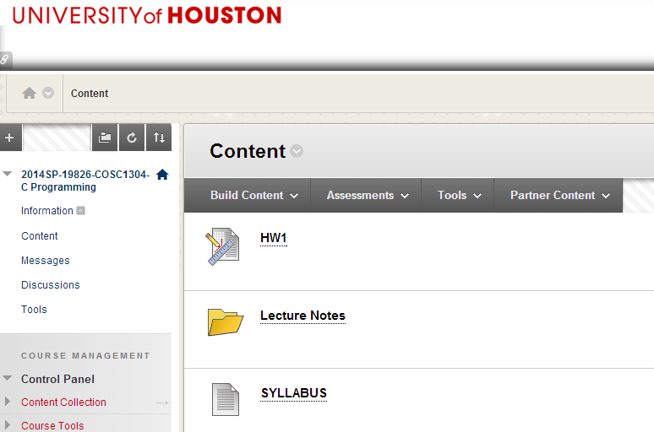
Get to your homework

Slide 10
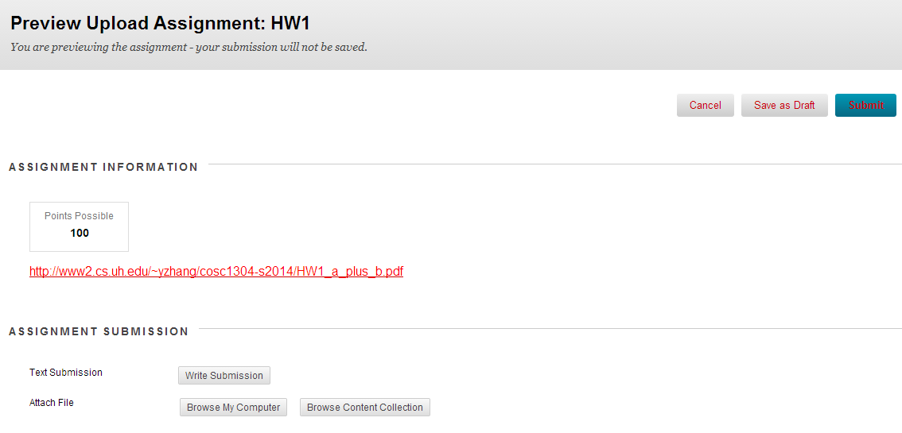
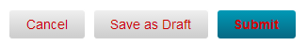
Get to your homework
Create a zip file if you are submitting multiple files!!!

