Slide 1
Programs
In this class we will program in C++
&
We will use Microsoft Visual Studio
2010

Slide 2
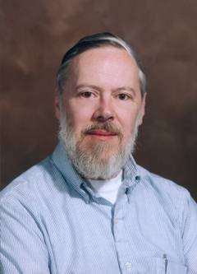
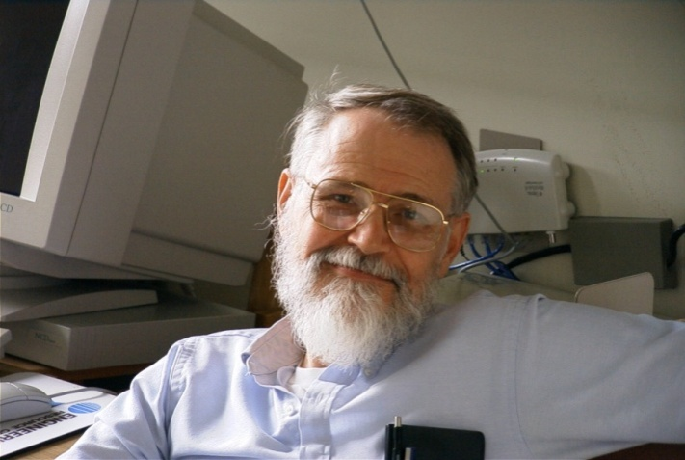
Geek heroes
Inventors of the C Language
Brian Kernighan
Programmer and writer extraordinaire
Dennis Ritchie
Designer and original implementer of C

Slide 3
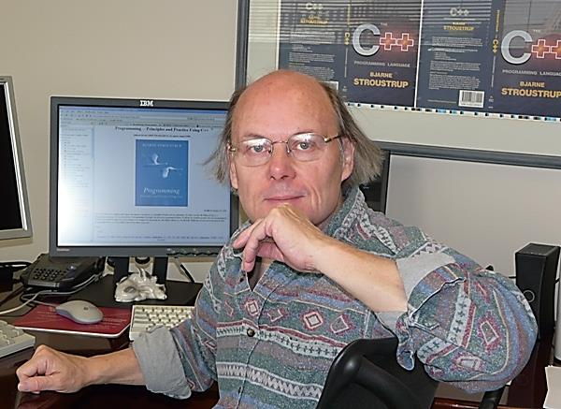
Bjarne Stroustrup
I'm a Managing Director in the technology division of Morgan Stanley in New York City, a Visiting Professor in Computer Science at Columbia University, and a Distinguished Research Professor in Computer Science at Texas A&M University.
I designed and implemented the C++ programming language. To make C++ a stable and up-to-date base for real-world software development, I stuck with its ISO standards effort for 20+ years (so far).

Slide 4
Visual Studio 2010 Walkthrough
Software Specifications for Monitoring the Card Players Weekly Meeting At the Community Center
The directors of the center wish to have an application developed for the receptionist on duty at the weekly card players meeting that will allow him to keep track of each card game group that arrives, the number of players in each card game, and the total number of participants that utilize the center for this activity

Slide 5
//cardGame.h
#pragma once
class Cardgame
{
int players;
static int totalParticipants;
public:
Cardgame(int players);
~Cardgame(void);
static int GetParticipants(){return totalParticipants;}
};

Slide 6
//cardGame.cpp
#include "Cardgame.h"
#include <iostream>
using namespace std;
Cardgame::Cardgame(int players)
: players(players)
{
totalParticipants += players;
cout << players << " players have started a new game. There are now "
<< totalParticipants << " players in total." << endl;
}
Cardgame::~Cardgame()
{
}

Slide 7
//testGames.cpp
#include "Cardgame.h"
#include <iostream>
using namespace std;
int Cardgame::totalParticipants=0;
void PlayGames()
{
Cardgame bridge(4);
Cardgame blackjack(8);
Cardgame solitaire(1);
Cardgame poker(5);
}
int main ()
{
PlayGames();
return 0;
}

