Slide 1
COSC 2320 Section 14702
Room 104 AH 5:30 – 7:00 PM TTh
Professor Olin Johnson
Office 596 PGH
713-743-3343
johnson@cs.uh.edu
Office Hours: 4:00 – 5:00 TTh
7:00 – 7:30 TTh
COSC 2320 - Data Structures
Credit Hours: 3.0 (Lecture Contact Hours:3; Lab Contact Hours:0)TCCN Equivalent: [TCCN-COSC 2436] Prerequisite: COSC 1320 . Introduction to various data structures (stacks, queues, lists, hash tables, trees, heaps, and graphs); sorting and searching; design, analysis, and comparison of algorithms.

Slide 2
Big-O Notation
Algorithm Analysis: The Big-O Notation
Algorithm Analysis: The Big-O Notation Notation
Analyze algorithm after design
Example
50 packages delivered to 50 different houses
50 houses one mile apart, in the same area
FIGURE 1-1 Gift shop and each dot representing a house

Slide 3
Text
Algorithm Analysis: The Big-O Notation (cont’d.)
Example (cont’d.)
Driver picks up all 50 packages
Drives one mile to first house, delivers first package
Drives another mile, delivers second package
Drives another mile, delivers third package, and so on
Distance driven to deliver packages
1+1+1+… +1 = 50 miles
Total distance traveled: 50 + 50 = 100 miles
FIGURE 1-2 Package delivering scheme

Slide 4
Algorithm Analysis: The Big-O Notation (cont’d.)
Example (cont’d.)
Similar route to deliver another set of 50 packages
Driver picks up first package, drives one mile to the first house, delivers package, returns to the shop
Driver picks up second package, drives two miles,
delivers second package, returns to the shop
Total distance traveled
2 * (1+2+3+…+50) = 2550 miles
FIGURE 1-2 Package delivering scheme

Slide 5
Algorithm Analysis: The Big-O Notation (cont’d.)
Example (cont’d.)
n packages to deliver to n houses, each one mile apart
First scheme: total distance traveled
1+1+1+… +n = 2n miles
Function of n
Second scheme: total distance traveled
2 * (1+2+3+…+n) = 2*(n(n+1) / 2) = n²+n
Function of n²

Slide 6
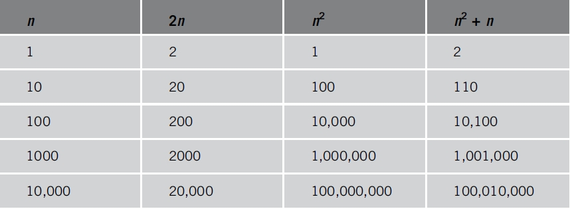
Algorithm Analysis: The Big-O Notation (cont’d.)
Analyzing an algorithm
Count number of operations performed
Not affected by computer speed
TABLE 1-1 Various values of n, 2n, n², and n² + n

Slide 7
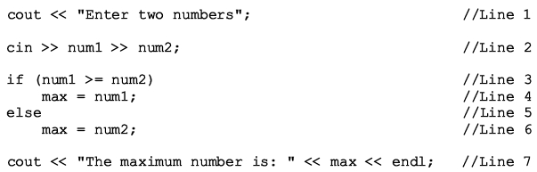
Algorithm Analysis: The Big-O Notation (cont’d.)
Example 1-1
Illustrates fixed number of executed operations

Slide 8
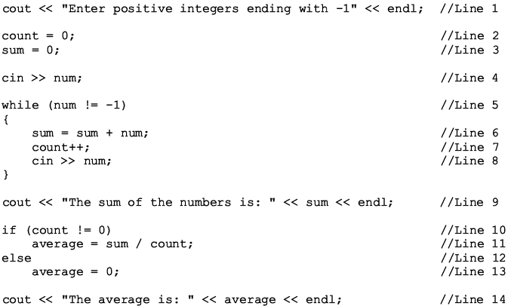
Algorithm Analysis: The Big-O Notation (cont’d.)
Example 1-2 Illustrates dominant ops

Slide 9
Algorithm Analysis: The Big-O Notation (cont’d.)
Search algorithm
n: represents list size
f(n): count function
Number of comparisons in search algorithm
c: units of computer time to execute one operation
cf(n): computer time to execute f(n) operations
Constant c depends computer speed (varies)
f(n): number of basic operations (constant)
Determine algorithm efficiency
Knowing how function f(n) grows as problem size grows

Slide 10
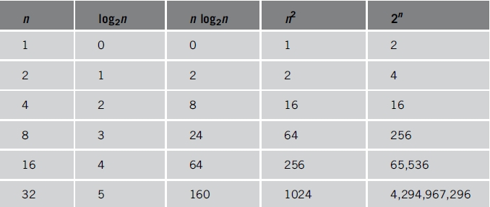
Algorithm Analysis: The Big-O Notation (cont’d.)
TABLE 1-2 Growth rates of various functions

Slide 11
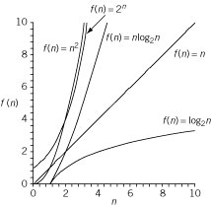
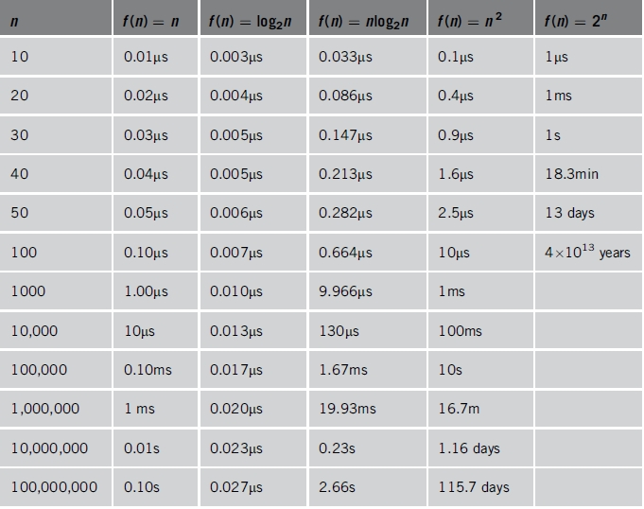
Algorithm Analysis: The Big-O Notation (cont’d.)
TABLE 1-3 Time for f(n) instructions on a computer that executes 1 billion instructions per second
Figure 1-4 Growth rate
of functions in Table 1-3

Slide 12
Algorithm Analysis: The Big-O Notation (cont’d.)
Notation useful in describing algorithm behavior
Shows how a function f(n) grows as n increases without bound
Asymptotic
Study of the function f as n becomes larger and larger without bound
Examples of functions
g(n)=n² (no linear term)
f(n)=n² + 4n + 20

Slide 13
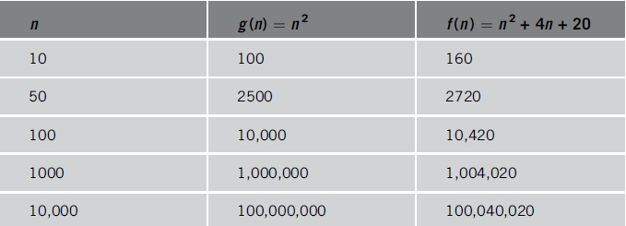
Algorithm Analysis: The Big-O Notation (cont’d.)
As n becomes larger and larger
Term 4n + 20 in f(n) becomes insignificant
Term n² becomes dominant term
TABLE 1-4 Growth rate of n² and n² + 4n + 20n

Slide 14
Algorithm Analysis: The Big-O Notation (cont’d.)
Algorithm analysis
If function complexity can be described by complexity of a quadratic function without the linear term
We say the function is of O(n²) or Big-O of n²
Let f and g be real-valued functions
Assume f and g nonnegative
For all real numbers n, f(n) >= 0 and g(n) >= 0
f(n) is Big-O of g(n): written f(n) = O(g(n))
If there exists positive constants c and n₀ such that f(n) <= cg(n) for all n >= n₀

Slide 15
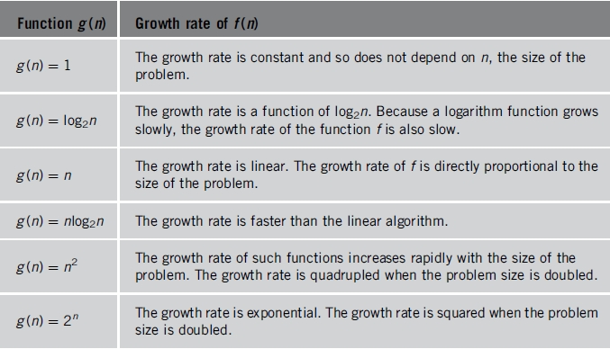
Algorithm Analysis: The Big-O Notation (cont’d.)
TABLE 1-5 Some Big-O functions that appear in algorithm analysis

Slide 16
Text

Slide 17
Text

Slide 18
Text

Slide 19
Text

Slide 20
Text

Slide 21
Text

Slide 22
Text

Slide 23
Text

Slide 24
Text

Slide 25
Text

Slide 26
Text

Slide 27
Text

