Slide 1
Data Structures Using C++ 2E
Chapter 2
Object-Oriented Design (OOD) and C++
Learn about inheritance
Learn about derived and base classes
Explore how to redefine the member functions of a base class
Examine how the constructors of base and derived classes work
Learn how to construct the header file of a derived class
Notes:
1

Slide 2
Objectives (cont’d.)
Explore three types of inheritance: public, protected, and private
Learn about composition
Become familiar with the three basic principles of object-oriented design
Learn about overloading
Become aware of the restrictions on operator overloading

Slide 3
Objectives (cont’d.)
Examine the pointer this
Learn about friend functions
Explore the members and nonmembers of a class
Discover how to overload various operators
Learn about templates
Explore how to construct function templates and class templates

Slide 4
Example
We will examine 3 docx files
In the directory
personType_text_files
This is the base class
Then we will look at other
Docx files in the directory
partTimeEmployeeType_text_files
For the inherited class

Slide 5
Inheritance
An “is-a” relationship
Example: “every employee is a person”
Allows new class creation from existing classes
Base class: the existing class
Derived class: new class created from existing classes
Inherits base classes’ properties
Reduces software complexity
Becomes base class for future derived class
Inheritance types
Single inheritance and multiple inheritance

Slide 6
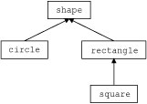
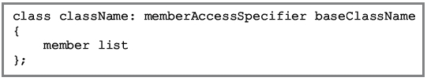
Inheritance (cont’d.)
Viewed as treelike or hierarchical
Base class shown with its derived classes
Derived class general syntax
No memberAccessSpecifier specified
Assume private inheritance
public
private
protected
FIGURE 2-1
Inheritance hierarchy

Slide 7
Inheritance (cont’d.)
Facts to keep in mind
private base class members
private to the base class
public base class member inheritance
public members or private members
Derived class
Can include additional members
Can redefine public member base class functions
All base class member variables
Derived class member variables

Slide 8
Redefining (Overriding) Member Functions of the Base Class
Base class public member function included in a derived class
Same name, number, and types of parameters as base class member function
Function overloading
Same name for base class functions and derived class functions
Different sets of parameters

Slide 9
Example of Operator Overloading
Rational Numbers
In directory: rationalType_text_files

Slide 10
Constructors of Derived and Base Classes
Derived class with own private member variables
Explicitly includes its own constructors
Constructors
Initialize member variables
Declared derived class object inherits base class members
Cannot directly access private base class data
Same is true for derived class member functions

Slide 11
Constructors of Derived and Base Classes (cont’d.)
Derived class constructors can only directly initialize inherited members (public data)
Derived class object must automatically execute base class constructor
Triggers base class constructor execution
Call to base class constructor specified in heading of derived class constructor definition

Slide 12
Constructors of Derived and Base Classes (cont’d.)
Example: class rectangleType contains default constructor
Does not specify any constructor of the class boxType
Write the definitions of constructors with parameters

Slide 13
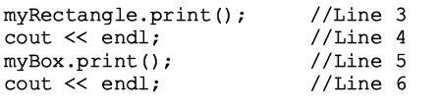

Constructors of Derived and Base Classes (cont’d.)
Consider the following statements

Slide 14
Header File of a Derived Class
Required to define new classes
Base class already defined
Header files contain base class definitions
New class header files contain commands
Tell computer where to look for base classes’ definitions

Slide 15
Multiple Inclusions of a Header File
Preprocessor command include
Used to include header file in a program
Preprocessor processes the program
Before program compiled
Avoid multiple inclusions of a file in a program
Use preprocessor commands in the header file

Slide 16
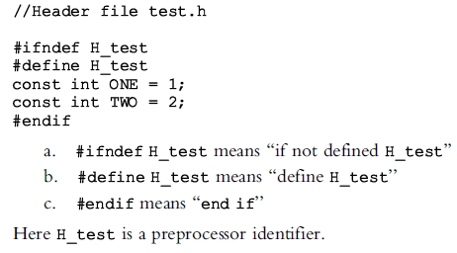
Multiple Inclusions of a Header File (cont’d.)
Preprocessor commands and meaning

Slide 17
Protected Members of a Class
private class members
private to the class
Cannot be directly accessed outside the class
Derived class cannot access private members
Solution: make private member public
Problem: anyone can access that member
Solution: declare member as protected
Derived class member allowed access
Prevents direct access outside the class

Slide 18
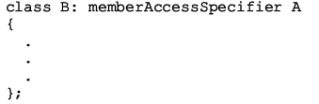
Inheritance as public, protected, or private
Consider the following statement
MemberAccessSpecifier: public, protected, or private

Slide 19
Inheritance as public, protected, or private (cont’d.)
public MemberAccessSpecifier
public members of A, public members of B: directly accessed in class B
protected members of A, protected members of B: can be directly accessed by B member functions and friend functions
private members of A, hidden to B: can be accessed by B member functions and friend functions through public or protected members of A

Slide 20
Inheritance as public, protected, or private (cont’d.)
protected MemberAccessSpecifier
public members of A, protected members of B: can be accessed by B member functions and friend functions
protected members of A, protected members of B: can be accessed by B member functions and friend functions
private members of A hidden to B: can be accessed by B member functions and friend functions through the public or protected members of A

Slide 21
Inheritance as public, protected, or private (cont’d.)
private MemberAccessSpecifier
public members of A, private members of B: can be accessed by B member functions and friend functions
protected members of A, private members of B: can be accessed by B member functions and friend functions
private members of A, hidden to B: can be accessed by B member functions and friend functions through the public or protected members of A

