Slide 1
Data Structures Using C++ 2E
Chapter 3
Pointers and Array-Based Lists
C++ has three types of data
Simple
Structured
Pointers
Notes:
1

Slide 2
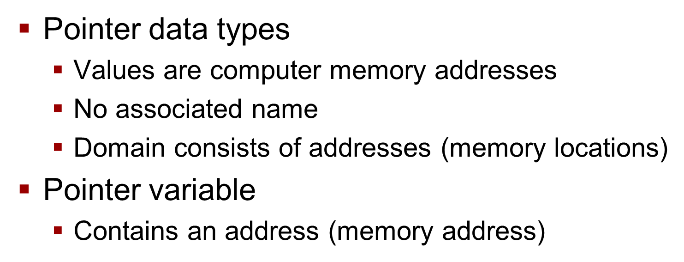
Data Structures Using C++ 2E
Chapter 3
Pointers and Array-Based Lists
Notes:
2

Slide 3
The Pointer Data Type and Pointer Variables
Declaring pointer variables
Specify data type of value stored in location pointer variable points to
General syntax
dataType *identifier;
Asterisk symbol (*)
Examples: int *p; and char *ch;

Slide 4
The Pointer Data Type and Pointer Variables (cont’d.)
Address-of operator (&)
Unary operator
Returns address of its operand
Dereferencing operator (*)
Unary operator
Different from binary multiplication operator
Also known as indirection operator
Refers to object where the pointer points (operand of the *)

Slide 5
The Pointer Data Type and Pointer Variables (cont’d.)
Pointers and classes
Dot operator (.)
Higher precedence than dereferencing operator (*)
Member access operator arrow ( ->)
Simplifies access of class or struct components via a pointer
What’s difference between struct & class?
Syntax
pointerVariableName -> classMemberName

Slide 6
The Pointer Data Type and Pointer Variables (cont’d.)
Initializing pointer variables
No automatic variable initialization in C++
Pointer variables must be initialized
If not initialized, they do not point to anything
Initialized using
Constant value 0 (null pointer)
Named constant NULL
Number 0
Only number directly assignable to a pointer variable

Slide 7
The Pointer Data Type and Pointer Variables (cont’d.)
Some C++ matters
What’s the difference between a struct and a class?
What’s a memory leak?

Slide 8
The Pointer Data Type and Pointer Variables (cont’d.)
Some examples involving pointers
Playing with Pointers
Example 3-2 page 135
Example 3-3 page 142

Slide 9
The Pointer Data Type and Pointer Variables (cont’d.)
Various List Data Types
Array lists
Linked lists
Doubly linked lists

Slide 10
The Pointer Data Type and Pointer Variables (cont’d.)
Dynamic variables
Variables created during program execution
Real power of pointers
Two operators
new: creates dynamic variables
delete: destroys dynamic variables
Reserved words

Slide 11
The Pointer Data Type and Pointer Variables (cont’d.)
Operator new
Allocates single variable
Allocates array of variables
Syntax
new dataType;
new dataType[intExp];
Allocates memory (variable) of designated type
Returns pointer to the memory (allocated memory address)
Allocated memory: uninitialized

Slide 12
The Pointer Data Type and Pointer Variables (cont’d.)
Operator delete
Destroys dynamic variables
Syntax
delete pointerVariable;
delete [ ] pointerVariable;
Memory leak
Memory space that cannot be reallocated
Dangling pointers
Pointer variables containing addresses of deallocated memory spaces
Avoid by setting deleted pointers to NULL after delete

Slide 13
The Pointer Data Type and Pointer Variables (cont’d.)
Operations on pointer variables
Operations allowed
Assignment, relational operations; some limited arithmetic operations
Can assign value of one pointer variable to another pointer variable of the same type
Can compare two pointer variables for equality
Can add and subtract integer values from pointer variable
Danger
Accidentally accessing other variables’ memory locations and changing content without warning

Slide 14
The Pointer Data Type and Pointer Variables (cont’d.)

Slide 15
Text

Slide 16
Text

Slide 17
Text

Slide 18
Text

Slide 19
Text

Slide 20
Text

Slide 21
Text

Slide 22
Text

Slide 23
Text

Slide 24
Text

Slide 25
Text

Slide 26
Text

Slide 27
Text

Slide 28
Text

Slide 29
Text

Slide 30
Text

