Slide 1
Data Structures Using C++ 2E
Chapter 5
Linked Lists
Notes:
1

Slide 2
Objectives
Learn about linked lists
Become aware of the basic properties of linked lists
Explore the insertion and deletion operations on linked lists
Discover how to build and manipulate a linked list

Slide 3
Objectives (cont’d.)
Learn how to construct a doubly linked list
Discover how to use the STL container list
Learn about linked lists with header and trailer nodes
Become aware of circular linked lists

Slide 4
Linked Lists
Collection of components (nodes)
Every node (except last)
Contains address of the next node
Node components
Data: stores relevant information
Link: stores address
FIGURE 5-1 Structure of a node

Slide 5

Linked Lists (cont’d.)
Head (first)
Address of the first node in the list
Arrow points to node address
Stored in node
Down arrow in last node indicates NULL link field
FIGURE 5-2 Linked list
FIGURE 5-3 Linked list and values of the links

Slide 6
Linked Lists (cont’d.)
Two node components
Declared as a class or struct
Data type depends on specific application
Link component: pointer
Data type of pointer variable: node type itself

Slide 7
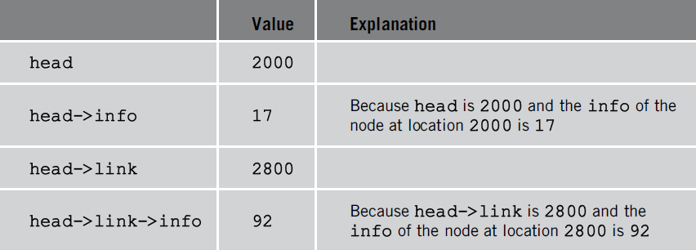
Linked Lists: Some Properties
Head stores address of first node
Info stores information
Link stores address of next node
Assume info type int
TABLE 5-1 Values of head and some of
the nodes of the linked list in Figure 5-4
FIGURE 5-4 Linked list with four nodes

Slide 8
Linked Lists: Some Properties (cont’d.)
Pointer current: same type as pointer head
current = head;
Copies value of head into current
current = current->link;
Copies value of current->link (2800) into current
FIGURE 5-5 List after the statement
current = current->link; executes

Slide 9
Linked Lists: Some Properties (cont’d.)
TABLE 5-2 Values of current, head, and some of the nodes of the linked list in Figure 5-5

Slide 10
Traversing a Linked List
Basic linked list operations
Search list to determine if particular item is in the list
Insert item in list
Delete item from list
These operations require list traversal
Given pointer to list first node, we must step through list nodes

Slide 11
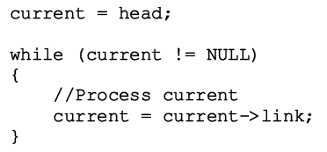
Traversing a Linked List (cont’d.)
Suppose head points to a linked list of numbers
Code outputting data stored in each node

Slide 12
Item Insertion and Deletion
Generic definition of a node on page 270
TABLE 5-3 Inserting a node in a linked list

Slide 13
Item Insertion and Deletion (cont’d.)
Sequence of statements to insert node
Very important
Use only one pointer (p) to adjust links of the nodes
Using two pointers
Can simplify insertion code somewhat

Slide 14
Item Insertion and Deletion (cont’d.)
Memory still occupied by node after deletion
Memory is inaccessible
Deallocate memory using a pointer to this node
FIGURE 5-10 List after the statement
p->link = p->link->link; executes

Slide 15
Building a Linked List
If linked list data unsorted
Linked list unsorted
Ways to build linked list
Forward
New node always inserted at end of the linked list
See example on page 274
See function buildListForward on page 277
Backward
New node always inserted at the beginning of the list
See example on page 277
See function buildListBackward on page 278

Slide 16
Visual Studio Example
buildListForward

Slide 17
Text

Slide 18
Text

Slide 19
Text

Slide 20
Text

Slide 21
Text

Slide 22
Text

Slide 23
Text

Slide 24
Text

Slide 25
Text

Slide 26
Text

Slide 27
Text

Slide 28
Text

Slide 29
Text

