Slide 1
Data Structures Using C++ 2E
Chapter 6: Recursion
Learn about recursive
Definitions
Algorithms
Functions
Explore the base case and the general case of a recursive definition
Notes:
1

Slide 2
Recursive Definitions
Recursion
Process of solving a problem by reducing it to smaller versions of itself
Example: factorial problem
5!
5 x 4 x 3 x 2 x 1 =120
If n is a nonnegative
Factorial of n (n!) defined as follows:

Slide 3
Recursive Definitions (cont’d.)
Direct solution (Equation 6-1)
Recursive definition (Equation 6-2)
Base case (Equation 6-1)
Case for which the solution is obtained directly
General case (Equation 6-2)
Case for which the solution is obtained indirectly using recursion

Slide 4
Recursive Definitions (cont’d.)
Recursion insight from factorial problem
Every recursive definition must have one (or more) base cases
General case must reduce to a base case
Base case stops recursion
Recursive algorithm
Finds problem solution by reducing problem to smaller versions of itself
Recursive function
Function that calls itself

Slide 5
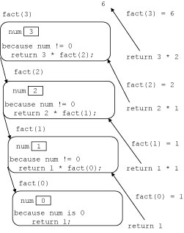
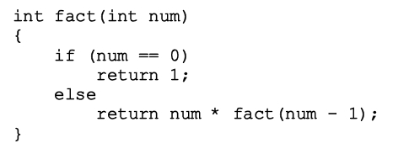
Recursive Definitions (cont’d.)
Recursive function implementing the factorial function
FIGURE 6-1 Execution of fact(4)

Slide 6
Recursive function comments
Recursive function has unlimited number of copies of itself (logically)
Every call to a recursive function has its own
Code, set of parameters, local variables
After completing a particular recursive call
Control goes back to calling environment (previous call)
Current (recursive) call must execute completely before control goes back to the previous call
Execution in previous call begins from point immediately following the recursive call

Slide 7
Direct and indirect recursion
Directly recursive function
Calls itself
Indirectly recursive function
Calls another function, eventually results in original function call
Requires same analysis as direct recursion
Base cases must be identified, appropriate solutions to them provided
Tracing can be tedious
Tail recursive function
Last statement executed: the recursive call

Slide 8
Infinite recursion
Occurs if every recursive call results in another recursive call
Executes forever (in theory)
Call requirements for recursive functions
System memory for local variables and formal parameters
Saving information for transfer back to right caller
Finite system memory leads to
Execution until system runs out of memory
Abnormal termination of infinite recursive function

Slide 9
Recursive Function Design
Understand problem requirements
Determine limiting conditions
Identify base cases, providing direct solution to each base case
Identify general cases, providing solution to each general case in terms of smaller versions of itself

Slide 10
Systems Considerations
OS View of a function call
Save the state of the calling program
Program counter
General registers
Floating registers
Transfer Control
Return Control by popping stack

Slide 11
Recursion Examples
Factorial
Largest Element in an Array
Fibonacci Number
Tower of Hanoi
Converting from Decimal to Binary
Backtracking
n Queens Puzzle n = 4, 8
Sudoku

Slide 12
Recursion Examples
We will look at:
Factorial
Largest Element in an Array
Fibonacci Number
Tower of Hanoi
Converting from Decimal to Binary
Backtracking
n Queens Puzzle n = 4, 8
Sudoku

Slide 13
Largest Element in an Array
FIGURE 6-2 list with six elements
list: array name containing elements
list[a]...list[b] stands for the array elements list[a], list[a + 1], ..., list[b]
list length =1, one element (largest)
list length >1
maximum(list[a],
largest(list[a + 1]...list[b]))

Slide 14
Largest Element in an Array
maximum(list[0], largest(list[1]...list[5]))
maximum(list[1], largest(list[2]...list[5]), etc.
Every time previous formula used to find largest element in a sublist
Length of sublist in next call reduced by one

Slide 15
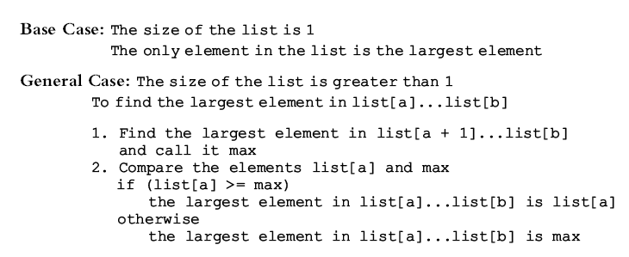
Largest Element in an Array
Recursive algorithm in pseudocode

Slide 16
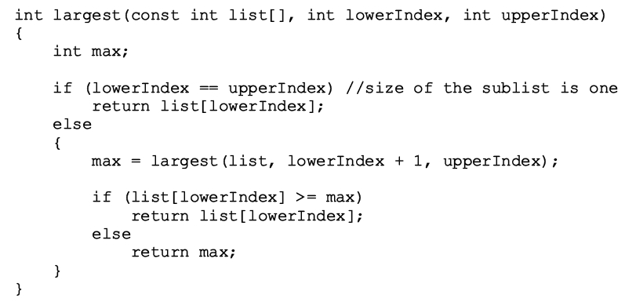
Largest Element in an Array
Recursive algorithm as a C++ function

Slide 17
Largest Element in an Array
FIGURE 6-3 list with four elements
Trace execution of the following statement
cout << largest(list, 0, 3) << endl;
Review C++ program on page 362
Determines largest element in a list

Slide 18
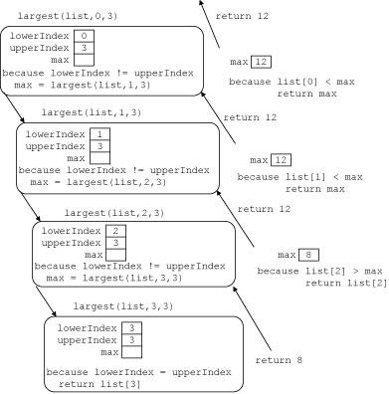
Fig 6-4 largest(list,0,3)

Slide 19
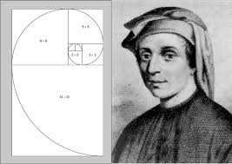
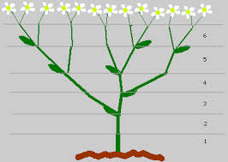
Fibonacci Number
In 1202 A D
He was studying rabbits
He introduced the Arabic numerals to Europe
There is a Fibonacci search, heap, graph

Slide 20
Fibonacci Number
Sequence: 1, 1, 2, 3, 5, 8, 13, 21, 34 . . .
Given first two numbers (a₁ and a₂)
nth number a_{n}, n >= 3, of sequence given by: a_{n} = a_{n-1} + a_{n-2}
Recursive function: rFibNum
Determines desired Fibonacci number
Parameters: three numbers representing first two numbers of the Fibonacci sequence and a number n, the desired nth Fibonacci number
Returns the nth Fibonacci number in the sequence

Slide 21
Fibonacci Number (cont’d.)
Third Fibonacci number
Sum of first two Fibonacci numbers
Fourth Fibonacci number in a sequence
Sum of second and third Fibonacci numbers
Calculating fourth Fibonacci number
Add second Fibonacci number and third Fibonacci number

Slide 22
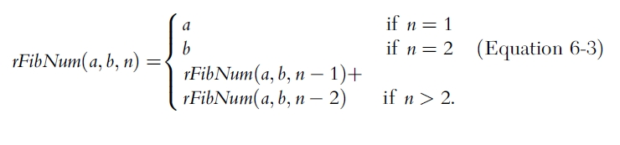
Fibonacci Number (cont’d)
Recursive algorithm
Calculates nth Fibonacci number
a denotes first Fibonacci number
b denotes second Fibonacci number
n denotes nth Fibonacci number

Slide 23
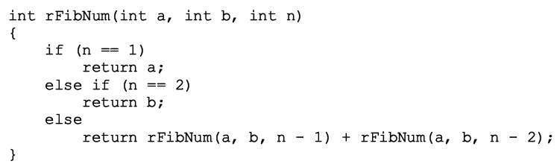
Fibonacci Number (cont’d.)
Recursive function implementing algorithm
Trace code execution
Review code on page 368 illustrating the function rFibNum

Slide 24
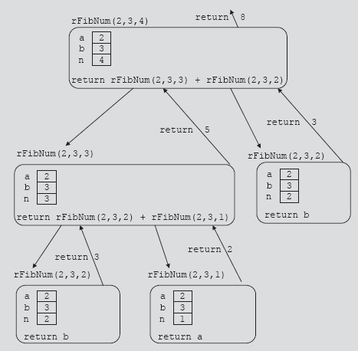
Fibonacci Number (cont’d.)
FIGURE 6-7 Execution of rFibNum(2, 3, 4)

Slide 25
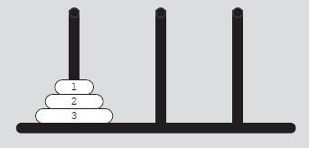
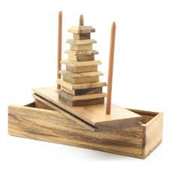
Tower of Hanoi
http://math.rice.edu/~lanius/domath/hanoi.html
FIGURE 6-8 Tower of Hanoi problem
with three disks

Slide 26
Tower of Hanoi
Object
Move 64 disks from first needle to third needle
Rules
Only one disk can be moved at a time
Removed disk must be placed on one of the needles
A larger disk cannot be placed on top of a smaller disk
FIGURE 6-8 Tower of Hanoi problem with three disks

Slide 27
Tower of Hanoi (cont’d.)
Case: first needle contains only one disk
Move disk directly from needle 1 to needle 3
Case: first needle contains only two disks
Move first disk from needle 1 to needle 2
Move second disk from needle 1 to needle 3
Move first disk from needle 2 to needle 3
Case: first needle contains three disks

Slide 28
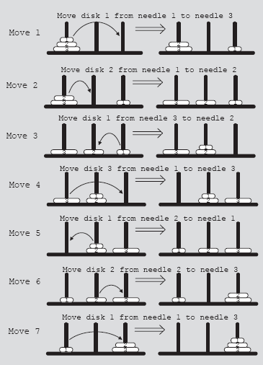
Tower of Hanoi (cont’d.)
FIGURE 6-9 Solution to Tower of Hanoi problem with three disks

Slide 29
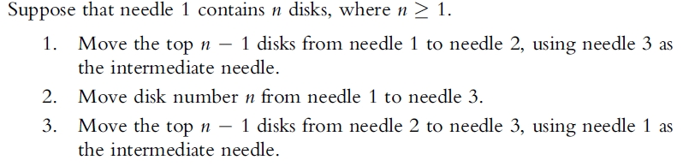
Tower of Hanoi (cont’d.)
Generalize problem to the case of 64 disks
Recursive algorithm in pseudocode

Slide 30
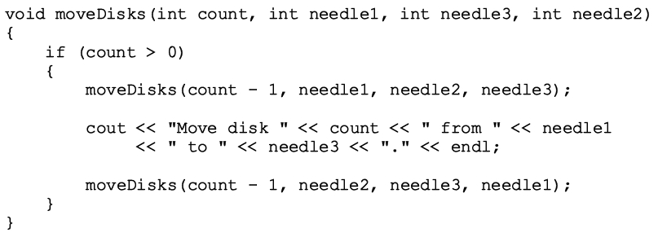
Tower of Hanoi (cont’d.)
Generalize problem to the case of 64 disks
Recursive algorithm in C++

Slide 31
Sudoku
Let’s use a little excel

