Slide 1
Recursion & Backtracking
The game of NIM
Getting out of a maze
The 8 Queen’s Problem
Sudoku

Slide 2
NIM
Johnson
vs
Challenger

Slide 3
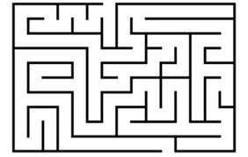
Maze

Slide 4
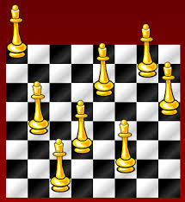
8 Queens

Slide 5
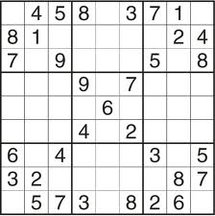
Sudoku

Slide 6
Text

Slide 7
Text

Slide 8
Text

Slide 9
Text

Slide 10
Text

Slide 11
Text

Slide 12
Text

Slide 13
Text

Slide 14
Text

Slide 15
Text

Slide 16
Text

Slide 17
Text

