Slide 1
Last Class on Chapter 6
HW 1 and HW 2
2. Greatest Common Devisor
3. Sudoku App
4. Chapter 6 Summary
5. Chapter 6 Questions

Slide 2
HW 1 and HW 2
HW 1 due today at 11:59 PM
HW 2 now available on TA’s
Web pages
It’s on recursion
Let’s take a look

Slide 3
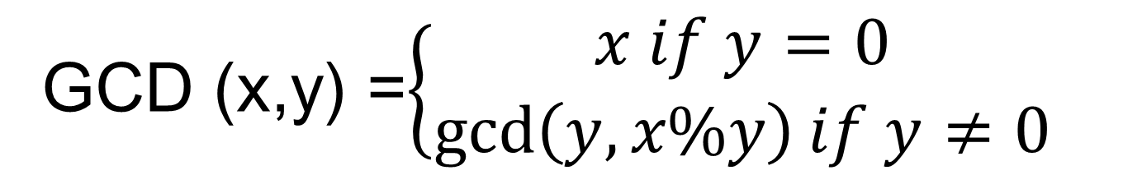
Greatest Common Devisor
GCD (x,y) =$\left\{\begin{aligned}x if y=0 \\ \gcd\left(y, x\%y\right)if y≠0\end{aligned}\right.$

Slide 4
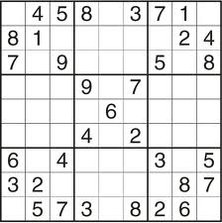
Sudoku

Slide 5
The Sudoku App
Writing the program
Debugging the program
Testing the program
Having fun with the program

