Slide 1
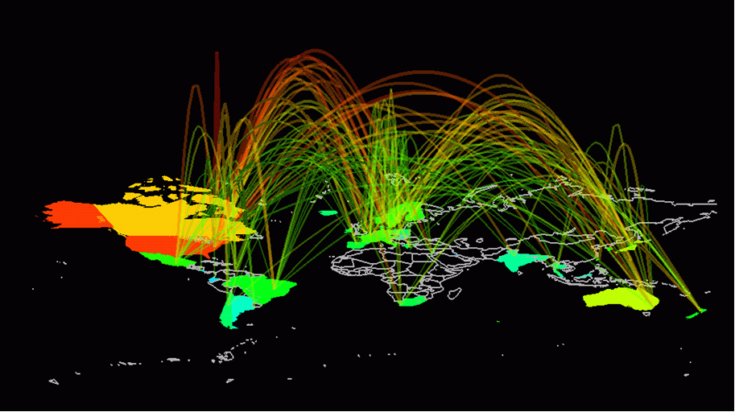
Software ideals and history
Bjarne Stroustrup
www.stroustrup.com/Programming

Slide 2
Abstract
This is a very brief and very selective history of software as it relates to programming, and especially as it relates to programming languages and C++. The aim is to give a background and a perspective to the ideas presented in this course.
We would have loved to talk about operating systems, data bases, networking, the web, scripting, etc., but you’ll have to find those important and useful areas of software and programming in other courses.
Stroustrup/Programming

Slide 3
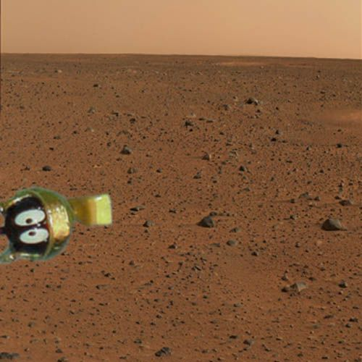
Overview
Ideals
  Aims, heroes, techniques
Languages and language designers
  Early languages to C++
  (There is so much more than
  what we can cover)
Stroustrup/Programming

Slide 4
History and ideas
One opinion
  History is bunk
Another opinion
  He who does not know history is condemned to repeat it
Our view
  There can be no professionalism without history
    If you know too little of the background of your field you are gullible
      History is littered with plausible ideas that didn’t work
        “I have a bridge I’d like to sell you”
  Ideas and ideals are crucial for practical use
    And they are the real “meat” of history
Stroustrup/Programming

Slide 5
What is a programming language?
A tool for instructing machines
A notation for algorithms
A means for communication among programmers
A tool for experimentation
A means for controlling computer-controlled gadgets
A means for controlling computerized devices
A way of expressing relationships among concepts
A means for expressing high-level designs
All of the above!
  And more
Stroustrup/Programming

Slide 6
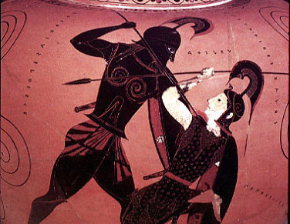
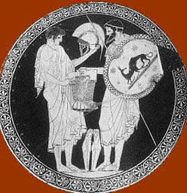
Greek heroes
Every culture and profession must have ideals and heroes
  Physics: Newton, Einstein, Bohr, Feynman
  Math: Euclid, Euler, Hilbert
  Medicine: Hippocrates, Pasteur, Fleming
Stroustrup/Programming

Slide 7
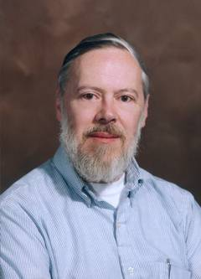
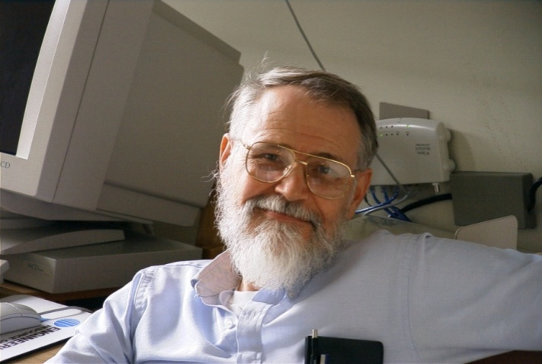
Geek heroes
Brian Kernighan
  Programmer and writer extraordinaire
Dennis Ritchie
  Designer and original implementer of C
Stroustrup/Programming

Slide 8
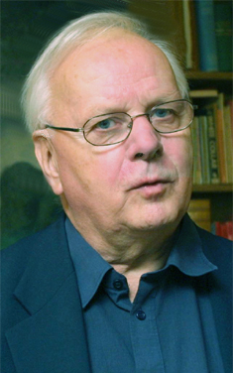
Another geek hero
Kristen Nygaard
  Co-inventor (with Ole-Johan Dahl) of Simula67 and of object-oriented Programming and object-oriented design
Stroustrup/Programming

Slide 9
Two extremes
Academic beauty/perfection/purity
Commercial expediency
The pressures towards both are immense
Both extremes must be avoided for serious progress to occur
  Both extremes encourage overstatement of results (hype) and understatement (or worse) of alternatives and ancestor languages
Stroustrup/Programming

Slide 10
Ideals
The fundamental aims of good design
  Represent ideas directly in code
  Represent independent ideas independently in code
  Represent relationships among ideas directly in code
  Combine ideas expressed in code freely
    where and only where combinations make sense
From these follow
  Correctness
  Maintainability
  Performance
Apply these to the widest possible range of applications
Stroustrup/Programming

Slide 11
Ideals have practical uses
During the start of a project, reviews them to get ideas
When you are stuck late at night, step back and see where your code has most departed from the ideals – this is where the bugs are most likely to lurk and the design problems are most likely to occur
  Don’t just keep looking in the same place and trying the same techniques to find the bug
    “The bug is always where you are not looking – or you would have found it already”
Stroustrup/Programming

Slide 12
Styles/paradigms
Procedural programming
Data abstraction
Object-oriented programming
Generic programming
Functional programming, Logic programming, rule-based programming, constraints-based programming, aspect-oriented programming, …
Stroustrup/Programming

Slide 13
Some fundamentals
Portability is good
Type safety is good
High performance is good
Anything that eases debugging is good
Access to system resources is good
Stability over decades is good
Ease of learning is good
Small is good
Whatever helps analysis is good
Having lots of facilities is good
You can’t have all at the same time: engineering tradeoffs
Stroustrup/Programming

Slide 14
Programming languages
Machine code
  Bits, octal, or at most decimal numbers
Assembler
  Registers, load, store, integer add, floating point add, …
  Each new machine had its own assembler
Higher level languages
  First: Fortran and COBOL
Rate of language invention
  At least 2000 a decade
Major languages today
  Really solid statistics are hard to come by
    IDS: about 9 million professional programmers
  COBOL, Fortran, C, C++, Visual Basic, PERL, Java, Javascript
    Ada, C#, PHP, …
Stroustrup/Programming

Slide 15
Early programming languages
1950s:
1960s:
1970s:
Simula
Lisp
Algol60
Algol68
Fortran
Pascal
BCPL
Classic C
COBOL
PL\1
Red==major commercial use
Yellow==will produce important “offspring”
Stroustrup/Programming

Slide 16
Modern programming languages
Lisp
Python
Smalltalk
PHP
Fortran77
Eiffel
Java95
Java04
Simula67
C89
C++
C++98
C++0x
Ada
Ada98
C#
Pascal
Object Pascal
COBOL04
Javascript
COBOL89
Visual Basic
Stroustrup/Programming
PERL

Slide 17
Why do we design and evolve languages?
There are many diverse applications areas
  No one language can be the best for everything
Programmers have diverse backgrounds and skills
  No one language can be best for everybody
Problems change
  Over the years, computers are applied in new areas and to new problems
Computers change
  Over the decades, hardware characteristics and tradeoffs change
Progress happens
  Over the decades, we learn better ways to design and implement languages
Stroustrup/Programming

Slide 18
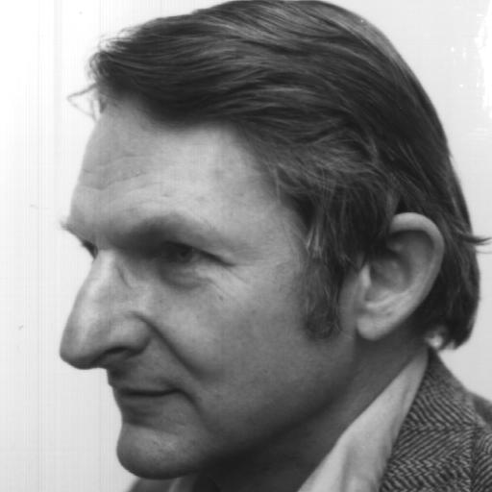
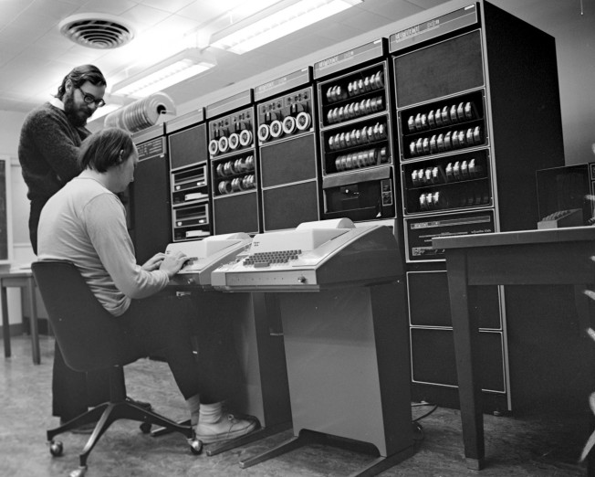
C
Dennis Ritchie
  Bell Labs
  C and helped with Unix
Ken Thompson
  Bell Labs
  Unix
Doug McIlroy
  Bell Labs
  Everybody’s favorite critic, discussion partner, and ideas man (influenced C, C++, Unix, and much more)
Stroustrup/Programming

Slide 19
C – 1978
(Relatively) high-level programming language for systems programming
  Very widely used, relatively low-level, weakly typed, systems programming language
  Associated with Unix and through that with Linux and the open source movement
  Performance becomes somewhat portable
  Designed and implemented by Dennis Ritchie 1974-78
Bjarne Stroustrup, BTL, 1985
Dennis Ritchie, BTL, 1974
Ken Thompson, BTL, 1972
C++
C++98
C++0x
CPL
BCPL
B
Classic C
C89
C99
Martin Richards, Cambridge, 1967
Christopher Strachey, Cambridge, mid-1960s
Stroustrup/Programming

Slide 20
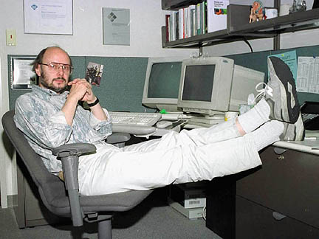
C++
Bjarne Stroustrup
  AT&T Bell labs
  Texas A&M University
  making abstraction techniques affordable and manageable for mainstream projects
  pioneered the use of object-oriented and generic programming techniques in application areas where efficiency is a premium
Stroustrup/Programming

Slide 21
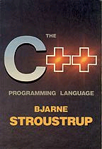
My ideals – in 1980 and still in 2008
“To make life easier for the serious programmer”
    i.e., primarily me and my friends/colleagues
  I love writing code
  I like reading code
  I hate debugging
Elegant and efficient code
  I really dislike choosing between the two
  Elegance, efficiency, and correctness are closely related in many application domains
    Inelegance/verbosity is a major source of bugs and inefficiencies
Stroustrup/Programming

Slide 22
C++ – 1985
C++ is a general-purpose programming language with a bias towards systems programming that
  is a better C
  supports data abstraction
  supports object-oriented programming
  supports generic programming
C++0c
C++98
1978-89
ARM C++
Classic C
C with Classes
C++
Simula 67
1979-84
1989
Stroustrup/Programming

Slide 23
Older Programming languages
Skip if necessary

Slide 24
Early languages – 1952
One language for each machine
  Special features for processor
  Special features for “operating system”
  Most had very assembler-like facilities
    It was easy to understand which instructions would be generated
  No portability of code
Stroustrup/Programming

Slide 25
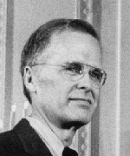
Fortran
John Backus
  IBM
  FORTRAN, the first high level computer language to be developed.
    We did not know what we wanted and how to do it. It just sort of grew.
  The Backus-Naur Form (BNF), a standard notation to describe the syntax of a high level programming language.
  A functional programming language called FP, which advocates a mathematical approach to programming.
Stroustrup/Programming

Slide 26
Fortran – 1956
Allowed programmers to write linear algebra much as they found it in textbooks
  Arrays and loops
  Standard mathematical functions
    libraries
  Users’ own functions
The notation was largely machine independent
  Fortran code could often be moved from computer to computer with only minor modification
This was a huge improvement
  Arguably the largest single improvement in the history of programming languages
Continuous evolution: II, IV, 77, 90, 0x
Stroustrup/Programming

Slide 27
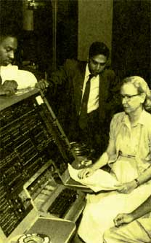

COBOL
“Rear Admiral Dr. Grace Murray Hopper (US Navy) was a remarkable woman who grandly rose to the challenges of programming the first computers. During her lifetime as a leader in the field of software development concepts, she contributed to the transition from primitive programming techniques to the use of sophisticated compilers. She believed that ‘we've always done it that way’ was not necessarily a good reason to continue to do so.”
Stroustrup/Programming

Slide 28
Cobol – 1960
Cobol was (and sometimes still is) for business programmers what Fortran was (and sometimes still is) for scientific programmers
The emphasis was on data manipulation
  Copying
  Storing and retrieving (record keeping)
  Printing (reports)
Calculation/computation was seen as a minor matter
It was hoped/claimed that Cobol was so close to business English that managers could program and programmers would soon become redundant
Continuous evolution: 60, 61, 65, 68, 70, 80, 90, 04
Stroustrup/Programming

Slide 29
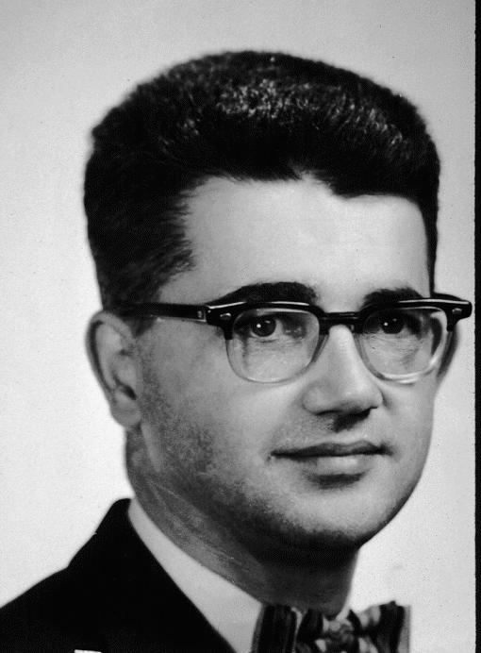
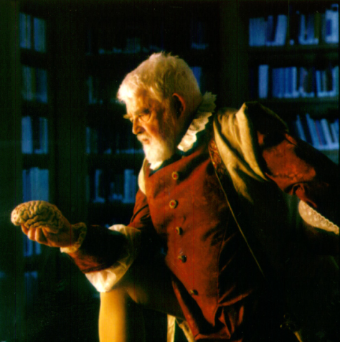
Lisp
John McCarthy
  Stanford University
  AI pioneer
Stroustrup/Programming

Slide 30
Lisp – 1960
List/symbolic processing
Initially (and often still) interpreted
Dozens (most likely hundreds) of dialects
  “Lisp has an implied plural”
  Common Lisp
  Scheme
This family of languages has been (and is) the mainstay of artificial intelligence (AI) research
  though delivered products have often been in C or C++
Stroustrup/Programming

Slide 31
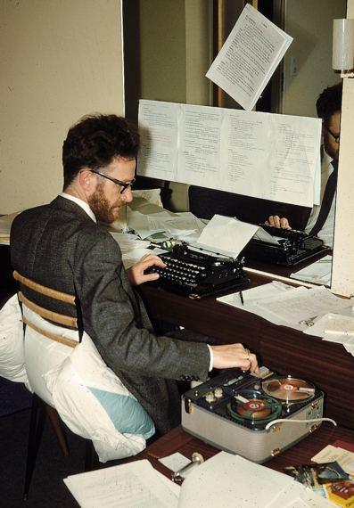
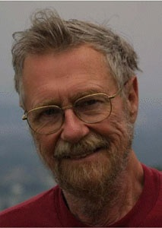
Algol
Peter Naur
  Danish Technical University and Regnecentralen
  BNF
Edsger Dijkstra
  Mathematisch Centrum, Amsterdam, Eindhoven University of Technology, Burroughs Corporation , University of Texas (Austin)
  Mathematical logic in programming, algorithms
  THE operating system
Stroustrup/Programming

Slide 32
Algol – 1960
The breakthrough of modern programming language concepts
  Language description
    BNF; separation of lexical, syntactic, and semantic concerns
  Scope
  Type
  The notion of “general purpose programming language”
    Before that languages were either scientific (e.g., Fortran), business (e.g., Cobol), string manipulation (e.g., Lisp), simulation, …
Never reached major non-academic use
Simula67
Algol58
Algol60
Algol68
Stroustrup/Programming
Pascal

Slide 33
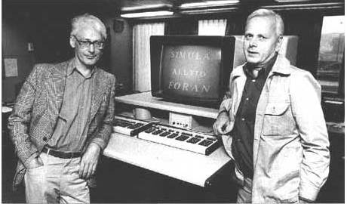
Simula 67
Kristen Nygaard and Ole-Johan Dahl
  Norwegian Computing Center
  Oslo University
  The start of object-oriented programming and object-oriented design
Stroustrup/Programming

Slide 34
Simula 1967
Address all applications domains rather then a specific domain
  As Fortran, COBOL, etc. did
  Aims to become a true general-purpose programming language
Model real-world phenomena in code
  represent ideas as classes and class objects
  represent hierarchical relations as class hierarchies
Classes, inheritance, virtual functions, object-oriented design
A program becomes a set of interacting objects rather than a monolith
  Has major (positive) implications for error rates
Stroustrup/Programming

Slide 35
More information
More language designer links/photos
  http://www.angelfire.com/tx4/cus/people/
A few examples of languages:
  http://dmoz.org/Computers/Programming/Languages/
Textbooks
  Michael L. Scott, Programming Language Pragmatics, Morgan Kaufmann, 2000, ISBN 1-55860-442-1
  Robert W. Sebesta, Concepts of programming languages, Addison-Wesley, 2003, ISBN 0-321-19362-8
History books
  Jean Sammet, Programming Languages: History and Fundamentals, Prentice-Hall, 1969, ISBN 0-13-729988-5
  Richard L. Wexelblat, History of Programming Languages, Academic Press, 1981, ISBN 0-12-745040-8
  T. J. Bergin and R. G. Gibson, History of Programming Languages – II, Addison-Wesley, 1996, ISBN 0-201-89502-1
Stroustrup/Programming

