Slide 1


Lecture 9
Recursive Algorithms
Prof. S.M. Lee
Department of Computer Science

Slide 2
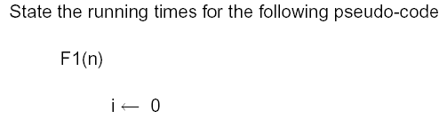
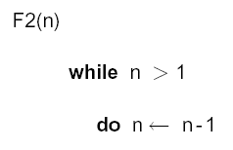


Answer:
Answer:

Slide 3
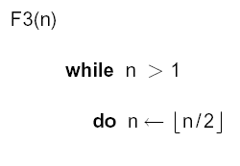
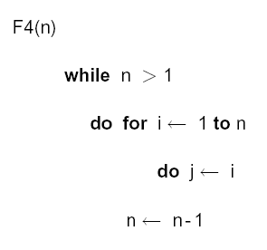

Answer:
Answer:

Slide 4
Recursion
Recursion is more than just a programming technique. It has two other uses in computer science and software engineering, namely:
as a way of describing, defining, or specifying things.
as a way of designing solutions to problems (divide and conquer).

Slide 5
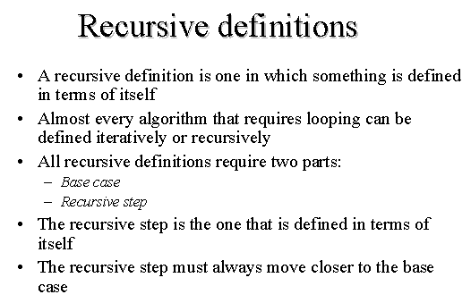

Slide 6
Recursion
Recursion can be seen as building objects from objects that have set definitions. Recursion can also be seen in the opposite direction as objects that are defined from smaller and smaller parts. “Recursion is a different concept of circularity.”(Dr. Britt, Computing Concepts Magazine, March 97, pg.78)

Slide 7
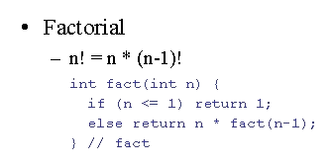
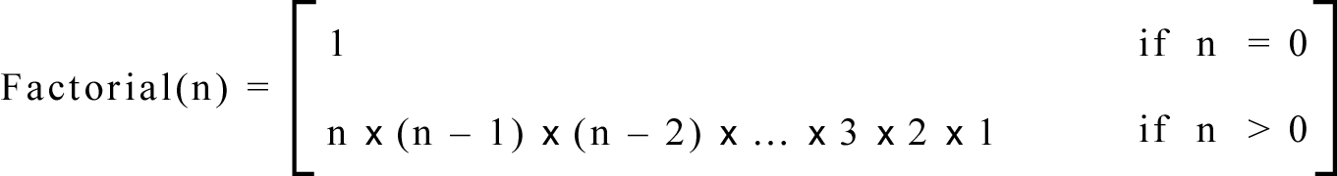
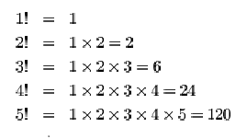
Iterative Definition
In general, we can define the factorial function in the following way:

Slide 8
Iterative Definition
This is an iterative definition of the factorial function.
It is iterative because the definition only contains the algorithm parameters and not the algorithm itself.
This will be easier to see after defining the recursive implementation.

Slide 9
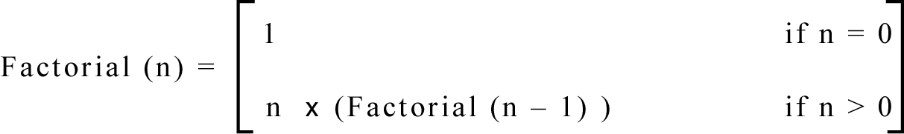
Recursive Definition
We can also define the factorial function in the following way:

Slide 10
Iterative vs. Recursive
Function does NOT
calls itself
Iterative 1 if n=0
factorial(n) =
n x (n-1) x (n-2) x … x 2 x 1 if n>0
Recursive
factorial(n) =
1 if n=0
n x factorial(n-1) if n>0
Function calls itself

Slide 11
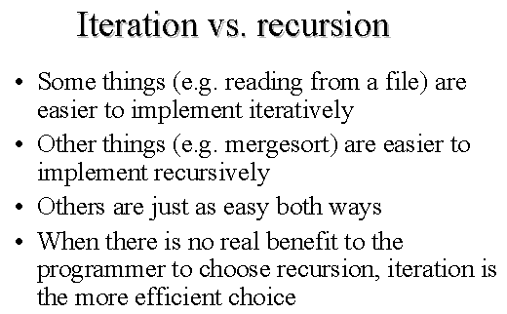
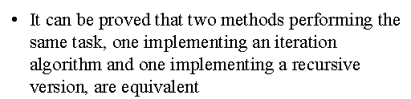

Slide 12
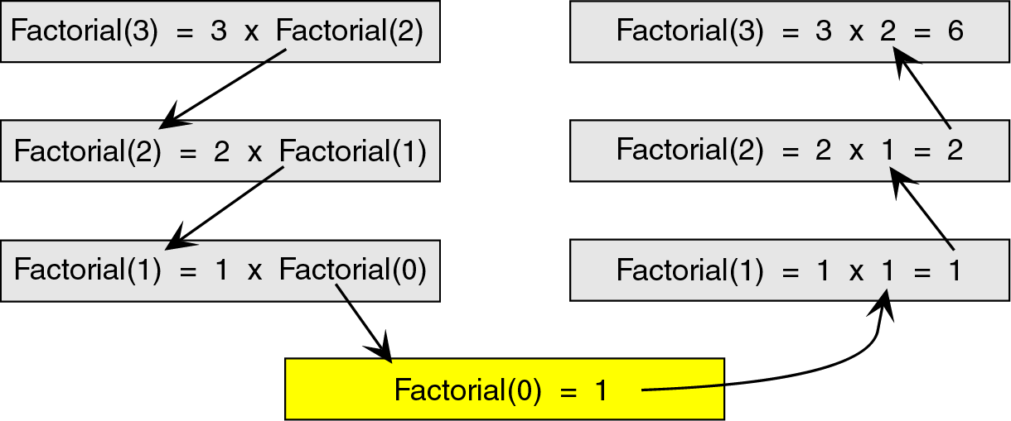
Recursion
To see how the recursion works, let’s break down the factorial function to solve factorial(3)

Slide 13
Breakdown
Here, we see that we start at the top level, factorial(3), and simplify the problem into
3 x factorial(2).
Now, we have a slightly less complicated problem in factorial(2), and we simplify this problem into 2 x factorial(1).

Slide 14
Breakdown
We continue this process until we are able to reach a problem that has a known solution.
In this case, that known solution is factorial(0) = 1.
The functions then return in reverse order to complete the solution.

Slide 15
Breakdown
This known solution is called the base case.
Every recursive algorithm must have a base case to simplify to.
Otherwise, the algorithm would run forever (or until the computer ran out of memory).

Slide 16
Breakdown
The other parts of the algorithm, excluding the base case, are known as the general case.
For example:
3 x factorial(2) ➔ general case
2 x factorial(1) ➔ general case
etc …

Slide 17
Breakdown
After looking at both iterative and recursive methods, it appears that the recursive method is much longer and more difficult.
If that’s the case, then why would we ever use recursion?
It turns out that recursive techniques, although more complicated to solve by hand, are very simple and elegant to implement in a computer.

Slide 18
Iteration vs. Recursion
Now that we know the difference between an iterative algorithm and a recursive algorithm, we will develop both an iterative and a recursive algorithm to calculate the factorial of a number.
We will then compare the 2 algorithms.

Slide 19
Iterative Algorithm
factorial(n) {
i = 1
factN = 1
loop (i <= n)
factN = factN * i
i = i + 1
end loop
return factN
}
The iterative solution is very straightforward. We simply loop through all the integers between 1 and n and multiply them together.

Slide 20
Recursive Algorithm
Note how much simpler the code for the recursive version of the algorithm is as compared with the iterative version ➔
we have eliminated the loop and implemented the algorithm with 1 ‘if’ statement.
factorial(n) {
if (n = 0)
return 1
else
return n*factorial(n-1)
end if
}

Slide 21
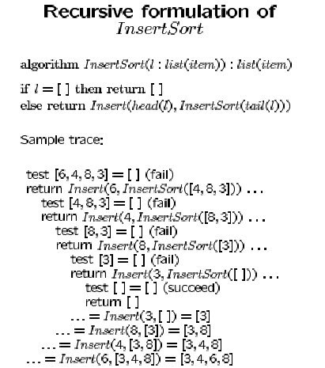

Slide 22
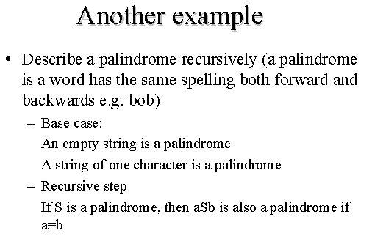

Slide 23
How Recursion Works
To truly understand how recursion works we need to first explore how any function call works.
When a program calls a subroutine (function) the current function must suspend its processing.
The called function then takes over control of the program.

Slide 24
How Recursion Works
When the function is finished, it needs to return to the function that called it.
The calling function then ‘wakes up’ and continues processing.
One important point in this interaction is that, unless changed through call-by- reference, all local data in the calling module must remain unchanged.

Slide 25
How Recursion Works
Therefore, when a function is called, some information needs to be saved in order to return the calling module back to its original state (i.e., the state it was in before the call).
We need to save information such as the local variables and the spot in the code to return to after the called function is finished.

Slide 26
How Recursion Works
To do this we use a stack.
Before a function is called, all relevant data is stored in a stackframe.
This stackframe is then pushed onto the system stack.
After the called function is finished, it simply pops the system stack to return to the original state.

Slide 27
How Recursion Works
By using a stack, we can have functions call other functions which can call other functions, etc.
Because the stack is a first-in, last-out data structure, as the stackframes are popped, the data comes out in the correct order.

Slide 28

Basic Recursion
What we see is that if we have a base case, and if our recursive calls make progress toward reaching the base case, then eventually we terminate. We thus have our first two fundamental rules of recursion:

Slide 29

Basic Recursion
1. Base cases:
  Always have at least one case that can be solved without using recursion.
2. Make progress:
  Any recursive call must make progress toward a base case.

Slide 30
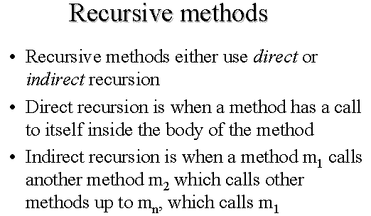

Slide 31
Limitations of Recursion
Recursion is a powerful problem-solving technique that often produces very clean solutions to even the most complex problems.
Recursive solutions can be easier to understand and to describe than iterative solutions.

Slide 32
Main disadvantage of programming recursively
The main disadvantage of programming recursively is that, while it makes it easier to write simple and elegant programs, it also makes it easier to write inefficient ones.
when we use recursion to solve problems we are interested exclusively with correctness, and not at all with efficiency. Consequently, our simple, elegant recursive algorithms may be inherently inefficient.

Slide 33
Limitations of Recursion
By using recursion, you can often write simple, short implementations of your solution.
However, just because an algorithm can be implemented in a recursive manner doesn’t mean that it should be implemented in a recursive manner.

Slide 34
Limitations of Recursion
Recursion works the best when the algorithm and/or data structure that is used naturally supports recursion.
One such data structure is the tree (more to come).
One such algorithm is the binary search algorithm that we discussed earlier in the course.

Slide 35
Limitations of Recursion
Recursive solutions may involve extensive overhead because they use calls.
When a call is made, it takes time to build a stackframe and push it onto the system stack.
Conversely, when a return is executed, the stackframe must be popped from the stack and the local variables reset to their previous values – this also takes time.

Slide 36
Limitations of Recursion
In general, recursive algorithms run slower than their iterative counterparts.
Also, every time we make a call, we must use some of the memory resources to make room for the stackframe.

Slide 37
Limitations of Recursion
Therefore, if the recursion is deep, say, factorial(1000), we may run out of memory.
Because of this, it is usually best to develop iterative algorithms when we are working with large numbers.

Slide 38
Application
One application of recursion is reversing a list.
Before we implemented this function using a stack.
Now, we will implement the same function using recursive techniques.

Slide 39
Fibonacci function:
fibonacci(0) = 1
fibonacci(1) = 1
fibonacci(n) = fibonacci(n-1) + fibonacci(n-2) [for n>1]
This definition is a little different than the previous ones because It has two base cases, not just one; in fact, you can have as many as you like.
In the recursive case, there are two recursive calls, not just one. There can be as many as you like.

Slide 40
Execution of Code for f(3)
x = 3
copy of f
y = ?
call f(2)
x = 2
copy of f
y = ?
call f(1)
x = 1
copy of f
y = ?
call f(0)
x = 0
copy of f
y = ?
return 1
y = 2 * 1 = 2
return y + 1 = 3
y = 2 * 3 = 6
return y + 1 = 7
y = 2 * 7 = 14
return y + 1 = 15
value returned by call is 15

Slide 41
Conclusion
A recursive solution solves a problem by solving a smaller instance of the same problem.
It solves this new problem by solving an even smaller instance of the same problem.
Eventually, the new problem will be so small that its solution will be either obvious or known.
This solution will lead to the solution of the original problem.

Slide 42
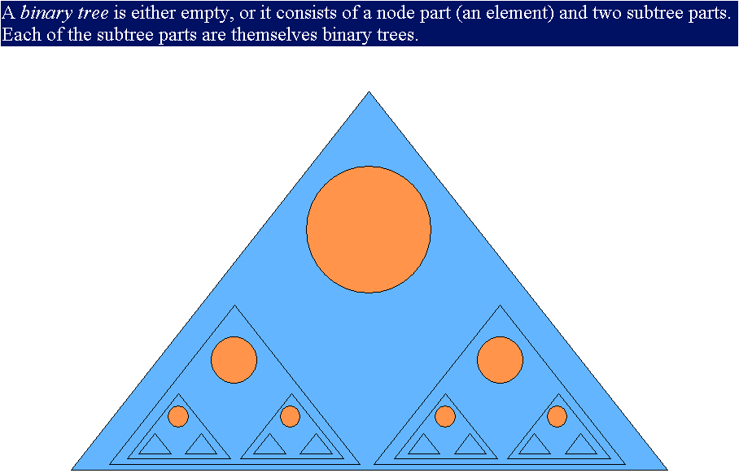

Slide 43
The main benefits of using recursion as a programming technique are these:
invariably recursive functions are clearer, simpler, shorter, and easier to understand than their non-recursive counterparts.
the program directly reflects the abstract solution strategy (algorithm).
From a practical software engineering point of view these are important benefits, greatly enhancing the cost of maintaining the software.

Slide 44
Consider the following program for computing the fibonacci function.
int s1, s2 ;
int fibonacci (int n)
{
if (n == 0) return 1;
else if (n == 1) return 1;
else {
s1 = fibonacci(n-1);
s2 = fibonacci(n-2);
return s1 + s2;
}
}

Slide 45
The main thing to note here is that the variables that will hold the intermediate results, S1 and S2, have been declared as global variables
. This is a mistake. Although the function looks just fine, its correctness crucially depends on having local variables for
storing all the intermediate results. As shown, it will not correctly compute the fibonacci function for n=4 or larger. However, if we move the declaration of s1 and s2 inside the function, it works perfectly.
This sort of bug is very hard to find, and bugs like this are almost certain to arise whenever you use global variables to storeintermediate results of a recursive function.

Slide 46
Recursion is based upon calling the same function over and over, whereas iteration simply `jumps back' to the beginning of the loop. A function call is often more expensive than a jump.

Slide 47
The overheads that may be associated with a function call are:
Space: Every invocation of a function call may require space for parameters and local variables, and for an indication of where to return when the function is finished. Typically this space (allocation record) is allocated on the stack and is released automatically when the function returns. Thus, a recursive algorithm may need space proportional to the number of nested calls to the same function.

Slide 48
Time: The operations involved in calling a function - allocating, and later releasing, local memory, copying values into the local
memory for the parameters, branching to/returning from the function - all contribute to the time overhead.

Slide 49
If a function has very large local memory requirements, it would be very costly to program it recursively. But even if there is
very little overhead in a single function call, recursive functions often call themselves many many times, which can magnify a
small individual overhead into a very large cumulative overhead.

Slide 50
int factorial(int n)
{
if (n == 0) return 1;
else return n * factorial(n-1);
}
There is very little overhead in calling this function, as it has only one word of local memory, for the parameter n. However, when we try to compute factorial(20), there will end up being 21 words of memory allocated - one for each invocation of the function:

Slide 51
factorial(20) -- allocate 1 word of memory,
call factorial(19) -- allocate 1 word of memory,
call factorial(18) -- allocate 1 word of memory,
.
.
.
call factorial(2) -- allocate 1 word of memory,
call factorial(1) -- allocate 1 word of memory,
call factorial(0) -- allocate 1 word of memory,
at this point 21 words of memory

Slide 52
and 21 activation records have been allocated.
return 1. -- release 1 word of memory.
return 1*1. -- release 1 word of memory.
return 2*1. -- release 1 word of memory.

Slide 53
Iteration as a special case of recursion
The first insight is that iteration is a special case of recursion.
void do_loop () { do { ... } while (e); }
is equivalent to:
void do_loop () { ... ; if (e) do_loop(); }
A compiler can recognize instances of this form of recursion and turn them into loops or simple jumps.
E.g.:
void do_loop () { start: ...; if (e) goto start; }
Notice that this optimization also removes the space overhead associated with function calls.

Slide 54
Most recursive algorithms can be translated, by a fairly mechanical procedure, into iterative algorithms. Sometimes this is very straightforward - for example, most compilers detect a special form of recursion, called tail recursion, and automatically translate into iteration without your knowing. Sometimes, the translation is more involved: for example, it might require introducing an explicit stack with which to `fake' the effect of recursive calls.

Slide 55
In general, there is no reason to incur the overhead of recursion when its use does not gain anything.
Recursion is truly valuable when a problem has no simple iterative solution.

Slide 56
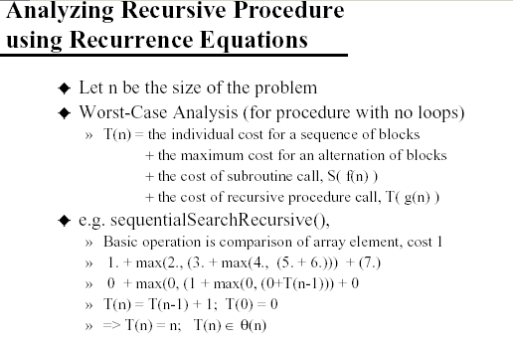

Slide 57
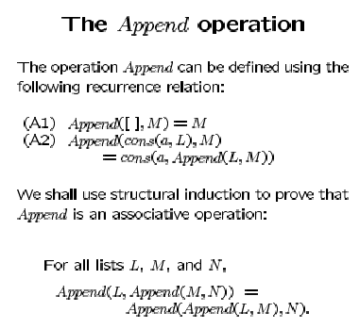

Slide 58
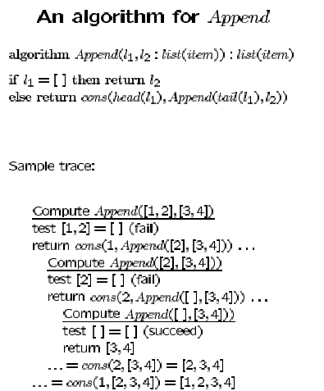

Slide 59
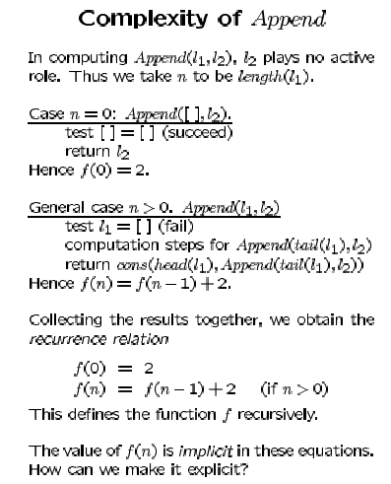

Slide 60
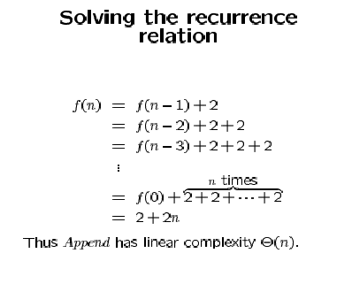

Slide 61
