Slide 1

Data Structures Using C++ 2E
Chapter 1
Software Engineering Principles and C++ Classes

Slide 2
Objectives
Learn about software engineering principles
Discover what an algorithm is and explore problem-solving techniques
Become aware of structured design and object-oriented design programming methodologies
Learn about classes
Become aware of private, protected, and public members of a class
Data Structures Using C++ 2E

Slide 3
Objectives (cont’d.)
Explore how classes are implemented
Become aware of Unified Modeling Language (UML) notation
Examine constructors and destructors
Become aware of an abstract data type (ADT)
Explore how classes are used to implement ADTs
Data Structures Using C++ 2E

Slide 4
Software Life Cycle
Program life cycle
  Many phases between program conception and retirement
  Three fundamental stages
    Development, use, and maintenance
Program retirement
  Program too expensive to maintain
    No new version released
Software development phase
  First and most important software life cycle phase
Data Structures Using C++ 2E

Slide 5
Software Development Phase
Four phases
  Analysis
  Design
  Implementation
  Testing and debugging
Analysis
  First and most important step
  Analysis requirements
    Thoroughly understand the problem
    Understand the problem requirements
    Divide problem into subproblems (if complex)
Data Structures Using C++ 2E

Slide 6
Software Development Phase (cont’d.)
Design
  Design an algorithm to solve the problem or subproblem
  Algorithm
    Step-by-step problem-solving process
    Solution obtained in finite amount of time
  Structured design
    Dividing problem into smaller subproblems
    Also known as: top-down design, stepwise refinement, and modular programming
Data Structures Using C++ 2E

Slide 7
Software Development Phase (cont’d.)
Design (cont’d.)
  Object-oriented design (OOD)
    Identifies components called objects
    Determines how objects interact with one another
    Object specifications: relevant data; possible operations performed on that data
  Object-oriented programming (OOP) language
    Programming language implementing OOD
  Object-oriented design principles
    Encapsulation, inheritance, and polymorphism
Data Structures Using C++ 2E

Slide 8
Software Development Phase (cont’d.)
Implementation
  Write and compile programming code
    Implement classes and functions discovered in the design phase
  Final program consists of several functions
    Each accomplishes a specific goal
  Precondition
    Statement specifying condition(s)
    Must be true before function called
  Postcondition
    Statement specifying true items after function call completed
Data Structures Using C++ 2E

Slide 9
Software Development Phase (cont’d.)
Testing and debugging
  Testing
    Testing program correctness
    Verifying program works properly
  Increase program reliability
    Discover and fix errors before releasing to user
  Test case
    Set of inputs, user actions, other initial conditions, and the expected output
    Document properly
  Black-box testing and white-box testing
Data Structures Using C++ 2E

Slide 10
Algorithm Analysis: The Big-O Notation
Analyze algorithm after design
Example
  50 packages delivered to 50 different houses
  50 houses one mile apart, in the same area
FIGURE 1-1 Gift shop and each dot representing a house
Data Structures Using C++ 2E

Slide 11
Algorithm Analysis: The Big-O Notation (cont’d.)
Example (cont’d.)
  Driver picks up all 50 packages
  Drives one mile to first house, delivers first package
  Drives another mile, delivers second package
  Drives another mile, delivers third package, and so on
  Distance driven to deliver packages
    1+1+1+… +1 = 50 miles
  Total distance traveled: 50 + 50 = 100 miles
FIGURE 1-2 Package delivering scheme
Data Structures Using C++ 2E

Slide 12

Algorithm Analysis: The Big-O Notation (cont’d.)
Example (cont’d.)
  Similar route to deliver another set of 50 packages
    Driver picks up first package, drives one mile to the first house, delivers package, returns to the shop
    Driver picks up second package, drives two miles, delivers second package, returns to the shop
  Total distance traveled
    2 * (1+2+3+…+50) = 2550 miles
FIGURE 1-3 Another package delivery scheme
Data Structures Using C++ 2E

Slide 13
Algorithm Analysis: The Big-O Notation (cont’d.)
Example (cont’d.)
  n packages to deliver to n houses, each one mile apart
  First scheme: total distance traveled
    1+1+1+… +n = 2n miles
    Function of n
  Second scheme: total distance traveled
    2 * (1+2+3+…+n) = 2*(n(n+1) / 2) = n²+n
    Function of n²
Data Structures Using C++ 2E

Slide 14
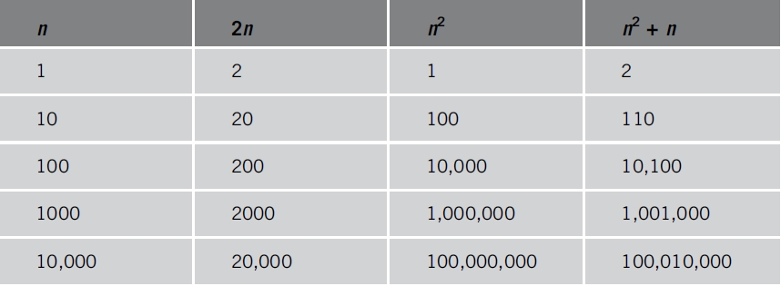
Algorithm Analysis: The Big-O Notation (cont’d.)
Analyzing an algorithm
  Count number of operations performed
    Not affected by computer speed
TABLE 1-1 Various values of n, 2n, n², and n² + n
Data Structures Using C++ 2E

Slide 15
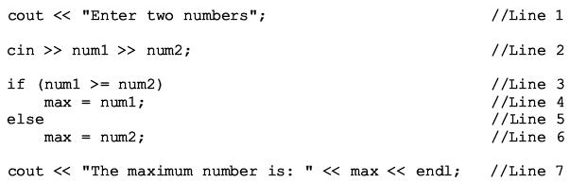
Algorithm Analysis: The Big-O Notation (cont’d.)
Example 1-1
  Illustrates fixed number of executed operations
Data Structures Using C++ 2E

Slide 16
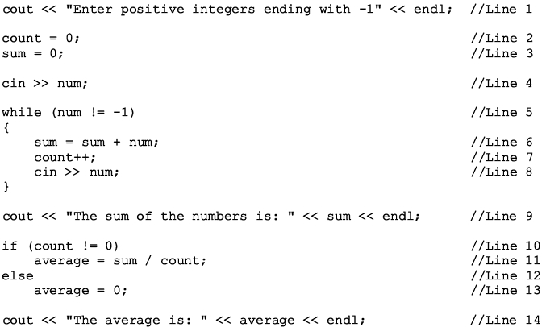
Algorithm Analysis: The Big-O Notation (cont’d.)
Example 1-2
  Illustrates dominant operations
Data Structures Using C++ 2E

Slide 17
Algorithm Analysis: The Big-O Notation (cont’d.)
Search algorithm
  n: represents list size
  f(n): count function
    Number of comparisons in search algorithm
  c: units of computer time to execute one operation
  cf(n): computer time to execute f(n) operations
  Constant c depends computer speed (varies)
  f(n): number of basic operations (constant)
  Determine algorithm efficiency
    Knowing how function f(n) grows as problem size grows
Data Structures Using C++ 2E

Slide 18
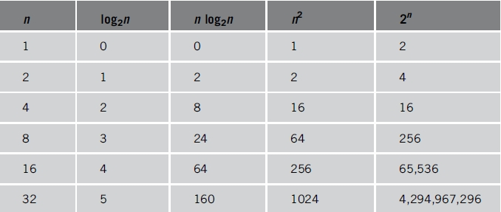
Algorithm Analysis: The Big-O Notation (cont’d.)
TABLE 1-2 Growth rates of various functions
Data Structures Using C++ 2E

Slide 19
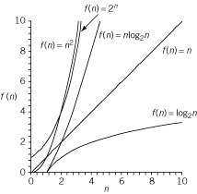
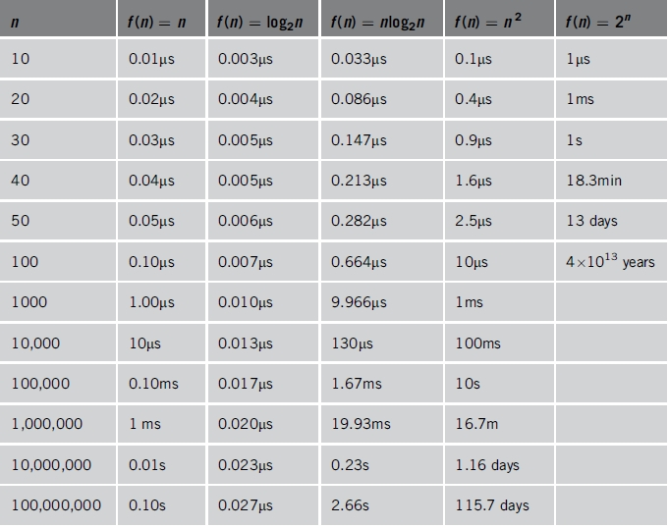
Algorithm Analysis: The Big-O Notation (cont’d.)
TABLE 1-3 Time for f(n) instructions on a computer that executes 1 billion instructions per second
Figure 1-4 Growth rate
of functions in Table 1-3
Data Structures Using C++ 2E

Slide 20
Algorithm Analysis: The Big-O Notation (cont’d.)
Notation useful in describing algorithm behavior
  Shows how a function f(n) grows as n increases without bound
Asymptotic
  Study of the function f as n becomes larger and larger without bound
  Examples of functions
    g(n)=n² (no linear term)
    f(n)=n² + 4n + 20
Data Structures Using C++ 2E

Slide 21
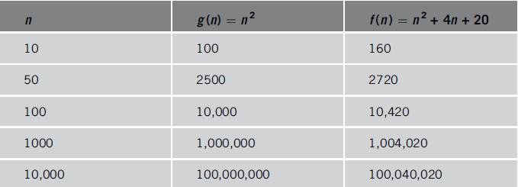
Algorithm Analysis: The Big-O Notation (cont’d.)
As n becomes larger and larger
  Term 4n + 20 in f(n) becomes insignificant
  Term n² becomes dominant term
TABLE 1-4 Growth rate of n² and n² + 4n + 20n
Data Structures Using C++ 2E

Slide 22
Algorithm Analysis: The Big-O Notation (cont’d.)
Algorithm analysis
  If function complexity can be described by complexity of a quadratic function without the linear term
    We say the function is of O(n²) or Big-O of n²
Let f and g be real-valued functions
  Assume f and g nonnegative
    For all real numbers n, f(n) >= 0 and g(n) >= 0
f(n) is Big-O of g(n): written f(n) = O(g(n))
  If there exists positive constants c and n₀ such that f(n) <= cg(n) for all n >= n₀
Data Structures Using C++ 2E

Slide 23
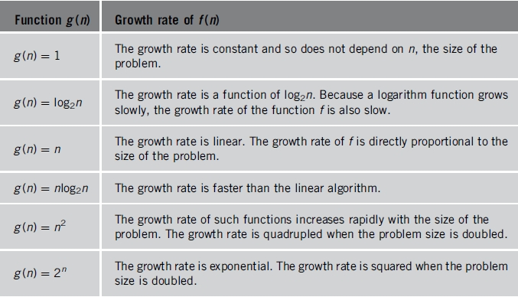
Algorithm Analysis: The Big-O Notation (cont’d.)
TABLE 1-5 Some Big-O functions that appear in algorithm analysis
Data Structures Using C++ 2E

Slide 24
Summary
Program life cycle software development phases
  Analysis, design, implementation, testing, and debugging
Algorithm: step-by-step problem-solving process
  Solution obtained in finite amount of time
Object-oriented design principles
  Encapsulation, inheritance, and polymorphism
Constructors guarantee class instance variables initialized
UML diagrams: graphical notation describing class and its members
Data Structures Using C++ 2E

Slide 25
Summary (cont’d.)
Data abstraction
  Separating logical data properties from implementation details
Class: collection of fixed number of components
    Components called members
Destructors: functions without a type
Structs: special type of classes
Abstract data type (ADT)
  Data type separating logical properties from implementation details
Data Structures Using C++ 2E

