Slide 1

CS 332: Algorithms
Asymptotic Performance
David Luebke <number> 11/08/26

Slide 2
Review: Asymptotic Performance
Asymptotic performance: How does algorithm behave as the problem size gets very large?
    Running time
    Memory/storage requirements
  Remember that we use the RAM model:
    All memory equally expensive to access
    No concurrent operations
    All reasonable instructions take unit time
      Except, of course, function calls
    Constant word size
      Unless we are explicitly manipulating bits
David Luebke <number> 11/08/26

Slide 3
Review: Running Time
Number of primitive steps that are executed
  Except for time of executing a function call most statements roughly require the same amount of time
  We can be more exact if need be
Worst case vs. average case
David Luebke <number> 11/08/26

Slide 4
An Example: Insertion Sort
InsertionSort(A, n) {
for i = 2 to n {
key = A[i]
j = i - 1;
while (j > 0) and (A[j] > key) {
A[j+1] = A[j]
j = j - 1
}
A[j+1] = key
}
}
David Luebke <number> 11/08/26

Slide 5
An Example: Insertion Sort
10
20
30
40
i = 4 j = 1 key = 20
A[j] = 10 A[j+1] = 20
1
2
3
4
InsertionSort(A, n) {
for i = 2 to n {
key = A[i]
j = i - 1;
while (j > 0) and (A[j] > key) {
A[j+1] = A[j]
j = j - 1
}
A[j+1] = key
}
}
David Luebke <number> 11/08/26

Slide 6
Insertion Sort
What is the precondition
for this loop?
InsertionSort(A, n) {
for i = 2 to n {
key = A[i]
j = i - 1;
while (j > 0) and (A[j] > key) {
A[j+1] = A[j]
j = j - 1
}
A[j+1] = key
}
}
David Luebke <number> 11/08/26

Slide 7
Insertion Sort
InsertionSort(A, n) {
for i = 2 to n {
key = A[i]
j = i - 1;
while (j > 0) and (A[j] > key) {
A[j+1] = A[j]
j = j - 1
}
A[j+1] = key
}
}
How many times will
this loop execute?
David Luebke <number> 11/08/26

Slide 8
Rules
Rule of sums
Rule of products
David Luebke <number> 11/08/26

Slide 9
Insertion Sort
Statement Effort
InsertionSort(A, n) {
for i = 2 to n { c₁n (why?)
key = A[i] c₂(n-1)
j = i - 1; c₃(n-1)
while (j > 0) and (A[j] > key) { c₄T
A[j+1] = A[j] c₅(T-(n-1))
j = j - 1 c₆(T-(n-1))
} 0
A[j+1] = key c₇(n-1)
} 0
}
T = t₂ + t₃ + … + t_{n} where t_{i} is number of while expression evaluations for the i^{th} for loop iteration
David Luebke <number> 11/08/26

Slide 10
Analyzing Insertion Sort
T(n) = c₁n + c₂(n-1) + c₃(n-1) + c₄T + c₅(T - (n-1)) + c₆(T - (n-1)) + c₇(n-1)
= c₈T + c₉n + c₁₀
What can T be?
  Best case -- inner loop body never executed
    t_{i} = 1 ➔ T(n) is a linear function
  Worst case -- inner loop body executed for all previous elements
    t_{i} = i ➔ T(n) is a quadratic function
  Average case
    ???
David Luebke <number> 11/08/26

Slide 11
Analysis
Simplifications
  Ignore actual and abstract statement costs
  Order of growth is the interesting measure:
    Highest-order term is what counts
      Remember, we are doing asymptotic analysis
      As the input size grows larger it is the high order term that dominates
David Luebke <number> 11/08/26

Slide 12
Upper Bound Notation
We say InsertionSort’s run time is O(n²)
  Properly we should say run time is in O(n²)
  Read O as “Big-O” (you’ll also hear it as “order”)
In general a function
  f(n) is O(g(n)) if there exist positive constants c and n₀ such that f(n) ≤ c ⋅ g(n) for all n ≥ n₀
Formally
  O(g(n)) = { f(n): ∃ positive constants c and n₀ such that f(n) ≤ c ⋅ g(n) ∀ n ≥ n₀
David Luebke <number> 11/08/26

Slide 13
Insertion Sort Is O(n²)
Proof
  Suppose runtime is an² + bn + c
    If any of a, b, and c < 0 then a=|a|, ..
  an² + bn + c ≤ (a + b + c)n² + (a + b + c)n + (a + b + c)
  ≤ 3(a + b + c)n² for n ≥ 1
  Let c’ = 3(a + b + c) and let n₀ = 1
Questions
  Is InsertionSort O(n³)?
  Is InsertionSort O(n)?
David Luebke <number> 11/08/26

Slide 14
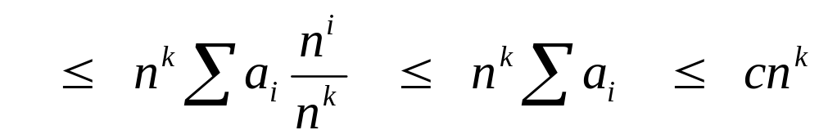
Big O Fact
A polynomial of degree k is O(n^{k})
Proof:
  Suppose f(n) = b_{k}n^{k} + b_{k-1}n^{k-1} + … + b₁n + b₀
    Let a_{i} = | b_{i} |
  f(n) ≤ a_{k}n^{k} + a_{k-1}n^{k-1} + … + a₁n + a₀
David Luebke <number> 11/08/26

Slide 15
Lower Bound Notation
We say InsertionSort’s run time is Ω(n)
In general a function
  f(n) is Ω(g(n)) if ∃ positive constants c and n₀ such that 0 ≤ c⋅g(n) ≤ f(n) ∀ n ≥ n₀
Proof:
  Suppose run time is an + b (a,b constants)
    Assume a and b are positive (what if b is negative?)
  an ≤ an + b
David Luebke <number> 11/08/26

Slide 16
Asymptotic Tight Bound
A function f(n) is Θ(g(n)) if ∃ positive constants c₁, c₂, and n₀ such that
c₁ g(n) ≤ f(n) ≤ c₂ g(n) ∀ n ≥ n₀
Theorem
  f(n) is Θ(g(n)) iff f(n) is both O(g(n)) and Ω(g(n))
  Proof:from definitions
David Luebke <number> 11/08/26

Slide 17

Practical Complexity
David Luebke <number> 11/08/26

Slide 18

Practical Complexity
David Luebke <number> 11/08/26

Slide 19

Practical Complexity
David Luebke <number> 11/08/26

Slide 20

Practical Complexity
David Luebke <number> 11/08/26

Slide 21
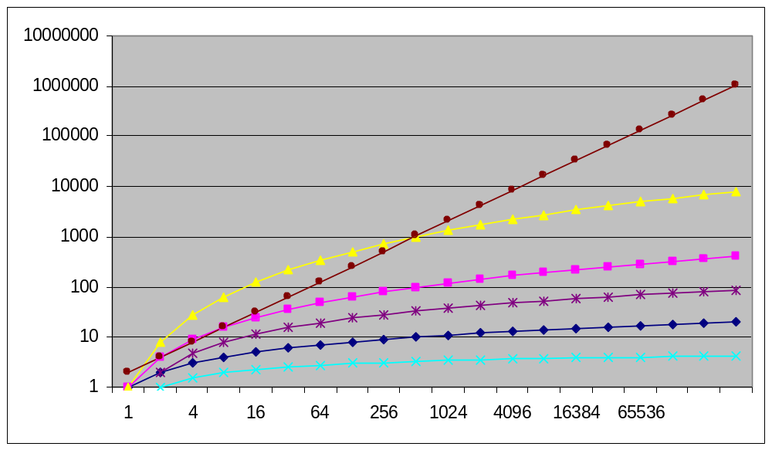
Practical Complexity
David Luebke <number> 11/08/26

Slide 22
Other Asymptotic Notations
A function f(n) is o(g(n)) if ∃ positive constants c and n₀ such that
f(n) < c g(n) ∀ n ≥ n₀
A function f(n) is ω(g(n)) if ∃ positive constants c and n₀ such that
c g(n) < f(n) ∀ n ≥ n₀
Intuitively,
  o() is like <
  O() is like ≤
  ω() is like >
  Ω() is like ≥
  Θ() is like =
David Luebke <number> 11/08/26

Slide 23
Deriving O(g(n)) for T(n)
Solving recurrences
  Substitution method
  Master theorem (advanced course)
David Luebke <number> 11/08/26

