Slide 1
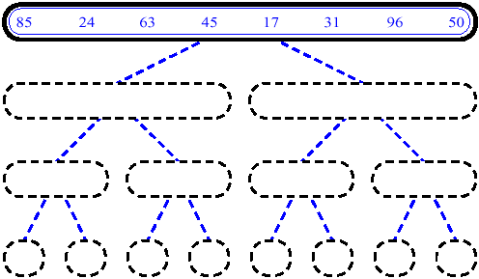
MergeSort (Example) - 1

Slide 2
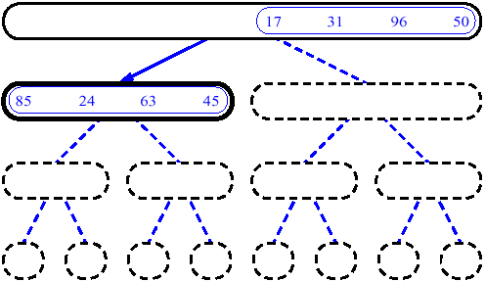
MergeSort (Example) - 2

Slide 3
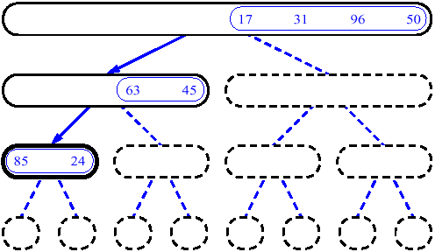
MergeSort (Example) - 3

Slide 4
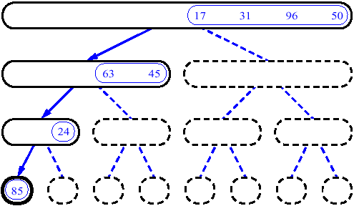
MergeSort (Example) - 4

Slide 5
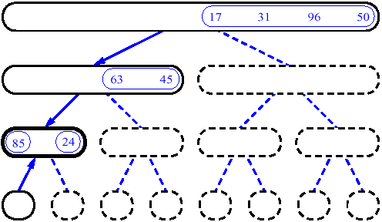
MergeSort (Example) - 5

Slide 6
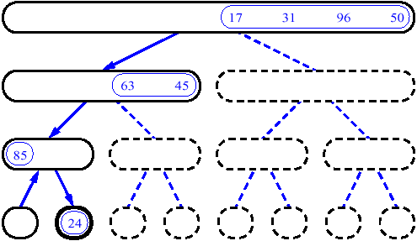
MergeSort (Example) - 6

Slide 7
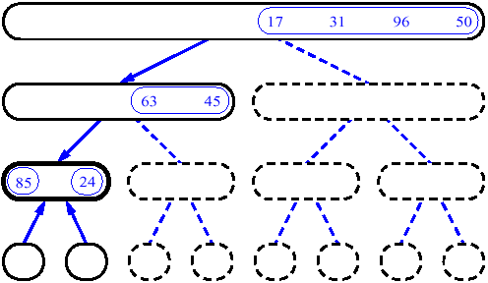
MergeSort (Example) - 7

Slide 8
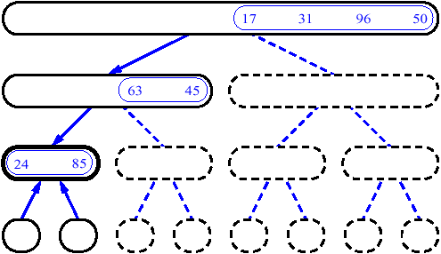
MergeSort (Example) - 8

Slide 9
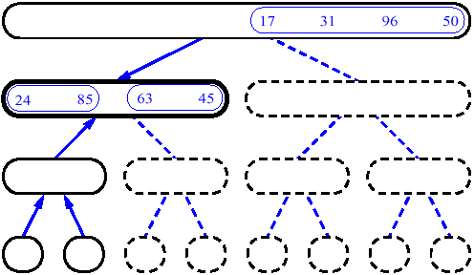
MergeSort (Example) - 9

Slide 10
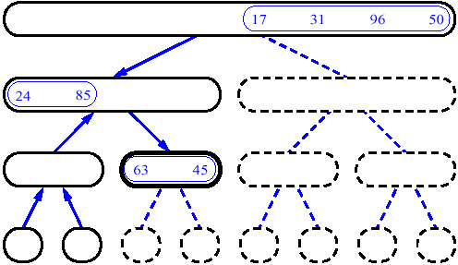
MergeSort (Example) - 10

Slide 11
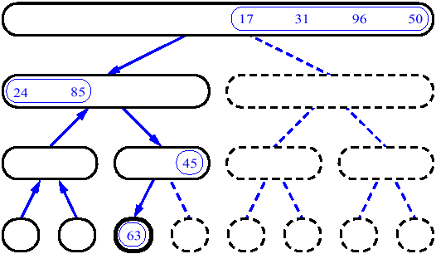
MergeSort (Example) - 11

Slide 12
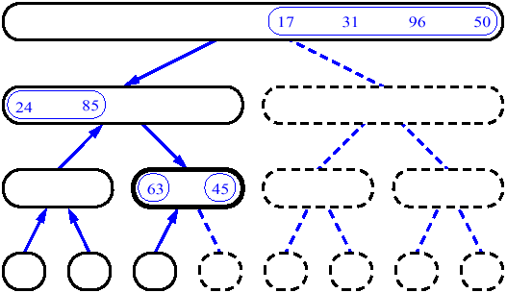
MergeSort (Example) - 12

Slide 13
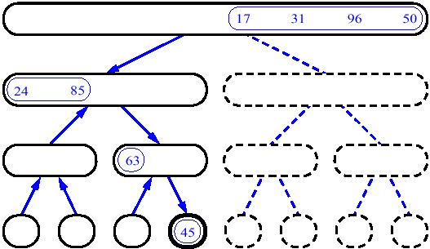
MergeSort (Example) - 13

Slide 14
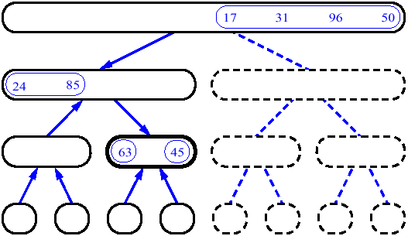
MergeSort (Example) - 14

Slide 15
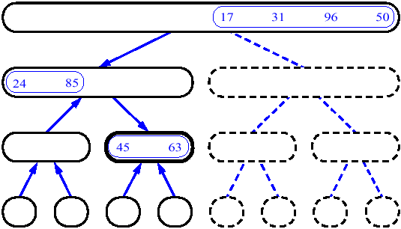
MergeSort (Example) - 15

Slide 16
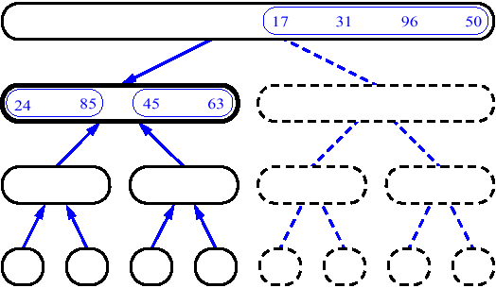
MergeSort (Example) - 16

Slide 17
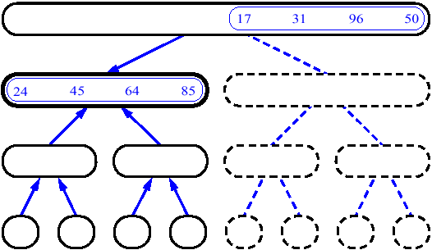
MergeSort (Example) - 17

Slide 18
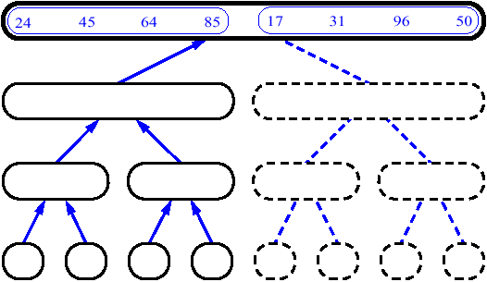
MergeSort (Example) - 18

Slide 19
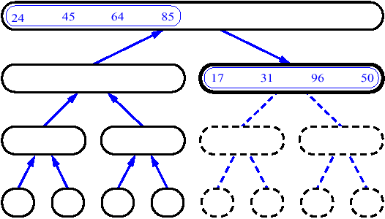
MergeSort (Example) - 19

Slide 20
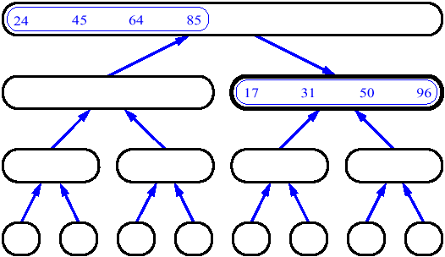
MergeSort (Example) - 20

Slide 21
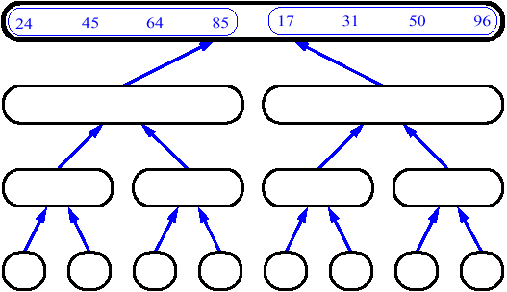
MergeSort (Example) - 21

Slide 22
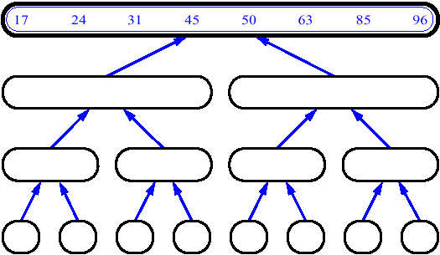
MergeSort (Example) - 22

Slide 23
14
23
45
98
6
33
42
67

Slide 24
14
23
45
98
6
33
42
67
Merge

Slide 25
14
23
45
98
6
33
42
67
6
Merge

Slide 26
14
23
45
98
6
33
42
67
6
14
Merge

Slide 27
14
23
45
98
6
33
42
67
6
14
23
Merge

Slide 28
14
23
45
98
6
33
42
67
6
14
23
33
Merge

Slide 29
14
23
45
98
6
33
42
67
6
14
23
33
42
Merge

Slide 30
14
23
45
98
6
33
42
67
6
14
23
33
42
45
Merge

Slide 31
14
23
45
98
6
33
42
67
6
14
23
33
42
45
67
Merge

Slide 32
14
23
45
98
6
33
42
67
6
14
23
33
42
45
67
98
Merge

