Slide 1
Using E-R and UML Models for DELS Modeling: A case study approach
Sheng Xu
Yudi Pranoto
Jinxiang Gu

Slide 2
Overview
Introduction to E-R and UML Models
Examples of E-R and UML models
Case Study: Wafer Fab
  Visual Presentation
  E-R Model
  UML Model
Discussion on Prediction, Control and Design of DELS with E-R and UML

Slide 3
Entity-Relationship Model
Entity type
  Collection of entities, e.g., Students, Instructors
  Primary key: each entity is assigned a primary key that differentiate it from the other entities in the same group
  Attributes: represent characteristics of the corresponding entity, e.g., Name, Date of Birth
Relationships (between entity type), e.g.,
  Student vs. department (one to many relation): a department has many students, but a student is registered in a single department.
  Student vs. class (many to many relation): a class has many students, and a student can register in multiple classes.
  Student vs. mailbox (one to one relation): a student has its own dedicated mailbox, although this is not the case in Georgia Tech.

Slide 4
UML Model
It is a much more complicated object-oriented modeling technique, which includes:
  Model: contain all of the underlying elements about a system
  Diagrams: capture different perspective about a system
  1. Class diagram and object diagram
  2. Use case diagram
  3. Interaction diagram
  Sequence diagram
  Collaboration diagram
  4. State diagram
  5. Implementation diagram
  Component diagram
  Deployment diagram

Slide 5
UML Model
Class Diagram
Use Case Diagram
Model
Interaction Diagram
State Diagram
Implementation Diagram

Slide 6
UML Diagrams
Class diagram: show types of entities (classes), and their relationships. An object diagram describes instances of classes and their relationships
Use case diagram: describe actors, use cases, and their relationships. It provides a natural high-level view of the intended functionality of the system.
Interaction diagram: include sequence diagram and collaboration diagram, and display instances and their relationships, organized either by space (collaboration diagram) or by time (sequence diagram).
State diagram: show states and their relationships, and is used to specify the overall behavior of a class.
Implementation diagram: describes software units that implement the system and their relationships.

Slide 7
UML vs. ER
ER has been mainly used in Database design, while UML is a standard object-oriented modeling language for all types of systems, which includes database modeling.
The most closest part of UML to ER is the class diagram, which represents the entities and their relationships. But UML has the additional capabilities to represent entity behaviors.

Slide 8
UML objects vs. Entities
Window
Window
size
window-ID
visibility
size
visibility
display()
hide()

Slide 9
Relationships in UML class diagrams
Association: one object is associated with another object, corresponding to the relationships in ER.
Aggregation: one object is an organized set of other objects, e.g., a tour is an ordered set of locations to be visited.
Generalization: one object is a more generalized type of another, student is a super class of undergraduate.
…..

Slide 10
Mapping of relationships between UML class diagrams and ER
The mapping between associations and ER relationships is straightforward.
Some other relationships can be converted to ER relationships also, e.g., generalization can be converted to a “is-a” relationship in ER.
But this might result in loss of information in the original UML model, e.g., aggregation can be converted to a “contains” relationship, but the ordered structure cannot be preserved. This is usually compensated by adding a note or comment in the ER model.

Slide 11
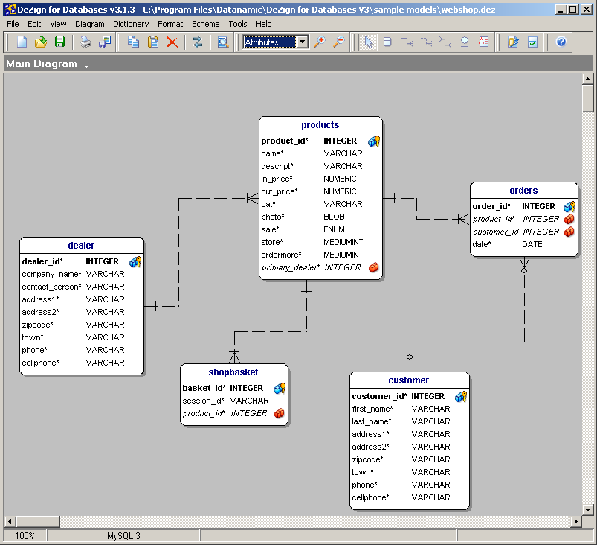
Example of ER Model: Web Shop

Slide 12
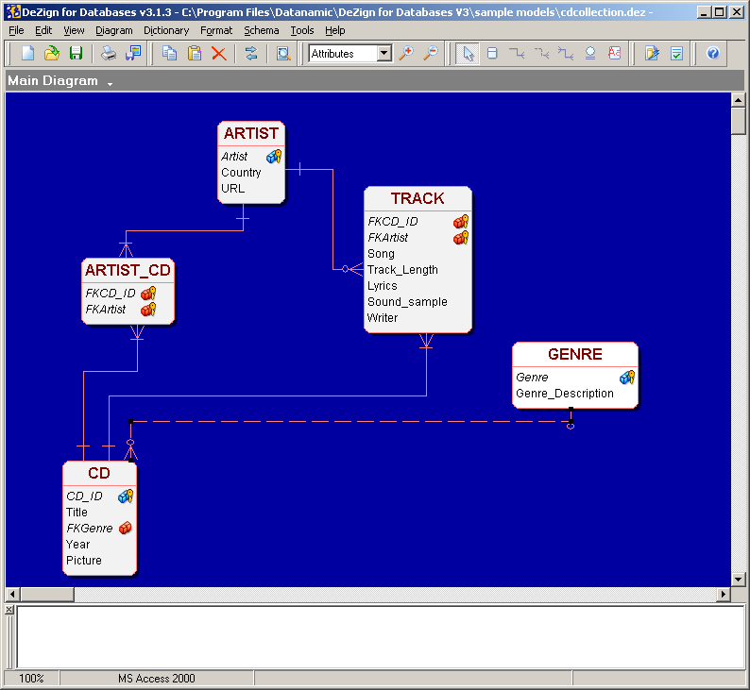
Example of ER Model: CD Collections

Slide 13
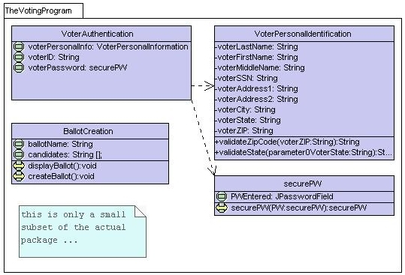
UML Model: Class Diagram
Show classes and their relationships to each other.

Slide 14
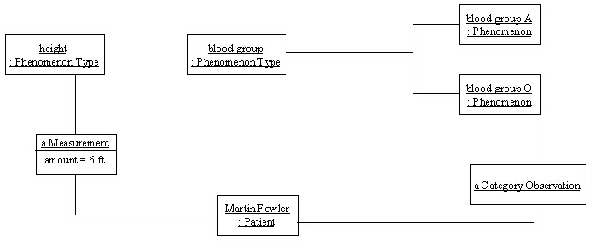
UML Model: Object Diagram
Object diagrams are instances of Class diagrams which show a snapshot of the detailed state of a system at a point in time.

Slide 15
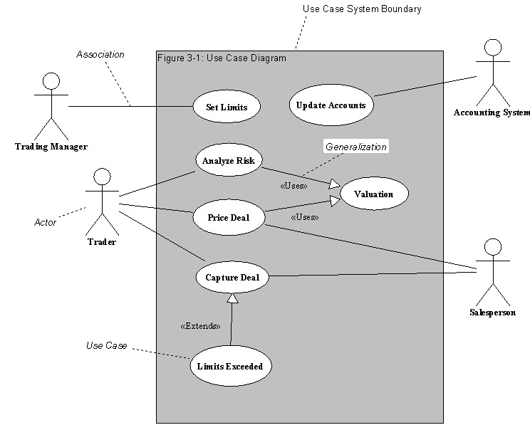
UML Model: Use Case Diagram
A generalized description of how a system will be used. Provides an overview of the intended functionality of the system

Slide 16
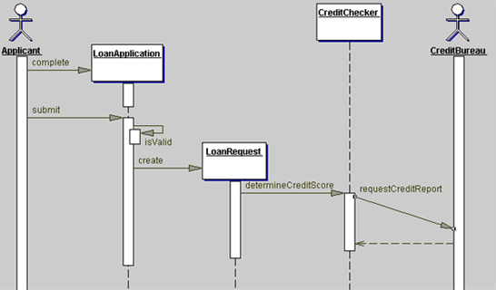
UML Model: Sequences Diagram
A description of sequences.

Slide 17
Case Study: 300mm Wafer-Fab
To model a 300mm Wafer Fab Controller for
material flow control, stocker control, etc.
Principles
1.Provide high-level instruction to devices
2.Initiate device operations, but it does not interfere with the accomplishment of these tasks

Slide 18
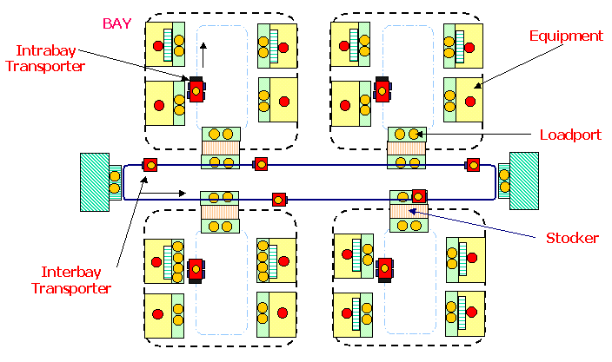
Case Study: 300mm Wafer-Fab
Station Family
Recipe
Lot

Slide 19
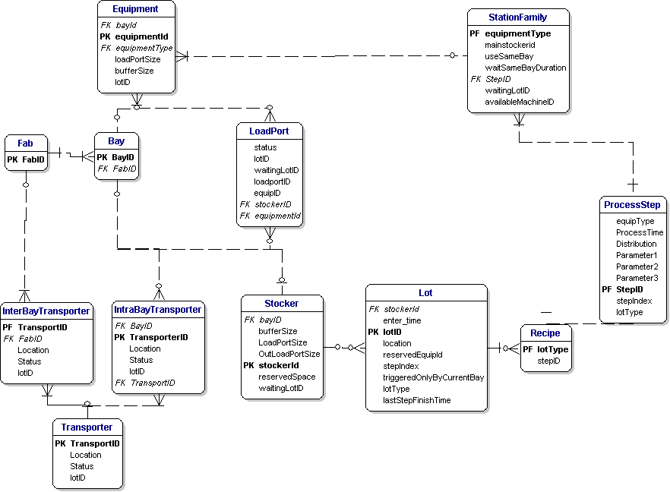
Wafer Fab: E-R Diagram

Slide 20
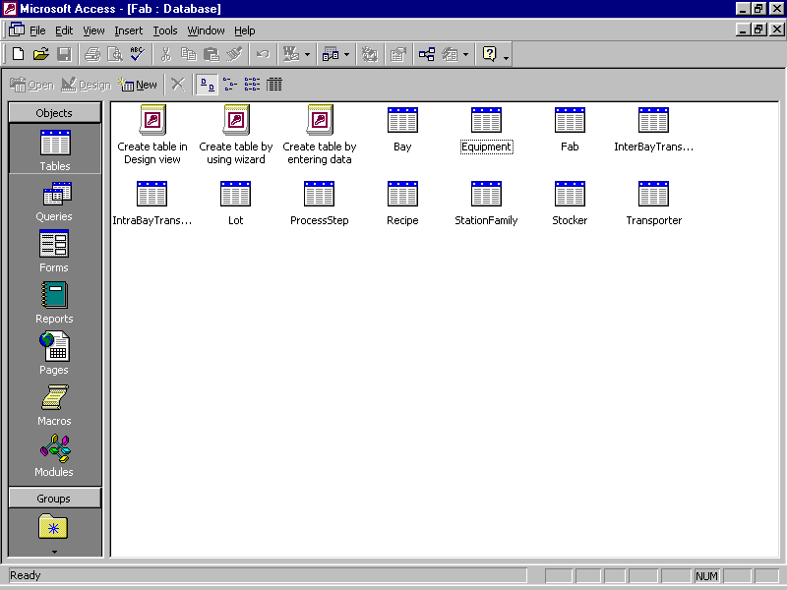
Wafer Fab: Database

Slide 21
Wafer Fab:UML
Use Case Diagram
Sequence Diagram
Flow Diagram
Class Diagram

Slide 22
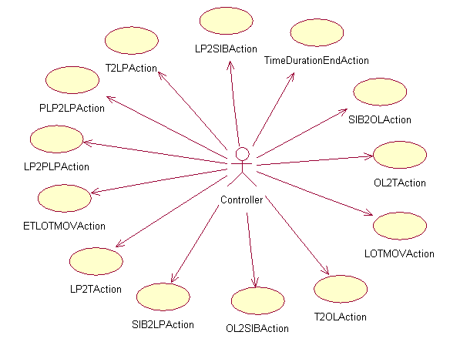
Wafer Fab:Use Case Diagram
The stocker ASRS put a lot from its load port(intra-bay side) into the its buffer
A lot has waited in the same bay for a period of specified time
The ASRS of the stocker put a lot from its buffer to its load port(inter-bay side)
The transporter retrieved the lot from the stocker load port

Slide 23
Wafer Fab: LP2SIB Event
Update location and status
Get next step equipment type from lot info
Choose the next step equipment
3.1 UseSameBay flag is true, wait WaitSameBayDuration time for the equipment for next process step in the same bay if it is not available
3.2 UseSameBay flag is false, move to the main stocker if it is specified
4. Assign next lot to the load port if available

Slide 24
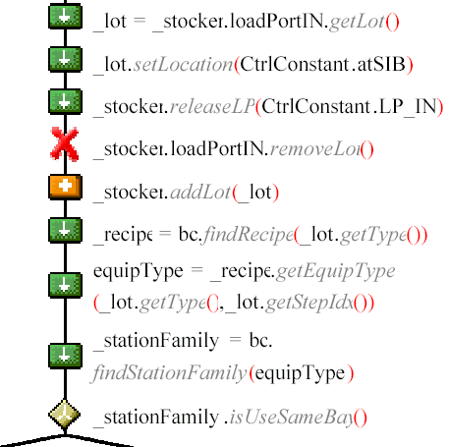
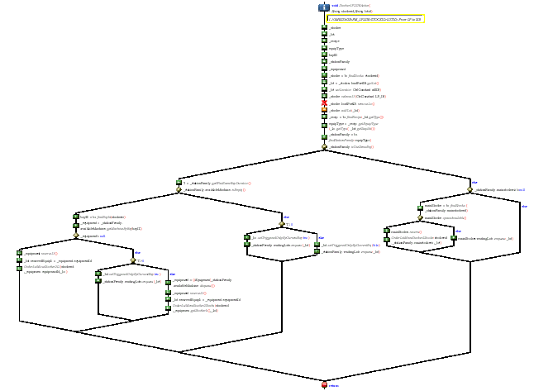
Wafer Fab: Flow Diagram

Slide 25
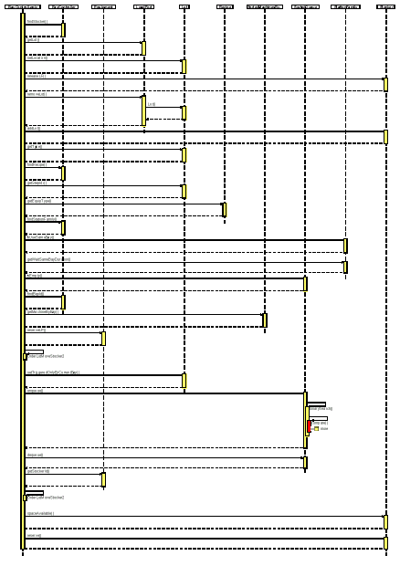
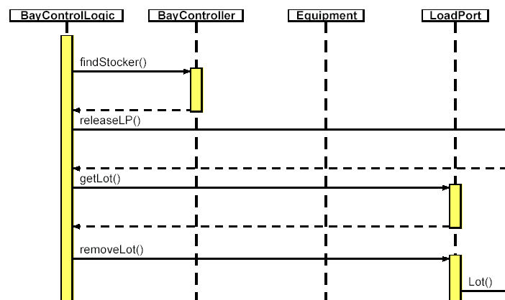
Wafer Fab: Sequence Diagram

Slide 26
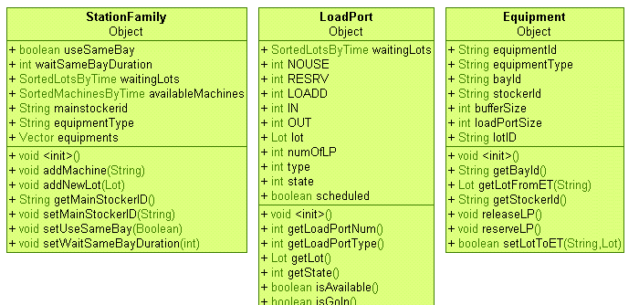
Wafer Fab: Class Diagram

Slide 27
--

Slide 28
Quote of the Day
Optimist: "The glass is half full."
Pessimist: "The glass is half empty."
Industrial Engineer: "That glass is twice as large as it needs to be."

