Slide 1


Slide 2
Relational Database Design Algorithms and Further Dependencies

Slide 3
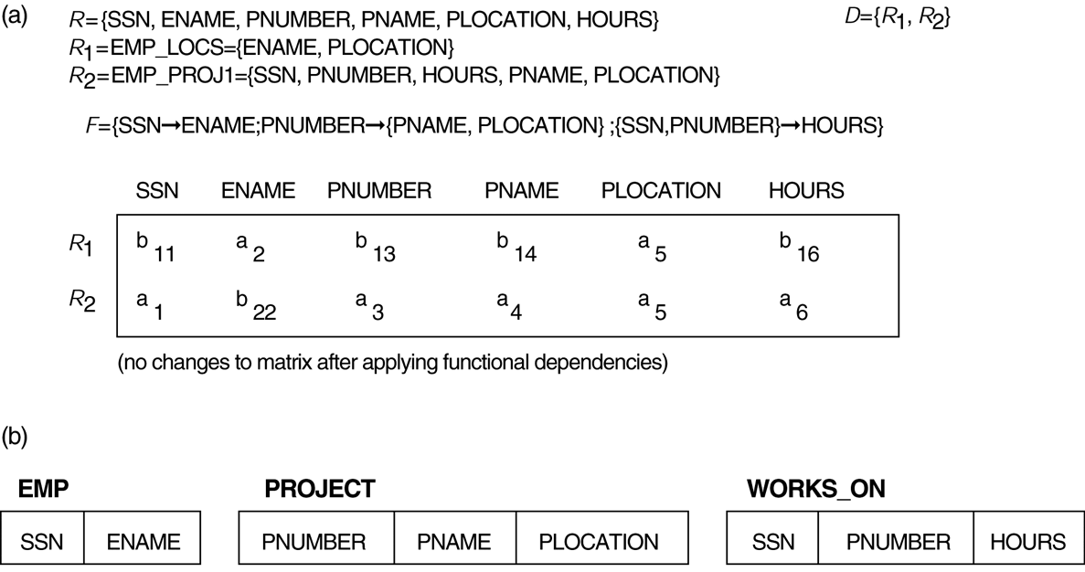
FIGURE 11.1
Lossless (nonadditive) join test for n-ary decompositions.
(a) Case 1: Decomposition of EMP_PROJ into EMP_PROJ1 and EMP_LOCS fails test. (b) A decomposition of EMP_PROJ that has the lossless join property.

Slide 4
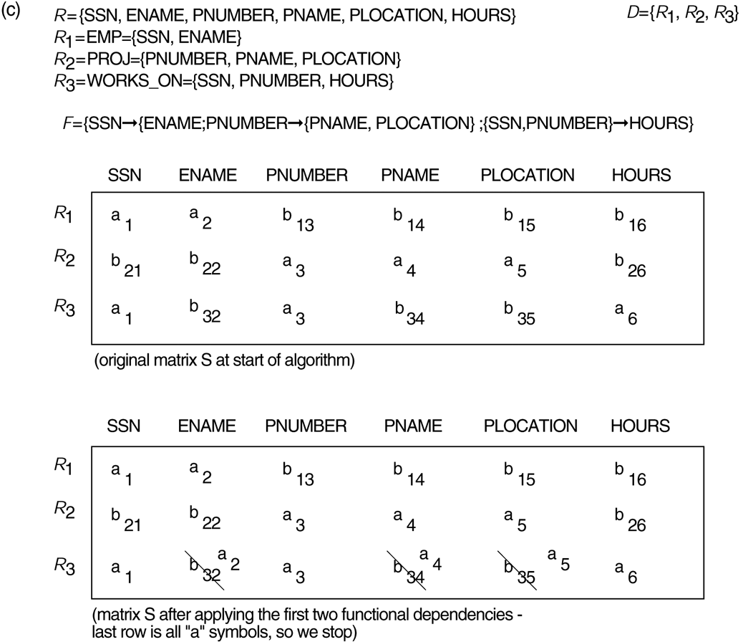
FIGURE 11.1 (continued)
Lossless (nonadditive) join test for n-ary decompositions.
(c) Case 2: Decomposition of EMP_PROJ into EMP, PROJECT, and WORKS_ON satisfies test.

Slide 5
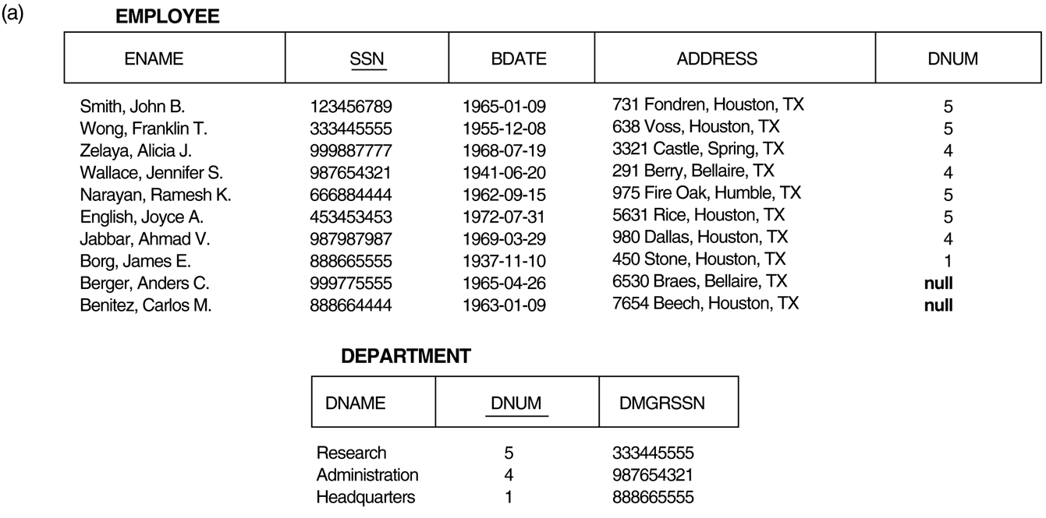
FIGURE 11.2
Issues with null-value joins. (a) Some EMPLOYEE tuples have null for the join attribute DNUM.

Slide 6
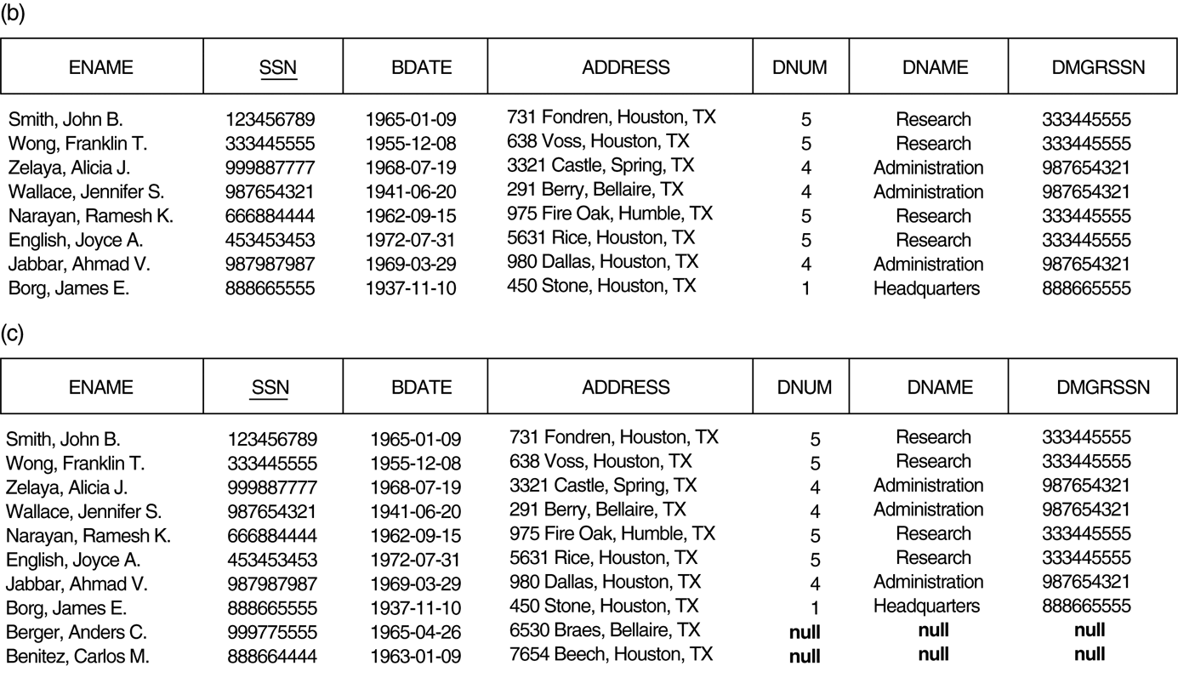
FIGURE 11.2 (continued)
Issues with null-value joins. (b) Result of applying NATURAL JOIN to the EMPLOYEE and DEPARTMENT relations. (c) Result of applying LEFT OUTER JOIN to EMPLOYEE and DEPARTMENT.

Slide 7
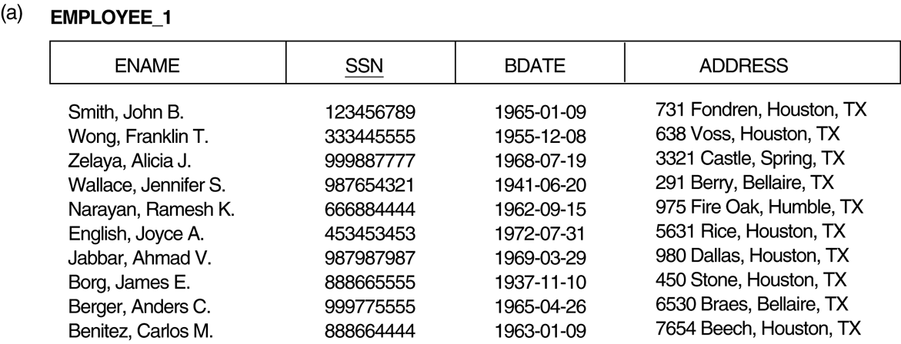
FIGURE 11.3
The “dangling tuple” problem. (a) The relation EMPLOYEE_1 (includes all attributes of EMPLOYEE from frigure 11.2a except DNUM).

Slide 8
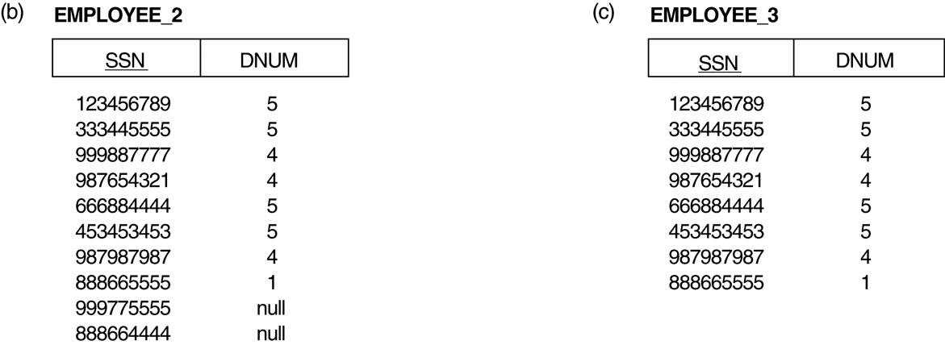
FIGURE 11.3 (continued)
The “dangling tuple” problem. (b) The relation EMPLOYEE_2 (includes DNUM attribute with null values). (c) The relation EMPLOYEE_3 (includes DNUM attribute but does not include tuples for which DNUM has null values).

Slide 9
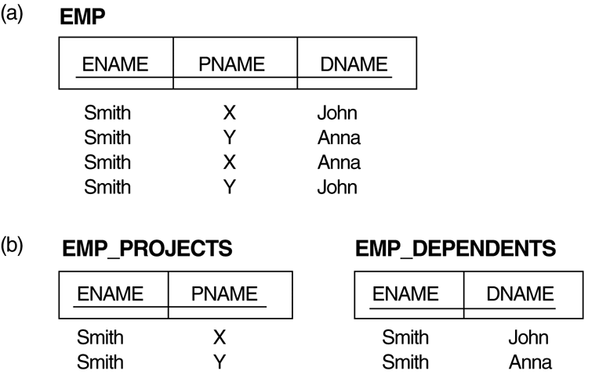
FIGURE 11.4
Fourth and fifth normal forms. (a) The EMP relation with two MVDs: ENAME ⇒ PNAME and ENAME ⇒ DNAME. (b) Decomposing the EMP relation into two 4NF relations EMP_PROJECTS and EMP_DEPENDENTS.

Slide 10
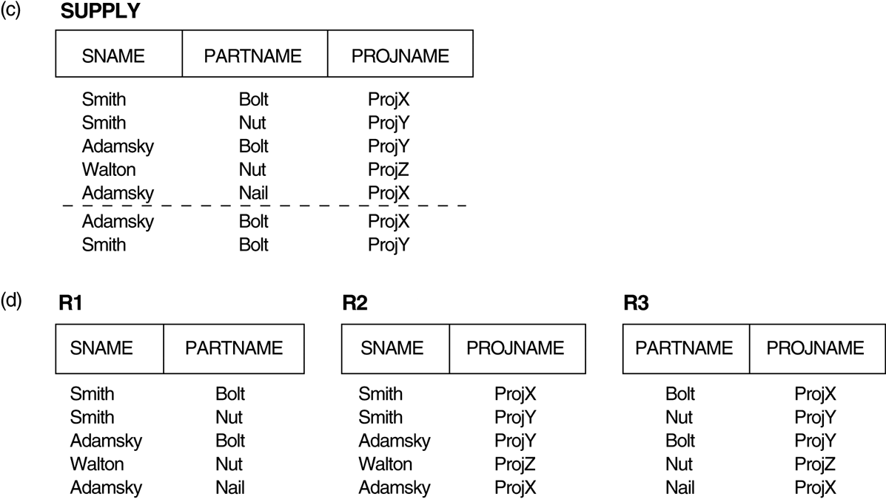
FIGURE 11.4 (continued)
Fourth and fifth normal forms. (c) The relation SUPPLY with no MVDs is in 4NF but not in 5NF if it has the JD(R1, R2, R3). (d) Decomposing the relation SUPPLY into the 5NF relations R1, R2, and R3.

Slide 11
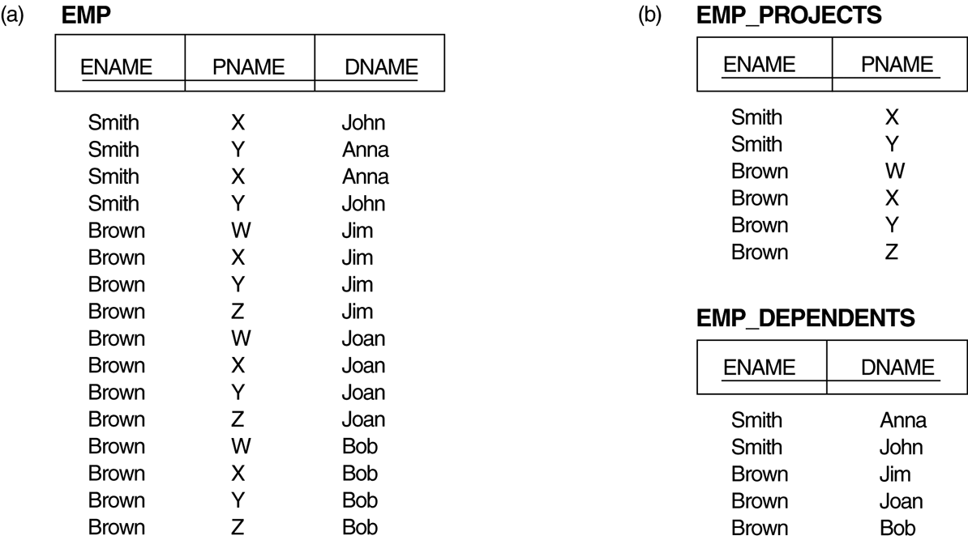
FIGURE 11.5
Decomposing a relation state of EMP that is not in 4NF. (a) EMP relation with additional tuples. (b) Two corresponding 4NF relations EMP_PROJECTS and EMP_DEPENDENTS.

Slide 12
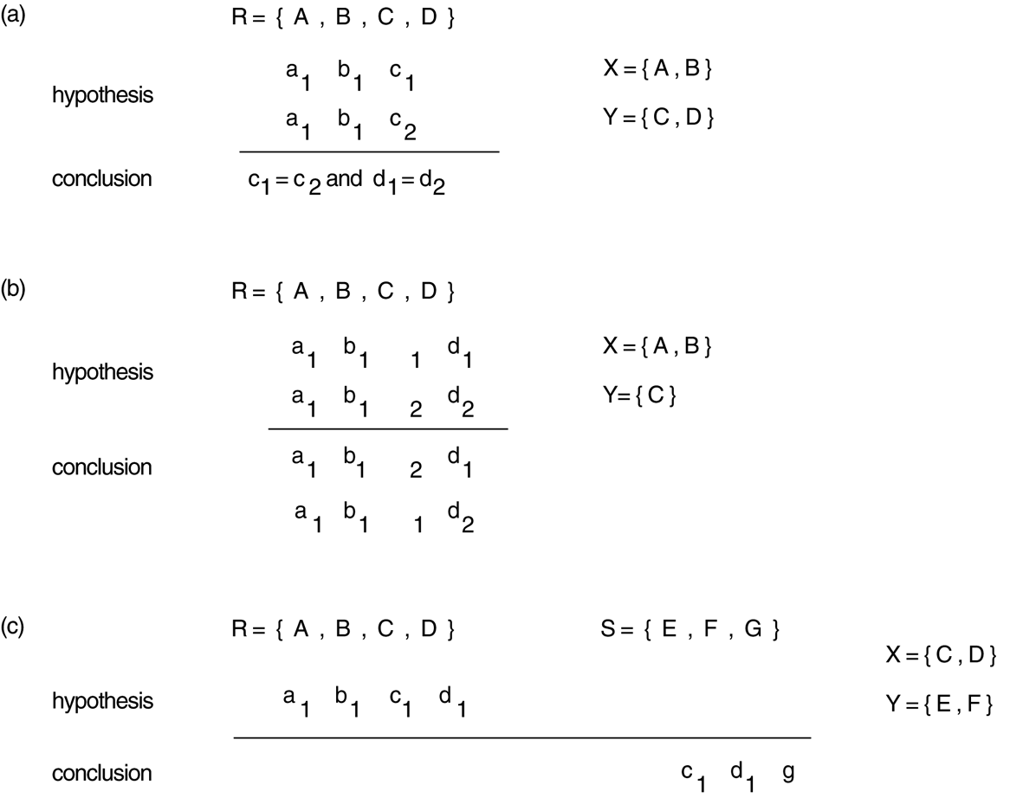
FIGURE 11.6
Templates for some common types of dependencies.
(a) Template for functional dependency X → Y. (b) Template for the multivalued dependency X ⇒ Y . (c) Template for the inclusion dependency R.X < S.Y.

Slide 13
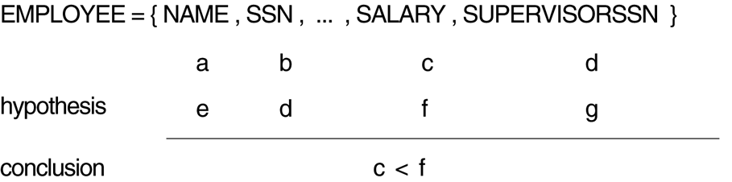
FIGURE 11.7
Templates for the constraint that an employee’s salary must be less than the supervisor’s salary.

Slide 14
A simpler example for 5NF
A | B | C
1 | 2 | X
Y | 2 | 3
1 | Z | 3
1 | 2 | 3

