Slide 1
CS 245: Database System Principles
Notes 02: Hardware
Hector Garcia-Molina
CS 245
Notes 2

Slide 2
Outline
Hardware: Disks
Access Times
Example - Megatron 747
Optimizations
Other Topics:
  Storage costs
  Using secondary storage
  Disk failures
CS 245
Notes 2

Slide 3
Hardware
DBMS
Data Storage
CS 245
Notes 2

Slide 4
P
Typical
Computer
...
...
M
C
Secondary
Storage
CS 245
Notes 2

Slide 5
Processor
Fast, slow, reduced instruction set,
with cache, pipelined…
Speed: 100 → 500 → 1000 MIPS
Memory
Fast, slow, non-volatile, read-only,…
Access time: 10⁻⁶ → 10⁻⁹ sec.
1 μs → 1 ns
CS 245
Notes 2

Slide 6
Secondary storage
Many flavors:
- Disk: Floppy (hard, soft)
Removable Packs
Winchester
SSD disks
Optical, CD-ROM…
Arrays
- Tape Reel, cartridge
Robots
CS 245
Notes 2

Slide 7
Focus on: “Typical Disk”
…
Terms: Platter, Head, Actuator
Cylinder, Track
Sector (physical),
Block (logical), Gap
CS 245
Notes 2

Slide 8
Top View
CS 245
Notes 2

Slide 9
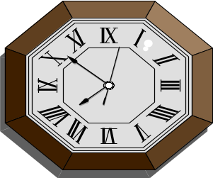
Disk Access Time
I want
block X
block x
in memory
?
CS 245
Notes 2

Slide 10
Time = Seek Time +
Rotational Delay +
Transfer Time +
Other
CS 245
Notes 2

Slide 11
Seek Time
3 or 5x
Time
x
1
N
Cylinders Traveled
CS 245
Notes 2

Slide 12
Average Random Seek Time
N
N
∑ ∑ SEEKTIME (i → j)
S =
N(N-1)
i=1
j=1
j≠i
CS 245
Notes 2

Slide 13
Average Random Seek Time
N
N
∑ ∑ SEEKTIME (i → j)
S =
N(N-1)
i=1
j=1
j≠i
“Typical” S: 10 ms → 40 ms
CS 245
Notes 2

Slide 14
Typical Seek Time
Ranges from
  4ms for high end drives
  15ms for mobile devices
Typical SSD: ranges from
  0.08ms
  0.16ms
Source: Wikipedia, "Hard disk drive performance characteristics"
CS 245
Notes 2

Slide 15
Rotational Delay
Head Here
Block I Want
CS 245
Notes 2

Slide 16
Average Rotational Delay
R = 1/2 revolution
R=0 for SSDs
Typical HDD figures
HDD Spindle [rpm] | Average rotational latency [ms]
4,200 | 7.14
5,400 | 5.56
7,200 | 4.17
10,000 | 3.00
15,000 | 2.00
Source: Wikipedia, "Hard disk drive performance characteristics"
CS 245
Notes 2

Slide 17
Transfer Rate: t
value of t ranges from
  up to 1000 Mbit/sec
  432 Mbit/sec 12x Blu-Ray disk
  1.23 Mbits/sec 1x CD
  for SSDs, limited by interface
  e.g., SATA 3000 Mbit/s
transfer time: block size
t
CS 245
Notes 2

Slide 18
Other Delays
CPU time to issue I/O
Contention for controller
Contention for bus, memory
CS 245
Notes 2

Slide 19
Other Delays
CPU time to issue I/O
Contention for controller
Contention for bus, memory
“Typical” Value: 0
CS 245
Notes 2

Slide 20
So far: Random Block Access
What about: Reading “Next” block?
CS 245
Notes 2

Slide 21
If we do things right (e.g., Double Buffer, Stagger Blocks…)
Time to get = Block Size + Negligible
block t
- skip gap
- switch track
- once in a while,
next cylinder
CS 245
Notes 2

Slide 22
Rule of Random I/O: Expensive
Thumb Sequential I/O: Much less
Ex: 1 KB Block
        Random I/O: ∼ 10 ms.
        Sequential I/O: ∼ <1 ms.
CS 245
Notes 2

Slide 23
Cost for Writing similar to Reading
…. unless we want to verify!
need to add (full) rotation + Block size
t
CS 245
Notes 2

Slide 24
To Modify a Block?
CS 245
Notes 2

Slide 25
To Modify a Block?
To Modify Block:
(a) Read Block
(b) Modify in Memory
(c) Write Block
[(d) Verify?]
CS 245
Notes 2

Slide 26
Block Address:
Physical Device
Cylinder #
Surface #
Sector
CS 245
Notes 2

Slide 27
Complication: Bad Blocks
Messy to handle
May map via software to
  integer sequence
  1
  2
  . Map Actual Block Addresses
  .
  m
CS 245
Notes 2

Slide 28
An Example
Megatron 747 Disk (old)
3.5 in diameter
3600 RPM
1 surface
16 MB usable capacity (16 X 2²⁰)
128 cylinders
seek time: average = 25 ms.
        adjacent cyl = 5 ms.
CS 245
Notes 2

Slide 29
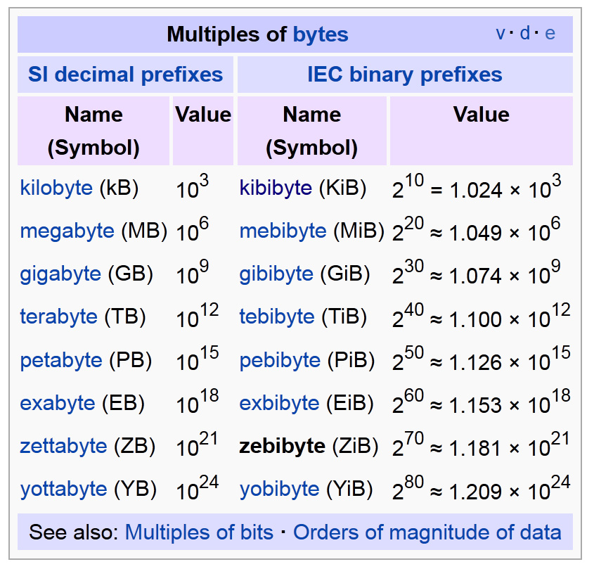
Kibibytes
1 kibibyte = 2¹⁰ bytes = 1024 bytes.
from
Wikipedia
CS 245
Notes 2

Slide 30
1 KB blocks = sectors
10% overhead between blocks
capacity = 16 MB = (2²⁰)16 = 2²⁴
# cylinders = 128 = 2⁷
bytes/cyl = 2²⁴/2⁷ = 2¹⁷ = 128 KB
blocks/cyl = 128 KB / 1 KB = 128
CS 245
Notes 2

Slide 31
3600 RPM 60 revolutions / sec
1 rev. = 16.66 msec.
One track:
...
CS 245
Notes 2

Slide 32
3600 RPM 60 revolutions / sec
1 rev. = 16.66 msec.
One track:
...
Time over useful data:(16.66)(0.9)=14.99 ms.
Time over gaps: (16.66)(0.1) = 1.66 ms.
Transfer time 1 block = 14.99/128=0.117 ms.
Trans. time 1 block+gap=16.66/128=0.13ms.
CS 245
Notes 2

Slide 33
Burst Bandwith
1 KB in 0.117 ms.
BB = 1/0.117 = 8.54 KB/ms.
or
BB =8.54KB/ms x 1000 ms/1sec x 1MB/1024KB
= 8540/1024 = 8.33 MB/sec
CS 245
Notes 2

Slide 34
Sustained bandwith (over track)
128 KB in 16.66 ms.
SB = 128/16.66 = 7.68 KB/ms
or
SB = 7.68 x 1000/1024 = 7.50 MB/sec.
CS 245
Notes 2

Slide 35
T1 = Time to read one random block
T1 = seek + rotational delay + TT
= 25 + (16.66/2) + .117 = 33.45 ms.
CS 245
Notes 2

Slide 36
Suppose OS deals with 4 KB blocks
...
1
2
3
4
1 block
T4 = 25 + (16.66/2) + (.117) x 1
+ (.130) X 3 = 33.83 ms
[Compare to T1 = 33.45 ms]
CS 245
Notes 2

Slide 37
TT = Time to read a full track
(start at any block)
TT = 25 + (0.130/2) + 16.66* = 41.73 ms
to get to first block
* Actually, a bit less; do not have to read last gap.
CS 245
Notes 2

Slide 38
The NEW Megatron 747 (Example 2.1 book)
8 Surfaces, 3.5 Inch diameter
  outer 1 inch used
2¹³ = 8192 Tracks/surface
256 Sectors/track
2⁹ = 512 Bytes/sector
CS 245
Notes 2

Slide 39
8 GB Disk
If all tracks have 256 sectors
  Outermost density: 100,000 bits/inch
  Inner density: 250,000 bits/inch
1
.
CS 245
Notes 2

Slide 40
Outer third of tracks: 320 sectors
Middle third of tracks: 256
Inner third of tracks: 192
Density: 114,000 → 182,000 bits/inch
CS 245
Notes 2

Slide 41
Timing for new Megatron 747 (Ex 2.3)
Time to read 4096-byte block:
  MIN: 0.5 ms
  MAX: 33.5 ms
  AVE: 14.8 ms
CS 245
Notes 2

Slide 42
Outline
Hardware: Disks
Access Times
Example: Megatron 747
Optimizations
Other Topics
  Storage Costs
  Using Secondary Storage
  Disk Failures
here
CS 245
Notes 2

Slide 43
Optimizations (in controller or O.S.)
Disk Scheduling Algorithms
  e.g., elevator algorithm
Track (or larger) Buffer
Pre-fetch
Arrays
Mirrored Disks
On Disk Cache
CS 245
Notes 2

Slide 44
Double Buffering
Problem: Have a File
        Sequence of Blocks B1, B2
      Have a Program
        Process B1
        Process B2
        Process B3
...
CS 245
Notes 2

Slide 45
Single Buffer Solution
(1) Read B1 → Buffer
(2) Process Data in Buffer
(3) Read B2 → Buffer
(4) Process Data in Buffer ...
CS 245
Notes 2

Slide 46
Say P = time to process/block
R = time to read in 1 block
n = # blocks
Single buffer time = n(P+R)
CS 245
Notes 2

Slide 47
Double Buffering
process
Memory:
Disk:
A
B
C
D
E
F
G
CS 245
Notes 2

Slide 48
Double Buffering
process
Memory:
Disk:
A
B
A
B
C
D
E
F
G
done
CS 245
Notes 2

Slide 49
Double Buffering
process
Memory:
Disk:
C
B
A
A
B
C
D
E
F
G
done
CS 245
Notes 2

Slide 50
Double Buffering
process
process
Memory:
Disk:
C
B
A
B
A
A
B
C
D
E
F
G
done
done
CS 245
Notes 2

Slide 51
Say P ≥ R
P = Processing time/block
R = IO time/block
n = # blocks
What is processing time?
CS 245
Notes 2

Slide 52
Say P ≥ R
P = Processing time/block
R = IO time/block
n = # blocks
What is processing time?
Double buffering time = R + nP
Single buffering time = n(R+P)
CS 245
Notes 2

Slide 53
Disk Arrays
RAIDs (various flavors)
Block Striping
Mirrored
logically one disk
CS 245
Notes 2

Slide 54
On Disk Cache
P
...
...
M
C
cache
cache
CS 245
Notes 2

Slide 55
SSDs
Source: Reza Sadri,
STEC ("the SSD Company")
storage is block oriented
(not random access)
lots of errors
  e.g., write of one block may cause an error of nearby block
  e.g., a block can only be written a limited number of times
logic masks most issues
  e.g., using log structure
sequential writes improve throughput (less bookkeeping)
  latency for seq. writes = random writes
  performance seq. reads = random reads
interface
HDD or
other
on-device
logic
SSD
CS 245
Notes 2

Slide 56

Add slides on Flash disk
CS 245
Notes 2

Slide 57
Block Size Selection?
Big Block → Amortize I/O Cost
Unfortunately...
Big Block ⇒ Read in more useless stuff!
and takes longer to read
CS 245
Notes 2

Slide 58
Trend
Trend
As memory prices drop,
blocks get bigger ...
CS 245
Notes 2

Slide 59
Storage Cost
nearline
tape &
optical
disks
offline
tape
10¹⁵
10¹³
magnetic
optical
disks
10¹¹
electronic
secondary
online
tape
10⁹
typical capacity (bytes)
electronic
main
10⁷
from Gray & Reuter
10⁵
cache
10³
10⁻⁹
10⁻⁶
10⁻³
10⁻⁰
10³
access time (sec)
CS 245
Notes 2

Slide 60
Storage Cost
from Gray & Reuter
10⁴
cache
electronic
main
online
tape
10²
electronic
secondary
magnetic
optical
disks
dollars/MB
nearline
tape &
optical
disks
10⁰
10⁻²
offline
tape
10⁻⁴
10⁻⁹
10⁻⁶
10⁻³
10⁻⁰
10³
access time (sec)
CS 245
Notes 2

Slide 61
Using secondary storage effectively (Sec. 2.3)
Example: Sorting data on disk
Conclusion:
  I/O costs dominate
  Design algorithms to reduce I/O
Also: How big should blocks be?
CS 245
Notes 2

Slide 62
Five Minute Rule
THE 5 MINUTE RULE FOR TRADING MEMORY FOR DISC ACCESSES
Jim Gray & Franco Putzolu
May 1985
The Five Minute Rule, Ten Years Later
Goetz Graefe & Jim Gray
December 1997
CS 245
Notes 2

Slide 63
Five Minute Rule
Say a page is accessed every X seconds
CD = cost if we keep that page on disk
  $D = cost of disk unit
  I = numbers IOs that unit can perform
  In X seconds, unit can do XI IOs
  So CD = $D / XI
CS 245
Notes 2

Slide 64
Five Minute Rule
Say a page is accessed every X seconds
CM = cost if we keep that page on RAM
  $M = cost of 1 MB of RAM
  P = numbers of pages in 1 MB RAM
  So CM = $M / P
CS 245
Notes 2

Slide 65
Five Minute Rule
Say a page is accessed every X seconds
If CD is smaller than CM,
  keep page on disk
  else keep in memory
Break even point when CD = CM, or
$D P
I $M
X =
CS 245
Notes 2

Slide 66
Using ‘97 Numbers
P = 128 pages/MB (8KB pages)
I = 64 accesses/sec/disk
$D = 2000 dollars/disk (9GB + controller)
$M = 15 dollars/MB of DRAM
X = 266 seconds (about 5 minutes)
(did not change much from 85 to 97)
CS 245
Notes 2

Slide 67
Disk Failures (Sec 2.5)
Partial → Total
Intermittent → Permanent
CS 245
Notes 2

Slide 68
Coping with Disk Failures
Detection
  e.g. Checksum
Correction
  ⇒ Redundancy
CS 245
Notes 2

Slide 69
At what level do we cope?
Single Disk
  e.g., Error Correcting Codes
Disk Array
Logical
Physical
CS 245
Notes 2

Slide 70
Operating System e.g., Stable Storage
Logical Block Copy A Copy B
CS 245
Notes 2

Slide 71
Database System
e.g.,
Log
Current DB Last week’s DB
CS 245
Notes 2

Slide 72
Summary
Summary
Secondary storage, mainly disks
I/O times
I/Os should be avoided,
especially random ones…..
CS 245
Notes 2

Slide 73
Outline
Hardware: Disks
Access Times
Example: Megatron 747
Optimizations
Other Topics
  Storage Costs
  Using Secondary Storage
  Disk Failures
here
CS 245
Notes 2

