Slide 1
CS 245: Database System Principles
Notes 03: Disk Organization
Hector Garcia-Molina
CS 245
Notes 3

Slide 2
Topics for today
How to lay out data on disk
How to move it to memory
CS 245
Notes 3

Slide 3
What are the data items we want to store?
a salary
a name
a date
a picture
CS 245
Notes 3

Slide 4
What are the data items we want to store?
a salary
a name
a date
a picture
What we have available: Bytes
8
bits
CS 245
Notes 3

Slide 5
To represent:
Integer (short): 2 bytes
e.g., 35 is
00000000
00100011
Real, floating point
  n bits for mantissa, m for exponent….
CS 245
Notes 3

Slide 6
To represent:
Characters
→ various coding schemes suggested,
most popular is ascii
Example:
A: 1000001
a: 1100001
5: 0110101
LF: 0001010
CS 245
Notes 3

Slide 7
To represent:
Boolean
e.g., TRUE FALSE
1111 1111
0000 0000
Application specific
e.g., RED → 1 GREEN → 3
BLUE → 2 YELLOW → 4 …
CS 245
Notes 3

Slide 8
To represent:
Boolean
e.g., TRUE FALSE
1111 1111
0000 0000
Application specific
e.g., RED → 1 GREEN → 3
BLUE → 2 YELLOW → 4 …
Can we use less than 1 byte/code?
    Yes, but only if desperate...
CS 245
Notes 3

Slide 9
To represent:
Dates
e.g.: - Integer, # days since Jan 1, 1900
- 8 characters, YYYYMMDD
- 7 characters, YYYYDDD
(not YYMMDD! Why?)
Time
e.g. - Integer, seconds since midnight
- characters, HHMMSSFF
CS 245
Notes 3

Slide 10
To represent:
String of characters
  Null terminated
  e.g.,
  Length given
  e.g.,
  - Fixed length
c
a
t
3
c
a
t
CS 245
Notes 3

Slide 11
To represent:
Bag of bits
Length
Bits
CS 245
Notes 3

Slide 12
Key Point
Fixed length items
Variable length items
- usually length given at beginning
CS 245
Notes 3

Slide 13
Also
Type of an item: Tells us how to
interpret
(plus size if fixed)
CS 245
Notes 3

Slide 14
Overview
Data Items
Records
Blocks
Files
Memory
CS 245
Notes 3

Slide 15
Record - Collection of related data items (called FIELDS)
E.g.: Employee record:
name field,
salary field,
date-of-hire field, ...
CS 245
Notes 3

Slide 16
Types of records:
Main choices:
  FIXED vs VARIABLE FORMAT
  FIXED vs VARIABLE LENGTH
CS 245
Notes 3

Slide 17
Fixed format
A SCHEMA (not record) contains
following information
- # fields
- type of each field
- order in record
- meaning of each field
CS 245
Notes 3

Slide 18
Example: fixed format and length
Employee record
(1) E#, 2 byte integer
(2) E.name, 10 char. Schema
(3) Dept, 2 byte code
55
s m i t h
02
Records
83
j o n e s
01
CS 245
Notes 3

Slide 19
Variable format
Record itself contains format
“Self Describing”
CS 245
Notes 3

Slide 20
Example: variable format and length
2
# Fields
Code identifying
field as E#
Integer type
Code for Ename
String type
Length of str.
5
I
46
4
S
4
F
O
R
D
Field name codes could also be strings, i.e. TAGS
CS 245
Notes 3

Slide 21
Variable format useful for:
“sparse” records
repeating fields
evolving formats
But may waste space...
CS 245
Notes 3

Slide 22
EXAMPLE: var format record with
repeating fields
Employee → one or more → children
3
E_name: Fred
Child: Sally
Child: Tom
CS 245
Notes 3

Slide 23
Note: Repeating fields does not imply
- variable format, nor
- variable size
John
Sailing
Chess
--
CS 245
Notes 3

Slide 24
Note: Repeating fields does not imply
- variable format, nor
- variable size
John
Sailing
Chess
--
Key is to allocate maximum number of
repeating fields (if not used → null)
CS 245
Notes 3

Slide 25
Many variants between fixed - variable format:
Example: Include record type in record
record type record length
tells me what
to expect
(i.e. points to schema)
5
27
. . . .
CS 245
Notes 3

Slide 26
Record header - data at beginning that describes record
May contain:
- record type
- record length
- time stamp
- other stuff ...
CS 245
Notes 3

Slide 27
Exercise: How to store XML data?
<table>
<description> people on the fourth floor <\description>
<people>
<person>
<name> Alan <\name>
<age> 42 <\age>
<email> agb@abc.com <\email>
<\person>
<person>
<name> Sally <\name>
<age> 30 <\age>
<email> sally@abc.com <\email>
<\person>
<\people>
<\table>
from:
Data on the Web,
Abiteboul et al
CS 245
Notes 3

Slide 28
Other interesting issues:
Compression
  within record - e.g. code selection
  collection of records - e.g. find common patterns
Encryption
CS 245
Notes 3

Slide 29
Encrypting Records
new
record
r
trusted
processor
E(r)
dbms
E(r₁)
E(r₂)
E(r₃)
E(r₄)
...
CS 245
Notes 3

Slide 30
Encrypting Records
search
F(r)=x
trusted
processor
??
dbms
E(r₁)
E(r₂)
E(r₃)
E(r₄)
...
CS 245
Notes 3

Slide 31
Search Key in the Clear
search
k=2
trusted
processor
Q: k=2
dbms
A: [2, E(b₂)]
[1, E(b₁)]
[2, E(b₂)]
[3, E(b₃)]
[4, E(b₄)]
...
each record is [k,b]
store [k, E(b)]
can search for records with k=x
CS 245
Notes 3

Slide 32
Encrypt Key
search
k=2
trusted
processor
Q: k’=E(2)
dbms
A: [E(2), E(b₂)]
[E(1), E(b₁)]
[E(2), E(b₂)]
[E(3), E(b₃)]
[E(4), E(b₄)]
...
each record is [k,b]
store [E(k), E(b)]
can search for records with k=E(x)
CS 245
Notes 3

Slide 33
Issues
Hard to do range queries
Encryption not good
Better to use encryption that does not always generate same cyphertext
k
E(k, random)
k
E
D
simplification
CS 245
Notes 3

Slide 34
How Do We Search Now?
???
search
k=2
A: [E(2,dhe), E(b₂)]
[E(2, lkz), E(b₄)]
trusted
processor
Q: k’=E(2)
dbms
[E(1, abc), E(b₁)]
[E(2, dhe), E(b₂)]
[E(3, nft), E(b₃)]
[E(2, lkz), E(b₄)]
...
each record is [k,b]
store [E(k, rand), E(b)]
can search for records with k=E(x,???)?
CS 245
Notes 3

Slide 35
Solution?
Develop new decryption function:
D(f(k₁), E(k₂, rand)) is true if k₁=k₂
CS 245
Notes 3

Slide 36
Solution?
Develop new decryption function:
D(f(k₁), E(k₂, rand)) is true if k₁=k₂
Q: check if D(f(2),*) true
search
k=2
A: [E(2,dhe), E(b₂)]
[E(2, lkz), E(b₄)]
trusted
processor
dbms
[E(1, abc), E(b₁)]
[E(2, dhe), E(b₂)]
[E(3, nft), E(b₃)]
[E(2, lkz), E(b₄)]
...
CS 245
Notes 3

Slide 37
Issues?
Cannot do non-equality predicates
Hard to build indexes
CS 245
Notes 3

Slide 38
What are choices/issues with data compression?
Leaving search keys uncompressed not as bad
Larger compression units:
  better for compression efficiency
  worse for decompression overhead
Similar data compresses better
  compress columns?
CS 245
Notes 3

Slide 39
Next: placing records into blocks
blocks ...
a file
CS 245
Notes 3

Slide 40
Next: placing records into blocks
blocks ...
a file
assume fixed
length blocks
assume a single file (for now)
CS 245
Notes 3

Slide 41
Options for storing records in blocks:
(1) separating records
(2) spanned vs. unspanned
(3) sequencing
(4) indirection
CS 245
Notes 3

Slide 42
(1) Separating records
Block
(a) no need to separate - fixed size recs.
(b) special marker
(c) give record lengths (or offsets)
- within each record
- in block header
R1
R2
R3
CS 245
Notes 3

Slide 43
(2) Spanned vs. Unspanned
Unspanned: records must be within one block
block 1 block 2
...
Spanned
block 1 block 2 ...
R1
R2
R3
R4
R5
R1
R2
R3
(a)
R3
(b)
R4
R5
R6
R7
(a)
CS 245
Notes 3

Slide 44
With spanned records:
need indication need indication
of partial record of continuation
“pointer” to rest (+ from where?)
R1
R2
R3
(a)
R3
(b)
R4
R5
R6
R7
(a)
CS 245
Notes 3

Slide 45
Spanned vs. unspanned:
Unspanned is much simpler, but may waste space…
Spanned essential if
record size > block size
CS 245
Notes 3

Slide 46
(3) Sequencing
Ordering records in file (and block) by some key value
Sequential file ( ⇒ sequenced)
CS 245
Notes 3

Slide 47
Why sequencing?
Typically to make it possible to efficiently read records in order
(e.g., to do a merge-join — discussed later)
CS 245
Notes 3

Slide 48
Sequencing Options
(a) Next record physically contiguous
...
(b) Linked
R1
Next (R1)
R1
Next (R1)
CS 245
Notes 3

Slide 49
Sequencing Options
(c) Overflow area
Records
in sequence
R1
R2
R3
R4
R5
CS 245
Notes 3

Slide 50
Sequencing Options
(c) Overflow area
Records
in sequence
header
R1
R2.1
R2
R1.3
R3
R4.7
R4
R5
CS 245
Notes 3

Slide 51
(4) Indirection
How does one refer to records?
Rx
CS 245
Notes 3

Slide 52
(4) Indirection
How does one refer to records?
Rx
Many options:
Physical Indirect
CS 245
Notes 3

Slide 53
Purely Physical
Device ID
E.g., Record Cylinder #
Address = Track #
or ID Block #
Offset in block
Block ID
CS 245
Notes 3

Slide 54
Fully Indirect
E.g., Record ID is arbitrary bit string
map
rec ID
r address
a
Rec ID
Physical
addr.
CS 245
Notes 3

Slide 55
Tradeoff
Flexibility Cost
to move records of indirection
(for deletions, insertions)
CS 245
Notes 3

Slide 56
Physical Indirect
Many options
in between …
CS 245
Notes 3

Slide 57
Example: Indirection in block
Header
A block: Free space
R3
R4
R1 R2
CS 245
Notes 3

Slide 58
Block header - data at beginning that describes block
May contain:
- File ID (or RELATION or DB ID)
- This block ID
- Record directory
- Pointer to free space
- Type of block (e.g. contains recs type 4;
is overflow, …)
- Pointer to other blocks “like it”
- Timestamp ...
CS 245
Notes 3

Slide 59
Options for storing records in blocks:
(1) separating records
(2) spanned vs. unspanned
(3) sequencing
(4) indirection
CS 245
Notes 3

Slide 60
Case Study: salesforce.com
salesforce.com provides CRM services
salesforce customers are tenants
Tenants run apps and DBMS as service
tenant A
salesforce.com
CRM App
tenant B
data
tenant C
CS 245
Notes 3

Slide 61
Options for Hosting
Separate DBMS per tenant
One DBMS, separate tables per tenant
One DBMS, shared tables
CS 245
Notes 3

Slide 62
Tenants have similar data
customer A B C D E F
a1 b1 c1 d1 e1 -
a2 b2 c2 - e2 f2
tenant 1:
customer A B C D G
a3 b3 c2 - -
a1 b1 c1 - g1
a4 - - d1
tenant 2:
CS 245
Notes 3

Slide 63
salesforce.com solution
customer tenant A B C
1 a1 b1 c1
1 a2 b2 c2
2 a3 b3 c2
2 a1 b1 c1
fixed schema for
all tenants
cust-other tenant A f1 v1 f2 v2 ...
1 a1 D d1 E e1
1 a2 E e2 F f2
2 a1 G g1
3 a4 D d1
var schema for
all tenants
CS 245
Notes 3

Slide 64
Other Topics
(1) Insertion/Deletion
(2) Buffer Management
(3) Comparison of Schemes
CS 245
Notes 3

Slide 65
Deletion
Block
Rx
CS 245
Notes 3

Slide 66
Options:
(a) Immediately reclaim space
(b) Mark deleted
CS 245
Notes 3

Slide 67
Options:
(a) Immediately reclaim space
(b) Mark deleted
  May need chain of deleted records
(for re-use)
  Need a way to mark:
    special characters
    delete field
    in map
CS 245
Notes 3

Slide 68
As usual, many tradeoffs...
How expensive is to move valid record to free space for immediate reclaim?
How much space is wasted?
  e.g., deleted records, delete fields, free space chains,...
CS 245
Notes 3

Slide 69
Concern with deletions
Dangling pointers
R1
?
CS 245
Notes 3

Slide 70
Solution #1: Do not worry
CS 245
Notes 3

Slide 71
Solution #2: Tombstones
E.g., Leave “MARK” in map or old location
CS 245
Notes 3

Slide 72
Solution #2: Tombstones
E.g., Leave “MARK” in map or old location
Physical IDs
A block
This space This space can
never re-used be re-used
CS 245
Notes 3

Slide 73
Logical IDs
Solution #2: Tombstones
E.g., Leave “MARK” in map or old location
map
ID
LOC
Never reuse
ID 7788 nor
space in map...
7788
CS 245
Notes 3

Slide 74
Insert
Easy case: records not in sequence
→ Insert new record at end of file or in deleted slot
→ If records are variable size, not as easy...
CS 245
Notes 3

Slide 75
Insert
Hard case: records in sequence
→ If free space “close by”, not too bad...
→ Or use overflow idea...
CS 245
Notes 3

Slide 76
Interesting problems:
How much free space to leave in each block, track, cylinder?
How often do I reorganize file + overflow?
CS 245
Notes 3

Slide 77
Free
space
CS 245
Notes 3

Slide 78
Buffer Management
DB features needed
Why LRU may be bad Read
Pinned blocks Textbook!
Forced output
Double buffering
Swizzling
in Notes02
CS 245
Notes 3

Slide 79
Swizzling
Memory Disk
block 1
block 1
Rec A
block 2
CS 245
Notes 3

Slide 80
Swizzling
Memory Disk
block 1
block 1
block 2
Rec A
Rec A
block 2
CS 245
Notes 3

Slide 81
Row vs Column Store
So far we assumed that fields of a record are stored contiguously (row store)...
Another option is to store like fields together (column store)
CS 245
Notes 3

Slide 82
Row Store
Example: Order consists of
  id, cust, prod, store, price, date, qty
CS 245
Notes 3

Slide 83
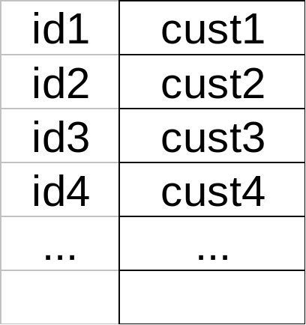
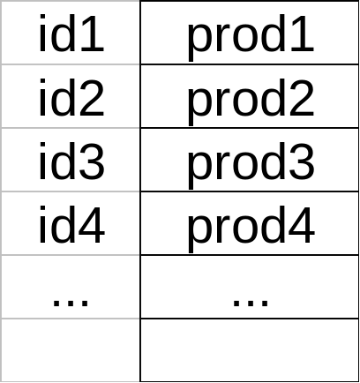
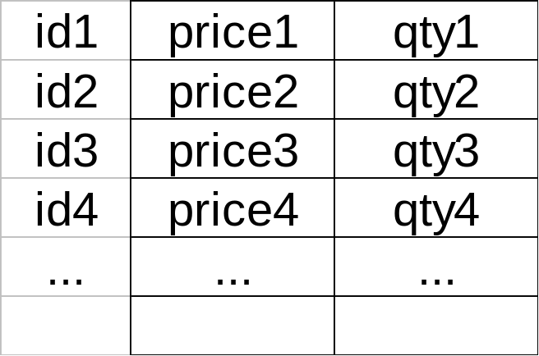
Column Store
Example: Order consists of
  id, cust, prod, store, price, date, qty
ids may or may not be stored explicitly
CS 245
Notes 3

Slide 84
Row vs Column Store
Advantages of Column Store
  more compact storage (fields need not start at byte boundaries)
  efficient reads on data mining operations
Advantages of Row Store
  writes (multiple fields of one record)more efficient
  efficient reads for record access (OLTP)
CS 245
Notes 3

Slide 85
Interesting paper to read:
Mike Stonebreaker, Elizabeth (Betty) O'Neil, Pat O’Neil, Xuedong Chen, et al. " C-Store: A Column-oriented DBMS," Presented at the 31st VLDB Conference, September 2005.
http://www.cs.umb.edu/%7Eponeil/
vldb05_cstore.pdf
CS 245
Notes 3

Slide 86
Comparison
There are 10,000,000 ways to organize my data on disk…
Which is right for me?
CS 245
Notes 3

Slide 87
Issues:
Flexibility Space Utilization
Complexity Performance
CS 245
Notes 3

Slide 88
To evaluate a given strategy, compute following parameters:
-> space used for expected data
-> expected time to
- fetch record given key
- fetch record with next key
- insert record
- append record
- delete record
- update record
- read all file
- reorganize file
CS 245
Notes 3

Slide 89
Example
How would you design Megatron 3000 storage system? (for a relational DB, low end)
  Variable length records?
  Spanned?
  What data types?
  Fixed format?
  Record IDs ?
  Sequencing?
  How to handle deletions?
CS 245
Notes 3

Slide 90
Summary
How to lay out data on disk
Data Items
Records
Blocks
Files
Memory
DBMS
CS 245
Notes 3

Slide 91
Next
How to find a record quickly,
given a key
CS 245
Notes 3

