Slide 1


Slide 2
Chapter 19
Database Recovery Techniques
Copyright © 2004 Pearson Education, Inc.

Slide 3
Chapter 19 Outline
Databases Recovery
1 Purpose of Database Recovery
2 Types of Failure
3 Transaction Log
4 Data Updates
5 Data Caching
6 Transaction Roll-back (Undo) and Roll-Forward
7 Checkpointing
8 Recovery schemes
9 ARIES Recovery Scheme
10 Recovery in Multidatabase System

Slide 4
Database Recovery
1 Purpose of Database Recovery
    To bring the database into the last consistent state, which existed prior to the failure.
    To preserve transaction properties (Atomicity, Consistency, Isolation and Durability).
  Example: If the system crashes before a fund transfer transaction completes its execution, then either one or both accounts may have incorrect value. Thus, the database must be restored to the state before the transaction modified any of the accounts.

Slide 5
Database Recovery
2 Types of Failure
  The database may become unavailable for use due to
  Transaction failure: Transactions may fail because of incorrect input, deadlock, incorrect synchronization.
  System failure: System may fail because of addressing error, application error, operating system fault, RAM failure, etc.
  Media failure: Disk head crash, power disruption, etc.

Slide 6
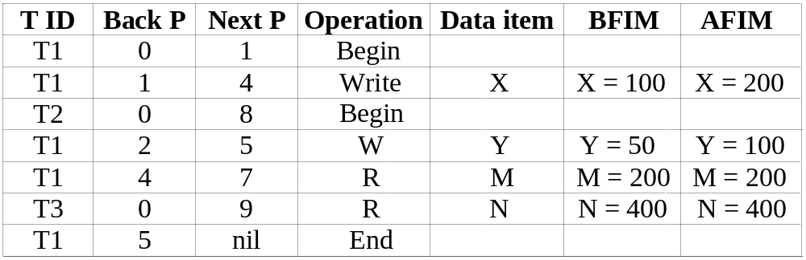
Database Recovery
3 Transaction Log
  For recovery from any type of failure data values prior to modification (BFIM - BeFore Image) and the new value after modification (AFIM – AFter Image) are required. These values and other information is stored in a sequential file called Transaction log. A sample log is given below. Back P and Next P point to the previous and next log records of the same transaction.

Slide 7
Database Recovery
4 Data Update
  Immediate Update: As soon as a data item is modified in cache, the disk copy is updated.
  Deferred Update: All modified data items in the cache is written either after a transaction ends its execution or after a fixed number of transactions have completed their execution.
  Shadow update: The modified version of a data item does not overwrite its disk copy but is written at a separate disk location.
  In-place update: The disk version of the data item is overwritten by the cache version.

Slide 8
Database Recovery
5 Data Caching
  Data items to be modified are first stored into database cache by the Cache Manager (CM) and after modification they are flushed (written) to the disk. The flushing is controlled by Modified and Pin-Unpin bits.
  Pin-Unpin: Instructs the operating system not to flush the data item.
  Modified: Indicates the AFIM of the data item.

Slide 9
Database Recovery
6 Transaction Roll-back (Undo) and Roll-Forward (Redo)
  To maintain atomicity, a transaction’s operations are redone or undone.
  Undo: Restore all BFIMs on to disk (Remove all AFIMs).
  Redo: Restore all AFIMs on to disk.
  Database recovery is achieved either by performing only Undos or only Redos or by a combination of the two. These operations are recorded in the log as they happen.

Slide 10
Database Recovery
Roll-back
We show the process of roll-back with the help of the following three transactions T1, and T2 and T3.
  T1 T2 T3
  read_item (A) read_item (B) read_item (C)
  read_item (D) write_item (B) write_item (B)
  write_item (D) read_item (D) read_item (A)
  write_item (A) write_item (A)

Slide 11
Database Recovery
Roll-back: One execution of T1, T2 and T3 as recorded in the log.
A B C D
30 15 40 20
  [start_transaction, T3]
  [read_item, T3, C]
  * [write_item, T3, B, 15, 12] 12
  [start_transaction,T2]
  [read_item, T2, B]
  ** [write_item, T2, B, 12, 18] 18
  [start_transaction,T1]
  [read_item, T1, A]
  [read_item, T1, D]
  [write_item, T1, D, 20, 25] 25
  [read_item, T2, D]
  ** [write_item, T2, D, 25, 26] 26
  [read_item, T3, A]
  ---- system crash ----
  * T3 is rolled back because it did not reach its commit point.
  ** T2 is rolled back because it reads the value of item B written by T3.

Slide 12
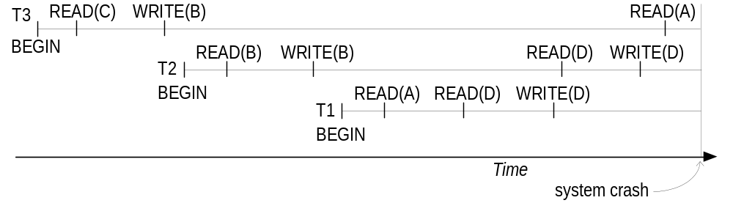
Database Recovery
Roll-back: One execution of T1, T2 and T3 as recorded in the log.
Illustrating cascading roll-back

Slide 13
Database Recovery
Write-Ahead Logging
  When in-place update (immediate or deferred) is used then log is necessary for recovery and it must be available to recovery manager. This is achieved by Write-Ahead Logging (WAL) protocol. WAL states that
  For Undo: Before a data item’s AFIM is flushed to the database disk (overwriting the BFIM) its BFIM must be written to the log and the log must be saved on a stable store (log disk).
  For Redo: Before a transaction executes its commit operation, all its AFIMs must be written to the log and the log must be saved on a stable store.

Slide 14
Database Recovery
7 Checkpointing
  Time to time (randomly or under some criteria) the database flushes its buffer to database disk to minimize the task of recovery. The following steps defines a checkpoint operation:
  Suspend execution of transactions temporarily.
  Force write modified buffer data to disk.
  Write a [checkpoint] record to the log, save the log to disk.
  Resume normal transaction execution.
  During recovery redo or undo is required to transactions appearing after [checkpoint] record.

Slide 15
Database Recovery
8 Recovery Scheme
Deferred Update (No Undo/Redo)
  The data update goes as follows:
  A set of transactions records their updates in the log.
  At commit point under WAL scheme these updates are saved on database disk.
After reboot from a failure the log is used to redo all the transactions affected by this failure. No undo is required because no AFIM is flushed to the disk before a transaction commits.

Slide 16
Database Recovery
  Deferred Update in a single-user system
There is no concurrent data sharing in a single user system. The data update goes as follows:
  A set of transactions records their updates in the log.
  At commit point under WAL scheme these updates are saved on database disk.
After reboot from a failure the log is used to redo all the transactions affected by this failure. No undo is required because no AFIM is flushed to the disk before a transaction commits.

Slide 17
Database Recovery
  Deferred Update in a single-user system
(a) T1 T2
  read_item (A) read_item (B)
  read_item (D) write_item (B)
  write_item (D) read_item (D)
  write_item (A)
(b)
  [start_transaction, T1]
  [write_item, T1, D, 20]
  [commit T1]
  [start_transaction, T1]
  [write_item, T2, B, 10]
  [write_item, T2, D, 25] ← system crash
  The [write_item, …] operations of T1 are redone.
  T2 log entries are ignored by the recovery manager.

Slide 18
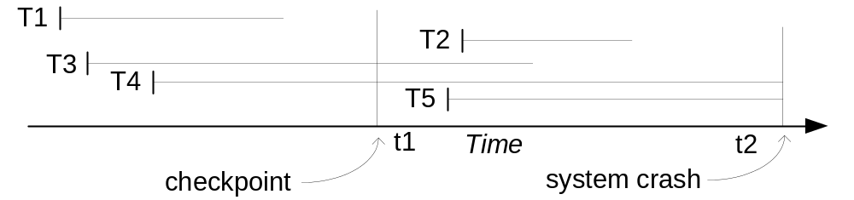
Database Recovery
  Deferred Update with concurrent users
This environment requires some concurrency control mechanism to guarantee isolation property of transactions. In a system recovery transactions which were recorded in the log after the last checkpoint were redone. The recovery manager may scan some of the transactions recorded before the checkpoint to get the AFIMs.
Recovery in a concurrent users environment.

Slide 19
Database Recovery
  Deferred Update with concurrent users
(a) T1 T2 T3 T4
  read_item (A) read_item (B) read_item (A) read_item (B)
  read_item (D) write_item (B) write_item (A) write_item (B)
  write_item (D) read_item (D) read_item (C) read_item (A)
  write_item (D) write_item (C) write_item (A)
  (b) [start_transaction, T1]
  [write_item, T1, D, 20]
  [commit, T1]
  [checkpoint]
  [start_transaction, T4]
  [write_item, T4, B, 15]
  [write_item, T4, A, 20]
  [commit, T4]
  [start_transaction T2]
  [write_item, T2, B, 12]
  [start_transaction, T3]
  [write_item, T3, A, 30]
  [write_item, T2, D, 25] ← system crash
  T2 and T3 are ignored because they did not reach their commit points.
  T4 is redone because its commit point is after the last checkpoint.

Slide 20
Database Recovery
  Deferred Update with concurrent users
Two tables are required for implementing this protocol:
Active table: All active transactions are entered in this table.
Commit table: Transactions to be committed are entered in this table.
During recovery, all transactions of the commit table are redone and all transactions of active tables are ignored since none of their AFIMs reached the database. It is possible that a commit table transaction may be redone twice but this does not create any inconsistency because of a redone is “idempotent”, that is, one redone for an AFIM is equivalent to multiple redone for the same AFIM.

Slide 21
Database Recovery
  Recovery Techniques Based on Immediate Update
  Undo/No-redo Algorithm
In this algorithm AFIMs of a transaction are flushed to the database disk under WAL before it commits. For this reason the recovery manager undoes all transactions during recovery. No transaction is redone. It is possible that a transaction might have completed execution and ready to commit but this transaction is also undone.

Slide 22
Database Recovery
  Recovery Techniques Based on Immediate Update
  Undo/Redo Algorithm (Single-user environment)
  Recovery schemes of this category apply undo and also redo for recovery. In a single-user environment no concurrency control is required but a log is maintained under WAL. Note that at any time there will be one transaction in the system and it will be either in the commit table or in the active table. The recovery manager performs:
  Undo of a transaction if it is in the active table.
  Redo of a transaction if it is in the commit table.

Slide 23
Database Recovery
  Recovery Techniques Based on Immediate Update
  Undo/Redo Algorithm (Concurrent execution)
  Recovery schemes of this category applies undo and also redo to recover the database from failure. In concurrent execution environment a concurrency control is required and log is maintained under WAL. Commit table records transactions to be committed and active table records active transactions. To minimize the work of the recovery manager checkpointing is used. The recovery performs:
  Undo of a transaction if it is in the active table.
  Redo of a transaction if it is in the commit table.

Slide 24
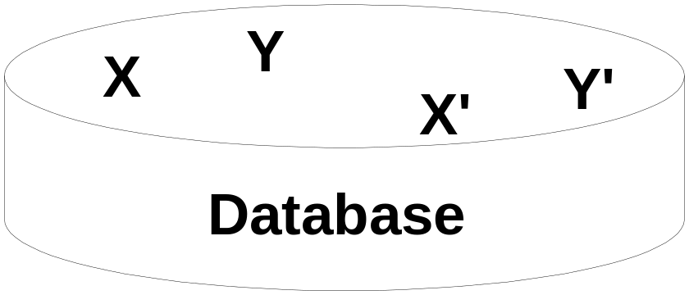
Database Recovery
  Shadow Paging
  The AFIM does not overwrite its BFIM but recorded at another place on the disk. Thus, at any time a data item has AFIM and BFIM (Shadow copy of the data item) at two different places on the disk.
X and Y: Shadow copies of data items
X` and Y`: Current copies of data items

Slide 25
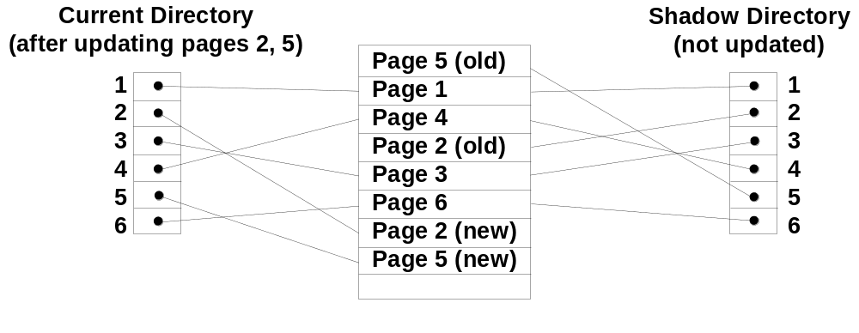
Database Recovery
  Shadow Paging
  To manage access of data items by concurrent transactions two directories (current and shadow) are used. The directory arrangement is illustrated below. Here a page is a data item.

