Slide 1
Optimization of Linear Recursive Queries: A Tutorial
Ordonez

Slide 2
Introduction
Recursion available in ANSI SQL
Graph algorithms; NP-completeness
Deductive databases and logic programming: datalog
More challenging query optimization
Syntax now available in most DBMSs

Slide 3
Directed Graphs
Consider G=(V,E)
A vertex in V is identified with i or j and i,j=1..n. An edge i,j has a direction
G may have cycles
G: adjacency list in table T
Transitive closure problem:
all vertices reachable from i

Slide 4
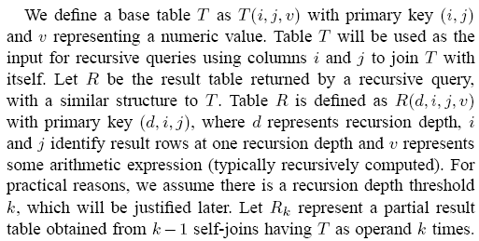
Definitions

Slide 5
Examples
V=cities,E=roads.
Is there some path from San Diego to NYC?: path from i to j?
shortest one?
V=employees, E=manager -> employee relationship
q1: all employees under i
q2: Is j supervised by i?
Bill of materials: The well-known part/subpart manufacturing DB

Slide 6
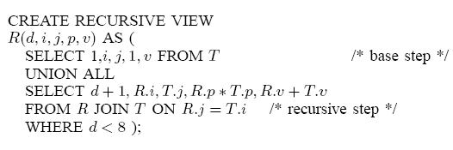
Recursive view R k: rec. depth n: graph size

Slide 7

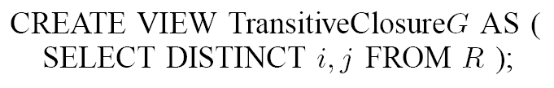
Transitive Closure: G+=(V,E’)

Slide 8


Power matrix

Slide 9
Technical details
Linear recursion
Inner joins
SELECTs must have same term types
No GROUP-BY, DISTINCT, HAVING, NOT IN, OUTER JOIN clauses inside R
Any SQL construct is valid on top of R
Recursive view can used as any table
Recursion depth k: loop with k-1 joins

Slide 10
Algorithms
Semi-naïve
Direct

Slide 11

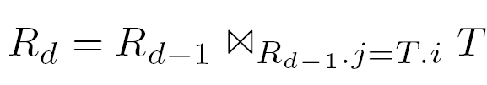



Semi-naive

Slide 12
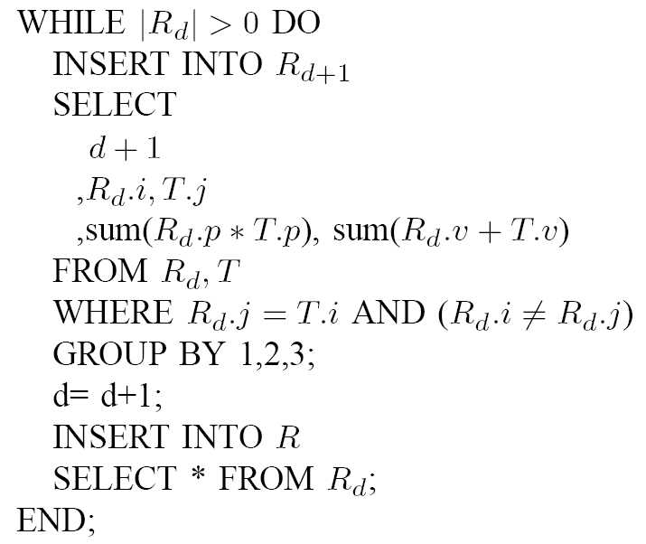
Semi-naïve SQL

Slide 13
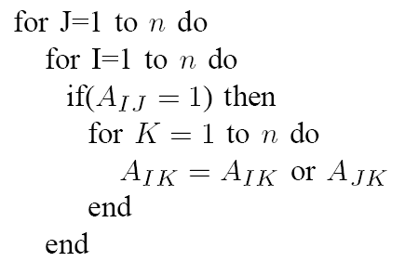
Direct
Binary matrix multiplication: TC

Slide 14
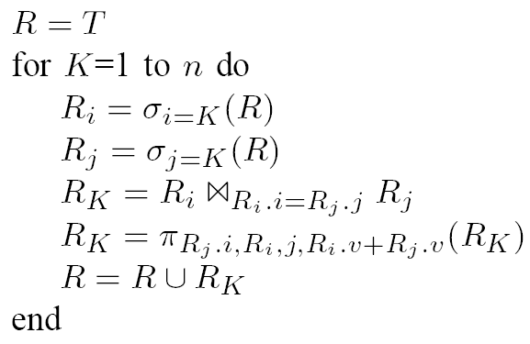
Direct

Slide 15
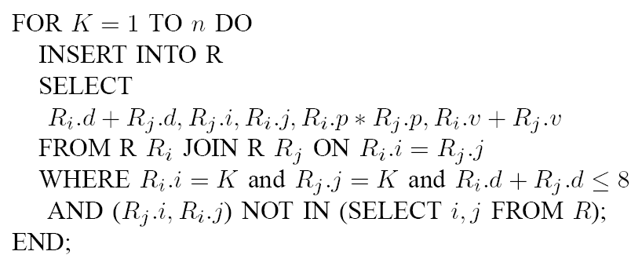
Direct SQL

Slide 16
Optimizations
Pushing aggregation
Early selection
External joins
Indexing

Slide 17
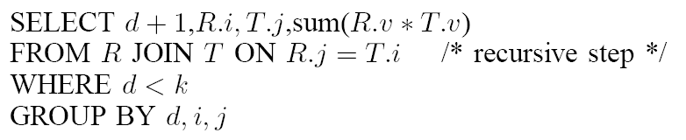
Pushing aggregation

Slide 18
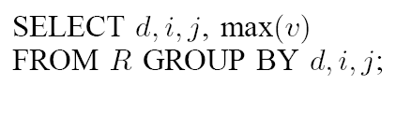
Pushing aggregation vertex

Slide 19
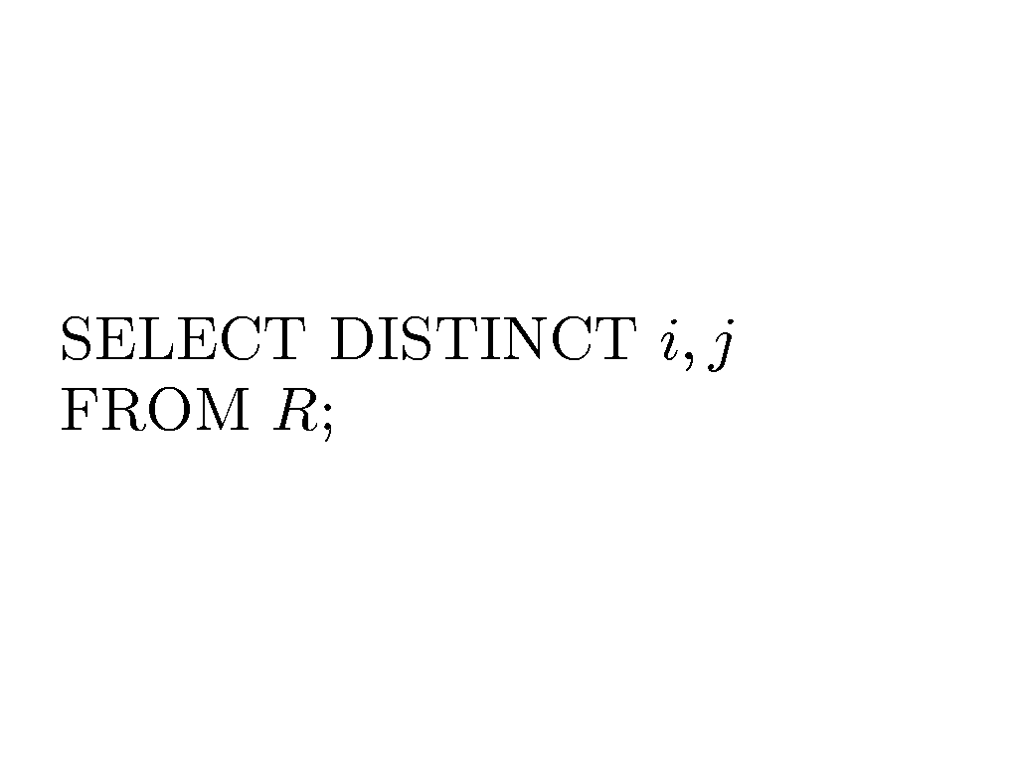
Pushing aggregation:
Using DISTINCT: many paths

Slide 20
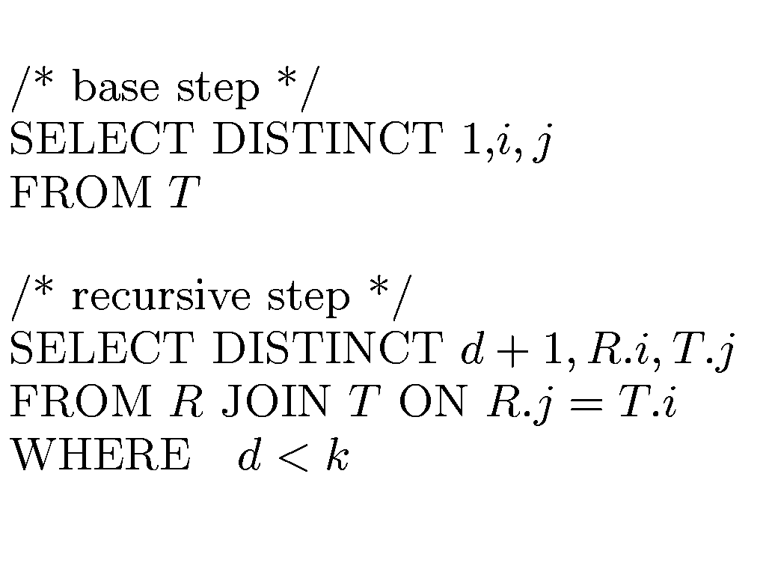
Eliminating duplicate rows

Slide 21
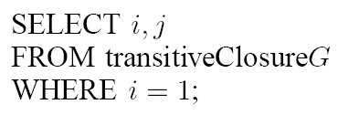
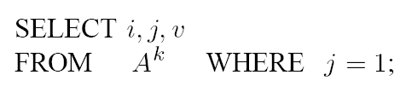
Row selection: WHERE clause

Slide 22
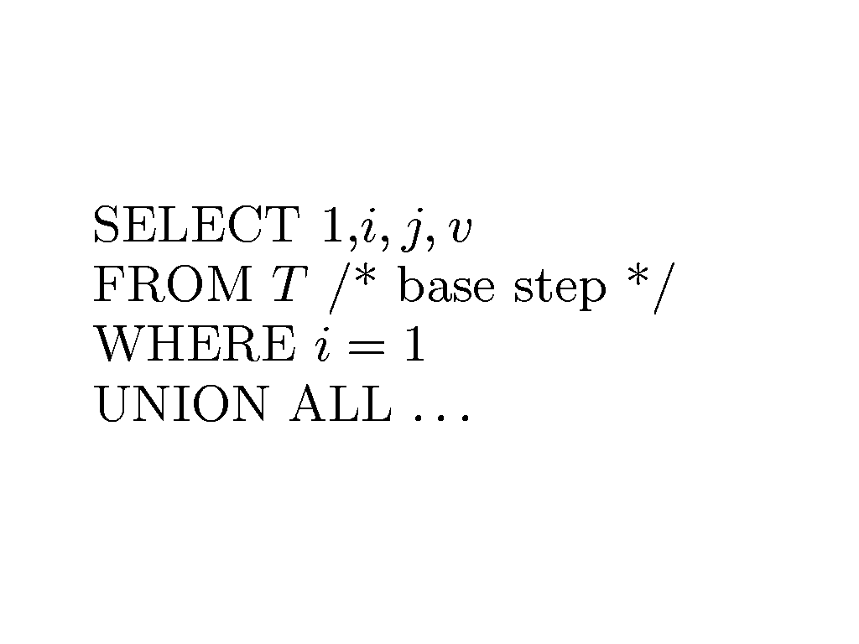
WHERE clause in base step

Slide 23
Issues with WHERE clauses
Incorrect to use a WHERE clause involving a join expression column in the recursive step
Infinite recursion: cycles
Monotonically increasing v OK
Recursion depth

Slide 24
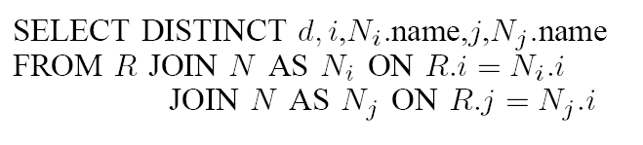
Non-recursive join

Slide 25
External join processing
Beginning
During recursion
End

Slide 26
Indexing
T is self-joined many times
R is appended many times
Subset of R at depth d-1 used at each recursive step d

Slide 27
Indexing schemes
Index on join expression:
  T is indexed on (i)
  R is indexed on (j)
Index on primary keys:
  T is indexed on (i,j)
  R is indexed on (d,i,j)

Slide 28
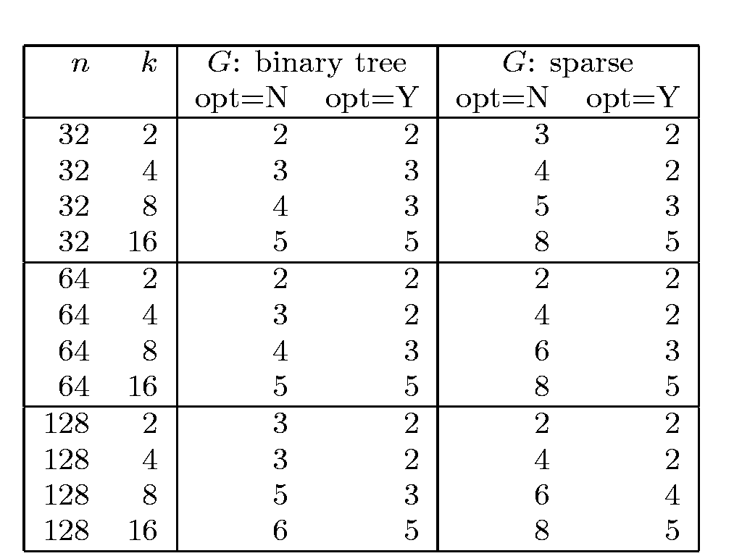
Impact of early row selection n: |V|, k=max recursion depth, times in secs

Slide 29
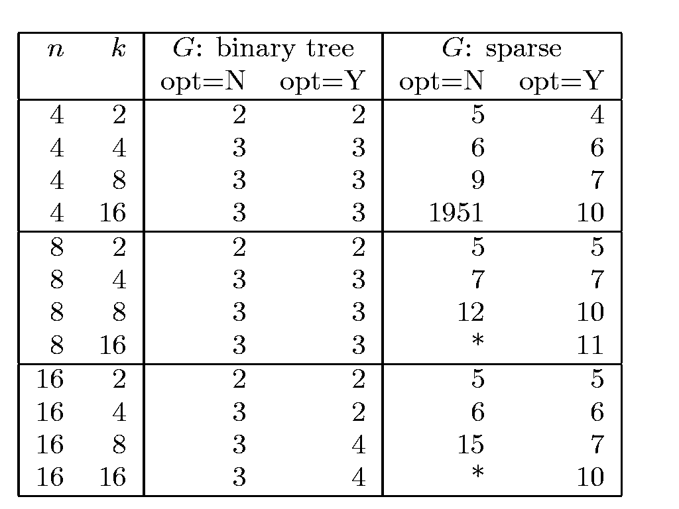
Impact of duplicate elimination n: |V|, k=max recursion depth, times secs

Slide 30
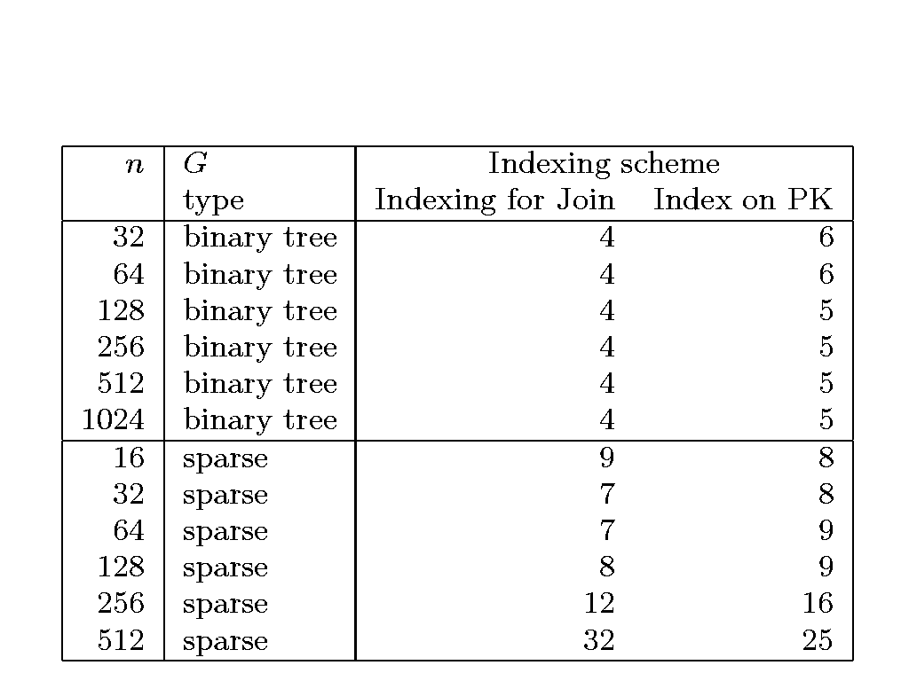
Indexing n: |V|, k=max recursion depth, times secs

Slide 31
Recommendations
Writing base step first
A wrong join expression may produce larger cartesian products than usual
Setting a maximum recursion depth k
Careful indexing

Slide 32
Conclusions
Constraints inside recursive view
Three optimizations: WHERE, DISTINCT, indexing
Max recursion depth
Graphs with cycles impact performance

