Slide 1
COSC 6340
Databases
Jehan-François Pâris
jfparis@uh.edu

Slide 2
Administrative details
Hours: MW 5:30-7:00 pm in SEC 202
Instructor: Jehan-François Pâris
Email: jfparis AT uh DOT edu
Office: 569 PGH
Telephone: 713-743-3341 (office hours)
Office hours: MW 4:30—5:00 and 7:10-7:40pm
Web page: www.cs.uh.edu/~paris
Twitter: jehanfrancois

Slide 3
Teaching Assistant
Yiqun Zhang
  Email: contact AT yzhang DOT us
  Office: PGH 575
  Office hours: MW 3:00 to 4:00PM

Slide 4
Topics to be covered (I)
Database design: ER model, relational model and algebra, normalization up to 5NF.
Internal subsystems of a relational DBMS: secondary storage, buffer management, indexing data structures, query optimizer, concurrency control, transaction processing, recovery.

Slide 5
Topics to be covered (II)
Advanced SQL programming: SPJ queries, aggregations, derived tables, pivoting, OLAP functions, recursive queries, UDFs, stored procedures.
Overview of security, cube and data mining techniques
Focus will be on implementation
of the relational DB model

Slide 6
Textbook
Ramez Elmasri and Shamkant B. Navathe. Fundamentals of Database Systems, Sixth Edition, Addison-Wesley Longman, Boston, MA, 2010
  Strongly recommended
Additional readings will be posted online
  Typically research papers.
  Accessing these papers from outside the UH domain may require a login (“cosc6340”) and a password to be given in class

Slide 7
Grading policy
Grade will be based on
  Two quizzes
  (50% of your grade)
  Two programming projects
  (50%)
People failing the projects or the quizzes will fail the course

Slide 8
The quizzes (I)
Will take place:
  Monday, March 9
  Monday, May 11 at 5:00 pm

Slide 9
The quizzes (II)
Will cover the materials covered during the past seven to eight weeks
  Last quiz will not be comprehensive
Will be closed-book
  Can bring a single two-sided sheet of notes

Slide 10
Hints for the quizzes
I like to ask
  Short problems
  Questions on advantages and disadvantages of specific solutions
Objective is to test that you can put to work the concepts you have learned

Slide 11
The projects (I)
Two projects
  Second project has a much higher weight than the first.
  Will be done by teams of two students:
    Team memberships will be assigned by instructor.
  Graded for correctness, efficiency and respect of good programming practices

Slide 12
The projects (II)
Late projects will be assessed a penalty of
5 points per day.
You will have a total of two grace days to be used at your discretion
You should drop the course if you cannot do the first project

Slide 13
Behaving in the classroom (I)
Students are expected to attend all lectures
  Could otherwise miss important announcements
People obviously immersed in non course-related activities such as browsing the web or playing solitaire will be asked to leave the classroom

Slide 14


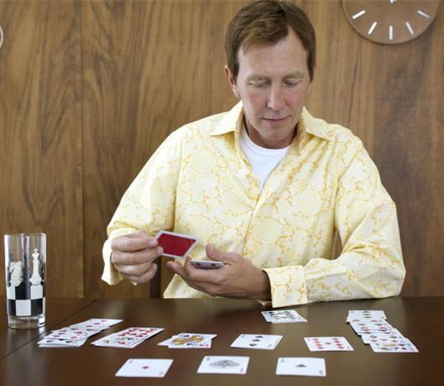
Behaving in the classroom (II)
X
X
X

Slide 15
Submitting your projects
In the manner to be announced by the TA

Slide 16
A reminder
Projects take more time than assignments

Slide 17
Academic honesty
No cheating or plagiarism will be tolerated in any quiz or project
What you turn in must be your own work
  If you include code from any source, you should mention it
The minimum penalty for any transgression will be an F grade for the course

Slide 18
You have
been warned!

Slide 19
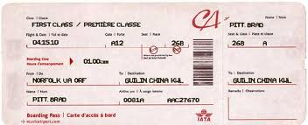
Unless you want to fly back home …
YOUR NAME
HOUSTON IAH
HOME TOWN
HOME TOWN
YOUR NAME

Slide 20
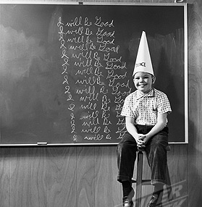
Your family will be so proud of you!

Slide 21
Timetable
First Project Due Early March
First Quiz Monday, March 9
Second Project Due Early May
Second Quiz Monday, May 11
at 5:00 pm

Slide 22
My last word
Please verify that your PeopleSoft account has your correct email address:
  I need it to get in touch with you

