Slide 1
Predict My Glucose
From personalized prediction to evidence-grounded explanation on AWS
Core idea
Meal photo + 7-day history
PMRF = the science
Personalized glucose prediction remains grounded in the trained multimodal model.
AWS = the product layer
Deploy the model, explain its output, retrieve evidence, and apply safety controls.
Goal for the mentor
Validate the simplest architecture that preserves scientific credibility and improves explainability.
PMRF personalized prediction
Bedrock explanation + medical evidence
Guardrails + grounded user report
Design principle
Predictive numbers stay in PMRF; Bedrock explains and grounds them.
Predict My Glucose · Mentor Discussion Rutgers Health Hack 2026 1

Slide 2
What we already have — and what AWS should add
Evidence first: the core model already works; AWS should improve deployment, safety, and explanation.
Current PMRF core
What we want AWS to add
• Meal photo + recent CGM + heart rate + 7-day history
• Personalized LightGBM + in-context transformer + ensemble
• SHAP / similar-meal explanations + 80% prediction interval
• No per-user retraining: personalization comes from profile, retrieval, and in-context history
• Model/API deployment and secure storage
• Bedrock explanation from structured PMRF/XAI outputs
• Curated medical RAG with citations and evidence support
• Guardrails from day one — not as a late add-on
• Optional meal GI/GL as explanation-only context for the hackathon
Evidence of predictive value
60-min glucose MAE: 20.2 mg/dL vs 27.5 population mean. Peak-rise MAE: 19.8 vs 28.2 mg/dL.
Privacy posture
Synthetic / de-identified data only; encrypted storage; minimize raw health data sent to the LLM.
Mentor focus: where does AWS materially improve deployment + grounded explanation without overengineering?
Predict My Glucose · Mentor Discussion Rutgers Health Hack 2026 2

Slide 3
Proposed AWS architecture
Clear data flow: storage and knowledge sources feed the backend / explanation layer; PMRF remains the prediction engine.
User / Web App
API Gateway
Backend API
PMRF Model
Amazon Bedrock
Guardrails
Supporting data & model layer
Amazon S3
meal photos · CGM · history
ECR + ECS/Fargate
or SageMaker endpoint
SHAP + similar meals
structured explanation features
Bedrock Knowledge Base
curated medical evidence
User report
citations + safety
Design principle
Numerical glucose predictions remain grounded in PMRF. Bedrock receives structured outputs / derived features plus retrieved evidence — not the raw longitudinal record when avoidable.
Personalization execution
No per-user LightGBM training job. /history builds profile + retrieval context; prediction is inference-time personalization.
Deployment constraint
Current prototype runs on CPU; target is sub-second PMRF inference before the LLM explanation step.
Predict My Glucose · Mentor Discussion Rutgers Health Hack 2026 3

Slide 4
Explainability becomes a core workflow
Separate predictive uncertainty from evidence support, and keep GI/GL explanation-only for the MVP.
Meal image
+ portion
Nutrition
estimate
PMRF
prediction
SHAP +
similar meals
Medical RAG
+ citations
Grounding /
evidence support
Guardrails
User report
Optional GI / GL context
food ID + portion → GI database → meal GI/GL
MVP scope rule
GI/GL helps explain the meal; it does NOT feed PMRF unless we retrain and revalidate later.
1 · What is predicted?
Trajectory · peak · time-to-peak · iAUC · 80% prediction interval
2 · Why is it predicted?
Meal composition · SHAP · similar meals · personal response history
3 · What may explain it?
Retrieved medical evidence + citations + grounding/evidence-support signal
Important distinction
PMRF uncertainty answers “how uncertain is the prediction?” Grounding/evidence support answers “how well is the explanation supported?”
Predict My Glucose · Mentor Discussion Rutgers Health Hack 2026 4

Slide 5
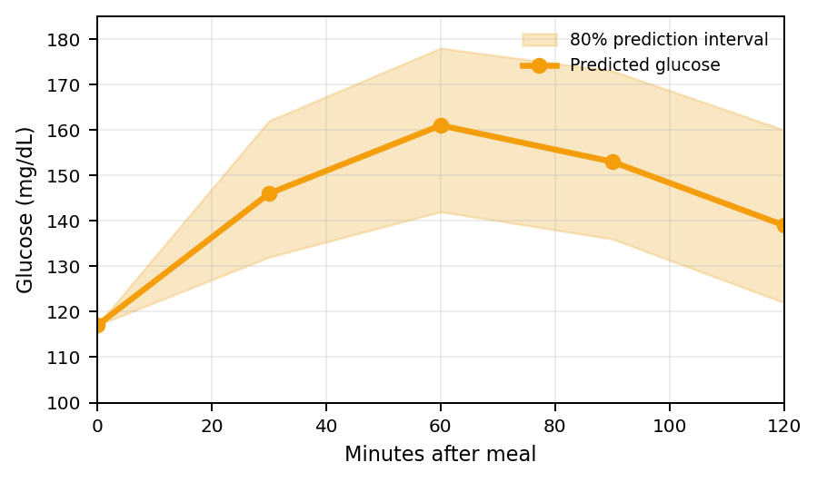
What the user could see
Illustrative mock-up: show uncertainty on the curve and evidence support on the explanation — not a black-box confidence label.
Predicted post-meal glucose
Why this response?
What drives it
Estimated moderate-high meal GL; carbohydrate amount is a major contributor.
Personal response
Your 7-day history suggests above-average carbohydrate sensitivity.
Physiological interpretation
The predicted prolonged elevation may be consistent with slower post-meal glucose recovery; research evidence is retrieved and cited.
Evidence support
0.76 · illustrative grounding score — not medical confidence
Peak 164
Rise +47
80% interval
Safety note
Decision support only; not diagnosis or medication advice.
Predict My Glucose · Mentor Discussion Rutgers Health Hack 2026 5

Slide 6
Hackathon MVP + questions for the mentor
Keep a working end-to-end demo first; then add the highest-value explainability layer.
MVP build order
Question 1 · Deployment
Given CPU inference, no per-user retraining, and a sub-second PMRF target, would you choose ECS/Fargate, Lambda, or SageMaker for this hackathon?
1
PMRF API + S3
Working predictor + secure data path
2
Frontend upload + curve
Show prediction + 80% interval
Question 2 · Grounded health explanation
What is the simplest Bedrock pattern for curated medical RAG + citations + grounding checks while minimizing sensitive data sent to the LLM?
3
Bedrock explanation + Guardrails
Convert XAI to user language safely
4
Curated medical RAG
Evidence + citations + grounding check
Question 3 · Scope
Is GI/GL useful as explanation-only context for the demo, or should we spend that time strengthening the medical evidence / explainability workflow?
5
GI/GL context — if time
Explanation-only; cut before medical RAG if needed
Decision rule
If time slips: keep PMRF → Bedrock + Guardrails → medical RAG; drop GI/GL first.
Predict My Glucose · Mentor Discussion Rutgers Health Hack 2026 6

