Slide 1

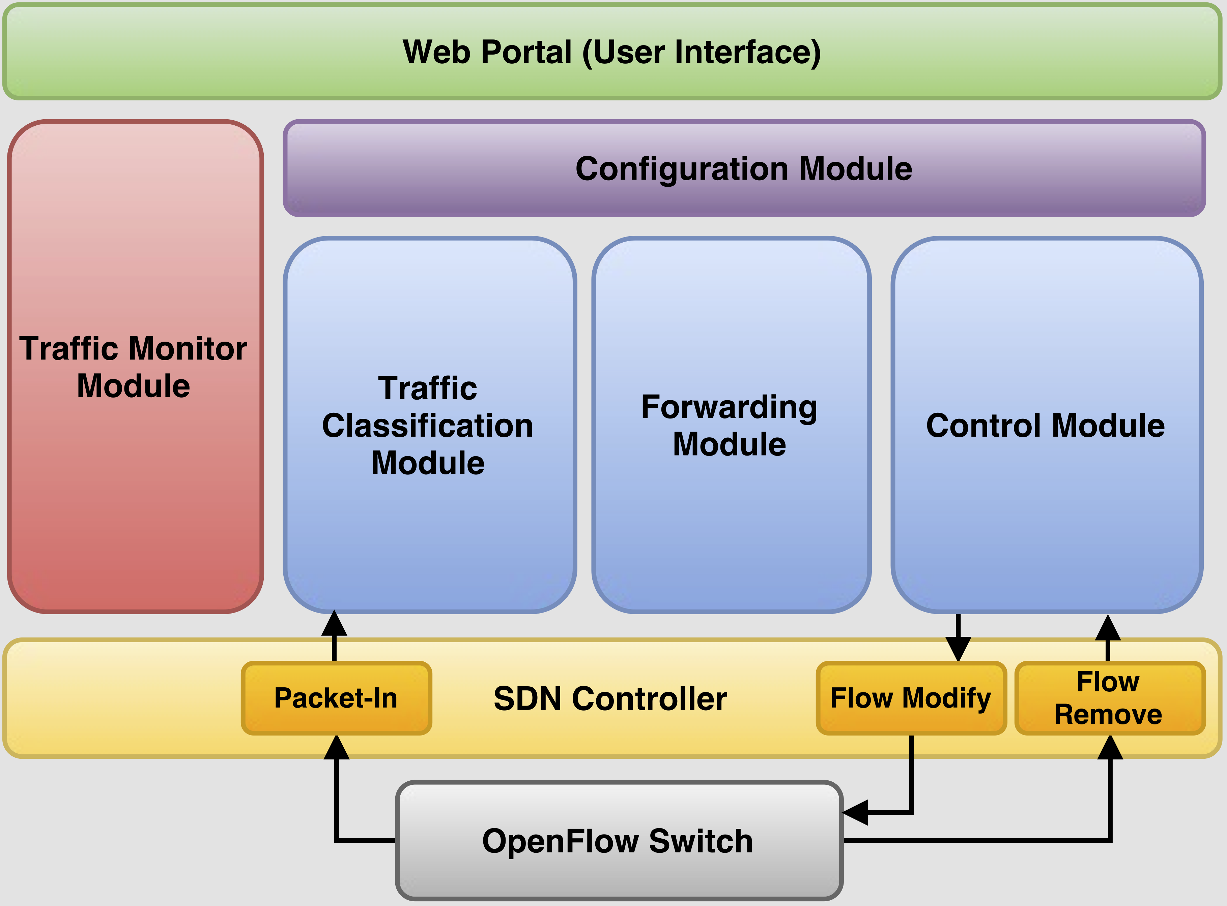
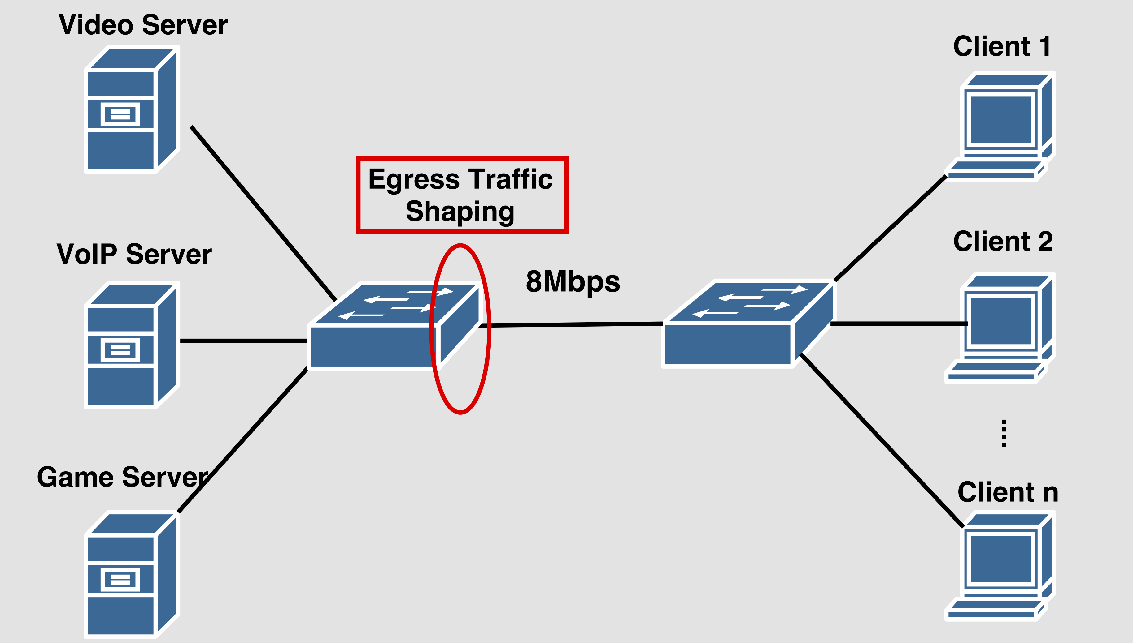





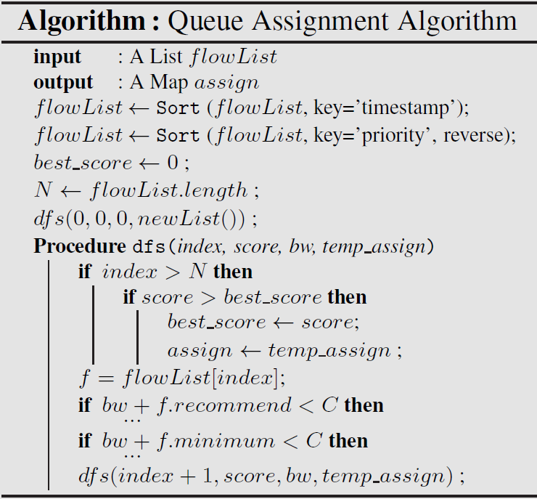
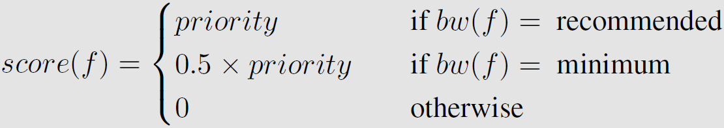
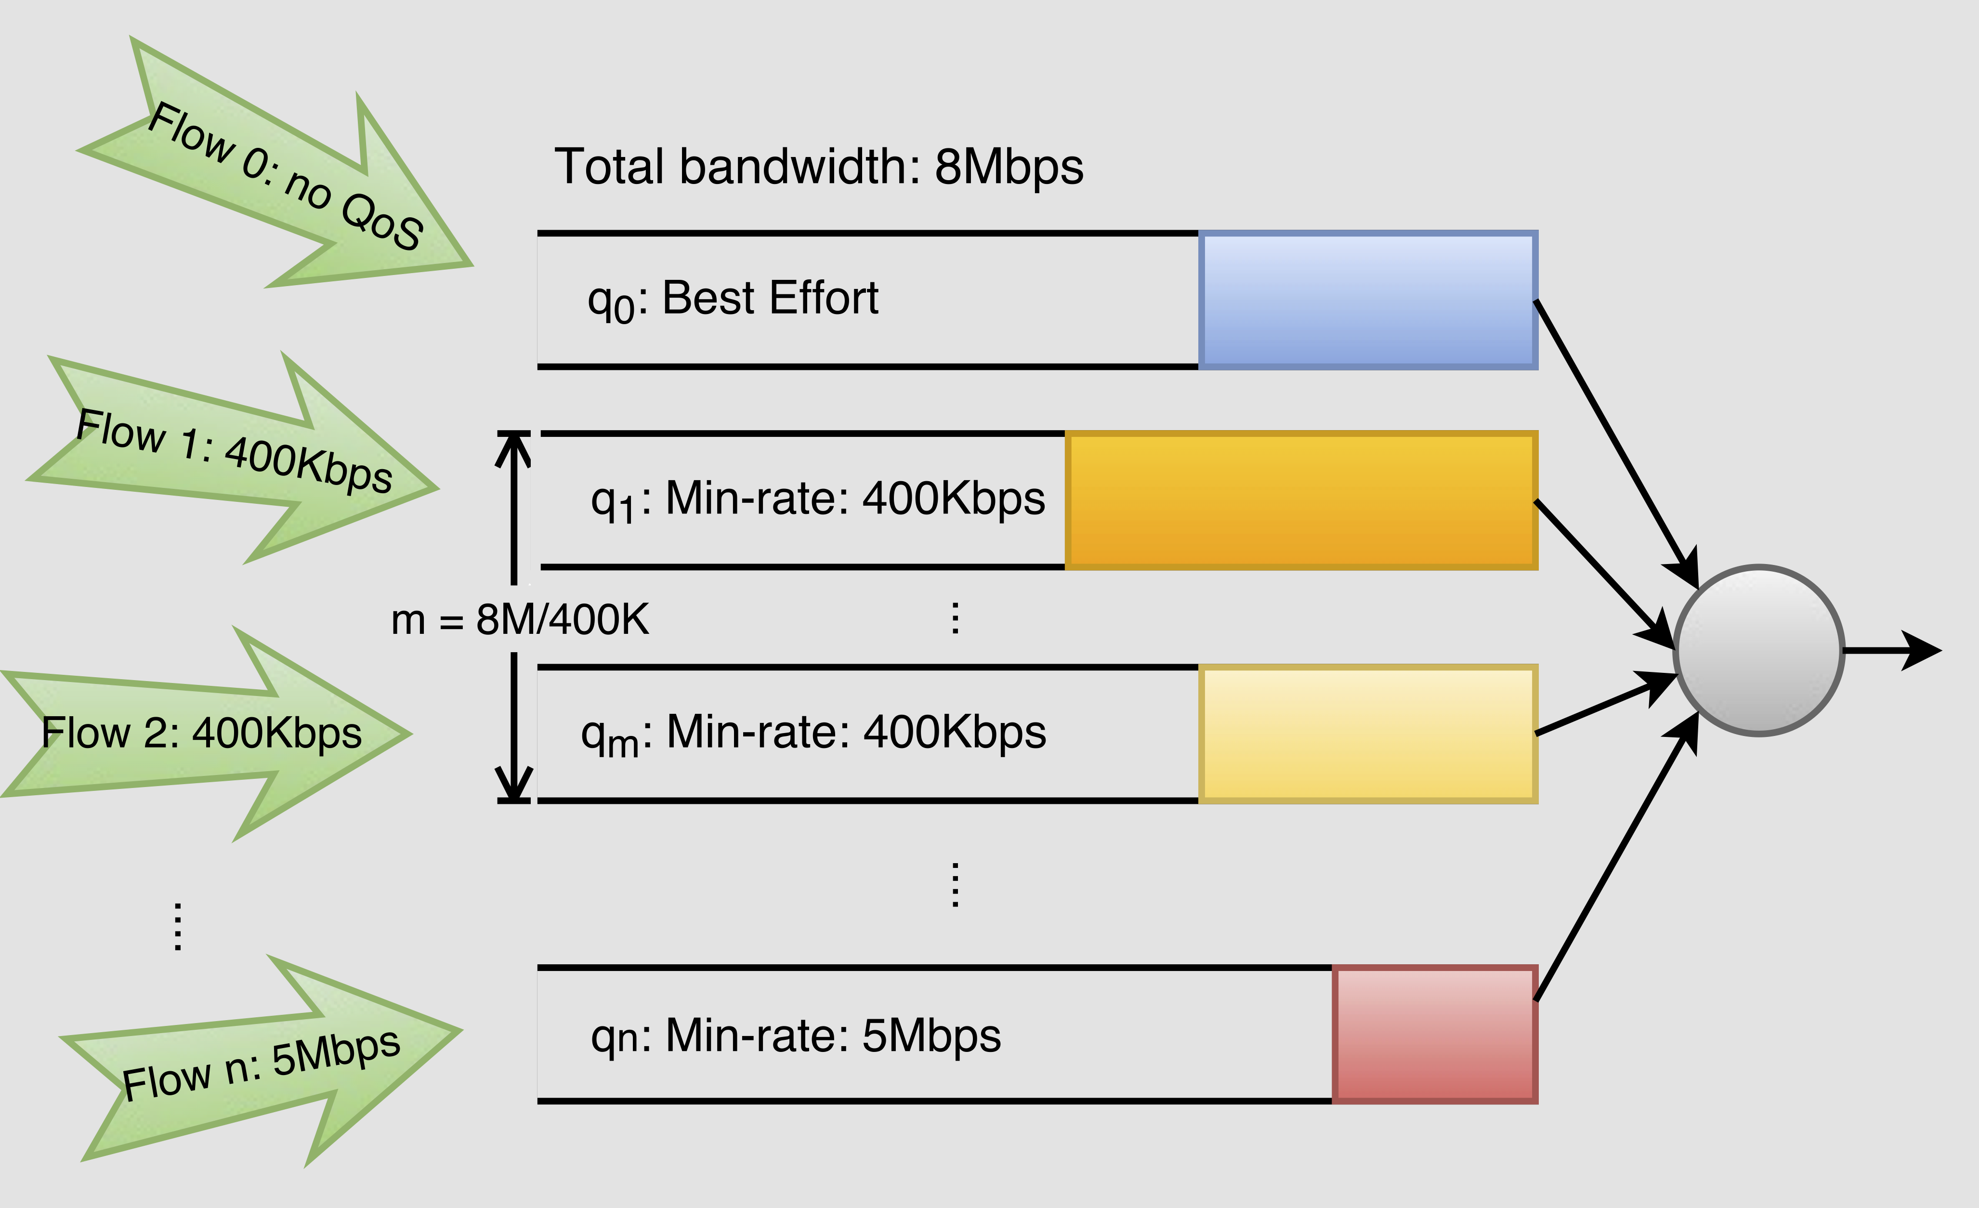
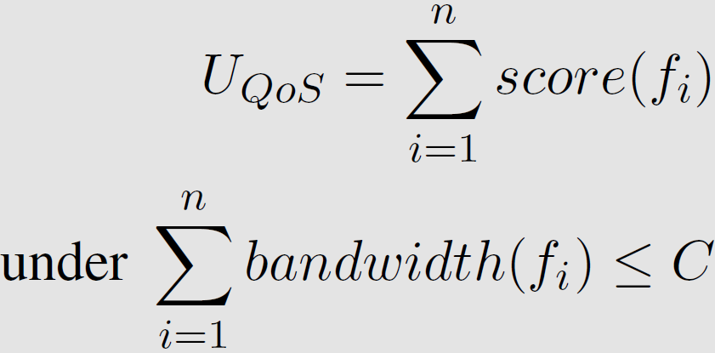
Configurable and Adaptive QoS Management via SDN
Yi Zhang (yzhng173@illinois.edu) , Qi Wang (qiwang11@illinois.edu)
CS538 Advanced Computer Networks
Department of Computer Science, University of Illinois Urbana-Champaign
MOTIVATION
QoSManager Architecture
EVALUATION
Bandwidth in a network(e.g. home) is limited
Users demand certain levels of Quality of Service (QoS) for difference services
Users’ demands may change based on different scenarios
Users are not savvy enough to configure the underlying network to meet their needs
We want to enable users to configure QoS at runtime
Experiment setup
QoS Configuration
Type | Minimum | Recommend | Priority
VoIP | 400Kbps | 1.2Mbps | 10
Video | 3.5Mbps | 5Mbps | 6
Game | 1.7Mbps | 3Mbps | 2
Q1: Is high priority traffic affected by low priority traffic?
Configurable: Users could modify QoS policies at runtime
Adaptive: QoSManger monitors the network and dynamically installs traffic shaping rules for application flows
With QoS
Without QoS
QoSManager TRAFFIC SHAPING
Q2: Can high priority flow acquire the desired bandwidth in a congested network?
PROBLEM DESCRIPTION
n traffic flows are competing for the shared link with capacity C. Thus, we need to prioritize the traffic flows
We assign a score to each flow as
The goal is to assign an appropriate rate to each flow to maximize the QoS utility function
The optimization of the QoS utility function is very similar to the Knapsack problem
First sort flows by timestamp and priority to avoid fluctuation
Then use DFS to compute the optimal assignment
With QoS
Without QoS
CONCLUSIONS
We design a flexible specification language to define QoS policies
We propose a novel queue assignment algorithm to maximize the QoS utility function
We design and implement QoSManager using SDN
We demonstrated the effectiveness of QoSManager by emulating different network scenarios
Flows without QoS are assigned to q₀
Flows with QoS are assigned to appropriate queues for per-flow rate control
QoSManager per-flow rate control

