Slide 1

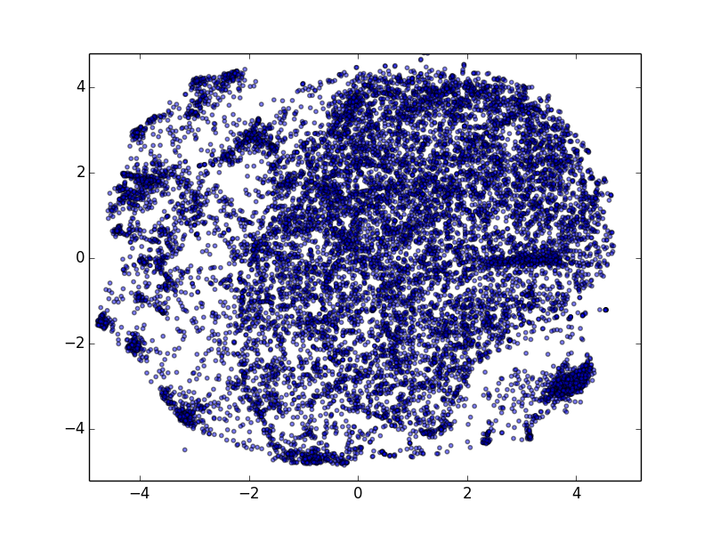
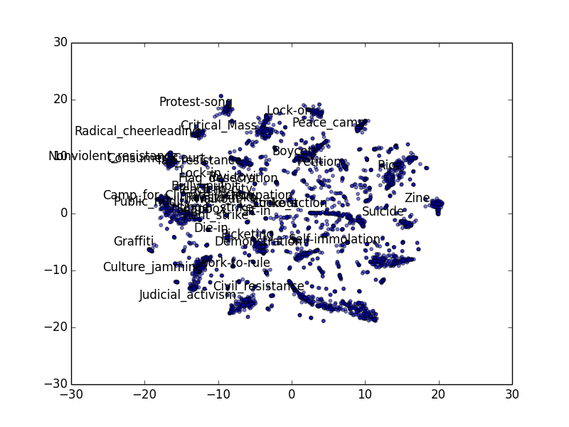
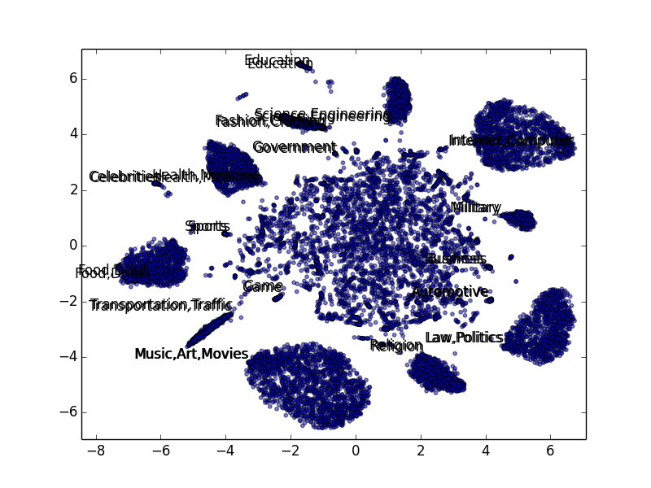
Semantic Categorization for Short Text and Twitter Stream
Yi Zhang, Qi Wang
University of Illinois Urbana-Champaign
ABSTRACT
INTRODUCTION
WORKFLOW AND METHODS
EVALUATION
General speaking, our project is try to provide a short text (e.g Twitter) categorization.
Existing Challenges:
Short-texting categorization is quite different from text clustering and topic modelling, which needs addition manual understanding to provide labels for generated clusters or topics for each running.
In addition to providing label information to text data, short-texting categorization becomes a challenging problem due to its data sparsity and lack of statistical concurrence. Traditional or well-performed algorithm on documents and large corpus fail to finish its functionality with short text.
The composition of short-text embedding with word/phrase embedding has been extended with directly incorporating sentence embeddings into the training model. But the drawback is that embedding of new-coming sentences should need additional training.
During the last decade we have witnessed an exponential growth of the amount of textual information being generated every day. Most of them are formed as short text. According to the statics revealed by Twitter, there are 58 million of tweets per day in average. Most of these short text are unstructured and noisy for algorithm to extract underlying semantic information easily, which become a bottleneck for application, such as fact finding in social network, event detecting and tracking from text, and so on. A kind of effort to solve this problem is short-text categorization.
Short-texting categorization is quite different from text clustering and topic modelling, which needs addition manual understanding to provide labels for generated clusters or topics for each running. But for large scale application for various propose. Effort should be made that try to decrease or even eliminate the long-lasting participation of human in this critical task.
In addition to providing label information to text data, short-texting categorization becomes a challenging problem due to its data sparsity and lack of statistical concurrence. Traditional or well-performed algorithm on documents and large corpus fail to finish its functionality with short text.
Crawling Twitter with query like “#Category/Related Keywords” for data collection. For this evaluation, we test with mainly 14 general categories, i.e. Law&Politics, Military, Food&Drink, Governemnt, Business, Science&Engineering, Fashion&Clothing, , Education, Automative&Transportation, Interent&Computer, Music&Art&Movies, Health&Medicine, and Religion. Each category contain 6-14 related keywords.
During testing, we delete the query “#Category/Related Keywords” appearing in tweets to ensure the algorithm not take the advantage of the specific queries we are using, but “understanding” what tweets are talking about.
We choose max-entropy model as baseline algorithm in this evaluation. We feed the max-entropy model with data we crawled from Twitter (about 100000 tweets and 16 big categories). But our algorithm doesn’t use any tweets for training.
CONCLUSIONS
 | Food, Drink | Internet, Computer | Automotive, Transportation | War, Military | Government, Politics | Religion | Science, Engineering | Sports
SemLoc | 92.8% | 81.5% | 70.1% | 62.3% | 80.5% | 70.1% | 74.7% | 79.3%
MaxEnt | 66.2% | 31.9% | 51.9% | 41.1% | 77.7% | 65.3% | 46.0% | 71.0%
WORD SPACE GENERATION
 | Health, Medicine | Business | Fashion, Clothing | War, Military | Education | Music, Art, Movies | Overall
SemLoc | 69.2% | 35.7% | 64.4% | 62.3% | 46.6% | 78.6% | 73.8%
MaxEnt | 42.1% | 31.8% | 62.8% | 41.0% | 47.4% | 52.6% | 52.3%
Craw related page from Wikipedia
Extract words/phrases and relevancy value from Wikipedia paragraphs.
Semantic Space Construction
(1) Training anchor points (words/phrases) space that try to embed the rank of relevancy with category vectors
(2) Mapping general words into a new categorized space based on anchor point space which try to keep their cosine similarity in the original space. This problem can be cast into a weighted least squared problem with quadratic constraints, which can be easily paralleled or distributed and solve efficiently
Semantic Localization
(1) Estimate the error of trained vectors with its similarity to different category heads.
(2) Regard a word in space as a Von Mises-Fisher distribution instead of a exact vector.
(3) Estimated the most likelihood tweet vector representation.
The evaluation results illustrate that our embedding based algorithm perform much better than the existing supervised NLP algorithm. In addition, the distributed representation for each tweet the algorithm generating can be easily applied to other related applications.
REFERENCES
CONTACT
Tomas Mikolov, Ilya Sutskever, Kai Chen, Greg S Corrado, and Jeff Dean. Distributed representations of words and phrases and their compositionality. In NIPS 13
Tomas Mikolov, Kai Chen, Greg Corrado, and Jeffrey Dean. Efficient estimation of word representations in vector space. arXiv preprint arXiv:1301.3781, 2013.
Quoc V Le and Tomas Mikolov. Distributed representations of sentences and documents. arXiv preprint arXiv:1405.4053, 2014.
Project members:
Shuochao Yao <syao9@iilinois.edu>
Qi Wang <qiwang11@iilinois.edu>
Guangxiang Du <gdu3@illinois.edu>

